Slide 1
1 CCR 301-26
COLORADO RULES FOR THE OPERATION, MAINTENANCE AND INSPECTION OF SCHOOL TRANSPORTATION VEHICLES
Susan M. Miller Brian P. Vasina
Lead Transportation Consultant Transportation Analyst
Miller_s@cde.state.co.us Vasina_b@cde.state.co.us
July 2016

Slide 2
Agenda
Welcome
Introductions
Review Changes in Operation, Maintenance and Annual Inspection Rules
Questions
Dismissal

Slide 3
Housekeeping
Sign-In Sheets
Phones
Restrooms
Food and Drink
Cleanliness

Slide 4
Motor Coach
Require Local Board of Education Resolution
4.01(a) Under federal law (49 USC 30112(a)), a new over-the-road motor coach (motor coach) bus may not be sold for the purpose of transporting school-age students to and from school or to school related events unless it meets all FMVSS requirements for school buses. Upon passage of a local board of education resolution, a school district may purchase a used over-the-road motor coach (motor coach) bus and/or attain a short term rental of a motor coach bus from a contract carrier for the transportation of students to school related events. Such resolution shall specify that consideration was given to the standards of safety to promote the welfare of students, including recommendations of national transportation organizations. In no event shall a motor coach bus be used for the transportation of students to and from school or school to school. A board resolution is not necessary for transporting students on common carriers.

Slide 5
Rule Process
Transportation Advisory Council extensive review
Colorado State Patrol
Federal Motor Carrier
Colorado Department of Revenue – CDL
CSPTA Trainers
District Trainers – rural and metro
Posted on website – comment period
Challenges – no undo hardship to rural districts and no excessive additional expense. Input, Input, Input

Slide 6
Emergency Rulemaking
During the June 8, 2016 State Board of Education the Board approved the new Colorado Rules for the Operation, Maintenance and Inspection of School Transportation Vehicles 1 CCR 301-26. Due to a technicality, the rulemaking process was not completed and must be started over. As such, CDE is proposing the State Board of Education conduct emergency rulemaking at a July 7, 2016 meeting. The proposed emergency rules would be consistent with the action taken at the June State Board of Education rulemaking hearing. At that time, the State Board voted to repeal two separate rules (1 CCR 301-26 and 1 CCR 301-29) and reenact a single, consolidated set of rules.

Slide 7
Resources
Resource Guide for the Colorado Rules for the Operation, Maintenance and Inspection of School Transportation Vehicles
School Bus, Multifunction Bus and Motor Coach Bus Guide
Type A Multifunction and Small Vehicle Route Operator Guide
Type A Multifunction and Small Vehicle Operator Guide
Colorado School Bus Technician’s Annual Inspection Guide
Colorado School Bus Driver Trainer’s Guide
License and Training Matrix
Website update – more user friendly
On-line streaming videos (over 600 to choose from)

Slide 8
Resource Guide for the Operation, Maintenance and Inspection of School Transportation Vehicles
Definitions
CDE School Transportation Unit Forms - newly formatted
Records Management - File Retention
Laws and Regulations Pertaining to School Transportation from Colorado Commercial Driver License Manual
Colorado Revised Statutes -
  Title 13 - Courts/Damages
  Title 18 - Education
  Title 19 - Children's Code
  Title 22 - Education
  Title 24 - Article 72 - Public (Open) Records

Slide 9
Resource Guide for the Operation, Maintenance and Inspection of School Transportation Vehicles
Colorado Open Records Act (CORA)
Title 42 - Education
Vehicles and Traffic - Uniform Motor Vehicle Law
CCR 301-14 Individuals with Disabilities Education Act (IDEA)
Part 382 - Controlled Substances and Alcohol Use and Testing (FMCSR)
Additional Resources and Websites

Slide 10
School Bus Driver Trainer Guide
Updated the 2011 revision of this guide working with the CSPTA Trainer Committee.
Available on the CDE Transportation Home Page

Slide 11
School Bus, Multifunction and Motor Coach Bus Guide
Driver Role and Responsibility
District and Federal Requirements
Vehicle Familiarization
Vehicle Inspections
Vehicle Operations
Adverse and Mountain Driving
Safety Equipment
Evacuations
Transporting Students
Student Management
Activity Trips
License and Training Matrix

Slide 12
Type A, Multifunction and Small Vehicle ROUTE Operator Guide
Driver Role and Responsibility
District Responsibilities
Vehicle Inspections
Vehicle Operations
Activity Trips
Accident and Emergency Procedures
Adverse Weather and Mountain Driving
First Aid Training
Trailer Towing
Loading and Unloading

Slide 13
Type A, Multifunction and Small Vehicle Operator Guide
Driver Role and Responsibility
District Responsibilities
Vehicle Inspections
Vehicle Operations
Activity Trips
Accident and Emergency Procedures
Adverse Weather and Mountain Driving
First Aid Information
Trailer Towing

Slide 14
School Transportation Technician Annual Inspection Guide
Vehicle Inspection Program
Inspection Requirements
Certification
Records/Documentation/Retention
Forms
Repair Procedures and Out of Service Criteria
Minimum Standards (all years)
Operation, Maintenance and Annual Inspection Rules

Slide 15
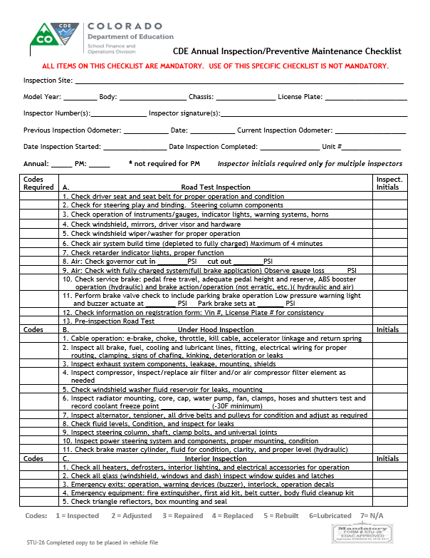
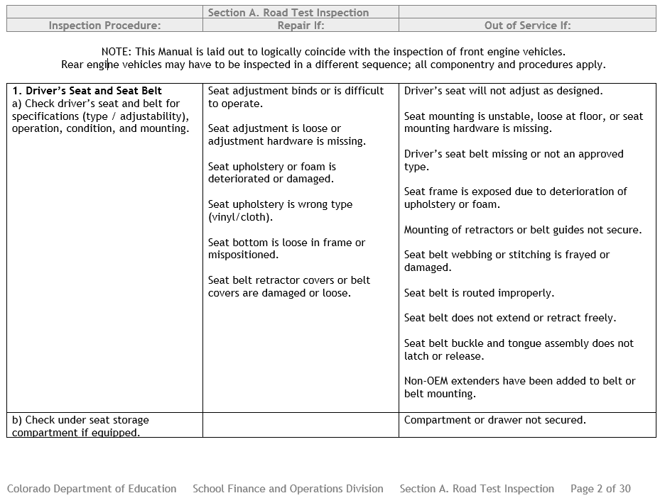

Slide 16
Tests
Adverse Weather and Mountain Driving Test - obsolete
CDE First Aid - obsolete
Annual Inspector Testing - same
School Bus Driver Operator - Changes annually - One test only
Type A, Multifunction and Small Vehicle Route Operator - Changes annually - One test only
Type A, Multifunction and Small Vehicle Operator - Changes annually - One test only

Slide 17
CDE Forms
Form # | Name of form | Last revised date
STAR 2
5 | Accident Report - Discontinued
6
7 | Used School Bus Dealers Registration | 4/16
8 | Small Vehicle Pre-Trip/Post-Trip Inspection Checklist | 4-16
9 | School bus/Multifunction/Coach Bus Pre-Trip/Post-Trip Checklist | 4-16
10
11
12 | Small Vehicle Route Operator Answer Sheet (NEW)
13 | CDE Annual Inspector Qualification and Recertification Test Answer Sheet | 4-16
14 | Mountain/.Adverse Test - Discontinued | 4-16
15 | School Bus Operator Answer Sheet | 4-16
16 | Small Vehicle Operator Answer Sheet | 4-16
17 | Small Vehicle Medical Form | 4-16
18 | Annual Inspector Hands-On Test Scoring Instructions | 4-16
19 | CDE Annual Inspector Hands-On Test Checklist | 4-16
20 | Application for Annual Inspector Qualification/Recertification | 4-16
21 | Annual Inspector Hands-on Performance Test - Score Sheet | 8-15
22 | Application for Inspecting Site | 4-16
23 | Discontinued as EDAC form transferred over to STAR | 4/16
24 | Brake Inspector Qualification Certificate | 4/16
25 | Affidavit of Annual Inspection | 4/16
26 | CDE Annual Inspection/PM Checklist form | 4/16
27 | CDE Annual Vo-Ag Trailer Inspection Checklist | 4-16
30 | Hands-on Tester Qualification/Recertification | 4-16
EDAC Required for:
STAR 2
STU 7
STU 8
STU 9
STU 20
STU 22
STU 24
STU 25
STU 26
STU 27
STU 30
Anything that is mandatory reporting.
We anticipate providing many of these forms in an electronic format.

Slide 18
Documentation of Training
4.02 School districts and service providers shall maintain separate files for each school transportation vehicle operator, school transportation paraprofessional, and school transportation annual inspector with written documentation evidencing all listed requirements indicated in Rule 5.00, Rule 6.00 and Rule 7.00, as applicable. Training documentation shall include the trainer name, date of the training, description of the training, duration of each topic covered and the signature of all attendees.
4.02(a) If a school transportation vehicle operator, school transportation paraprofessional, or school transportation annual inspector works for more than one school district, each district shall maintain a file with documentation in accordance with this rule.

Slide 19
Sample Documentation
Class Agenda
Date
Introductions
Student Confidentiality Peggy Burns Video 45 min.
Railroad Crossings Operation Lifesaver (Mrs. Smith) 1 hour
First Aid Mr. Brown ( School Nurse) 3 hours
District Policies Mr./Mrs. Supervisor 30 min.
Pre-Trip/Post-Trip Joe Technician 1 hour
Staff in Attendance
1.____________________
2.____________________
3.____________________
If you have a significant amount of staff in attendance, you can have a separate sign-in sheet and attach it to one of the agendas and place in a separate file. If you have drivers that were not in attendance, anticipate advising how and when they received the training.

Slide 20
Operator Files
If possible try to organize your staff files in sections for example:
Pre-Service
Copy of Licenses
Motor Vehicle Records
Annual Tests
Annual Performance Evaluations including pre-trip
Medical
Required Training per Rules
In-Service Training
Additional Training – Wheelchairs, CSRS
Acknowledgments – Guides, District Policy, etc.

Slide 21
Fleet Files
Separate File for each vehicle
Repair Orders
Work Orders
Permanent File – Line Set Tickets, Owners Manual, Instruction Manuals for lifts, radios, etc.
Preventative Maintenance Repair Order and Checklist
Annual Inspection Repair Order and Checklist
Affidavit
Day to day small repairs
Anything that does not pass a pre-trip should generate a repair request.

Slide 22
Non-Compliance
3.01 CDE will perform periodic School Transportation Advisory Reviews (STAR) of school districts and service providers to evaluate and assist with compliance of these rules.
3.01(a) CDE will provide school districts and service providers written notification of the STAR findings.
3.01(b) Upon receipt of the written notification of STAR findings, school districts or service providers shall respond in writing to outline corrective actions if necessary.
STAR Process
Schedule through 2020 is posted on our website home page.
Written notice to Superintendent/Transportation Director of pending review during school year
Written notice to Superintendent/Transportation Director from CDE Staff of type ( Operation/Fleet) review, and specific date and time.
Review conducted – assistance requested for vehicle inspections
Written letter of review findings – Commendations and Non-Compliance
District required to send written response to non-compliance concerns, how they will correct them.
Once district response received and satisfactory – written “Thank You” then file is closed

Slide 23
Non-Compliance
3.02 CDE shall revoke or suspend the certificate for a school transportation annual inspector, school transportation annual inspector hands-on tester or inspection site under the following circumstances:
3.02(a) A school transportation annual inspector, school transportation annual inspector hands-on tester or inspection site does not meet the requirements outlined in these rules.
3.02(b) School transportation annual inspections or hands-on tests have not been properly conducted.

Slide 24
Annual Inspector/Hands On Tester
6.01 School transportation annual inspector is a person qualified to perform annual inspections on a school transportation vehicle to confirm the vehicle complies with CDE regulations.
7.01 School transportation annual inspector hands-on tester is a person qualified to proctor hands-on tests to annual inspector candidates.

Slide 25
District Responsibilities
outline job responsibilities and develop job qualification standards copy to employee upon employment 4.01
shall maintain separate files 4.02 and 11.03 (vehicles)
more than one school district, each district shall maintain a file with documentation 4.02(a)
DOT approved substance abuse testing program ( CDL drivers, training also required per Fed.)4.03
shall not permit a school transportation vehicle operator to transport students, while the operator's ability or alertness is so impaired, through fatigue, illness or any other cause, as to make it unsafe for the operator to transport students. 4.04
shall have written emergency procedures and/or contingency plans to be followed in the event of a traffic accident, vehicle breakdown, unexpected school closing, unforeseen route change or relocation of a student stop in an emergency. 4.05
shall ensure that documentation outlining transportation related services and requirements, including required use of Child Safety Restraint Systems and medical and behavioral information as it relates to student transportation, is available to applicable school transportation vehicle operators and paraprofessionals prior to providing transportation services. 4.06
shall ensure vehicles and trailers inspections conducted by a CDE certified annual inspector. 10.01
must ensure all school transportation vehicles are systematically inspected, maintained and repaired to ensure that school transportation vehicles are in safe and proper operating condition. 11.01
shall have a system to document preventative maintenance, reported defects and repairs made to school transportation vehicles. 11.02
shall have a procedure in place to verify that students are not left on an unattended school transportation vehicle.

Slide 26
Driver Qualification Files
5.01 School transportation vehicle route operators (transporting students to and from school or from school to school) driving a School Bus with the capacity of 16 or greater passengers (counting the driver) and school transportation vehicle operators, other than route operators, driving vehicles with the capacity of 16 or greater passengers (counting the driver), including a School Bus, Multifunction Bus and Motor Coach Bus, shall meet or exceed the following requirements:
Copy of CDL License with proper endorsements – minimum of 18 years old
DOT Medical Examination Certificate – not entire form (will be done electronically soon via CDL)
MVR - current/please initial
Documentation of Pre-Service Training - type of vehicle(s) to be driven, the type of duties they may be required to perform and in student confidentiality requirements prior to transporting students.
Documentation the driver received or has access to the CDE School Bus/Multifunction Bus/Motor Coach Bus Operator Guide prior to transporting students (new driver)
Documentation of all in-service training - minimum of 6 hours annually
Copy of passing Annual Written Test (SB/MF/MC)
Documentation of successfully passing pre-service and annual performance evaluation, including pre-trip
Documentation of pre-service training on type of vehicles to be driven, type of duties
Documentation of student confidentiality training
Documentation of first aid, CPR, and universal precautions training within 90 calendar days (new driver) – or copy of certification of such training (2 years)
Documentation of CSRS and wheelchair training if applicable.
Documentation operator has received Drug and Alcohol Training

Slide 27
Driver Qualification Files
5.02 School transportation vehicle route operators (transporting students to and from school or from school to school) driving vehicles with the capacity of 15 or fewer passengers (counting the driver), including Type A Multifunction Bus and Small Vehicle, shall meet or exceed the following requirements
Copy of current valid driver license – minimum of 18 years old
DOT Medical Examination Certificate – not entire form
Current MVR – please initial
Documentation of Pre-Service Training
Documentation the driver received or has access to the CDE Type A Multifunction and Small Vehicle ROUTE Operator Guide prior to transporting students (new driver)
Documentation of all in-service training - minimum of 6 hours annually
Copy of passing Annual Written Test (Type A MF/SV Route Operator Test)
Documentation of successfully passing pre-service and annual performance evaluation, including pre-trip
Documentation of pre-service training on type of vehicles to be driven, type of duties
Documentation of student confidentiality training
Documentation of first aid, CPR, and universal precautions training within 90 calendar days (new driver) – or copy of certification of such training (2 years)
Documentation of CSRS and wheelchair training if applicable.
Documentation operator has received Drug and Alcohol Training – Per district policy

Slide 28
Driver Qualification Files
5.03 School transportation vehicle operators, other than route operators, driving vehicles with the capacity of 15 or fewer passengers (counting the driver), including Type A Multifunction Bus and Small Vehicle, shall meet or exceed the following requirements:
Copy of current valid driver license – minimum of 18 years old
Completed and signed copy of STU-17 and any doctor releases
Current MVR – please initial
Documentation of Pre-Service Training
Documentation the driver received or has access to the CDE Type A Multifunction and Small Vehicle Operator Guide prior to transporting students (new driver)
Documentation of all in-service training
Copy of passing Annual Written Test (Type A MF/SV)
Documentation of successfully passing pre-service driving performance evaluation, including pre-trip
Documentation of pre-service training on type of vehicles to be driven, type of duties
Documentation of student confidentiality training
Documentation operator has been given or had access to first aid, CPR, and universal precautions information
Documentation of CSRS and wheelchair training is applicable.

Slide 29
Paraprofessional Files
5.04 School transportation paraprofessional is a person assigned to assist a school transportation vehicle operator control behavior of students in the bus and/or ensure the safety of students getting on and off the school transportation vehicle.
Documentation that paraprofessional has received pre-service training for the type of duties they may be required to perform prior to transporting students. (new)
For example:
Wheelchair Securement
CSRS’s
Proper Body Mechanics
Communicating with Special Needs Children

Slide 30
Annual Inspector Files
6.01 School transportation annual inspector is a person qualified to perform annual inspections on a school transportation vehicle to confirm the vehicle complies with CDE regulations.
Copy of valid driver license with proper class and endorsements for the size and type of vehicle(s) to be inspected.
Documentation of a Brake Inspector Qualification Certificate
Documentation of two years of verifiable experience in the maintenance of light, medium or heavy duty vehicles.
Documentation of successfully passing the CDE initial Hands-on performance test
Documentation of successfully passing the CDE annual inspector qualification written test initially, and every three years a passing recertification written test.

Slide 31
Pre-trip/Post trip Vehicle Inspections
8.01 Each school transportation vehicle shall have a daily pre-trip and post-trip inspection performed and documented by the school transportation vehicle operator or a district or service provider authorized transportation employee. A daily pre-trip inspection shall be completed prior to a vehicle being placed in service. A daily post-trip inspection shall be completed at the end of daily operation of each vehicle.
8.02 The pre-trip and post-trip inspection requirements for school transportation vehicles, other than small vehicles, shall include at a minimum all items listed on the CDE School Transportation Vehicle (School Bus/Multifunction Bus/Motor Coach Bus) – Pre-Trip and Post Trip Requirements Form (STU-9).
8.03 The pre-trip and post-trip inspection requirements for school transportation small vehicles shall include at a minimum all items listed on the CDE School Transportation Vehicle (Small Vehicle) – Pre-Trip and Post Trip Requirements Form (STU-8).
8.04 School districts and service providers shall have a procedure in place to verify that students are not left on an unattended school transportation vehicle.

Slide 32
Inspection Site Certification
9.01 A CDE Inspection Site Certificate is required at each facility/location where annual inspections for school transportation vehicles are performed.
9.02 The inspection site shall meet or exceed the following criteria to acquire and maintain an inspection site certificate.
9.02(a) The inspection site shall be large enough to accommodate the vehicle, equipment and tools necessary to perform the inspection.
9.02(b) The inspection site shall have a floor surface or pad adequate to safely support the maximum weight of the largest vehicle to be inspected.
9.02(c) The inspection site shall have adequate lighting and ventilation.
9.02(d) The inspection site or inspector shall, at the time of inspection, have the equipment and tools necessary to properly complete the annual inspection.
9.02(e) The inspection site or inspector shall have tools designed and calibrated to take accurate readings of appropriate measurements, such as brakes and tires.
9.03 The district or service provider shall submit a request for an inspection site certificate on the CDE Application for Inspecting Site Certification Form (STU-22) that the above criteria have been satisfied.
9.04 The district or service provider shall post the CDE Inspection Site Certificate at the inspection site.
Application for Site Certification also provides a tool list of required tools.

Slide 33
Annual Inspection
10.01 School districts and service providers shall ensure all school transportation vehicles and trailers pursuant to 1 CCR 301-26-R-12.11 have a CDE annual inspection conducted by a CDE certified annual inspector.
10.01(a) Recently purchased school transportation vehicles shall successfully pass a CDE annual inspection prior to transporting students.
10.02 Annual inspection results shall be documented on the CDE Affidavit of Annual Inspection for School Transportation Vehicles Form (STU-25).
10.02(a) A copy of the current Affidavit is maintained inside the vehicle and a copy is placed in the vehicle file.
10.03 All annual inspection criteria of school transportation vehicles must meet or exceed manufacturer’s specifications. The annual inspection shall be documented and shall include at a minimum all fields listed on the CDE Annual Inspection and Preventive Maintenance Requirements Form (STU-26).
10.04 All annual inspection criteria of trailers must meet or exceed manufacturer’s specifications and shall include at a minimum all fields listed on the CDE Trailer Annual Inspection and Preventive Maintenance Requirements Form (STU-27).
10.05 During the annual inspection, all four wheels shall be pulled for full inspection of the foundation brake system. The three exceptions are:
10.05(a) School transportation vehicles with less than 4,000 miles since the previous annual inspection shall have two wheels (one front and one rear) pulled different than those pulled for the previous inspection.
10.05(b) School transportation vehicles equipped with a retarder meeting the specifications outlined in 1 CCR 301-25- R-33.00, shall have two wheels (one front and one rear) pulled which are different than those pulled for the previous inspection.
10.05(c) Trailers pursuant to 1 CCR 301-26-R-12.11 shall have 50 percent of the wheels pulled different than those pulled for the previous inspection.

Slide 34
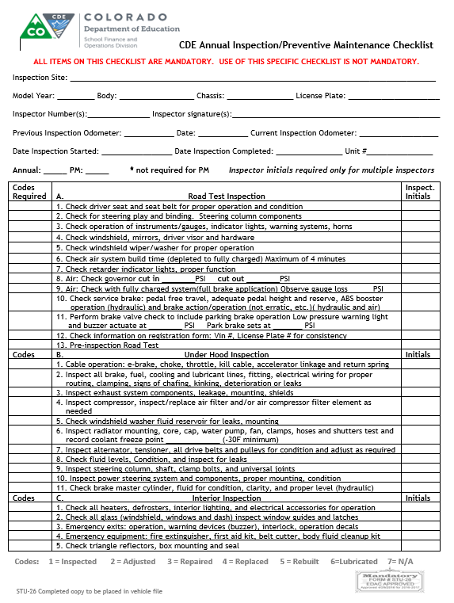
Common errors found during Supervisory Assistance Reviews
Incomplete Forms
Box’s not marked
Previous Year Mileage
Date Missing
No Mileage

Slide 35
Maintenance and Repair
11.01 School districts and service providers must ensure all school transportation vehicles are systematically inspected, maintained and repaired to ensure that school transportation vehicles are in safe and proper operating condition.
11.02 School districts and service providers shall have a system to document preventative maintenance, reported defects and repairs made to school transportation vehicles.
11.03 School districts and service providers shall maintain separate files for each school transportation vehicle with documentation of all annual inspections, all preventative maintenance and all reported damage, defects or deficiencies and the corresponding repair and maintenance performed.
11.04 Any identified damage, defect or deficiency of a school transportation vehicle must be reported to the school district or service provider which:
11.04(a) Could affect the safety of operation of the school transportation vehicle, or
11.04(b) Could result in a mechanical breakdown of the school transportation vehicle, or
11.04(c) Results in noncompliance with Colorado Minimum Standards Governing School Transportation Vehicles (1 CCR 301-25) and/or manufacturer’s specifications.
11.05 Documentation for reported defects must include all of the following:
11.05(a) The name of the school district or service provider.
11.05(b) Date and time the report was submitted.
11.05(c) All damage, defects or deficiencies of the school transportation vehicle.
11.05(d) The name of the individual who prepared the report

Slide 36
Maintenance and Repair
11.06 Following a reported damage, defect or deficiency of a school transportation vehicle, school districts and service providers or a representative agent must repair the reported damage, defects or deficiencies, or document that no repair is necessary, ensuring that the vehicle is in safe and proper operating condition prior to transporting students.
11.07 School districts and service providers shall not transport students in a school transportation vehicle which is not in safe and proper operating condition. A school transportation vehicle shall be designated as “out-of-service” by a school district or service provider, a school transportation annual inspector or the CDE School Transportation Unit.
11.07(a) Exemption - Any school transportation vehicle discovered to be in an unsafe condition while being operated on the highway, roadway or private road may be continued in operation only to the nearest place where repairs can safely be affected. Such operation shall be conducted only if it is less hazardous to the public than to permit the vehicle to remain on the highway, roadway or private road.
11.08 Following a school transportation vehicle being placed “out-of-service”, a school district, service provider or a representative agent must make required repairs, ensuring that the vehicle is in safe and proper operating condition prior to transporting students. In the event of being placed “out-of-service” during an annual inspection, the school transportation vehicle must successfully pass a CDE annual inspection prior to transporting students.
11.09 The preventative maintenance inspection on air drum brake systems shall include, at a minimum, that the brake rod travel has been measured and documented. The applied pressure method shall be used.
11.09(a) The inspection interval shall not exceed 4,000 miles for buses equipped with a manual slack adjuster air brake system.
11.09(b) The inspection interval shall not exceed 6,000 miles for buses equipped with an automatic slack adjuster air brake system.

Slide 37
Maintenance and Repair
11.10 The preventive maintenance inspection interval on air disc brake systems shall not exceed 6,000 miles and shall include, at a minimum; inspection and documentation of:
11.10(a) Inspect the pad thickness by checking the mechanical wear indicators.
11.10(b) Inspect the visible part of the rotors for cracks, excessive wear, damage, etc.
11.10(c) Inspect running clearance. If the caliper has no movement or appears to move greater than the distances indicated by the manufacturer, then a full wheel removal inspection will be necessary.
11.11 The preventive maintenance inspection interval for hydraulic brake systems shall not exceed 6,000 miles and shall include, at a minimum, inspection and documentation of:
11.11(a) Proper parking brake operation.
11.11(b) Proper brake fluid level and clarity.
11.11(c) Adequate pedal reserve.
11.11(d) Proper hydraulic/vacuum assist operation.
11.11(e) Visual inspection for brake fluid leakage.
11.12 If brake adjustment or repair is needed, the work shall be completed by or supervised by a DOT or equivalent qualified brake inspector meeting the requirements of 49 CFR 396.25.

Slide 38
Operation of a School Transportation Vehicle
12.01 A school transportation vehicle shall not be operated in a manner which is unsafe or likely to cause an accident or damage of the vehicle.
12.02 A school transportation vehicle shall not be placed in motion on a roadway, highway or private road with the passenger entry door/service door open.
12.03 A school transportation vehicle's headlights or daytime running headlights shall be activated while the vehicle is in operation.
12.04 A school transportation vehicle shall not be fueled while students are on board, except in instances when unloading the students would present a greater hazard or peril to their safety.
12.05 Use of tobacco products as defined in Section 18-13-121(5), C.R.S., use or possession of illegal controlled substances, use or possession of alcohol and use or possession of marijuana or cannabinoid product, except as otherwise allowed by law, aboard any school transportation vehicle shall be prohibited at all times.
12.06 A school transportation vehicle operator shall not consume food unless the vehicle is stopped at a safe location with the park/emergency brake set.
12.07 When a school transportation vehicle is equipped with a roof mounted strobe lamp, the use of the strobe lamp is permitted only when the vehicle presents a hazard to other motorists, such as loading or unloading students in inclement weather or to enhance visibility of the vehicle when barriers inhibit such visibility.
12.08 A school transportation vehicle operator may use the strobe, in addition to the four-way hazard lamps, to warn other motorists that the vehicle is not in motion or is being operated at a speed of twenty-five miles per hour or less.

Slide 39
Operation of a School Transportation Vehicle
12.09 The school transportation vehicle operator shall use extreme caution when backing. Before backing on a roadway, highway or private property, the horn or audible warning device shall be sounded and four-way hazard lamps actuated or there shall be a person outside the vehicle giving direction.
12.09(a) Backing a school transportation vehicle when students are outside of the vehicle at a student stop is prohibited.
12.10 School transportation vehicles including Type A, B, C and D School Bus, Multifunction Bus and Motor Coach Bus shall not be operated with a trailer or other vehicle attached while students are being transported.
12.11 School transportation small vehicles, with the capacity of 15 or fewer passengers (counting the driver), may tow trailers while students are being transported to the extent that trailering is a necessary component of a district sponsored program.

Slide 40
Authorized Passengers
13.01 Only district personnel, students enrolled in a district, law enforcement officials or individuals that have received prior authorization from the school district or service provider may be passengers on any school transportation vehicle.
13.02 The number of passengers transported on any school transportation vehicle shall not exceed the maximum seating capacity of the vehicle. Small vehicle capacity shall not exceed the number of safety belts as designed by the vehicle manufacturer.
13.03 Passengers shall not be permitted to stand in any school transportation vehicle while the vehicle is in motion. This does not preclude authorized persons (such as school transportation paraprofessionals) from completing their duties as required.
13.04 School districts and service providers shall consider the size of the passengers when determining the number of passengers that can safely occupy a school transportation vehicle seat.

Slide 41
Safety Restraints
14.01 A school transportation vehicle operator shall have the safety belt fastened, worn correctly and properly adjusted prior to the school transportation vehicle being placed in motion.
14.02 All passengers in a school transportation vehicle under 10,000 lbs. GVWR shall have their safety belts fastened, worn correctly and properly adjusted prior to the school transportation vehicle being placed in motion.

Slide 42
Transportation of Miscellaneous Items
15.01 A school transportation vehicle operator shall make a reasonable and prudent determination that all carry-on items are properly handled in order to minimize the danger to all others.
15.02 All baggage, articles, equipment or medical supplies not held by individual passengers shall be secured in a manner which assures unrestricted access to all exits by occupants, does not restrict the driver's ability to operate the bus and protects all occupants against injury resulting from falling or displacement of any baggage, article or equipment. Oxygen cylinders secured to a wheelchair shall be considered to be in compliance with this subsection, provided they do not impede access to any exit.
15.03 All chemicals and cleaning supplies carried on a school transportation vehicle must meet the following precautions:
15.03(a) Container is non-breakable.
15.03(b) Container is labeled with contents.
15.03(c) Pressurized aerosols are prohibited.
15.03(d) Container is secured in a bracket, or in a closed compartment in the driver’s area or a compartment on the exterior of the bus.
15.03(e) Containers and quantities of products are kept to a reasonable size.
15.04 Interior-decorations shall not be located within the driver’s area (which includes the space in front of the front barriers including the step-well, dash, walls and ceiling, the windshield, the entry door, the driver’s side window, and all windows in front of the front barrier), the first two passenger windows on both sides of the vehicle and all windows on the rear of the vehicle. Other decorations within the passenger compartment shall not:
15.04(a) Cover any required lettering.
15.04(b) Impede the aisle or any emergency exit.
15.04(c) Hang from the walls and/or ceiling

Slide 43
Maximum Driver Time
Formerly – Hours of Service – NO Change

Slide 44
Route Planning
17.01 School transportation small vehicles, Type A Multifunction Buses with 15 or fewer passenger capacity (counting the driver) and School Buses (Types A, B, C, and D) may be used to transport students to and from school. Multifunction Buses Type B, C and D and Motor Coach Buses shall not be used to transport students to and from school.
17.02 The location of student stops shall consider factors including:
17.02(a) Ages of the students.
17.02(b) Visibility.
17.02(c) Lateral clearance.
17.02(d) Student access.
17.02(e) Control of other motorists.
17.02(e)(1) Student stops for Type A Multifunction Buses with 15 or fewer passenger capacity (counting the driver) and school transportation small vehicles should be located off of the roadway whenever possible.
17.03 School transportation vehicle operators shall stop at least 10 feet away from students at each designated stop. The school transportation vehicle operator shall apply the parking brake and shift the vehicle into neutral or park prior to opening the service door of a bus or passenger door(s) of a small vehicle.
17.04 The school transportation vehicle operator shall stop as far to the right of the roadway, highway or private road as possible before discharging or loading passengers, allowing sufficient area to the right and front of the vehicle but close enough to the right to prevent traffic from passing on the right so students may clear the vehicle safely while in sight of the operator.
17.04(a) Exception: The school transportation vehicle operator may block the lane of traffic when passengers being received or discharged are required to cross the roadway.

Slide 45
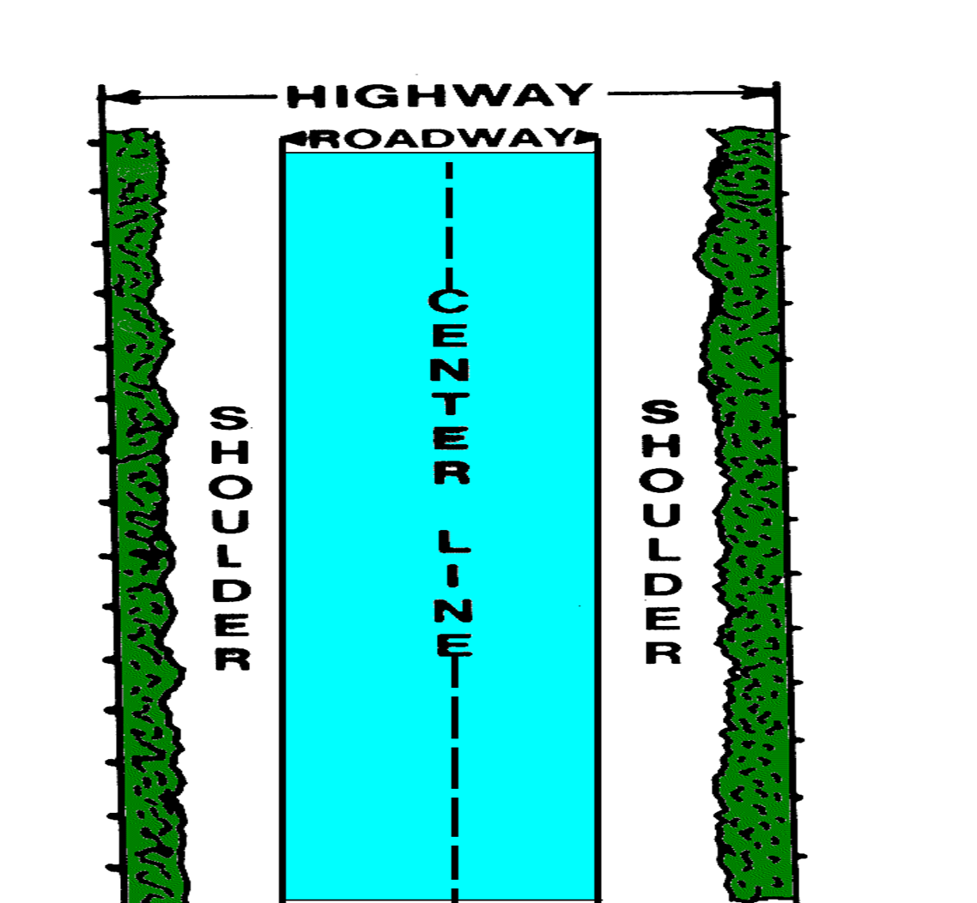
Highway vs. Roadway

Slide 46
Not Crossing – Paved Shoulder

Slide 47
Not Crossing – No Shoulder

Slide 48
Not Crossing – Dirt Road

Slide 49
Crossing – Paved Road

Slide 50
Crossing – No Shoulder

Slide 51
Crossing – Dirt Road

Slide 52
Prohibited – More than 2 lanes

Slide 53
Prohibited - Median

Slide 54
Route Planning
17.05 Student stops shall not be located on the side of any major thoroughfare whenever access to the destination of the passenger is possible by the use of a road or street which is adjacent to the major thoroughfare.
17.06 If students are required to cross a roadway, highway or private road on which a student stop is being performed, they are prohibited from crossing a roadway, highway or private road constructed or designed to permit three or more separate lanes of vehicular traffic in either direction or with a median separating multiple lanes of traffic. This does not include crossing the roadway, highway or private road with the assistance of a traffic controls signal or with the assistance of a crossing guard.
17.07 Four-way hazard lamps shall be used on private property such as parking lots.
17.08 Alternating flashing red warning signal lamps shall not be activated within 50 feet of an intersection if the intersection is controlled by a traffic control signal.
17.09 Routes shall be planned as to:
17.09(a) Eliminate, when practical, railroad crossings.
17.09(b) Have stops be a minimum of 200 feet apart since alternating flashing amber warning signal lamps must be activated a minimum of 200 feet in advance of the stop.
17.09(b)(1) Exception: Student stops located in areas where wildlife may create a high risk of threat to students’ safety while they are waiting and/or walking to a student stop, may designate student stops less than 200 feet apart upon detailed written approval by the school district board of education and/or their designee. A copy of the written approval shall be kept in the school transportation office and route operators shall be given written notice of the exception and have it indicated on route sheets.

Slide 55
Route Planning
17.10 Pursuant to Section 42-4-1903(2), C.R.S., school transportation vehicle operators are not required to actuate the alternating flashing red warning signal lamps on a school bus when the student stop is at a location where the local traffic regulatory authority has by prior written designation declared such actuation unnecessary and when discharging or loading passengers who require the assistance of a lift device and no passenger is required to cross the roadway. Further, Type A Multifunction Buses with 15 or fewer passenger capacity (counting the driver) and school transportation small vehicles do not have the functionality to control traffic. In these instances, the school transportation vehicle operator shall stop as far to the right off the roadway as possible to reduce obstruction to traffic, activate the four-way hazard warning lamps a minimum of 200 feet prior to the student stop, continue to display the four-way hazard warning lamps until the process of discharging or loading passengers has been completed, and deactivate the four-way hazard lamps before resuming motion. Students are prohibited from crossing any lanes of traffic to access the student stop or after disembarking.
17.11 School transportation vehicle operators shall not relocate a student stop without approval of the school district or service provider.
17.12 School transportation vehicle operators of School Buses, Multifunction Buses and Motor Coach Buses, whether transporting students or not, shall apply the following procedures during the process of approaching, stopping and crossing railroad tracks:
17.12(a) Activate the four-way hazard lamps not less than 200 feet from the railroad crossing to alert other motorists of the pending stop for the crossing.
17.12(b) Stop the bus within 50 feet but not less than 15 feet from the nearest rail.
17.12(c) When stopped, the bus should be as far to the right of the roadway as possible and should not form two lanes of traffic unless the highway is marked for four or more lanes of traffic.
17.12(d) Use a prearranged signal to alert students to the need for quiet aboard the bus when approaching railroad tracks. Turn off all noise making equipment (fans, heater, radio, etc.)

Slide 56
Route Planning
17.13 After quietness aboard the stopped bus has been achieved, bus operators shall open the service door and operator window. The bus operator shall listen and look in both directions along the track(s) for any approaching train(s) and for signals indicating the approach of a train.
17.13(a) If the tracks are clear, the bus operator shall close the service door and may then proceed in a gear low enough to permit crossing the tracks without having to manually shift gears. The bus operator shall cancel the four-way hazard lamps after the bus has cleared the tracks.
17.13(b) When two or more tracks are to be crossed, the bus operator shall not stop a second time unless the bus is completely clear of the first crossing and has at least 15 feet clearance in front and at least 15 feet clearance to the rear.
17.13(c) Before crossing the tracks, the bus operator shall verify that there is enough space after the tracks for the bus plus 15 feet if it is necessary to stop after crossing the tracks.
17.14 School transportation vehicle operators of School Buses, Multifunction Buses and Motor Coach Buses are not required to stop at crossings controlled by a red, amber, green traffic control signal when it is in the green position or when the crossing is controlled by a police officer or human flag person.

Slide 57
Emergency Evacuation Drills
18.01 Emergency evacuation drills shall be conducted with students by all school transportation vehicle operators and school transportation paraprofessionals at least twice during each school year, following the procedures in the Colorado Department of Education School Bus/Multifunction Bus/Motor Coach Bus Operator Guide.
18.01(a) One drill shall be conducted in the fall and the second drill conducted in the spring.
18.01(b) Substitute and Multifunction operators of 16 or greater capacity (counting the driver) vehicles shall be trained how to conduct the emergency evacuation drills.
18.02 Students on school related events shall receive emergency evacuation instruction prior to departure.
18.03 School district and service providers shall maintain records documenting that the required evacuation drills were conducted and/or evacuation instruction was given.

Slide 58
Questions
Thank You!

