Slide 1
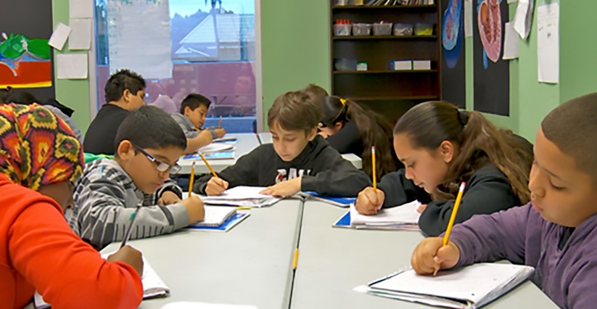
The Principles of Writing: Writing is Messy

Slide 2
Educators and leaders will understand that writing is not a linear or sequential process, but requires commitment, consistency, and flexibility as students discover their voice.

Slide 3
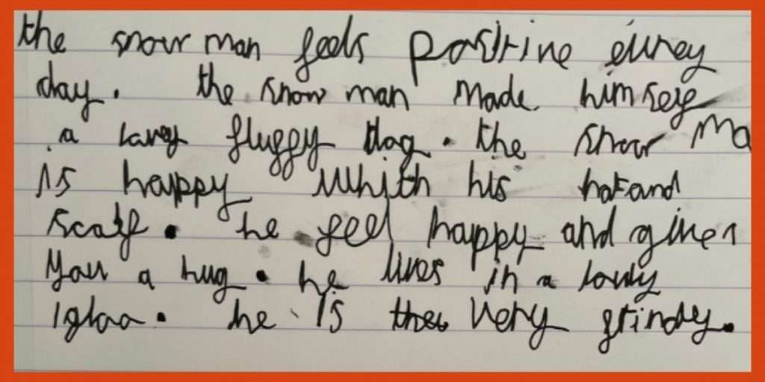
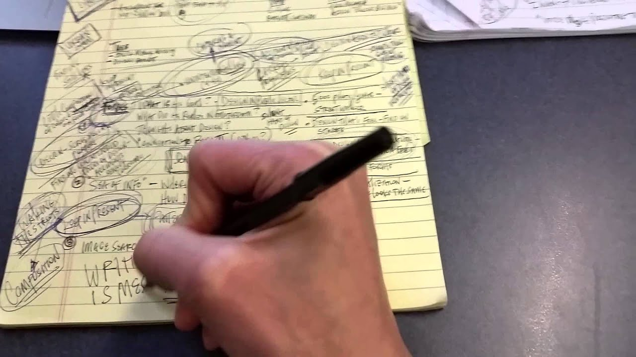
Principle 1: Writing is messy!

Slide 4
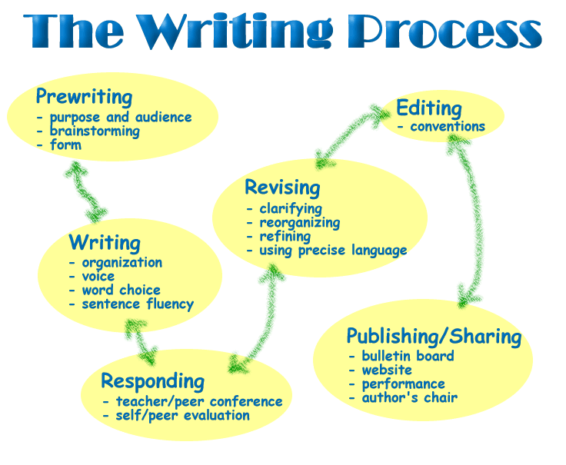
If only writing were this simple . . .

Slide 5
Prewriting/
Planning
Brainstorming ideas
Purpose and audience
Genre and modality of writing (form)
Revision
Clarifying
Reorganizing
Refining
Using precise language
Drafting/
Writing
Organization
Voice (tone, mood)
Word choice
Fluency
Editing
Grammar/ Punctuation
Conventions
Publishing/ Sharing
(Best Draft)
Bulletin
Website
Parents/Students
Responding
Teacher/peer conferencing
Self/peer evaluation

Slide 6
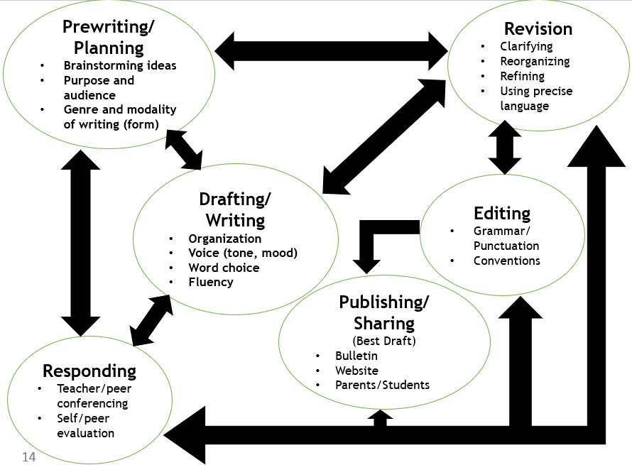
What does the writing process look like in classrooms across the your building? Does it mirror this one?

Slide 7
Prewriting/
Planning
Brainstorming ideas
Purpose and audience
Genre and modality of writing (form)
Revision
Clarifying
Reorganizing
Refining
Using precise language
Drafting/
Writing
Organization
Voice (tone, mood)
Word choice
Fluency
Editing
Grammar/ Punctuation
Conventions
Publishing/ Sharing
(Best Draft)
Bulletin
Website
Parents/Students
Responding
Teacher/peer conferencing
Self/peer evaluation

Slide 8
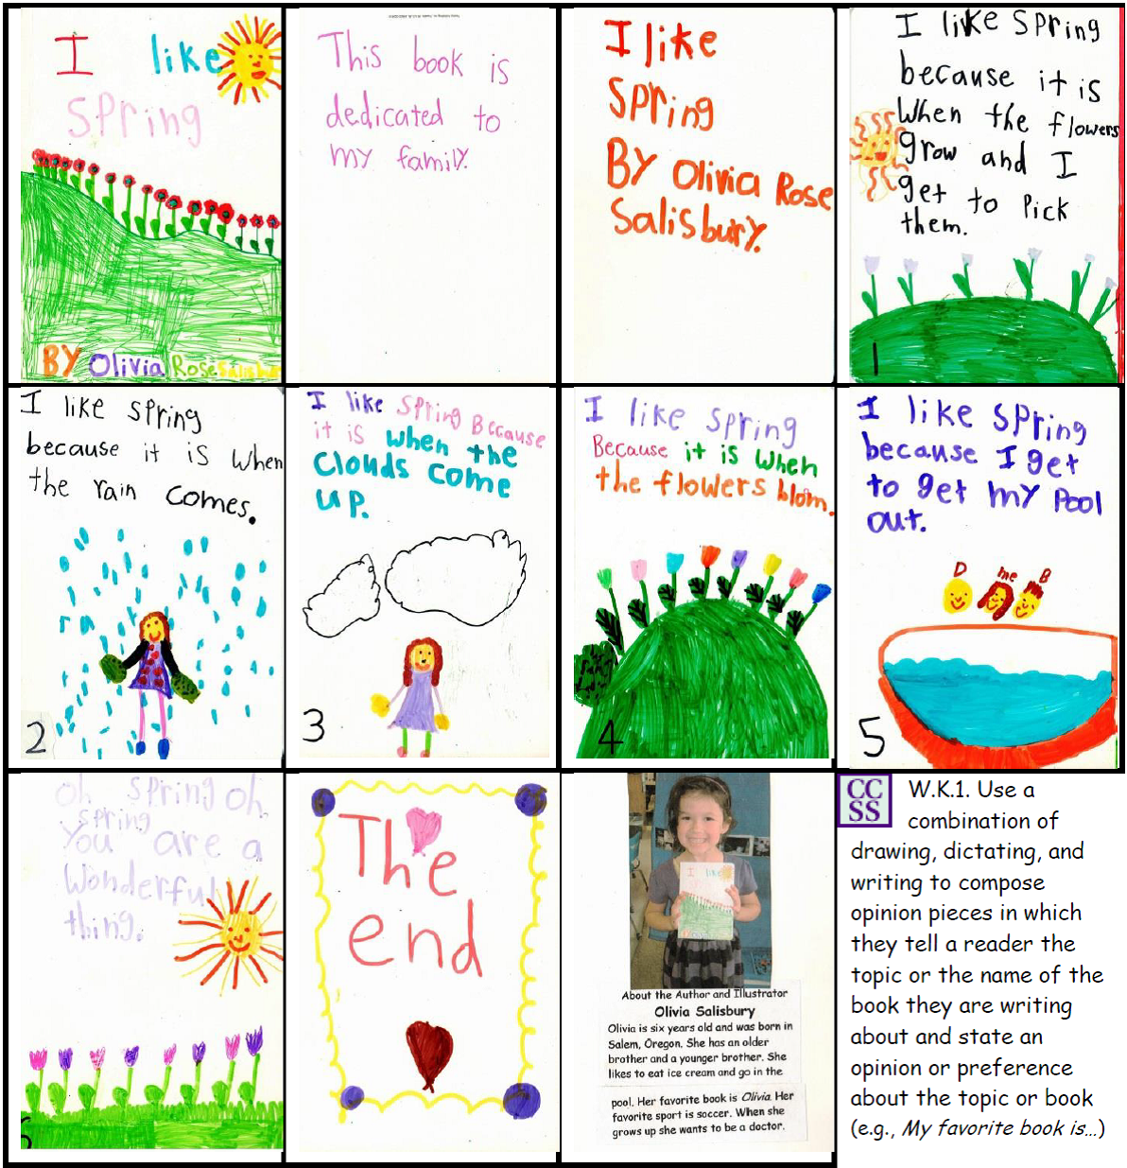
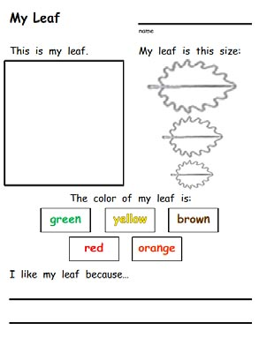
Elementary Example: Grades K-2
Lead your children into organizational thinking with this template. Help them identify the topic, provide a detailed drawing, add facts about the topic, and summarize with a statement of opinion. Later in the year, this organizational plan becomes a way of thinking that leads to quality informational writing.
Children take “writerly/scientific walks” and notice the changing seasons. Connections to nature inspire thinking, talking, drawing, and writing. We sing ”______ is coming, ______is coming, how do you think I know?” We talk about what we like about each season and why. Children are challenged to use the word “because” to extend their writing.

Slide 9
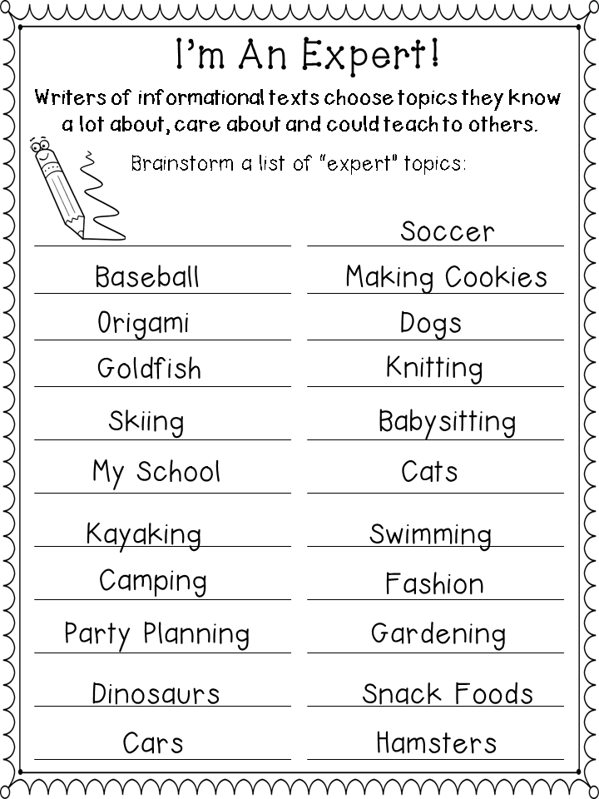
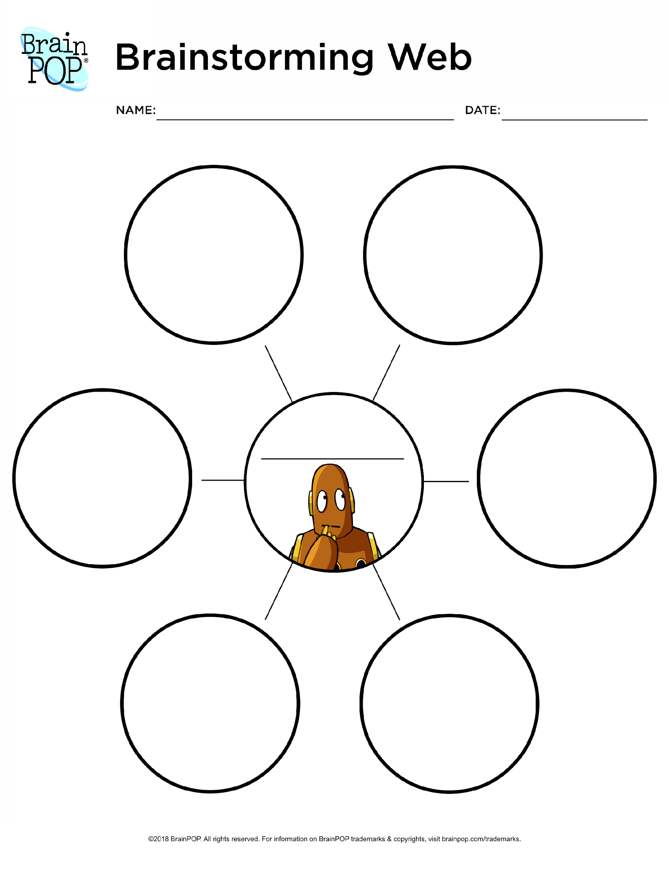
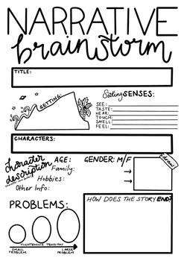
Elementary Examples: Grades 3-5
Student prompt: If you can write a _____________ about anything, what would you write?

Slide 10
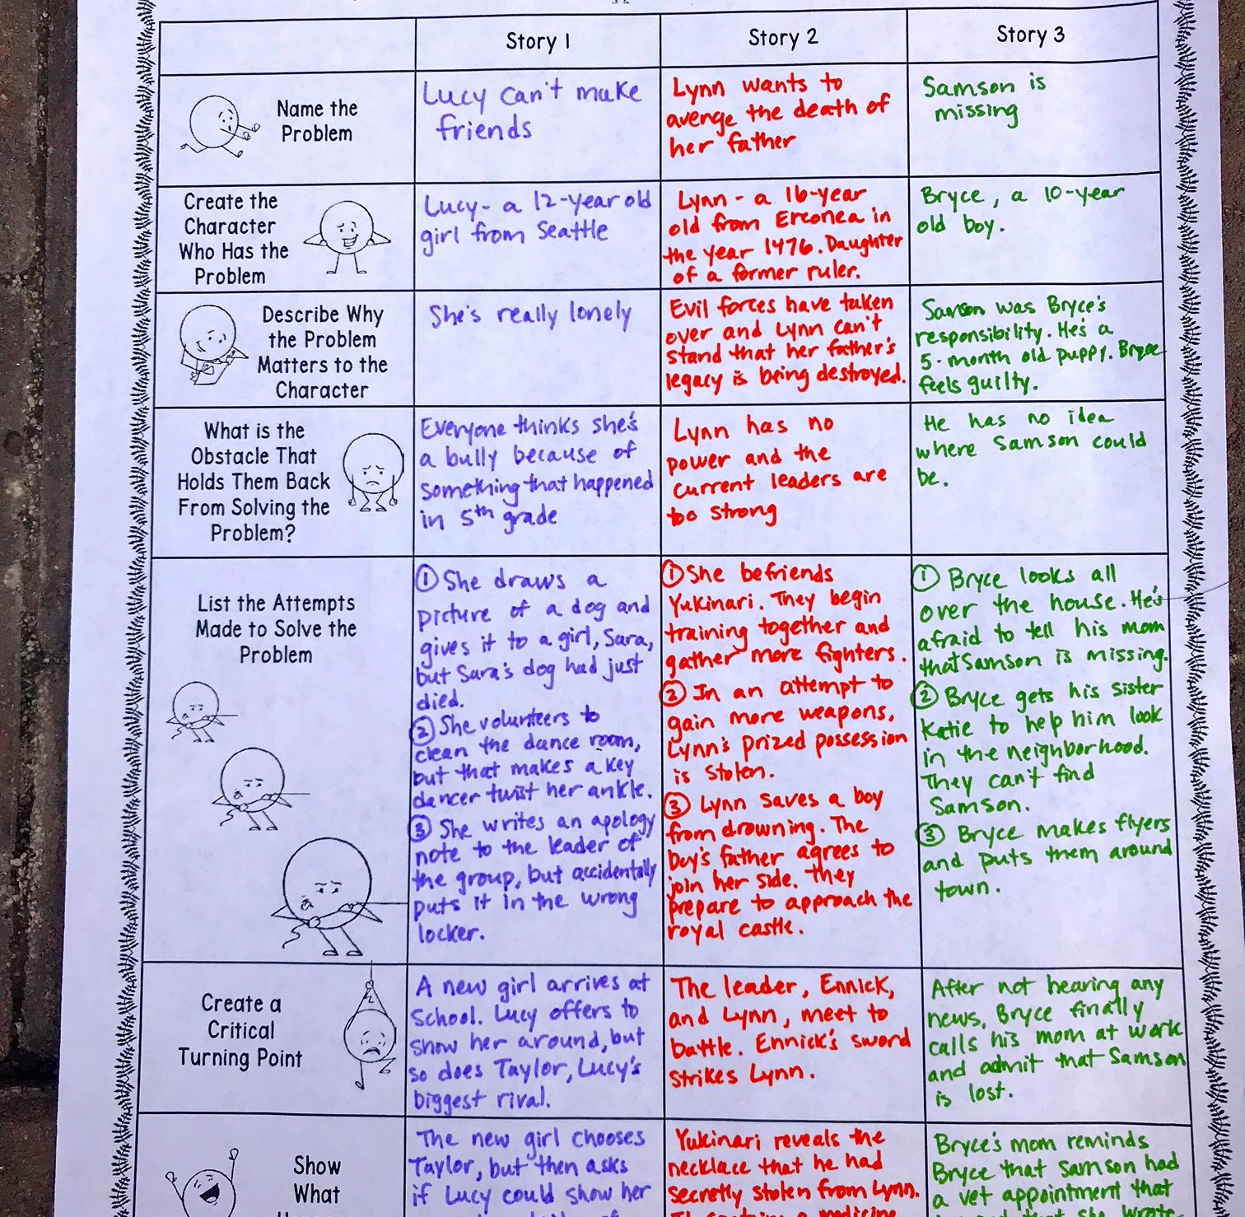
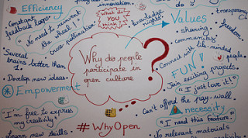
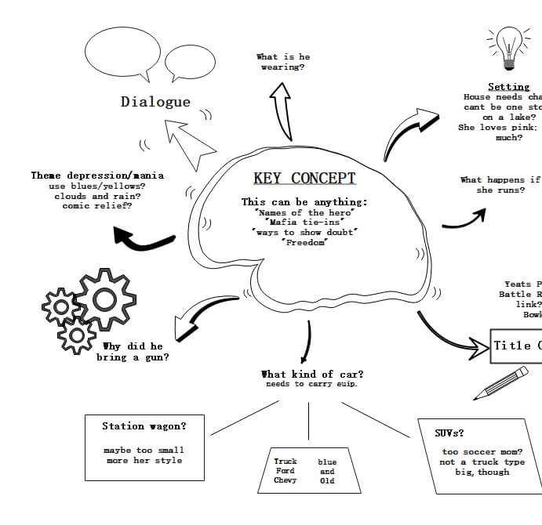
Middle/High School Examples

Slide 11
Prewriting/
Planning
Brainstorming ideas
Purpose and audience
Genre and modality of writing (form)
Revision
Clarifying
Reorganizing
Refining
Using precise language
Drafting/
Writing
Organization
Voice (tone, mood)
Word choice
Fluency
Editing
Grammar/ Punctuation
Conventions
Publishing/ Sharing
(Best Draft)
Bulletin
Website
Parents/Students
Responding
Teacher/peer conferencing
Self/peer evaluation

Slide 12
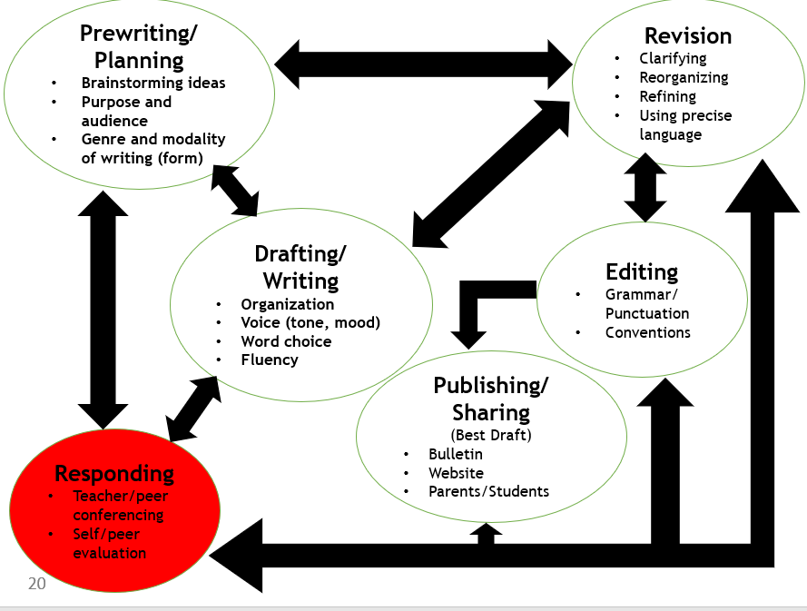
How are teachers building in time for teacher/peer conferencing and peer/self evaluation in your classroom?
Teacher/peer conferencing should focus on 1-2 elements each time. Refrain from focusing on grammar, punctuation, and spelling until student has a strong topic, clear and specific details, and development of narrative or informational writing.

Slide 13
Prewriting/
Planning
Brainstorming ideas
Purpose and audience
Genre and modality of writing (form)
Revision
Clarifying
Reorganizing
Refining
Using precise language
Drafting/
Writing
Organization
Voice (tone, mood)
Word choice
Fluency
Editing
Grammar/ Punctuation
Conventions
Publishing/ Sharing
(Best Draft)
Bulletin
Website
Parents/Students
Responding
Teacher/peer conferencing
Self/peer evaluation

Slide 14
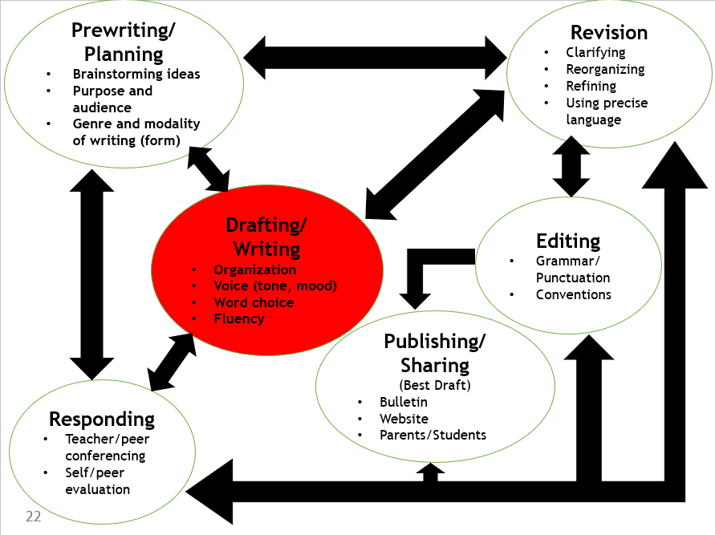
Are teachers writing alongside students? Why of why not? How are teachers modeling writing for students?
Demonstrating writing in real-time in which students can see your process—how you brainstorm/gather ideas, how you begin drafting, and revisions to your writing—builds confidence, reduces the pressure, and inspires risk taking.

Slide 15
Prewriting/
Planning
Brainstorming ideas
Purpose and audience
Genre and modality of writing (form)
Revision
Clarifying
Reorganizing
Refining
Using precise language
Drafting/
Writing
Organization
Voice (tone, mood)
Word choice
Fluency
Editing
Grammar/ Punctuation
Conventions
Publishing/ Sharing
(Best Draft)
Bulletin
Website
Parents/Students
Responding
Teacher/peer conferencing
Self/peer evaluation

Slide 16
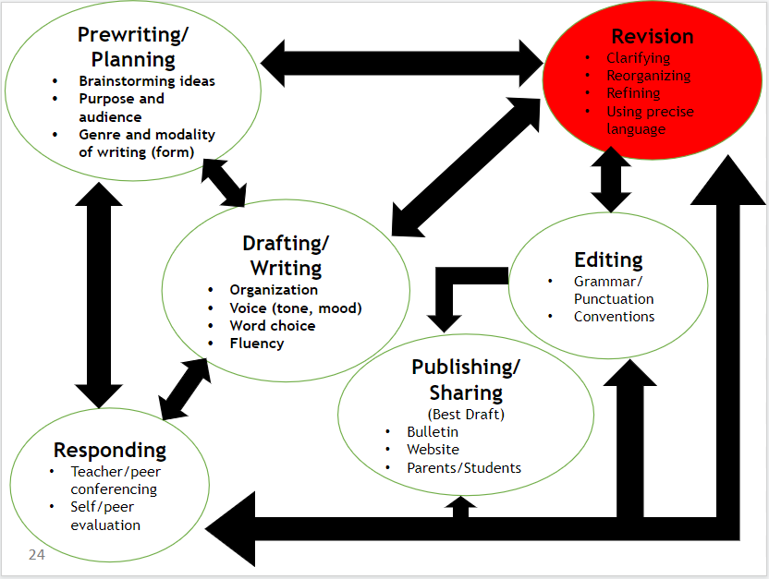
Is there a revision process in place for students? If so, how often are students given the opportunity to revise their writing? Does it only occur after they have submitted a rough draft? How many drafts are students permitted to submit and revise?
Writing is iterative! Therefore, students should be permitted to revise their drafts as often as needed in order to turn in their “best” draft. Teachers should place more value on the process than the final product. This does not preclude or negate requiring student submission of what we call a final draft but understanding that even the “best” so-called writers submit their best drafts for publishing!

Slide 17
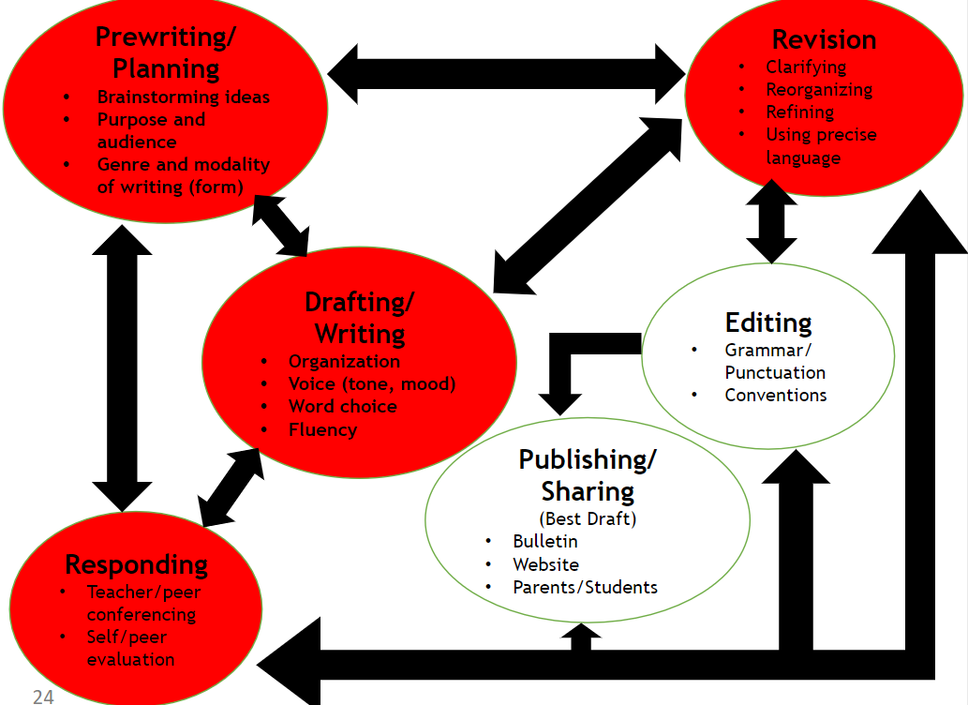
The writing process requires . . .
Commitment from teachers across all content areas and grade levels.
Consistency in practice, because practice makes permanent.
Flexibility. Writing is not a linear process.
Conferencing in each stage
Modeling writing for students
Acceptance of the best draft as the final product.

