Slide 1
Colorado’s Framework for Writing Instruction: What is it?

Slide 2
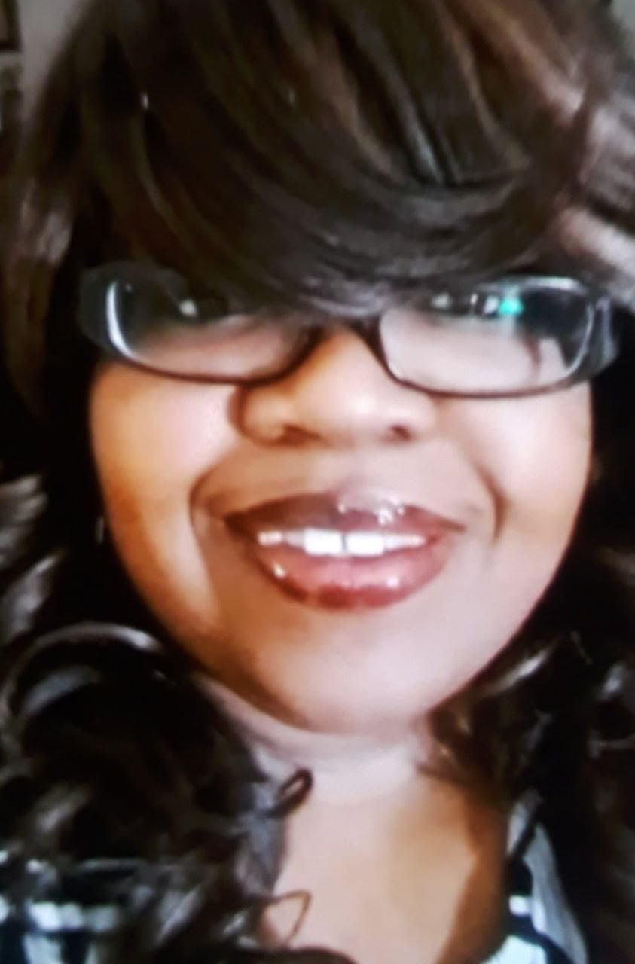
Welcome!
Dr. Olivia Gillespie Ed.D
Reading, Writing, and Communicating Content Specialist, Office of Standards and Instructional Support
gillespie_o@cde.state.co.us
720-930-1298
Notes:
[Estimated time: 2 minutes]

Slide 3
Introductions
Name, district/school/CDE, and current role
A passion that keeps you going in challenging times.
What are you looking forward to the most in our conversation today? o

Slide 4
Session Norms
Be present and engaged in the work.
Speak your truth and respect the truth of others.
Everyone’s voice is not only welcomed, but also needed.
This is a JUDGEMENT FREE ZONE!
Notes:
[Estimated time: 1 minute]

Slide 5
To provide educators and leaders with an overview of Colorado’s Framework for Writing Instruction, specifically answering the following questions:
What is the Colorado Framework for Writing Instruction?
Why do we need a framework for writing in Colorado?
How does each component of the framework’s organizational structure intersect and make for a comprehensive and systematic approach to writing and writing instruction?

Slide 6
Why is writing and explicit writing instruction important? Why is it critical that we view writing and writing instruction as foundational and as an essential component of literacy?
https://jamboard.google.com/d/1kVKSXgKZxnCAmCvDq0aFIk3PiQB6bLUdGbWqXg_XVI8/viewer?f=2

Slide 7
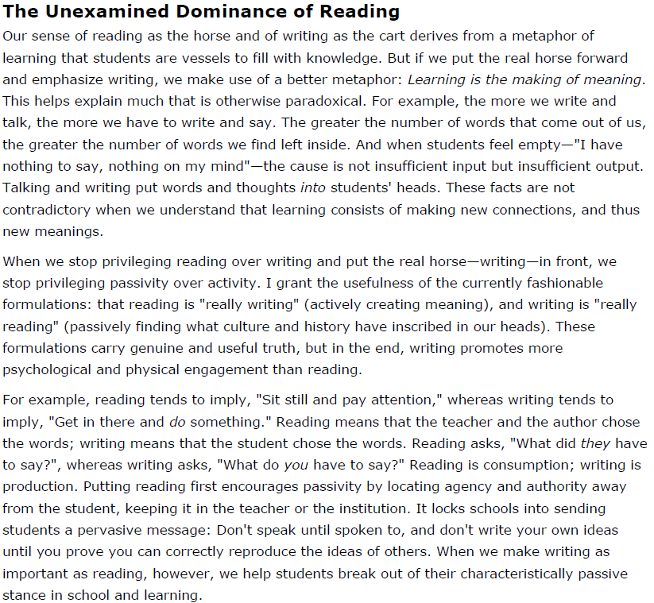

Slide 8
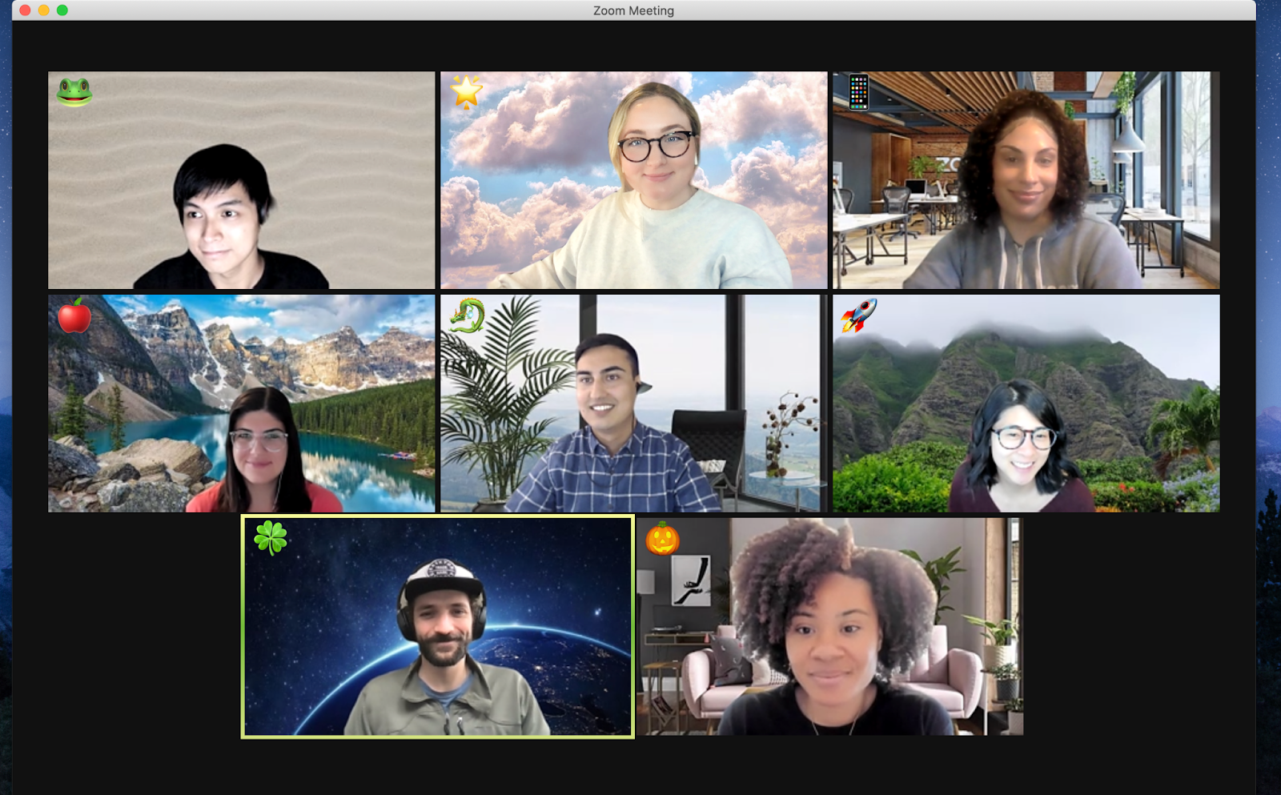
Breakout Rooms

Slide 9
Group Discussion:
Which phrase, sentence, and/or idea from the excerpt reflects your philosophy or approach to writing instruction?
How does the phrase, sentence, or idea you selected align with your belief about writing and/or writing instruction?
What would happen if you and your team viewed writing and reading as integrated, interdependent, and inter-related?

Slide 11
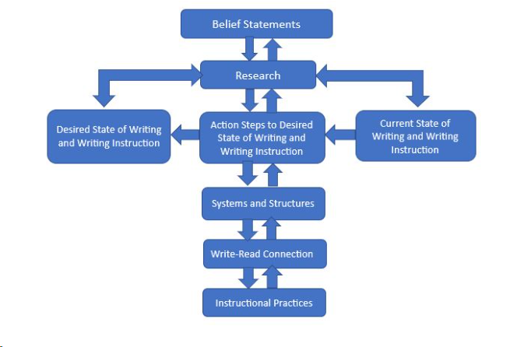
What is the Colorado Framework for Writing Instruction?

Slide 13
Grounding our Work: Prewriting/Planning Stage
Feb. 2021
SIS Needs Assessment Survey (350+ educator/leaders participated).
Apr. 2021
CDLL (Colorado District Literacy Leaders) confirmed the need for CDE support and focus on secondary writing.
May 2021
Assembled a volunteer cohort of literacy leaders to co-create the Colorado Writing Framework in response to district needs.
June 2021
Colorado Writing Framework Cohort convened for a 2-day work session to produce the first draft.

Slide 14
Grounding our Work: Feedback/Conferencing/Revision Stage
Dec. 2021
Reconvened to conduct a feedback loop involving higher education, teachers, and students.
Jan/Feb 2022
Reconvened to discuss the feedback and determine steps for revision of the framework.
April/May 2022
Revised framework based on the feedback received.
June 2022
Presented the revised draft to teachers/leaders at the 2022 Teaching and Learning CoLabs for feedback.

Slide 15
Grounding our Work: Feedback/Conferencing/ Revision/ Publishing Stage
Sept-Dec 2022
New members to the cohort. Looked at the feedback from the CoLabs to make changes.
Jan-May 2023
Revised sections of the framework to add the write-read connection, systems and structures, and instructional practices.
June 2023
Presented the current draft at the 2023 Teaching and Learning CoLabs
July 2023
Released the current draft Framework on the CDE website

Slide 16
The Colorado Framework for Writing Instruction is intended to support district- and school-level leaders in facilitating conversations with their literacy leaders, instructional coaches, and teachers to develop a research-based framework toward the teaching of writing.

Slide 17
The framework begins with a lean toward examining the beliefs around writing, in general, and teaching writing, in particular. Because of the complexity and the unique demands inherent in the teaching of writing, it is important for district and school leadership to bring to the surface the beliefs that teachers hold.
The result is to identify, and develop, if necessary, shared beliefs that teachers hold regarding the teaching of writing and align those beliefs with research and evidence-based practices that support the effective teaching of writing.

Slide 18
Why start with beliefs?
Whether they are conscious or unconscious, articulated or not, those beliefs influence decisions made in the classroom. It’s important for teachers and leaders, individually and collectively, to surface those beliefs. Beliefs lead to practices.

Slide 19
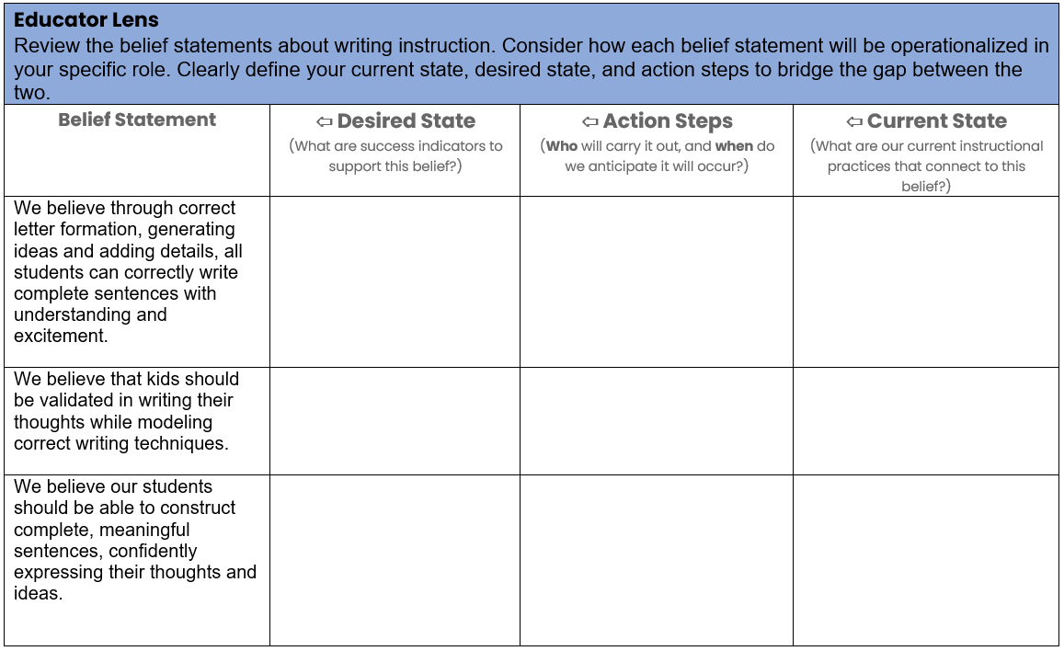
This framework connects these more abstract beliefs to a research base.
From there, it offers the elements of a “desired state” of teaching writing: the observable teacher behaviors that demonstrate effective writing instruction and the student behaviors that follow those actions.
Both teachers and leaders are asked to examine their current state of writing v. their desired state of writing and then, develop measurable action steps to achieve their desired state of writing.

Slide 20
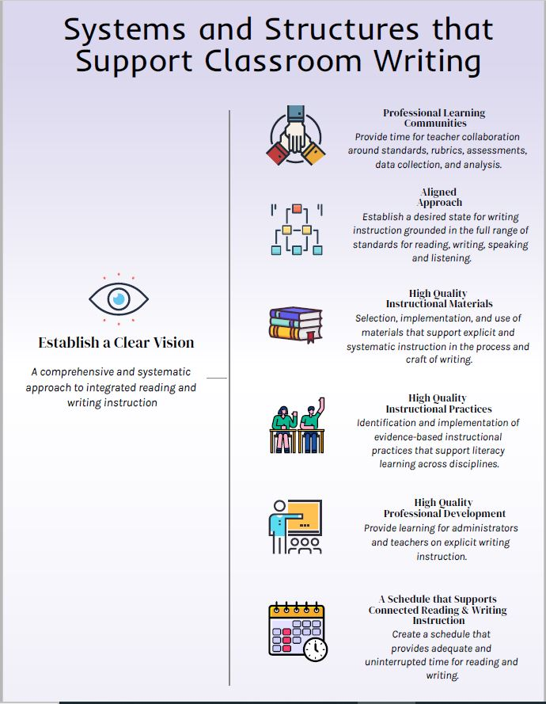
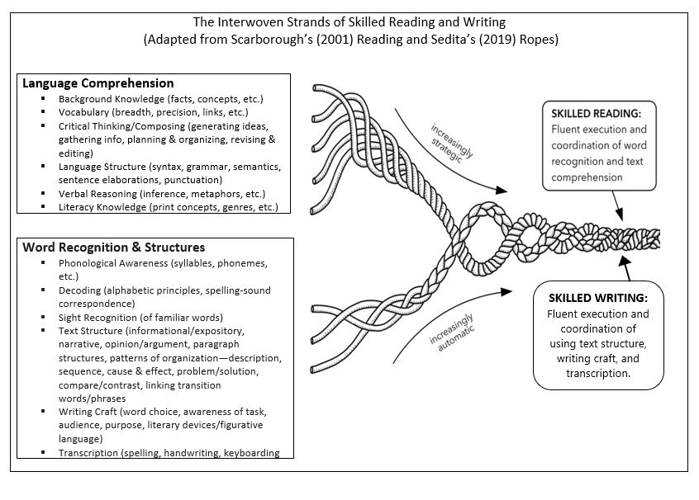
Finally, the framework connects the instructional practices to the implementation of an instructional system that is comprehensive and systematic in its approach to integrate research and evidence-based structures that sees the importance, interdependence, and intersectionality of reading and writing.

Slide 21
Breakout Rooms

Slide 22
What do you believe about writing and writing instruction?
How does your belief about writing impact how you teach or lead writing instruction in your district, school, content area, and/or grade level?
How are you connecting writing with reading to support literacy in your district, school, content area, and/or grade level?
https://jamboard.google.com/d/1kVKSXgKZxnCAmCvDq0aFIk3PiQB6bLUdGbWqXg_XVI8/edit?usp=sharing
Notes:
Estimated time: 3 minutes
Say: Before we begin, I wanted to take two minutes to do a heart check. Oftentimes, as teachers, we always check on the social-emotional well-being on our students and our colleagues, often at the expense of ourselves; however, how many times do we stop to do it for ourselves? Therefore, before we dive into this standards training further, I wanted each of you to do your own heart check, especially now with what is happening. I want you to take a few minutes and free write, doodle, make that to-do list, or just process your thoughts, feelings, etc., even if it’s about having to sit through this virtual PD on Zoom. It is your thoughts. I am not collecting it to assess your writing skills or artistic expression. I will however, ask for a few brave souls to share out.

Slide 24
Colorado Framework for Writing Instruction
1. Created to support Colorado districts and school with writing and writing instruction
2. Establish shared beliefs about writing and writing instruction. Beliefs lead to classroom instruction
3. Beliefs must be anchored in research and evidenced based practices.
5. Determine your district and/or school’s desired state of writing and then map out measurable actions steps to achieve the desired state.
4. As an instructional team, examine your current state of writing and writing instruction
6. The framework connects instructional practices to the implementation of an instructional system that is comprehensive and systematic in its approach to integrate all literacies, especially writing and reading.

Slide 26
https://docs.google.com/forms/d/e/1FAIpQLSeDbnaLZA-yEkCHXx8Xu-bUThMU_rFlsnDwOv5ON5TKA5VUiQ/viewform?usp=sharing

Slide 27
Dr. Olivia Gillespie, Ed.D
Reading, Writing, and Communicating Content Specialist, Office of Standards and Instructional Support
gillespie_o@cde.state.co.us
720-930-1298
Notes:
[Estimated time: 2 minutes]

