Slide 1
An Introduction to the Colorado Academic Standards

Slide 2
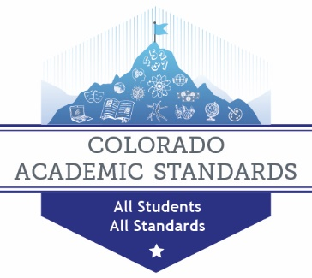
Setting the Context: Colorado’s Educational Landscape
178 school districts, 1900 schools, close to 60,000 teachers and over 3485 administrators
Close to 75% of the 178 school districts are considered rural school districts
Less than 5000 students
The largest school districts are Denver Public Schools (91,794), Jeffco Public Schools (86,097 students), Douglas Schools (67,597), Cherry Creek Schools (55,657)

Slide 3
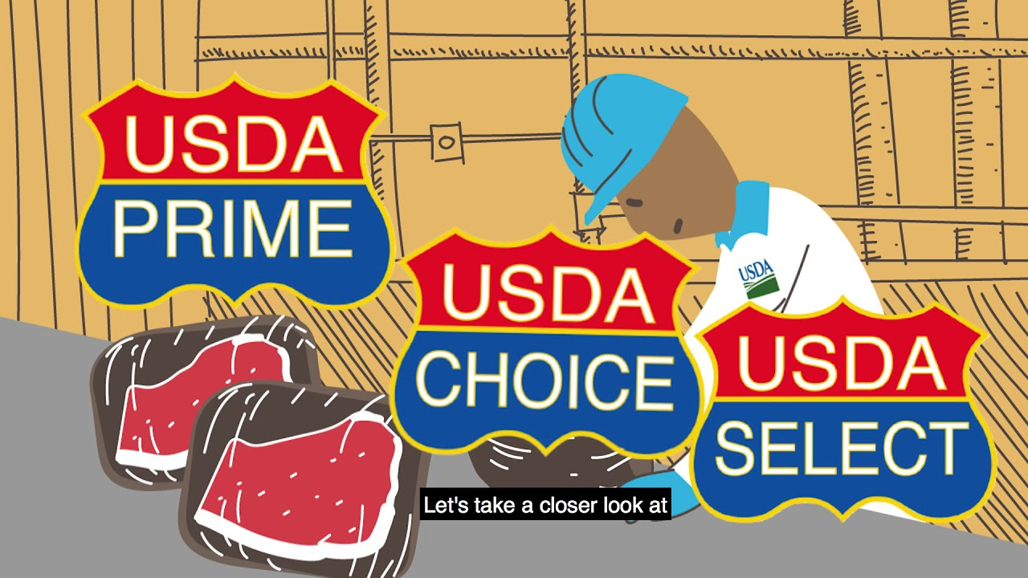
What Are Standards?
“A level of quality or attainment”
The USDA has standards for meat quality
The construction industry has standards (level of quality) for buildings
Education has standards that outline what students should know and be able to do
The Colorado Academic Standards (CAS) establish expectations for all students.

Slide 4
Why Standards?
2008 - Senate Bill 08-212, Colorado’s Achievement Plan for Kids (CAP4-K), called for the development of rigorous standards for students. The Colorado Department of Education engaged in a year-long process to update its academic standards
Standards provide a framework for establishing rigorous learning for all students
The knowledge and skills that prepare students to enter post secondary life and be successful, informed, active, and productive citizens.

Slide 5
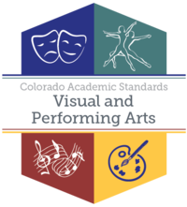
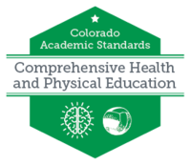
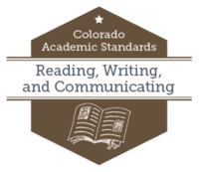
Standards Final Approval
8 Sets of Standards/16 Content Areas
Drama/ Theatre
Dance
Music
Visual Arts
2
4
History
Geography
Economics
Civics
Financial Literacy
5

Slide 6
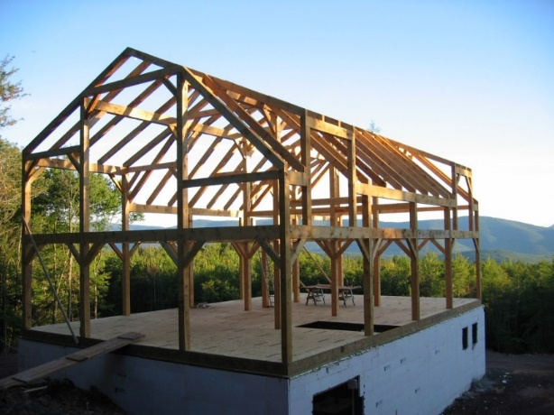
Standards Provide a Framework
Colorado’s constitution guarantees that school districts have latitude in terms of graduation requirements, curriculum, instructional resources, etc.
The state cannot mandate curriculum or instructional programming.
Thus, the local school districts use the Colorado Academic Standards to develop curriculum that is aligned to the standards.

Slide 7
What is Curriculum?
Curriculum
An organized plan of instruction that engages students in mastering the standards
Standards
Textbooks
Instructional Materials
Resources

Slide 8
2020 CAS Organization
Content Area
Standards (History - 1; Geography - 2; Economics & PFL - 3; Civics - 4)
Prepared Graduate Statements
Grade Level Expectations (GLE) articulate knowledge and skills
Evidence Outcomes (EO)
Academic Context and Connections

Slide 9
“Decoding” the CAS
Prepared Graduate Statements
Grade Level Expectations
Evidence Outcomes
Academic Context and Connections
Colorado Essential Skills
Inquiry Questions
Nature and Skills of _________
Disciplinary, Information, and Media Literacy
Notes:
Prepared Graduates:
The P-12 concepts and skills that all students who complete the Colorado education system must master to ensure their success in a postsecondary and workforce setting.
Grade Level Expectation:
What do students need to know?
Grade Level Expectations: The articulation, at each grade level, the concepts and skills of a standard that indicates a student is making progress toward being ready for high school.
Evidence Outcomes:
How do we know that a student can do it?
The indication that a student is meeting an expectation at the mastery level.
Academic Context and Connections:
Academic context and connections are the subject-specific elements needed to create context for learning. This right side section highlights essential skills, practices and other important connections necessary for students to understand, apply and transfer the knowledge and skills within the Grade Level Expectation.
Colorado Essential Skills
The critical skills needed to prepare students to successfully enter the workforce or educational opportunities beyond high school embedded within statute (C.R.S. 22-7-1005) and identified by the Colorado Workforce Development Committee.
Inquiry Questions
The sample questions that are intended to promote deeper thinking, reflection and refined understandings precisely related to the grade level expectation.
Nature and Skills of Civics
The characteristics and viewpoint one keeps as a result of mastering the grade level expectation.
Disciplinary, Information, & Media Literacy
The disciplinary, information, and media literacy skills necessary to demonstrate mastery of the Evidence Outcomes.

Slide 10
Concepts, Skills, and Content
Notes:
Concepts – use example of “jobs”

Slide 11
Standards Resources

Slide 12
Standards On-Line System
https://www.cde.state.co.us/standardsandinstruction
Notes:
This is the main webpage for the Office of Standards and Instructional Support. http://www.cde.state.co.us/standardsandinstruction
You will see navigation icons. You will notice that there are various ways you can access the standards. The Blue Icon is for the current CAS (2009/2010). The Yellow Icon is for the 2020 CAS in Word or PDF formats. The Orange Icon is for the on-line standards system. Let’s select the Orange icon, “Interact with the 2020 Standards Online.”
[estimated time: < 1 minute]

Slide 13
Implementation Modules
Introductory Module
Pre-assessment
Becoming Standards Literate
Module 1:
An Introduction to Disciplinary Literacy
Module 2:
An Introduction to Standards Literacy
Module 3:
Historical Perspective of the CAS
Module 4:
Differences between the 2009 & 2020 CAS
Module 5:
A Close Read of the 2020 CAS
Module 6:
Making Connections within the CAS
Available now at: https://www.cde.state.co.us/standardsandinstruction/2020implementation
Notes:
Module 3: A brief history of the CAS, review and revision process
Module 4: Noting the changes within the standards document
Module 5: Exploring innovations within the CAS
Module 6: Illustrates the connections among the elements of the standards document

Slide 14
Implementation Modules
Module 7:
Introduction to Curriculum & Resource Alignment
Module 8:
Interpreting the Standards
Module 9:
Mapping the 2020 CAS to Curriculum
Module 10:
Identifying Gaps in the Curriculum
Module 11:
Planning to Fill the Gaps
Module 12:
Introduction to Instruction and the 2020 CAS
Module 13: Best, First Instruction
Module 14:
High-Impact Instructional Strategies
Module 15:
Instructional Innovations within the 2020 CAS
Module 16:
Classroom Instruction
Module 17:
Are You Standards Literate?
Available now at: https://www.cde.state.co.us/standardsandinstruction/2020implementation
Notes:
Module 3: A brief history of the CAS, review and revision process
Module 4: Noting the changes within the standards document
Module 5: Exploring innovations within the CAS
Module 6: Illustrates the connections among the elements of the standards document

Slide 15
The Office of Standards and Instructional Support
https://www.cde.state.co.us/standardsandinstruction
Name | Position/Content Area | Email
Aguilar, Carla | Music | Aguilar_c@cde.state.co.us
Bruno, Joanna | Director | Bruno_j@cde.state.co.us
Buck, Lulu | World Languages | Buck_l@cde.state.co.us
Garcia, Maya | Science & STEM | Garcia_m@cde.state.co.us
Gillespie, Olivia | Reading, Writing, Communicating | Gillespie_o@cde.state.co.us
Goodwin, Donna | Visual Arts | Goodwin_d@cde.state.co.us
Hartman, Stephanie | Social Studies | Hartman_s@cde.state.co.us
Hofmeister, Judi | Dance, Drama, Theater | Hofmeister_j@cde.stat.co.us
Hurley, James | Comprehensive Health & Physical Education | Hurley_j@cde.state.co.us
Johnson, Raymond | Mathematics | Johnson_r@cde.state.co.us
Summers, Chris | Computer Science | Summers_c@cde.state.co.us
Wooten, Alyssa | Personal Financial Literacy | Wooten_a@cde.state.co.us

Slide 16
The End

