Slide 1
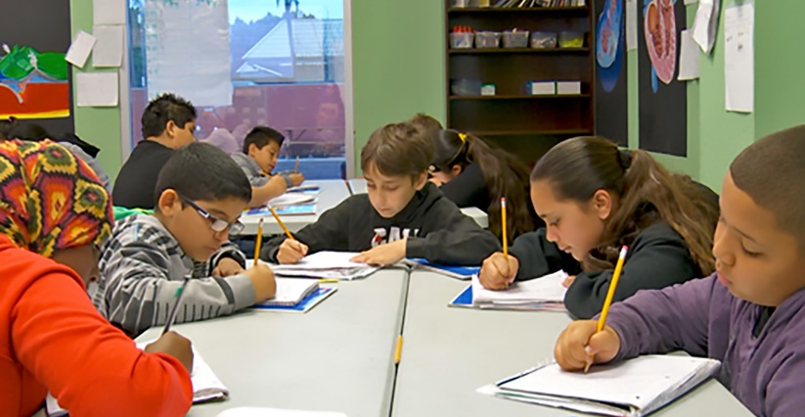
Creating a “Belief Contract” for Writing

Slide 2
Effective Writing Instruction: Creating a “Belief Contract” for Writing

Slide 3
Walk teachers through the process for developing a “Belief Contract” for writing instruction:
Brainstorm writing and the teaching of writing.
Create belief statements.
Examine current and desired state of writing Instruction.
Align belief statements to desired state.
Identify observable success indicators of the desired State.
Identify professional development and instructional materials needed to move from current state to desired state.

Slide 4
1. Brainstorm writing and the teaching of writing.
Instructions: At your table, discuss the big ideas that anchor your school’s writing initiative(s). Then, write those big ideas on sticky notes and place them on the designated chart paper hanging in the room.

Slide 5
Grades K-2 Big Idea Brainstorming (Examples from Aspen View Academy)
Generating ideas
Writing in complete sentences to explore ideas
Promoting Sound Spelling
Writing Stamina
Overcoming Obstacles
Excitement about Writing/
Confidence
Letter Formation
Modeling

Slide 6
Grades 3-5 Big Idea Brainstorming (Examples from Aspen View Academy
Informational Writing
Opinions
Research
Authenticity
Journaling
Step-Up to Writing
Spelling & Grammar
Sentence Structures

Slide 7
Grades 6-8 Big Idea Brainstorming (Examples from Aspen View Academy)
Expression
Analyzing their Opinions
Being Passionate
Voice
Remembering Information
Connection
Truthful
Reflecting
Technology

Slide 8
2. Creating belief statements.
Step One: Examine the big ideas listed on chart paper and narrow the big ideas to three priorities.
Step Two: Each table will select one priority to craft a belief statement.
Step Three: Discuss the what you believe about the priority selected and draft a belief statement on the notepad. Place the notepad on the designated chart paper. Reference page 3 from the “Establishing a Framework for the Teaching of Writing Guidance for District-Level Leaders” handout for examples of belief statements).

Slide 9
K-2 Belief Statements Anchoring Contract (Example from Aspen View Academy)
We believe through correct letter formation, generating ideas and adding details, all students can correctly write complete sentences with understanding and excitement.
We believe that kids should be validated in writing their thoughts while modeling correct writing techniques.
We believe our students should be able to construct complete, meaningful sentences, confidently expressing their thoughts and ideas.

Slide 10
Grades 3-5 Belief Statements Anchoring Contract (Example from Aspen View Academy)
We believe writing is messy and perfection is not the goal.
We believe writing should be seen across all content areas and for many different purposes.
We believe that kids should feel free to write their own opinions in their own linguistical way.

Slide 11
Grades 6-8 Belief Statements Anchoring Contract (Example from Aspen View Academy)
We believe writing allows a student’s voice to express truth and therefore, connect with the world.
We believe writing starts with remembering which leads to reflecting that allows truthful expression.
We believe students should share their opinions and be comfortable using their voice to analyze their thoughts.

Slide 12
3. Examine the current and desired state of writing instruction.
On the same sheet of chart paper in which your group placed your belief statements, create a T-chart. Write “Current State” on the left side and “Desired State” on the right side.
Begin listing the current state of writing instruction.
Next, list your desired state of writing instruction. Align the desired state with the belief statement.

Slide 13
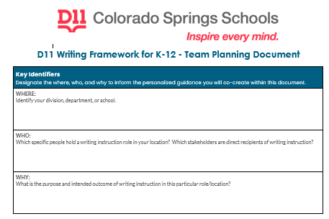
How will your school achieve the desired state?
How will you know you are successful?
What indicators will you use to measure success?
Use the Colorado Springs School District 11-Planning Doc
to create action steps to achieve the desired state.

Slide 14
Now that your team has identified the action steps needed to achieve the desired state, what professional development or learning opportunities are do teachers need to implement the action steps?

Slide 16
Resources
Elementary Writing
Building a Community of Writers, Grades 3-5
Implementing the Writing Process (Grades K-5)
Does Disciplinary Literacy Have a Place in Elementary Schools?
Content Area and Disciplinary/Strategies and Frameworks. International Literacy Association.
What Works Clearinghouse: Teaching Elementary Students to Write Effectively
Secondary Writing
Project Write Now (Real Voices Write Now)
What Works Clearinghouse: Teaching Secondary Students to Write Effectively
Creating an Engaged Community of Writers
Culturally Responsive Disciplinary Literacy Strategies Instruction
The Write Center
Disciplinary Literacy. CEEDAR Center
Gifted and Talented:
Differentiating the Language Arts for High Ability Learners
English Language Learners:
Improving Writing Skills: ELL and the Joy of Writing: Colorin Colorado
Common Core Writing and ELLs: Ferlazzo, Larry.
Professional Development/Educators
Project Write Now (for educators)
ReadWriteThink (Professional Development)

Slide 17
Additional Readings/Resources
Changing How Writing is Taught.” Graham, Steve. Article identifies factors that inhibit good writing instruction, including instructional time; teachers’ preparation and beliefs about writing; national, state, district, and school policies; and historical, social, cultural, and political influences. It then examines how we can address these factors and change classroom writing practices for the better.
Effective Writing Instruction/Time for a Revolution. Hochman, Judith. Argues that writing is a neglected “R” in our schools.
Growing Extraordinary Writers: Leadership Decisions to Raise the Level of Writing Across a School and a District. Calkins, Lucy and Mary Ehrenworth. An article on the necessity of creating the school conditions that foster growth in student writing.
Instructional Leadership in Writing: An Exploration of Elementary Principal Efficacy and Identities in a Neglected Subject. VanSlander, Jennifer L. A dissertation on teacher and principal identity as writers and the impact it has on writing instruction. The conclusions and findings starting on page 138 are very interesting.
Key Literacy Component: Writing. Several researchers have found that, much like reading, improving one’s writing skills improves one’s capacity to learn, and learning to write well requires instruction.
Leadership and Writing: How Principals’ Knowledge, Beliefs, and Interventions Affect Writing Instruction in Elementary and Secondary Schools. McGhee, Marla W. and Chulsub Lew. Researchers argue that principals “ho have strong knowledge of and belief in effective writing practices act in ways that help teachers do their best work.
Progressive Writing Instruction: Empowering School Leaders and Teachers. Lacina, Jan; Block, Cathy Collins.
Position Statement on Writing Instruction in School. NCTE. (2022) Challenges and Instructional Recommendations
Taking Initiative on Writing. NCTE. Resources for school leaders to consider as they create a school-wide writing initiative.
The Write Way by Fisher, Douglas. Short article on writing’s benefit to student achievement.
Voices From the Middle; Urbana Vol. 19, Iss. 3. (Mar 2012): 10-17. The article examines how several large districts approach writing instruction.
Why Kids Can’t Write. Goldstein, Dana. New York Times article exploring the challenge of teaching writing.
Writing First. Elbow, Peter. Argues that reading is privileged over writing in artificial and detrimental ways.
Writing Next. Graham, Steve. Highlights specific techniques for teaching writing and identifies 11 elements of writing instruction found to be effective for helping students learn to write well and to use writing as a tool for learning.

