Slide 1

Welcome to 10th Grade!!

Slide 2

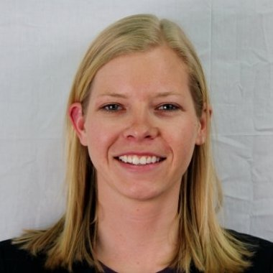
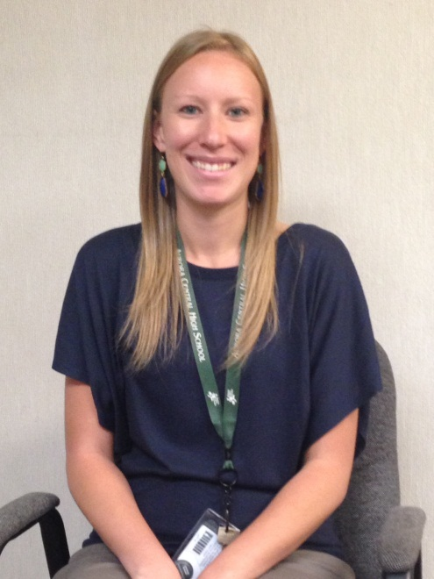
Who’s my Counselor?
Ms. McCorkel
9th and 10th Grade
Gar - Oro
Ms. Benson
9th and 10th Grade
Orp - Z
Ms. Unks
9th and 10th Grade
A - Gaq

Slide 3
11th and 12th Counselors

Slide 4
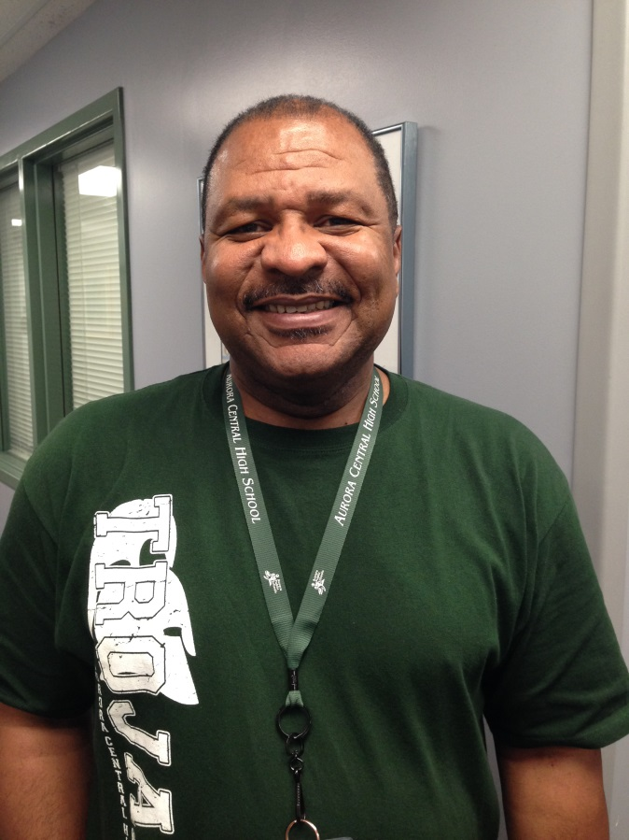

Goodwill
Mr. Gibson
Ms. EgBune

Slide 5
What do we do?
Our job is to support, listen, and advocate for YOU!
We work with students in 3 areas:
  Social/Emotional: anxiety, stress, depression, anger management, relationships, friendships, problem solving
  Academic: Grades, study skills, motivation, goal setting, organization, time management
  College/Career: Planning for the future, discovering interests and options
SPEAK UP! We can’t help you if we don’t know what you need…your job is to let us know how we can help you!

Slide 6
Confidentiality
What you say in here…stays in here!
UNLESS:
Someone is hurting you
You want to hurt someone
You want to hurt yourself

Slide 7

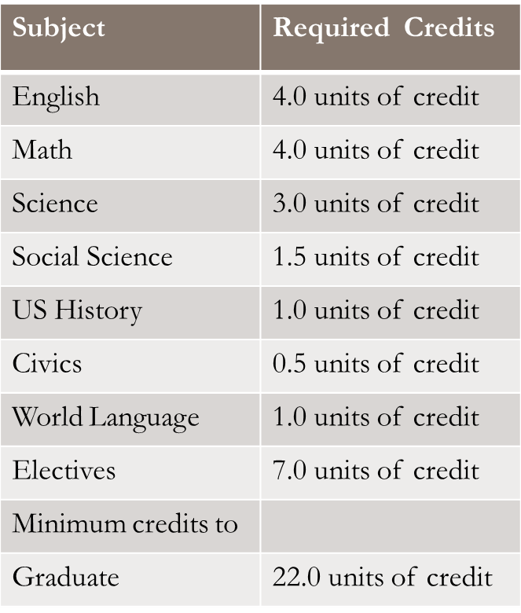
To Be on Track to Graduate
APS GRADUATION REQUIREMENTS
HEAR GRADUATION REQUIREMENTS
Subject | Required Years
English | 4 Years
Math (must include algebra 1, Geometry, Algebra II or equivalents) | 4 Years
Natural/Physical Science (two units must be lab based) | 3 Years
Social Science | 1.5 Years
US History | 1 Year
Civics | 0.5 Years
Foreign Language | 1 Year
Academic Electives | 2 years

Slide 8



NCAA Eligibility
You must get all A’s, B’s, and C’s!
ACT Scores are factored in
Credit Recovery DOES NOT COUNT!!

Slide 9
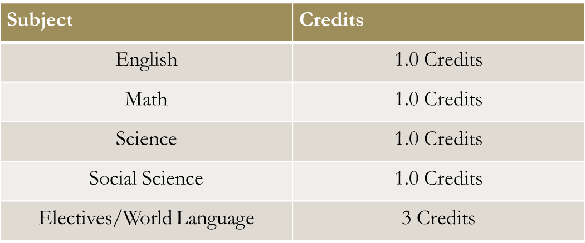
What do I do if I fail?
You must MAKE UP the credit if you fail a course, even if you only fail for one quarter.
By now you should all have…

Slide 10
G.P.A
What does it stand for?
Grade Point Average
A =4
B=3
C=2
D=1
F=0

Slide 11
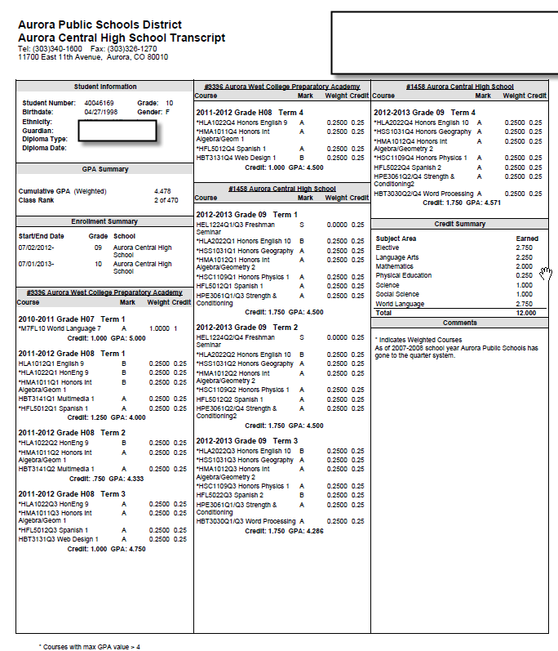

Slide 12
How to be Successful at ACHS
Set Goals
Communicate and advocate for yourself. Talk to teachers if you are struggling in a class.
Check your grades on IC
Attend ALL classes (everyday and on time)
Attend tutoring after school
Ask for help—We can’t help you if we don’t know what you need
Get involved – join after school clubs and activities

Slide 13
Quiz! Question 1
How many credits do you need to graduate?

Slide 14
Question 2:
What grades do you need to be eligible for the NCAA?

Slide 15
Question 3:
What is a GPA?

Slide 16
Question 4:
How many credits will you receive if you pass 3 quarters and fail one quarter?

Slide 17
Question 5:
To be on track to graduate, how many credits should you have right now?

Slide 18
Question 6:
How many credits of English do you need to graduate?

Slide 19
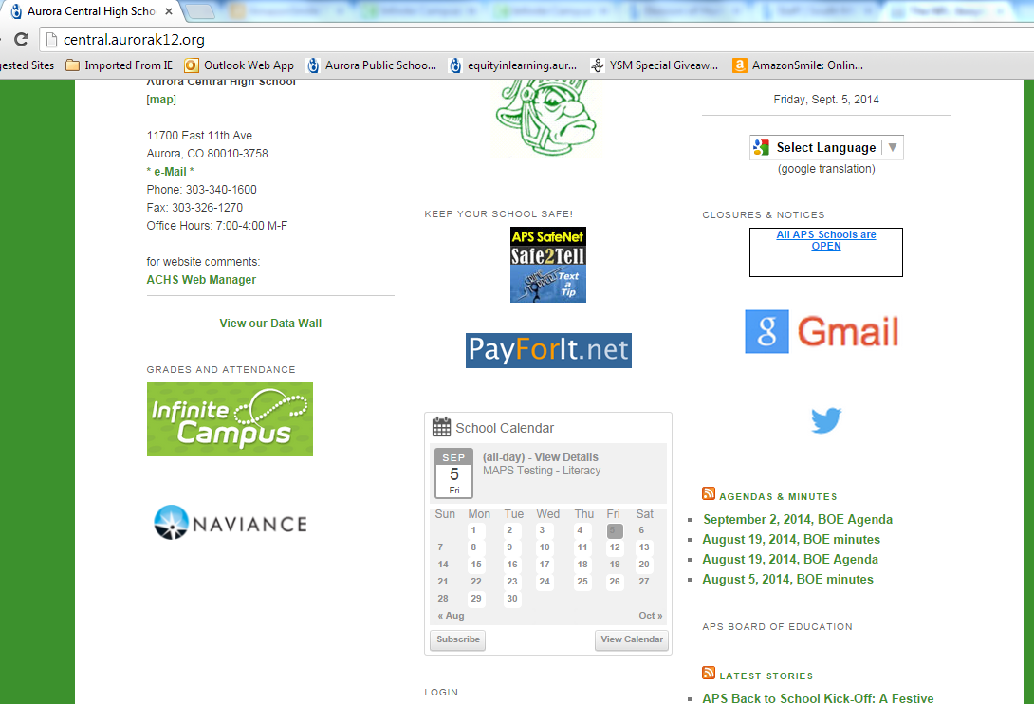
Go to Central.aurorak12.org and click on NAVIANCE

Slide 20
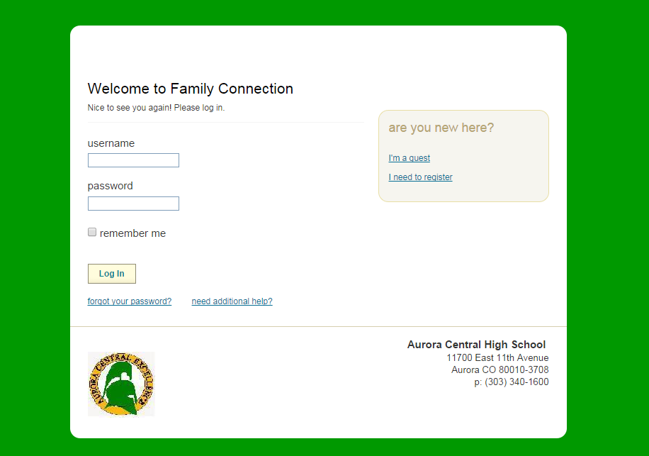
Student ID #
6 digit birthday. For example, if your birthday is
December 25, 2000, type 122500

Slide 21
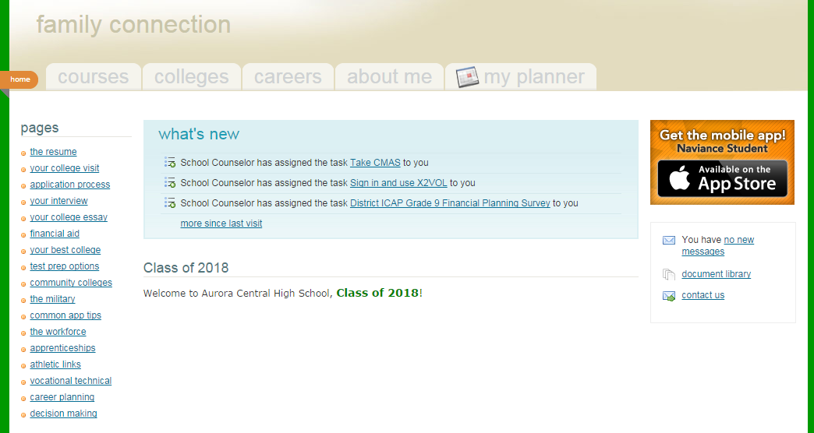
Click on My Planner

Slide 22
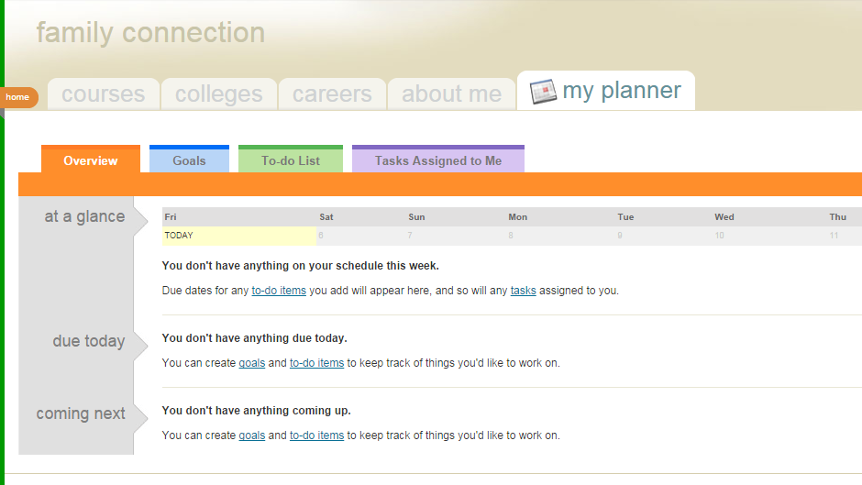
Click on Tasks Assigned to Me

Slide 23
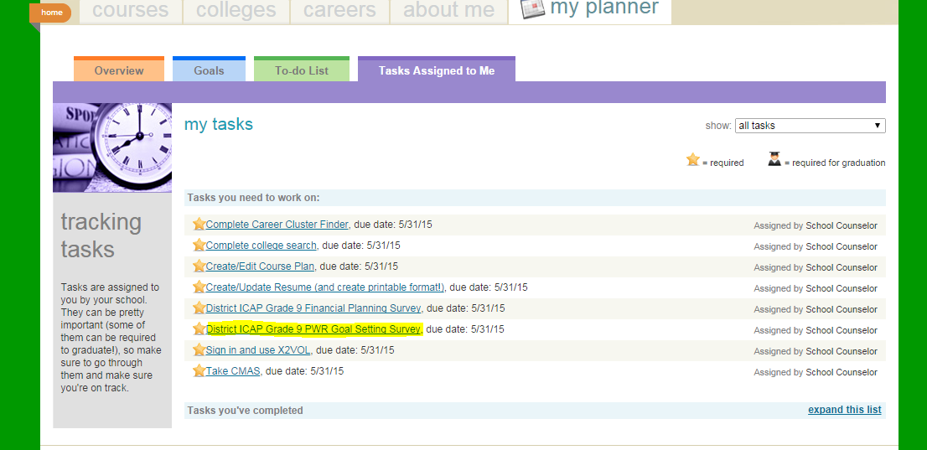
District ICAP Grade 9 PWR Goal Setting Survey

Slide 24
