Slide 1
UIP Review: Understanding Feedback from the CDE Review
April 2013

Slide 2
Goals
Successful students
Prepare students to thrive in their education and in a globally competitive workforce.
Ensure every student is on track to graduate postsecondary and workforce ready.
Increase achievement for all students and close achievement gaps.
Ensure students graduate ready for success in postsecondary education and the workforce.
Increase national and international competitiveness for all students.
Great teachers and leaders
Ensure effective educators for every student and effective leaders
for every school and district.
Increase and support the effectiveness of all educators.
Optimize the preparation, retention, and effectiveness of new educators.
Eliminate the educator equity gap.
Outstanding schools and districts
Build the capacity of schools and districts to meet the needs of
Colorado students and their families.
Increase school and district performance.
Turnaround the state’s lowest performing districts and schools.
Foster innovation and expand access to a rich array of high quality school choices for students.
Best education system in the nation
Build the best education system in the nation.
Lead the nation in policy, innovation, and positive outcomes for students.
Operate with excellence, efficiency, and effectiveness to become the best SEA in the nation.
Attract and retain outstanding talent to CDE.
Students
Educators
Schools/ Districts
State
2
Notes:
CDE is prioritizing their work through focused goals at the student level, the educator level, the school and district level, and finally, the state level.
Let’s look at CDE as the state education agency. CDE has a strategic plan, all work happening in the organization must be linked to the strategic plan and progress is reported monthly. More than ever, CDE is committed to becoming more of a SUPPORT arm than purely a compliance driven organization.
At the school/district level, CDE is supporting districts in the UIP process and working closely with districts and schools to ensure that priority and turnaround schools get the assistance they need to become high-functioning buildings for all the kids they serve.
And, at the Educator level, CDE recognizes how complex the teacher and principal roles are and, as they work on implementation of the new educator evaluation requirements, they are focused on supporting educators every step of the way. We know that having great teachers and excellent school leaders are the most important school-based factors in student achievement and CDE is working with educators from across the state to build a Model Evaluation System that is based on professional growth and meaningful feedback for all educators.
At the student level, CDE is supporting districts as they implement the new Colorado Academic Standards… building tools and resources for educators which help to simplify implementation and ensure success with students. CDE also works carefully with districts with RTI, interventions and IEP’s.

Slide 3
Today’s Session
  Overview of themes from the CDE UIP Review
  Identify common challenges identified through the CDE UIP review process
  Provide the opportunity to ask CDE staff specific questions about feedback a school received on their feedback form
  Consider how the school/district may approach addressing feedback from CDE through ongoing planning processes

Slide 4
Purpose of UIP Review and Feedback
Compliance
Support
SB 163: Review of all Turnaround and Priority Improvement Schools and Districts
Accountability:
State Graduation and Completion plans
Federal (Title IA, IIA, and III) improvement plans
Specific grant programs: School Improvement Funds
Provide specific feedback on UIP Quality Criteria to improve quality of improvement planning in schools and districts
Notes:
Erin

Slide 5
CDE UIP Review Process
January 22- March 1
118 CDE staff participated in review process
Teams of 2-10 staff per review
  Schools 2-4 reviewers per team
  Districts 3-10 reviewers per team

Slide 6
212 School Plans Reviewed
52
Turnaround Plans
140
Priority Improvement Plans
20
TIG
Improvement or
Performance Plans

Slide 7
28 District Plans Reviewed
5
Turnaround Plans
19
Priority Improvement Plans
4
TDIP/ SGCP
Improvement Plans

Slide 8
CDE Expectations
Districts are responsible for accrediting schools
District responsibility for ensuring schools’ requirements are met
Feedback from CDE is intended strengthen the plan
Changes should be considered within a district/school improvement planning process and timeline

Slide 9
Plan Quality
Priority performance challenges are not clearly identified. Performance challenges are developed from trends and specify the areas of needed improvement on which the school will focus its efforts. Prioritization of challenges reflects the magnitude of the challenges, guides root cause analysis, and provides for more focused improvement strategies. The UIP Handbook provides guidance on identifying trends and
priority performance challenges.
High Plan Quality
Identifies targets that may move the school out of priority improvement, but some may not be set sufficiently high to result in the school meeting expectations within the five‐year timeframe. Consider the degree to which the Major Improvement Strategies associated with the annual targets in the target setting worksheet will bring about the results articulated in this form.
Example: Given the emphasis in Major Improvement Strategy #1 on Balanced Literacy, would you expect to see a 5% increase in reading achievement and the same 5% increase that is articulated in the target setting form for math achievement?
Degree of Focus of CDE Feedback
Low Plan Quality

Slide 10
UIP Review Process: Positive Themes
The UIPs are getting better!
Improved description of previous targets and progress toward meeting targets
More comprehensive analysis of TCAP and increased inclusion of local data
More precise articulation of trends
Clearer identification of priority performance challenges (reflecting greater understanding of what priority performance challenges are)
A more extensive data narrative that describes the school and addresses the majority of the Quality Criteria
More ambitious and appropriate targets for achievement and growth

Slide 11
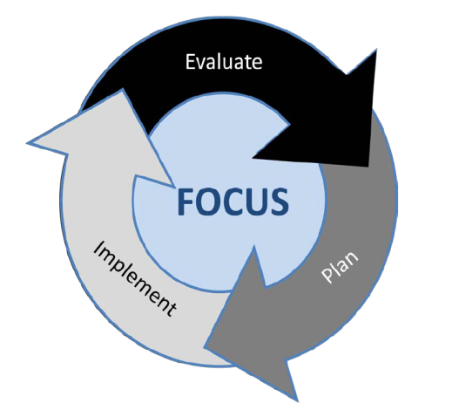
Continuous Improvement

Slide 12
Unified Improvement Planning Processes
Gather and Organize
Data
Preparing to Plan
Section IV:
Target Setting
Section IV:
Action Planning
Section III: Data Narrative
Review Performance Summary
Describe Notable
Trends
Prioritize Performance Challenges
Identify
Root
Causes
Set
Performance Targets
Identify Major Improvement Strategies
Ongoing:
Progress Monitoring
Identify
Interim Measures
Identify Implementation Benchmarks

Slide 13
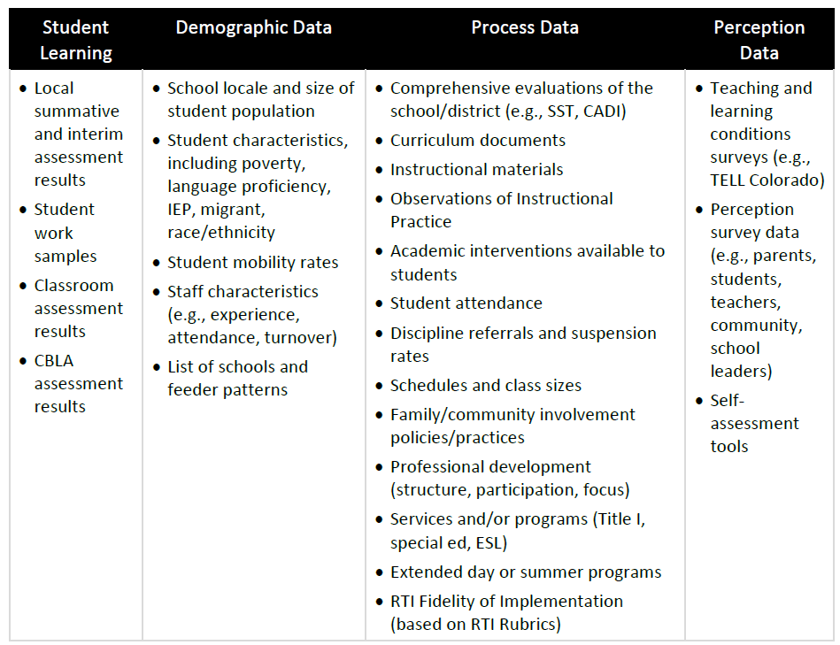
p. 7 UIP Handbook
UIP and Data

Slide 14
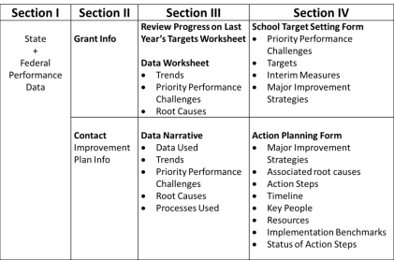
Big Idea: Lack of Consistency
The same element is presented differently in different sections of the plan:
Persistently low and decreasing performance across all populations in all content areas.
In grades 3-8 reading achievement data for the last three years indicates that an average of 56% (from 2009-2011) of students do not meet proficiency levels of CSAP.
Priority Performance Challenges:
Raise the level of Tier I instructional rigor through professional development, mentoring and coaching, and effective PLC’s.
Notes:
This happened frequently with Prioritized Performance Challenges, Root Causes and Major Improvement Strategies: those items that get represented in multiple placed in the plan.

Slide 15
Section I | Section II | Section III | Section IV
State + Federal Performance Data | Grant Info | Review Progress on Last Year’s Targets Worksheet Data Worksheet Notable Trends Priority Performance Challenges Root Causes | School Target Setting Form Priority Performance Challenges Targets Interim Measures Major Improvement Strategies
 | Contact Improvement Plan Info | Data Narrative Data Used Notable Trends Priority Performance Challenges Root Causes Processes Used | Action Planning Form Major Improvement Strategies Associated root causes Action Steps Timeline Key People Resources Implementation Benchmarks Status of Action Steps
Notes:
Section 1: p 1
Section 2: p 3
Section 3: Data Worksheet p 5
Data Narrative p 9
Section 4: Target Setting p 12
Action Planning p 15

Slide 16
Big Idea: Lack of Coherence
There is not a logical progression across the steps of the Unified Improvement Planning process:
  It is not clear how Major Improvement Strategies:
    Logically address root causes
    Will bring about the student performance described in the target setting form (annual targets, interim measures)
Targets are related to Priority Performance challenges
Priorities grew out of a comprehensive data analysis
  40% of a schools population are English Language learners, no disaggregation of their achievement, growth, or language attainment progress.
  All priorities and actions address whole school without considering needs of this group of students
Notes:
Extreme example

Slide 17
Big Idea: Timeframe
Many plans ended May 2013 -More than 1/3 of the plans were written for one year
The UIP should be a two year plan that gets revised on at least an annual basis
Revision process should be updated with current information, then planning projected out; modifications should be made based on determinations from data (interim measures/implementation benchmarks)
Notable Trends, Priority Performance Challenges
Root Cause Analysis
Target Setting,
Action Planning
What has been happening?
Where do we need to go?
?
2010
2011
2012
2013
2014
2015
Interim Measures,
Implementation Benchmarks

Slide 18
Big Idea: Combined Plans
Small systems have the option to submit a plan that addresses the need of all schools within the district
School identified for Priority Improvement and Turnaround
Needs of that school must be identifiable throughout the plan (data analysis, target setting action planning)
Unified ≠ Simplified

Slide 19
Discussion
Do these themes make sense?
Is there feedback for your schools related to these themes? Which ones?
Would addressing these “big ideas” strengthen the plans of your schools?

Slide 20
Common Theme:
Trend Statements
State data only
Inconsistent evidence of analysis (e.g. listing only, or table presentations)
  Example: “We looked at NWEA and STAR data.”
Limited disaggregations beyond grade level.
  Consider other groups of students: (e.g. SPF Growth Gaps)

Slide 21
Trend Statements
Consider: provide more information than TCAP to describe what the data tell you about the school’s performance over time, rather than just presenting the data.
Local performance data allows the school to determine whether the trends were consistent across data sources other than CSAP and across all years served by the school and whether identified trends pertained to all grades.
Do the current CBLA results align with TCAP reading data?

Slide 22
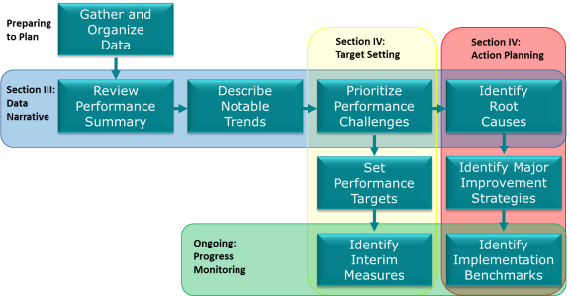
Common Theme: Prioritized Performance Challenges
Did not set the strategic focus for the rest of the plan
Has implications for the rest of the planning process

Slide 23
Common Theme: Priority Performance Challenges
The same element get presented differently in different sections of the plan:
How does this provide focus for improvement?
Persistently low and decreasing performance across all populations in all content areas.
In grades 3-8 reading achievement data for the last three years indicates that an average of 56% (from 2009-2011) of students do not meet proficiency levels of CSAP.
Priority Performance Challenges:
Raise the level of Tier I instructional rigor through professional development, mentoring and coaching, and effective PLC’s.
Notes:
This happened frequently with Prioritized Performance Challenges, Root Causes and Major Improvement Strategies: those items that get represented in multiple placed in the plan.

Slide 24
Common Theme: Prioritized Performance Challenges
Frequently not framed in terms of student performance outcomes. There was a lot of:
What we NEED to do
    Example: Reading: In order to meet state targets for a level increase to MEETS, reading Median Growth Percentile (MGP)must increase from 45 to 55 MGP.
What the problem is (root causes)
    In prior years, the schedule did not provide teachers time to plan units of instruction collaboratively both within and across grade-levels to unpack the standards (CCSS, CAS, and WiDA), align instruction to essential learning goals (ELGs), and systematically assess student progress.
Consider: examination across content areas and performance indicators

Slide 25
Common Theme: Prioritized Performance Challenges
Consider:
Examination across content areas and performance indicators to identify themes that are cross-cutting, leads to examination of systemic root causes.
  Example: Do challenges in Reading exist across both Achievement and Growth performance indicators?
Describe how performance challenges became prioritized.
  Who was involved, criteria considered for the prioritization?

Slide 26
Common Theme: Root Cause
Root cause analysis process that is sufficiently detailed and focused on the priority performance challenges.
  Aligned to priority performance challenge
  Appropriate magnitude
  Considers multiple data sources

Slide 27
Common Theme: Root Cause
Lack of Verification
Examples:
  “We feel this is due to low expectations…”
  “Ineffective planning of units and lessons has led to ineffective instruction because the intended outcomes are not the main focus.”
  “Upon completion of “The Five Whys: Root Cause Identification” protocol, we came to the consensus that as a school staff, we were not data driven.”
Consider
  Identifying results and data sources that were used to verify root causes.
    80% of walkthroughs identified that…
    90% of parent surveys indicated…
    70% of lesson plans showed a lack of…

Slide 28
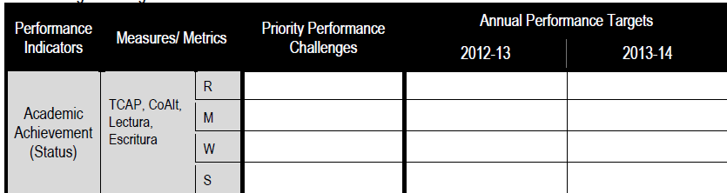
Common Theme: Target Setting
68
What is being measured?
Is it specific enough to know if the target has been achieved?

Slide 29
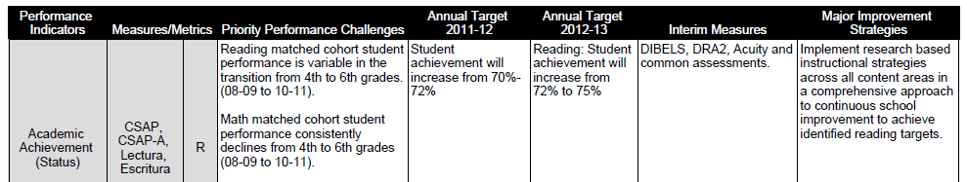
Common Theme: Interim Measures
Interim Measures: Is there enough detail to identify if progress is being made?
Considerations:
Frequency of administration?
What changes would you expect to see to make your target?
Does DRA2 measure math performance?
Will DIBELS tell you if you are addressing your Priority Performance Challenges for 4-6th grade students?

Slide 30
Common Theme: Major Improvement Strategies
Not just an inversion of the root cause
A major improvement strategy is an overall research-based approach to improvement designed to explicitly address the root causes, not just an inversion of the root cause
Major Improvement Strategies not clearly linked to data presented in previous sections

Slide 31


Common Theme: Action Planning
Action plan steps that are sufficiently detailed to guide the improvement work.
Example:

Slide 32
Common Theme: Implementation Benchmarks
Many benchmarks address completion of action steps (completed rubric) or artifacts of evidence (Surveys for Teachers and Students), but not the effectiveness of their implementation
Identifying what the artifacts will be examined for e.g. Walk through observation forms indicating increasing percentage of fidelity to X model, with 90% of observations indicating practices (list out) implementation by May 2013
How will you know what you are doing is having the desired effect?

Slide 33
Now what?
Consider the district/school timeline for improvement planning.
When does it make sense to consider the feedback from CDE?
What additional information is needed to address feedback?
What skills may needed to fully understand or respond to feedback?

Slide 34
Evaluation
Please provide us with feedback using post-it notes at your table
    - Things that worked well for this session
    - Things that we should change
    - Questions you still have
    - A-ha’s from today’s session
?
!

