Slide 1




Multi-Tiered Family, School & Community Partnering:
“On the Team and At the Table”
MTSS(RtI) Mini-Grant Summit:
FSCP Toolkit Training
June 28, 2012
Notes:
Key Points:
These slides have notes to guide presentations for stakeholders or for independent study. The slides can be “cut and pasted” for school or stakeholder use in supporting family and community engagement in the RtI process.
It will be more understandable if all slides are viewed in sequence, but the five sections can be studied independently. These are: Definition, Rationale (Law and Research), Challenges and Solutions, Tiered RtI Family and Community Partnering, and Data-Based Action Planning. There is also a brief introduction to RtI.
A “toolkit” icon notes when there are written materials, handouts, resources available on the slide topic.
There is a separate set of Activity slides which can be included in this presentation if desired, or they can be utilized independently.
There is a separate set of “Back-to-School” slides which are samples from this presentation organized for easy access to a school site wanting to share information with stake holders.

Slide 2
Introductions
Who are you? Who are we?
How many of you are parents?
What is important for you to hear today?
Notes:
Key Points:
-Ask how many are parents themselves.
-Ask to use that lens, as well as their professional role, in interacting with the material.
-Inclusive alternate: ask those who are not parents to think about own school experiences w/their families.
-Because people are in very different places with this information, it is helpful to know what people want to gain from the presentation.

Slide 3

Outcomes
Participants will:
Know about key family, school & community partnering implementation components (RtI Rubric): definition, research, legal mandates, challenges and solutions, tiers, roles and responsibilities
Gain exposure to tools and resources
Think about a data-based action plan for tiered partnering
Notes:
Key Points:
-Outcomes for slides & module material outlined.

Slide 4

“Time is Our Currency”
George Batsche
“
Notes:
Key Points:
-Time is theme of module.
-Icon seen on slides address time specifically.
-Goal is efficient, effective support for student achievement in & out of school.
-Time often cited as barrier to family-school partnering; ways to overcome this barrier identified throughout module.
-Students benefit significantly when effective relationships are in place.

Slide 5
Presentation At A Glance
“Honoring Your Time”
Presentation Topics
  Definition
  Rationale
  Challenges and Solutions
  Multi-Tiered Partnering, Roles and Responsibilities
  Data-Based Action Planning
Activities
Tiered Toolkit
Notes:
Key Points:
-Entire RtI Family & Community Engagement Module was developed for easy navigation.
-Can be adapted to individual sites and stakeholder needs.
-Material to be accessed flexibly.
-Time is our most valuable resource.

Slide 6
Multi-Tiered System of Supports
RtI
MTSS
PBIS
Notes:
Key Points:
-The national language is shifting to combining RtI, PBIS, and other tiered systems of support into one framework, MTSS or Multi-Tiered System of Supports.
Ideas to Consider:
-Identify the various tiered supports in your site and how families participate.

Slide 7
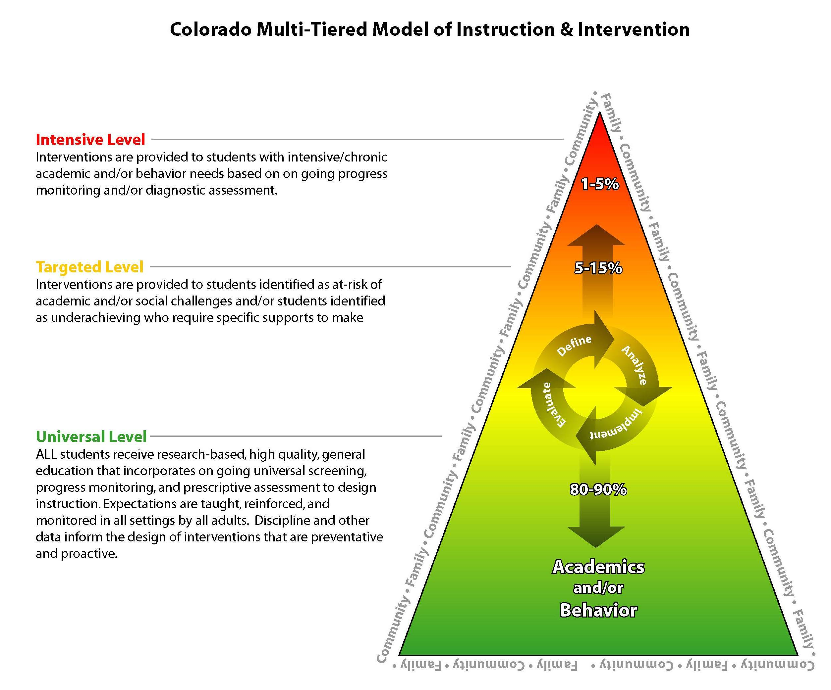

Notes:
Key Points:
-RtI is a multi-tiered model.
-Read tier descriptions & percentages.
-In Colorado, tiers represent both behavior & academic learning.
-Students move up & down tiers as needed for learning.
-Progress monitoring data drives this process.
-As students move up tiers, provide more intense & specialized instruction.
-Problem-solving process is the circle in the middle, interventions prescribed & monitored by team.
Ideas to Consider:
-Does your site and/or district have a multi-tiered model for student interventions?
-If so, what are some of the specific components?

Slide 8
Core Colorado RtI Principles
We Believe…
ALL children can learn and achieve high standards as a result of effective teaching.
All students must have access to a rigorous, standards-based curriculum and research-based instruction.
Intervening at the earliest indication of need is necessary for student success (Pre K-12).
A comprehensive system of tiered interventions is essential for addressing the full range of student needs.
Student results are improved when ongoing academic and behavioral performance data are used to inform instructional decisions.
(CDE, 2008b)
Notes:
Key Points:
-Core principles developed by state-wide task force on RtI.
Ideas to Consider:
-Discuss how these relate to your site, situation. Would you add or change any?

Slide 9
Core Colorado RtI Principles
Collaboration among educators, families, and community members is the foundation to effective problem-solving and instructional decision-making
Ongoing and meaningful involvement of families increases student success
All members of the school community must continue to gain knowledge and develop expertise in order to build capacity and sustainability.
Effective leadership at all levels is crucial for the implementation of RtI.
(CDE, 2008b)
Notes:
Key Points:
-Highlighted principles relate specifically to families, schools & communities partnering for student success.

Slide 10
Six Essential Components of Colorado RtI
Leadership
Curriculum & Instruction
Problem-Solving Process
Progress Monitoring
School Culture & Climate
Family and Community Partnering
(CDE, 2008b)
Notes:
Key Points:
-Six components established by the RtI Task Force.
-Each component important to implementing RtI.
Ideas to Consider:
-How would each of these areas be defined in your site?
-How are they a component of your RtI framework?

Slide 11
SLD Criteria: State/Public Agency Requirements (Federal Rule 300.307, 2006)
A State must adopt … criteria for determining whether a child has a specific learning disability.
The criteria must not require the use of a severe discrepancy between intellectual ability and achievement.
The criteria must permit the use of a process based on the child’s response to scientific, research-based interventions.
A public agency must use the State criteria adopted.
Notes:
Key Points:
-Background as to why every school in Colorado must have an RtI process.
Ideas to Consider:
-Do families and staff have a shared understanding of the RtI process, law, and rationale for implementation?

Slide 12
Amended Rules for the Administration of Colorado ECEA
Final approval by State Board of Education – November 8, 2007.
Effective date following final approval by Attorney General and publication in the Colorado Register – December 30, 2007.
Date by which all Administrative Units must implement the new SLD Criteria – August 15, 2009.
Notes:
Key Points:
-Timeline for RtI implementation in Colorado.

Slide 13
Colorado READ Act (2012)
If a student’s reading skills are below grade level expectations…the local education provider shall ensure that the student receives appropriate interventions through an RtI (or comparable) framework…
Notes:
Key Points: This is new legislation to become effective in 2013. RtI is now in Colorado law in two places.

Slide 14
Eight Guiding Practices of
School-wide PBIS
Administrative Leadership
Team Implementation
Define Concrete Expectations
Teach Behavior Expectations
Acknowledge and Reward Positive Behavior
Monitor and Correct Behavior
Use Data for Decision Making
FAMILY AND COMMUNITY PARTNERSHIPS
Notes:
Key Points:
-Colorado was one of the first states to include “Family and Community Partnerships” as one of the guiding practices.
-Families and community members can participate in all of the other practices, coordinating positive behavior supports in all the facets of a student’s life, which can increase behavior learning and successes.

Slide 15
Colorado RtI Video
Secondary Implementation http://www.cde.state.co.us/media/rti/training01/rtivideo03.html
Notes:
Key Points:
-Video was made by CDE highlighting core principles & essential components.
-Principals, teachers, families & students share their thoughts.
-Video is overview & appropriate for all stakeholders.
Ideas to Consider:
-A school or district may want to add clips from individual site, relating to specific RtI components seen locally.

Slide 16

Definition
“Partnering is a relationship involving close cooperation between parties having joint rights and responsibilities.”
(Christenson & Sheridan, 2001)
Notes:
Key Points:
-Helpful to have definition of partnering.
-Definition provided is general, specifically describing relationship between families & schools.
Ideas to Consider:
-What is your (team’s, school’s, organization’s) definition of partnering?

Slide 17
Activity #1
What is your definition of partnering?
Partnering is ______________________.
Please share with your team.
Notes:
17
Activity #1: Define Partnering
Materials: Sheets with the the Partnering Sentence Stem; Writing Utensils
Outcome: Participants engage in discussing personal and/or team definitions of partnering. Participants hear varying definitions and have an opportunity to collaborate on creating a mutually-shared definition.
Instructions: (These can be varied to fit audiences.) Please write down a brief response to “Partnering is ____________________________”. Then discuss response with your team (or a neighbor). Create a team partnering definition or list the characteristics your team identified. Share key points with entire group. Optional discussion points: ask would responses be different if all were educators or family members or community resources? or any different group from the current one? what would students say? or compare with given definition.
Conclusion: Individual, team or dyad keeps their responses to re-examine after a role-play activity or listening to other components of workshop or to take back to professional setting to share with others “Partnering” can be applied to staff as well as families and communities.

Slide 18
Partnering Principles
The focus is always on student success – every student, measurable goals, progress data and doing what works. (Lines et al., 2011)
The key is to coordinate learning between home and school, sharing responsibility and data.(Weiss et al.,2009)
Students are “main actors in their own education” (Epstein et al, 2002). Students link home and school.
Notes:
Key Points:
-General principles about learning that can help teachers, families, administrators & others understand importance of partnering, & the different dimensions.
-Focuses on student’s learning & how helpful it is to a student to have it “coordinated”.
-The importance of students being able to tie two worlds together is supported in the research.
-Must recognize the many school communities implementing RtI & working with families are in different places with implementation; some need time and practice; some are “there”.
Ideas to Consider:
-Discuss these points and what they mean from your, as well as others’ perspectives.

Slide 19
Partnering Principles
Money is not needed (or not much) - just a shift in time, conversations, resources and everyday practices; teachers, students, families, and community resources are all available.
Partnering is a transparent process for families, students, educators and community resources.
Mutual accountability for student success is created between home and school.
Notes:
Key Points:
-Important to explore research-based options offering promise in increasing student achievement and success.
-Many people do not think of this “valued added” piece of partnering with families.
-Relationships are based on trust and “no surprises” - both stem from transparency in processes, as in RtI.
-Inclusion of all parties means responsibility is shared.

Slide 20
Partnering Principles
Cultural and linguistic differences are directly addressed because:
  partnering creates common ground;
  students see their worlds working together;
  there is a forum to understand the culture of the family and the culture of the school. (Coll & Chatman,2005)
Notes:
Key Points:
-Families & educators alike can be hesitant & afraid to reach out when cultures and languages are different.
-When genuine efforts to TRY, everyone benefits - especially the students. Always try.
-Acknowledge that more time needed when language differences - interpreters and/or cultural liaisons usually a part of the picture
-Be proactive, work with community resources.
-Ask students how to share about school with families—this honors their knowledge and insight.
Ideas to Consider:
-What ideas can be proactively generated for your school community about establishing intentional partnerships between school staff and families with language differences - having a plan, which can includes families, students and community members helps build in the time and resources in advance.

Slide 21
Partnering Vocabulary
Words:“WE”, “OUR”, “US”
Goals: What do we want to ACHIEVE TOGETHER?
Roles: How can WE PARTNER around that?
Data: How will WE KNOW it is working?
Input: What does the family or school or community resource THINK, FEEL, KNOW?
Decisions: WE ALL are “at the table” and “on the team”.
Responsibilities: What are WE EACH doing?
Students: What is BEST for OUR student?
Notes:
Key Points;
-When students are learning new concepts, we teach, practice new words.
-Same true if partnering as adults - pronouns shift from “I’s” to “we’s” & focus in on shared goals, data, input, decision-making & responsibilities.
-Always ask “what is best for ‘our student’?” –Might not always be agreement, but will always be a focus.
Ideas to Consider:
-Posting shared language in conference/meeting rooms can cue “team building” and conversation - between all partners.

Slide 22
Rationale
“…parents are a child’s first teachers…”
(Adams et al., 2003)
Research, Law, and the Shift
Notes:
Key Points:
-For some, shift in thinking to shared responsibility & equal partnership is contrary to belief systems & practices.
-Stems from training, cultural backgrounds, & own histories.
-Others may ask “why now?” or “where is this coming from?”
-Others: “we can’t add one more thing to our plates” or “there is no more time in the day”.
-For all stakeholders, important to provide answers to questions & present the rationale for why partnering between schools, families and community resources is worth time & effort from all parties.
-Following information intended to provide necessary information to support the shift to having families “on the team and at the table”.

Slide 23
The Research: Summary of 40 Years
For Students:
  Higher achievement, more homework completion, come to school more and stay in school longer, observing more similarities between home and school
For Families:
  Becoming more supportive of child and teachers, becoming more confident in how to help child learn, learning more about education programs
For Teachers and Schools:
  Improved teacher morale, higher ratings of teachers by parents, parents support schools and bond issues
  (Christenson & Sheridan, 2001; Epstein et al, 2002; Henderson & Mapp, 2002)
Notes:
Key Points:
-Summary of converging research reports on the benefits to partnership.
-Focus on benefit, support & strengthening of learning opportunities for student.

Slide 24
Time
In the US, students spend 91% of their time from birth - 18 outside of school; once in school, they spend 70% of their waking hours outside of school (Clarke, 1990).
Notes:
Key Points:
-Facts from research help understand why coordinating learning at home & school increases achievement.
-Understandings are linked to knowledge of human learning, memory and generalization; spaced application and practice solidifies learning.

Slide 25

Student Achievement
Factors Influencing Achievement
1. Guaranteed and Viable Curriculum 2. Challenging Goals/Effective Feedback
3. Parent and Community Involvement 4. Safe and Orderly Environment 5. Collegiality and Professionalism
RESEARCH
School
RESEARCH
6. Instructional Strategies
7. Classroom Management
8. Classroom Curricula Design
Teacher
9. Home Environment
10.Learned Intelligence/ Background Knowledge
11. Motivation
Student
RESEARCH
(Marzano, 2003)
Notes:
Key Points:
-Chart summarizes factors influencing student achievement
-Two of 11 directly related to families - Parent and Community Engagement and Home Environment.
-Three more, Classroom Management, Learned Intelligence/Background Knowledge, and Motivation relate to home-school coordination.
-Factors might be overlooked—sometimes educators focus on most readily apparent factors like curriculum.
-All home-related factors can be addressed through communication, outreach, information sharing & partnering around interventions.
Ideas to Consider:
-Put these home-related factors “on the agenda” for discussions about improving student achievement.

Slide 26
Student Achievement
Home Environment Components That WORK AT ALL LEVELS - Supporting School at Home
1. Communication About School
  Frequent and systematic discussions with child about school
  Parents encouraging their children regarding schoolwork
  Parents providing resources to help child do schoolwork (including community partnering)
2. Supervision of homework, TV viewing, after-school activities (including community partnering)
(Marzano, 2003)
Notes:
Key Points:
-Basic actions can improve student achievement & are manageable strategies for most families.
-Important for families to have information & to know how to access support if difficulties.
-Important for educators to embrace concept that for many families actions are how they support the school, teachers & learning - at home vs. more traditional “at school” activities.
Ideas to Consider:
-Discuss how a site might communicate this information to families & community resources who might be able to support after school time.

Slide 27
Student Achievement
Why Family-School Partnering Works?
The C’s: Coordinated or Connected or Continuous or Complementary or Congruent or Consistent Learning
Students learn and retain skills more effectively. (Sheridan, 1997)
Practice increases memory traces and fluency. (Gage & Berliner, 1991)
Applying learned knowledge in the real world reinforces concepts. (Gage & Berliner, 1991)
Summarizing information forces more in-depth processing. (Gage and Berliner, 1991)
Adults who care make an emotional and motivational difference! (Pianta et al.,1996)
Notes:
Key Points:
-These are basic learning principles which explain why “out-of-school” partnering supports learning and achievement.
-The more families know about the curriculum, instruction, and what students are learning, the more they can reinforce concepts at home.
-Two-way communication and follow-up with families are important in supporting learning at home.

Slide 28
Every Family, Every Student
Diversity in Learning, Culture, Language, Age
School practices (such as frequent communication and having meaningful roles for parents) are a stronger predictor of parent involvement than parents’ educational level, income status, or ethnic background. (Epstein, 1991)
Parents, regardless of educational level, income status, or ethnic background, want their children to be successful in school. Across groups, parents want information about how schools function, children’s development/learning, & parents’ roles in supporting their children. (Christenson, 1995)
All students benefit from family-school partnering, including those who are at the secondary level and those who experience differences in culture, learning, and economic status. (Jeynes, 2005, 2007)
Notes:
Key Points:
-Applying partnering efforts to families with culturally & linguistically diversity can be challenging, complex.
-Additional time & resources often needed.
-Research cited above validates why & how schools need pursue outreach to those students & families with perseverance and intentionality.
-Tiered RtI partnering is with each family & every student; must be acceptance & knowledge that sometimes need for more, different resources; true both in supporting educator learning, and in communicating with families.
Ideas to Consider:
-Assess school community’s partnering from all stakeholders’ perspectives. Mutual learning is often needed - if so, how can it occur effectively?

Slide 29
Secondary School Research on Family-School Partnerships
There are more challenges in secondary schools:
  Teachers have more students for lesser time, families live farther away
  Teachers tend to be “academic specialists” and have not typically been involved with families
  Students are balancing independence and need for guidance and support
  Subject matter, instruction and systems are more complex
  Parents need more guidance in supporting school and postsecondary success
Typically, family involvement drops off in secondary schools unless intentional, strategic partner planning is in place.
(Epstein et al, 2002)
Notes:
Key Points:
-Educational issues have different focus & context in secondary schools compared to elementary schools.
-RtI & family-school-community partnering examples of phenomenon.
-Research has summarized why family -school partnering can be .challenging in secondary schools - & reasons stem from all parties, including students.
Ideas to Consider:
-If a secondary site, assess current practices and beliefs among teachers, students & families.

Slide 30

The Law: No Child Left Behind
(First Statutory Definition in Elementary and Secondary Education Act ESEA)
Defines parent involvement as:
Regular, two-way and meaningful communication
An integral role in assisting with their child’s learning
Full partners in their child’s education
Notes:
Key Points:
-First time in history that Elementary and Secondary Education Act (ESEA) ever included a full definition of parent involvement; highlights shown here.
-Some people believe that family component of law will become more central in upcoming reauthorization.
-Important concepts in this definition are two-way, assisting with their child’s learning, and full partners.
-Key researchers in the field testified to Congress when this definition was being developed.

Slide 31
The Law:
Individuals with Disabilities Education Act (IDEA 2004)
IDEA 2004, Congress stressed: “strengthening the role and responsibility of parents and ensuring that families of such children have meaningful opportunities to participate in the education of their children at school and at home.” 20 U.S.C. 1401( c)(5)(B)
Notes:
Key Points:
-IDEA 2004 strongly stresses parent role & rights throughout the special education eligibility & IEP process.
-Important to examine practices ensuring families & schools truly partnering in way Congress intended.
-Important to highlight “home & school” which focuses on importance of coordinating & communicating around instruction & student progress.
Ideas to Consider:
-Discuss how the IEP/special education team currently partners with families in school - referral, assessment planning, eligibility, IEP development, specialized instruction, and monitoring of progress.

Slide 32
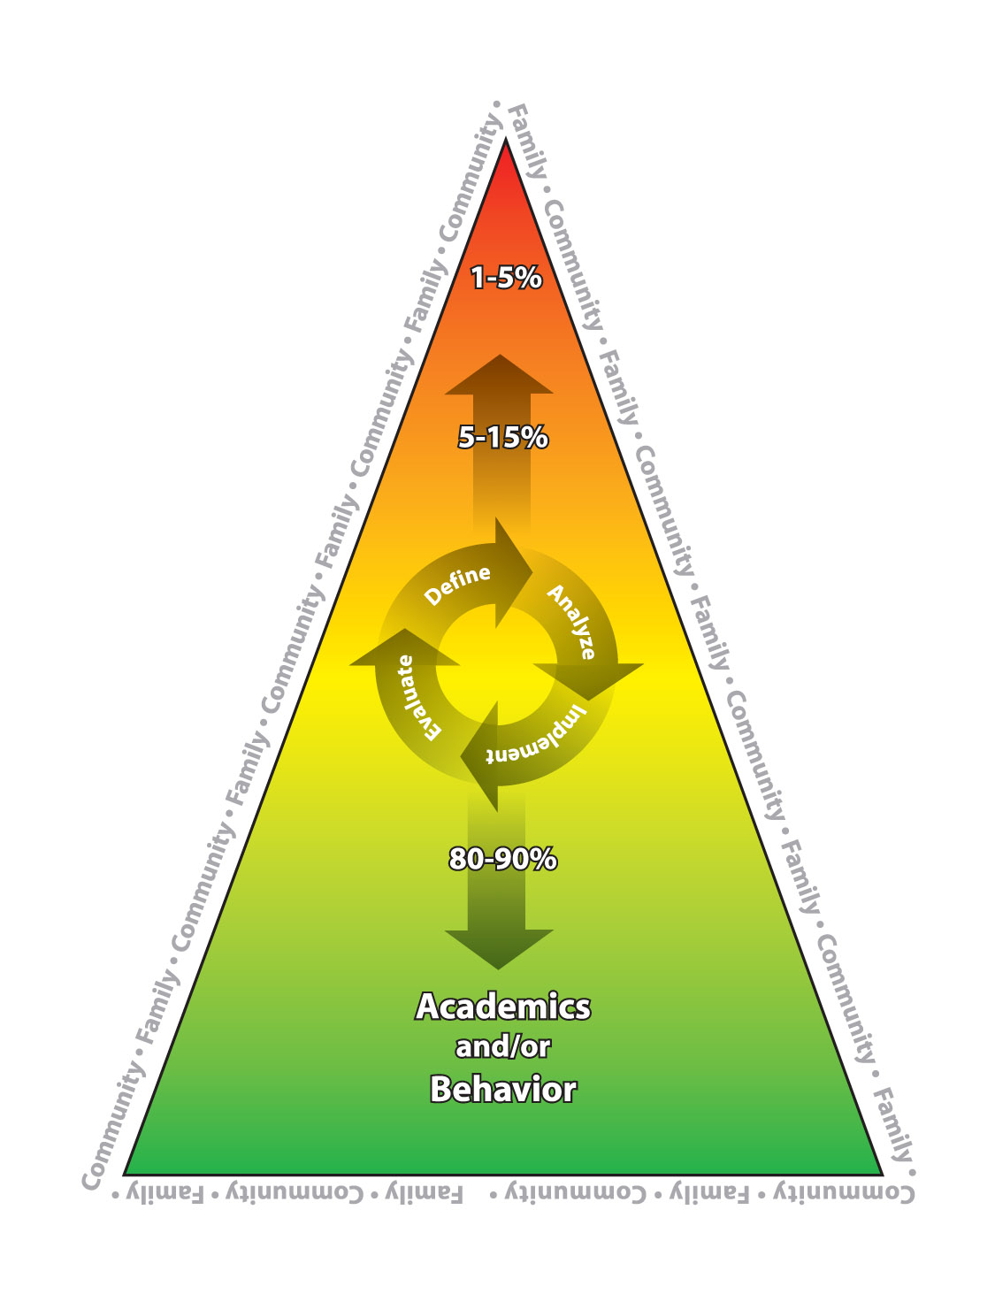
The Law: Response to Intervention (RtI)
RtI is a required criterion in Colorado for identifying students with specific learning disabilities (ECEA, 2007) and must be implemented in every school.
The child does not make sufficient progress …when using a process based on the child’s response to scientific, research-based intervention (RtI) as determined by a body of evidence.
Parents must receive information about:
  Amount and nature of data collected;
  Strategies for increasing the child’s rate
  of learning
  Results of repeated assessment of child’s
  progress.
  (CDE, 2007; CDE, 2008b)
Family and Community Partnering is one of the six RtI components in Colorado.
Notes:
Key Points:
-This is a summary of the key points in federal and state law regarding the information families must receive through the RtI process when a student is identified as having a specific learning disability.
-As in any disability, families are partners in any decision-making.

Slide 33
The Law: Colorado READ Act (2012)
The parent plays a central role in supporting the student’s efforts…the parent is strongly encouraged to work with the student’s teacher in implementing the READ Plan and to supplement the intervention instruction the student receives in school, the READ plan will include strategies the parent is encouraged to use at home to support the student’s reading success…
Notes:
Key Points: This s new legislation with explicit family partnering requirements.

Slide 34
A National Shift Based on the Law and Research
The Six Types of Parent Involvement (Epstein, 1995)
Parenting
Communicating
Volunteering
Learning at Home
Decision-Making
Collaborating with Community
National Standards for Family-School Partnerships(PTA,2009)
Welcoming All Families
Communicating Effectively
Supporting Student Success
Speaking Up for Every Child
Sharing Power
Collaborating with Community
Notes:
Key Points:
-This comparison highlights differences in language and emphasis between 1995 and 2009.
-Joyce Epstein’s work is a foundation of the family-school partnering field and she has continued to research, advise, and support the effort nationally.
-The National PTA has adopted explicit standards focusing on positive student outcomes for every student.
-Key differences include the 2009 words: effectively, all families, student success, every child, sharing power.

Slide 35
What is the Shift?
Traditional Parent Involvement
Parents only
Schools have the primary responsibility for educating students
School initiated, formal activities and meetings
Family Partnering
Family = student, parents and/or other caregivers in a child’s life
Families and schools share responsibility for a child’s education; each has unique knowledge and skills
Flexible hours and meeting venues; ongoing sustainable relationship-building
Notes:
Key Points:
-Comparisons highlight the shifts in beliefs and practices that are occurring because of the research, laws & their focus on educational outcomes for all students. The shift is summarized as being between traditional parental involvement and family partnering.
-Nothing “wrong” about traditional family involvement - has served many well & much of can & should continue.
-Our understanding & knowledge are growing & with it, an expanded view of how family-school-community partnering supports educational success.
Ideas to Consider:
-Discuss the shift with all stakeholders; create a “then and now” activity for a specific community, with the “now” being what is current practice and/or the goal for expanded partnering.

Slide 36
What is the Shift?
Traditional Parent Involvement
School initiated, one-way information sharing, often about problems
Educational plans developed and implemented by school and shared with parents; parents give consent
Structured volunteering at school (usually fundraisers, events) with a small group of parents
Family Partnering
Ongoing, two-way communication about successes, concerns, information
Educational plans developed and delivered conjointly by schools and families including RtI, ILP,ALP, FBA/BIP, and IEP
Supporting learning at home and school for all families
Notes:
Key Points:
-Comparisons highlight the shifts in beliefs and practices that are occurring because of the research, laws & their focus on educational outcomes for all students. The shift is summarized as being between traditional parental involvement and family partnering.
-Nothing “wrong” about traditional family involvement - has served many well & much of can & should continue.
-Our understanding & knowledge are growing & with it, an expanded view of how family-school-community partnering supports educational success.
Ideas to Consider:
-Discuss the shift with all stakeholders; create a “then and now” activity for a specific community, with the “now” being what is current practice and/or the goal for expanded partnering.

Slide 37
What is the Shift?
Traditional Parent Involvement
When a student struggles, teachers tend to “go it alone”, then refer to child study group/special education if continuing problems; families “sign consent” and the special education team tests for eligibility.
Family Partnering
When a student struggles, families and teachers work together, then refer to the RtI problem-solving team if concerns continue; the team, including families and teachers, prescribes interventions and monitors progress.
Notes:
Key Points:
-Comparisons highlight the shifts in beliefs and practices that are occurring because of the research, laws & their focus on educational outcomes for all students. The shift is summarized as being between traditional parental involvement and family partnering.
-Nothing “wrong” about traditional family involvement - has served many well & much of can & should continue.
-Our understanding & knowledge are growing & with it, an expanded view of how family-school-community partnering supports educational success.
Ideas to Consider:
-Discuss the shift with all stakeholders; create a “then and now” activity for a specific community, with the “now” being what is current practice &/or the goal for expanded partnering.

Slide 38
Challenges and Solutions
“Hurdlers know there will be several obstacles…they plan ahead as to how to overcome. With a little foresight…there can be successful navigation”.
(adapted from Ellis and Hughes, 2002)
Notes:
Key Points:
-Despite 30 years research supporting benefits of schools and families working together, still difficult to occur in many places.
-Real and significant challenges.
-Some schools developed strong systemic family-school relationships which are sustainable & intentional - they have identified barriers & overcome them.
-Quotation from “Partnerships by Design”, a well-developed family partnership planning tool.
-Implies that by identifying & planning for challenges, can successfully reach end goal, find solutions.

Slide 39
Escalator Video: “Don’t Panic And Think About What You Already Have In Place!” http://www.youtube.com/watch?v=47rQkTPWW2I
Notes:
Key Points:
This video reminds us to think about the resources we have and how to use them to solve problems as they arise in our practices - whether an educator, family member, student, or community resource.

Slide 40
Activity #5
What Are Your Challenges? Prioritize ONE for Educators and ONE for Families.
 | Challenges | Solutions
Educators | 1.
Families | 1.
Notes:
40
Activity #5 Answer: What are Your Challenges?
Materials: Copies of Challenges/Solutions Chart for Each Participant and One for Table; Writing Utensils
Outcome: Participants will identify their biggest challenges for educators and families in implementing partnering throughout their school community. Prioritizing them helps in planning for future work.
Instructions: Please take a minute and write down what you think are your “Big 3” challenges for each of educators and families. Then share with team and prioritize for your site with numbers 1, 2, and 3. Then we will compare yours with the research (see next slide).
Conclusion: The prioritized challenges can guide initiative planning such as deciding on training needs, shifts in staff time, accessing family cultural liaisons.

Slide 41
Activity #5:
Research Summary of Challenges for Educators AND Families
Limited time to build trust, relationships, ongoing two-way communication
Limited skills and knowledge in how to partner
Fear of inadequacy, conflict, “reliving” negative experiences
Cultural and linguistic differences between families and schools
Lack of clearly stated partnering beliefs, expectations of shared responsibility, and role descriptions
(Esler, Godber, & Christenson, 2008)
Notes:
41
Key Points:
-These identified challenges, or hurdles, are a summary from the literature.
-They demonstrate that challenges are similar for both families and educators.
-Each can be addressed by discussing and problem-solving.
Ideas to Consider:
If using as a component of Activity #5, discuss how individual or team’s list compares to these.

Slide 42
Activity #6
What Are Your Solutions? Find One for Your Educator Challenge and One for Your Family Challenge.
 | Challenges | Solutions
Educators |  | 1.
Families |  | 1.
Notes:
42
Activity #6 Answer: What are Your Solutions?
Materials: Copies of Challenges/Solutions Chart for Each Participant and One for Table; Writing Utensils
Outcome: Participants will generate possible solutions to their previously identified challenges. This component will hopefully result in some brainstorming, “out-of-the-box” thinking about shifting time, resources, and people “at the table”.
Instructions: Please take a minute and generate possible solutions for your challenges with your team. It is helpful to think of at least two solutions for each prioritized challenge. Check out the “Thinking About Solutions” ideas in next slide.
Conclusion: Teams can keep these brainstorming results to use in future planning and work. They can assess ideas for realistic implementation.

Slide 43
Activity #6
Thinking About Solutions…
Flexible Hours: Come in early or stay late once a week with “comp time”
Stated Beliefs and Expectations: Partnering plan, shared responsibility, equal partners, homework, behavior
Creative Communication: Texting, emailing, list serves copied to students, voice mailing, websites, breakfasts, lunches, meeting at school day cares
Joint “Professional Development”: Families, educators, and community resources learning together, online opportunities
Small Gatherings with Families and Students: Class open houses at various times, drop-in centers
Interactive Homework: Families participate and provide feedback
Student Ambassadors: Assigning home and school communication tasks, teaching parents, calling all parents to invite to school
Cultural and Language Liaisons: Family to family, home and community visits
(Suggestions from the field)
Notes:
43
Key Points:
-Planning for hurdles involves generating solutions & measuring effectiveness.
-The ideas above have been generated by workshop participants, professionals involved in the field & families.
-It is important to look at your challenges and target solutions accordingly
-Often more than one solution is needed for a challenge.
-Most of the suggestions require a shift in thinking, time, & resources—but not increases in budget or staff. They are using existing resources in new ways.
Ideas to Consider:
-What are the solutions you might have to your challenges?
-Discuss with various stakeholders in your community.

Slide 44
Multi-Tiered Partnering
“On the Team and At the Table”
Roles and Responsibilities
Universal, Targeted, Intensive
Notes:
Key Points:
-Section is about three tiers & how partnering can be thought of in tiers
-How to smartly & efficiently support all families & educators working together for student success.
-Each tier has specific roles, responsibilities, & resources - for families, educators, & community partners.

Slide 45
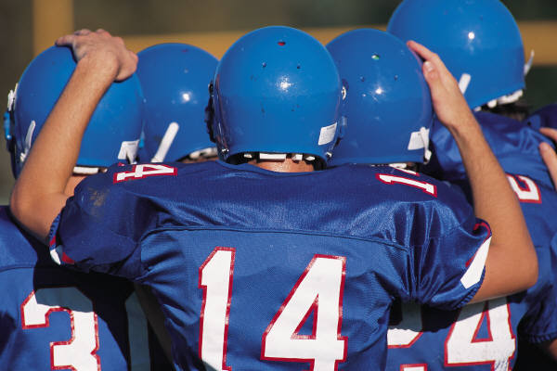
Educators, Families, Students and Community Resources:
“On the Team”
On a football team, every player has a job to do and a role to play. Each player is respected for his/her unique expertise. Each player practices and works to become better at executing personal responsibilities. The team works together to obtain the best results possible.
Notes:
Key Points:
-Families, educators & community resources all want school success for their students.
-Each person, including student, has specific responsibility which is unique & special.
-Best possible outcome obtained when individuals & teams practice, respect each “player” & share goals.
Ideas to Consider:
-Use this analogy to help staff, families, and students discuss their responsibilities, including ongoing communication around successes and concerns. Personalize with school teams or activities.

Slide 46

Educators, Families, Students and Community Resources:
“At the Table”
Picture a table where people are discussing a problem.
  Respecting and listening
  Understanding different perspectives
  Focusing on positive outcomes
  Disagreeing at times
  Intentionally working to compromise
  Each involved party has a place “at the table”, even if he/she can’t attend. All voices are heard.
Notes:
Key Points:
-Families, students, educators & community resources all have same mission & equal voices at table.
-Goal is positive outcomes for all.
-Focus is on student’s success.
Ideas to Consider:
-Discuss the school’s “tables”. Do all parties (including students, families & community resources) have a place? Who has a voice? How are differences resolved? What would an observer see? How many tables do you have?

Slide 47
Multi-Tiered Family & Community Partnering:
Respecting Time and Resources
Intensive Tier 1-5% (includes all Universal, Targeted)
Individualized school and community partnering for a few families, students and school staff.
Targeted Tier 5-15% (includes all Universal)
Focused school/community outreach and problem-solving partnering for some families, students and school staff.
Universal Tier 80-90%
Positive school climate with school-wide efforts to welcome, include, and support ALL families, students, and school community members; Stated beliefs that: (1) education is a shared responsibility between families and schools; (2) families are equal partners; (3) students achieve more when families and schools work together; (4) community participation supports school success.
( CDE, 2008b; Epstein et al, 2002)
Notes:
Key Points:
-Family-school-community partnering in tiers aligns time & resources effectively; responsibilities & expertise can be utilized according to need.
-Each tier includes previous one, but provides additional support or focus.
-Partnering may be different across time or situation for any stakeholder as circumstances & expectations change.
-Universal Tier similar to core curriculum: more consistently & broadly implemented the more effective it will be.
-Can be applied to entire districts, communities, sites, classrooms, &/or special programs.
-Percentages used as guidelines in any setting in thinking through time & resources in each situation.
-Example: classroom of 30 students, 3 student/ families may need targeted or intensive support.
-Important to use data in making decisions.
Ideas to Consider:
-Discuss specific site tiers.

Slide 48
Universal
Targeted
Intensive
Continuum of Support for Every Student
Math
Homelessness
Sports
Family Illness
Soc skills
Literacy
Language Differences
Tiers are Fluid, Focusing on Student Success…
Notes:
A student does not “live” in one area – they have skills that span the continuum of interventions and needs.
Another reminder and correction: Label behavior…not people. We’ve gotten into the habit or had a “lethal mutation” (Kent McIntosh) where we’ve started labeling students according to the triangle – “That’s our red-zone student…..” Just because a student needs intensive intervention for reading, does not mean they need intensive support for all academic content areas – in fact, they will probably be very successful in other areas! Instead, we need to shift our language to labeling the type of supports the student needs.
48

Slide 49
ACTIVITY #7 Multi-Tiered Family & Community Partnering Checklist
Intensive Tier - A FEW Families/Staff
___Individualize family-school partnering plans when needed (Examples: home visits, daily communication) ___ Provide school, family, and community wraparound when needed. ___Provide conflict resolution support and process when needed.
Targeted Tier - SOME Families/Staff
___Designate people and process to reach out individually to encourage families and staff who may be hesitant or uncomfortable. ___Include families as equal partners throughout the RtI Problem-Solving Process; provide support and information. ___Support teachers and families in mutually developing and implementing individual student plans; coordinate interventions between home and family. (Examples: ALP, IEP, BIP, ILP) __Provide support/education groups and targeted resources for families and/or teachers. __Link with community resources.
Universal Tier - ALL Families/Staff
SCHOOL ___Communicate beliefs: 1. Education is a shared responsibility between home and school; (2) Families are equal partners; (3) Students achieve more when families and schools work together; (4) Community participation supports school success. ___Share RtI process with all staff, family, and community resources. ___Create caring, culturally responsive climate for all families; provide culture and language liaisons. ( family volunteers) ___Provide parenting education, “learning at home”, and volunteer opportunities; contact families personally whenever possible. (Example: family to family) ___Make school and classroom visiting available. ___Involve families in school decision-making. CLASSROOM ___Contact every family to create ongoing, two-way communication. ___Ensure each family, including students, understands school/class rules and homework expectations. ___Plan and explain how families and teachers will partner if a student struggles. ___Tell students that school and home are working together to support their success.
(adapted from CDE, 2008b; Epstein et al, 2002)
Notes:
Activity #7 Multi-Tiered Family & Community Checklist
Materials: Copy of Multi-Tiered Family & Community Partnering Checklist and next Slides #73, 74; Writing Utensils
Outcome: Participants will identify the tiered partnering practices in place at their site.
Instructions: Please take a minute and check the practices that are routinely occurring at your school/district after reviewing tier descriptions. Add comments or other actions
Conclusion: Team can celebrate successes and discuss, plan how to implement those not yet actionable. Other actions can be added or tiered developed for specific frameworks or initiatives, such as PBIS or dropout prevention.

Slide 50

Why Might A Teacher or Family or Community Resource Move to the Targeted or Intensive Tier?
Student is struggling
Teacher is struggling
Family is struggling
Communication or partnering needs more support
Notes:
Key Points:
-In tiered partnering framework, students, families or teachers may need more support or focused opportunities to successfully support school success.
-Examples include: student at-risk in reading achievement, teacher unsure about how best to help a child having difficulty completing assignments, family suddenly homeless & unable to access school transportation, or difficulty communicating between home & school.
-Important to recognize sometimes need for more targeted or intensive support so that there is acceptance & access to appropriate resources.
Ideas to Consider:
-Think about your school community. How does a student, family, or teacher access additional opportunities in helping a student succeed?

Slide 51
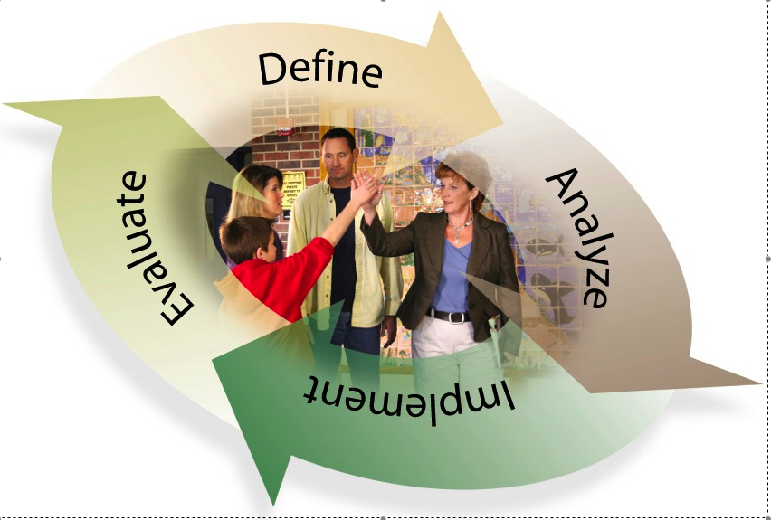
Individual Problem-Solving Process
DEFINE
Directly Measure Behavior/Skill
EVALUATE
Response to Intervention
ANALYZE
Validate Problem
Identify Contributing Variables
IMPLEMENT
Develop Plan and Implement as Intended
Progress Monitor and Modify as Necessary
Notes:
Key Points:
-Process referred to in Colorado Rules (and taken from the Federal Register: 2.08 (6) (b) (ii) (B) “The child does not make sufficient progress to meet age or state-approved grade-level standards in one or more of the areas identified in section 2.08(6)(b)(I) when using a PROCESS based on the child’s response to scientific, research-based intervention as determined by a body of evidence demonstrating: 2.08(6)(b)(ii)B(I) Academic skill deficit(s); and 2.08(6)(b)(ii)(B) (II) Insufficient progress in response to scientific, research-based intervention.
This process is the “motor or elevator” that moves interventions up and down the tiers.
-Process occurs & should occur outside of actual meeting; Steps 1 and 2 addressed with teachers, family members & in collecting/analyzing existing data.
-Actual meetings are efficient & focused on data.
-Family “high-fiving” teacher is a symbol of the partnership in this process; all adults partnering for student success - family, general, special education & administration.
-Problem-solving process must be implemented consistently & with fidelity; process must be clear, transparent & defensible.
-Process is circular showing it is continuous & there is continual evaluation & adjustment according to responsiveness.
-Must be measurable goals & specific monitoring tools.
-Helpful, according to those working with process, to have trained staff, familiar in process & interventions.

Slide 52
Family Role in Problem-Solving Process
Share responsibility as an equal partner.
Collaborate & communicate with teachers about student.
Support student learning at home.
Attend problem-solving team meeting, if possible. If attending isn’t possible, it is important to communicate before and after a meeting.
Partner in intervention planning and monitoring.
Participate in decisions for any assessment and/or referral for special education evaluation. (CDE, 2008,b)
Notes:
Key Points:
-Key responsibilities for families.
-Best practice to share family roles with all in advance of a problem-solving meeting so all can prepare and understand how to participate.
Ideas to Consider:
-Tailoring these to a specific site, with school process identified.

Slide 53
Baselines (PLAAFP) and Goals
What is the baseline, present level of academic achievement and functional performance, current status?
  What is the number?
What is OUR measurable goal, outcome, target?
  Is the goal observable?
  Is the goal measurable/quantifiable? Can it be counted?
  Is the goal both ambitious and realistic?
Notes:
Key Points:
-In RtI & problem-solving, essential that measurable goal, outcome or target set & that this emerges from present level of performance, or baseline.
-Measurability or numerical quality is mandated.
-New skill or way of thinking for teachers & families, important to explain & practice.
-Students respond well to clear, measurable goals - should be aware & included in process.
-Goals reasonable, ambitious, challenging, need to be attempted.
-Normed benchmarks & expectations important to consider if available - often are, but may not be readily apparent or used.

Slide 54
Prescribing Interventions
Interventions are prescribed based on data and resource availability.
About research-based instructional practice or interventions:
  are found to be reliable, trustworthy and valid based on evidence
  ongoing documentation and analysis of student outcomes helps to define effective practice
  in the absence of evidence, the instruction/intervention must be considered “best practices” based on available research and professional literature.
(CDE, 2008b)
Notes:
Key Points:
-Full definition: A research-based instructional practice or intervention is: one found to be reliable, trustworthy, and valid based on evidence to suggest that when the program is used with a particular group of children, the children can be expected to make adequate gains in achievement. Ongoing documentation and analysis of student outcomes helps to define effective practice. In the absence of evidence, the instruction/intervention must be considered “best practices” based on available research and professional literature.
-NCLB cites “research-based” many times as a requirement for instruction. It is also a legally cited component of RtI.
-Many areas of instruction where research has not yet identified proven programs and methodology; in these situations, schools follow best instructional practices & evaluate effectiveness frequently to adjust instruction according to data.
-Schools must use interventions that are available & can be implemented with fidelity by personnel.
-Important to recognize many schools working on developing continuum of interventions, but reviewing, purchasing, & training demands resources over time.

Slide 55

Monitoring Progress
Progress monitoring is a research-based practice that regularly (weekly, biweekly, or monthly) measures students’ academic or behavioral progress in order to evaluate the effectiveness of teaching practices and to make informed instructional decisions. Progress monitoring becomes more frequent with the intensity of the intervention. The same tool is used over time.
Notes:
Key Points:
-Progress monitoring is monitoring progress!
-2 key concepts are crucial to remember:
1) Frequency of monitoring increases with intensity of the intervention.
2) The same tool must be used over time and be measuring the specific variable identified in the goal.
-Self-monitoring by students is an effective strategy.
-Visual displays of progress-monitoring data help all stakeholders understand progress; leads to shared decision-making.
-In problem-solving process, families provided copies of progress-monitoring data.
Ideas to Consider:
-Discuss what and how progress-monitoring data are shared with families and students.

Slide 56
Visual Data Displays
Visual data show the same information to all partners so can equally share in decision-making. This lessons conflicts and biases. Visual data help in creating common understanding.
Target
Aimline
Base Line
Notes:
Key Points:
-Visual data displays provide same information to all parties & makes information understandable to all parties.
-Visual data help students understand own learning.
-Important families & educators share common understanding of terms: baseline, target, aimline.
-Data then graphed in comparison to assess progress & response to intervention.
Ideas to Consider:
-There are numerous graphing programs and tools available, both online and in existing technology. How might families and students learn about these, as well as educators?

Slide 57
ACTIVITY #9
Define Family-School Partnering Roles and Responsibilities: Choose One and Name a “Job”
SCHOOL | HOME
Principal | Family
Teacher | Student
Specialist/School Mental Health | Community Members
“Front Line Staff” (Clerical, other, etc.) | PTA/PTO
School Accountability Committee (SAC) | School Accountability Committee (SAC)
(CDE, 2009)
Notes:
Materials: Chart Paper for Each Job Description; Copies of Sample Job Descriptions; Blank Paper; Writing Utensils
Outcome: Participants will have the opportunity to create family-school-community partnering job descriptions for various school staff roles and families, community resources. Then there can be a comparison with what currently exists in their sites and future thinking about what might be helpful to define into explicit expectations.
Instructions: Please take a few minutes to walk around the room and add your thoughts to the charts on the wall for each of the above roles (or sit at your table and write down ideas for the roles on a sheet of paper). It is not necessary to write on each, but please do so on the ones you feel are most relevant to your position and/or you feel you have the strongest ideas about their possible responsibilities. Then return to your seat and review the samples at your table and compare your thoughts. The group ideas will then be shared from the charts with all participants’ input (or individuals can discuss the job descriptions from sheets at table). Sample job descriptions from the module toolkit can be used for ideas or in discussions.
Conclusion: Participants will have ideas to share about partnering roles and responsibilities. Many may already have specifically defined partnering as part of performance appraisal procedures, supervision, professional learning communities and these practices can be shared with others.

Slide 58

Referral for Special Education Evaluation
Please refer to Guidelines for Identifying
Students with Specific Learning Disabilities. (CDE, 2008a)
Notes:
Key Points:
-Next slides present general conceptualization of possible referral to special education in RtI framework.
-The Guidelines for Identifying Students with Specific Learning Disabilities (CDE, 2008a) should be used by teams in making decisions.

Slide 59
What is the Role of the Parents in the RtI Process?
http://www.nrcld.org/rti_practices/parent.html
Notes:
Key Points:
-Video clip, available at given link, describes family participation in RtI problem-solving process when decision to pursue special education eligibility made.
-Experienced educator & parent provide information.
Ideas to Consider:
-Show this clip to school staff and families as the problem-solving process is initiated for a student or give out for stakeholders to view on their own, with explanation.
-Discuss differences in how both families and staff might view special education referral through the RtI problem-solving vs. traditional process, based on this educator’s story.

Slide 60
Sufficient Progress with Intense Intervention
Please refer to Guidelines for Identifying Students with Specific Learning Disabilities. (CDE, 2008a)
Notes:
Key Points:
-Simplified chart showing targeted intervention not resulting in progress & an intensive intervention resulting in sufficient progress (gap is closing); note the change in colors.
-Decision would probably be to continue with intervention.

Slide 61
Insufficient Progress With Intense Intervention
Possible SPED Referral/Determination or More Intervention
Please refer to Guidelines for Identifying Students with Specific Learning Disabilities. (CDE, 2008a)
Notes:
Key Points:
-Simplified chart -- in practice, may have been more than two interventions implemented.
-Illustrates insufficient progress that may inform need for special education referral or ultimately, a determination of SLD (evidence of insufficient progress).

Slide 62
Special Education Referral Process
Referral when a disability is suspected made by
  problem-solving team (including parent)
  parent
Inform parent of intent to refer (if not involved in decision)
Review existing data (with disability criteria)
Obtain informed parental consent & provide and explain procedural rights
Develop evaluation plan with parent input
Multidisciplinary team, including parents and classroom teachers, reviews data and criteria; decides whether eligibility criteria for a disability are met.
Please refer to Guidelines for Identifying Students with Specific Learning Disabilities. (CDE, 2008a)
Notes:
Key Points:
-Summary of special education referral process in RtI framework.
-Families & classroom teachers are team members in eligibility decisions, representing a change from previous SLD aptitude-achievement discrepancy eligibility process, when decision was made by a team of specialists based on numerical data.
-It is essential to refer a student for special education eligibility when a disability is suspected.
Ideas to Consider:
-Use these process points as a “check” for your team in referring a student for special education consideration.

Slide 63
Data-Based Action Planning
Data are necessary to calibrate perceptions. The collection of data informs continual improvement efforts. (Wellman & Lipton, 2004)
Toolkit, Data Sources, Ongoing Planning, and Implementation
Notes:
Key Points:
-Data-based planning guides efficient & effective partnering practices.
-Important to know baseline/PLOP, target/goal, & how to progress monitor efforts—to use language of RtI.
-Planning should not be time-consuming or complicated; use KISS method - keep it small & simple -Planning should not involve completing pages of documents to be put in files -should be active, living, breathing & integrated into existing structures, meetings.
-Always ask: “where are we now?” “Where are we going?” “How are we getting there?” “How will we know we are there?”
-Quantity & quality of partnering efforts are both important.
-Data collection is necessary, not optional, but doable.
Ideas to Consider:
-Who are leaders in this area? Who are family champions? Is there interest in partnering/already actively engaged in being “on the team and at the table”? What are the existing meetings and structures?

Slide 64

Tarzan Principle: Link It Altogether and Move Away from “Random Acts” of Partnering to Intentional Practices
School Engagement/Dropout Prevention; Postsecondary Readiness
ICAP
UIP
District and School Accountability Committees; PTO/PTA
MTSS - RtI, Special Education, PBIS
Educator Effectiveness
Colorado Growth Model and New Content Standards
Notes:
Key Points:
-All listed areas incorporate families, schools, & communities to some extent; important to link, apply partnering practices throughout a system.
-Can be on everyone’s agenda, so becomes component of the infrastructure.
-A tiered model, defined partnering job descriptions, & some joint training & discussion opportunities can help allocate resources & time within existing venues.
Ideas to Consider:
-Think about how all stakeholders can hear about tiered family & community partnering. Think about clear, consistent messages about expectations and responsibilities.

Slide 65
Family & Community Partnering:
“On the Team and at the Table” Toolkit
Table of Contents
Training Materials
Universal Tier: Tools and Resources
  School
  Classroom
III. Targeted/Intensive Tiers: Tools and Resources
IV. Planning and Evaluation: Tools and Resources
V. Web and Text Resources
VI. References
Available online at http://www.cde.state.co.us/rti/FamilyCommunityToolkit.htm
Notes:
Key Points:
-Sample partnering materials and data tools are available online in the RtI Family & Community Partnering; “On the Team and At the Table” Toolkit.

Slide 66
Action Planning Steps (Rubric)
  Insure Shared Knowledge: Provide research, rationale, and definition for family-school partnering to families, students, educators, community in multiple ways
  Identify Existing Practices: Assess current multi-tier practices, challenges, and resources; use multiple data sources; collect any needed data
  Implement Ongoing Actions: Action plan by aligning initiatives, using data, setting measurable goals, assigning actions with resources and tools, following plan, and evaluating; USE AND SHARE DATA!
Notes:
Key Points:
-These three action planning steps can help guide individuals (family members and teachers), teams, organizations, schools, and districts in planning and implementing school, family & community partnering.
-Step #1 is necessary for shared understanding of the shift from traditional parent involvement to family-school partnering with shared responsibility for student success.
-Step #2 is necessary to inventory what is already in place, “hurdles” that need to be addressed, and missing information.
-Step #3 is necessary for data-based planning, implementation, and evaluation; applying data-based decision making to partnering initiatives so can be effective and continuously improving.

Slide 67
Today’s Toolkit Data Sources
All Tiers
Partnering Definition
Challenges and Solutions
Tiered Partnering Practices
Roles and Responsibilities/Job Descriptions
Notes:
Key Points:
-These are sample data and planning tools that are in the RtI Family & Community Partnering: “On the Team and At the Table”.
-These tools all can be implemented as activities; see Stakeholder Training Slides and Activities.

Slide 68
Other Data Sources
Document Review (Word Count, Consistency)
  Partner language, family input, “two-way”
Committees/Teams Agenda Items (Percentages of Meetings)
  Leadership, instructional, professional learning communities discussing partnering
Event Participation (Percentages)
  Disaggregated for conferences, volunteering, student performances
Notes:
Key Points:
-These are possible existing data and planning sources to establish current status of partnering practices and future goals.
-It is important to understand what is already working and where/what to prioritize in planning.

Slide 69
Other Data Sources
Teacher-Family Two-Way Contacts (Percentages)
  First-of-year personal outreach, homework completion, positive celebrations, problem-solving; email, voice mail, texting, podcasts, websites
Student Planning Team – Planning and Intervention Participation (Percentages)
  IEP, ALP, RtI, Behavior, Other
Surveys, Monitoring
  Educator Effectiveness, Event Feedback, TELL
Notes:
Key Points:
-These are possible existing data and planning sources to establish current status of partnering practices and future goals.
-it is important to understand what is already working and where/what to prioritize in planning.

Slide 70
Speak Up… http://www.youtube.com/watch?v=v-FKs2RWtGQ
Notes:
Key Points:
This video is remind everyone to speak up if they have something to say - both during the presentation and at their places of work - about family-school-community partnering.

Slide 71

“Tell Me I Forget. Show Me I Remember. Involve Me I Understand.”
Chinese Proverb
Notes:
Key Points:
-Quotation highlights result of people from different perspectives, backgrounds, training & roles involving each other in common mission.
-Learning that comes with truly living an experience deeper & more lasting when involved vs. just being told or being shown.
-Walking in another’s moccasins another way share message.
-Words imply teachers & families will understand more by collaborating in students’ education, each learning to understand.
-Proverb also chosen because of importance in teaching how to genuinely learn the culture of the school & culture of home.
Ideas to consider:
-Do you have a mission or vision statement in your school community? Or a favorite quotation that is seen in many places, publications around families and schools partnering?

Slide 72
Thanks to the Following Partners for Their Time & Input in Developing This Module
Colorado Department of Education
  Exceptional Student Services Unit
  Early Childhood Unit, Office of Teaching and Learning
  Gifted Education Unit
  Language, Culture and Equity Unit
  Prevention Initiatives
Colorado Parent Information and Resource Center (CPIRC)
Colorado Special Education Advisory Committee (CSEAC)
Denver Metro Community Parent Resource Center (Denver Metro CPRC)
PEAK Parent Training and Information Center (PTI)
Numerous family advocates, professionals, other interested individuals
Notes:
Key Points:
-Families & educators worked together on slides & entire module.
-Preview sessions & feedback opportunities occurred.
-Much thanks to all...

Slide 73
Thanks for Coming Today! Please Share
Your Feedback and Contact Us for More Information
Cindy Dascher, Parent and Family Consultant Exceptional Student Services Unit
Colorado Department of Education
http://www.cde.state.co.us/
dascher_@cde.state.us
303-866-6767
Cathy Lines, RtI Consultant
clines1@comcast.net
303-506-0484

Slide 74
Thanks for Coming Today! Please Share Your Feedback and Contact Us for More Information
Tina House, CPIRC, Co-Chair, State Advisory Council for Parent Involvement in Education (SACPIE) http://www.cpirc.org/
thouse@claytonearlylearningcenter.org
303-355-5487
Yvette Plummer, Denver Metro CPRC http://www.denvermetrocprc.org/
yvettep@denvermetrocprc.org
303-365-2772
Beth Schaffner, PEAK Parent Center
http://www.peakparent.org/
bschaffner@peakparent.org
719-531-9400

Slide 75
CDE MTSS and SLD Information
RTI (Response-to-Intervention)
http://www.cde.state.co.us/RtI/
PBIS (Positive Behavior Interventions and Supports)
http://www.cde.state.co.us/pbis/
SLD (Specific Learning Disabilities
http://www.cde.state.co.us/cdesped/SD-SLD.asp
State Personnel Development Grant (School, Family & Community Partnering
http://www.cde.state.co.us/RtI/spdg/Family.htm

Slide 76
Additional Resources
Constantino, S.M., (2008). 101 ways to create real family engagement. Galax, VA: ENGAGE! Press.
Constantino, S.M. (2003). Engaging all families: Creating a positive school culture by putting research into practice. Lanham, MD: Scarecrow Education.
Epstein, J.L., Sanders, M.V., Simon, B.S., Salinas, K.C., Jansorn, N.R., & Van Voorhis, F.L. (2002). School, family, and community partnerships: Your handbook for action. Thousands Oaks, CA: Corwin Press.
Jenkins, T. (2007). When a child struggles in school. Charleston, SC: Advantage
Henderson, A.T., Mapp, K.L., Johnson, V.R., & Davies, D. (2007). Beyond the bake sale: The essential guide to family-school partnerships. New York: The New Press.
Lines, C.L., Miller, G.L.,& Arthur-Stanley, A.(2011). The power of family-school partnering: A practical guide for mental health professionals and educators. New York: Routledge.
Lawrence-Lightfoot, S. (2002). The essential conversation: What parents and teachers can learn from each other. New York: Random House.
Notes:
Key Points:
-These are suggested text resources.
Ideas to Consider:
-Choosing and reading a book by a team or group, such as “book club” as a shared learning activity to develop common understanding about family-school partnering.

Slide 77
References
Bridgeland, J.M., Diliulio, J.J., & Balfanz, R. (2009). On the frontlines of schools: Perspectives of teachers and principals on the high school dropout problem. Washington, DC: Civic Enterprises, LLC. Retrieved from http://www.civicenterprises.net/reports/on_the_front_lines_of_schools.pdf
Christenson, S. L. (1995). Families and schools: What is the role of the school psychologist? School Psychology Quarterly, 10, 118-132.
Christenson, S. L., & Sheridan, S. M. (2001). Schools and families: Creating essential connections for learning. New York: Guilford Press.
Clark, R.M. (1990). Why disadvantaged students succeed: What happens outside of school is critical. Public Welfare, (17-23).
Colorado Department of Education. (2007). ECEA rules. Retrieved from http://www.cde.state.co.us/cdesped/download/pdf/ECEARules_Effective12-30-07.pdf, September 10, 2008.
Colorado Department of Education. (2008a). Family involvement in schools: Engaging parents of at-risk youth. Denver, CO: Author.
Colorado Department of Education. (2008b). Guidelines for identifying students with Specific Learning Disabilities. Denver, CO: Author.
Colorado Department of Education. (2008c). Response to intervention (RtI): A practitioner’s guide to implementation. Denver, CO: Author.
Colorado Department of Education (2009). Response to intervention (RtI): Family & community partnering: “On the team and qt the table” toolkit: Denver, CO: Author.
Colorado Department of Education (2010). District accountability handbook. Denver, CO: Author.
Colorado Department of Education (2011). Commissioner’s report to the state board of education: Dropout prevention and student engagement unit.
Epstein, J.L. (1991). Paths to partnership: What can we learn from federal, state, district, and school initiatives. Phi Delta Kappan, 72 (5).
Epstein, J.L. (1995). School/family/community partnerships: Caring for the children we share. Phi Delta Kappa, 76 (9), 701-702
Notes:
Key Points:
-These are the works cited throughout the presentation slides.

Slide 78
References
Epstein, J.L., Sanders, M.V., Simon, B.S., Salinas, K.C., Jansorn, N.R., & Van Voorhis, F.L. (2002) School, family, and community partnerships: Your handbook for action. Thousands Oaks, CA: Corwin Press.
Esler A.N., Godber Y., & Christenson, S. L.(2008). Best practices in supporting home-school collaboration. In A. Thomas & J. Grimes (Eds.), Best practices in school psychology V (pp. 917-936)). Bethesda, MD: National Association of School Psychologists.
Gage, N.L. & Berliner, D.C. (1991). Educational psychology (5th ed.). Boston: Houghton-Mifflin.
Garcia Coll, C., & Chatman, C. (2005). Ethnic and racial diversity. In H. Weiss, H. Kreider, M.E. Lopez, & C. Chapman (Eds.), Preparing educators to involve families: From theory to practice (pp. 135-142). Thousand Oaks, CA: Sage Publications.
Henderson, A.T., Mapp, K.L., Johnson, V.R., & Davies, D. (2007). Beyond the bake sale: The essential guide to family-school partnerships. New York: The New Press.
Henderson, A. & Mapp, K. (2002). A new wave of evidence: The impact of school, family, and community connections on achievement. Austin, TX: National Center for Family & Community Connections with Schools.
Hirsch, E., Sioberg, A., & Germuth, A. (2009). TELL Colorado: Creating supportive school environments to enhance teacher effectiveness. Retrieved from http://tellcolorado.org/sites/default/files/attachments/Colorado_TELL--finalreport.pdf
May 30, 2011.
Hoover-Dempsey, K.V., Whitaker, M.C., & Ice, C.L.(2010). Movtivation and commitment to family-school partnerships. In S.L. Christenson & A.L. Reschly (Eds.), Handbook of school-family partnerships (pp. 30-60). New York: Routledge.
Lines, C., Miller, G.L., Arthur-Stanley, A. (2011). The power of family-school partnering: A practical guide for school mental health professionals and educators. New York: Routledge.
Notes:
Key Points:
-These are the works cited throughout the presentation slides.

Slide 79
References
Marzano, R. J. (2003). What works in schools: Translating research into action. Alexandria, VA: Association for Supervision and Curriculum Development.
National Parent Teachers Association (2009). PTA national standards for family-school partnerships: An implementation guide. Retrieved December 6, 2009, from http://www.pta.org/Documents/National_Standards_Implementation_Guide_2009.pdf.
New Teacher Center. (2011). What are the voices of Colorado’s teachers telling us? Retrieved May 30,201,1 from http://tellcolorado.org/sites/default/files/attachments/CO11_brief_general_trends.pdf
Pianta, R. & Walsh, D. B. (1996). High-risk children in schools: Constructing sustaining relationships. New York, NY: Routledge.
Sheridan, S.M. (1997). Conceptual and empirical bases of conjoint behavioral consultation. School Psychology Quarterly, 12, 119-133.
Simon, B.S. (2001). Family involvement in high school: Predictors and effects. NASSP Bulletin, 85 (627), 8-19.
Wellman, B. & Lipton, L. (2004). Data-driven dialogue: A facilitator’s guide to collaborative inquiry. Sherman, CT: MiraVia.
United States Bureau of the Census (2004). Population predictions. Retrieved
May 17,2008, from http://www.census.gov/ipc/www/usinterimproj/
United States Department of Education. 2006.Assistance to states for the education of children with disabilities and preschool grants for children with disabilities. Final Rule. Federal Register, 71.
Weiss, H., Little, P., Bouffard, S., Deschenes, S., & Malone, H. (2009). Strengthen what happens outside of school to improve what happens inside. Phi Delta Kappan, 90(8), 592-596.
Notes:
Key Points:
-These are the works cited throughout the presentation slides.

