Slide 1
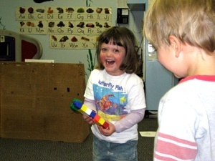
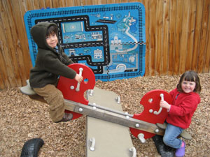

Observation:
The Heart of Authentic Assessment
Presented by

Slide 2
Overall Goals for this Session
To enhance your observation skills by increasing your understanding of:
  Authentic assessment
  The essential role of observation in authentic assessment
  Key practices for effectively observing young children

Slide 3
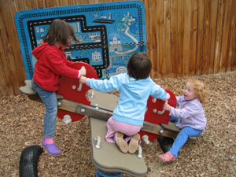
What is
Authentic Assessment?

Slide 4
Do We Really Want to Test Young Children?
There is widespread concern about the use of high pressure methods of testing or assessing young children
Example:
An unknown adult pulls a child out of her familiar environment, sits her down at a table, and “quizzes” her on specific bits of knowledge or skill and expects to see this child at her best

Slide 5
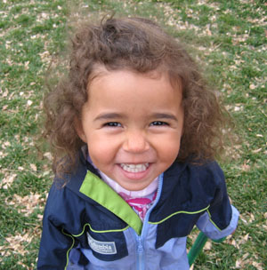
Authentic Assessment…
Is an approach that is natural and non-threatening to children
Gives us a more realistic understanding of what young children know and can do in their everyday lives

Slide 6
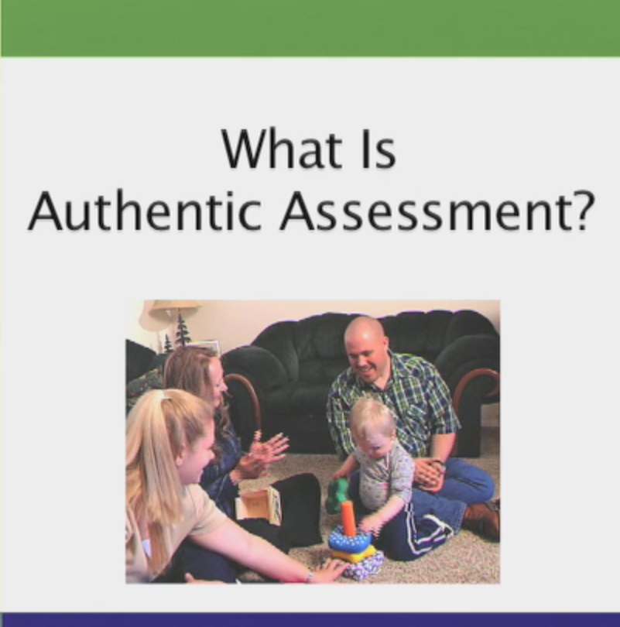
Let’s Watch!
What is
Authentic
Assessment?

Slide 7
Authentic Assessment…
Ongoing: Is a natural part of what teachers do every day
Whole child: Helps us observe all areas of a child’s growth and development
Naturalistic: Occurs as a child interacts with familiar materials, people and activities
perspectives: Uses information from a variety of sources
Useful: Helps teachers plan, measure progress, work with families and individualize curriculum
Multiple

Slide 8
Ongoing observation of children
in their everyday routines and activities
is at the heart of
authentic assessment

Slide 9
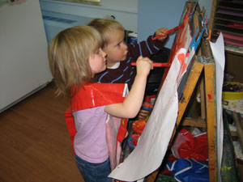
Key Practices for Effective Observation

Slide 10
Six Key Practices for Effective Observation
Make observation a routine part of your work
Engage families in the observation process
Use strategies that match your purposes
Observe as objectively as possible
Document your observations
Reflect on and use your observations

Slide 11
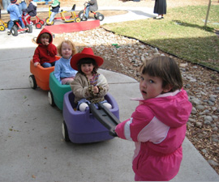
Naturalistic observation means observing children…
as they interact with familiar toys, materials, and people,
in the context of everyday routines, activities, and places,
unobtrusively.

Slide 12
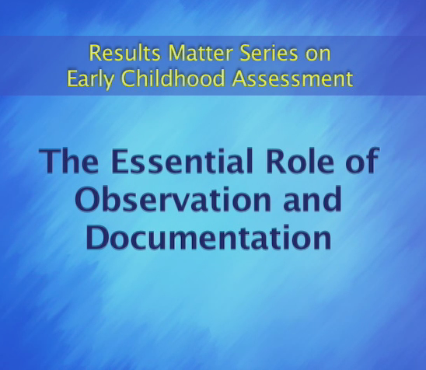
Let’s Watch!
The Essential
Role of
Observation
and
Documentation

Slide 13
Six Key Practices for Effective Observation
Make observation a routine part of your work
Engage families in the observation process
Use strategies that match your purposes
Observe as objectively as possible
Document your observations
Reflect on and use your observations

Slide 14
Be open to learning from families
When families share their observations, we develop a more complete and accurate picture of the child
Let families know that you value their observations and participation in ongoing authentic assessment

Slide 15
Examples of ways to create opportunities for families to share their observations
Give families concrete examples
of the kinds of information you
would like them to share
Make portfolios accessible to
families and invite them to contribute
Place a basket at sign-in for families to drop off photos and notes for the teachers

Slide 16
Six Key Practices for Effective Observation
Make observation a routine part of your work
Engage families in the observation process
Use strategies that match your purposes
Observe as objectively as possible
Document your observations
Reflect on and use your observations

Slide 17
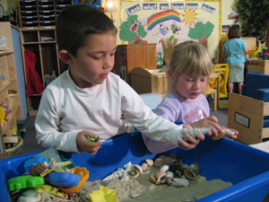
Observation might help you …
Plan curricula and learning activities
Document children's progress
Share information with families
Complete an assessment instrument
Let children know that you value their work
Share the good work of your program with the community

Slide 18
Examples of how purposes should influence how you go about observing
Purpose of Observation | Ways You Might Observe
Plan curriculum and teaching strategies | You might observe children participating in activities and jot down ideas for new activities and changes in the environment
Measure and describe children's progress | You might have an item in mind from a particular assessment tool and watch for children to demonstrate their level of mastery
Inform families about their children's learning | You might look for a specific aspect of a child’s learning that the parents told you is of interest

Slide 19
Observation might be planned or spontaneous
Planned
Sometimes we intentionally plan our observations for specific purposes. When we do this, we might plan how, when, and where we will observe
Spontaneous
Other times, we observe spontaneously in response to something that is happening in the classroom that we want to capture and learn about

Slide 20
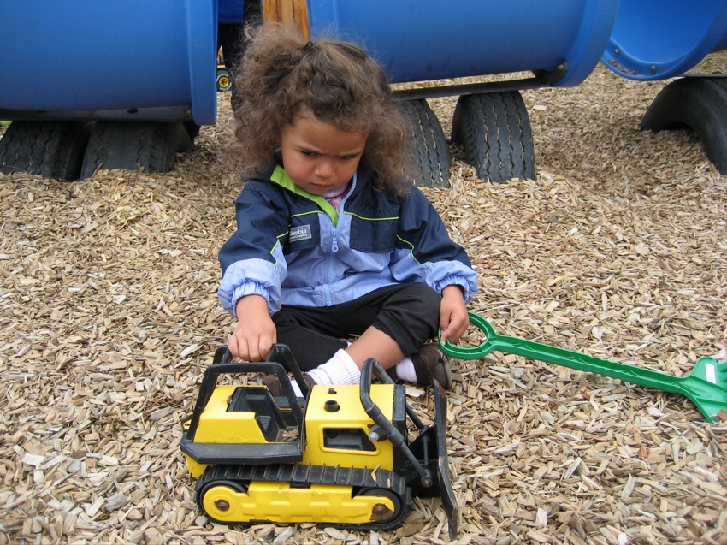

Slide 21
Six Key Practices for Effective Observation
Make observation a routine part of your work
Engage families in the observation process
Use strategies that match your purposes
Observe as objectively as possible
Document your observations
Reflect on and use your observations

Slide 22
No two people will see the same child in identical ways. Two open and honest teachers can be asked to observe the same child. What they see and the interpretation they make will depend on what they decide to look for and on their own particular perspectives.
(Martin, S., Take a Look, 2007)

Slide 23
Objective vs. Subjective Descriptions
Objective
Descriptions of your observations provide the facts and details with as little interpretation as possible
Example: There was a crowd of about 50 people in front of the museum
Subjective
Descriptions of your observations are influenced by your opinions, past personal experiences, and background
Example: There was an impatient crowd of about 50 people waiting endlessly to enter the museum

Slide 24
Are these descriptions objective or subjective?
Sarah puts dishes on table for the bear and the doll and says "you...one...you...one... ME!"
Tanaya sets the table, probably imitating how it happens at home.
Zack has been crying because he misses his mom and is afraid she won’t come back. He clings to his blanket for comfort.
Luis kisses his mom goodbye and smiles. He cries after the preschool door closes and then crawls on Ms. S's lap.

Slide 25
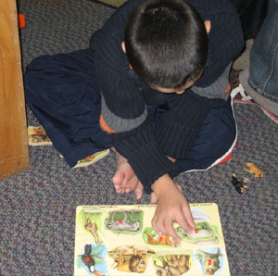
When we reflect on our descriptions we need to remember that…
We observed the child at only one point in time and we need to avoid jumping to conclusions
We each have our own “filters” (values, beliefs, or feelings) that sometimes cloud how we interpret our observations

Slide 26
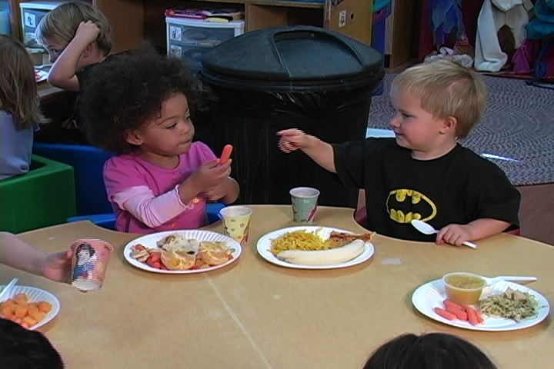
Observation
Practice 1
Henry at Mealtime

Slide 27
Observe Henry
As you observe Henry:
  Jot down your descriptions of what you see and hear him do
  Avoid making interpretations

Slide 28
Six Key Practices for Effective Observation
Make observation a routine part of your work
Engage families in the observation process
Use strategies that match your purposes
Observe as objectively as possible
Document your observations
Reflect on and use your observations

Slide 29
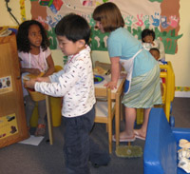
Examples of ways to document your observations
Observation notes
Work samples
Photographs, video,
and audio recordings
Portfolios (traditional and online)

Slide 30
Writing Effective Observation Notes
Be Factual: Describe only what
actually happened
Be Brief: Keep it short, but provide enough detail that you will be able to remember and understand what happened
Be Relevant: Include key details such as direct quotes and information about the context

Slide 31
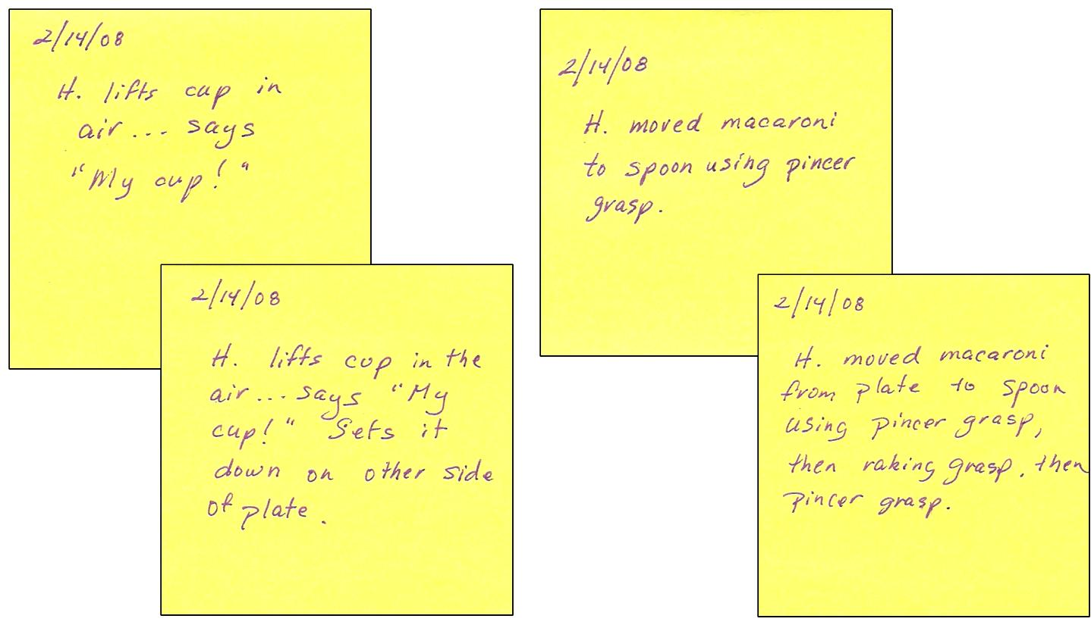
Examples of Observation Notes for Henry

Slide 32

Work Samples

Slide 33
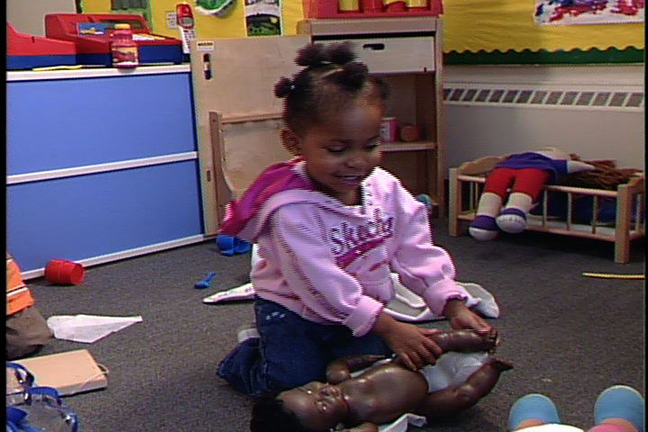
Photographs

Slide 34
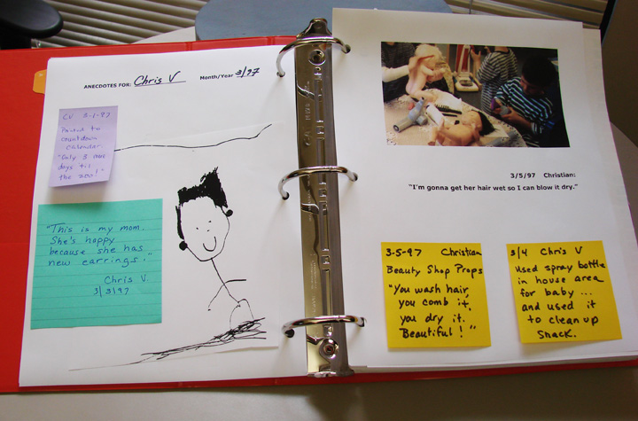
Traditional Portfolios

Slide 35
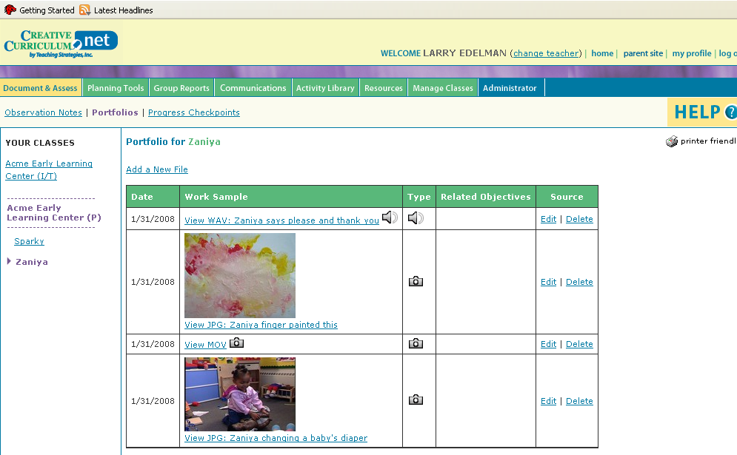
Online Portfolios (e.g. CC.net)

Slide 36
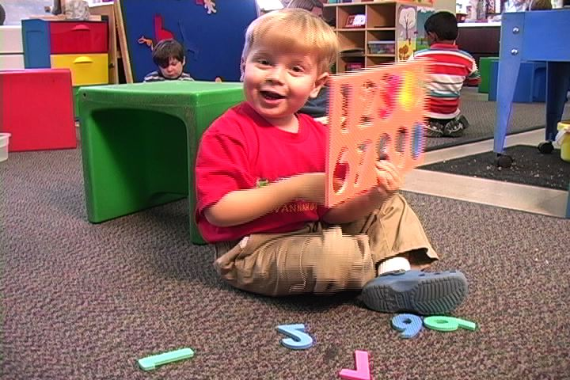
Observation
Practice 2
Caul

Slide 37
Observing Caul
Remember to be objective
Write your notes in ways that are:
  Factual
  Brief
  Relevant
  Keep in mind the purpose of this observation:
  You are observing Caul to gather information to share with his parents at an upcoming
  parent-teacher conference

Slide 38
Six Key Practices for Effective Observation
Make observation a routine part of your work
Engage families in the observation process
Use strategies that match your purposes
Observe as objectively as possible
Document your observations
Reflect on and use your observations

Slide 39
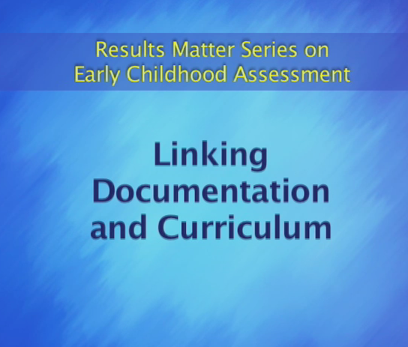
Let’s Watch!
Linking Documentation to Curriculum

Slide 40
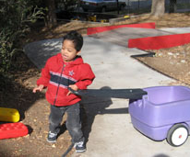
Observation helps us…
Understand individual children's…
Interests
Strengths
Challenges
Plan…
The kinds of activities and
materials to provide
When and how to rotate activities
How to expand on activities

Slide 41
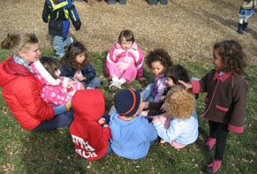
We might use information we gain from ongoing observation to…
Plan curricula and
learning activities
Share the good
work of our
program with
the community
Document children's
progress
Share information
with families
Let children
know that we
value their work
Complete an
assessment
instrument

Slide 42
A Process for Reflection and Action
Observe/
Document
Act
Reflect

Slide 43
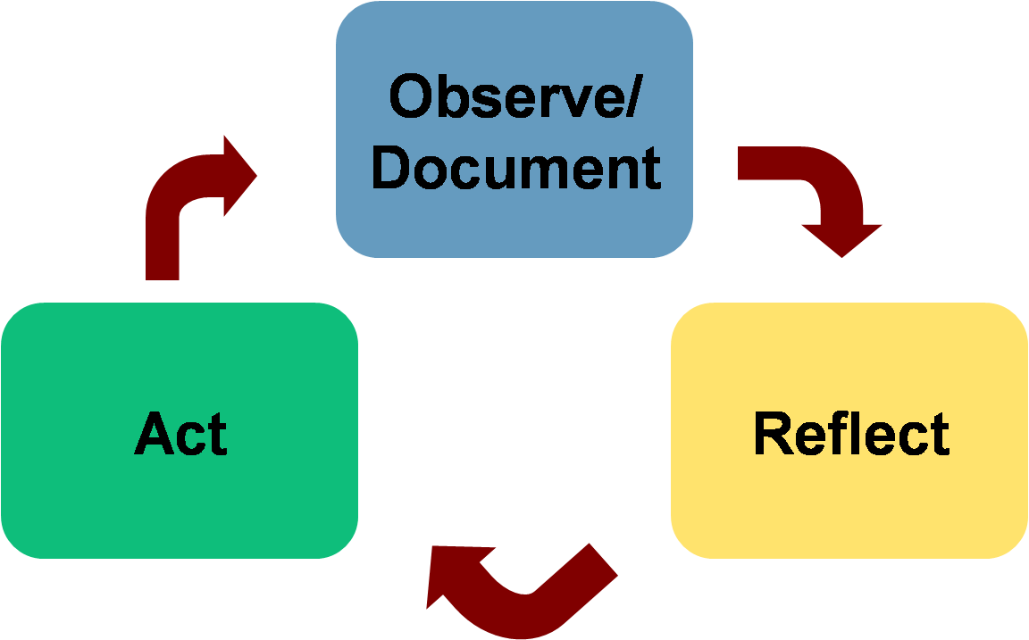
Observe/Document
We document what we observe as objectively as possible:
  We note the things that we actually see and hear,
  We focus on facts,
  We try to remain nonjudgmental, and
  We avoid being subjective; we guard against allowing our personal views, values, feelings, or background to influence what we note.

Slide 44
Reflect
Once we document our observations:
  We pause and reflect on what we observed to make meaning of what we have, and
  We put our observations in context of other things we know about the child.

Slide 45
Sample Questions to Guide Reflection
What was my purpose for observing?
What similarities or patterns do I notice?
What do these observations seem to suggest?
What else might be going on?
What else do I want to observe or find out?
How does this observation fit with other things that I know about the child from previous observations?
How will I document my interpretations?

Slide 46
Act
Once we reflect on our observations, we decide what actions to take. For instance, we might decide:
  To do more observations,
  To rate an item on an assessment system, or
  Ways we want to individualize our teaching.

Slide 47
Example 1 of Observe/Reflect/Act
I observed: Henry sometimes scoops macaroni independently with the spoon in his left hand and at other times uses his right hand for assistance.
I reflected: What is affecting Henry’s ability to spoon the macaroni independently with one hand? Has he been demonstrating this skill long enough that I should expect him to be using it consistently? Should I do something to encourage his consistent and independent use of this skill or should I just wait for it to happen naturally?
I acted: When needed, I’ll remind Henry to position his plate close to him so it will be easier to use his spoon independently. I’ll continue to observe to see if this helps.

Slide 48
Example 2 of Observe/Reflect/Act
I observed: Henry takes turns communicating with Teagan, using finger pointing and eye contact. He made sounds when pointing, but I couldn’t tell if these were words.
I reflected: In what ways does Henry communicate differently with different people or during other activities? Have I observed Henry’s communication often enough in different settings to have a good understanding of his skills?
I acted: I will make additional observations of Henry, at different times of the day, in different activities, and with adults as well as other children.

Slide 49
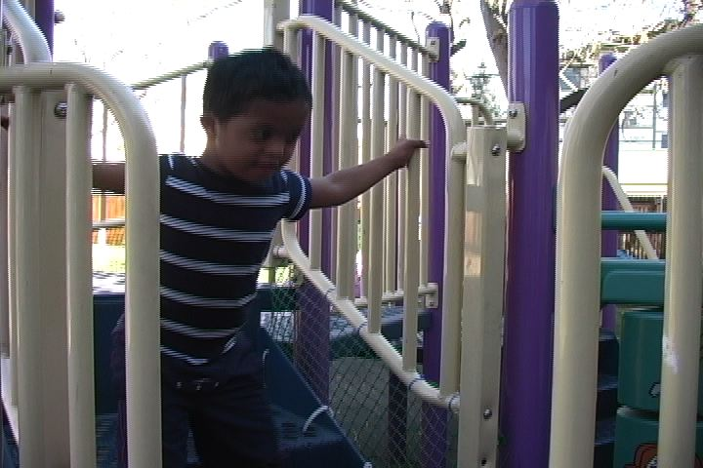
Observation
Practice 3

Slide 50
Observing Kaleb
Remember to be objective
Write your notes in ways that are:
  Factual
  Brief
  Relevant
  Keep in mind the purpose of this observation:
  Kaleb’s physical therapist asked you to give her a good idea about Kaleb’s skills as he moves about and uses
  various pieces of equipment on the playground

Slide 51
In Summary:
Six Key Practices for Effective Observation
Make observation a routine part of your work
Engage families in the observation process
Use strategies that match your purposes
Observe as objectively as possible
Document your observations
Reflect on and use your observations

Slide 52
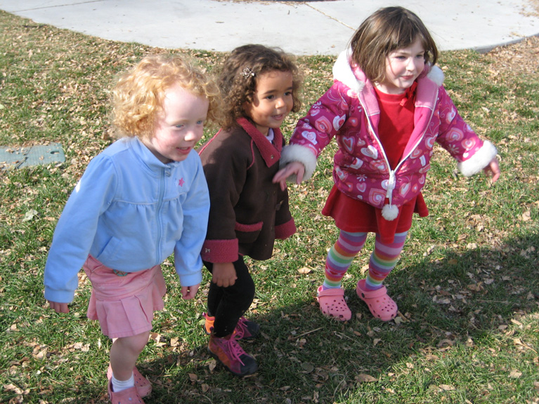
Ready, Set,…

Slide 53

Let’s Watch!
So Many
Ways to
Learn

Slide 54
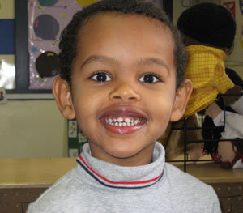
Thank
You!
Results Matter – Colorado
Colorado Department of Education

