Slide 1
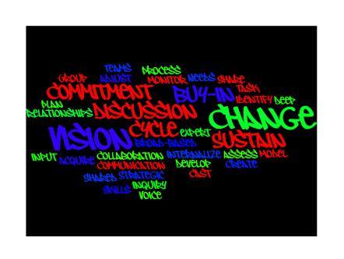
Foster Care Education:
Improving Educational
Outcomes for Children and Youth
Sheree Conyers
State Coordinator of Foster Care Education
Colorado Department of Education

Slide 2
Proud Sponsors

Slide 3
Sense of Urgency
National research shows that children in foster care are:
at high-risk of dropping out of school
are unlikely to attend and graduate from college
higher rates of suicide, homelessness, unemployment and teen pregnancy

Slide 4
National Facts and Figures
Less than 70% of youth in foster care finish high school before leaving care.
Children and youth in out-of-home care experience 1 or 2 placement changes per year on average.
Students in foster care score 16 to 20 percentile points below others in statewide standardized tests.
Sources:
www.caseyfamilyservices.org www.wsipp.wa.gov

Slide 5
Why It Matters?
Positive school experiences create:
• all around child well being;
• children who are successful in school and in life; and
• increase their chances for personal fulfillment and self-sufficiency.

Slide 6
Purpose
The program is dedicated to ensuring that students in foster care are successful.
This includes:
Course completion
Advancement to the next grade
Accrual of credits for graduation
A pathway to postsecondary readiness

Slide 7
Action
The program is designed to work with school districts to…
Increase learning supports
Implement effective strategies
Strengthen partnerships with child welfare and community agencies
Coordinate educational transition

Slide 8
Our Framework for Success
Laws and Legislation
Dedicated Resources
Coordinated Efforts and Response
Improving Educational Supports

Slide 9
Fostering Connections Act of 2008
Sweeping legislation that affects many areas of child welfare law and school stability!

Slide 10
School Stability
Stay in same school if in best interest of students.
If moving schools is in best interests, immediate and appropriate enrollment in a new school, with all educational records provided to new school.
When a child’s residence changes, there is often pressure to move the child to a new school.
Source: www.americanbar.org

Slide 11
Colorado School District Child Welfare Education Liaisons House Bills 08-1019 and 1274
Ensures proper school placement, transfer, and enrollment of foster children.
The bill requires the sending school transfer the school records to the receiving school within 5 days. The receiving school must enroll the student within 5 days of receiving the records.
The liaisons work with all parties to ensure a foster child remains in an educational situation that promotes stability.

Slide 12
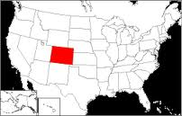
Colorado School District Child Welfare Education Liaisons
Designated by each school district and state Charter School Institute
Go to ww.cde.state.co.us for a map of the Child Welfare Education Liaisons for each school district.

Slide 13
Contact Information
Sheree Conyers, State Coordinator
Foster Care Education: Improving Educational Outcomes for
Children and Youth
Phone 303-561-2192
Cell 303-501-4031
Email Conyers_S@cde.state.co.us
Website: www.cde.state.us.co

