Slide 1

Food Safety &
Menu Planning
Office of School Nutrition

Slide 2

Food Safety Basics
Employee Hygiene
  Hand Washing
  Attire/Jewelry/Hair/Fingernails
  Tasting Foods
Sanitation/Cleaning
  Cross Contamination
Temperature Control
  Temperature Danger Zone

Slide 3
Employee Hygiene
“Hand washing is the single most important means of preventing the spread of infection.” –CDC
Wear a clean apron when preparing food
Hair should always be restrained
No artificial nails or nail polish should be worn
When hands are bandaged, wear single-use gloves to cover the bandage
Never reuse a bowl or spoon already used for tasting

Slide 4
Sanitation/Cleaning
All surfaces that come into contact with food must be cleaned and sanitized. This includes:
  Service line
  Serving station
  Dishes
  Utensils
  Measuring devices
  Cooking pots
  Equipment
Avoid Cross Contamination
  Separate raw, cooked, and ready-to-eat foods
  Separate unwashed from washed produce
  Store chemicals away from food supply areas

Slide 5
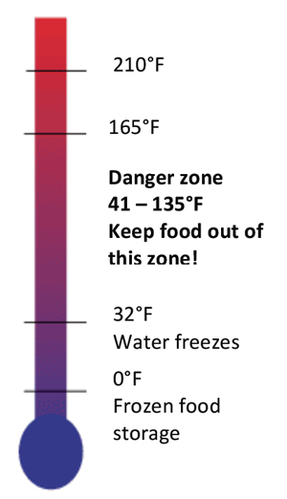
Temperature Control
Keep hot foods hot and cold foods cold
Proper time and temperatures must be followed for cooking, holding, cooling and reheating foods
Check temperatures with appropriate thermometers

Slide 6

Importance of Menu Planning
The goal of the Summer Food Service Program (SFSP) is to serve nutritious breakfasts, lunches, suppers, and snacks to children
All meals served must meet meal pattern requirements
Notes:
Meal patterns ensure that children receive well-balanced meals and establish the minimum portions for each meal component that must be served to each child in order for the participating sponsor to receive reimbursement for a meal.

Slide 7
Food Buying Guide
USDA Food Buying Guide
The Food Buying Guide for Child Nutrition Programs has all of the current information in one manual to help you 1) buy the right amount of food and the appropriate type of food for your program(s), and 2) determine the specific contribution each food makes toward the meal pattern requirements.
Notes:
http://www.fns.usda.gov/tn/resources/foodbuyingguide.html

Slide 8

USDA Foods (commodities)
Sponsors eligible to receive foods (commodities) under the SFSP include:
  sponsors preparing meals onsite or at a central kitchen
  sponsors purchasing meals from a school food authority that participates in the NSLP
  SFA sponsors that procure their SFSP meals from the same food service management company that competitively provided their most recent NSLP and/or SBP meals
Notes:
Indicate your commodity request on the sponsor application

Slide 9

Menu Planning Considerations
Be practical
Cycle menus
Calculate serving sizes and costs
Check the budget
Check the inventory
Check labor and equipment
Notes:
Some sponsors post their summer menus on their websites- get ideas from others!
Know how much the meals are going to cost you and plan your budget accordingly.

Slide 10
Create Menus For All Meals
Menus are required for all SFSP meals served
  Breakfast, lunch, supper, snack
Be specific, no assorted fruit or fresh vegetables
Record all menu changes
Document all menu items; inventory, receiving list, invoice, etc.
Notes:
Colorado does not require production records in the SFSP.

Slide 11
Which Meal Pattern Do I Use?
If you Do Not Participate in the SBP or the NSLP; You must follow the Summer Food Service Program Meal Pattern Requirements
If you Do Participate in the SBP or the NSLP; Sponsors serving meals that are prepared in schools may use the meal requirements of those programs instead of the SFSP meal patterns
Notes:
Sponsors serving meals that are prepared in schools may, with prior State agency approval, as indicated on their application use the meal requirements of those programs instead of the SFSP meal patterns.

Slide 12


SFSP Breakfast Meal Pattern
One serving of milk
One serving of a vegetable or fruit or 100% juice
One serving of grain or bread
A meat or meat alternate is optional
Notes:
One serving of milk is 8 ounces.
One serving of vegetable or fruit is ½ cup. Only juice that is 100% juice meets the ½ cup requirement.
Additional meal pattern information is located on page 9 of the 2013 Nutrition Guidance for Sponsors (tab 2).

Slide 13

SFSP Lunch and Supper Pattern
One serving of milk
Two or more servings of vegetable and/or fruits
One serving of grain or bread
One serving of meat or meat alternate
Notes:
One serving of milk is 8 ounces.
One serving of vegetable or fruit is ¾ cup total.
Additional meal pattern information is located on page 9 of the 2013 Nutrition Guidance for Sponsors.

Slide 14
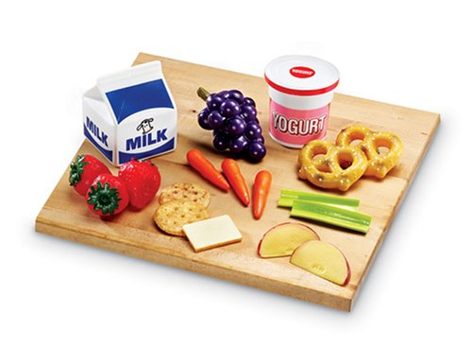
SFSP Snack Meal Pattern
For a snack to be a reimbursable meal it must contain two food items
Each item must be from a different food component
However, juice cannot be served when milk is served as the only other component

Slide 15
Offer Versus Serve | When choosing OVS in the SFSP, the following rules apply:
Schools electing to use OVS must use the options relevant to their menu planning approach.
Other SFSP sponsors wishing to use OVS must follow the OVS requirements for the SFSP food-based menu planning approach.
When relying on the SFSP food-based menu planning approach; a child may decline only one food item offered at breakfast and up to two of the food items offered at lunch or supper.
Sponsors must offer a complete meal to SFSP participants (i.e., all required food items/components must be offered and children must not be urged to decline components).
Notes:
Please note that OVS is not required, but is at the option of the sponsor as indicated on the application.
For more information see page 44 in the 2013 Administrative Guidance for Sponsors manual.

Slide 16
Offer Versus Serve
OVS may be implemented for breakfast, lunches, or suppers only
No OVS for snacks, as snacks only contain two components
Sites using unitized meals may use OVS
Notes:
For OVS, the fruit/vegetable are linked together to total the ¾ cup requirement. If a child refuses one of the fruit/vegetable, it counts as 2 declined items. If you do a unitized meal, you can have a sharing table or you may use OVS (A child may only refuse one item at breakfast and up to two of the food items offered at lunch or supper.)

Slide 17
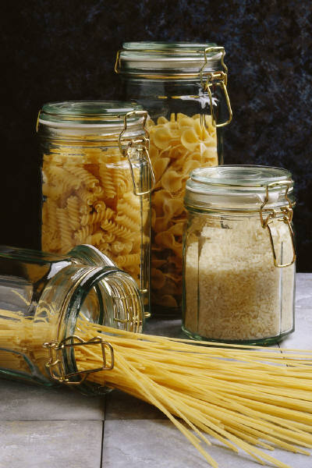
Grains/Breads
Menu Ideas to Increase Variety
Use a variety of breads such as pita pockets, pizza crust, focaccia bread, bagels, corn bread, tortillas, and English muffins
Substitute unsweetened, whole-grain ready-to-eat cereal for croutons in a salad or in place of crackers with soup
Try brown rice or whole-wheat pasta
Add whole-grain flour or oatmeal when making cookies
Use whole grains in mixed dishes, such as barley in vegetable soup or stews and bulgur wheat in casseroles or a stir-fry
Notes:
2013 Nutrition Guide p. 14; Enriched breads, cereals, pasta , Whole-grain breads, cereal, and pasta

Slide 18

Meat/Meat Alternate
Menu Ideas to Increase Variety
Try whole-grain pita bread sandwiches or pita pockets stuffed with tuna, lettuce, and tomato, or chicken salad
Make a vegetarian whole-grain pita pocket with favorite veggies, chickpeas, and plain yogurt
Serve peanut butter with apple chunks on whole wheat bread
Serve lean meats, skinless poultry, and lower fat cheeses
Mix ground beef with ground turkey for hamburgers or taco filling
Make a whole-grain submarine sandwich with roast turkey or ham and cheese
Try lentils or navy beans in a soup
Notes:
2013 Nutrition Guide p.11; Meat, fish, poultry, and eggs, Cheese, Dry beans and peas (Can also count as a vegetable, but not in the same meal.)

Slide 19
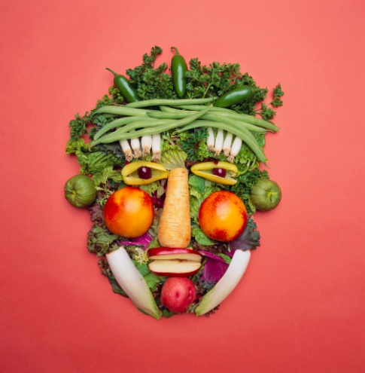
Vegetables
Menu Ideas to Increase Variety
Top baked potatoes with broccoli and cheese
Dip raw carrots and cauliflower in low-fat/fat-free yogurt dip or low-fat/fat-free salad dressing
Encourage children to try vegetables such as eggplant, yellow squash, turnips, and spaghetti squash
Use spinach and other greens for salads
Serve seasonal fresh vegetables
Notes:
2013 Nutrition Guide p.12 Vegetables (dark green, deep yellow, starchy, other), Dry beans and peas (can also count as a meat alternate, but not in the same meal.)
Use a different combination of two or more servings of fruits and/or vegetables for lunch. Include various forms such as raw or cooked, fresh, frozen, canned in juices, or dried.

Slide 20

Fruit
Menu Ideas to Increase Variety
Serve fresh, ripe fruits when they are in season, such as cantaloupe, peaches, watermelon, strawberries, plums, pears, and grape halves
Offer canned fruits packed in light syrup or in natural juices
Buy frozen mixed fruit and add fresh banana slices
Choose a fruit to top a dessert like pudding or gelatin
Try using an orange glaze on chicken breasts
Introduce unfamiliar fruits such as kiwi, papaya, mango, apricots, dates, and figs
Notes:
2013 Nutrition Guide p.13; Citrus fruits, melon, berries, and other fruit.
Juice drinks with at least 50-percent-strength juice may be used for snack and lunch, but children must be served double the volume of these drinks to meet the requirement.

Slide 21

Milk
Menu Ideas to Increase Variety
Offer only whole milk to children between the ages of 1-2
Only offer fat-free or low-fat milk to children ages 2 and above
For children who require it, serve alternative types of milk (a lactose-free or lactose-reduced) if available
Try shelf-stable (UHT or ultra high temperature) milk
Notes:
2013 Nutrition Guide p.15. Low fat white, skim flavored milk. Shelf stable milk still tastes better cold.

Slide 22

Choking Risks
Foods that may cause choking in young children include:
  Hot dogs
  Nuts and seeds
  Raw carrots
  Raisins
  Chunks of meat
  Peanut butter (spoonful)
  Whole grapes
  Marshmallows
  Round or hard candy
  Chips
  Popcorn
  Pretzels
  Raw celery
  Cherries with pits
  Large pieces of fruit with skin
Notes:
If your menu contains a lot of these items, you may want to revise your menu.

Slide 23
Crediting Foods
If a site chooses to purchase additional food with SFSP funds, the food must be a creditable food under the meal pattern requirements.
Notes:
2013 Nutrition Guide p.20 Summer Food Service Program sponsors can use the Food Buying Guide for Child Nutrition Programs located on internet at: http://teamnutrition.usda.gov/Resources/foodbuyinguide.html
SFSP Memorandum #6-2012; Additional Foods in the Summer Food Service Program.
Condiments served with a creditable food are exempt from this restriction.

Slide 24

How to Plan a Summer Lunch Menu
Begin with the main dish or entree:
    consider a source of protein from the meat or meat alternate group.
    Sometimes, grains, vegetables, or fruits may be part of the main dish,
    such as a taco, burrito, or chef's salad
Choose a combination of a fruit and a vegetable that go together
Include whole-grain bread that is rich in fiber
Add low-fat or fat-free milk as the beverage
Notes:
Use the Summer Menu Checklist on page 26 in the 2013 Nutrition Guide.
See sample summer menus on pages 27-29 in the 2013 Nutrition Guide.

Slide 25
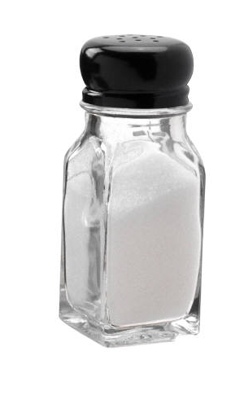
Minimize Sodium
No extra salt
Less processed foods
Make from scratch when possible
Substitute fresh items for processed items

Slide 26

Minimize Sugars
Reduce the amount of sugar in recipes
Purchase fruit packed in it’s own juice

Slide 27
Is Your Menu Boring?
    Use sensory words:
      Crunchy
      Tart
      Juicy
    Use exciting & fun names:
      Peachy
      School Spirit Salad Bar
      So Lettuce Get Together Salad Bar
      Silly Sliced Peaches
    Color the names of menu items
      Fire Engine Red Tomatoes
      Sunny Yellow Bananas
      Garden Green Salad
    Choose a theme
      Holidays – Fourth of July
      Events – Football & Baseball
      Ethnic Foods – from Mexico, Spain, or Ireland, etc.
Notes:
Kids are more willing to eat different foods if they are named in a fun way.

Slide 28
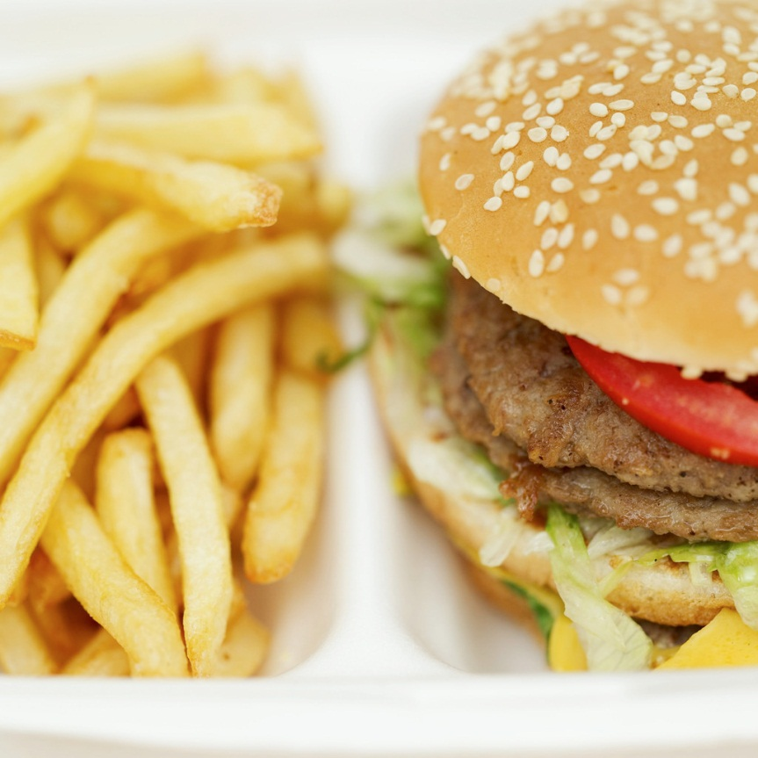
Jazz Up Your Menus
What descriptive words would you add to this menu?
    Cheeseburger on bun
    Lettuce/Tomato/Pickle
    French fries
    Apple
    Milk
Notes:
See page 38-41 on ways to jazz up your meals in the in the 2013 Nutrition Guide. Jack cheese burger, crispy fries, fresh apple, cold milk.

Slide 29
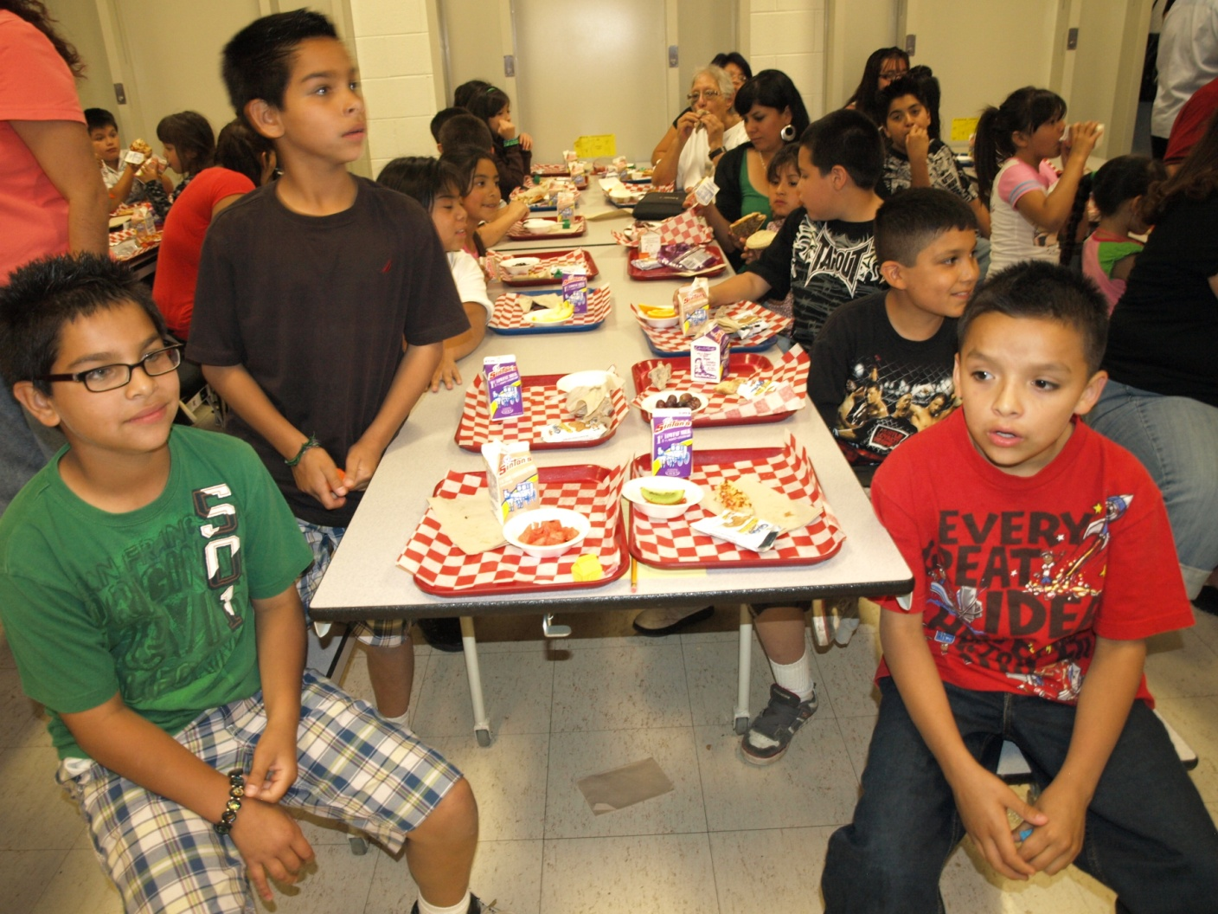
Denver Public Schools SFSP kick off

Slide 30
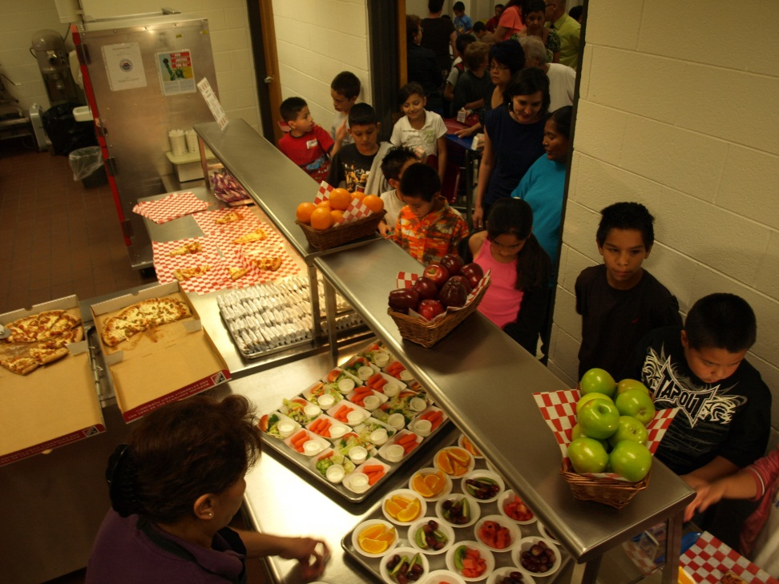
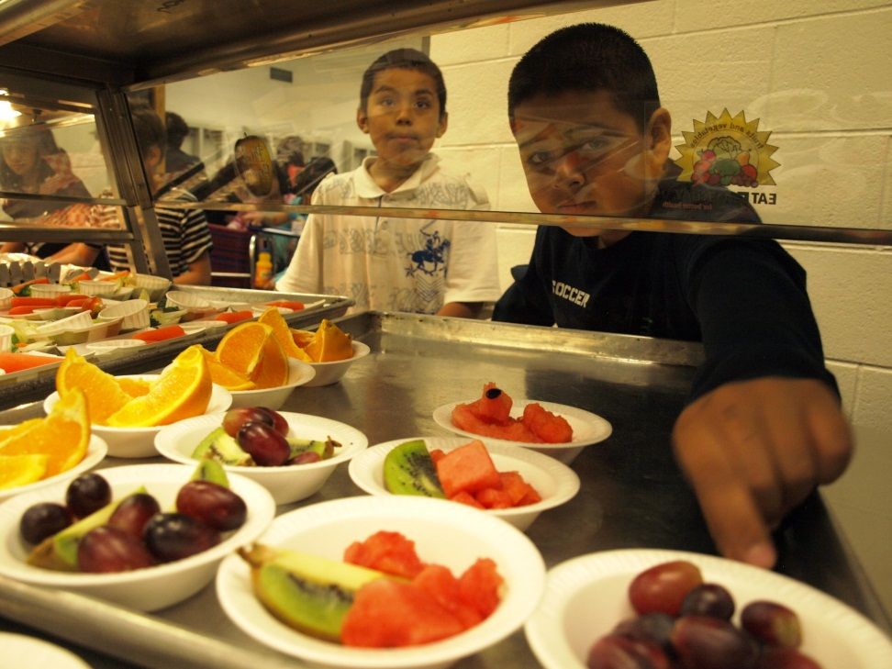
Create Happy Times
To Create a Happy Eating Environment:
Make meal time a happy time
Consider the physical environment
Create a healthy atmosphere
Provide nutrition education
Promote nutrition education activities
Notes:
For a list of nutrition activities see page 34-36 of the 2013 Nutrition Guide.

Slide 31
Resource For Menu Ideas
Cooks for Kids Season one - NFSMI http://www.nfsmi.org/DocumentSearch.aspx?type=advance&title=&number=&keywords=&from=&to=&category=&subject=18&audience=0&course=0&media=0&language=0

