Slide 1
Using the Food Buying Guide to Calculate Purchase Quantities & Meal Component Contributions
http://www.fns.usda.gov/tn/Resources/foodbuyingguide.html

Slide 2
Starchy Vegetable Example: -How do you use the Food Buying Guide to determine how much corn on the cob to purchase to provide seventy-five ½ cup portions of corn (starchy vegetable component)?
Step 1: Locate a menu item in the appropriate section of the Food Buying Guide
Example: Corn on the cob is located in Column 1 in the Vegetable section of the Food Buying Guide

Slide 3
Starchy Vegetable Example: -How do you use the Food Buying Guide to determine how much corn on the cob to purchase to provide seventy-five ½ cup portions of corn (starchy vegetable component)?
Step 2: Locate the appropriate Serving Size per Meal Contribution (Column 4)
Example: Our desired portion size is a ½ cup portion of corn on the cob

Slide 4
Starchy Vegetable Example: -How do you use the Food Buying Guide to determine how much corn on the cob to purchase to provide seventy-five ½ cup portions of corn (starchy vegetable component)?
Step 3: Based on Serving Size per Meal Contribution (Column 4) determine the appropriate food to purchase in Column 1 (Food As Purchased, AP)
Example: Based on a ½ cup serving size in Column 4, you would need to purchase 5-1/4-inch ear (medium) frozen corn on the cob

Slide 5
Starchy Vegetable Example: -How do you use the Food Buying Guide to determine how much corn on the cob to purchase to provide seventy-five ½ cup portions of corn (starchy vegetable component)?
Step 4: Calculate Exact Quantity by taking the desired number of servings divided by Servings Per Purchase Unit, EP (Column 3): Servings / EP = Exact Quantity
Example: 75 servings / 2.44 (EP) = 30.74 lbs (Exact Quantity)

Slide 6
Starchy Vegetable Example: -How do you use the Food Buying Guide to determine how much corn on the cob to purchase to provide seventy-five ½ cup portions of corn (starchy vegetable component)?
Step 5: Calculate Purchase Quantity by taking the desired number of servings multiplied by the Purchase Units for 100 servings (Column 5) / 100
Example: (75 servings x 41.0) / 100 = 30.75 lbs (Purchase Quantity)

Slide 7
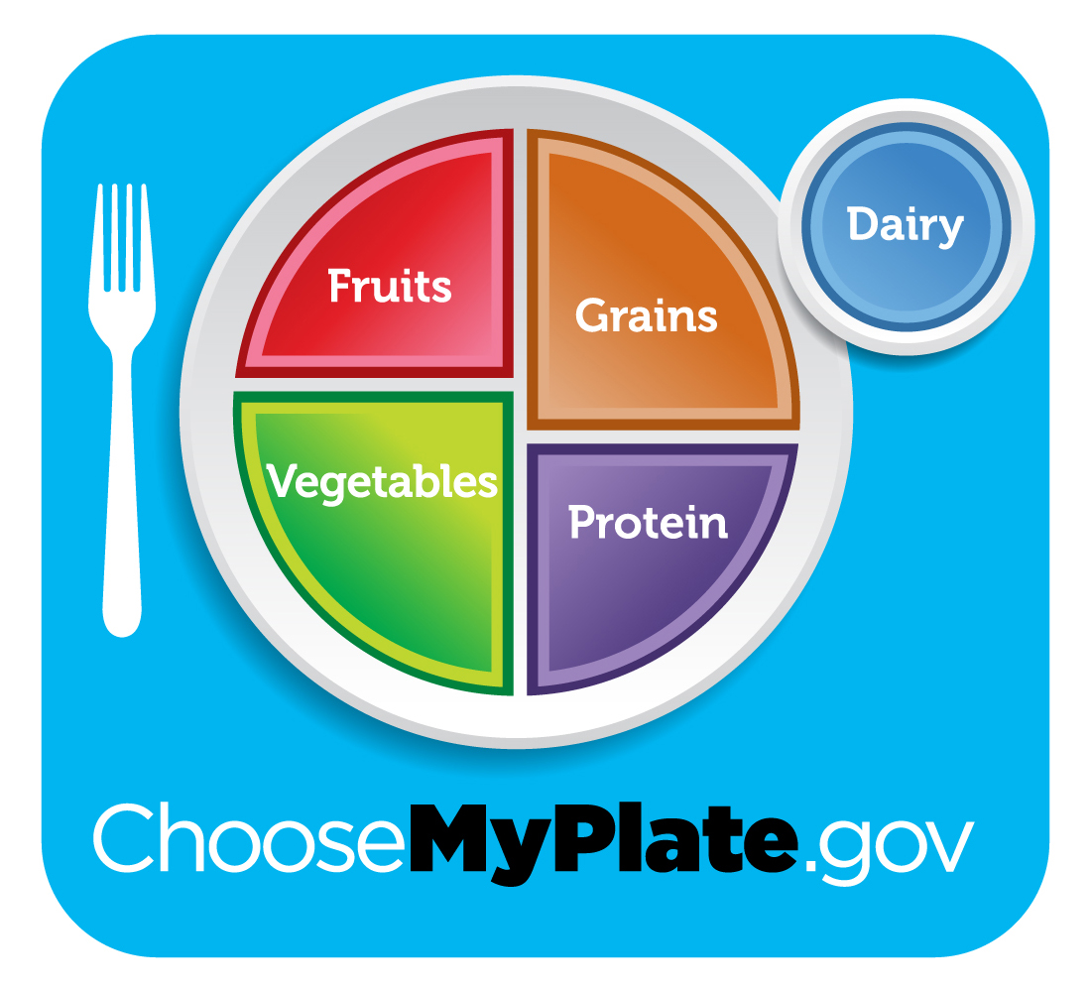
Starchy Vegetable Example: -How do you use the Food Buying Guide to determine how much corn on the cob to purchase to provide seventy-five ½ cup portions of corn (starchy vegetable component)?
Solution: Use calculated Purchase Quantity to purchase desired amount
Example: Use calculated Purchase Quantity of 30.75 lbs to purchase the correct amount of corn on the cob (5 -1/4-inch) for seventy-five ½ cup servings

Slide 8
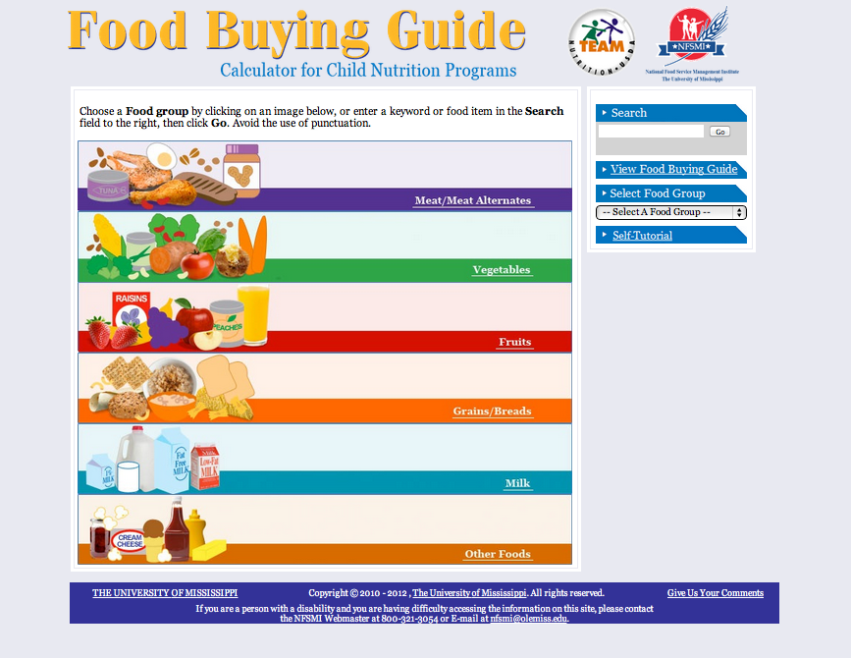
Food Buying Guide Calculator
This helpful online resource will do the calculations for you!
http://fbg.nfsmi.org/

Slide 9
Lunch Meal Pattern Component Requirements
 | K-5 |  | 6-8 |  | 9-12
 | Daily | Weekly | Daily | Weekly | Daily | Weekly
Meat/Meat Alternates | 1 oz | 8-10 oz | 1 oz | 9-10 oz | 2 oz | 10-12 oz
Grains | 1 oz | 8-9 oz | 1 oz | 8-10 oz | 2 oz | 10-12 oz
Fruits | ½ c | 2 ½ c | ½ c | 2 ½ c | 1 c | 5 c
Vegetables | ¾ c | 3 ¾ c | ¾ c | 3 ¾ c | 1 c | 5 c
Dairy | 1 c | 5 c | 1 c | 5 c | 1 c | 5 c
Notes:
Look at handout.
The new lunch meal pattern requires daily and weekly amounts of all 5 components based on three different grade levels. Grains and meat/meat alternates also have minimum and maximum ranges that must be adhered to.

Slide 10
Vegetable Subgroup Component Requirements
 | K-5 | 6-8 | 9-12
Dark Green | ½ c | ½ c | ½ c
Red/Orange | ¾ c | ¾ c | 1 ¼ c
Beans/Peas | ½ c | ½ c | ½ c
Starchy | ½ c | ½ c | ½ c
Other | ½ c | ½ c | ¾ c
Additional | 1 c | 1 c | 1 ½ c
Notes:
Look at handout.
The new lunch meal pattern requires daily and weekly amounts of all 5 components based on three different grade levels. Grains and meat/meat alternates also have minimum and maximum ranges that must be adhered to.

