Slide 1
Condiments
2012-13 School Year
All Employee Summer Training

Slide 2
Agenda
Definitions and Why?
Breakfast Condiments
Lunch Condiments
Condiment Cart and Display Standards
Using up “old products” and Cafeteria Guidelines
Heinz Training

Slide 3
Definitions and Why?
Condiments =
  Ketchup, mustard, mayo, picante, bbq, dressing, pepper, jelly, etc..
  NOT: sandwich or taco accompaniments (lettuce, pickle, tomato, etc)
Why Change Needed?
  New Regulations
  Cost Control
  Modeling Moderation
    “All foods work into a balanced diet”
    Portion control

Slide 4
Breakfast Condiment Item
Jelly, individual cups
  When:
    Served with toast and bagel
  What:
    1 each per slice of toast or whole bagel
  Where:
    On line next to toast or bagel
    On black tray with item or in clear food box next to item
  Storage-shelf stable
Notes:
Note: clear food boxes come in many different sizes and shapes. Work with Dolly to order the correct size.

Slide 5
Breakfast Condiment Item
Picante Sauce, bulk
  When:
    Served with omelet, breakfast pocket, breakfast burrito
  What:
    2oz. portion cup with lid
    Allowed 1 portion cup per entrée purchased
  Where:
    On line in cold crock next to entrée with “picante sauce” sign
    Storage- refrigerate after opening
      Portion cups: temp after service, if <41 F label/date/refrigerate up to 3 days.
Notes:
If students want extra portions of picante sauce, can purchase a la carte
When forecasting think about how many will actually select the condiment with the entrée. Many students will not, but some will. A lesson learned from year rounds is not to forecast 200 omelet and 200 picante sauce.
FYI-the cold crock does need to be froze for 8 hrs before each use.

Slide 6
Breakfast Condiment Item
Cream Cheese, Plain, individual cups
  When:
    Served with bagel
  What:
    1 each per whole bagel
  Where:
    On line next to bagel
    In cold crock on line next to item with “cream cheese” sign
  Storage: refrigerate

Slide 7
Lunch Condiment Items
Bulk Dressings-
  Creamy Caesar (Caesar Salad)
  Asian Sesame (Oriental Salad)
  Balsamic (Spinach Strawberry Salad)
  Italian (Chef Salad)
  Ranch (Chef Salad)
  Honey Mustard (Chef Salad)
  Cold Veggie Side
    Can use bulk Ranch, Italian, Honey Mustard. Vary qty. of each based on demand.
    In 1 oz. portion cup, only to pair with veggie side (packets are only dressing sold a la carte)
Standards:
  1 oz. portioned into cup with lid
  Serve in salad container and on cold veggie tray
  Use “may take 1 with cold veggie side” sign
  Portion cups = temp after service, if <41 F label/date/refrigerate for up to 3 days.

Slide 8
Lunch Condiment Items
Dressing Packets- A la Carte
  Italian
  Ranch
  Honey Mustard
Solution for those students who want dressing for other items not menu’d with a dressing or additional portions
A la Carte only
Charge a la carte price
Place at register in clear food box with “limit 2” sign
Shelf stable packets
Notes:
Can choose all or just some flavors to sell.
Review with secondary's the disposable black oval bowls. A sleeve of each should be at your schools when you arrive back. These are surplus items we found when cleaning out the warehouse. This is a great place to utilize those until they are gone. We can’t reorder! Change to food boxes when supply is gone.

Slide 9
Lunch Condiment Item
BBQ Sauce, individual cups
  When:
    Served with chicken nuggets
  What:
    purchased pre-portioned, 1 each
  Where:
    On line next to entrée in clear food box
  Storage- shelf stable

Slide 10
Lunch Condiment Item
Marinara Sauce, bulk
  When:
    Served with cheese stuffed breadsticks and breaded mozzarella sticks
  What:
    Serve out of hot well, into 2 oz. portion cup
  Storage- discard after service
10

Slide 11
Lunch Condiment Item
Picante Sauce, bulk
  When:
    Served with burritos, tacos, nachos
  What:
    2oz. portion cup with lid
    1 portion cup per entrée purchased
  Where:
    On line in cold crock next to entrée with “picante sauce” sign
    Storage- refrigerate after opening
      Portion cups: temp after service, if <41 F label/date/refrigerate up to 3 days.
11

Slide 12
Lunch Condiment Item
Mayonnaise, individual packets
  When:
    Served with chicken sandwich, hamburger, cheeseburger, deluxe sub
    Daily for secondary's on sandwich line
  What:
    1 each
  Where:
    On line next to entrée in clear food box
    Storage- shelf stable
12

Slide 13
Lunch Condiment Item
Syrup, individual cups (Elementary ONLY)
  When:
    Served with French Toast Sticks (Breakfast for Lunch)
  What:
    1 each
  Where:
    On tray with entree
    Storage- shelf stable
13

Slide 14
Extra Portions
All condiments are offered but don’t have to be served or taken by a student. Allows students choice.
Extra amounts or condiments may be purchased per a la carte price list.
  Pre-portion cup’d dressings are not sold a la carte, only packets

Slide 15
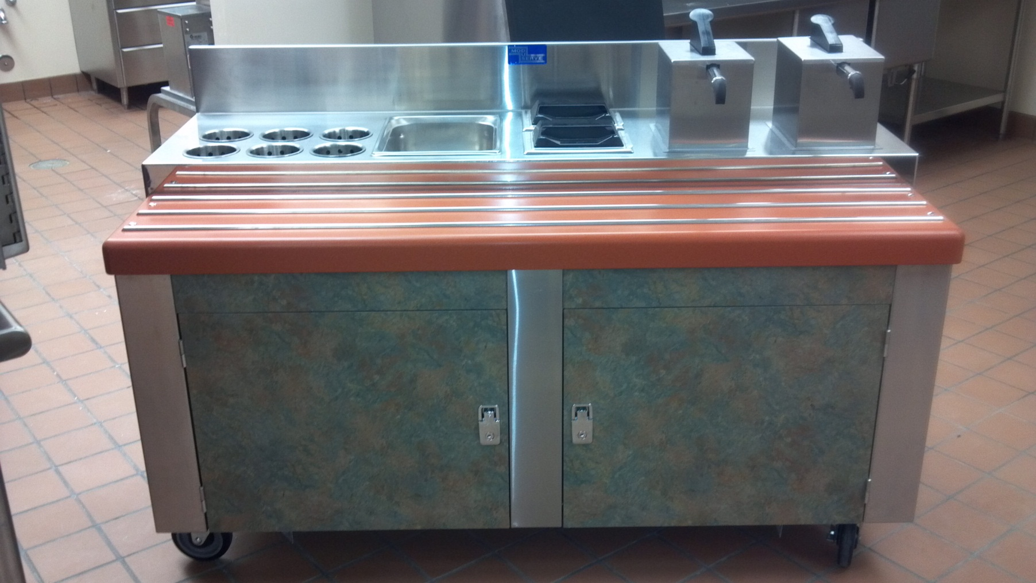
Introducing THE CONDIMENT CART
Notes:
This is our ideal condiment cart. Black Forest, being our newest school, is the only school with this set-up. At each of your schools, please envision this look and try to accomplish this standard in your space. Use the supervisor team to help you. Some schools will have more of a challenge then others. Schools that come to mind are three model schools (Belleview, Timberline, Canyon Creek) and Holly Ridge. For these schools, please talk with your supervisor about your condiment cart and plan.

Slide 16
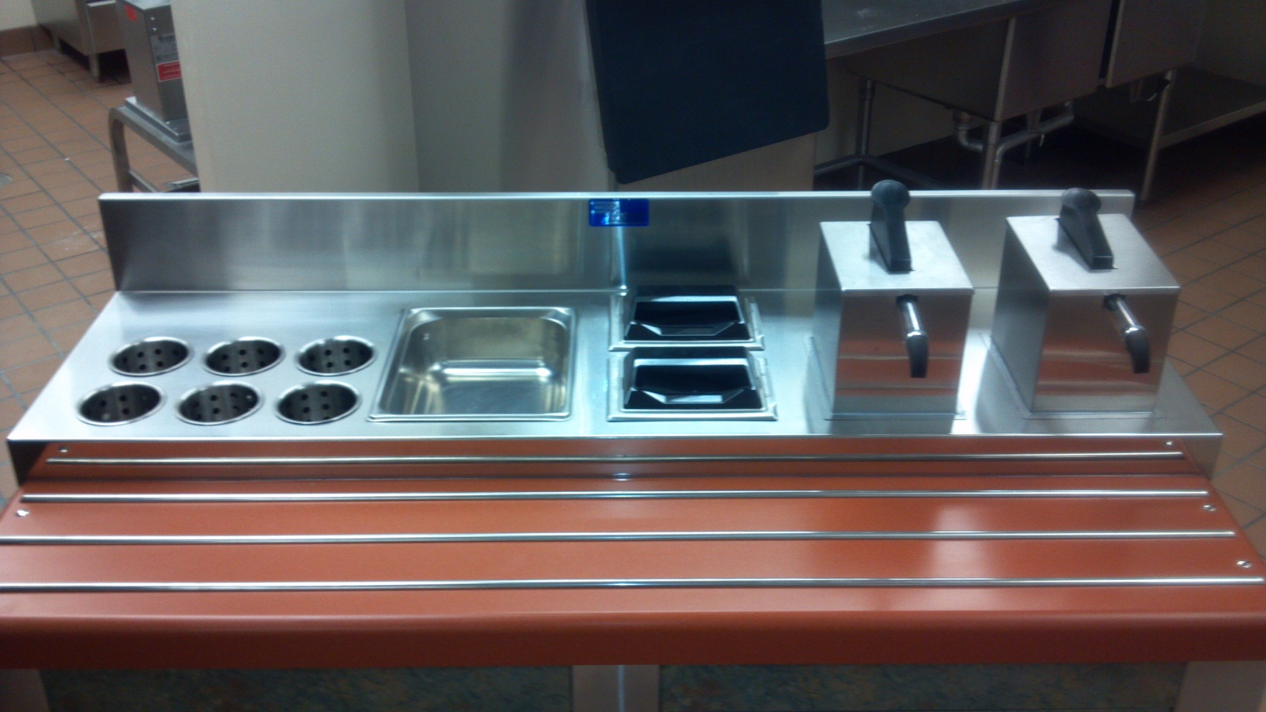
Condiment Cart: Top View
Notes:
This is to show standards for any condiment cart: silverware in stainless holders with handles facing up, pan or crock for black pepper packets, napkins in dispensers to minimize waste, ketchup and mustard in pumps.

Slide 17
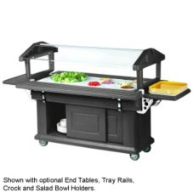
Other Condiment Cart
Cambro Salad Bar
Table or Counter
Notes:
You can easily meet the standards using Cambro Salad Bars, a table or counter space.

Slide 18
Condiment Cart or Counter Standards
18
What Products:
  Ketchup
  Mustard
  Black Pepper Packets
When:
  Breakfast: no Mustard, Ketchup on days egg products are served only, black pepper daily
  Lunch: all products offered daily
Where: on cart or table with sign “1 pump = 1 serving”

Slide 19
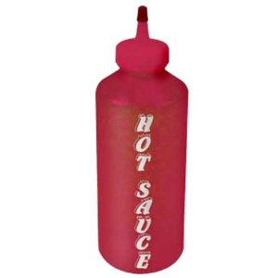
Hot Sauce
All levels can have the option to offer hot sauce daily
In transition
Until further notice:
    Purchase hot sauce in bulk jug
    Portion in squeeze bottle(s) for service
      Order red bottle (pictured here)
      Can use clear bottle with laminated signs until hot sauce squeeze bottle received.
Notes:
The goal is to switch to a Heinz product and pump in the future. Until that point we have a standard to portion hot sauce in a squeeze bottle. The key is that bottle must be labeled.

Slide 20
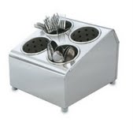
Other Standards/Display
Standards
  Napkins in holder (TBD)
  Flatware in stainless cylinder in holder
  Black pepper in crock
  Ketchup/Mustard pumps
  No drip cuts or Insulice
  Signage:
    1 pump = 1 serving
    1 dressing comes with 1 veggie
    Limit 2
  BLUE painters tape only, no tape on serving line or condiment cart, remove before wash
20
Notes:
Standards:
Napkins- our napkin spec and holder has not yet been finalized. Therefore it is okay to use the same procedure for putting napkins out that you used last year. Do not order a holder until notified by leadership.
Flatware-stainless cylinders are CCSD standard. They are more expensive. Knowing this, please plan to replace slowly throughout the school year. White or black can be used until you are able to transition to the standard.
Black Pepper- because so many condiments are unable to be used due to calorie, sodium or fat requirements; black pepper is a great way to allow students the choice to flavor food further. Please use a crock style container to place these packets in.
Pump- We will now purchase ketchup and mustard in cryovac bags and place them in the Heinz pump dispensers. We will train on this in a few minutes.
Signage- 1 pump = 1 serving gets posted on the condiment cart, 1 dressing comes with 1 veggie sign goes on the sneeze guard above your vegetable tray, limit 2 goes on your food box or basket you keep the dressing packets in at the register.
BLUE- must use blue tape only, no masking tape. No tape should be seen from the customers point of view, remove before washing.

Slide 21
“Old Products” and Cafeteria Guidelines
Old Products
  Taco Bell Sauce
  Soy and Teriyaki Sauce
  Bulk Syrup and BBQ
  Ketchup and Mustard
Cafeteria hot water and microwave
Notes:
Old Products: In an effort to reduce food waste, we will start the school year and phase into being 100% compliant with the standards of our new condiment program. This is because we will need to use up our old stock of products.
Taco Bell Sauce: use with burrito until your stock is used up. Then, change to the picante sauce.
Soy and Teriyaki Sauce: if you have 3 gallon or less, pick break and spoil the item, open and discard the product. Call supervisor to schedule a pick up if you have full cases.
Syrup and BBQ sauce: please portion in 2oz portion cups to use up on BFL and Chicken Nugget days, then begin ordering individual cups.
Ketchup and Mustard:
#10 or gallon jugs- use pump lid and pump for service, keep original lid for storage overnight. Date with day opened, must discard if not used up in 7days.
#10 can- use pump lid and pump for 1st service, transfer leftover product to a crock or drip cut, use drip cut first the following day and then open next #10 can. Drip cuts must be labeled with name of product.
Cafeteria: Hot water and microwaves are a customer service tool for the school to use for home lunch students. Knowing this we should not be purchasing these items or using our carts to place them on. Furthermore, we are asking that unless directly asked by your principal, we do not automatically fill and put the hot water out in the cafeteria. There are many reasons for reducing this practice, work with your supervisor on how to handle this.

Slide 22
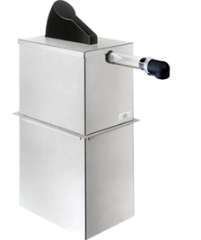
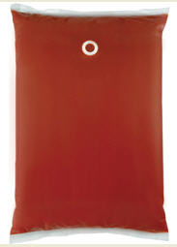
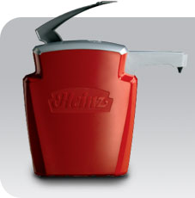
Condiment Pumps
Notes:
Cryovac bag, Heinz dispenser and Server dispenser (Example: Black Forest or future schools selected to have condiment carts designed)

Slide 23

Condiment Products and Pump Assembly Training
Products
Pumps
  Bags
  Load
  Storage-14 days
  Cleaning
Website Training Video
www.heinzdispensercare.com
Notes:
Turn it over to Heinz Rep

Slide 24
Questions?
24

