Slide 1
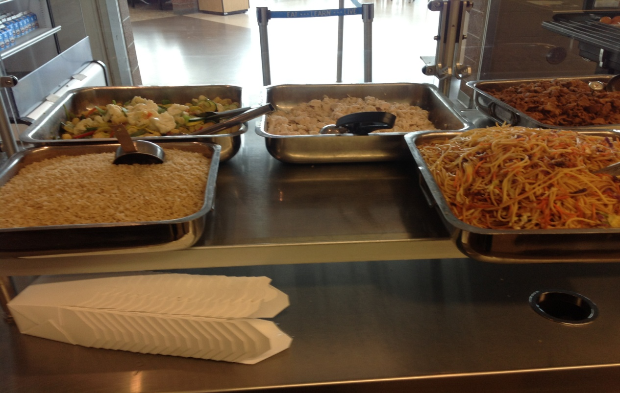
Recipe Design and Destination Stations
Jim D. Rowan, FMP
Adams SD50

Slide 2
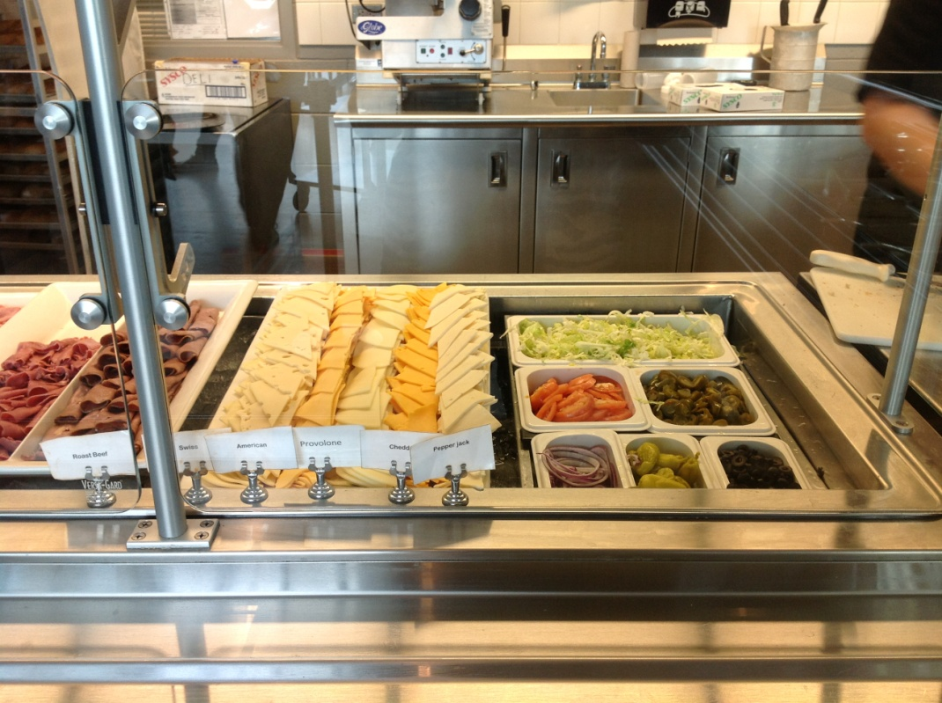
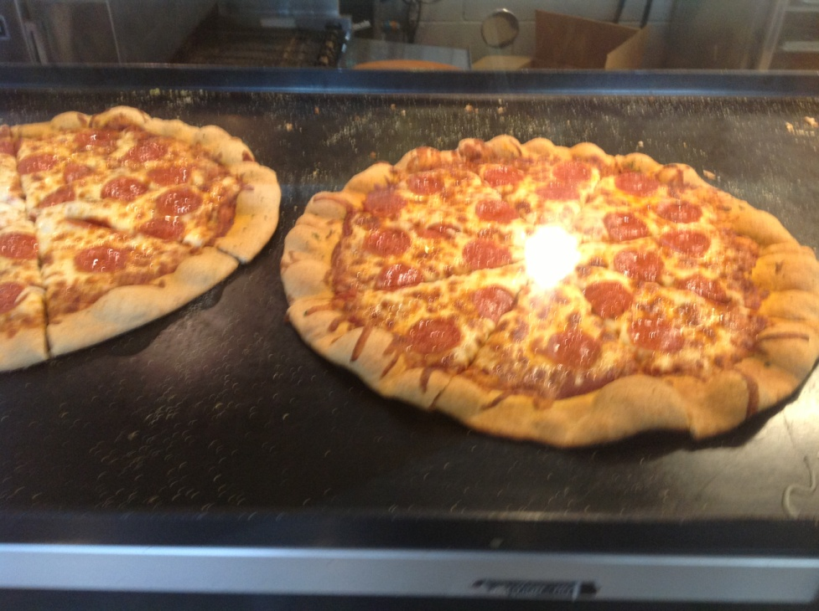
Deciding what stations or destinations can be difficult.
Talk to your students about what they would like to see.
Consider changing the way you serve

Slide 3
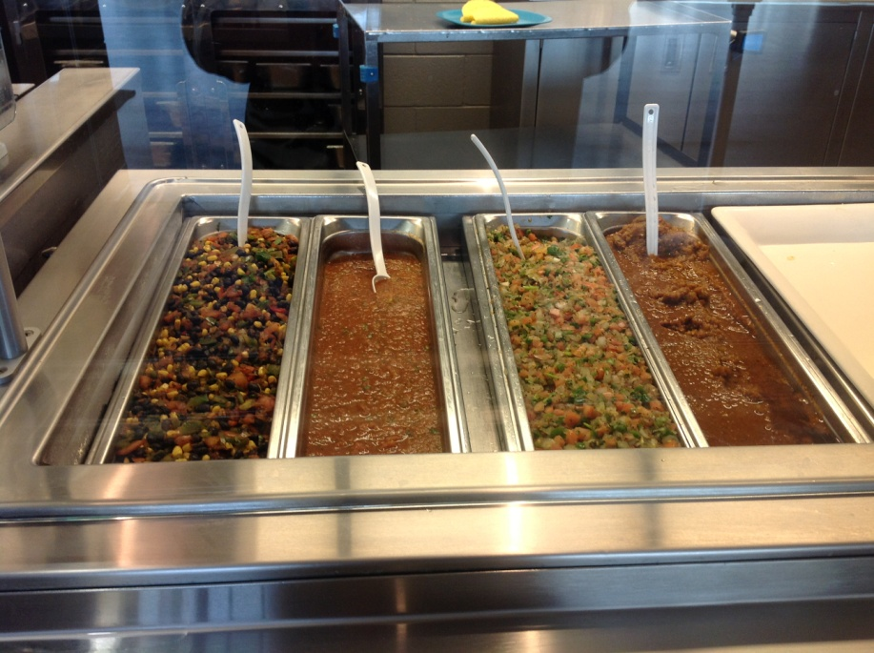
Make the Decision!
Is it Themed? This can make it easier
Now menu the station
What are you serving? Is it new?
From the menu, you need to find recipes
Where are you getting them now? Do they work?
Change is GOOD!!

Slide 4
Recipes - Writing or Modifying
Modification of an existing recipe is easiest
Burger, Beef (USDA Commodity Charbroiled
Patty 2.25 oz) on a Bun (2 oz WG)
Step Ingredients 1 Servings 25 Servings 50 Servings
Charbroiled Beef Patties AP 1 ea 25 ea 50 ea
Bun, Hamburger, Whole Grain, 1 ea 25 ea 50 ea
2 oz AP
Step Method
1 Thaw beef patties completely in cooler.
Shingle patties down in the bag.
Preheat convection oven to 375 degrees F.
Cook for 22-28 minutes.
CCP: Heat to an internal temperature of 165 degrees F.
CCP: Hold at 140 degrees F until sandwiches are assembled. Keep covered during holding to prevent the burgers from drying out.
2 To assemble each sandwich, place one heated beef patty on the bottom half of one hamburger bun. Close the hamburger bun.
CCP: Serve immediately, or wrap for self service and hold for hot service at 140 degrees F.
Portion Size = 1 Each
Recipe Notes:
One serving (1 each) provides 2 oz. meat/meat alternate and 2 servings of whole grain for the food based school meal patterns
One 2.25 oz Fully Cooked Beef Patty provides 2.0 oz equivalent meat/meat alternate for the Child Nutrition Meal Pattern Requirements.

Slide 5
Let’s make this a Jalapeno Jack Burger
Step Ingredients 1 Servings 12 Servings 24 Servings
1 Charbroiled Beef Patties 1 ea 12 ea 24 ea
2 Cheese, Monterey Jack, 3/4 oz 18.75oz 37.5 oz
Slice, .75 oz
Bun, Hamburger, , 1 ea 12 ea 24 ea
Whole Grain 2 oz
3 Jalapeno Peppers, 2 tbsp 1-1/2 cup 3 cup
Fresh, Sliced
Onions, Fresh, 1/4" Diced 2 tbsp 1-1/2 cup 3 cup
Tomatoes, Fresh, 3 ea 36 ea 72 ea
1/4" Each Slice
Step Method
1 Heat beef patties
CCP: Place burger patties on sheet pans and heat according to package directions to an internal temperature
of 165 F.
CCP: Hold at 140 degrees F until sandwiches are assembled. Keep covered during holding to prevent the burgers from drying out.
2 Assemble
Place one cooked beef patty on the bottom half of each hamburger bun and top with 3/4oz of cheese.
3 Add 2 tbsp sliced jalapeno peppers, 2 tbsp chopped onion, and 3 tomato slices on each burger. Top with remaining hamburger bun half.
CCP: Serve immediately or package and hold for hot service at 140 degrees F.
Portion Size= 1 Each
Note: Sandwiches should be batch cooked for optimal product quality
Recipe Notes:
One serving (1 each) provides 2.5 oz. meat/meat alternate, 2 servings of whole grain and ½ cup vegetables for food based
school meal patterns

Slide 6
Locations to find recipes
http://www.fns.usda.gov/tn/Resources/usda_recipes.html
http://www.indianharvest.com/foodservice-segments/k-12-schools
http://www.tysonfoodservice.com/Recipes/Recipe-Collections/Schools.aspx
Most manufacturers have a K12 specific area in their website with recipes

Slide 7
