Slide 1
Article 44 of Title 22, C.R.S. Part 3 Public School Financial Transparency Act
Terry Christensen
Senior Consultant
Public School Finance Unit

Slide 2
Financial Transparency Act
With the passage of HB10-1036, The General Assembly enacted the "Public School Financial Transparency Act", which directs local education providers to post financial information on-line, in a downloadable format, for free public access.

Slide 3
Local Education Provider
School District
Board of Cooperative Services
State Charter School Institute
District Charter School
Institute Charter School

Slide 4
Compliance Timeline
Commencing July 1, 2010
FY2009-10 and FY2010-11 Annual Budgets
District Budget Document
Uniform Budget Summary Sheet
FY2009-10 Financial Audit
Quarterly Financial Statements
Salary Schedules or Policies

Slide 5
Compliance Timeline
Additionally commencing July 1, 2011
Accounts Payable Check Registers
Credit, Debit and Purchase Card Statements

Slide 6
Compliance Timeline
Additionally commencing July 1, 2012
Investment Performance Reports

Slide 7
Compliance Timeline
Each local education provider shall update the information specified within sixty days after the completion or receipt of the applicable report, statement, or document.

Slide 8
Financial Transparency Act 22-44-304 (2) C.R.S.
Nothing shall direct or require a local education provider to post personal information relating to payroll, including but not limited to payroll deductions or contributions, or any other information that is confidential to otherwise protected from public disclosure pursuant to state or federal law.

Slide 9
Financial Transparency Act
A local educational provider shall maintain the prior two budget years’ financial information on-line until the end of the current budget year.
Notes:
Three years of information is to be maintained on-line

Slide 10
Financial Transparency Act
A link shall be provided to CDE’s website or the location information for CDE’s website where a member of the public may access information or reports that are submitted directly to CDE.
Notes:
This can be a link to the CDE main page, the PSFU website, SchoolView, etc.

Slide 11
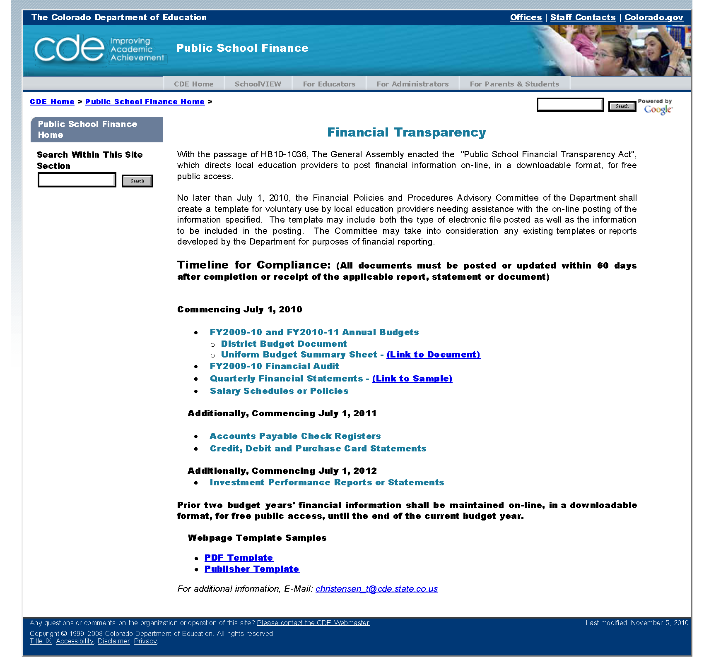
Website Link

Slide 12
Budget – contents – mandatory C.R.S. 22-44-105
The budget shall be presented in the format established by the state board of education.
The budget shall:
Be presented in a summary format, understandable to layperson.
Be presented in a summary format that allows for comparisons of revenues and expenditures among school districts by pupil.
Be presented in a format that itemizes expenditures by fund, by pupil.

Slide 13
Budget – contents – mandatory C.R.S. 22-44-105
Describe the expenditure
Show amount budgeted for current fiscal year
Show the amount estimated to be expended for the current fiscal year
Show amount budgeted for ensuing fiscal year
Summarize revenues by revenue source
Summarize expenditures by function (program), fund and object

Slide 14
Budget – contents – mandatory C.R.S. 22-44-105
Include a uniform summary sheet for each fund that details the following:
Beginning fund balance and estimated ending fund balance
Anticipated fund revenue by source
Anticipated transfers and allocation to and from the fund
Anticipated expenditures by program and object
Amount of reserves
(The template is currently being updated by CDE and will be post ASAP)

Slide 15
QUARTERLY FINANCIAL REPORT 22-45-102(1)(b)(I-IV)
Statue requires the board of education to review the financial condition of the district at least quarterly during the fiscal year. The board shall required the appropriate district personnel to submit a financial report covering the fiscal actions involving the general fund and any other funds that the board may request, at least quarterly.
GENERAL FUND | FY20XX-20XX (Prior Year) |  |  |  | FY20XX-20XX (Current Year)
 | For Period Ending September 30, 20XX |  |  |  | For Period Ending September 30, 20XX
 | BUDGET | ACTUAL | PERCENTAGE OF BUDGET |  | BUDGET | ACTUAL |  | PERCENTAGE OF BUDGET |  | EXPECTED YEAR END BALANCE
BEGINNING FUND BALANCE | 250,000.00 | 250,000.00 |  |  | 250,000.00 | 260,000.00
REVENUE | 3,000,000.00 | 650,000.00 | 21.67% |  | 3,120,000.00 | 680,000.00 |  | 21.79%
EXPENDITURES | 3,000,000.00 | 750,000.00 | 25.00% |  | 3,080,000.00 | 760,000.00 |  | 24.68%
ENDING FUND BALANCE | 250,000.00 | 150,000.00 | 60.00% |  | 290,000.00 | 180,000.00 |  | 62.07% |  | 300,000.00
CAPITAL RESERVE | FY20XX-20XX (Prior Year) |  |  |  | FY20XX-20XX (Current Year)
 | For Period Ending September 30, 20XX |  |  |  | For Period Ending September 30, 20XX
 | BUDGET | ACTUAL | PERCENTAGE OF BUDGET |  | BUDGET | ACTUAL |  | PERCENTAGE OF BUDGET |  | EXPECTED YEAR END BALANCE
BEGINNING FUND BALANCE | 10,000.00 | 10,000.00 |  |  | 11,000.00 | 11,000.00
REVENUE | 131,000.00 | 32,751.00 | 25.00% |  | 131,000.00 | 32,751.00 |  | 25.00%
EXPENDITURES | 130,000.00 | 8,000.00 | 6.15% |  | 133,000.00 | 40,000.00 |  | 30.08%
ENDING FUND BALANCE | 11,000.00 | 34,751.00 | 315.92% |  | 9,000.00 | 3,751.00 |  | 41.68% |  | 9,000.00
 |  |  |  |  | Specific Resolution Needed for Use of Portion of BFB
Notes:
Minimum requirements

Slide 16
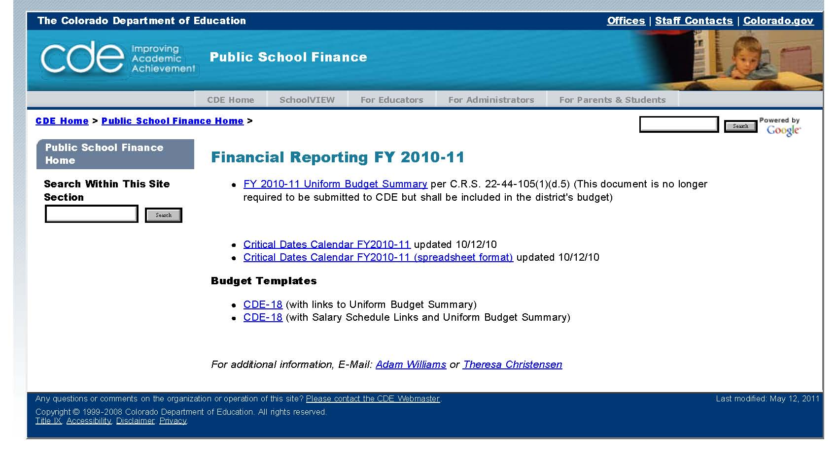
Website Link

Slide 17
District Website Links
Adams 12 Five Star
Website
Colorado Springs 11
Website
The Academy of Charter Schools
Website
Don’t make the page hard to find, it should be no more then 1-2 mouse clicks from the homepage.

