Slide 1
Steps to Complete the KSR Collection

Slide 2
Steps to Complete the KSR Collection Overview
Step 1: Selecting Assessment Tool
Step 2: Gathering Data
Step 2a: GOLD® Users: Obtaining the Colorado Kindergarten Readiness Report
Step 2b: DRDP-K Users: Aggregating Data Manually
Step 2c: NC-KEA Users: Aggregating Data Manually
Step 3: Uploading Data to CDE Data Pipeline.
*Please don’t forget to officially submit your data through the Status Dashboard and send in your sign-off sheet!

Slide 3
Step 1: Selecting Assessment Tool
Step 1: Please select your assessment tool
This is done in Pipeline under “School Readiness”
Video tutorial (approx. 2 min long) is linked here
Guide document with screenshots under “File Layout” on the website

Slide 4
Step 2: Gathering Data
PLEASE NOTE:
GOLD® Users: Please follow the instructions for Step 2a only and then proceed to Step 3.
DRDP-K Users: Please follow Step 2b only and then proceed to Step 3.
North Carolina KEA Users: Please follow Step 2c only and then proceed to Step 3.
COR Users: Please follow the assessment protocol and then manually aggregate your data following the later parts of either Steps 2b or 2c, and then proceed to Step 3.

Slide 5
Step 2a: Obtaining the Colorado Kindergarten Readiness Report out of GOLD® (1 of 4)
Navigate to the Reports area in Teaching Strategies.

Slide 6
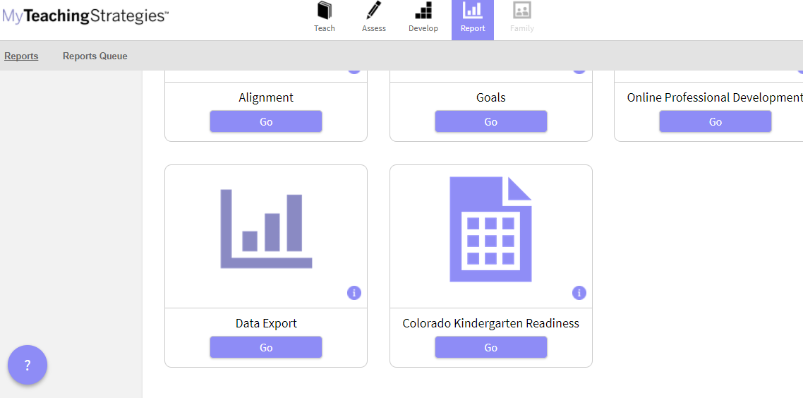
Step 2a: Obtaining the Colorado Kindergarten Readiness Report out of GOLD® (2 of 4)
Scroll to the bottom and find the Colorado Kindergarten Readiness report.
Please note that this report is only available in GOLD® administrator accounts.
Click on “GO”.

Slide 7
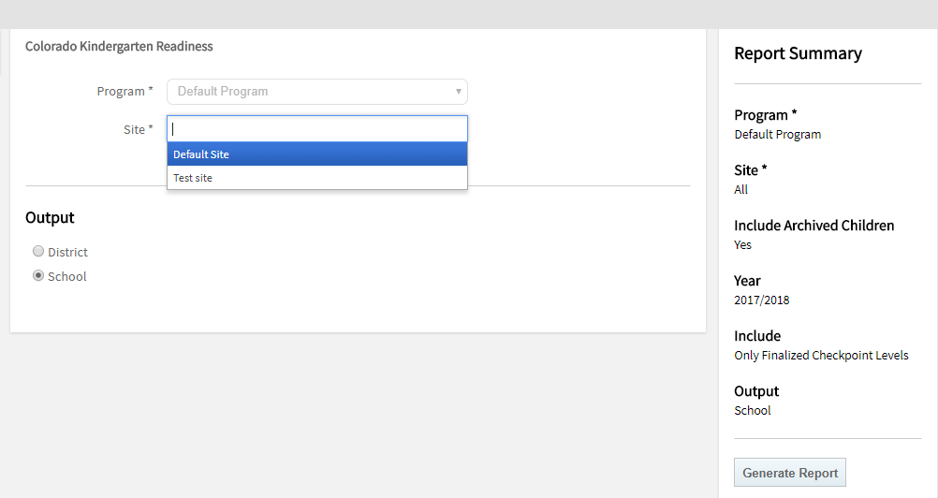
Step 2a: Obtaining the Colorado Kindergarten Readiness Report out of GOLD® (3 of 4)
Enter sites and make sure to select “School” under “Output”.
Click on “Generate”.

Slide 8
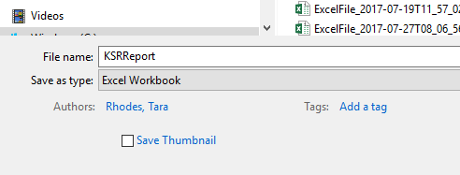
Step 2a: Obtaining the Colorado Kindergarten Readiness Report out of GOLD® (4 of 4)
Teaching Strategies will take you to the Reports Queue. Next, download the export file.
Double-click on the file to open it in Excel and make sure to save as an .xlsx extension by doing a “File – Save As”.

Slide 9
Troubleshooting Colorado Kindergarten Readiness Report
If data are not populating in the Colorado Kindergarten Readiness report, please check the following:
Have teachers finalized their data? You should see a white checkmark in a green circle on the Checkpoint by Child area if they have.
Has it been 24 hours since the data were finalized?
Were data entered in the correct checkpoint? The report only pulls from the Fall checkpoint, so make sure data are in the correct checkpoint.
Were data entered in the correct license? Sometimes it is difficult to distinguish the preschool side from the kindergarten side. The easiest way is to see if the Colorado Kindergarten Readiness report is in the Reports area. If it is, then you are logged into the Kindergarten side. (The preschool side does not have this report option.)
If none of these work, please reach out to Teaching Strategies or check the support portal:
COSupport@teachingstrategies.com; (844) 840-4653
Support Portal: https://teachingstrategies.force.com/portal/s/

Slide 10
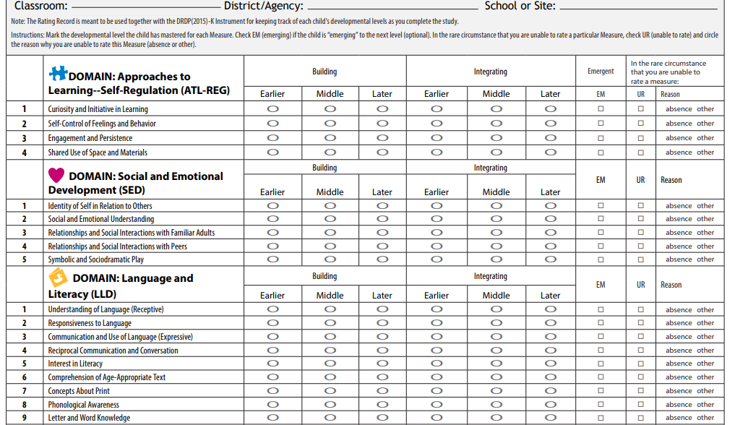
Step 2b: DRDP-K Users: Aggregating Data Manually
Steps:
1. Score each child according to the Developmental Continuum for Kindergarten.

Slide 11
Step 2b: DRDP-K Users: Aggregating Data Manually
2. Sum the number of items in each domain where the child met the “Building Later” point.
3. Divide this number by the total number of items in that domain.
Domain Name | Domain Items | Total Number of Items in Domain
Approaches to Learning- Self Regulation | ATL-REG 1 – ATL-REG 4 | 4
Social and Emotional Development | SED 1 – SED 5 | 5
Language and Literacy (Language Portion)* | LLD 1 – LLD 4 | 4
Language and Literacy (Literacy Portion)* | LLD5 – LLD 10 | 6
Cognition, Including Math and Science | COG 1 – COG 6 | 6
Physical Development | PD 1 – PD 4 | 4

Slide 12
Step 2b: DRDP-K Users: Aggregating Data Manually
4. If the child met the “Building Later” point on the progression for 70% or more of the items in the category, then the child is considered as meeting the benchmark for kindergarten entry expectations for state reporting purposes.
5. Repeat this process for each child for each domain. Then, sum the number of children that met 0 of 6 domains, 1 of 6 domains, etc.
6. Report this information in the State Board approved file layout and submit to the state via the Colorado Department of Education’s Data Pipeline during the collection window. The file layout and a template for use can be found on the website.
NOTE: Please note that demographic information, such as gender, race, ethnicity, and free- and reduced-lunch status must also be tracked for each child and matched with their category in the required state reporting format.

Slide 13
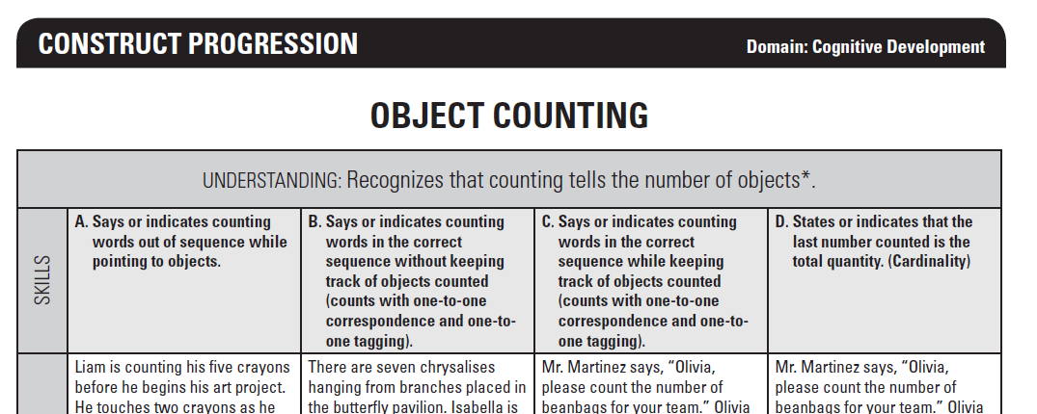
Step 2c: NC-KEA Users: Aggregating Data Manually
Steps:
1. Score each student according to the Construct Progressions.

Slide 14
Step 2c: NC-KEA Users: Aggregating Data Manually
Steps:
2. Record the student’s placement on the progression.
3. Compare the student’s placement on the progression to the benchmark for kindergarten entry expectations for state reporting purposes.
4. Convert the letters to numbers if necessary, and repeat this process for each student for each domain. Then, sum the number of students that met 0 of 6 domains, 1 of 6 domains, etc.
NOTE: Students must meet the benchmark for all items within a domain in order to be considered as meeting that domain.

Slide 15
Step 2c: NC-KEA Users: Aggregating Data Manually
CAP4K Domain | NC KEA Construct Progression | Rating for Kindergarten Entry Expectations
Physical Development | Crossing Midline | C
Physical Development | Fine Motor-Grip and Manipulation | D
Physical Development | Fine Motor-Hand Dominance | C
Social Emotional Development | Emotional Literacy | D
Language and Comprehension | Following Directions | G
Cognition | Engagement in Self-Selective Activities | C
Math | Object Counting | C
Literacy* | Book Orientation | D
Literacy* | Print Awareness | E
Literacy* | Letter Naming | H

Slide 16
Step 2c: NC-KEA Users: Aggregating Data Manually
Steps:
* Just a reminder that by HB 15-1323, assessments used for the READ Act can be used to inform the literacy domain for school readiness.
5. Report this information in the State Board approved file layout and submit to the state via the Colorado Department of Education’s Data Pipeline during the collection window. The file layout and a template for use can be found on the website.
NOTE: Please note that demographic information, such as gender, race, ethnicity, and free- and reduced-lunch status must also be tracked for each student and matched with their category in the required state reporting format.

Slide 17
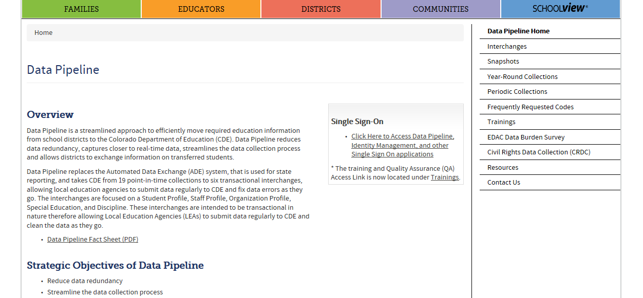
Step 3: Uploading into Data Pipeline (1 of 6)
Navigate to Data Pipeline.
Click on the link under “Single Sign-On”, then choose Data Pipeline, and then log in.
Once logged in, please select “File Upload” along the left-hand side. Then select “Data File Upload”.
If you need help logging in, please contact your local access manager (LAM).

Slide 18
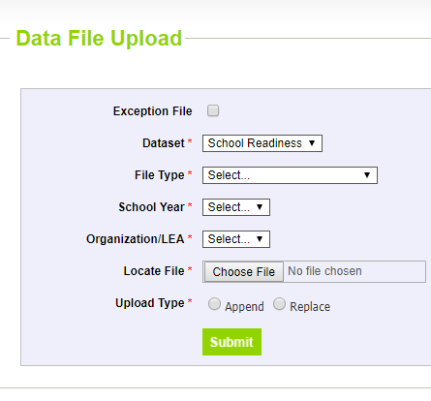
Step 3: Uploading into Data Pipeline (2 of 6)
The following screen should appear after selecting “Data File Upload”.
Fill in the drop-down menus and then hit “Submit”. For this collection, please select “School Readiness” for Dataset.

Slide 19
Step 3: Uploading into Data Pipeline (3 of 6)
You will know that your file was “successfully submitted” to Pipeline when you see the following message:
However, this does not mean that you are error-free. This just means that Data Pipeline has accepted your file.

Slide 20
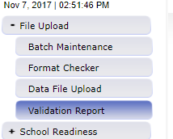
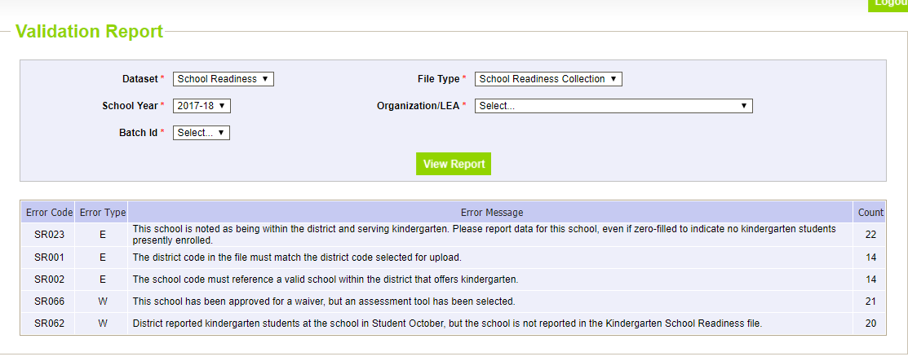
Step 3: Uploading into Data Pipeline (4 of 6)
To check for errors, please go to either Batch Maintenance or Validation Report.
I am showing the
Validation Report option below:

Slide 21
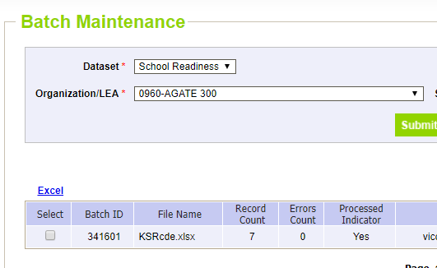
Step 3: Uploading into Data Pipeline (5 of 6)
If you have errors, please work to clean them up.
Once you are error-free, your validation report will show the following:
Once you are error-free, your batch maintenance will show the following:

Slide 22
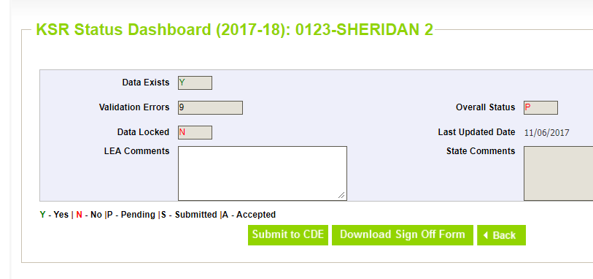
Step 3: Uploading into Data Pipeline (6 of 6)
Once you are error-free, please don’t forget to:
Officially submit to CDE
Send in your sign-off form

Slide 23
Thank you!
Please reach out to Tara Rhodes, P-3 Data Analyst and Kindergarten School Readiness Collection Lead, if you have any questions or concerns.
Phone: 303.866.6243
Email: Rhodes_t@cde.state.co.us

