Slide 1
School Readiness Update
May 20, 2020
Megan Prior Rogers
Tara Rhodes

Slide 2
Overview
The Colorado State Board of Education voted to change the data reporting for the Kindergarten School Readiness (KSR) data collection on March 11, 2020.
The Board chose to add named domains to the collection:
Social-emotional development
Physical and motor development
Language
Cognition
Literacy
Mathematics
CDE gained approval to implement this change in Fall 2021-2022.

Slide 3
Results of the State Board Decision
What Will Remain Consistent:
Teacher involvement
Data available to districts
Timelines
What Will Change:
Submission for Data Pipeline
Reporting of Statewide Results
The intention is to have a better understanding across the state of school readiness to inform policy decisions.
Notes:
-Our intention is to work with vendors to accommodate this change. We’ve had initial conversations so far.

Slide 4
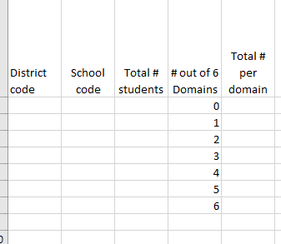
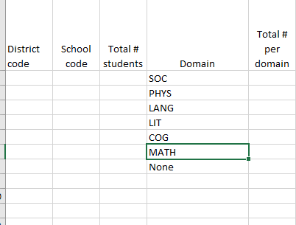
Technical Implications
Through the 2020-2021 school year, the file layout asks for the number of domains in which a student has met the kindergarten school readiness benchmark.
In 2021-2022, it is anticipated that this will change to the name of the domain. One option is shown below.
2020-2021 layout
2021-2022 layout
Notes:
-Key:
Social-Emotional: SOC
Physical and Motor Development: PHYS
Language Comprehension: LANG
Cognition: COG
Literacy: LIT
Mathematics: MATH

Slide 5
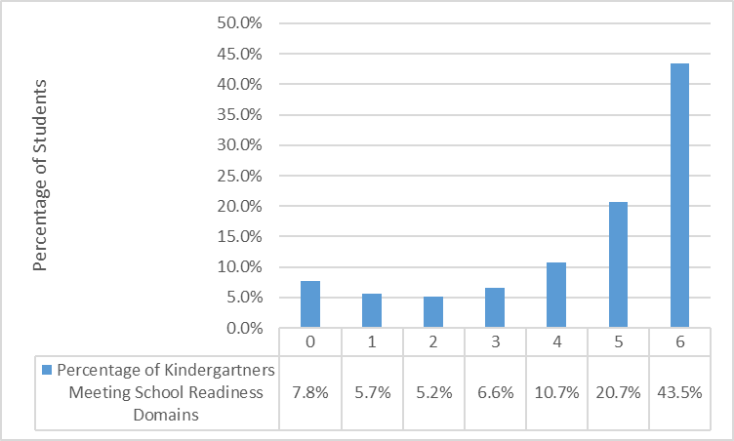
Report Implications (Current View)
*Pulled from 2020 CAP4K Report.

Slide 6
Report Implications (2021-2022)
*Graph is representative of fictitious data in the 2022 CAP4K Report.

Slide 7
Questions? Contact Information: Megan Prior Rogers, rogers_m@cde.state.co.us Tara Rhodes, Rhodes_t@cde.state.co.us

