Slide 1
School Counselor Corps Grant
Webinar #1
Needs Assessment
October 2, 2024

Slide 2
Before We Begin
This training will be recorded.
Closed-captioning: click the Live Transcript option on your bottom Zoom toolbar, under more.
Slides and recording will be posted to the Grant Training website.

Slide 3
Housekeeping
Sign in for record of attendance.
Change your name in Zoom to include your name and school/organization.
Keep video on throughout the webinar.
Use the raise hand function or chat to engage.

Slide 4
Today’s Objectives
By the end of this session, grantees should:
Increase confidence in completing questions 7, 8, and 9 on the Development Year Report.
Increase understanding in the development and distribution of the SCCG Needs Assessment.
Increase confidence in completing questions 10 and 11 on the Development Year Report.

Slide 5
Welcome and Check-In
Are you pro-pumpkin spice flavoring?

Slide 6
Share one “ah-ha” moment from the
in-person training.

Slide 7
Where We Left Off...
Intentional Data Review
SCHOOL COUNSELING PROGRAM
STUDENT ACHIEVEMENT
ATTENDANCE
BEHAVIOR

Slide 8
Development Year Report:
Intentional Data Review Questions
Questions 7, 8, and 9 on the Development Year Report:
Outline your district and/or school intentional data review process.
Outline your district and/or school intentional data review findings.
What are the two determined areas of data focus based on the intentional data review (check all that apply)?
Achievement
Attendance
Behavior

Slide 9
Development Year Report:
Intentional Data Review Process Look-Fors
Question 7: Outline your district and/or school intentional data review process.
In one to two paragraphs summarize your team’s process of the intentional data review.
What data sources did you look at?
Who was involved in the process?
Did any data stand out to your team throughout the process?

Slide 10
Development Year Report:
Intentional Data Review Finding Look-Fors
Question 8: Outline your district and/or school intentional data review findings.
In one to two paragraphs summarize the intentional data review findings.
Responses should illustrate what your team learned from the data review and how your team selected two focus areas.
What data stood out?
Were there gaps in data results?
Was data missing?

Slide 11
Development Year Report:
Intentional Data Review Exemplar I, Part I
Aurora Hills Middle School
"For the intentional data review, we utilized the data from Infinite Campus, iReady, PBIS Rewards, and Tableau to examine achievement, attendance, and behavior data. We had to work with an administrator to pull the iReady reports and decided that this information was not as relevant for counselors to utilize. For achievement, we looked at both the “F Report” in Infinite Campus to see how many students had an F in at least one core class during quarters 1, 2, and 3, and we looked at iReady test scores to see trends and student progress in Math and English learning. It was decided that the iReady reports were not as relevant as the grades report, so we focused on that. The F Report we pulled showed that ____ % of our students had failed at least one core class (Science, Social Studies, Math, English) in at least one quarter (Quarters 1-3). We decided to only look at the report from Quarters 2 and 3 next and found __% of students had failed at least one core class in at least one of those quarters...”

Slide 12
Development Year Report:
Intentional Data Review Exemplar I, Part II
Aurora Hills Middle School
“...For the attendance data we looked at the trends in Tableau through Infinite Campus. We noticed that many of our students are above the federally recommended attendance rate of 90%. We also noticed that __% of our students fell into the moderately chronic absent range meaning their attendance rates fell between 80-89.9% and __% of our students were severely chronically absent meaning their attendance rates falls below 80%.
For our behavior data, we looked at PBIS Rewards, which is the system our school uses for referrals. The referrals are broken into two categories: Major and Minor. Of our referrals, __% were major referrals, and __% were Minor Referrals. Looking at this data, we noticed that the largest portion of the major referrals were for _________. The data did not present clear themes as to when these incidents are happening, as the referrals were mainly put in during a teacher’s planning time or after school."

Slide 13
Development Year Report:
Focus Area Look-Fors
Question 9: What are the two determined areas of focus based on the intentional data review (check all that apply)?
Achievement
Attendance
Behavior
Choose the two areas based on the data reviewed and identified needs.
What do you need to know more about?
What areas can you create SMART goals around?
Can your school counseling program impact the focus areas?

Slide 14
Intentional Data Review Check-In

Slide 15
School Counseling System
SCCG technical assistance, webinars, trainings, and funding will support the school counseling system goals.
Individual site SMART goals will focus on student outcomes.

Slide 16
Questions on Intentional Data Review

Slide 17
Dig Deeper with a Needs Assessment
After student needs are determined through the Intentional Data Review and school data analysis
gain understanding through the needs assessment.
Open the ASCA National Model (4th ed.) to pages 37-38.
Gather background and additional information for context.
Determine contributing factors and targeted interventions.
Provide input from students, staff, and stakeholders.
Share perspectives and subjective experiences.
Assist in developing goals and interventions that directly respond to the identified needs.
(ASCA, 2019, pp. 37-38, 42)

Slide 18
SCCG Needs Assessment
For the SCCG, you will need to complete and report on one needs assessment per funded site.
Gather supplemental data for 2 focus areas (academic, attendance, behavior).
A minimum of 3 questions should be asked per identified focus area.
A minimum of 2 stakeholder groups should be asked questions.
Think sustainability:
SCCG School Counselors know how to create and administer a yearly needs assessment
Will all of the data collected be used?
Equity and resources.

Slide 19
Common Questions
“If we are funded for multiple sites, can I do multiple needs assessments?”
Yes, you may need different needs assessments depending on intentional data findings and chosen focus area
Keep in mind workload and alignment- can you develop an assessment with your team?
“Do I need to align my area of focus to my original application?”
No, needs and priorities may have changed since the intentional data review. You can choose to go in a different direction if needed.
“How many questions do I have to include in the needs assessment?”
A minimum of 12 questions should be asked (3 questions per selected focus area, 2 stakeholder groups)
Grantees can choose to ask more questions if needed
“Can I use questions from other school or district surveys and questionnaires?”
Yes, if your district completes surveys that have applicable questions to your focus areas, please align work as much as possible.
Notes:
Brooke

Slide 20
Before You Begin
Review and ensure that all student data collections follow
federal, state, and local policies.
Examples:
Family Educational Rights Privacy Act (FERPA)
Student Data Transparency and Security Act
Protection of Pupil Rights Amendment (PPRA)
Visit CDE’s 2024 Data Privacy and Security page to learn more.

Slide 21
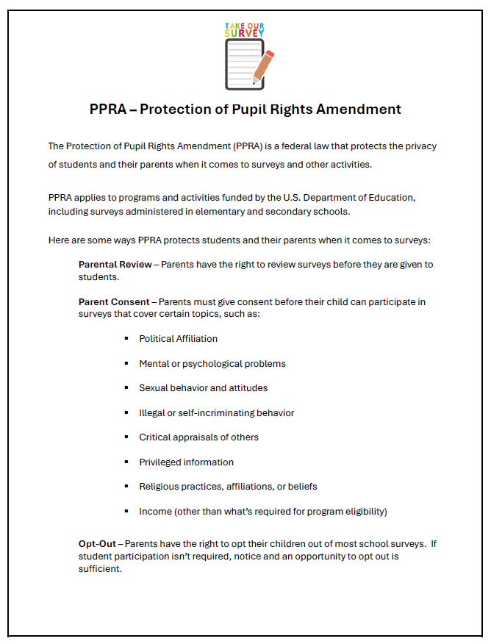
Data Privacy and Security
Melissa Peterson
Access the handout under the Webinar #1 materials.
Data Privacy Manager peterson_m@cde.state.co.us

Slide 22
Needs Assessment Process I
Focus Area:
Attendance
Stakeholder 1
Stakeholder 2
Teacher
Student
EXAMPLE QUESTIONS
EXAMPLE QUESTIONS
What do you do when a student misses class?
What is the makeup work policy for a student that misses class?
What time of day is your class?
What are the top three reasons you miss school?
What do you enjoy about school?
What happens when you miss school?

Slide 23
Needs Assessment Process II
Focus Area:
Behavior
Stakeholder 1
Stakeholder 2
Teacher
Student
EXAMPLE QUESTIONS
EXAMPLE QUESTIONS
What behaviors most often disrupt student learning?
What interventions have you implemented when a student is disruptive?
What supports do you need to improve student behavior?
How does your school teach you about resolving conflict?
What happens when you get in trouble at school?
What helps you calm down when you get upset or angry?

Slide 24
Needs Assessment Steps
Who?
Participants, data sharing, and consent.
What?
Types of data and design.
QUESTIONS AND DATA
TIMELINE
STAKEHOLDERS
METHOD
When?
Confirm dates for process, collection, interpretation, and sharing results.
How?
Delivery, format, storage.

Slide 25
Create a Timeline
TIMELINE
When will your team...
Discuss dates to notify stakeholders and gain feedback?
Create questions? Review final assessment?
Confirm federal, state, and local policies are followed?
Inform the community and stakeholders and gain consent to distribute.
Distribute surveys, interviews, questionnaires, etc.?
How long will needs assessment occur?
Review and interpret results?
Action plan based on results?
Share results with stakeholders and the community?
Revisit data?

Slide 26
2. Consider Stakeholders
STAKEHOLDERS
What are federal, state, and local policies related to questions and data collection?
Do you need consent to ask questions?
Engage stakeholders for support, feedback, and permission.
Administrators, school district leadership, school counselors, teachers, families, etc.
Who are the participants?
Students
Staff
Families
Community
How are you sharing information with stakeholders?
How will you ensure all stakeholders are involved?
Languages
Access

Slide 27
3. Needs Assessment Distribution
METHOD
What method(s) are you using to collect needs assessments?
Conversations, interviews, climate surveys, opinion surveys, questionnaires, focus groups, etc.
What format are you using to collect data?
Electronic, paper, spoken, etc.
Where and how will you distribute questions?
In classrooms, individual interviews, staff meetings, emails, etc.
How will data be stored and who has access?

Slide 28
Needs Assessment Questions
QUESTIONS AND DATA
Types of data needed?
Qualitative and quantitative
Design and develop questions:
What do you already know?
What do you need to know?
What is the goal of your question?
Can you use the results to inform programming?
What will follow up be?
How does each question align to the grant goals?
What languages should the questions be asked in?
Are questions developmentally appropriate?
Who can provide feedback on questions?
Do you need consent to ask the questions?

Slide 29
Resources
QUESTIONS AND DATA
Attendance Works Self- Assessments
CDE’s Comprehensive Needs Assessment Website
CDE’s Positive Behavior Interventions and Supports (PBIS) Resource Website
Healthy Kids Colorado Survey
Teaching and Learning Conditions Colorado
Interest inventories, district-wide surveys and questionnaires.

Slide 30
Final Considerations
Needs assessments must follow federal, state, and local policies.
The grantee LEP is responsible for any survey put out to stakeholders.
Review all questions that will be administered.
Share and review the SCCG guidelines in this presentation with any supervisors or consultants.
Ensure the needs assessment work is relevant to the grant.

Slide 31
Experiences From the Field
Aurora Hills
Middle School
Southwest Open
Charter School
Aurora Public Schools
Montezuma- Cortez RE-1
Gabrielle Tonk
Counseling Services Coordinator
Casey Simpson
Executive Director
Danielle Clifton
School Counselor
Kelly Batt
School Counselor

Slide 32
Development Year Report:
Needs Assessment Look-Fors Part I
Questions 10. Outline your district and/or school needs assessment(s) process.
In one to two paragraphs summarize:
What was your process in creating and collecting the data?
Did you have to obtain consent to administer or ask specific questions?
How was the assessment created?
How did you identify questions?
What questions were included?
How was the assessment distributed?
How did you notify stakeholders?
What stakeholders completed the assessment?
Why were those stakeholders chosen?
Who was involved in the process?

Slide 33
Development Year Report:
Needs Assessment Look-Fors Part II
Questions 10. Outline your district and/or school needs assessment(s) and findings
In one to two paragraphs summarize:
Responses should illustrate what your team learned from the needs assessment.
What were overall themes, patterns, trends?
Were there gaps in data results?
Was data missing?

Slide 34
Development Year Report:
Needs Assessment Exemplar I
Aurora Hills Middle School:
“For the Achievement needs assessment, we utilized a survey already in place by our district for ICAP called the “Game Plan Survey,” which is done at the beginning of the year and for the Attendance needs assessment, we created a short Google form survey for students to fill out; this was completed in April 2024. Both were done in classes with the help of a teacher as part of a lesson (Game Plan Survey) or a “Do Now” (attendance needs assessment). After doing a bulk classroom session to complete these surveys, we returned to get as many students as possible to complete the surveys individually.
Achievement Findings: For each question, the top three answers are provided
Question 1: This school year, my goal is to improve my ______(select all that apply) Grades (__%) Work Habits (__%) Study Skills (__%)
Question 2: What are the tools you will use to meet your goal? Ask A Teacher For Help (__%) Attend Class (__%) Participate in Class (__%)
Question 3: I need help in the following areas: Improving Study Skills (__%) Passing My Grade (__%) Feeling less stressed when I take a test (__%)
Attendance Findings: For each question, the top three answers are provided (if applicable)
Question 1: What are issues/reasons that impact your attendance? Select all that apply I have no issues that impact me coming to school (__%) I don’t want to come to school (__%) Transportation Issues (__%)
Question 2: I understand that MY attendance at school is important: Yes (__%) No (__%)
Question 3: My attendance at school is important to my family Yes (__%) No (__)."
Overall data findings were also shared.

Slide 35
Development Year Report:
Needs Assessment Exemplar II
Chinook Trail Middle School
"We initiated a comprehensive needs assessment comprising 20 questions, which we administered to our entire student body. Recognizing the importance of transparency and collaboration, we provided families with the questions in advance, fostering open communication and partnership in addressing student needs. The assessment covered various aspects of student life, including home routines, social-emotional interactions within the school community, academic support, and future aspirations. Each question was assigned points, reflecting the significance of different areas in enhancing student well-being. Lower scores indicated areas where specific students required targeted support. Through this process, we gained valuable insights into our students' career aspirations, academic challenges, and personal/social needs. Building upon this foundation, we are committed to implementing strategies such as peer mediation, restorative justice practices, and community circles to foster positive relationships and address conflicts constructively. Furthermore, we recognize the significance of addressing issues such as tardiness, which can impact both academic performance and social dynamics within the school environment. By incorporating peer mediation and restorative justice approaches, we aim to cultivate a culture of accountability and mutual respect among students, staff, and the broader community. In alignment with our commitment to student success, we are dedicated to utilizing the findings from the needs assessment to tailor our support services effectively. By collaborating with families, implementing restorative practices, and fostering a supportive community environment, we strive to empower our students to thrive academically, socially, and personally.”
Overall data findings were also shared.

Slide 36
Breakout Rooms
Introduce yourself with your name, school, and region.
Discuss:
What are student needs you need to learn more about.
Who do you need to gather information from?
Brainstorm 2-3 questions to ask.

Slide 37
Questions on Needs Assessment

Slide 38
Mark Your Calendars!
Webinars:
Webinar #2: November 6, 2024- register via Zoom
Regional Trainings:
Register for the regional training in your region.
October 15, 2024: Durango, CO
October 30, 2024: Glenwood Springs, CO
November 13, 2024: Lamar, CO
December 11, 2024: Greeley, CO
January 14, 2025: Denver, CO
February 4, 2025: Colorado Springs, CO
An individual registration email will be sent from Sched.
Virtual Professional Development with Hatching Results, Inc.
Webinar #3: Identifying Gaps in Data on February 11, 2025- register via Zoom

Slide 39
Next Steps
Sign in for record of attendance.
A certificate of attendance will be sent to email on form.
Complete Zoom survey questions.
Complete the intentional data review.
Begin planning and delivering the SCCG needs assessment.

Slide 40
Contact Us
If questions come up, please reach out.
SCCG Program
Jennicca Mabe​
Mabe_j@cde.state.co.us ​
303-923-0974​
Brooke Morgan​
Morgan_b@cde.state.co.us​
303-923-0966​
CDE Grants Fiscal
Gloria Kochan
kochan_g@cde.state.co.us
720.916.6488

Slide 41
References
American School Counselor Association. (2019a). The ASCA national model: A framework for school counseling programs (4th Edition).
Alexandria, VA: Author.
American School Counselor Association. (2019b). The ASCA national model implementation guide (2nd edition) [eBook edition]. Alexandria,
VA: Author.
Attendance Works. (2018). Resources: self-assessments. https://www.attendanceworks.org/resources/self-assessment/
Colorado Department of Education. (2024, March 15). Data Privacy and Security. https://www.cde.state.co.us/dataprivacyandsecurity
Colorado Department of Education. (2024, March 27). Consolidated application: Comprehensive needs assessments.
https://www.cde.state.co.us/fedprograms/consapp/na
Colorado Department of Education. (2024, May 22). Positive Behavioral Interventions and Supports: Resources.
https://www.cde.state.co.us/mtss/pbistoolsresources
Colorado Department of Education. (2024). Teaching and Learning Conditions Colorado. https://www.cde.state.co.us/site/tlccsurvey/
Colorado Department of Public and Health Environment. (2024). Healthy Kids Colorado survey information. https://cdphe.colorado.gov/hkcs

Slide 42
Thank you!
Please reach out with questions.

