Slide 1
Value of Pathways Teams
SCCGP Training
October 18, 2017

Slide 2
Agenda
THEME:
How can I help students build meaningful pathways through high school and into the world beyond?
GUIDING QUESTIONS FOR OUR DISCUSSION:
What are PATHWAYS?
Where can we learn more?
Who is on our TEAM?
Let’s have Meaningful Career Conversations

Slide 3
A little Context
Notes:
Popcorn out definition of PATHWAYS

Slide 4
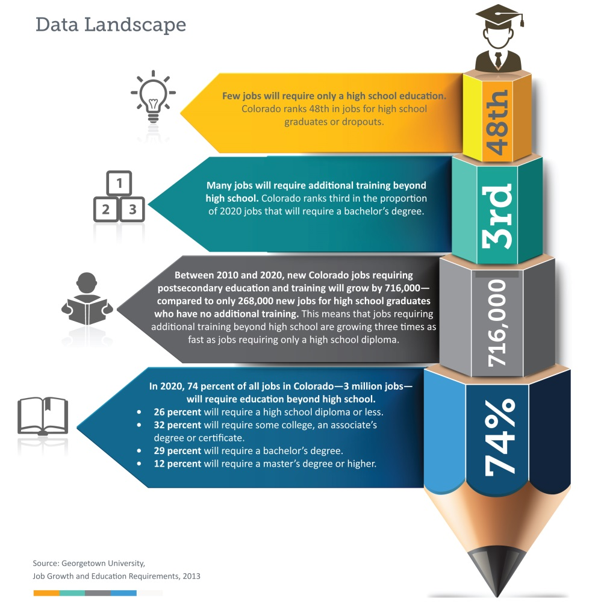
It’s an Economic Story

Slide 5




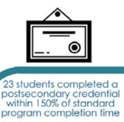
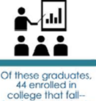




Colorado’s Talent
18 graduates
employed within one year
9th grader
HS Graduate
18
College
Yr 2
100
77
44
35
23
Notes:
How can we fill gaps
Help students get/stay engaged and find the right pathway?

Slide 6
What are PATHWAYS?
Notes:
Popcorn out definition of PATHWAYS

Slide 7


Pathways
CAREERS
Notes:
We are all CAREER BOUND
But what does it mean to be READY
And How do we get there?

Slide 8
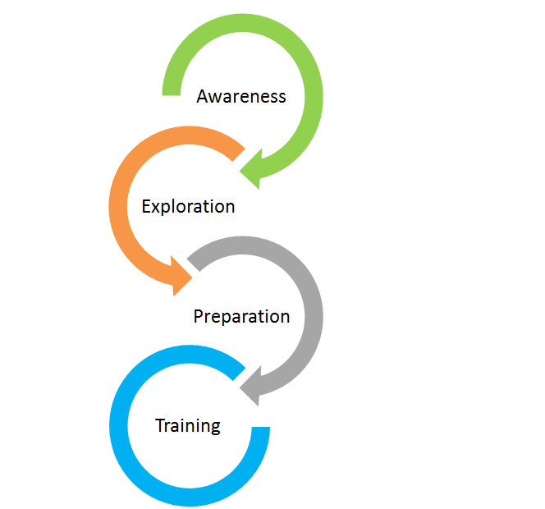
Preparing Students for Meaningful Careers
Help students articulate their interests and skills
Gain awareness of the needs of the labor market and understand how their interests intersect with those needs
Gain broad exposure to careers
Earn stackable industry recognized credentials
Connect with opportunities to enhance skills and apply what he or she is learning
Notes:
Different types of preparation go into ensuring students are ready for life after high school. The state’s work-based learning framework emphasizes activities related to awareness about one’s self, broad exposure and exploration of the labor market and the plethora of career opportunities to expand student’s imagination about what is possible, preparation that allows students to develop and enhance employable skills and demonstrate career readiness.

Slide 9
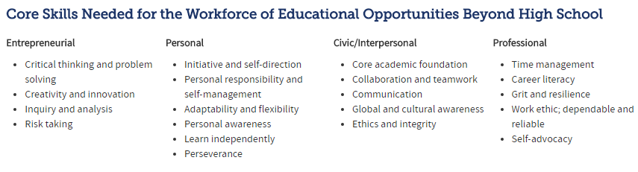
What does it mean to be career ready?
PWR Description
"Colorado high school graduates demonstrate the knowledge and skills (competencies) needed to succeed in postsecondary settings and to advance in career pathways as lifelong learners and contributing citizens."
Source: Adopted by the Colorado State Board of Education and Colorado Commission on Higher Education (Winter 2016).
Notes:
In Colorado, the state school board has adopted the term postsecondary and workforce readiness to describe the skills students need to succeed after high school. These skills should help students succeed in whatever next step they choose be it career, college or even the military. Because Colorado is local control, individual school districts determine what it means to graduate ready and incorporate graduation requirements from a menu of options intended to demonstrate student readiness for next steps.
What does PWR look like for your students? Was this determined in conversation with students, parents, businesses, colleges the community?

Slide 10
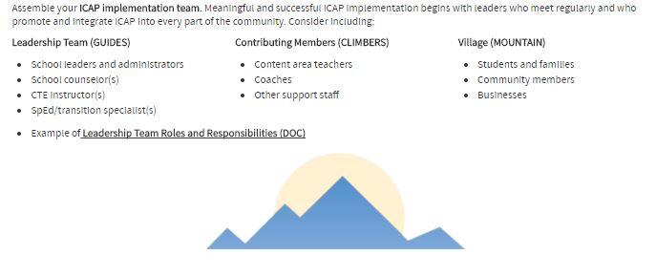
Who’s on my TEAM?
Meaningful and successful PLANNING and IMPLEMENTATION begins with leaders who meet regularly and who promote an integrate strategic ideas into every part of the community. Consider including:
Notes:
Assemble your ICAP IMPLEMENTATION TEAM
Meaningful and successful PLANNING and IMPLEMENTATION begins with leaders who meet regularly and who promote an integrate strategic ideas into every part part of the community.
Consider inlcuding:

Slide 11
Where can we learn more?

Slide 12



Leveraging Career Pathway Tools for Meaningful Career Support
Renise Walker, Colorado Workforce Development Council
October 18, 2017
Notes:
Handouts needed:
-Meaningful career conversations 1 pgr.

Slide 13
Discussion
At your table, discuss the following:
How do you currently equip students for future careers? On a scale of 1-5, how effective are your current career preparation efforts? (1-completely ineffective, 5-national model for success)
If you could change one thing about your approach, what would it be?
Which community partners does your school/district engage in the conversation about career readiness? What role do the businesses in your community play in helping to prepare students for the workforce?
·
Notes:
Importance of intersections with in-demand careers and student interests and aptitutes

Slide 14
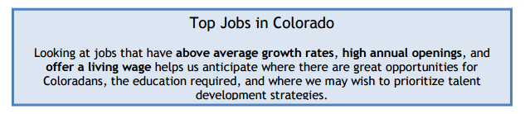
Colorado Career Pathways Legislation
HB15-1274
Creation of Career Pathways for Students
for Critical Occupations in Growing Industries.
Notes:
Melissa
Career Pathways Framework:
Building Industry-Driven Career Pathways Systems in Colorado Industry-driven Career Pathways ensure that education, training, and workforce systems stay deeply attuned and responsible to the needs of labor, preparing students and workers with the skills and credentials needed for careers.
HB15-1274 concerning the creation of Career Pathways for students for critical occupations in growing industries.
Top jobs, in the Talent Pipeline Report, are defined as having above average growth rates, high annual openings, and offer a living wage.

Slide 15
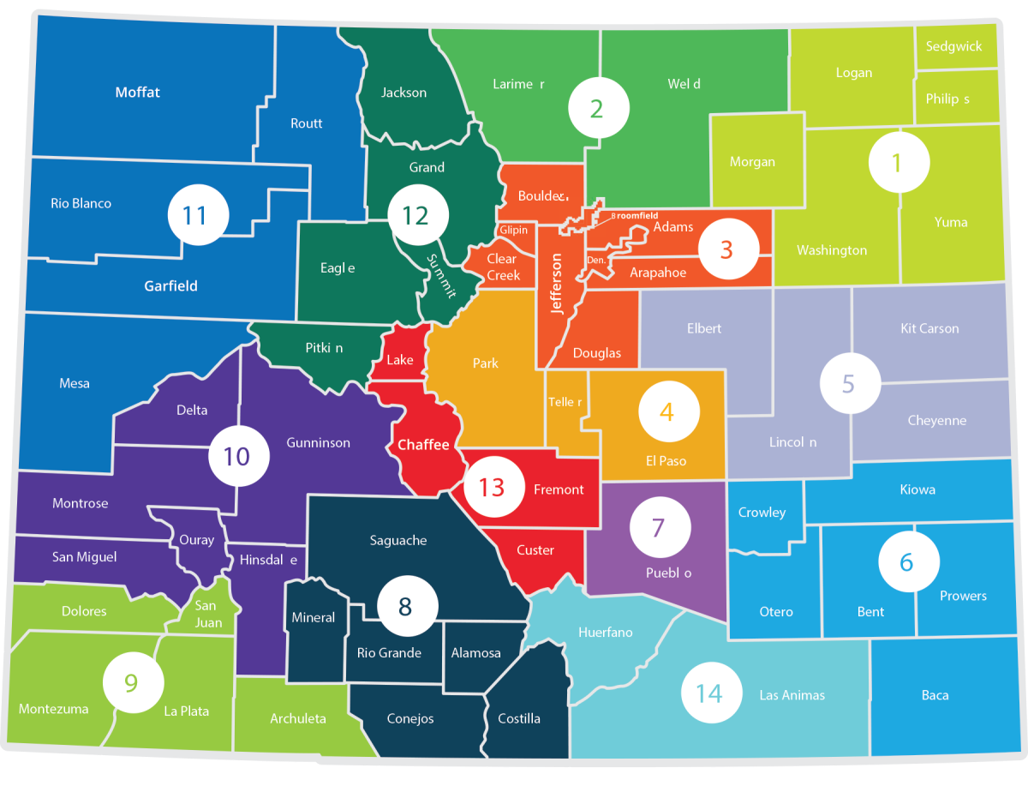

Labor Market Information

Slide 16


Labor Market Information

Slide 17
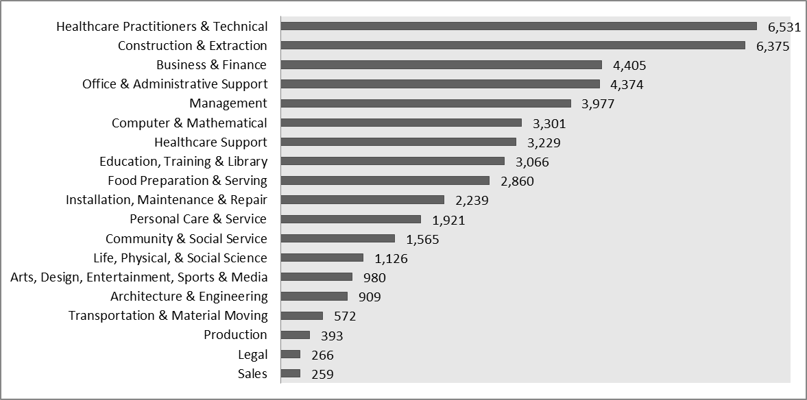
Annual Openings by Occupational Cluster

Slide 18
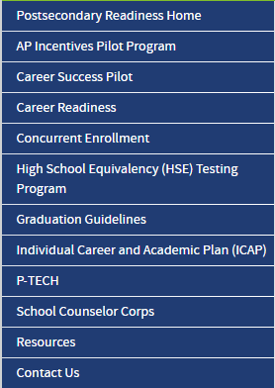


Statewide Initiatives
Notes:
Colorado has been working to increase postsecondary and workforce readiness of students for years. The state has strong foundations in this area through CTE and has begun expanding resources and investments in newer initiatives like the meaningful career conversations tool, career pathways tools and the statewide work-based learning framework that is currently under development and includes a range of work-based learning activities including: job shadows, career fairs to internships and apprenticeships.

Slide 19
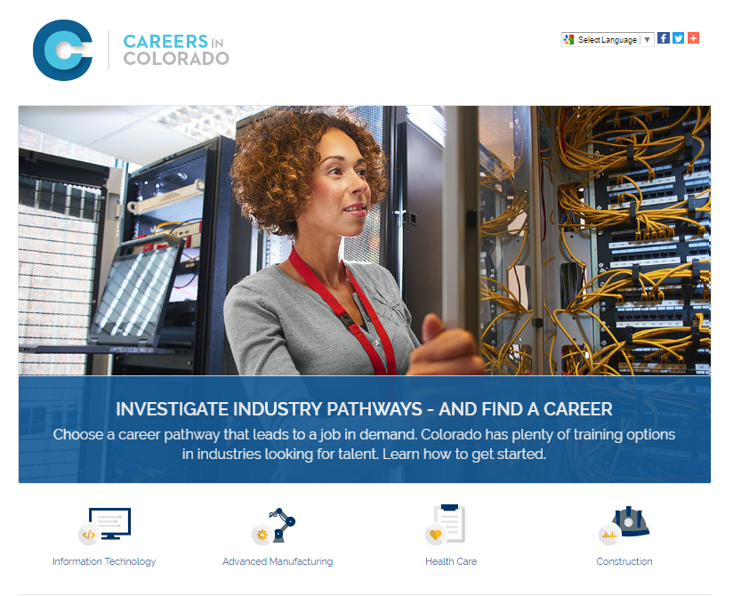
Careers in Colorado
Building the Careers in Colorado website is a collaborative effort between CWDC, CCCS, CDHE to provide a free online resource career pathways in Colorado critical occupations.

Slide 20
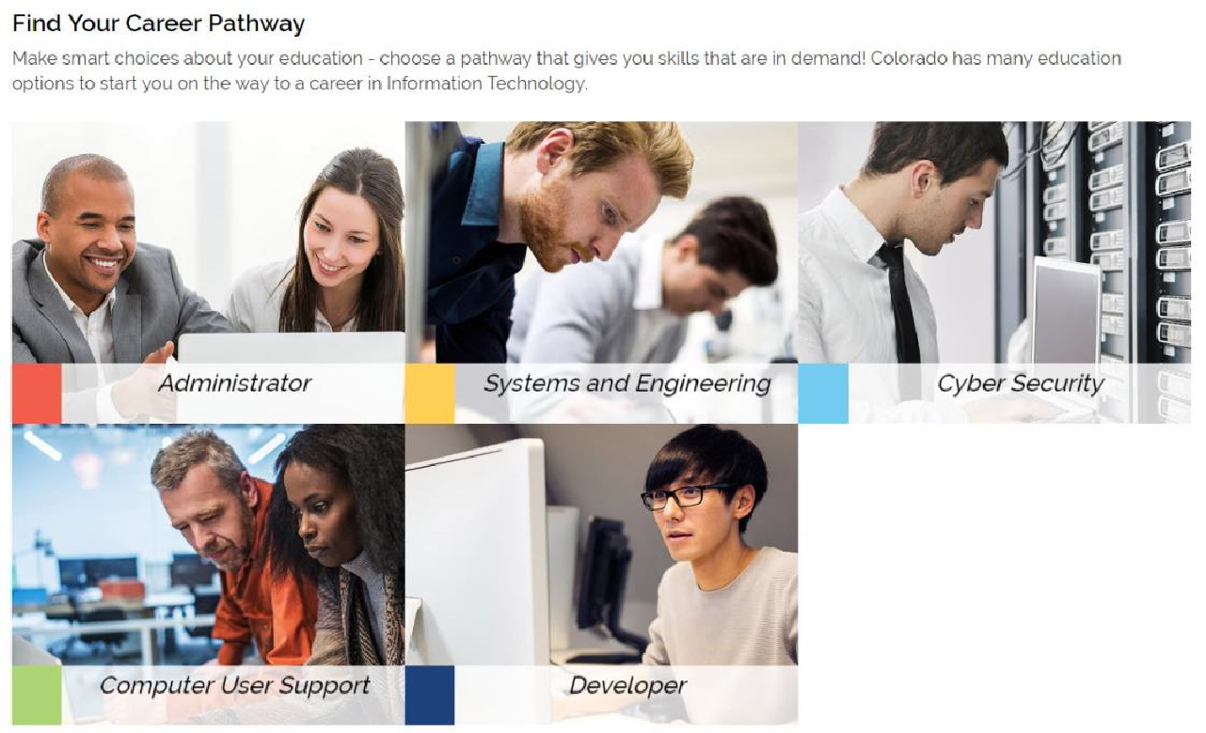
Information Technology Career Pathways
The new, interactive, regional career pathways module for the Information Technology industry is now available.
Notes:
The new, interactive, regional career pathways module for the Information Technology industry is now available. It can be reached through CollegeInColorado.org from the Explore Careers section and from two new portfolio activities (Explore Industries and Explore Pathways), as well as via CareersinColorado.org.
The career pathways module will allow students to gain an overview of career opportunities in the Information Technology industry -- and will allow them to drill down and “walk along” career pathways exploring the careers and the related knowledge, skills, abilities requirements, and educational opportunities to move forward along the career pathways. Highly interactive, the module includes a gap analysis for the knowledge, skill, and abilities requirements for a career of interest and comprehensive take-away information reports.
End users are given the opportunity to explore the five different career pathways within the Information Technology industry. Each pathway will provide the end user with in-depth information about the careers within that pathway and how they form a career sequence, the related, regional educational opportunities, and links to supporting resources.

Slide 21
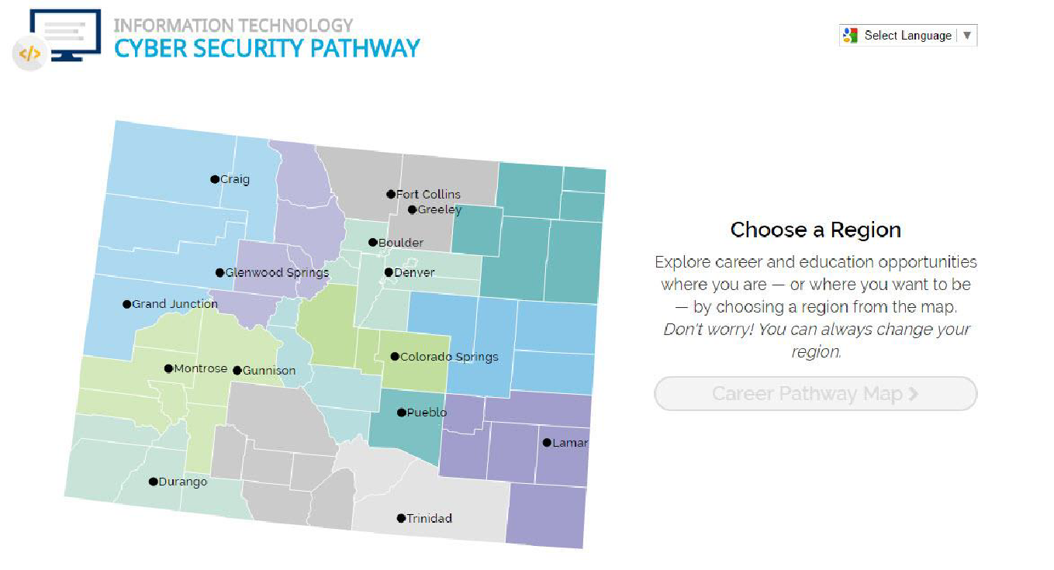
Choose a Region for localized career and educational opportunities
After choosing a region, users can a diagram of the career pathway and can choose to explore from the beginning or starting with a career of interest.
Notes:
Upon clicking to further explore the pathways, end users are presented with a map from which they can choose a region. By doing so, the user is presented with labor market information and educational opportunities relevant to their location. After choosing a region, users can review a diagram of the career pathway and can choose to explore from the beginning or starting with a career of interest.

Slide 22
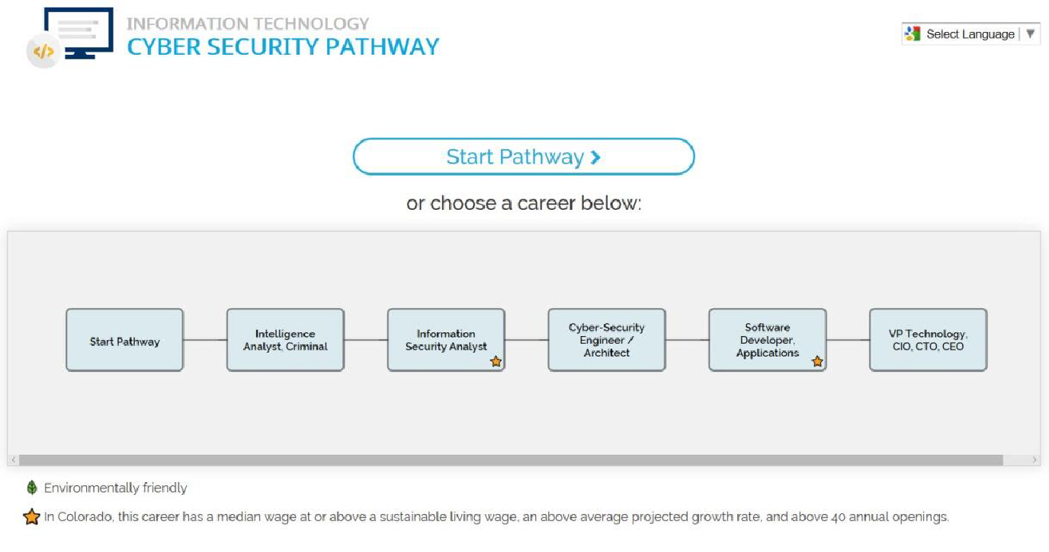
End users can explore from the beginning of the pathway or jump into a career of interest

Slide 23
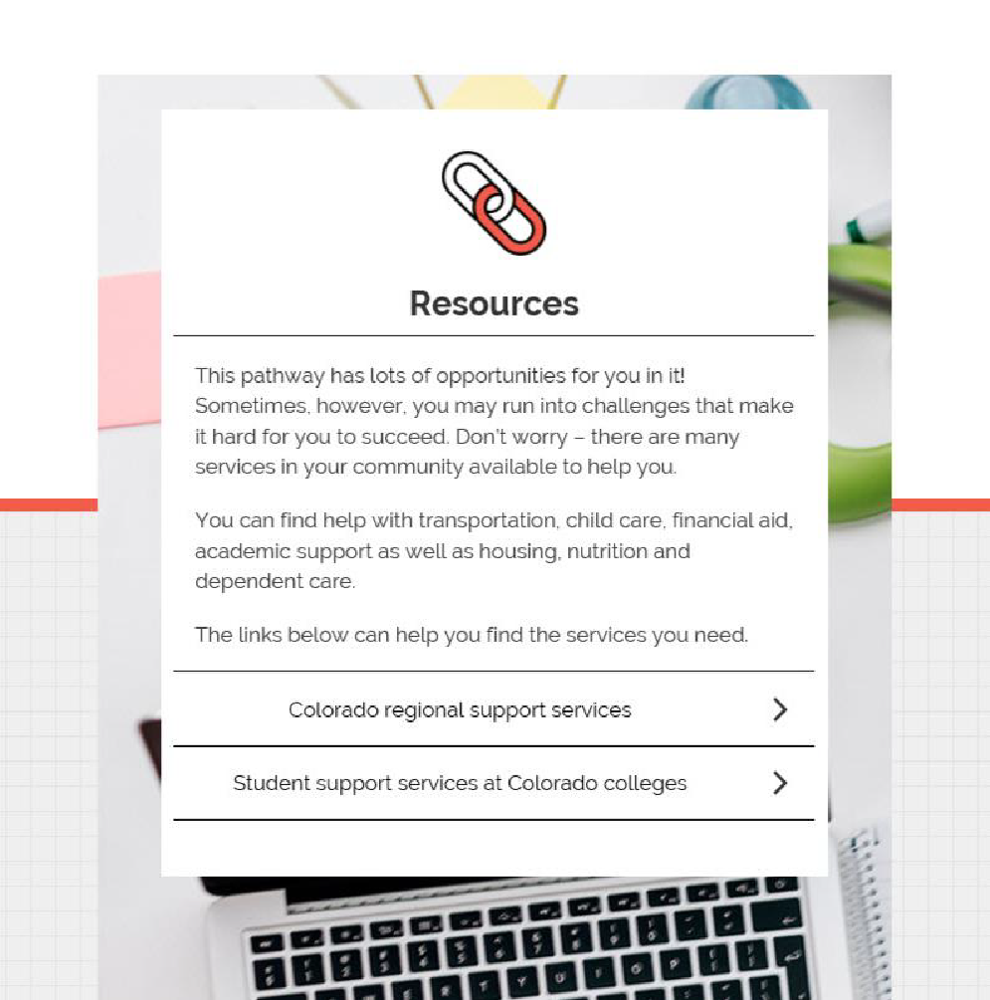
Links to local community resources
Notes:
Following this, end users can also see and access local community resources such as childcare, housing and mental health support, to name just a few.

Slide 24
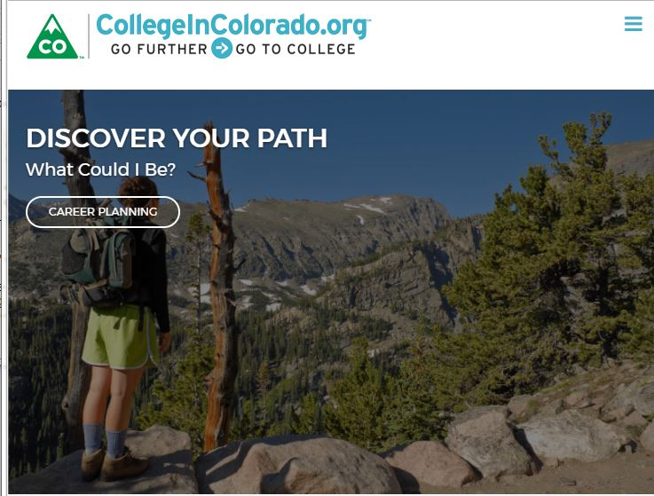

Slide 25
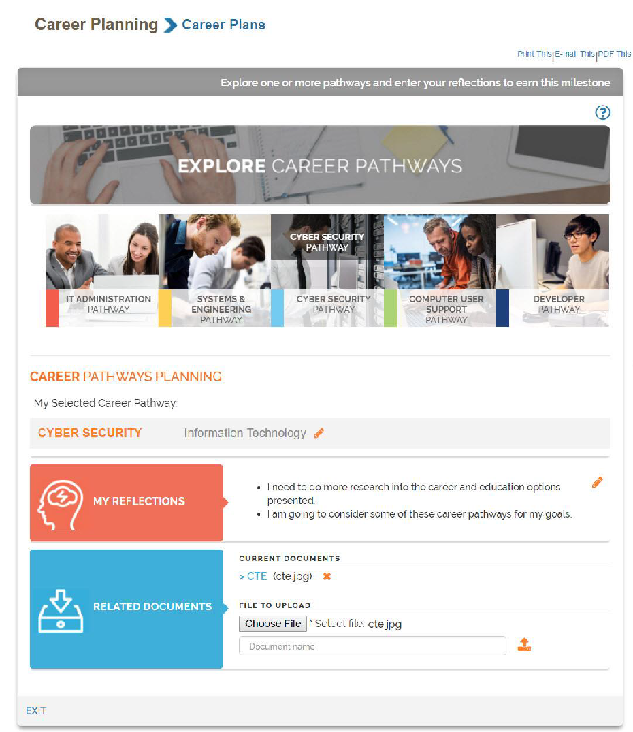
Explore Pathways Activity with student responses
Notes:
The completion of the activity can be tracked through the ICAP Tracking Report (if the activity is included in an ICAP) or through the Milestone Tracking Report.

Slide 26
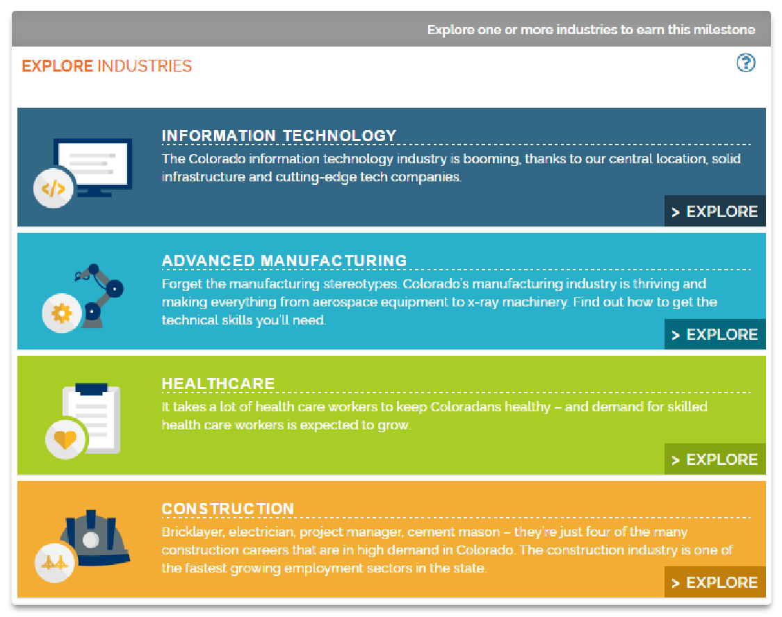
Explore Industries ICAP activity
Notes:
The new Explore Industries activity provides access – either directly from the student’s portfolio or through an ICAP -- to new industry overview web pages that have been created to develop student awareness of Colorado industries with bright future employment opportunities. The completion of the exploration can be tracked through the ICAP Tracking Report or Milestone Tracking Report.

Slide 27
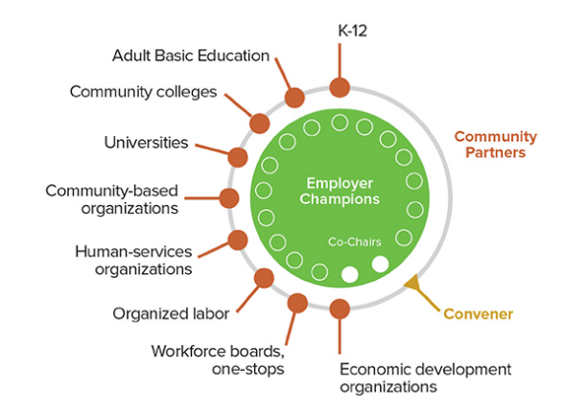
Industry Engagement

Slide 28
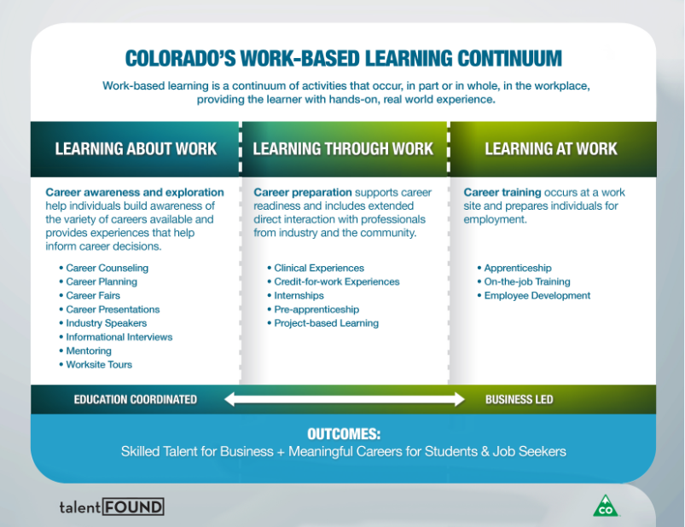

Slide 29
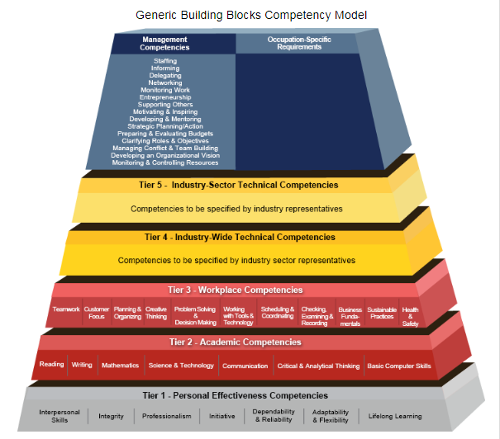


Competency Model Clearinghouse

Slide 30
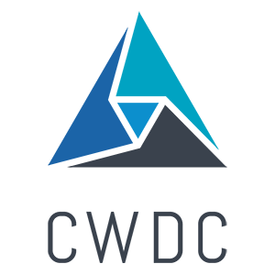
Resources
CDE Postsecondary and Workforce Pathways Resources- Information and state guidance to advance PWR
CareersinColorado- Career Pathway Navigation for high demand industries
Colorado Work-based Learning Continuum
Colorado Talent Dashboard- Resource to understand needs of labor market
TalentFound- Gateway to Colorado’s talent development system (under development)
LaunchMyCareerColorado-Return on Investment Tool to help students compare cost to anticipated earning value of continuing education
Competency Model Clearinghouse- Resource developed by USDOL spotlighting the skills and competencies needed by industry

Slide 31
Who’s on my TEAM?
Notes:
Popcorn out definition of PATHWAYS

Slide 32
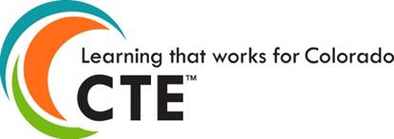
Pathways & CTE

Slide 33
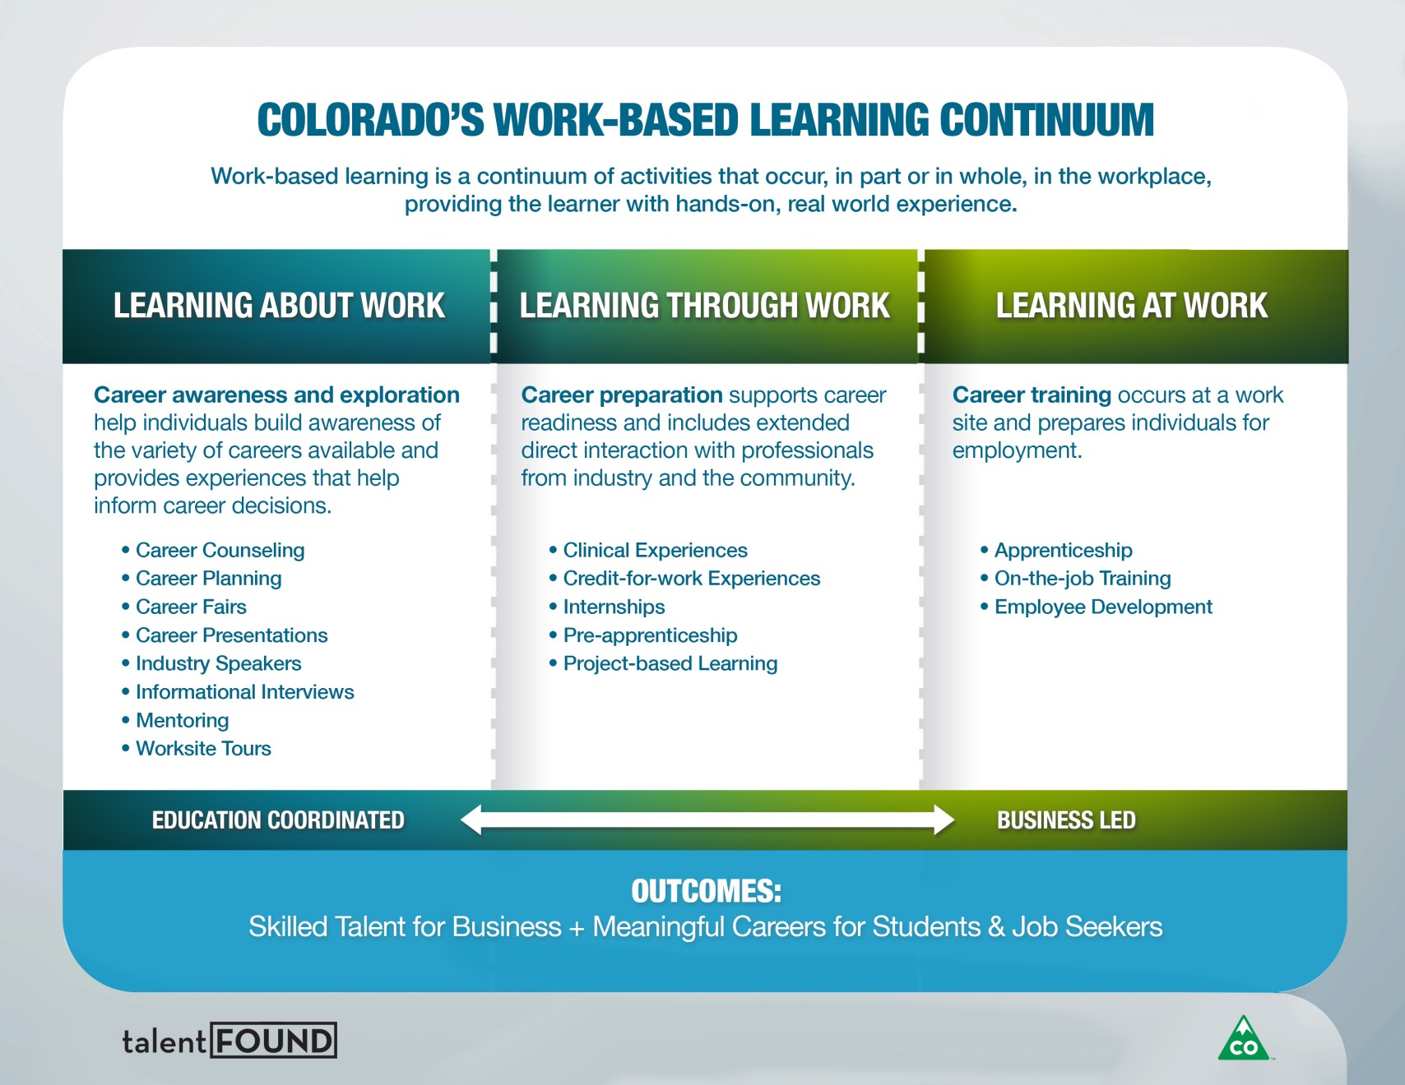
Pathways with CTE and YOU!

Slide 34
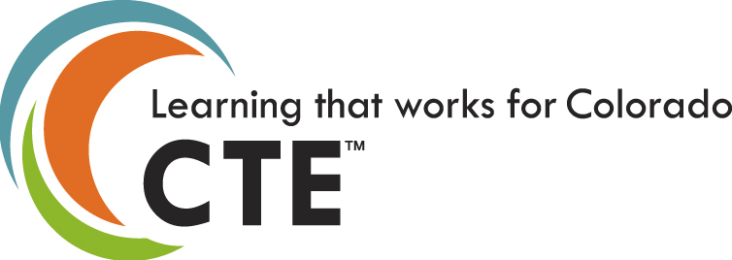
CTE ensures a thriving Colorado economy by providing relevant and rigorous education that is connected, responsive and real.
19,606
MS
96,854
HS
32,878
PS

Slide 35
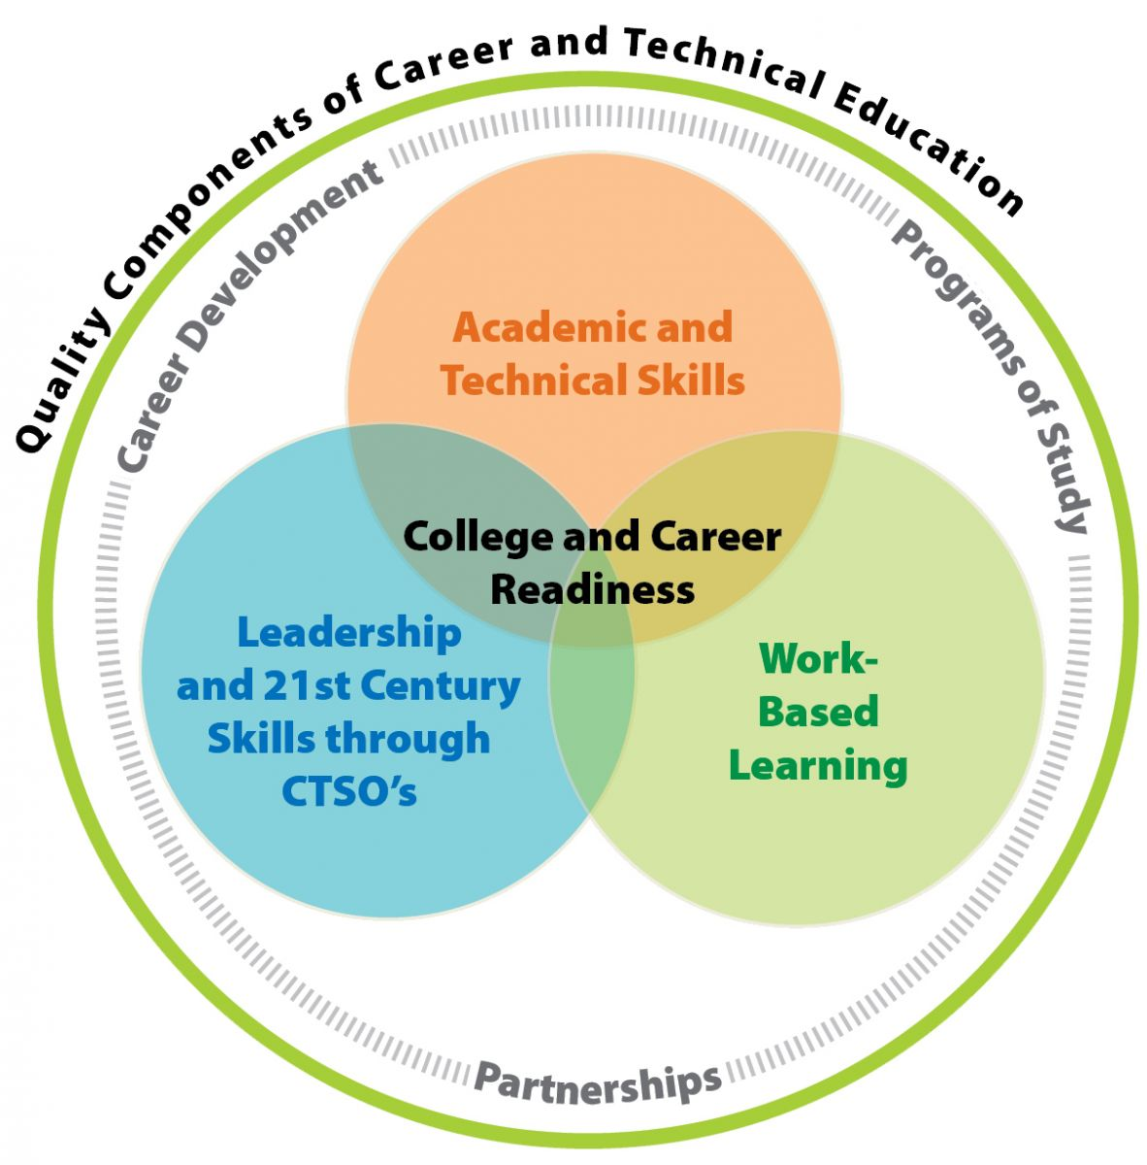
Career and College Readiness

Slide 36


Colorado Career Cluster Model
Top Growth Areas in Colorado
Management and Administration
Administrative Services
Business Information Technology
Corporate/General Management
Human Resource Management
Operations Management
Marketing
Marketing Communications
Marketing Management
Marketing Research
Merchandising
Professional Sales/Sales Management
CTSOs – DECA, FBLA, PBL
Finance
Accounting
Banking Services
Corporate Finance
Insurance
Securities & Investments
Government & Public Administration
Foreign Service
Governance
Legal Services
Planning
Public Management & Administration
Regulation
Revenue & Taxation
Agriculture, Food & Natural Resources
• Animal Science*
• Agribusiness Systems
• Food Products & Processing Systems*
• Natural Resource & Environmental Systems*
• Plant Science*
• Power, Structural & Technical Systems*
Energy
• Electromechanical Generation & Maintenance*
• Electrical Energy Transmission & Distribution*
• Energy Efficiency & Environmental Technology*
• Fossil Energy Extraction, Processing & Distribution*
• Renewable Energy Production*
* STEM affiliated pathway CTSO – FFA
STEM (Science, Technology, Engineering & Math)
See also STEM affiliated pathways noted by *
• Research, Exploration & Innovation
• Design, Development & Application
Arts, A/V Technology and Communication
• Audio/Video Technology & Film
• Journalism & Broadcasting
• Performing Arts
• Printing/Publishing
• Visual & Design Arts^
Information Technology
• Information Support and Services
• Interactive Media
• Network Systems & Telecommunications*
• Programming & Software Engineering*
CTSOs – TSA, CCCSO, SkillsUSA, ^FCCLA
Agriculture, Natural Resources & Energy
Business, Marketing & Public Administration
Postsecondary & Workforce Readiness (PWR)
Entrepreneurial: Critical Thinking & Problem Solving, Creativity & Innovation, Inquiry & Analysis, Informed Risk Taking
Personal: Initiative& Self-Direction, Personal Responsibility & Self-Management, Adaptability & Flexibility , Learning Style Awareness
Civic: Core Academic Foundation, Collaboration & Teamwork, Communication, Global & Cultural Awareness
Professional: Time & Work Management, Career Literacy, Grit & Resilience, Work Ethic, Dependability & Reliability
Academic: Application of knowledge & skills,, Evaluation, Discernment
+ CTE Pathway for Special Populations include:
Alternative Cooperative Education (ACE) CTSO – (SC)²
STEM, Arts, Design & Information Technology
Hospitality, Human Services & Education (+)
Hospitality & Tourism
• Lodging
• Recreation, Amusements & Attractions
• Restaurants, Food & Beverage Services
• Travel & Tourism
Human Services
• Consumer Services
• Counseling & Mental Health Services
• Early Childhood Development
• Family & Community Services
• Personal Care Services~
Education & Training
• Administration and Administrative Support
• Professional Support Services
• Teaching and Training
+ FACS Core & World Of Work (WOW)
CTSOs – FCCLA, ~Skills USA
Skilled Trades &
Technical Sciences
Architecture & Construction
Construction
Design & Pre-construction*
Maintenance & Operations
Manufacturing
Health, Safety & Environmental Assurance
Logistics & Inventory Control
Manufacturing Production
Maintenance, Installation & Repair
Production/Process Technology*
Quality Assurance
CTSOs – TSA, SkillsUSA
Transportation, Distribution & Logistics
Facility & Mobile Equipment Maintenance
Health, Safety & Environmental Management
Logistics, Planning & Management Services
Planning, Management & Regulation
Sales & Service
Transportation Operations
Transportation/Systems Infrastructure
Warehousing & Distribution Center Operations
* STEM affiliated pathway
Health Science, Criminal Justice &
Public Safety
Health Science
Biotechnology Research & Development*
Diagnostic Services
Health Informatics
Supportive Services
Therapeutic Services
Law, Public Safety~, Corrections & Security
Correction Services
Emergency & Fire Management Services
Law Enforcement Services
Security & Protective Services
CTSOs – HOSA & ~SkillsUSA
* STEM affiliated pathway
Updated September 2017 www.coloradostateplan.com + www.cccs.edu + www.careersincolorado.org + www.talentfoundco.org

Slide 37
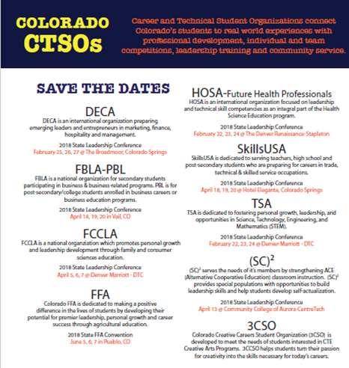

Slide 38
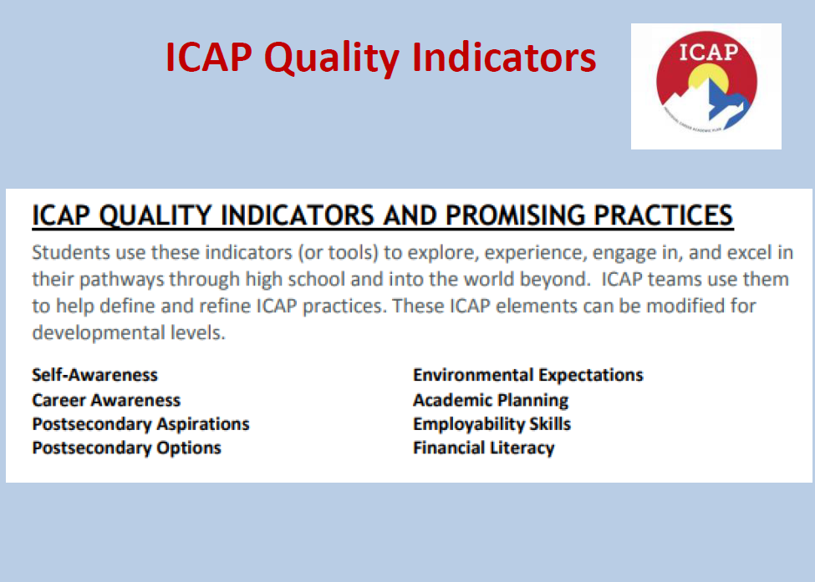

Slide 39
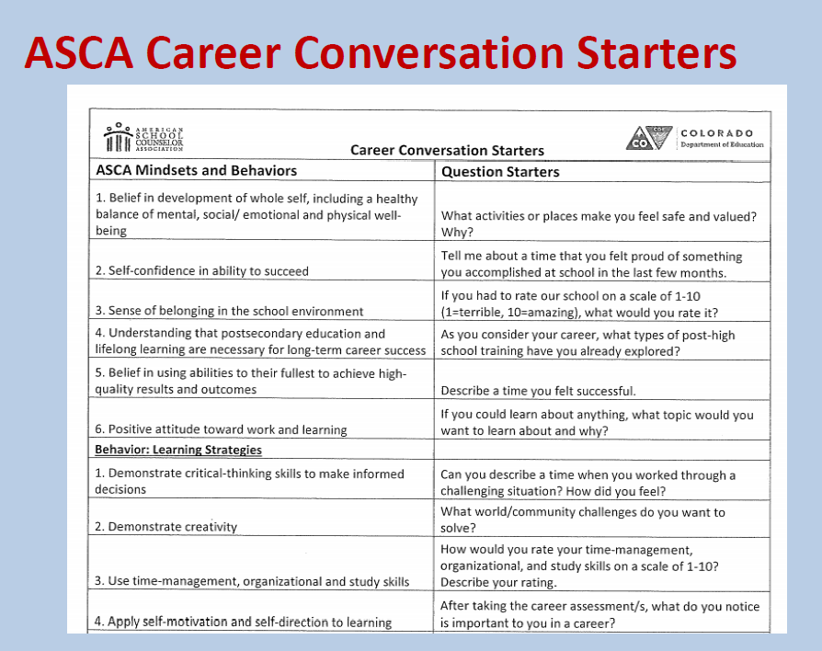

Slide 40
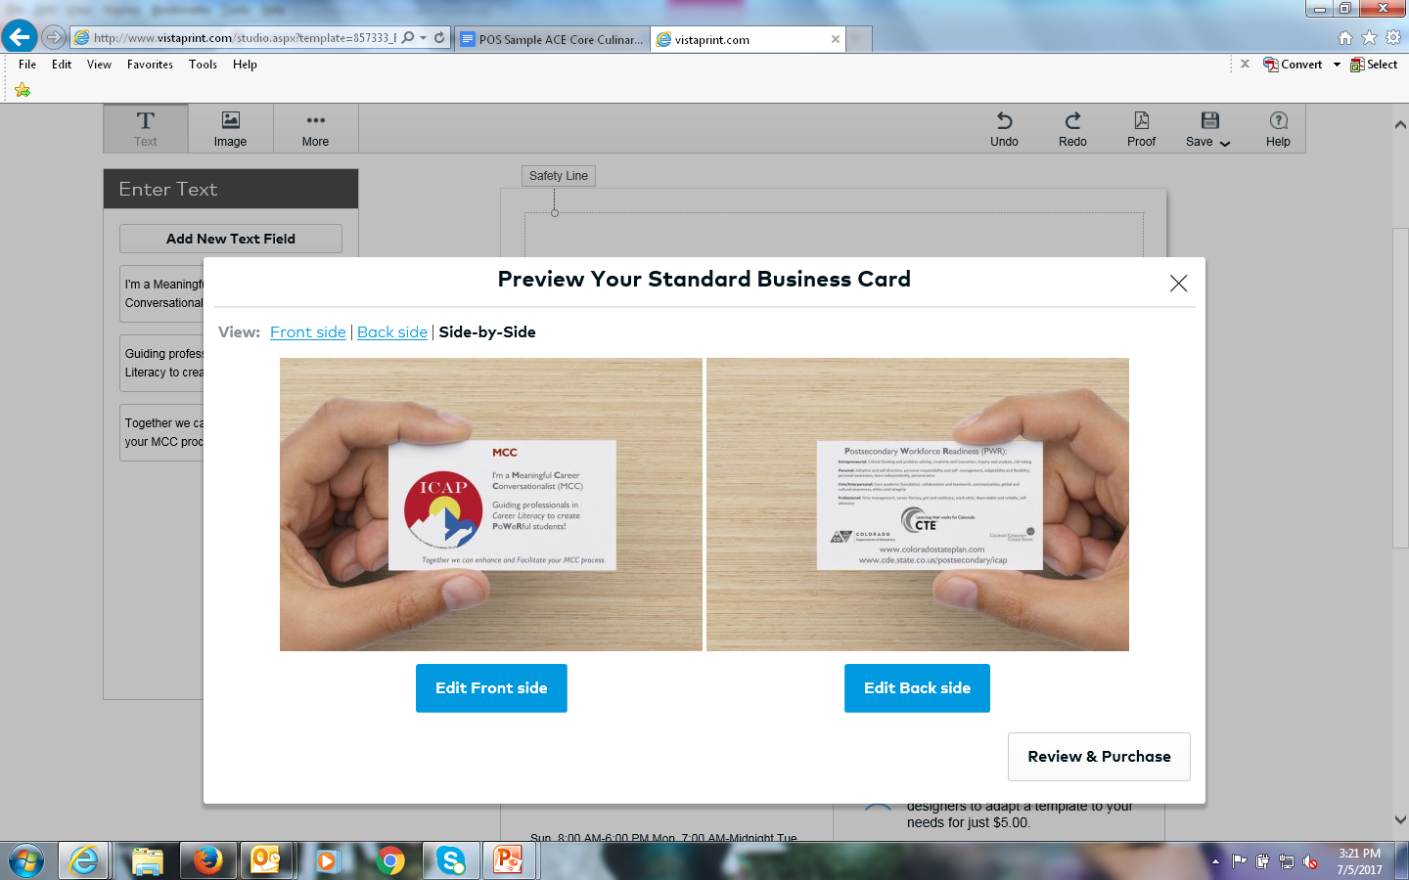
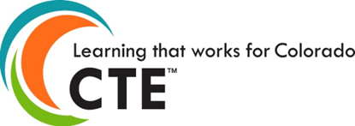
WE WANT YOU!
Join us in becoming an MCC! Meaningful Career Conversationalist.
ICAP = MCC
MCC = doing ICAP
We are unofficially rebranding!

Slide 41

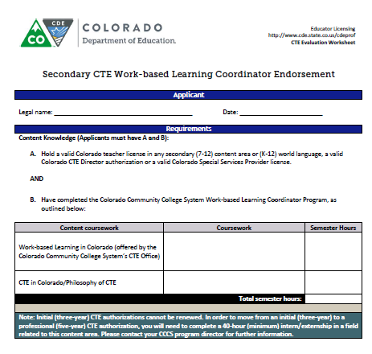
Secondary CTE
WBL Coordinator Endorsement
Content Knowledge (Applicants must have A and B):
A. Hold a valid Colorado teacher license in any secondary (7-12) content area or (K-12) world language, a valid Colorado CTE Director authorization or a valid Colorado Special Services Provider license.
AND
B. Have completed the Colorado Community College System Work-based Learning Coordinator Program, as outlined below:
CTE in Colorado/Philosophy of CTE
Work-based Learning in Colorado (offered by the Colorado Community College System’s CTE Office)
Notes:
Melissa

Slide 42
Questions?

Slide 43
Contacts
Robin Russel
Graduation Guidelines Manager, CDE
Russel_r@cde.state.co.us
Renise Walker
Education Liaison, CDE and CWDC
Renise.Walker@state.co.us
Lauren Jones
CTE Program Director, CCCS
Lauren.Jones@cccs.edu

Slide 44
MS Pathways

Slide 45
MS Pathways & CTE in Colorado

Slide 46
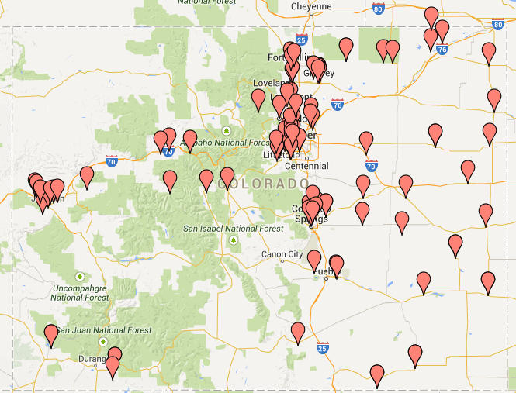
Where are we now

Slide 47
Cool Data Tidbit!
1,917 MS students in the 12-13 enrollment continued into a high school program in 13-14.
561 MS students in the 12-13 enrollment continued into a high school program in 13-14 within the same career cluster.
1,594 MS students in the 12-13 enrollment continued into a high school program in 13-14 in a different career cluster.

Slide 48
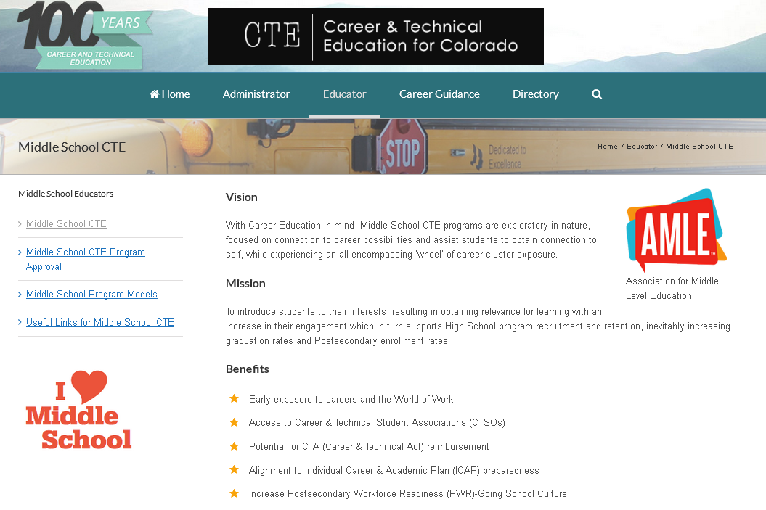

Slide 49
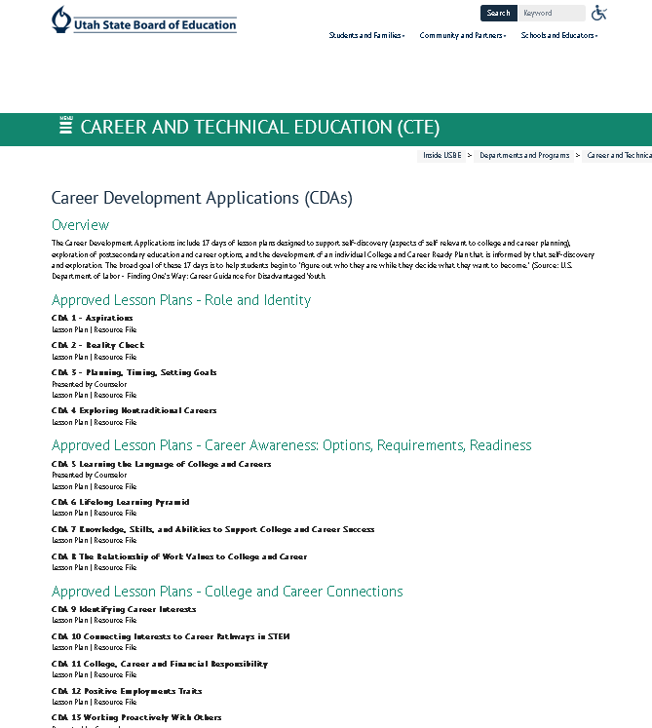

Slide 50


Did you know?!
MARCH is Middle Level Education Month!
Hashtag: #MLEM18
8
http://www.amle.org/AboutAMLE/MiddleLevelEducationMonth/tabid/295/Default.aspx#2824144-resources

Slide 51
Resources
Education & related resources:
CDE Postsecondary and Workforce Readiness Resources
CTE website
CDE CTE Credentialing information
Youth Apprenticeships through CareerWise Colorado
Registered Apprenticeships information via the CDLE Work-Based Learning Unit
Labor market data, career pathways, and sector partnerships:
Colorado Workforce Development Council- including the BEL Commission
Talent Pipeline Report – annual report re: Colorado’s labor market
Colorado Talent Dashboard-to understand the needs of the labor market
TalentFound- Gateway to Colorado’s talent development system (under development)
Career Pathways overview
Careers in Colorado -Career pathways work for high-demand industries (IT, advanced manufacturing, healthcare and construction)
Colorado Sector Partnership Information
What are sector partnerships? overview
Connecting with Colorado Workforce Centers
Notes:
Melissa

Slide 52
Resources
CDE Postsecondary and Workforce Pathways Resources- Information and state guidance to advance PWR
CareersinColorado- Career Pathway Navigation for high demand industries
Colorado Work-based Learning Continuum
Colorado Talent Dashboard- Resource to understand needs of labor market
TalentFound- Gateway to Colorado’s talent development system (under development)
LaunchMyCareerColorado-Return on Investment Tool to help students compare cost to anticipated earning value of continuing education
Competency Model Clearinghouse- Resource developed by USDOL spotlighting the skills and competencies needed by industry

Slide 53
Questions?

Slide 54
Contacts
Robin Russel
Graduation Guidelines Manager, CDE
Russel_r@cde.state.co.us
Renise Walker
Education Liaison, CDE and CWDC
Renise.Walker@state.co.us
Lauren Jones
CTE Program Director, CCCS
Lauren.Jones@cccs.edu

