Slide 1





School Counselor Corps Grant
Virtual Welcome
2025-2026
Cohort 15

Slide 2


Today’s Objectives
By the end of this session, grantees should:
Increase knowledge and understanding of the School Counselor Corps Grant (SCCG) Program.
Understand the Development Year Process (DYP) and the connection to grant reporting.
Calendar grant webinars, trainings, and reporting requirements.

Slide 3

























Welcome Cohort 15!

Slide 4

Cohort 15
Who were you at 15?
Share one thing you loved to do, were interested in, or disliked at 15.

Slide 5


Your School Counseling Specialist
Each grantee has been assigned to one School Counseling Specialist for support throughout the year.
Brooke Morgan:
Adams-Arapahoe 28J
Arickaree R-2
Brush RE-2(J)
Caprock Academy
CIVICA Colorado
Doral Academy of Colorado
Estes Park R-3
Harrison 2
Johnstown-Milliken RE-5J
Orton Academy
Strasburg 31J
Stone Creek School
St Vrain Valley RE1J
Jennicca Mabe:
AUL Denver
Centennial
Denver Public Schools
District 49
DSST: CollegView High School
Durango
Ignacio
Kiowa
Moffat
Mancos
Ricardo Flores Magon Academy- CSI
Wiley

Slide 6

Goals of SCCGP
Colorado Revised Statute 22-91-103
Increase the availability of effective school counseling to:
Increase the graduation rate​
Increase the percentage of students who appropriately prepare for, apply to and continue into postsecondary education
Support work-based learning awareness, education, and opportunities

Slide 7

Comprehensive School Counseling
American School Counselor Association (ASCA)
Academic development, career development, and social/emotional development (American School Counselor Association, 2023a, 2023b, 2023c)
Colorado Revised Statute 22-91-102
Professional school counselors are trained to provide comprehensive programs that facilitate the development of the whole child in areas of academic, career, and personal and social needs.

Slide 8

Benefits of Comprehensive School Counseling
Improvement in:
Social skills
Academic performance
Engagement and academic relationships
Graduation rates
College entrance and persistence rates
Closing the achievement gap
Decreased:
Chronic absenteeism
Suspensions
Emotional distress
Drug use
(American School Counselor Association, n.d.b)
(American School Counselor Association, 2023c)
See more empirical research studies
supporting the value of
school counseling here.

Slide 9

SCCGP Development Year Process (DYP)
Year 1
The purpose of the developmental year is to
explore and plan for implementation.
Trainings and webinars will guide your team in building
a comprehensive and data-driven school counseling program with actionable steps.

Slide 10
Steps to the DYP
Step - Foundation to School Counseling: Build SCCG team and develop a school counseling program vision and mission.
Step 2- Intentional Data Review: Collect and analyze data on the school counseling program and student achievement, attendance and behavior (discipline) to choose grant focus areas.
Step 3- Targeted Needs Assessment: Complete a targeted needs assessment to gather more information on focus areas.
Step 4- Needs and SMART Goals: Identify needs and write two to three grant goals on priority areas.
Step 5- Root Cause and Interventions: Determine root causes of identified needs to inform school counseling interventions that support grant goals.
Step 6- Assessment and Action Planning: Report SCCG School Counseling Program results and plan for year two implementation.

Slide 11
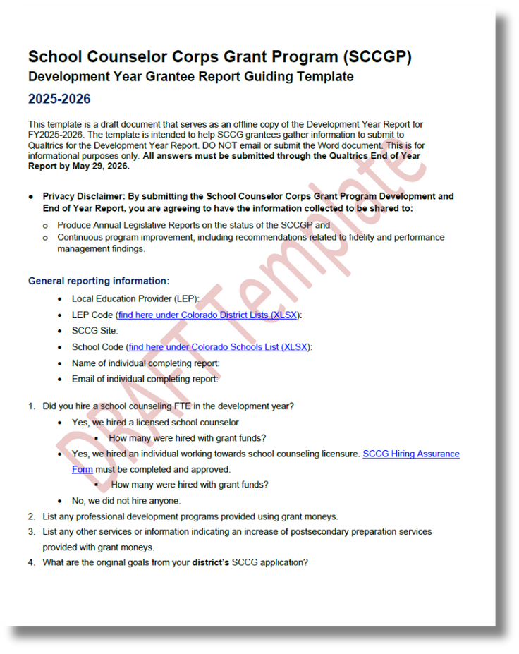
DYP and Reporting
Access the guiding template on the
SCCG Reporting webpage.
Step 1: Foundation to School Counseling
Questions 5 and 6
Step 2: Intentional Data Review and Findings
Questions 7, 8
Step 3: Data and Needs Assessment
Questions 9 and 10
Step 4: Goals
Question 11
Step 5: Root Cause and Interventions
Questions 12 and 13
Step 6: Reporting and Planning

Slide 12

Cohort 15 Fall Training
September 9, 2025, from 9:00 AM to 4:00 PM
Where: Colorado Springs, University of Colorado Colorado Springs
1420 Austin Bluffs Pkwy, Colorado Springs, CO 80918
Who should attend?
SCCG program contact
Each funded site’s administrator
Registration: Complete right now
Meals: lunch will be provided
What to bring?
Bring data
Laptop
Focus on
DYP Steps 1-3

Slide 13

Prepare for In-Person Training
For the September 9, 2025, In-Person Training,
Bring or have access to the following data:
Unified Improvement Plan (UIP)
School Counseling data
Student Achievement data
Student Attendance data
Student Behavior data
Bring the school and district mission and vision statements
Read through Development Year Report template

Slide 14
School Counseling Data
Examples of School Counseling Data to Bring:
Time and effort assessment
Number of school counselors
Student to school counselor ratio
School counseling goals
Number of School Counselor and Administrator meetings
School counselor years of experience
Comprehensive programming (academic, career, social-emotional)
School counselor evaluation
Qualitative data on how school community views school counselors
Potential Data Tools:
ASCA Use-of-Time Template (2025)
Environmental Scan Model (Carlson, 2020)

Slide 15

Achievement Data
Examples of Data for Review:
Grades, grade point average (GPA),competencies
Credits (on-track for graduation)
Missing work/assignments
Test scores
SRD rates/READ plans
Graduation rates, matriculation, FAFSA completion, etc.
Enrollment in specific courses (ex. Algebra)
Potential Data Tools:
Schoolview- Explore School and District Data
Read Act Dashboard
State Accountability Data Explorer

Slide 16

Attendance Data
Examples of Data to Bring:
Daily attendance rates
Specific classroom attendance
Attendance and/or participation in extracurriculars and clubs
Chronic absenteeism
Dropout rates
Truancy rates
Potential Data Tools:
Attendance Goal Calculator Dashboard
Colorado Dropout Rate Dashboard
Colorado Attendance Data Spreadsheets
Learning Environment District Profile Reports

Slide 17

Behavior (Discipline) Data
Examples of Data for Review:
Number of responses to classroom
Referrals
Suspensions
Expulsions
Positive Behavioral Interventions and Supports (PBIS)
Potential Data Tools:
Learning Environment District Profile Reports
CDE Suspension and Expulsion Statistics

Slide 18


Regional Training
Each grantee will choose ONE regional training to attend.
Attend the training in Colorado Springs or closest to your school’s region.
Who should attend: Cohort 15 building administration and SCCGP planning year team
Dates and Locations:
September 10, 2025: University of Colorado Colorado Springs
Note this is the day after the Fall In-Person Training
October 21, 2025: Colorado Mountain College, Steamboat Springs
October 28, 2025: Limon Community Building, Limon
November 12, 2025: Denver, Legacy Campus
November 18, 2025: Adams State University, Alamosa
December 9, 2025: Northeastern Junior College, Sterling
Registration:
An email link will be sent directly to the you from Eventbrite.
SCCG program contact and each funded site’s administrator must attend.
Details of event will be shared once registered.

Slide 19

DYP Webinars
Webinars will occur from 9:00 to 11:00 AM via Zoom.
October 1, 2025: Webinar #1
Data and Targeted Needs Assessment
November 5, 2025: Webinar #2
SMART Goals
January 14, 2026: Webinar #3
Mid-Year Check-In
February 4, 2026: Webinar #4
Analyzing Data
March 4, 2026: Webinar #5
Interventions
April 29, 2026: Webinar #6
Assessment and Action Planning
Links to register will be on the To Do’s list, grant training website, and will be sent in the monthly emails.

Slide 20

Questions
Email or call as questions come up.

Slide 21
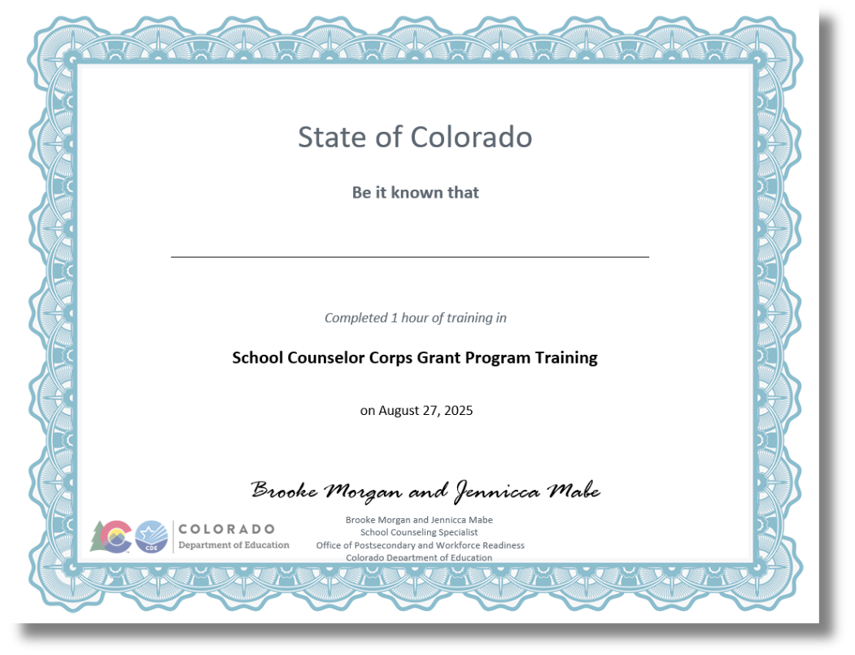

To Do’s and CEUs- Cohort 15

Slide 22
Wrap Up and Optimistic Closure
Sign in for record of attendance.
To Do’s & CEU’s will be emailed to the email on record of attendance.
Complete Zoom survey questions.
Share your favorite beginning of the year school supply in the chat.

Slide 23


Contact Us
If questions come up, please reach out.
SCCG Program
Jennicca Mabe​
Mabe_j@cde.state.co.us ​
303-923-0974​
Brooke Morgan​
Morgan_b@cde.state.co.us​
303-923-0966​
CDE Grants Fiscal
Gloria Kochan
kochan_g@cde.state.co.us

Slide 24
References
American School Counselor Association. (n.d.b). Empirical research studies supporting the value of school counseling.
https://www.schoolcounselor.org/getmedia/7d00dcff-40a6-4316-ab6c-8f3ffd7941c2/Effectiveness.pdf
American School Counselor Association. (2023a). The school counselor and academic development.
Statements/ASCA-Position-Statements/The-School-Counselor-and-Academic-Development
American School Counselor Association. (2023b). The school counselor and career development.
Statements/ASCA-Position-Statements/The-School-Counselor-and-Career-Development
American School Counselor Association. (2023c). The school counselor and social/emotional development.
Positions/Position-Statements/ASCA-Position-Statements/The-School-Counselor-and-Social-Emotional-Developm
American School Counselor Association. (2025). Templates and Tools.
https://www.schoolcounselor.org/About-SchoolCounseling/ASCA-National-Model-for-School-Counseling-Programs/Templates-Resources
Carlson, L. (2020). Environmental scan model for school counselors. International Journal of Social Policy and Education 2(9), 5-15.
https://www.researchgate.net/publication/363047223_Environmental_Scan_Model_for_School_Counselors

Slide 25
References Continued
Colorado Department of Education. (2019, June 4). State Accountability Data Explorer. SchoolView®: School and district data.
https://www.cde.state.co.us/code/accountability-dataexplorertool
Colorado Department of Education.(2023, May 5). READ Act Data Dashboard. https://www.cde.state.co.us/code/readactdashboard
Colorado Department of Education. (2024, September 9). District Profile Reports. Discipline.
https://www.cde.state.co.us/code/districtprofilereports
Colorado Department of Education. (2024). Explore school and district data. SchoolView®: School and district data.
https://www.cde.state.co.us/schoolview/explore/welcome/
Colorado Department of Education. (2024, December 18). Attendance Goal Calculator Dashboard. Attendance.
https://www.cde.state.co.us/code/attendance-goal-calculator
Colorado Department of Education. (2025, January 21). Dropout Dashboard. Dropout.
https://www.cde.state.co.us/code/dropoutdashboard
Colorado Department of Education. (2025, January 24). Suspension/Expulsion Statistics.
https://www.cde.state.co.us/cdereval/suspend-expel
Colorado Department of Education. (2025, August 8). Attendance. Reports and Data.
https://www.cde.state.co.us/cdereval/truancystatistics

Slide 26
Thank you!
We look forward to seeing you soon.

