Slide 1





School Counselor Corps Grant
Virtual Welcome
2025-2026
August 27, 2025

Slide 2


Before We Begin
This meeting will be recorded.
Closed-captioning: click the live transcript option on your bottom Zoom toolbar, under more.
Slides and recording will be posted to the SCCG Documents and Materials website.
Sign in for record of attendance.

Slide 3




Engage Today
Join us by:
Updating your name in Zoom and include your school.
Muting your microphone.
Using the raise hand function or typing in the chat.
Keeping your video on.

Slide 4

Today’s Objectives
By the end of this session, grantees should:
Increase knowledge and understanding of the School Counselor Corps Grant (SCCG) Program.
Understand actionable steps to set the year up for success.
Increase awareness of resources available to support SCCG planning, implementation, and program requirements.

Slide 5






Meet Your CDE Grant Support
Jennicca Mabe
Brooke Morgan
Gloria Kochan
School Counseling Specialist
Mabe_j@cde.state.co.us
School Counseling Specialist
Morgan_b@cde.state.co.us
Grants Fiscal Analyst
Kochan_g@cde.state.co.us

Slide 6
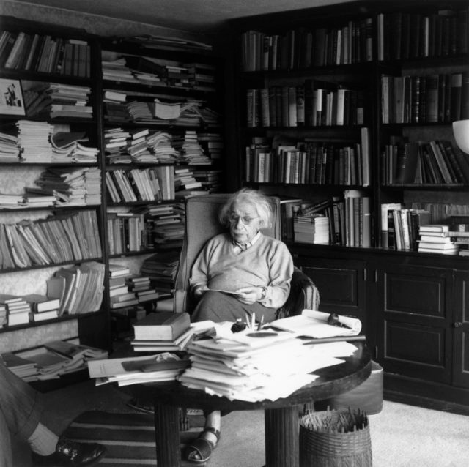
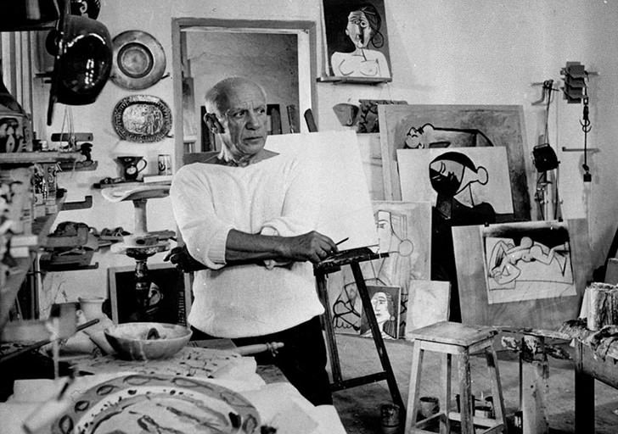


Which Office? I

Slide 7
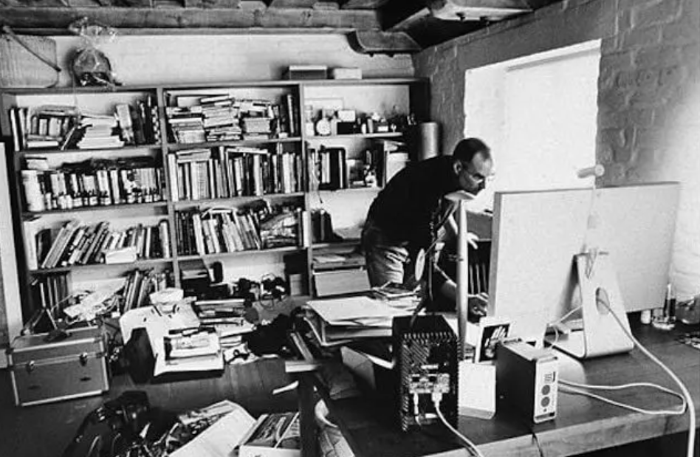



Which Office? II

Slide 8
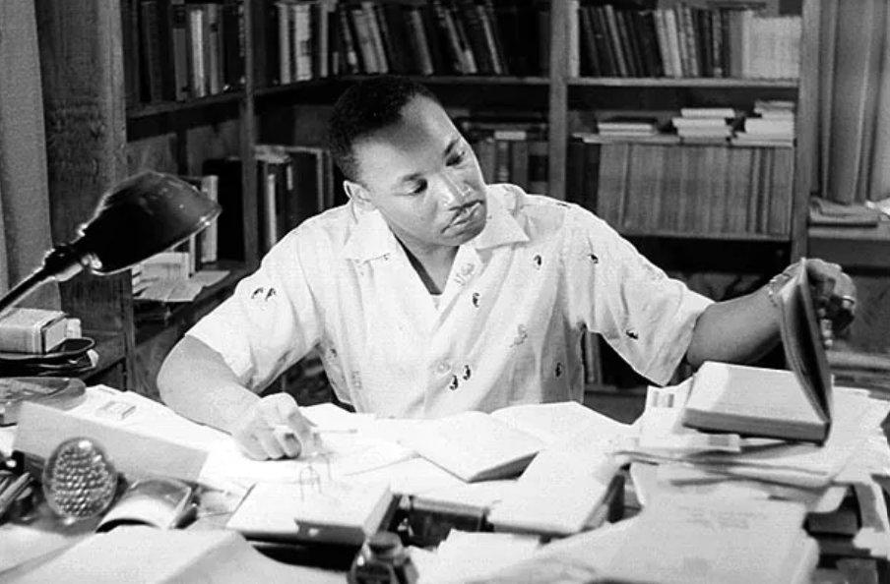
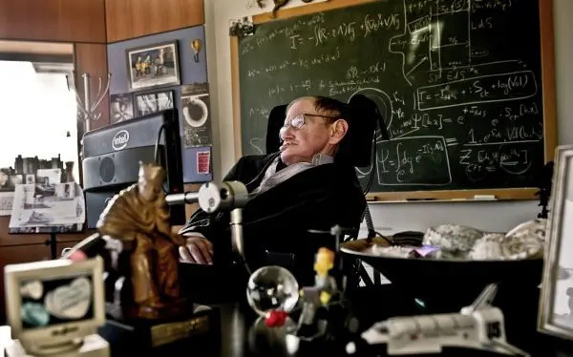


Which Office? III

Slide 9
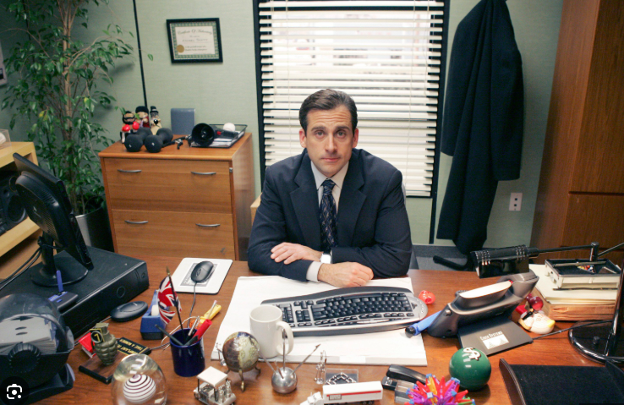



Which Office? IV

Slide 10








Did you read the Welcome Packet?

Slide 11
SCCGP Vision and Mission
SCCG Program Vision Statement:
Each Colorado Local Education Provider will have the awareness and access to apply for the School Counselor Corps Grant Program and enhance the implementation of comprehensive and sustainable school counseling programs.
SCCG Program Mission Statement:
The School Counselor Corps Grant Program will support sustainable comprehensive school counseling programs through training, technical support, and assistance to SCCGP grantees according to C.R.S. 22-91-101 through 105.

Slide 12

Our Role Within CDE
We are here to support you!
We assist grantees in developing and implementing comprehensive school counseling programs working towards grant goals and improve the level of school counseling across the state through:
Monitoring utilization of grant funds
Collaborating
Building community
Professional development/training
Sharing information and best practices
Evaluating and reflecting

Slide 13
Jennicca Supports
Academy 20
Aguilar Reorganized 6
Archuleta County 50 Jt
AUL Denver
Bethune R-5
Big Sandy 100J
Branson Reorganized 82
Burlington RE-6J
Calhan RJ-1
Centennial
Cherry Creek 5
Cotopaxi RE-3
CSI-Colorado Early Colleges
CSI- New Legacy
CSI- The Academy of Charter Schools
Denver County 1 (DPS)
District 49
DSST: CollegView High School
Durango
Elizabeth School District
Ignacio
Kiowa
Lake County R-1
La Veta Re-2
Lewis-Palmer 38
Mancos
McClave Re-2
Moffat
Montezuma-Cortez RE-1- Southwest Open Charter School
Pueblo City 60
Pueblo County 70
Rocky Ford R-2
Ricardo Flores Magon Academy- CSI
Salida R-32
San Juan BOCES
Sheridan 2
Trinidad 1
Vilas School RE-5
Wiley

Slide 14

Brooke Supports
Adams-Arapahoe 28J (APS)
Arickaree R-2
Brush RE-2(j)
Caprock Academy
Center 26 JT
CIVICA Colorado
Clear Creek RE-1
Colorado River BOCES- Yampah Mountain School
Colorado Springs 11
Doral Academy of Colorado
Estes Park R-3
Fort Morgan Re-3
Fountain 8
Garfield 16
Garfield Re-2
Genoa-Hugo C113
Greeley 6
Jefferson County R-1
Johnstown-Milliken RE-5J
Justice High Charter School
Harrison 2
Harrison 2- Atlas Preparatory
Limon RE-4J
Lone Star 101
Orton Academy
Sanford 6J
Steamboat Springs RE-2
Strasburg 31J
Stone Creek School
St Vrain Valley RE1J
Summit RE-1
Upper Rio Grande School District C-7
Weld County School District RE-3J
Weld RE-4
West Grand 1-JT
Wiggins RE-50(J)

Slide 15
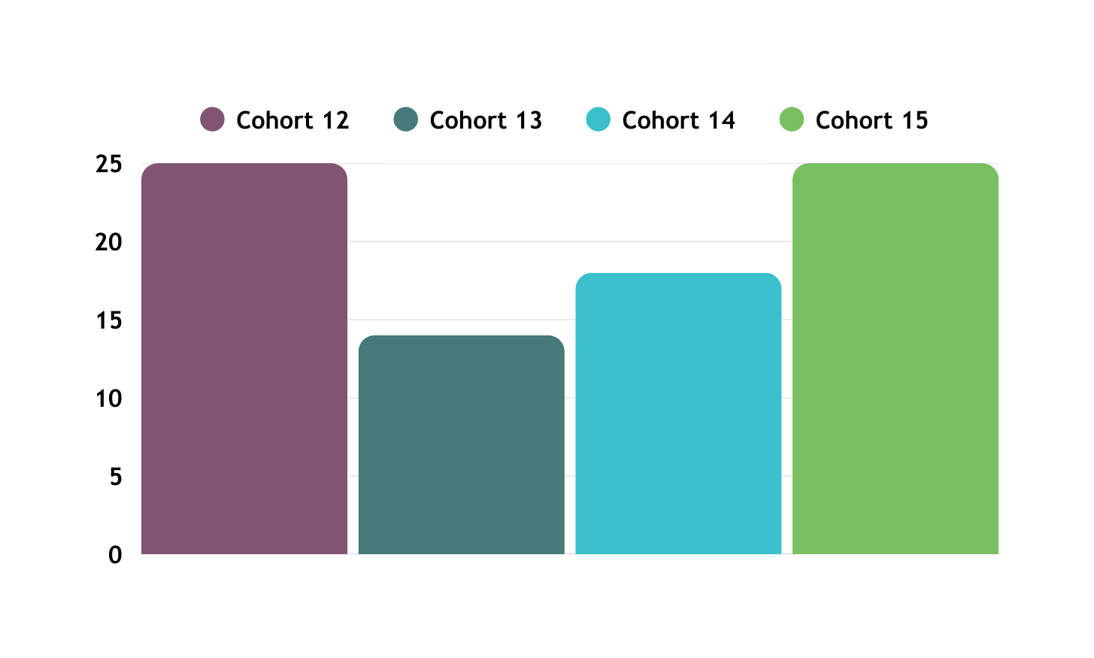
Number of Local Education Providers
82 LEPs in FY2025-2026
Cohort 15: 25
Cohort 14: 18
Cohort 13: 14
Cohort 12: 25
Number of Local Education Providers (LEPs)
Cohort Years

Slide 16
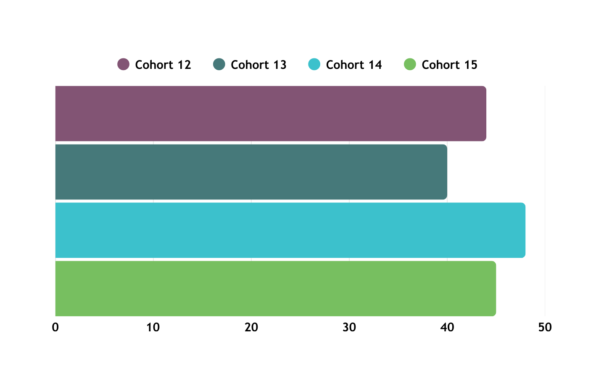
Number of SCCGP Sites
177 funded sites in FY2025-26
Cohort 15: 45 sites
Cohort 14: 48 sites
Cohort 13: 40 sites
Cohort 12: 44 sites
Cohort Years
Number of Funded Sites

Slide 17
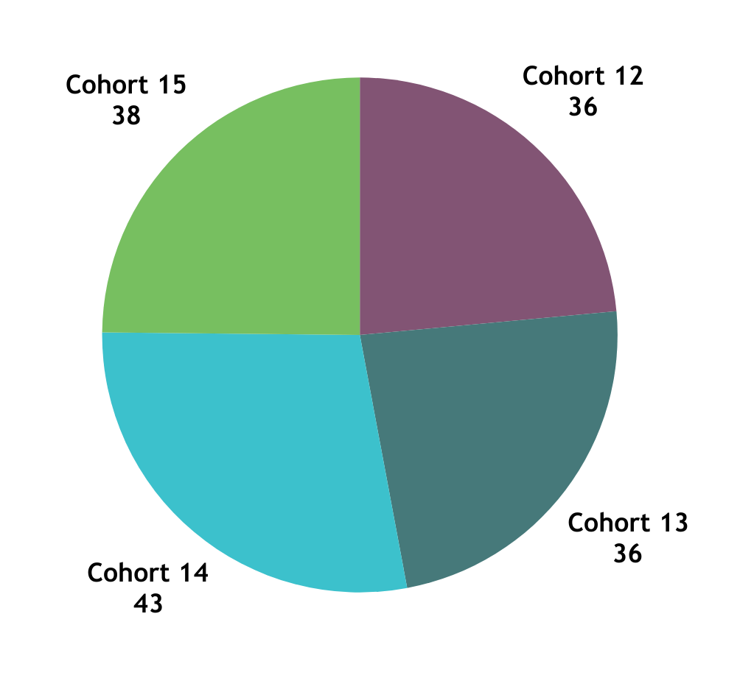
Number of School Counselor FTE
157 Planned School Counselor(SC) FTE in FY2025-26
Cohort 15: 39 SCs
Cohort 14: 43 SCs
Cohort 13: 36 SCs
Cohort 12: 36 SCs

Slide 18
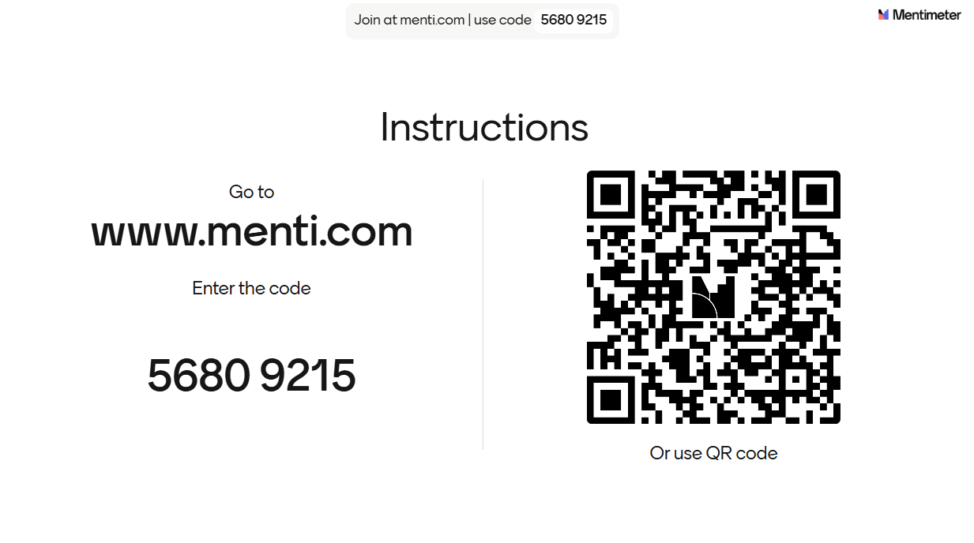
Who is in the room?

Slide 19


The Why Behind the Work
Colorado Revised Statute 22-91-101
(1)(k) Reducing the student-to-counselor ratio to support...
Closing the achievement gap
Decrease the dropout rate
Increasing the number of students who matriculate into postsecondary education without the need for remediation
(2) Best interests of the students in the state to...
Increase the number of school counselors available
Improve the level of school counseling services

Slide 20

Defining Success
How do you personally define success?
How do you define student success?
How do you define programming success?

Slide 21

Steps to SCCGP Success
Team members and responsibilities
Planning for data collection and reporting
Know your resources
Mark your calendar

Slide 22
SCCGP Team
School Counselors
School Administrators
District
Leaders
Fiscal
Support
CDE
Support
Attend trainings in-person and virtually
Drive programming and reflection of SCCG
Create and monitor SMART goals
Deliver interventions and programming
Collaborate with team for alignment and sustainability
Attend trainings in-person and virtually
Collaborate with school counselor for programming, alignment, and sustainability
Attend trainings in-person and virtually
Collaborate with school counselors, administrators, and fiscal contacts
Support alignment across schools
Sustainability plans
Follow all local policies and guidelines
Work with program to complete budget
Submit budget
Complete and submit Interim Financial Report (IFR) and Annual Financial Report (AFR)/ Final Expenditure Report (FER)
Attend virtual fiscal trainings
Address statutory requirements
Support, management, and technical assistance
Statewide trainings and professional development
Comprehensive school counseling implementation and advocacy
Evaluating and reflecting

Slide 23
Team Norms and Timeline
When should tasks be accomplished?
Reporting dates
Budget deadlines
When will the team meet?
How often will the team meet?
SCCG MEETINGS
DEFINE TASKS
TIMELINE
Who will attend grant trainings?
How will information be shared?
How will schools and fiscal collaborate?
Who will complete the budgets?
Who will submit and approve the budgets?

Slide 24

Your SCCGP Team
Let us know who is on your team!
Please complete form now.
Contacts will be used to send individual registration links for the regional trainings.
Turn camera off while completing and back on when finished.

Slide 25
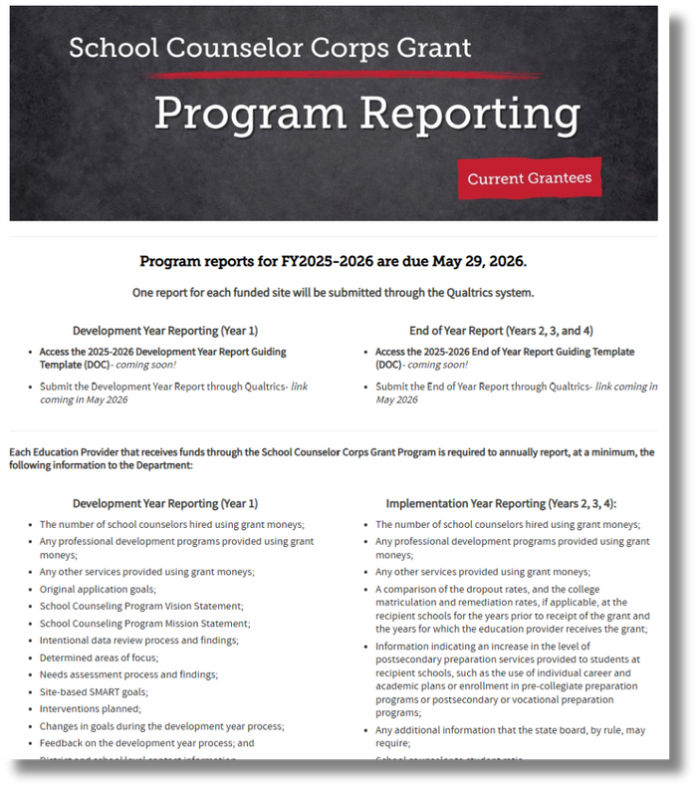
“Begin with the end in mind.”
-Stephen R. Covey
Program reports for FY2025-2026 are due May 29, 2026
Access templates for reports on the Program Reporting webpage.
Cohort 15: Development Year Report
Cohorts 12, 13, and 14: End of Year Report
Support for reporting will occur at the Regional Training
Download the guiding template today
Create a plan to monitor goal progress and track School counseling data

Slide 26

Reporting and Evaluation
The information collected via CDE’s
Development Year and End of Year Reports will be used for:
Continuous quality improvement in strengthening the SCCGP
To ensure accountability to grant expectations
To fulfill Department reporting requirements
To elevate the positive impact school counselors make

Slide 27

Implementation Planning
Be Intentional
Define your scope and focus for the year
Align with SMART goals and student needs
Create a plan and calendar
Adjust if needed
Continuous improvement cycle
Create an overview of the school counseling programming
Who will receive services?
What services will be delivered? When? Where? How long?
What resources are needed?
What is anticipated impact?
(American School Counselor Association, 2019) (Colorado Department of Education, 2025)
Evaluate
Plan
Focus
Implement

Slide 28

Resources
What is your go-to favorite school counseling resource?
What resources do you need more of?
What is the best way to share resources?

Slide 29
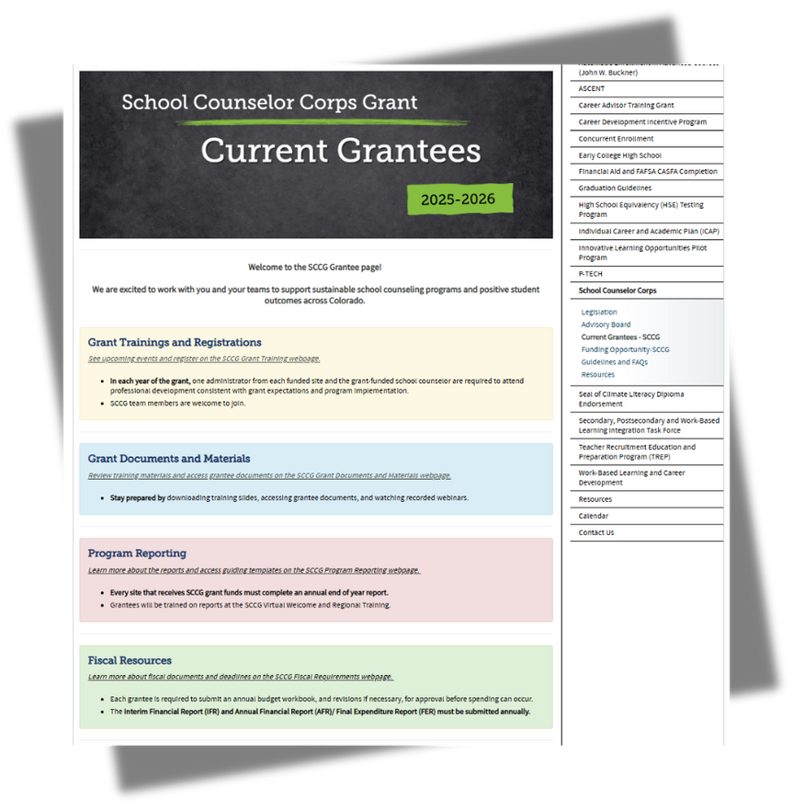
Grantee Website
Bookmark the
SCCG Current Grantee Webpage
Grant training registration dates and links
Download training slides and documents
Download the reporting guides
Fiscal submission links and financial resources

Slide 30
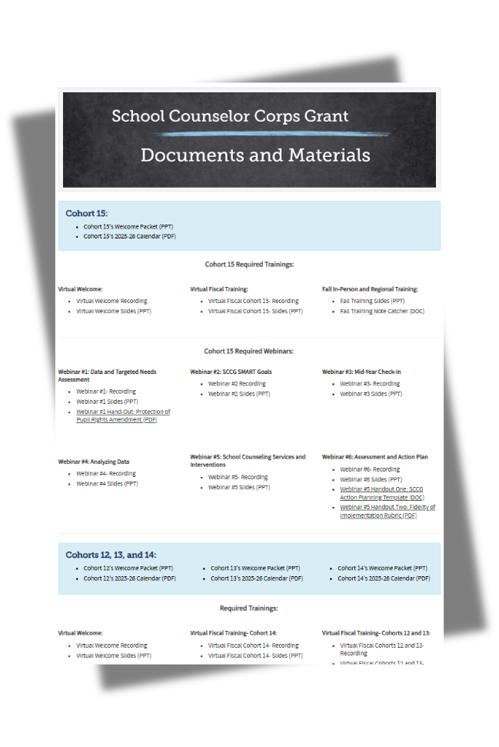

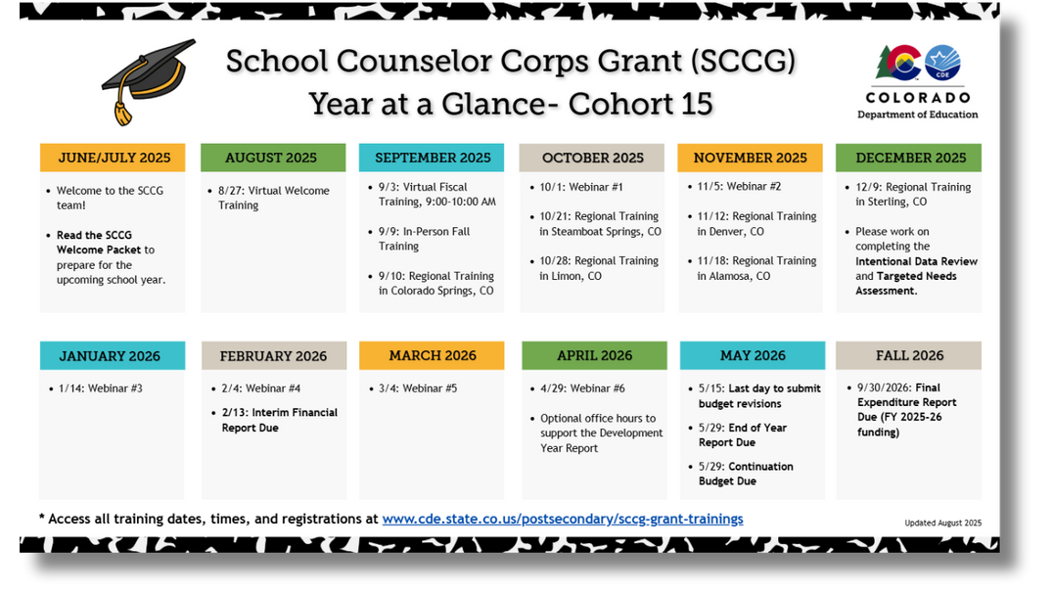
SCCGP Calendar
Download your cohort’s calendar under the
Documents and Materials Webpage

Slide 31
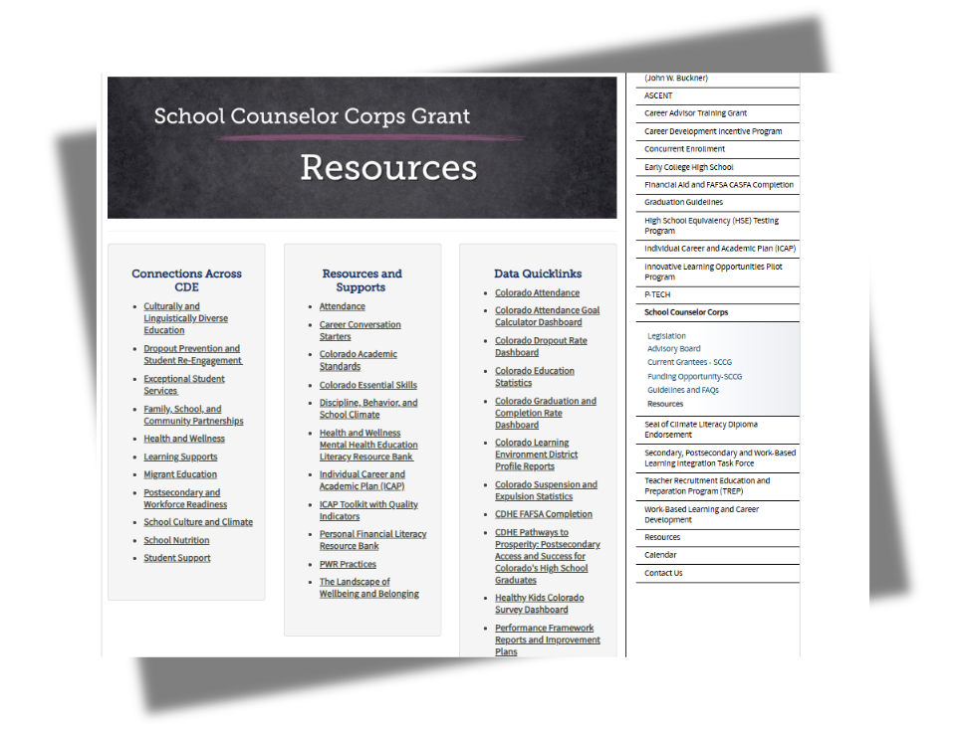
SCCGP Resources
Data collection quicklinks
Professional development opportunities
Resources and supports

Slide 32

SCCGP Monthly Emails
Check your email the first week of each month for
grant communication.
Important dates
Resources
Grant requirements and deadlines

Slide 33

Hiring and Tuition Guidance
1
2
3
4
5
CONTACT
READ and COMPLETE
CONSIDER and
READ
COMPLETE
SUBMIT
and WAIT
Consider if tuition reimbursement is an option
Read Tuition Guidelines
Read FAQs
Complete Tuition Reimbursement Assurances*
Submit budget with tuition reimbursement included*
Wait for final approval from CDE Program
*Email approval must be obtained before hiring and using grant funds.
Contact school counseling specialist to inform them you have started this process.
Read Hiring Guidelines
Complete Hiring Assurances*
It is not a SCCG requirement to offer tuition stipend/reimbursement to those working toward school counseling licensure.

Slide 34

Questions
Email or call as questions come up.

Slide 35


Regional Training
Each grantee will choose ONE regional training to attend.
EventBrite invites to the (PWR Regional Training) will be sent via email.
Everyone on your team should attend the same training.
Cohort 12,13,14: building administrator and any SCCGP grant-funded school counselor
Cohort 15: building administrator and SCCGP planning year team
Dates and Locations:
September 10, 2025 University of Colorado Colorado Springs
October 21, 2025, Colorado Mountain College, Steamboat Springs
October 28, 2025 Limon Community Building, Limon
November 12, Denver, Legacy Campus
November 18, 2025 Adams State, Alamosa
December 9, 2025 Northeastern Junior College, Sterling

Slide 36
Intervention Groups
Cohort 12, 13, 14
Need ideas? Have ideas to share? Want to connect?
Try the new optional SCCGP Virtual Intervention Groups
October 15, 2025 9-10am
December 3, 2025 9-10am
February 18, 2026 9-10am
April 15, 2026 9-10am
Attend just one, or all, and bring your best ideas to share and discuss:
Tier one, two, and three interventions with Comprehensive School Counseling
ICAP
Data Collection

Slide 37


Mark Your Calendar!
Virtual Fiscal Welcome
Cohort 14 and 15: September 3, 2025, from 9:00 to 10:00 AM
Cohorts 12 and 13: September 3, 2025, from 10:00 to 11:00 AM
Upcoming Training
Cohort 15:
Fall In-Person Training: September 9, 2025, from 9:00 AM to 4:00 PM
All Cohorts:
Regional Training: register for one in the fall or winter
Mid Year Check-In: January 14, 2026, from 9:00 to 11:00 AM

Slide 38
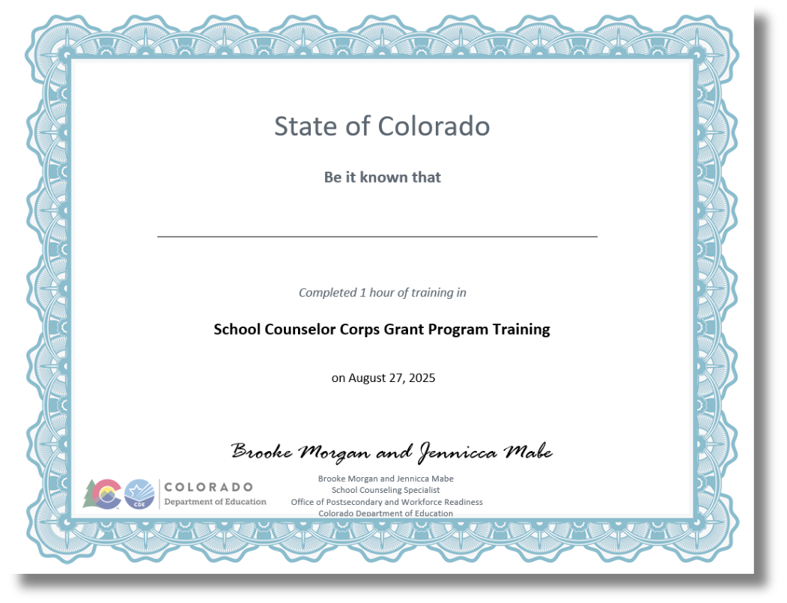

To Do’s and CEUs- Cohorts 12, 13, and 14

Slide 39
Wrap Up and Optimistic Closure
Sign in for record of attendance.
To Do’s & CEU’s will be emailed to the email on record of attendance.
Complete Zoom survey questions.

Slide 40


Contact Us
If questions come up, please reach out.
SCCG Program
Jennicca Mabe​
Mabe_j@cde.state.co.us ​
303-923-0974​
Brooke Morgan​
Morgan_b@cde.state.co.us​
303-923-0966​
CDE Grants Fiscal
Gloria Kochan
kochan_g@cde.state.co.us

Slide 41
References
American School Counselor Association. (2019). The ASCA national model: A framework for school counseling programs
(4th Edition). Alexandria, VA: Author.
Colorado Department of Education. (2025, August 19). Unified improvement planning. https://www.cde.state.co.us/uip

Slide 42
Thank you!
We look forward to seeing you soon.

