Slide 1




School Counselor Corps Grant
Regional Training
2025-2026
Cohorts 14 and 15

Slide 2



Welcome
On the nametag at your seat, please write your:
  Name
  Grades or levels you work with
Cassie Court
High School

Slide 3
Before We Begin
  Please sit with your team.
  WIFI: UCCS-Guest, no password
  Slides are available on the Grant Documents and Materials website.

Slide 4






Meet Your CDE Grant Support
Jennicca Mabe
Brooke Morgan
Gloria Kochan
School Counseling Specialist
Mabe_j@cde.state.co.us
School Counseling Specialist
Morgan_b@cde.state.co.us
Grants Fiscal Analyst
Kochan_g@cde.state.co.us

Slide 5

Housekeeping
  Today’s Materials:
    Agenda
    Reports, exemplars
  Restrooms
  Get up, move, take care of yourself

Slide 6

Today’s Objectives
Cohort 15 familiarize themselves with Development Year Report.
Cohort 14 familiarize themselves with End of Year Report.
Cohort 14 Review the Development Year Report.
Cohort 15 Review the End of Year Report.
Cohort 14 Review Exemplars of the Development Year Report.
Cohort 15 Review Exemplars of the End of Year Report.

Slide 7

Role of the School Counselor
  Know the role of a school counselor.
  Support the role of the school counselor.
  Sustain the role of the school counselor through data.

Slide 8
Utilize Your SCCG Team
School Counselors
School Administrators
District
Leaders
CDE
Support
  Attend trainings in-person and virtually
  Drive programming and reflection of SCCG
  Create and monitor SMART goals
  Deliver interventions and programming
  Collaborate with team for alignment and sustainability
  Attend trainings in-person and virtually.
  Collaborate with school counselor for programming, alignment, and sustainability
  Attend trainings in-person and virtually
  Collaborate with school counselors, administrators, and fiscal contacts
  Support alignment across schools
  Sustainability plans
  Address statutory requirements
  Support, management, and technical assistance
  Statewide trainings and professional development
  Comprehensive school counseling implementation and advocacy
  Evaluating and reflecting

Slide 9
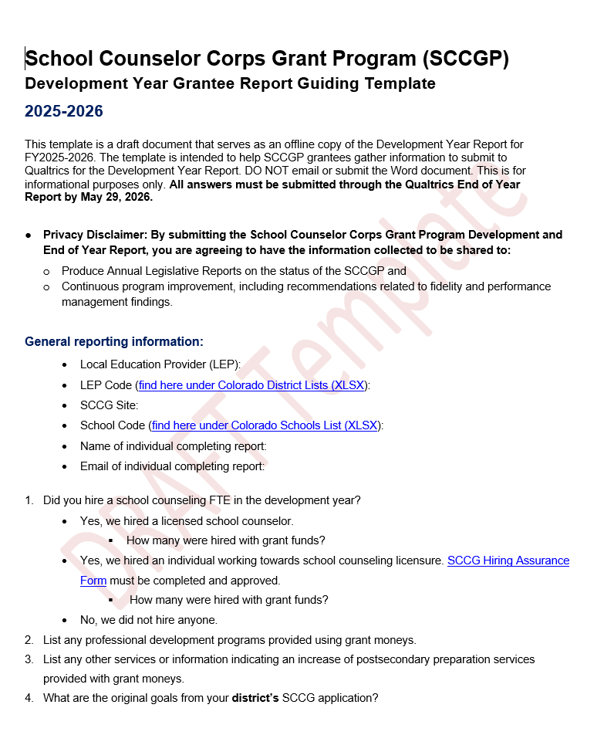
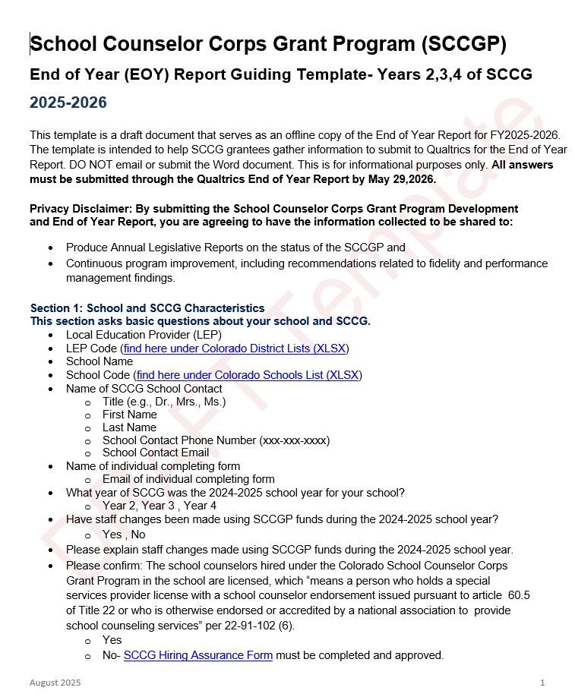
SCCG Reporting Guides
Download Guiding Templates
SCCG Development Year Report
SCCG End of Year Report

Slide 10
SCCGP Reports- Q’s to Answer
  Cohort 15 Development Year Report answer
    Question #3
    Question #11
    Question #12
  Cohort 14 End of Year Report answer
    Section 3 What quantitative and qualitative data measures...
    Section 8: SCCGP Sustainability

Slide 11
SCCG Reporting Similarities
  The Development Year Report and End of Year Report are both completed in Qualtrics.
  SCCG reports are completed for each funded site.
  Tips for success:
    Start collecting data early.
    Meet with SCCG team, administration, district leadership, etc.
      Larger districts or multiple funded sites: district leaders are encouraged to collaborate with sites before the reports are submitted.

Slide 12
Reporting in Qualtrics
All reports are due May 29, 2026.
  Qualtrics does not save work. It may be helpful to work off the template and then transfer information all at once.
  Reporting revisions will require you to resubmit the entire report.
  Qualtrics submission links will be emailed and posted to the website in Spring 2026.

Slide 13

SCCG Reports
  SCCG Development Year Report:
    More narrative responses.
    Establishes SMART goals and a plan for implementation.
  SCCG End of Year Report:
    More quantitative responses.
    Illustrates progress and evidence towards goals.
    Demonstrates level of implementation.

Slide 14

Reporting Reviews
Brooke and Jennicca review each report and provide feedback or request revisions if needed.
Before submitting, make sure...
  Each question is fully answered.
    Narrative responses should be more than one sentence.
  SMART goals are student-outcome based with a measurable baseline and target included.
  ASK questions. We are here to help.
  Cohort 15:
    Make sure to write a true SMART Goal- training at November webinar.
  Cohort 14:
    Goal progress should include data points and measurements.
    If you meet your goal, submit another goal.

Slide 15
SCCG Exemplar Reports: Now Compare
  Cohort 15 review the exemplar Development Year Report.
    Question #3
    Question #11
    Question #12
  Cohort 14 review the exemplar End of Year Report.
    Section 3 What quantitative and qualitative data measures...
    Section 8: SCCGP Sustainability

Slide 16

Reflection #2
What was something that stood out to you on the exemplar?

Slide 17

Questions

Slide 18
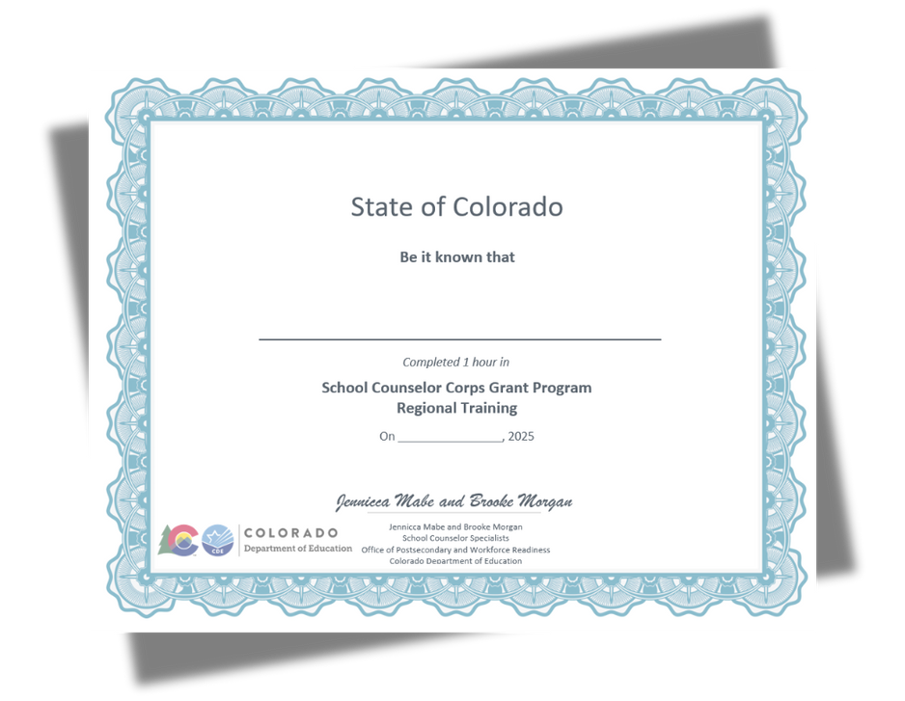
Credit For Today
Receive an hour SCCG CEU for this morning’s training.
Regional Training CEUs will be passed out at the end of the day.

Slide 19


Contact Us
SCCG Program
Jennicca Mabe​
Mabe_j@cde.state.co.us ​
303-923-0974​
Brooke Morgan​
Morgan_b@cde.state.co.us​
303-923-0966​
CDE Grants Fiscal
Gloria Kochan
kochan_g@cde.state.co.us

Slide 20
References I
American School Counselor Association. (2023). The role of the school counselor.
https://www.schoolcounselor.org/getmedia/ee8b2e1b-d021-4575-982c-c84402cb2cd2/Role-Statement.pdf
American School Counselor Association. (2024). School counselor roles and ratios.
https://www.schoolcounselor.org/About-School-Counseling/School-Counselor-Roles-Ratios
Colorado Department of Education. (2025, August 26). School Counselor Corps Grant Program reporting.
https://www.cde.state.co.us/postsecondary/sccg-program-reporting

Slide 21
Thank you!

