Slide 1




School Counselor Corps Grant
Regional Training
2025-2026
Cohorts 12 and 13

Slide 2


Before We Begin
  Please sit with your team.
  WIFI: UCCS-Guest, no password
  Slides are available on the Grant Documents and Materials website.

Slide 3

Housekeeping
  Today’s Materials
    Nametag: name and grade or levels you work with
    Note Catcher
  Schedule for the day
  Restrooms

Slide 4






Meet Your CDE Grant Support
Jennicca Mabe
Brooke Morgan
Gloria Kochan
School Counseling Specialist
Mabe_j@cde.state.co.us
School Counseling Specialist
Morgan_b@cde.state.co.us
Grants Fiscal Analyst
Kochan_g@cde.state.co.us

Slide 5

Today’s Objectives
By the end of this session, grantees should:
Increase knowledge and understanding successful administrator and school counselor relationships.
Collaboratively reflect on and assess current school counseling program.
Increase connection with school counselors and administrators from the Pikes Peak Region.

Slide 6


Warm Up
What is your work superpower?

Slide 7

Administrator and
School Counselor Superpowers
  Increased alignment
  Collective responsibility
  Enhanced student support
  Crisis prevention and response
  Data-informed decision making
  Successful student impact
(Schonebaum, 2024)

Slide 8
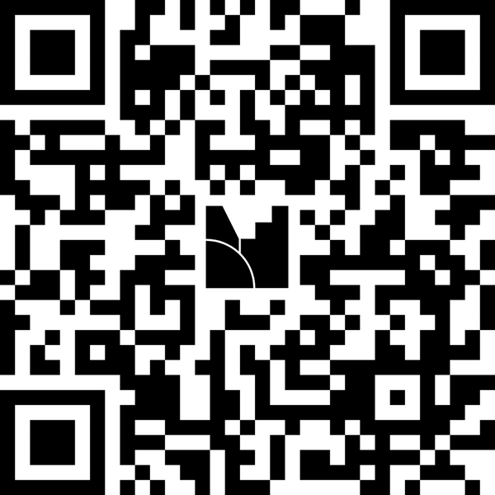
Reflection and Understanding
Go to www.menti.com and enter the code 4967 1228

Slide 9


Working Together
Respect Shared Values and Beliefs Communication Joint Responsibility
(Emily Goodman-Scott, Christina Tillery, Erin Crane, 2021)

Slide 10


Establishing Intent
  What is the role of the principal?
  What is the role of the school counselor?
  How can the two roles collaborate to prioritize school needs?
  What barriers exist that impede successful administrator and school counselor relationships?
  What is one area you have been successful in with your administrator and school counselor collaboration?
  What resources and strategies supported that success?

Slide 11
Strategies for Success
Intent Communication Collaboration Education
  Consistent administrator and school counselor meetings
  Honesty and transparency
    Use of Time
  Collaborative Stakeholder Presentations
    Goals, successes, and challenges
  Professional Development
    Collaborate on school-counseling specific professional development, attend training as a team.
(Schonebaum, 2024)

Slide 12
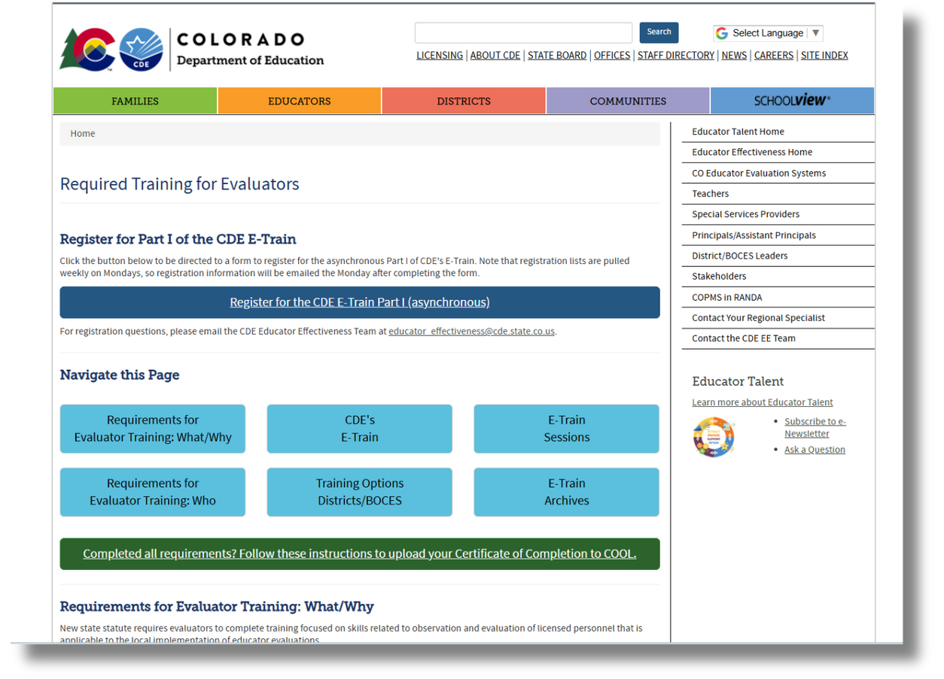
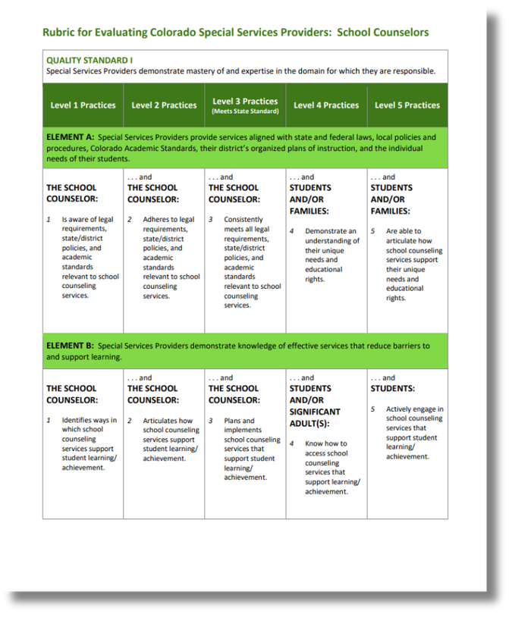
CDE Resources

Slide 13
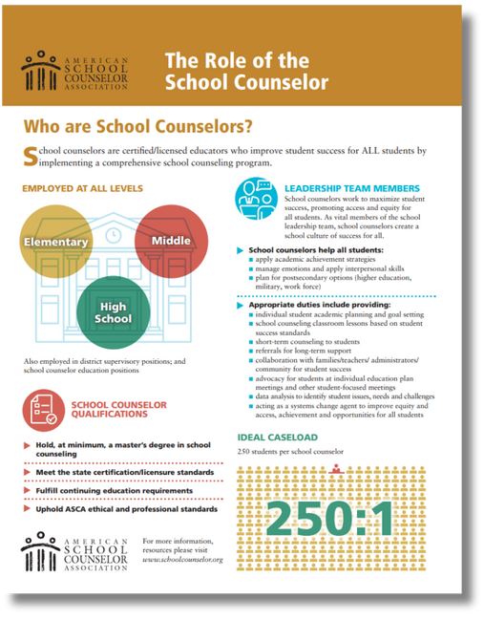
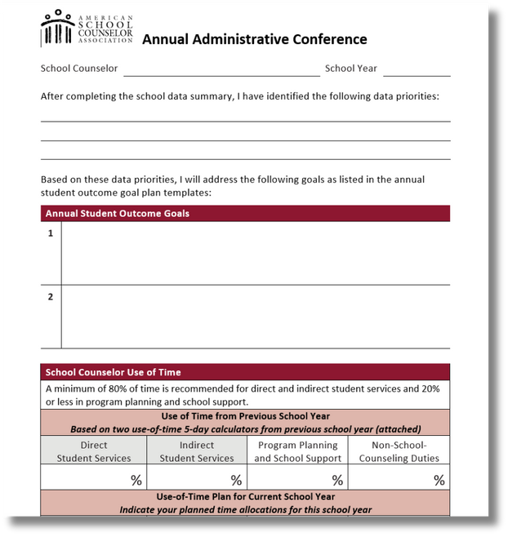
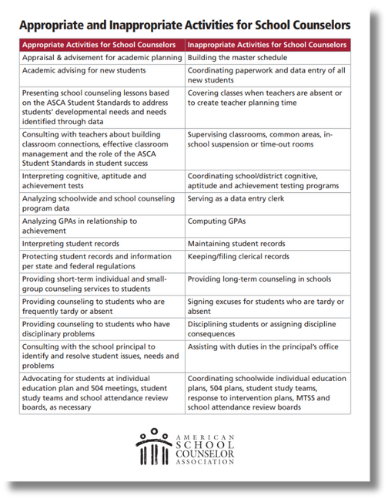
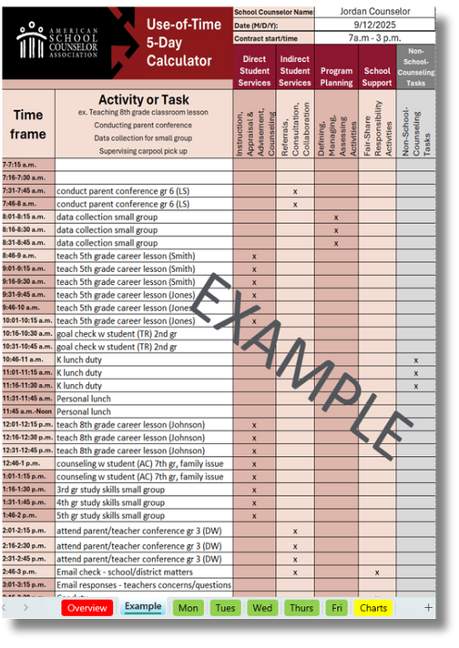
ASCA Resources
View more of ASCA’s (2025) Resources on the School Counselor and Principal Relationship
Download ASCA Templates and Tools

Slide 14
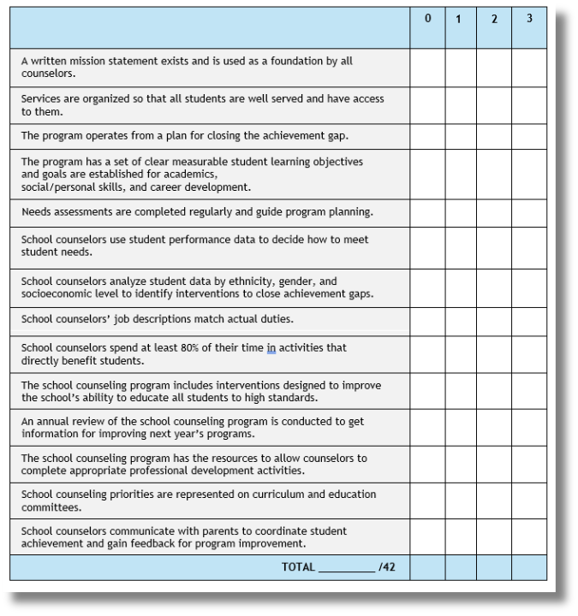
Planning Together Part I
  Complete rubric separately.
    Select the level that best describes current progress for each strategy or service.
  Add up total points at the bottom of page.
  As a school counselor and administrator team, discuss your two rubrics.
    Were they rated similarly?
    What differences exist?

Slide 15

Planning Together Part II
  What are the school counseling program’s strengths? What strategies and services of the school counseling program are you proud of?
  What areas need additional support or attention? What resources are needed to improve implementation in those areas?
  What are one to two actions the administrator and school counselor can collaborate on to increase comprehensive school counseling implementation by Spring 2026?
Be ready to share
with the whole group.

Slide 16

Connecting Regionally
Each school pick a representative to share one of the following in whole group.
  What strategies and services of your school counseling program are you proud of?
  What resources helped your team be successful?
  What program planning or implementation strategies facilitated your school counseling program’s success?
Do you have any questions for the whole group?

Slide 17

Mark Your Calendars!
Required Training:
  Mid-Year Virtual Check-In: January 14, 2026, from 9:00 to 11:00 AM
  Virtual Professional Development: choose one to attend
    February 4, 2026: Analyzing Data
    March 4, 2026: K-12 College and Career Readiness
Reporting:
  Annual Financial Report Due: September 30, 2025
  Interim Financial Report Due: February 13, 2026
  End of Year Report Due: May 29, 2026
  Continuation Budget Due: May 29, 2026

Slide 18
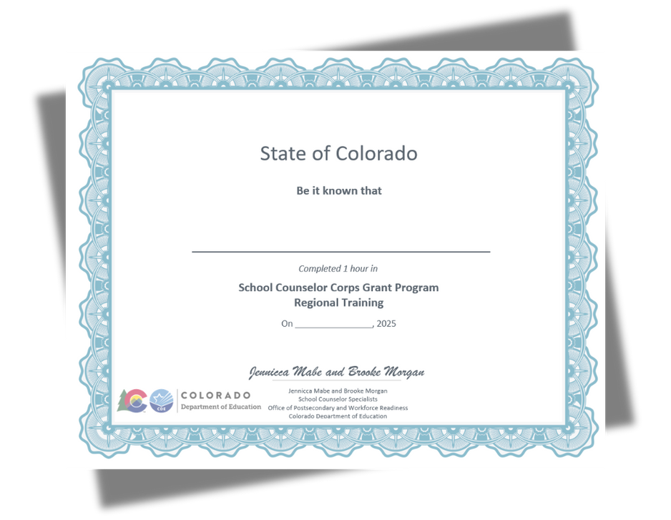
Credit for Today
You will receive the PWR Regional Training CEU at the end of the day.

Slide 19

Optimistic Closure
Before you leave, share one bright idea you learned from another school or district on your sticky note.
Turn the sticky note in for the morning CEU.

Slide 20

Questions

Slide 21


Contact Us
If questions come up, please reach out.
SCCG Program
Jennicca Mabe​
Mabe_j@cde.state.co.us ​
303-923-0974​
Brooke Morgan​
Morgan_b@cde.state.co.us​
303-923-0966​
CDE Grants Fiscal
Gloria Kochan
kochan_g@cde.state.co.us

Slide 22
References I
American School Counselor Association. (n.d.). Appropriate and inappropriate activities for school counselors.
https://www.schoolcounselor.org/getmedia/8fe536c2-7a32-4102-8ce7-42e9b0683b3b/appropriate-activities-of-school-counselors.pdf
American School Counselor Association. (2023). ASCA research report: School and district administrators and the school counselor role.
https://www.schoolcounselor.org/getmedia/22407831-42f9-46da-8fe9-f5ffb64ee285/asca-research-report-admin.pdf
American School Counselor Association. (2023). The role of the school counselor.
https://www.schoolcounselor.org/getmedia/ee8b2e1b-d021-4575-982c-c84402cb2cd2/Role-Statement.pdf
American School Counselor Association. (2025). School counselor/ principal relationships.
https://www.schoolcounselor.org/Publications-Research/Publications/Free-ASCA-Resources/Enhancing-the-Principal-School-Counselor-Relations
American School Counselor Association. (2025). Templates and Tools.
https://www.schoolcounselor.org/About-School-Counseling/ASCA-National-Model-for-School-Counseling-Programs/Templates-Resources
Colorado Department of Education. (2025, September 2). Required training for evaluators.
https://www.cde.state.co.us/educatoreffectiveness/e-train
Goodman-Scott, E. , Tillery, C., & Crane, E. (2021, September 1). It takes two. ASCA School Counselor.
https://www.schoolcounselor.org/Magazines/September-October-2021/It-Takes-Two?sso=f029cf5f-ed6e-4277-83cc-08dde69ff98a
Rubric for Evaluating Colorado Special Service Providers: School Counselors. (n.d.).
https://www.cde.state.co.us/educatoreffectiveness/sspcounselorrubric
Schonebaum, P. (2024, January 1). Collective harmony. ASCA School Counselor.
https://www.schoolcounselor.org/Magazines/January-February-2024/Collective-Harmony

Slide 23
Thank you!

