Slide 1





School Counselor Corps Grant
Cohort 15
Fall In-Person Training
September 9, 2025

Slide 2


Before We Begin
  Please sit with your team.
  Scan the QR Code on the table to sign-in for attendance.
  Wi-Fi: UCCS-Guest, no password
  Slides are available on the SCCG Documents and Materials website.

Slide 3

Housekeeping
  Today’s Materials
    Nametag: name and grade or levels you work with
    Agenda
    Note Catcher
  Restrooms
Get up, move, take care of yourself

Slide 4






Meet Your CDE Grant Support
Jennicca Mabe
Brooke Morgan
Gloria Kochan
School Counseling Specialist
Mabe_j@cde.state.co.us
School Counseling Specialist
Morgan_b@cde.state.co.us
Grants Fiscal Analyst
Kochan_g@cde.state.co.us

Slide 5

Today’s Objectives
By the end of this session, grantees should:
Increase knowledge of the School Counselor Corps Grant (SCCG) and American School
Counselor Association National Model.
Begin writing a school counseling program mission and vision statement.
Increase knowledge and confidence in collecting school data to inform comprehensive school counseling programming.
What is one goal you have for the day?

Slide 6

Building Community Part I
  Write your name, school, and town or city on your sticky note.
  In your group, come up with a fun fact about your area or school and write it on your sticky note.
Jennicca Mabe
Colorado Dep of Education
Palmer Lake, CO
Each year, Palmer Lake lights a 500ft star on Sundance Mountain every night between Thanksgiving and New Years.

Slide 7
SCCGP Team
School Counselors
School Administrators
District
Leaders
Fiscal
Support
CDE
Support
  Attend trainings in-person and virtually
  Drive programming and reflection of SCCG
  Create and monitor SMART goals
  Deliver interventions and programming
  Collaborate with team for alignment and sustainability
  Attend trainings in-person and virtually
  Collaborate with school counselor for programming, alignment, and sustainability
  Attend trainings in-person and virtually
  Collaborate with school counselors, administrators, and fiscal contacts
  Support alignment across schools
  Sustainability plans
  Follow all local policies and guidelines
  Work with program to complete budget
  Submit budget
  Complete and submit Interim Financial Report (IFR) and Annual Financial Report (AFR)/ Final Expenditure Report (FER)
  Attend virtual fiscal trainings
  Address statutory requirements
  Support, management, and technical assistance
  Statewide trainings and professional development
  Comprehensive school counseling implementation and advocacy
  Evaluating and reflecting

Slide 8

Your School Counseling Specialists
Jennicca Mabe:
  AUL Denver
  Centennial
  Denver Public Schools
  District 49
  DSST: College View High School
  Durango
  Ignacio
  Kiowa
  Moffat
  Mancos
  Ricardo Flores Magon Academy- CSI
  Wiley
Brooke Morgan:
  Adams-Arapahoe 28J
  Arickaree R-2
  Brush RE-2(J)
  Caprock Academy
  CIVICA Colorado
  Doral Academy of Colorado
  Estes Park R-3
  Harrison 2
  Johnstown-Milliken RE-5J
  Orton Academy
  Strasburg 31J
  Stone Creek School
  St Vrain Valley RE1J

Slide 9

Reflection and Direction
Reflection
Direction

Slide 10


Lessons From the Field

Slide 11
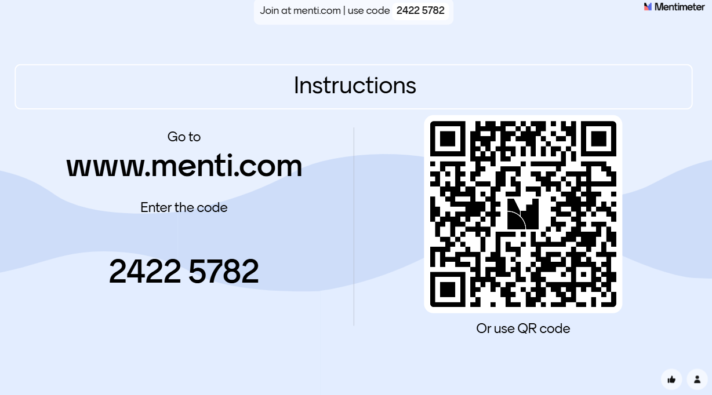

Reflection

Slide 12


Direction: Statute
Colorado Revised Statute 22-91-101
(1)(k) Reducing the student-to-counselor ratio to support...
  Closing the achievement gap
  Decrease the dropout rate
  Increasing the number of students who matriculate into postsecondary education without the need for remediation
(2) Best interests of the students in the state to...
  Increase the number of school counselors available
  Improve the level of school counseling services

Slide 13

Direction: SCCGP Goals
Colorado Revised Statute 22-91-103
  (1) (a) Increase the availability of effective school counseling to help:​
    (I) Increase the graduation rate​
    (II) Increase the percentage of students who appropriately prepare for, apply to and continue into postsecondary education; and​
  (b) Support work-based learning awareness, education, and opportunities

Slide 14
Direction: SCCGP Vision and Mission
SCCG Program Vision Statement:
  Each Colorado Local Education Provider will have the awareness and access to apply for the School Counselor Corps Grant Program and enhance the implementation of comprehensive and sustainable school counseling programs.
SCCG Program Mission Statement:
  The School Counselor Corps Grant Program will support sustainable comprehensive school counseling programs through training, technical support, and assistance to SCCGP grantees according to C.R.S. 22-91-101 through 105.

Slide 15

Building Community Part II
  Find a person not in your group.
  Introduce yourself and share your fun fact.
Brooke Morgan
Colorado Department of Education
Colorado Springs, CO
It has been said that Colorado Springs has over 300 days of sunshine in a year.

Slide 16
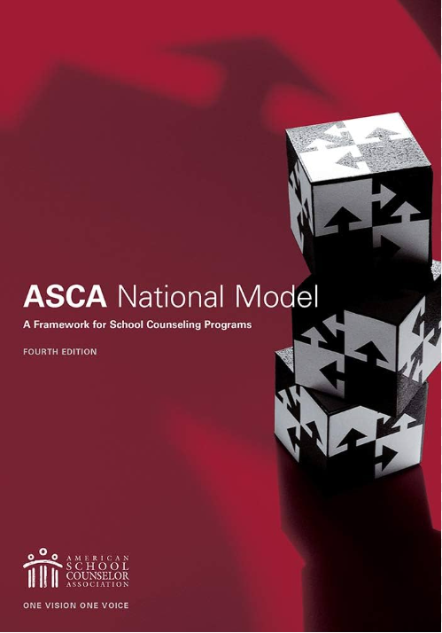

ASCA National Model®
Leadership Advocacy Collaboration Systemic Change
“School counselors work to maximize student success, promoting access and equity for all students. As vital members of the school leadership team, school counselors create a school culture of success for all.
School counselors help all students:
  Apply academic achievement strategies
  Manage emotions and apply interpersonal skills
  Plan for postsecondary options.”
(American School Counselor Association (ASCA), 2023, para.2)

Slide 17
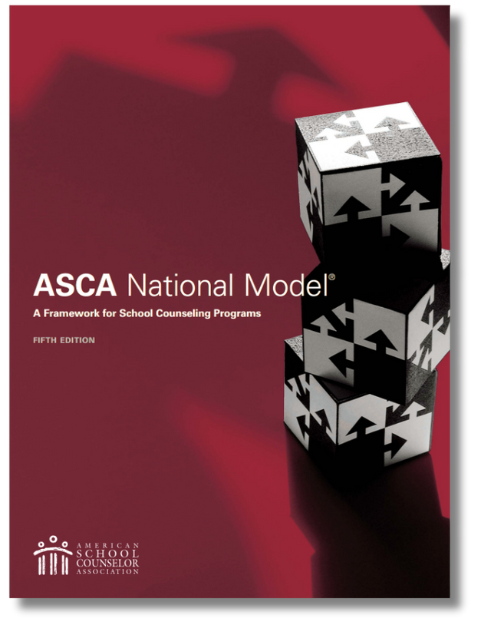
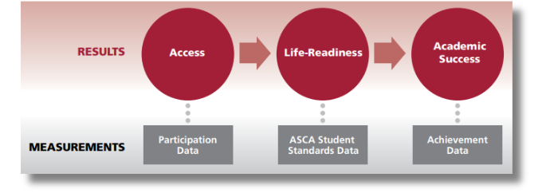
ASCA National Model® 5th Edition
Access the 5th Edition Summary

Slide 18
History of School Counseling I
  Expansion in positions by Federal Legislation.
  1952 American School Counselor Association Established
  Clinically oriented approach
1900s
1920s
1930s
1940-50s
  Vocational guidance in secondary schools​
  Guidance Services under Pupil Personnel Services
Adapted from material in Gysbers, N. C. (2010), Remembering the Past, Shaping the Future: A History of School Counseling. Alexandria, VA: American School Counselor Association.(Gysbers, 2010)

Slide 19

History of School Counseling II
  Colorado passes HB08-1370: SCCG
  Colorado passes SB09-25: Individual Career Academic Plan (ICAP)
  School counseling models, frameworks and organization
1960-70s
1980-90s
2000s
2008 & 2009
2025
  School counseling as a program​
  Elementary School Counseling
  2001- Federal legislation for terminology switch from guidance counselor to school counselor
  2003 ASCA National Model is published and 3 Domains are established
Adapted from material in Gysbers, N. C. (2010), Remembering the Past, Shaping the Future: A History of School Counseling. Alexandria, VA: American School Counselor Association.(Gysbers, 2010)

Slide 20






The School Counselor’s Role
Summarize the role of a school counselor in 3-4 words.​
Who can you work with to advocate for the appropriate role of a school counselor?
What is your favorite responsibility as a school counselor?​
What is a school duty that is inappropriate for a school counselor?
What is an appropriate school counselor duty or activity?
Is the current role of a school counselor accepted in your building? Why or why not?

Slide 21

Direction: The Role of the School Counselor
  Know the role of a school counselor
  Support the role of the school counselor
  Sustain the role of the school counselor through data

Slide 22
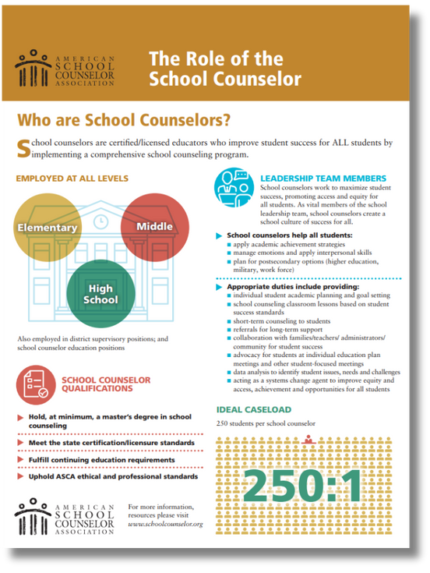
ASCA: The Role of the School Counselor
American School Counselor Association (ASCA)
  ASCA School Counselor Professional Standards (ASCA, 2025a)
  ASCA Ethical Standards (ASCA, 2022)
  ASCA Appropriate Use of School Counselor (ASCA, n.d.)
  Learn more by visiting: ASCA’s School Counselor Roles and Ratios website (ASCA, 2025a)
(ASCA, 2023)

Slide 23
CDE: Role of the School Counselor
CRS 22-91-102:
  (6) “School counselor” means a person who holds a special services provider license with a school counselor endorsement issued pursuant to article 60.5 of this title 22 or who is otherwise endorsed or accredited by a national association to provide school counseling services. “School counselor” includes a person who holds a special services intern authorization pursuant to section 22-60.5-111 (3).”
CDE Licensing:
  Master's Degree or higher in School Counseling as defined by accreditation by the Council for Accreditation of Counseling & Related Educational Programs (CACREP)
  Minimum of 100 clock hour practicum
  Minimum of 600 clock hour internship, with multiple grade levels of students under the supervision of a licensed school counselor

Slide 24

Break: 10 Minutes

Slide 25
SCCGP and ASCA Alignment
Development Year Process:
  Step 1: Foundation to School Counseling: Build SCCG team and develop a school counseling program vision and mission.
  Step 2: Intentional Data Review: Collect and analyze data on the school counseling program and student achievement, attendance and behavior/discipline to choose grant focus areas.
  Step 3: Targeted Needs Assessment: Complete a targeted needs assessment to gather more information on focus areas.
  Step 4: Needs and SMART Goals: Identify needs and write two to three grant goals on priority areas.
  Step 5: Root Cause and Interventions: Determine root causes of identified needs to inform school counseling interventions that support grant goals.
  Step 6: Assessment and Action Planning: Report SCCG School Counseling Program results and plan for year two implementation.

Slide 26

Beginning the Vision and Mission Statements
Open the ASCA National Model (4th ed.) to page 29.
Start with Beliefs 3-2-1 Activity:
                Name 3 personal beliefs
                Name 2 SCCG beliefs
                Name 1 aligning school counseling belief

Slide 27

School Counseling Vision
Open the ASCA National Model (4th ed.) to page 30.
              Illustrate a future picture of success for ALL students
                What will academic, career, and social/emotional success of students look like?
                Future oriented (5-15 years, after graduation)
              Dream Big- what student outcomes will be achieved?
              Drives the school counseling programming
              Align with district vision
(ASCA, 2019a)

Slide 28
School Counseling Vision Examples
  “The vision of Wiggins RE-50J School District Counseling Program is for all students to depart empowered with the knowledge and skills necessary to achieve academic, social-emotional, and career success, and to reach their fullest potential as respectful, responsible citizens.”
    Wiggins Primary School in Wiggins RE-50(J)
  “The Weld Central High School Counseling Department envisions a future where students are inspired, prepared, and empowered to achieve their academic and professional dreams. We strive to foster a culture of lifelong learning, resilience, and adaptability, guiding students toward fulfilling careers and higher education opportunities. Our vision is to be a catalyst for student's personal and professional growth, equipping them with the knowledge, skills, and confidence to thrive in an ever-evolving global landscape.”
    Weld Central High School in Weld County School District RE-3J

Slide 29

Writing Vision Statements
Align
What are key words/themes in the school and district vision? How can they be incorporated?
Communicate
Share the vision statement with students, staff, families, the community, stakeholders, etc.
Brainstorm and
Create a List
What do you hope students will achieve, do, and/or be in 15 years because of the school counseling program?
Develop Statement
Combine future statements and aligning language to create a statement of the future world where student outcomes are successfully achieved.
(ASCA, 2019a)

Slide 30

School Counseling Mission
Open the ASCA National Model (4th ed.) to page 31.
              Focus, direction, purpose
                Explains how the school counseling program will achieve the vision
                What does the school counseling program do?
                Ensures equity and access for all students
              Align
                With school and district mission statements
                Appropriate school counselor role
              Keep it simple
(ASCA, 2019a)

Slide 31
School Counseling Mission Examples
  “The Comprehensive School Counseling Program at Genoa-Hugo strives to positively impact the lives of our students by partnering with parents, community, faculty, and staff. The School Counselor offers an innovative, comprehensive program addressing student academic and career goals as well as personal and social needs. We provide students with the opportunities to acquire the educational and social competencies necessary for their growth toward lifelong success and as an effective, responsible member of society in a diverse and changing world.”
    Genoa-Hugo K-12 at Genoa-Hugo C113
  "At Stevens, the school counseling program supports all students to be welcomed in an environment where they feel safe and a sense of belonging. All students will have equitable access to social emotional learning and support and will understand their strengths and skills to help them succeed personally and academically."
    Stevens Elementary School in Jefferson County Public Schools

Slide 32


Writing Mission Statements
Address Student Needs
Emphasize equity, access, and all students
Align
What are key words/ themes in the school and district mission? How can they be incorporated?
Communicate
Share the mission statement with students, staff, families, the community, stakeholders, etc.
Brainstorm and
Create a list
What is the most important work of the school counseling program? Include important roles of the school counselor.
Develop Statement
Combine future statements and aligning language to create a statement of the future world where student outcomes are successfully achieved.
(ASCA, 2019a)

Slide 33
Vision and Mission Statements
Align with your school and district BUT be specific to the school site.
Review and update as needed.
Vision
  Focus on students and their outcomes
  Future oriented
  Descriptive and optimistic
  Focus on the three domains of school counseling (academic, career, and social/emotional)
  Use active voice and the present tense
(ASCA, 2019 a and b)
Mission
  Focus for school counseling program
  Long-term
  Incorporate school counselor as advocate
  Equity and access
  Use active voice

Slide 34

Lunch is Served
Please be back and prepared to begin at 12:45 PM.

Slide 35

Colorado School Counseling Association (CSCA)
Maddie Francis
2023-2024 School Counselor of the Year
CSCA PR/ Marketing Chair
Learn more at CSCA’s website.
10% off CSCA conference registrations: CORPS2025

Slide 36

Data and School Counselors
Comprehensive school counseling decisions can’t happen without data.
              School counselors need to know:
                Where to find data
                How to interpret data
                How to use data (leading and lagging) to inform programming
              School Counselors need to show data to:
                Demonstrate progress and effectiveness of work
                Advocate for the appropriate role of the school counselor

Slide 37

School Counseling Impact
The goal is to align school counseling work with school priorities.
  Look at and download your school’s Unified Improvement Plan (UIP)
    What are your school’s priorities?
    How can the school counseling program support those areas?

Slide 38

Administrator and School Counselor Collaboration
Round I:
Administrators and Leadership: Does your school counselor support your UIP work? If yes, how so? If not, why not?
School Counselors and Teachers: Do you support your school’s UIP development? If so, how. If not, why not?
Round II:
Administrators and Leadership: What are some ways school counselors can support areas of ___________?
School Counselors and Teachers: Can you please share about your school’s UIP Process. I.e. who is involved, what data is reviewed, what conversations are had, what priorities are focused on?

Slide 39

Data and the SCCGP
C.R.S. 22-91-103 (1)(e)
  Collect data on its counseling program to demonstrate the impact of the school counseling program on:
    Student achievement
    Student attendance
    Student behavior
  Guide future action and improve future results for all students

Slide 40

Data and ASCA Part I
              Student needs drive the focus and direction of the school counseling program
              Ensures equitable school counseling services
                ALL students benefit
              Evaluates and determines effectiveness of school counseling strategies, interventions, and activities
(ASCA, 2019a, p. 32)

Slide 41
Data and ASCA Part II
“The use of data helps school counselors:
    Monitor student progress
    Identify students who are having difficulties or discipline problems
    Identify barriers to learning
    Understand factors affecting student behavior
    Identify access and equity issues
    Close achievement, opportunity, and attainment gaps
    Assess the effectiveness of school counseling program activities
    Improve, modify or change services provided to students
    Educate stakeholders about the power of a school counseling program.”
(ASCA, 2019a, p. 32)

Slide 42

Types of Data
  Participation Data
    Answers the question of “who participated?”
      How many students were impacted?
      How much time?
      How many sessions or activities?
  Standards and Mindsets and Behavior Data
    Illustrates students progress and “what they learned”
    Measure change in the attitudes, knowledge, and skills
    Collect before and after strategy, intervention, activity
  Outcome Data: Measures impact of strategy, intervention, or activity on attendance, achievement, and/or discipline (behavior)
(ASCA, 2019a, pp. 34- 36)

Slide 43


Data Categories
            Quantitative Data:
                Numerical expression
                Counted and measured
                Answer questions of “how many,” “how much,” or “how often?”
                Examples: number of people, percentage of students, average hours
            Qualitative Data:
                Descriptive
                Language expression
                Answers questions of “why” and “how?”
                Often subjective and shares perspectives
                Example sources: interviews, needs assessments, observations
(FullStory Education Team, 2021)

Slide 44
Afternoon Break: 10 Minutes

Slide 45
Intentional Data Review
The education provider shall collect data on its counseling program to demonstrate the impact of the school counseling program on student achievement, attendance, and behavior.
School Counseling Program
STUDENT ACHIEVEMENT
STUDENT ATTENDANCE
STUDENT BEHAVIOR
C.R.S. 22-91-103 (1)(e)

Slide 46

Intentional Data Review Process
Look at data for each bucket.
School Counseling Program
STUDENT
ACHIEVEMENT
STUDENT
ATTENDANCE
STUDENT
BEHAVIOR
Evaluate school counseling program
Evaluate student achievement
Evaluate student attendance
Evaluate student behavior
C.R.S. 22-91-103 (1)(e)

Slide 47
Finding the Data
Did You Know?
“Data Hunter” and “Data Scientist” are job titles.
School Counseling Program
STUDENT
ACHIEVEMENT
Write it down...
  Who is your district data hunter/scientist for each bucket?
STUDENT
ATTENDANCE
STUDENT
BEHAVIOR

Slide 48
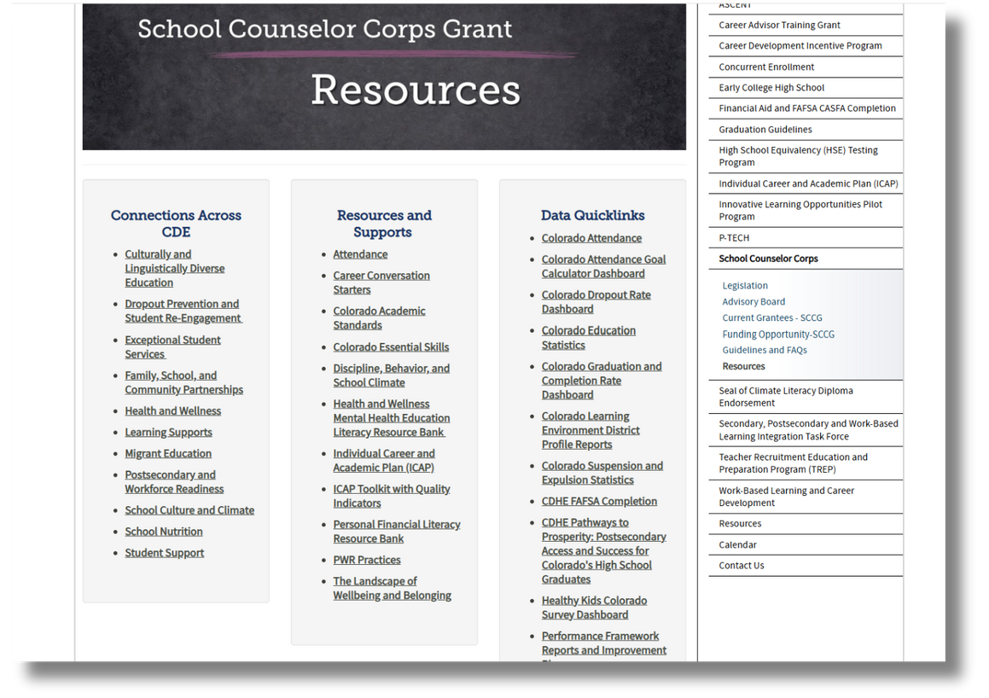
Data Quicklinks
Bookmark the
SCCG Resources website to
access publicly available
data sources.

Slide 49

Data Reminders
              Finding data shouldn’t be difficult to find or expensive
              Data is readily available in every school- you just need to know where to look
              Look at existing data BEFORE you write goals, give surveys or needs assessments, or make decisions and changes
              Never be afraid to look at the ugly data, it is where the work lives

Slide 50
School Counseling Data
  Examples of School Counseling Data:
    Time and effort assessment
    Number of school counselors
    Student to school counselor ratio
    School counseling goals
    Number of school counselor and administrator meetings
    School counselor years of experience
    Comprehensive programming (academic, career, social-emotional)
    School counselor evaluation
    Qualitative data on how school community views school counselors
  Potential Data Tools:
    ASCA Use-of-Time Template (2025)
    Environmental Scan Model (Carlson, 2020)
School Counseling Program

Slide 51
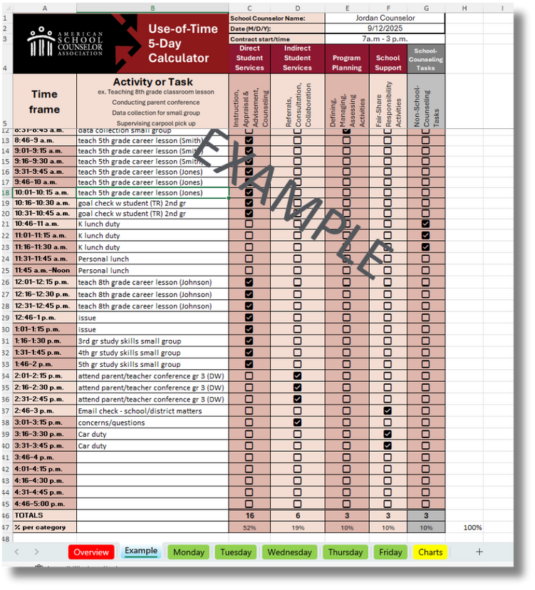
Use-of-Time
Access ASCA's Use-of-Time Calculator:
  Time and Effort Assessment required per C.R.S. 22-91-103 (1)(d)
    Snapshot of the school counselor's use of time
  Base use of time on student needs
    80% or more in direct and indirect services
    20% of time for program management and school support
  Advocate for the best use of time
    Did time spent address student needs?
    Do you have a rationale for programming?
    Can you justify changes to use of time?
(ASCA, 2019, p. 63)

Slide 52
School Counseling Data Review
What school counseling data did you bring today?

Slide 53
Achievement Data Review
  Examples of Data:
    Grades, grade point average (GPA),competencies
    Credits (on-track for graduation)
    Missing work/assignments
    Test scores
    SRD rates/READ plans
    Graduation rates, matriculation, FAFSA completion, etc.
    Enrollment in specific courses (ex. Algebra)
  Potential Data Tools:
    Schoolview- Explore School and District Data
    Read Act Dashboard
    State Accountability Data Explorer
STUDENT
ACHIEVEMENT

Slide 54
Attendance Data Review
  Examples of Data:
    Daily attendance rates
    Specific classroom attendance
    Attendance and/or participation in extracurriculars and clubs
    Chronic absenteeism
    Dropout rates
    Truancy rates
  Potential Data Tools:
    Attendance Goal Calculator Dashboard
    Colorado Dropout Rate Dashboard
    Colorado Attendance Data Spreadsheets
    Learning Environment District Profile Reports
STUDENT
ATTENDANCE

Slide 55
Behavior (Discipline) Data Review
  Examples of Data:
    Number of responses to classroom
    Referrals
    Suspensions
    Expulsions
    Positive Behavioral Interventions and Supports (PBIS)
  Potential Data Tools:
    Learning Environment District Profile Reports
    CDE Suspension and Expulsion Statistics
STUDENT
BEHAVIOR

Slide 56
Data Review
What data did you bring today?

Slide 57


Choose a Data Focus
Pick 2 areas of focus from the Intentional Data Review to dig deeper.
  Must choose focus areas from data needs revealed in:
    Student Achievement
    Attendance
    Behavior (Discipline)
  Consider SMART goals for the next 3 years

Slide 58
Dig Deeper with the Needs Assessment
  The needs assessment should answer questions in the focus areas AFTER you have done the initial data review.
  What questions do you still have after reviewing your school counseling program and looking at student outcome data?

Slide 59

Webinar #1: Targeted Needs Assessment
  Stop, spend some time in the data.
  Wait until Webinar #1 in October to begin the Targeted Needs Assessment.

Slide 60
SMART Goal Reflection
SMART GOAL Example:
  CDE School will reduce the total number of students referrals by 17% from 180 total referrals to 150 total referrals, by May of 2029. This will be measured by the number of referrals in Infinite Campus and reviewed by administration and school counselors.
If you had to write a SMART goal today...
what would it say?

Slide 61

Mark Your Calendar for Webinars
Webinars will occur from 9:00 to 11:00 AM via Zoom.
  October 1, 2025: Webinar #-Targeted Needs Assessment
  November 5, 2025: Webinar #2- SMART Goals
  January 14, 2026: Webinar #3- Mid-Year Check-In
  February 4, 2026: Webinar #4- Analyzing Data Hatching Results
  March 4, 2026: Webinar #5- Interventions
  April 29, 2026: Webinar #6- Assessment and Action Planning
Links to register are on the Grant Training website and
will be sent in the monthly emails.

Slide 62


Mark Your Calendar for Training
Each grantee will choose ONE regional training to attend.
  Eventbrite invites to the (PWR Regional Training) will be sent via email.
    Everyone on your team should attend the same training.
      Cohort 12,13,14: building administrator and any SCCGP grant-funded school counselor
      Cohort 15: building administrator and SCCGP planning year team
  Dates and Locations:
    September 10, 2025, University of Colorado Colorado Springs
    October 21, 2025, Colorado Mountain College, Steamboat Springs
    October 28, 2025, Limon Community Building, Limon
    November 12, Denver, Legacy Campus
    November 18, 2025, Adams State, Alamosa
    December 9, 2025, Northeastern Junior College, Sterling

Slide 63

To Do’s
  Review the ASCA National Model pages 1-28
  Finish Vision and Mission Statements ASCA pages 29-31
  Finalize Intentional Data Review Process ASCA pages 32-40
  Choose Two Focus areas to be ready for the needs assessment training on Oct 1.
  Register for webinars
  Look for Regional Training invites

Slide 64
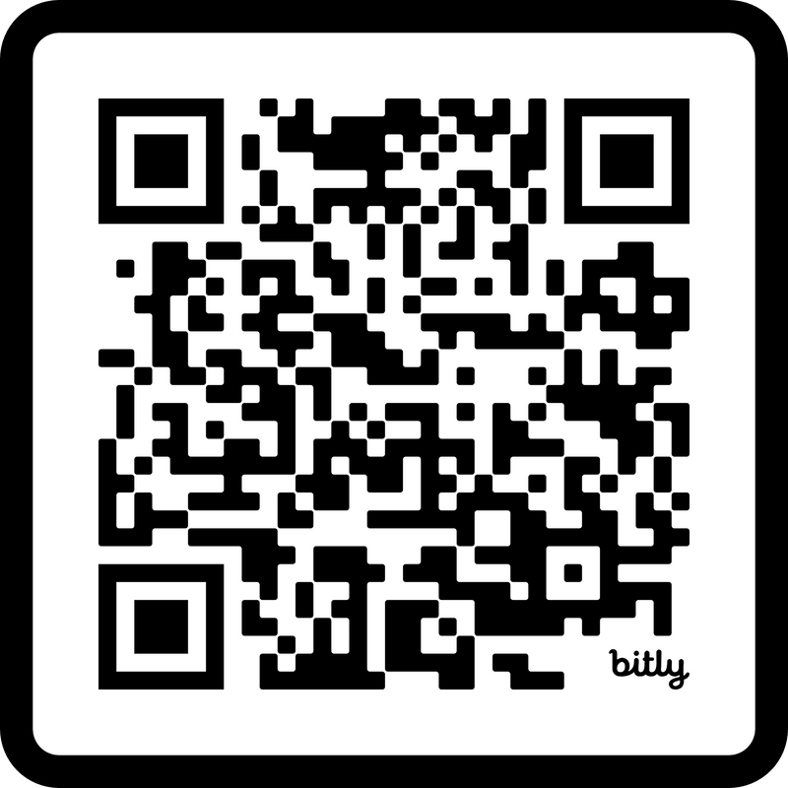
Training Evaluation and Feedback
Please complete the form on today’s training.
https://bit.ly/C15Fall

Slide 65

Questions
Email or call as questions come up.

Slide 66


Contact Us
If questions come up, please reach out.
SCCG Program
Jennicca Mabe​
Mabe_j@cde.state.co.us ​
303-923-0974​
Brooke Morgan​
Morgan_b@cde.state.co.us​
303-923-0966​
CDE Grants Fiscal
Gloria Kochan
kochan_g@cde.state.co.us

Slide 67
References I
American School Counselor Association. (n.d). Appropriate and inappropriate activities for school counselors.
https://www.schoolcounselor.org/getmedia/8fe536c2-7a32-4102-8ce7-42e9b0683b3b/appropriate-activities-of-school-counselors.pdf
American School Counselor Association. (2019a). The ASCA national model: A framework for school counseling programs (4th Edition).
Alexandria, VA: Author.
American School Counselor Association. (2019b). The ASCA national model implementation guide (2nd edition) [eBook edition]. Alexandria, VA: Author.
American School Counselor Association. (2022). ASCA ethical standards for school counselors.
https://www.schoolcounselor.org/getmedia/44f30280-ffe8-4b41-9ad8-f15909c3d164/EthicalStandards.pdf
American School Counselor Association. (2023). The role of the school counselor.
https://www.schoolcounselor.org/getmedia/ee8b2e1b-d021-4575-982c-c84402cb2cd2/Role-Statement.pdf
American School Counselor Association. (2025a). ASCA School Counselor Professional Standards & Competencies. Alexandria, VA: Author.
https://www.schoolcounselor.org/getmedia/a8d59c2c-51de-4ec3-a565-a3235f3b93c3/SC-Competencies.pdf
American School Counselor Association. (2025b). School counselor roles and ratios.
https://www.schoolcounselor.org/About-School-Counseling/School-Counselor-Roles-Ratios
American School Counselor Association (2025c). The ASCA National Model: A Framework for School Counseling Programs (Fifth Edition). Alexandria, VA:
Author.
American School Counselor Association. (2025). Templates and Tools.
https://www.schoolcounselor.org/About-School-Counseling/ASCA-National-Model-for-School-Counseling-Programs/Templates-Resources
Carlson, L. (2020). The environmental scan model for school counselors. International Journal of Social Policy and Education, 2(9), 5-15.
https://www.researchgate.net/publication/363047223_Environmental_Scan_Model_for_School_Counselors

Slide 68
References II
Colorado Department of Education. (n.d.). Performance framework reports and improvement plans.
https://www.cde.state.co.us/schoolview/frameworks/welcome#uip/
Colorado Department of Education. (2019, June 4). State Accountability Data Explorer. SchoolView®: School and district data.
https://www.cde.state.co.us/code/accountability-dataexplorertool
Colorado Department of Education.(2023, May 5). READ Act Data Dashboard. https://www.cde.state.co.us/code/readactdashboard
Colorado Department of Education. (2024, September 9). District Profile Reports. Discipline.
https://www.cde.state.co.us/code/districtprofilereports
Colorado Department of Education. (2024). Explore school and district data. SchoolView®: School and district data.
https://www.cde.state.co.us/schoolview/explore/welcome/
Colorado Department of Education. (2024, December 18). Attendance Goal Calculator Dashboard. Attendance.
https://www.cde.state.co.us/code/attendance-goal-calculator
Colorado Department of Education. (2025, January 21). Dropout Dashboard. Dropout.
https://www.cde.state.co.us/code/dropoutdashboard
Colorado Department of Education. (2025, January 24). Suspension/Expulsion Statistics.
https://www.cde.state.co.us/cdereval/suspend-expel
Colorado Department of Education. (2025, August 8). Attendance. Reports and Data.
https://www.cde.state.co.us/cdereval/truancystatistics
Colorado Department of Education. (2025, August 15). School Counselor Corps Grant Program resources.
https://www.cde.state.co.us/postsecondary/scc_resources
Colorado Department of Education. (2025, August 19). Unified improvement planning. https://www.cde.state.co.us/uip

Slide 69
References III
FullStory Education Team. (2021, October 5). Qualitative vs. quantitative data: What’s the difference?
https://www.fullstory.com/blog/qualitative-vs-quantitative-data/
Gysbers, N. C. (2010). Remembering the Past, Shaping the Future: A History of School ​Counseling. Alexandria, VA: American School Counselor Association.​ https://www.schoolcounselor.org/getmedia/4a2b2400-513e-4189-a819-fb84cf037b9f/remembering-the-past.pdf

Slide 70
Thank you!
We look forward to seeing you soon.

