Slide 1
Understanding the Foster Care Provisions in the Every Student Succeeds Act (ESSA): Considerations for Middle School Counselors
School Counselor Corps Grant Program Fall Workshop
October 18, 2017

Slide 2
Agenda
Defining Foster Care and Colorado Demographics
Intent of School Stability and Foster Care Provisions
Foster Care Provisions in Every Student Succeeds Act and Colorado State Statute
Best Interest Determination Meetings
Special Considerations
School counselor advocacy
Resources

Slide 3
Defining Student in Foster Care
“Student in foster care” means that an individual has experienced an out-of-home placement and has been enrolled in a Colorado public school during the time period or school year referenced.
The foster care placement could be brief, such as a few days, or might occur across multiple years.”
3

Slide 4
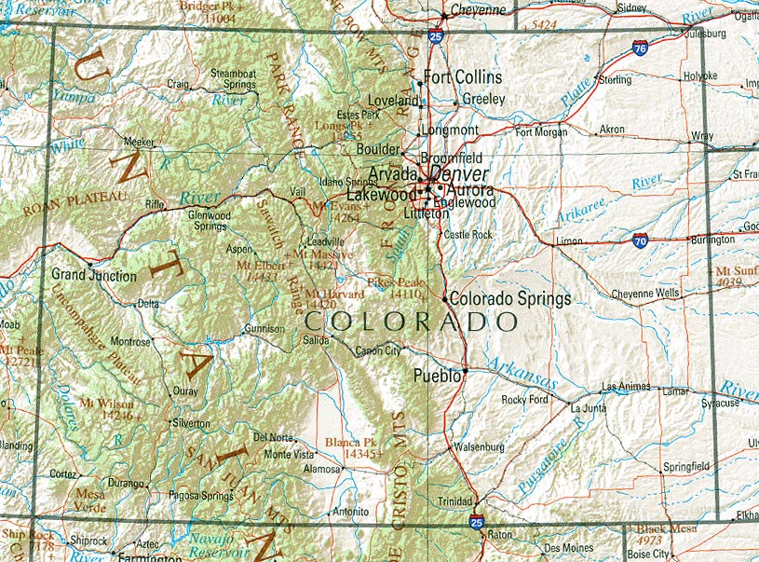
Colorado Foster Care Education Demographics
4,956
K-12 foster care students (2014-15)
44% White
Students in Foster Care
(2014-15)
55%
Students in foster care are male
(2014-15)
87%
Districts include students in foster care
60%
attend school in the Denver metro area
42.2%
(2,092)
Grades P-5
19.3%
(956)
Grades 6 to 8
38.5%
(1,908)
High School
(9th-12th grade)
37% Hispanic/Latino
12%
Black/African American
30%
Special education designation
(2015-16)

Slide 5
Every Student Succeeds Act Foster Care Provisions and Colorado Specific Laws
State Point of Contact: Kristin Myers, State Coordinator for Foster Care Education at Colorado Department of Education
LEA Single Point of Contact: C.R.S. 22-32-138 requires each school district and the state charter school institute to designate a person to at as the Child Welfare Education Liaison (CWEL).
Best Interest Determination: The Colorado Department of Human Services created several sample templates for child welfare agencies and school districts to coordinate transitions and transfers for children and youth in foster care at: https://www.colorado.gov/pacific/cdhs/forms-20

Slide 6
Every Student Succeeds Act Foster Care Provisions and Colorado Specific Laws
Immediate Enrollment in School and Transfer of School Records
C.R.S. 22-32-138 (2)(a) states CWEL’s and Child Welfare Agencies have 5-days to transfer records and enroll students in an out-of-home placement (ESSA states immediately)
Records cannot be withheld due to outstanding fees at the previous school. Note: this is now true for ALL Colorado students.

Slide 7
Fee Waivers
Students in out-of-home placements are entitled to free lunch (including Kinship placements)
Fee waivers are mandated in Colorado State Statute under C.R.S. 22-32-138.
Note: this includes, but is not limited to any general fees, fees for books, fees for lab work, fees for participation in school or extracurricular activities, and fees for before-school or after-school programs.
The school district or school shall not limit the opportunity of a student in out-of-home placement to participate in-school and extracurricular activities before-school and after-school programs due to waiver of the participation fees.

Slide 8
Transportation
The Colorado Department of Human Services created a sample MOU for districts to use, and can be found at: https://www.colorado.gov/pacific/cdhs/forms-20
Transportation plans are in varying stages of completion across the state.
CDE and CDHS are hosting a series of convenings for additional guidance/support.

Slide 9
School Credit and Absences
Partial credit must be awarded for coursework completed in previous school
Absences from school are considered excused for court appearances or participation in court-ordered activities including, but not limited to, family visitation or therapy.
Reference: C.R.S. 22-32-138

Slide 10
Best Interest Determination
County child welfare caseworker is responsible for inviting related parties and facilitating meeting prior to the school move (see flowchart)
CWEL responsibilities

Slide 11
Special considerations for transitions
Are parental rights still in tact? How much should that parent be included in the educational decisions?
District of origin for parent (not address of out-of-home placement)
Definition of school of origin
Students on an IEP
School safety considerations
Students in facility schools or residential treatment
Contact information and flow of communication

Slide 12
School Counselor Advocacy
Know ESSA foster care provisions and Colorado laws that protect students in foster care
Know the other professionals involved, and their role
Create a welcoming environment through a trauma-informed lens
Work intentionally on ICAP to align courses and work with the student interests
Assist the student in communicating this information to caseworkers and GAL in a developmentally appropriate way
Know about scholarship information and specialized programs in colleges (even at the middle school level)
Focus on what is in the best interest for the student (not necessarily what is best or most convenient for adults)

Slide 13
Non-Regulatory Guidance
ESSA guidance encourages educational and child welfare agencies to consider ways to support better outcomes for student in foster care and facilitate successful transitions from the elementary and secondary education to college and careers.
View the full document: Non-Regulatory Guidance

Slide 14
Kristin Myers, State Coordinator for Foster Care Education (303)866-6007 myers_k@cde.state.co.us Foster Care Education Website: http://www.cde.state.co.us/dropoutprevention/fostercare_index
Foster Care Education Contact Information

