Slide 1


Before We Begin Webinar #5
  This training will be recorded.
  Closed-captioning: click the Live Transcript option on your bottom Zoom toolbar, under more.
  Slides and recording will be posted to the Grant Training website under Webinar #5.

Slide 2




School Counselor Corps Grant
Webinar #5
Assessment and Action Planning
April 30, 2025

Slide 3
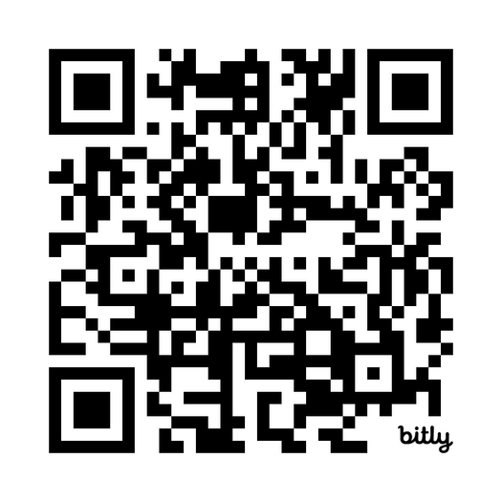
Housekeeping
  Sign in for record of attendance.
  Please change name in Zoom to include your name and school/organization.
  Keep video on throughout the webinar.
  Use the raise hand function or chat to engage.

Slide 4










Maycember
1
2
3
SCCG
4
5
6
7
8
9

Slide 5

Maycember Breathing Exercise
  Deep breathing relieves stress
  Deep breathing lowers your heart rate
  Deep breathing helps you sleep better
Box Breathing (4-4-4-4):
  Inhale for 4 seconds
  Hold for 4 seconds
  Exhale for 4 seconds
  Hold for 4 seconds
British Heart Foundation
James Nester

Slide 6

DYP- Where Are We Now?
  Webinar #1- October 2, 2024- Needs Assessment
  Webinar #2- November 6, 2024: SMART Goals
  Webinar #3- February 11, 2025: Hatching Results Identifying Gaps in Data
  Webinar #4- March 19, 2025: Interventions and Supports
  Webinar #5- April 30, 2025- Assessment and Action Planning

Slide 7

Today’s Agenda and Objectives
By the end of this webinar, grantees will be able to:
  Prepare for hiring a licensed school counselor.
  Assess the school counseling program and use data to action plan for grant year two.
  Educate stakeholders on the SCCG and comprehensive school counseling programming.
  Complete the Development Year Report.
    Please have a SMART goal ready to share
*Please take breaks as needed.

Slide 8

Continuous Improvement
  Focus: prioritize and align to SCCG
  Evaluate: gather, analyze, and interpret
  Plan: Improvement strategies (school counseling program services) based on data, root cause analysis, and best practices
    Development Year Report and budget
  Implement
    School counseling program services
Evaluate
Plan
Focus
Implement
(CDE, 2024)

Slide 9

Assessing the School Counseling Program and Services
See page 85 in the ASCA National Model (4th edition).

Slide 10
School Counseling Program Assessment
  Regularly assess the school counseling program for effectiveness to:
    Plan and improve.
    Illustrate “how students are different as a result of the school counseling program.”
  Collect and analyze school counseling data on:
    Participation
    Standards, quality indicators, Mindsets and Behaviors
    Student outcomes in attendance, achievement, behavior/discipline
  Track data over time:
    Achievement, attendance, and discipline data illustrates trends, strengths, gaps, and systemic priorities.
(ASCA, 2019, pp. 85, 89, and 92)

Slide 11

School Counseling Assessment Resources
  School Counselor Corps Grant:
    Development Year and End of Year Reports
    Fidelity of Implementation (FOI) Rubric
  Access Optional Resources on the ASCA’s Templates and Tools webpage:
    School Counseling Program Assessment
    Annual Results Reports:
      Classroom and Group Mindsets and Behaviors
      Closing the Gap

Slide 12

Reporting Results
  Illustrate school counseling program effectiveness and impact
  Inform decisions for program improvement
    Intentional activities, interventions, professional development and budget items to meet needs
  Educate stakeholders:
    Document use of time
    Student needs and gaps, trends, progress
  Advocate
    Student needs
    Systemic changes
    Sustainability
(ASCA, 2019)

Slide 13
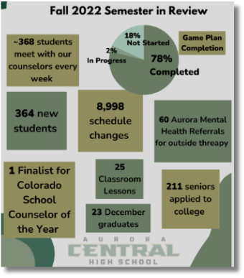
Sharing Results
  Review and ensure that all data collections and information sharing follow federal, state, and local policies.
  Example methods of sharing results:
    Staff meetings
    Professional Learning Communities
    Leadership Meetings
    Advisory Meetings
    Newsletters
    Bulletin Boards
    School Board Presentations
    Websites
    Infographics
    Slideshows/Presentations
    Handouts
Aurora Central High School
Counseling Department, 2023

Slide 14
The Power of School Counseling Reports
The Report Template That Sparked a Movement: Making School Counseling Visible
April 2, 2025, Written By Jasmine Arellano-Najera
  Join a breakout room, introduce yourself and your school/level.
  Read the linked blog post and review linked templates.
  Discuss:
    What data was included in reports?
    How did the reports support the role of the school counselor?
    How could you incorporate school counselor reports into your practice? Why would you want to?
In the chat, share one way you can utilize school counseling reports to support sustainability.

Slide 15
School Counseling Action Planning
See page 46 in the ASCA National Model (4th edition).

Slide 16

Action Planning
  Be Intentional
    “Define the scope, focus, timing and setting of planned instruction.”
    Align with SMART goals and student data.
  Create Action Plans
    Continuous improvement cycle- adjust if needed
    Determine who needs services and what will be delivered
    Identify standards to address student needs
    Select activities, curriculum, and resources needed
    Share the plan and identified outcomes (goals)
    Schedule services and calendar programming
2024-2025
2025-2026
(ASCA, 2019, p. 46)

Slide 17

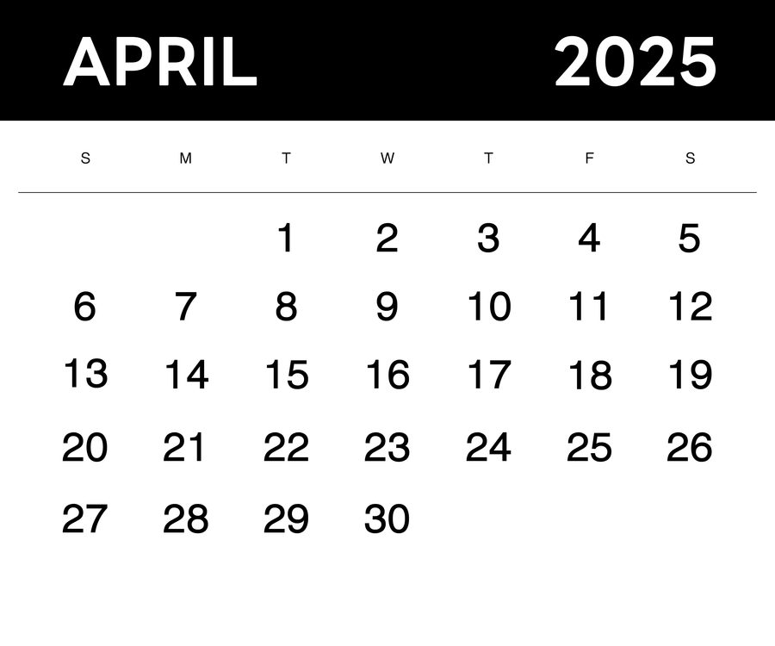



What Type of Planner Are You?

Slide 18
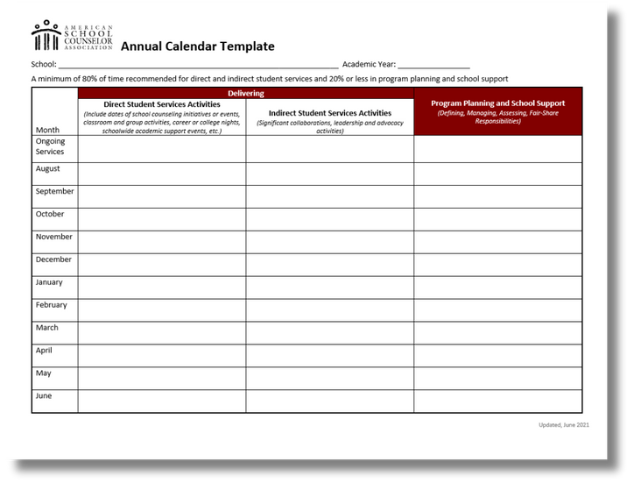
Calendars
  Intentional:
    Define priorities and focus
    Guide future actions
  Inform and Advocate:
    Publish for students, families, school staff, and leadership
    Educate on access for all, role of school counselor, and goals
  Accountability
    Publicly planned and protected time
    Encourage involvement
  Annual, weekly, monthly
(ASCA, 2021, pp. 68-71)
Access ASCA’s Annual Calendar under the ASCA Templates and Tools webpage

Slide 19

SCCG Team Meetings
  Evaluate
    Gather, analyze, interpret
    Progress towards goal and outcomes, impact
    Strengths, barriers, opportunities for improvement
  Focus and Plan
    Priorities and alignment
    Timelines and calendars
    Baseline data, progress monitoring, and goals
    Sustainability
  Implement
    School counseling program services
  Advocate
    Share results
    Sustainability

Slide 20

SCCG Grant Requirements
  Trainings:
    Virtual Welcome
    Virtual Fiscal Training
    In-Person Regional Training
    Virtual Professional Development
  SCCG Reporting:
    End of Year Report
    Fiscal:
      Budget workbook deadlines
      Annual Financial Report
      Interim Financial Report

Slide 21
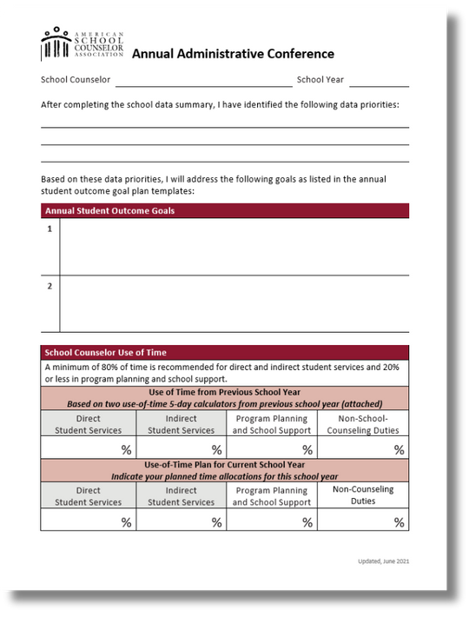
Annual Administrative Conference
  Formal discussion with school counselor(s) and administrator
  Complete within the first two months of school
  Increase understanding of the counseling program:
    Priorities and alignment of goals
    School counselor's use of time
    Current ratios
    Provided services
    Professional development
    School counselor commitments
  Advocacy
(ASCA, 2019, pp. 58-62)
Access the Annual Administrative Conference under the ASCA Templates and Tools webpage

Slide 22
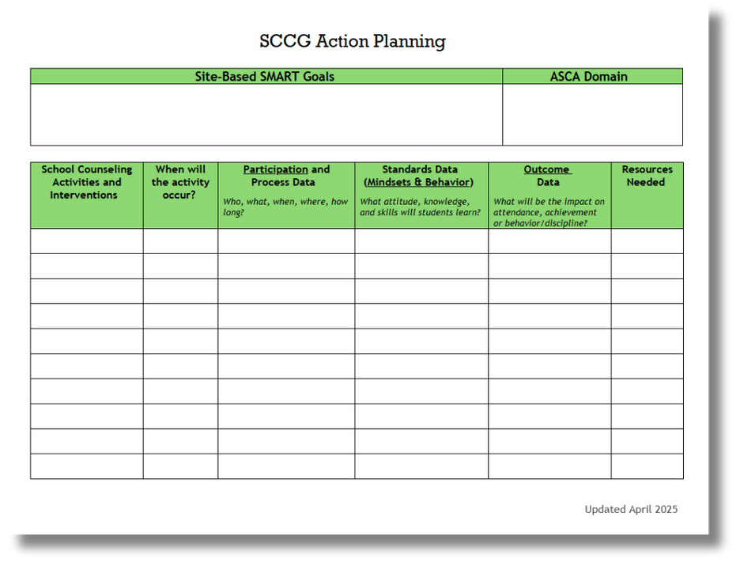
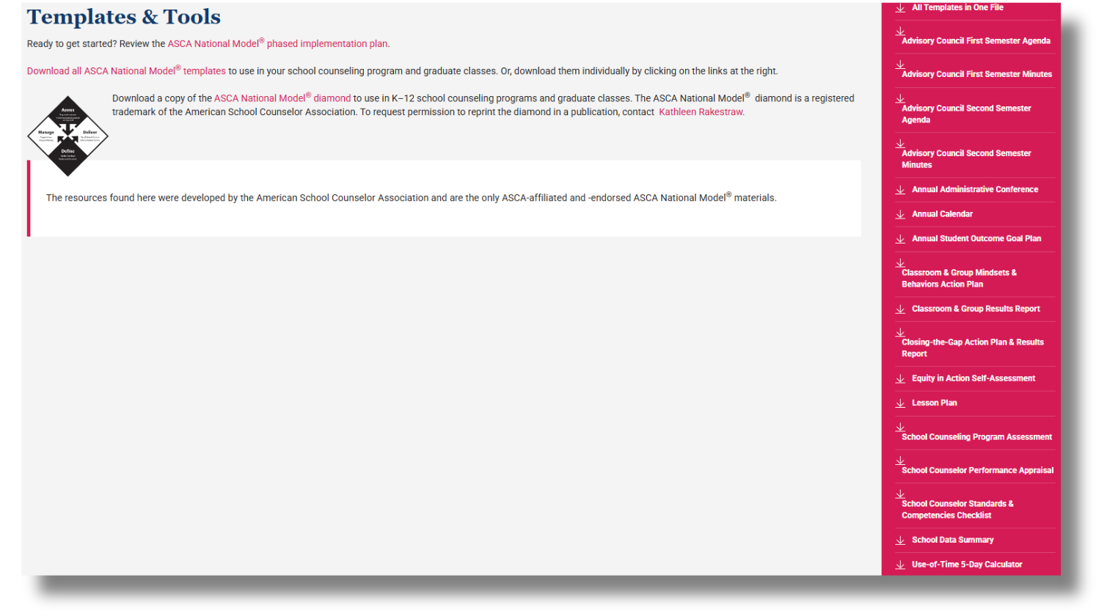
Action Planning Tools
Download the SCCG Action Planning Template on the SCCG Training and Material website
Access ASCA’s templates on their Templates and Tools webpage

Slide 23

Questions on Action Planning

Slide 24
Development Year Report
Who:
Every FUNDED site fills out this report but there should be collaboration as a district.
What:
An end of year report to track comprehensive school program planning and legislatively required data.
Why:
Legislatively required report that supports SCCG and comprehensive school counseling program evaluations.
Type in the chat how far along you are on the end of report from 0-5?

Slide 25
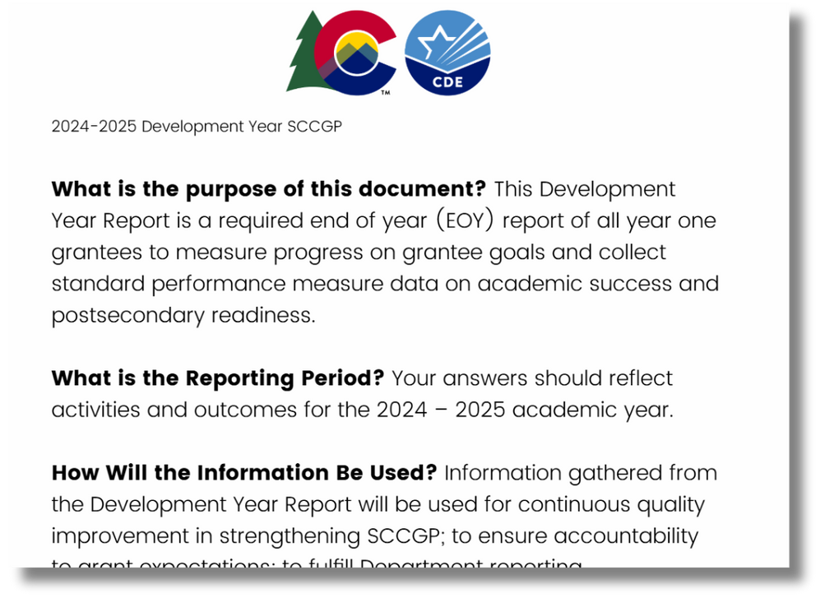
Development Year Report Submission
  Submit the Development Year Report via the Qualtrics link.
  Download a copy of completed report for your records.
  Please note: Qualtrics does not save work.
    Download and use the guiding template to collect the information and then copy into Qualtrics when ready.

Slide 26


SCCG Goals
SCCG Goals
C.R.S. 22-91-103
Application Goals
SMART
Goals

Slide 27
SCCG SMART Goal Reminders
Two SCCG SMART goals:
  Must be student outcome based.
  Must address a need in attendance, achievement, or behavior.
Additional goals can be written to address:
  ICAP
  Social Emotional Learning
  Climate and Culture
  Implementation of Comprehensive School Counseling

Slide 28
SCCG Goal Template
  Plug your smart goal into this template to see if it works:
  By May 2028, the __________________________________ (specific student group, grade level, etc.), will ________ (decrease/increase) ____________________ (student outcome area based in achievement, attendance, or behavior/discipline) by ________ % (percent change), from _________(baseline) to _______ (target). Data will be collected through_____.

Slide 29

SMART Goal Breakout
  Introduce yourself and your school/level.
  Share which area your SMART goal addresses:
    Behavior, achievement, attendance
  Share your SMART goal.
  Share interventions you plan to use.

Slide 30

Development Year Report Reminders
Brooke and Jennicca review each report and
provide feedback or require revisions if needed.
Before submitting, make sure:
  Each question is fully answered- narrative responses should be more than one sentence.
  Goals must be student-outcome based with a measurable baseline and target included.
  The report can be used as a critical tool for those who may inherit the grant if staff changes occur.

Slide 31
Development Year Reports Due
May 30, 2025
Access all reporting details and the submission link on the SCCG Reporting website.

Slide 32
Budget Revisions
Last day to submit a budget revision for FY2024-25 is May 15, 2025.
  If the FY2024-25 budget needs to change, a budget revision must be submitted and approved through GAINS before spending can occur.
  Do not purchase or pay using SCCG funds until a budget has been approved in writing.
  Steps to complete a budget revision are available to download.
    Include date of changes in description (i.e. Revised 3/15/2025).

Slide 33

No Carryover
  Read the Elimination of State Grant No Cost Extension Letter.
    Emailed to grant contacts on the week of April 3, 2025.
Spend, Spend, Spend

Slide 34
Continuation Budgets
Budget for the 2025-2026 school year due on May 30, 2025.
  All budgets available now in GAINS.
    Update budget sections with anticipated costs for FY2025-26.
      Year two- hiring a 1.0 FTE school counselor is required.
    Revisions are expected.
  Instructions on completing continuation budgets on the GAINS Training Resources webpage.
    View written instructions
    Watch the recorded webinar
    Download a copy of the instructions
  Access budget workbook reminders for details on description needs.

Slide 35
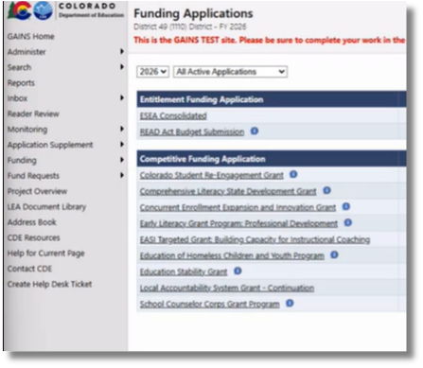
Completing Budgets in GAINS
  Find the continuation budgets in the 2026 fiscal year on the Funding Applications page.
    To complete the budget, select fiscal year 2026 on the Funding Applications Page.
    Look for funding application with “continuation” included.
    Update contact information and budget sections.
If there are any technical assistance questions, please contact GAINS@cde.state.co.us or complete a GAINS Help Ticket.

Slide 36
Continuation Budgets Due
May 30, 2025

Slide 37
Questions on Reporting and Budgets

Slide 38

Hiring the School Counselor
  What will you or did you include in job description?
  Who will be involved in the hiring process?
  Barriers to hiring?

Slide 39
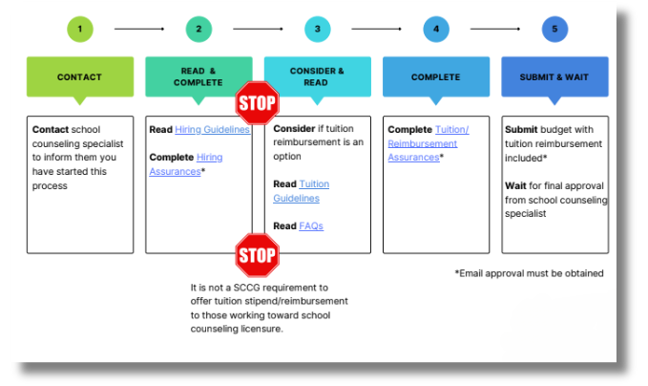
Hiring the School Counselor
All SCCG positions must be filled with a Colorado licensed school counselor.
  See Hiring Guidance and Tuition Support if a candidate is not a licensed school counselor yet.
  Districts must contact SCCG program support before making an employment offer as these guidelines should be used only when hiring a licensed school counselor is not a possibility and does require CDE support documents.
  Supports school counselor pipeline with SCCG funding.

Slide 40

SCCG Deadlines
  May 15, 2025: 2024-2025 budget revisions due
  May 30, 2025: Continuation Budgets due
  May 30, 2025: Development Year Report due
  June 30, 2025: last day to spend FY2024-2025 funds
    Check district guidelines

Slide 41
To Do Today!
Get ready for next year and...
  Register for the 2025-2026 Virtual Welcome.
    Required for site-based administrator and grant-funded school counselor.
  Register for the 2025-2026 Fiscal Welcome.
    Open to all SCCG team members, specifically helpful for fiscal representatives and those completing fiscal documents.

Slide 42
Changes in Your SCCG Team
If you are leaving please email Jennicca or Brooke a point of contact.
If you are leaving please leave:
  Original grant application
  Intentional Data Review materials
  Needs Assessment
  Development Year Report
  Continuation Budget
  Jennicca and Brooke contact info

Slide 43


This Summer
We work throughout the summer.
Call or email us if you need something!
SCCG Program
Jennicca Mabe​
Mabe_j@cde.state.co.us ​
303-923-0974​
Brooke Morgan​
Morgan_b@cde.state.co.us​
303-923-0966​
CDE Grants Fiscal
Gloria Kochan
kochan_g@cde.state.co.us

Slide 44

Feedback
Please share feedback on today’s webinar through the Zoom survey questions.
Help our team plan for regional trainings next year! Share your feedback in this optional form.

Slide 45
Questions

Slide 46
References
American School Counselor Association. (2019). The ASCA national model: A framework for school counseling programs (4th Edition). Alexandria,
VA: Author.
American School Counselor Association. (2025). Templates and tools.
https://www.schoolcounselor.org/About-School-Counseling/ASCA-National-Model-for-School-Counseling-Programs/Templates-Resources
Arellano-Najera, Jasmine. (2025, April 2). The report template that sparked a movement: Making school counseling visible. Hatching Results©.
https://www.hatchingresults.com/blog/2025/4/report-template-making-school-counseling-visible
Aurora Central High School Counseling. (2023). SCCG CDE site visit [Google Slides]. https://sites.google.com/aurorak12.org/achs-counseling/
Colorado Department of Education. (2025, April 16). School Counselor Corps Grant program reporting.
https://www.cde.state.co.us/postsecondary/sccg-program-reporting
Colorado Department of Education. (2025, April 18). Unified improvement planning. https://www.cde.state.co.us/uip

Slide 47
Thank you!
Please reach out with questions.

