Slide 1


Before We Begin Webinar #4
  This training will be recorded.
  Closed-captioning: click the Live Transcript option on your bottom Zoom toolbar, under more.
  Slides and recording will be posted to the Grant Training website under Webinar #4.

Slide 2




School Counselor Corps Grant
Webinar #4
Interventions and Supports
March 19, 2025

Slide 3

Housekeeping
  Sign in for record of attendance.
  Please change name in Zoom to include your name and school/organization.
  Keep video on throughout the webinar.
  Use the raise hand function or chat to engage.

Slide 4








Spring Break Wish or Reality?
1
2
3
4
5
6
7
8

Slide 5

Today’s Agenda and Objectives
By the end of this webinar, grantees will increase awareness and understanding of:
  The SCCG legislative and funding process
  Review Development Year Process (DYP)
  School counseling interventions and supports
  Budget revisions and continuation budgets
*Please take breaks as needed.

Slide 6

Intervention Activity Scenario #1
Student A is an 11th grader referred to the school counselor for failing math two semesters in a row.
After gathering more background information, the school counselor discovers:
  Parents report the student is bullied.
  Student reports he enjoys CTE classes and a credit check confirms he is passing all CTE classes.
  The student may need to drop CTE classes because there is a policy that students maintain a 3.0 GPA to participate.

Slide 7
Intervention Activity Scenario #2
Student C is an 8th grader referred to the school counselor by a parent for receiving a C in every subject for the last 3 quarters.
During an MTSS meeting, the school counselor shares the parents’ concern and looks for more information:
  Staff respond, “she’s doing fine” or “at least she’s not failing”.
    Report the student is quiet in class, keeps to herself, and doesn’t have many friends.
  Student standardized test scores are above average.
  The student is asked what she wants to study in high school, she shrugs her shoulders and looks at her phone.

Slide 8
Intervention Activity Scenario #3
Student B is a 5th grader referred to the school counselor for individual support following 3 behavioral referrals.
After gathering more background information, the school counselor discovers:
  Teachers report she tries really hard in academics and does well in school, when she is there.
  Student reports her mom works two jobs and she often has to watch her younger siblings and misses school.
  Student reports she wants to be a veterinarian and looks forward to science lessons before lunch.

Slide 9














Legislative Process
Joint Budget Committee recommends budget for General Assembly.
Gov also proposes budget.
Legislature opens January (both House & Senate)
Bills are proposed and written
01
02
03
Bills and spending proposals heard by the
General Assembly.
“Long Bill” with programs and spending for agencies is voted on and passed
Legislature closes end of May 2025
04
05
06

Slide 10


SCCG Funding Model
FY2024-25 SCCG funding available
for allocation: $11,609,184
$720,000
Supplemental
$$
14
$3,420,000
10
11
13
$3,240,000
12
$3,930,000
$3,690,000

Slide 11

SCCG Budgeting
It is important to spend every dollar!

Slide 12

DYP- Where Are We Now?
  Webinar #1- October 2, 2024- Needs Assessment
  Webinar #2- November 6, 2024: SMART Goals
  Webinar #3- February 11, 2025: Hatching Results Identifying Gaps in Data
  Webinar #4- March 19, 2025: Interventions and Supports
  Upcoming: Webinar #5- April 30, 2025- Action Planning and Results Reports

Slide 13
Review: Data
Intentional Data Review:
  The education provider shall collect data on its counseling program to demonstrate the impact of the school counseling program on student achievement, attendance, and behavior. C.R.S. 22-91-103 (1)(e)
Choose a Data Focus:
  Pick 2 areas of focus from the Intentional Data Review to dig deeper.
School Counseling Program
Student Achievement
Attendance
Behavior

Slide 14

Review: Needs Assessment
After student needs are determined through the Intentional Data Review and school data analysis gain understanding through the needs assessment.
  SCCG requires one needs assessment per funded site.
    Gather supplemental data for 2 focus areas (academic, attendance, behavior).
      A minimum of 3 questions should be asked per identified focus area.
      A minimum of 2 stakeholder groups should be asked questions.
  Analyze the data to write SMART Goals and create interventions

Slide 15



Review: SMART Goals
  Goals must be created for each funded site:
    Year 1: Create at least two student outcome goals on attendance, achievement, or behavior/discipline data.
    Years 2-4:Report on goal progress.
  Goals should be:
    Based on school outcome data.
    Guide implementation activities and interventions.
    Align with the school counseling program vision and mission statement.
    Align with the school improvement plan.
SCCG Goals
C.R.S. 22-91-103
Application Goals
Site-Based
SMART
Goals
(ASCA, 2019, p. 41)

Slide 16

Review: Writing SMART Goals
Site-Based Goals must be written in SMART goal format and include the following 5 components:
  Support a student outcome in achievement, attendance, or behavior.
  Include baseline data.
  Include target data.
  Include percentage change.
  Written to be completed by 2028.

Slide 17

Hatching Results® Review:
Hatching Results® Day One: Identifying Gaps in the Data
  Slides and recording available to SCCG grantees only. Email for access.
    Use data to identify student supplemental supports
    Evidence of disproportionality and gaps
Hatching Results® Day Two: Finding the Root Cause
  Slides and recording available to SCCG grantees only. Email for access.
    Integrate root cause analysis into a Tier 2 approach
    Align interventions to the root cause

Slide 18

Delivering School Counseling Services
See page 77 in the ASCA National Model (4th edition).

Slide 19

Direct Services
Direct Student Services are between the school counselor and student.
  Instruction: teaching through the classroom, small group, or individually.
  Appraisal: analyze and assess abilities, interests, skills, and achievement.
  Advisement: recommendations for the future based on tests, inventories, etc.
  Counseling: assistance and support during times of transition, heightened stress, critical change, etc.
    Short-term, brief, targeted
(ASCA, 2019, pp. 77-80)

Slide 20

Indirect Services
Indirect Student Services occur when school counselors work with others to support students and their needs.
  Consultation: providing information, opinions and recommendations or seeking information from an expert
  Collaboration: working together, shared responsibility
  Referrals “occur when a students’ needs extend beyond the training and/or responsibilities of the school counseling role.”
(ASCA, 2019, pp. 81-82)

Slide 21
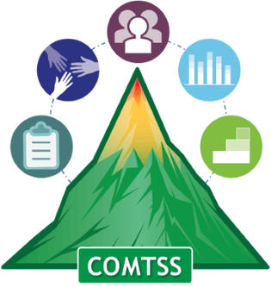
Interventions and Supports
Root causes must be determined to appropriately apply interventions.
  Merriam-Webster Inc. (2025) defines an interventions as:
    “the act or an instance of intervening”
    “the act of interfering with the outcome or course especially of a condition or process (as to prevent harm or improve functioning)” (para. 1-2).
  CDE’s (2025) Colorado Multi-Tiered Systems of Support
  ASCA (2021) The School Counselor and Multitiered System of Support
  Hatching Results’® (2024) Examples of Tiered School Counseling Supports

Slide 22


School Counseling and Continuum of Supports
Tier 3
Select interventions based on the root causes of identified student needs.
Tier 2
Tier 1
System Supports

Slide 23
Supporting the System
If the root cause is not a student issue it may be a system issue.
  System issues occur when the problem, need, or challenge is outside of a student’s control.
  Example system supports:
    Staff professional development and training
    Coaching
    Professional Learning Communities
    School-wide policies, expectations, and procedures
    Wraparound services and systems
    Parent and community engagement events
System Supports

Slide 24
Intervention Ideas Scenario #1
Student A is an 11th grader referred to the school counselor for failing math two semesters in a row.
After gathering more background information, the school counselor discovers:
  Parents report the student is bullied.
  Student reports he enjoys CTE classes and a credit check confirms he is passing all CTE classes.
  Administration explains that the student may need to drop CTE classes because there is a policy that students maintain a 3.0 GPA to participate.

Slide 25

Tier One School Counseling Services
Tier One services are for all students, universal, schoolwide
  Preventative and data-driven
    Instruction, initiatives, schoolwide events, workshops, large groups, etc.
  Examples:
    School counseling classroom lessons, fifth grade middle school orientation, FAFSA lunch and learn, anti-bullying assemblies, career awareness fair
    Assist in developing and teaching schoolwide expectations
  Approximately 80% of students are successful after receiving tier one services.
(ASCA, 2021; Goodman-Scott et al., 2023)

Slide 26
Intervention Ideas Scenario #2
Student C is an 8th grader referred to the school counselor by a parent for receiving a C in every subject for the last 3 quarters.
During an MTSS meeting, the school counselor shares the parents’ concern and looks for more information:
  Staff respond, “she’s doing fine” or “at least she’s not failing”.
    Report the student is quiet in class, keeps to herself, and doesn’t have many friends.
  Student standardized test scores are above average.
  The student is interviewed and when asked what she wants to study in high school, she shrugs her shoulders and looks at her phone.

Slide 27

Tier Two School Counseling Services
Tier Two services are focused interventions for students that need additional supports.
  Interventions are delivered after reviewing data to determine which students are in need of more support.
  Examples:
    Small group instruction on conflict resolution
    Check-In Check-Out for goal-monitoring
    Consultation with staff and families
  Approximately 10-15% of students will have additional needs that may be met with tier two interventions and supports.
(ASCA, 2021; Goodman-Scott et al., 2023)

Slide 28

Tier Three School Counseling Services
Tier Three services are intensive and more frequent interventions for a few students.
  Interventions are delivered after reviewing data to determine which students need intensive supports.
  Examples:
    Small groups
    Coordinating wrap-around services, referrals, and resources
    Assists with Functional-Behavior Assessments and Behavior Intervention Plans
  Approximately 5% of students may respond or need tier three interventions and supports.
(ASCA, 2021; Goodman-Scott et al., 2023)

Slide 29
Intervention Ideas Scenario #3
Student B is a 5th grader referred to the school counselor for individual support following 3 behavioral referrals.
After gathering more background information, the school counselor discovers:
  Teachers report she tries really hard in academics and does well in school, when she is there.
  Student reports her mom works two jobs and she has to watch her younger siblings which causes her to miss the bus.
  Student reports she wants to be a veterinarian and looks forward to science lessons before lunch.

Slide 30
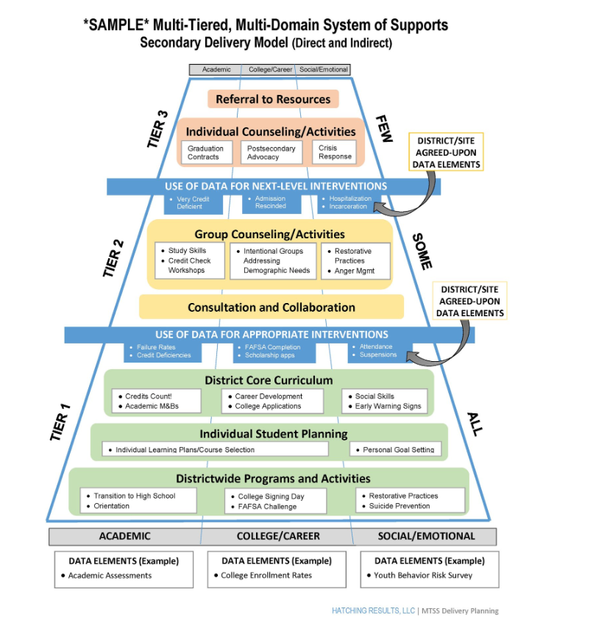

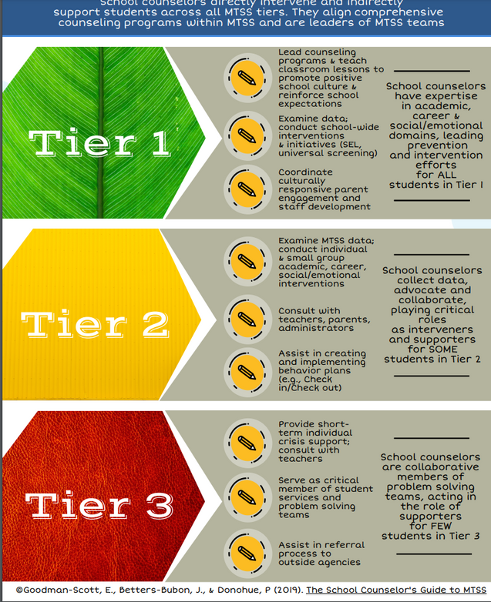

Examples of Tiered Systems of Supports
Hatch (2017)
©Goodman-Scott, E., Betters-Bubon, J., & Donohue, P (2019)

Slide 31





Experience From the Field
Weld RE-4
Atlas Middle School
Becca Larrick
Assistant Principal
Sarah Cyr (she/her)
Director of Post-Secondary Success
Kayla Kaji-Covey
9th Grade School Counselor
Ana Palacios
College and Career Counselor

Slide 32

When Selecting Interventions...
  Does the intervention impact the root cause of the identified need in the SMART goal?
  Is the intervention specific to the identified population in the SMART goal(s)?
  Can the intervention be monitored with data? What data and how often?
  Are funds needed for the intervention?

Slide 33

Interventions Without SCCG Funding
  A licensed comprehensive school counselor is a __________ intervention.
  What is now in place that wasn’t before?
  What are FREE interventions?

Slide 34
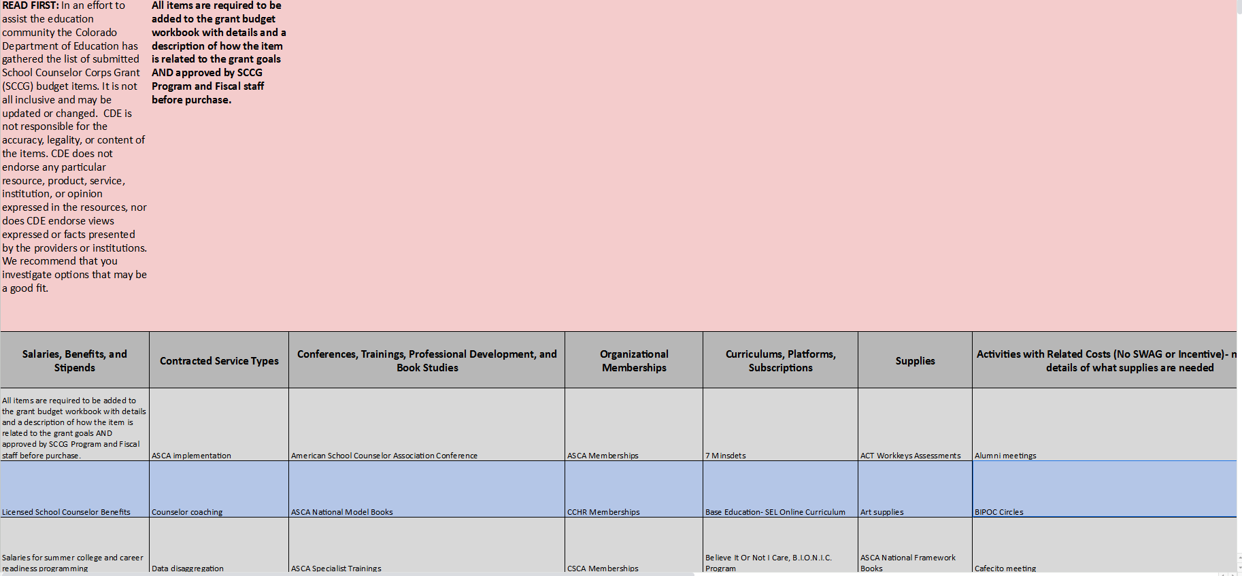
Grantee Budget Ideas

Slide 35


Where Are We Headed?
  School counseling program mission and vision focus and provide direction for implementation.
SCHOOL COUNSELING PROGRAM FOUNDATION
  High level overview of school counseling program and outcome data.
  Choose two focus areas & gather supplementary data through needs assessment.
INTENTIONAL DATA REVIEW
NEEDS ASSESSMENT
  Start developing SMART goals.
  Determine root causes of identified needs.
SMART GOALS
ROOT CAUSE
  Analyze data to identify interventions that address the root cause of identified needs and support the site-based SMART goals.
INTERVENTIONS
Development Year Report Due
May 30, 2025

Slide 36
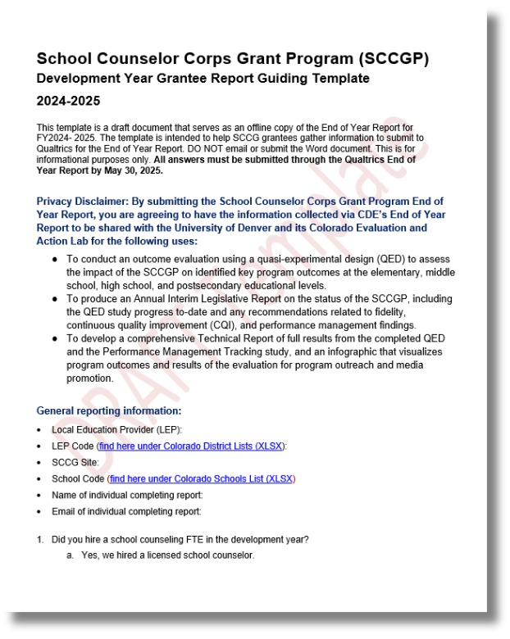
Development Year Report:
Interventions
Development Year Report Guiding Template
Question #13
  What are the appropriate interventions you plan to implement to address your district and school identified needs and goals? Explain how selected interventions will target the root cause of identified needs.
Question #14:
  Did the district/school original application goals and interventions change after completing the development year process? If so, how?

Slide 37

Questions on Interventions and Supports

Slide 38
Fiscal Updates
Interim Financial Report (IRF):
  SCCG meetings if underspent to support you and your team.
  Talk with local fiscal department and make sure you know how much you have spent and need to spend.
Carryover:
  Carryover will not be approved unless...
    Vacancy savings due to shortages in hiring.
    Grantees must submit a narrative request for approval by AFR deadline in September 2025.
Important Dates:
  Budget revisions accepted until May 15, 2025.
  Continuation Budgets due May 30, 2025.
  2024-2025 spending DONE June 30, 2025.
    Confirm district dates for spending requirements.

Slide 39
GAINS- Budget Revisions
Last day to submit a budget revision for FY2024-25 is May 15, 2025.
  If the FY2024-25 budget needs to change, a budget revision must be submitted and approved through GAINS before spending can occur.
  Do not purchase or pay using SCCG funds until a budget has been approved in writing.
  Steps to complete a budget revision are available to download.
    Include date of changes in description (i.e. Revised 3/15/2025).

Slide 40
Continuation Budget
Budget for 2025-2026 school year due on May 30, 2025.
  All budgets available now in GAINS.
  To complete the budget select fiscal year 2026...
      Update each section with anticipated costs for FY2025-26.
      Download the written directions or recording available online.
      Access budget workbook reminders for details on description needs.
  To confirm allocation amounts please email Jennicca or Brooke.

Slide 41
Questions on Budgets

Slide 42

Mark Your Calendars!
  Wednesday April 30, 2025: SCCG Webinar #5 (last one!)
    Zoom Registration
  Fiscal Dates:
    May 15, 2025: 2024-2025 budget revisions due
    May 30, 2025: continuation budgets due
    September 30, 2025: submit carryover request
  Reporting Dates:
    May 30, 2025: Development Year Report due
      Qualtrics submission link in May update email.

Slide 43

Prepare For the Last Webinar
  Discuss ways to communicate interventions to stakeholders.
  Begin completing the Development Year Report template.
  Have at least one SMART goal ready to review.

Slide 44

Feedback
Please share feedback on today’s webinar through the Zoom survey questions.
Help our team plan for regional trainings next year! Share your feedback in this optional form.

Slide 45


Contact Us
If questions come up, please reach out.
SCCG Program
Jennicca Mabe​
Mabe_j@cde.state.co.us ​
303-923-0974​
Brooke Morgan​
Morgan_b@cde.state.co.us​
303-923-0966​
CDE Grants Fiscal
Gloria Kochan
kochan_g@cde.state.co.us

Slide 46
References
American School Counselor Association. (2019). The ASCA national model: A framework for school counseling programs (4th Edition). Alexandria,
VA: Author.
American School Counselor Association. (2021). The school counselor and multitiered system of supports.
https://www.schoolcounselor.org/Standards-Positions/Position-Statements/ASCA-Position-Statements/The-School-Counselor-and Multitiered
System-of-Sup
Colorado Department of Education. (2025, January 24). Colorado multi-tiered systems of supports. https://www.cde.state.co.us/mtss/COMTSS
Goodman-Scott, E., Betters-Bubon, J., & Donohue, P. (2019). The School Counselor's Role in Multi-Tiered Systems of Support.
https://www.schoolcounselors4mtss.com/_files/ugd/7ddd06_cf4474962b4549008586251c280b1022.pdf
Goodman-Scott, E., Betters-Bubon, J., Donohue, P. & Olsen, J. (Ed.). (2023). The school counselor’s guide to multi-tiered systems of support
[eBook edition] (2nd ed.) Routledge.
Hatch, T. (2017, March 8). Multi-tiered, multi-domain system of supports. Hatching Results, LLC.
https://www.hatchingresults.com/blog/2017/3/multi-tiered-multi-domain-system-of-supports-by-trish-hatch-phd
Hatching Results ® (2024). Examples of tiered school counseling program supports.
https://docs.google.com/document/d/1L2A2Kp_N_zJVXEMDniUdz5x08soAtUa21NDGQ1Wa_y8/edit?tab=t.0
Merriam-Webster, Inc. (2025, March 16). Dictionary definition. https://www.merriam-webster.com/dictionary/intervention

Slide 47
Thank you!
Please reach out with questions.

