Slide 1


Before We Begin Webinar #2
  This training will be recorded.
  Closed-captioning: click the Live Transcript option on your bottom Zoom toolbar, under more.
  Slides and recording will be posted to the Grant Training website.

Slide 2




School Counselor Corps Grant
Webinar #2
Smart Goals
November 6, 2024

Slide 3

Housekeeping
  Sign in for record of attendance.
  Change your name in Zoom to include your name and school/organization.
  Keep video on throughout the webinar.
  Use the raise hand function or chat to engage.

Slide 4
Self-Care or Luxury? Office Scavenger Hunt
Self-Care
Luxury
  A picture of someone or a pet that brings you joy
  Decor to fit your personality
  A picture of a place you want to go
  A picture of you accomplishing something
  Thank you notes
  Your favorite quote(s)
  Lunch
  Snacks for yourself
  A comfortable set up: chair, lighting, etc.
  Something that smells good (no candles people)
  A window
  A sticky note with your leave time

Slide 5


Keys to Administrator and School Counselor Success
Communication barriers
Student support
Defines the role of the school counselor
Reduces school counselor burnout
Regular Meetings
ASCA Model
School counseling goals

Slide 6

Today’s Objectives
By the end of this session, grantees will:
Identify the five required components of SCCG SMART goals.
Understand how to write two to three SMART goals for the SCCG.

Slide 7

Where Are We Now?
  Webinar #1- October 2, 2024- Needs Assessment
  Webinar #2- November 6, 2024: SMART Goals
  Webinar #3- February 11, 2025: Hatching Results Identifying Gaps in Data
  Webinar #4- March 19, 2025: SMART Goals and Interventions
  Webinar #5- April 30, 2025- Action Planning and Results Reports

Slide 8
Where We Left Off...
Intentional Data Review:
  The education provider shall collect data on its counseling program to demonstrate the impact of the school counseling program on student achievement, attendance, and behavior. C.R.S. 22-91-103 (1)(e)
Choose a Data Focus:
  Pick 2 areas of focus from the Intentional Data Review to dig deeper.
School Counseling Program
Student Achievement
Attendance
Behavior

Slide 9
Needs Assessment Refresh
  After student needs and 2 focus areas are determined through the Intentional Data Review and school data analysis, gain understanding through the needs assessment.
    Gather background and additional information for context.
    Determine contributing factors and targeted interventions.
    Assist in developing goals and interventions that directly respond to the identified needs.
(ASCA, 2019a, pp. 37-38, 42)
  For the purpose of the SCCG, you will need to complete and report on 1 needs assessment per funded site.
    Gather supplemental data for 2 focus areas (academic, attendance, behavior).
      A minimum of 3 questions should be asked per identified focus area.
      A minimum of 2 stakeholder groups should be asked questions.

Slide 10

Welcome and Breakout Rooms
Introduce yourself with your name, school, region.
Discuss:
  What was your school’s process for the intentional data review?
    What data sources did you look at?
  What was your school’s process for the needs assessment?
    What questions have you asked or plan to ask in your needs assessment?
  Have you experienced and barriers or challenges collecting the data? If so, what?

Slide 11

Reviewing and Analyzing Data
  Once the intentional data review and needs assessment are complete, begin analyzing data with your team!
  The SCCG Webinar on with Hatching Results, Inc. on February 11, 2025, will focus on identifying gaps in data.

Slide 12
Prepare for Analyzing Data
  With your team look for:
    Areas of success.
    Gaps in achievement, attendance, discipline, opportunities, and resources.
    Patterns over time.
    1-2 identified student needs.
    Alignment with school priorities and goals.
  Discuss with Administration:
    How the school counseling program can support school priority areas.
    Potential SCCG Goals and alignment with school/district priorities.
(ASCA, 2019a)

Slide 13

Data Tells a Story
  What can you celebrate?
  What needs does your data reveal?
  Why should data drive our decisions?

Slide 14

Questions on Data Review and Needs Assessment

Slide 15


Development Year Report:
SMART Goals
Question #11 of the Development Year Report Guiding Template
  What are two to three site-based SMART goals for the remainder of the grant cycle?
  SMART Goal Statement (may use template below) #1/2_________________.
    SMART GOAL Template: By May 2028, the __________________________________ (specific student group, grade level, etc.), will ________ (decrease/increase) ____________________ (student outcome area based in achievement, attendance, or discipline) by ________ % (percent change), from _________(baseline) to _______ (target). Data will be collected through_____.

Slide 16

Identifying Priorities for Goals
  School counselors and their teams should review and analyze data each year to determine:
    What gaps exits
    Which students need additional supports
    What goals the school counseling program will focus resources and efforts on.
(ASCA, 2019a, p.39)

Slide 17



Layers of SCCG Goals
SCCG Goals
C.R.S. 22-91-103
Application Goals
Site-Based
SMART
Goals

Slide 18
SCCG Goals
C.R.S. 22-91-103 (1)
  The goals of the program are to:
    (I) Increase the availability of effective school-based counseling to help increase the graduation rate within the state and increase the percentage of students who appropriately prepare for, apply to, and continue into postsecondary education; and
  (II) Support work-based learning awareness and education for students at the middle school and high school levels and work-based learning opportunities at the high school level.
SCCG Goals
C.R.S. 22-91-103
Application Goals
Site-Based
SMART
Goals

Slide 19
SCCG Application Goals
  What were the goals and outcomes identified in the original SCCG application?
  How do you feel about the original goals?
  Who do the goals need to be shared with?
  Will the goals change for specific sites? Why?
SCCG Goals
C.R.S. 22-91-103
Application Goals
Site-Based
SMART
Goals

Slide 20

Site-Based SMART Goals
  Goals must be created for each funded site:
    Year 1: Create at least two student outcome based and site-based goals.
  SCCG Reporting:
    Year 1: Creation of site-based goals for the Development Year Report.
    Years 2-4: report goal progress on End of Year Report.
  If changes must be made to goals, please reach out to Brooke or Jennicca for formalized process.
SCCG Goals
C.R.S. 22-91-103
Application Goals
Site-Based
SMART
Goals

Slide 21
Student Outcome Goals Part I
“Statements identifying the measurable impact the school counseling program will have on student achievement, attendance, or discipline.”
  Based on school outcome data.
  Guide implementation activities and interventions.
  Align with the school counseling program vision and mission statement.
  Align with the school improvement plan.
    What are the overall school needs?
    How can the school counseling program support or directly impact these goals?
(ASCA, 2019a, p. 41)

Slide 22
Student Outcome Goals Part II
  Promote student outcomes:
    Attendance: attendance rates, chronic absenteeism, truancy, dropout rates, etc.
    Achievement: Grades, GPA, credits, test scores, SRD rates/READ plans, graduation rates, matriculation, FAFSA completion, enrollment in specific courses (ex. Algebra, Concurrent Enrollment, credit recovery), etc.
    Behavior/Discipline: Classroom response, referrals, suspensions, expulsions etc.
  Show how students will be different because of the activities and supports of the comprehensive school counseling program.
(ASCA, 2019b)

Slide 23
Types of School Counseling Goals
  Student Outcome Goals: measure the impact of the school counseling program on student achievement, attendance, or discipline.
  Program Goals: measure implementation, activities, and components of the school counseling delivery.*
  Staff Goals: measure staff outcomes or professional growth focus areas.*
(ASCA, 2019a)
Program goals and staff goals can be written BUT
each funded site must have two student outcome goals reported each grant year.

Slide 24

Writing SMART Goals
Site-Based Goals must be written in SMART goal format and include the following 5 components:
  Support a student outcome in achievement, attendance, or behavior/ discipline.
  Include a baseline data point.
  Include a target data point.
  Include a percentage change.
  Written to be completed by 2028.

Slide 25
SMART Goal Format
One topic addressed and student outcome based.
Should be targeted, motivating, and realistic.
Accomplished by 2028.
SPECIFIC
MEASURABLE
ATTAINABLE
RELEVANT
TIMEBOUND
Include baseline data, target data, and a percentage change.
Align with determined focus areas (attendance, behavior, achievement).

Slide 26

Specific Goals
SPECIFIC
  Specific to site-based needs identified through data:
    Schoolwide needs
    Specific student subgroups
  One topic addressed per goal:
    Is it clear and concise?
    Avoid including interventions in the goal statement.
  Student outcome based
    How does the goal impact students’ attendance, achievement, or behavior?

Slide 27

Measurable Goals
MEASURABLE
  Make sure to include:
    Baseline data point
    Target data point
    Percentage change between the baseline and target data point
      CalculatorSoup®’s (2024) Percentage change calculator
  Considerations:
    How will the goal be measured?
    How will data be collected?
    Who will collect the data?
    Who will document the data over time?

Slide 28

Attainable Goals
ATTAINABLE
  Considerations:
    Is the goal challenging?
    Can the school counseling program realistically achieve this goal?

Slide 29

Relevant Goals
RELEVANT
  Make sure to include:
    A student outcome (achievement, attendance, behavior/discipline)
  Considerations:
    Does your SMART goal relate to the
      Purpose and goals of the SCCG?
      Needs identified through school data?
      Schoolwide goals and priorities?

Slide 30

Timebound Goals
TIMEBOUND
  Make sure to include:
    Each SCCG SMART goal should be written to monitor and achieve by May 2028.
    SCCG goals are NOT annual goals.
  Considerations:
    Think long term sustainability.
    What happens if you achieve your goal before time is up?

Slide 31
SMART Goal Template
By May 2028, the __________________________________ (specific student group, grade level, etc.), will ________ (decrease/increase) ____________________ (student outcome area based in achievement, attendance, or behavior/discipline) by ________ % (percent change), from _________(baseline) to _______ (target). Data will be collected through_____.

Slide 32
Example #1 Goal
SMART Goal: By May 2028, the 20 students identified with 30 or more absences in 2024-25, will decrease the cumulative number of absences by 21% from 600 total absences to 475 absences.
Specific: 20 students identified with 30 or more absences
Measurable: Cumulative number of absences (to be reviewed every 4 weeks)
Attainable: 21% (baseline is 600 absences for entire group)
Relevant: Attendance is one of the SCCG focus areas. One of our school priorities over the next 4 years is reducing chronic absenteeism.
Timebound: May 2028 is the end of the grant cycle

Slide 33
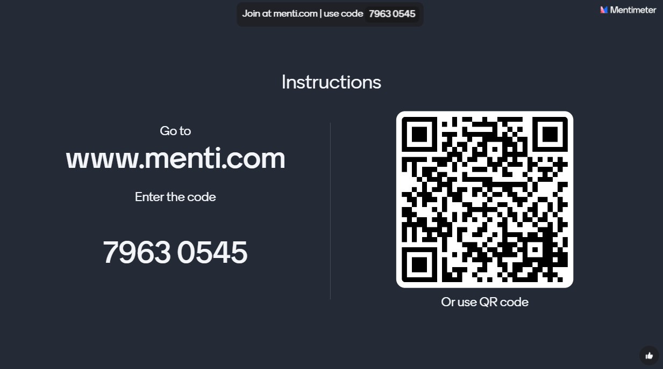
Practice #1

Slide 34
Example #2 Goal
SMART Goal: By 2028, students at CDE High School whose primary language is Spanish, will increase attendance rates at FAFSA events by 28% from 7% to 35%. A survey will be given at all 10 FAFSA events to measure attendance.
Specific: Students at CDE High School who report their primary language as Spanish, FAFSA events
Measurable: Attendance survey at 10 FAFSA events, baseline 7%
Attainable: 28% increase
Relevant: Attendance and postsecondary matriculation are SCCG focus areas. One school priority over the next 4 years is increasing matriculation rates for students who report their primary language is Spanish.
Timebound: May 28 is the end of the grant cycle

Slide 35
Practice #2

Slide 36

Examples of SMART Goals
For more examples, see page 44 in the ASCA National Model (4th Edition) and Hatching Results® (n.d) Examples of School Counseling SMART Goals .

Slide 37

Communicate SMART Goals
Who should SMART goals be shared with?
  Administrators
  School staff
  Families
  Stakeholders
Why share SMART goals?
  Accountability
  Sustainability
  Program Advocacy
What are ways your team plans to communicate goals?

Slide 38




Experience From the Field
Weld County
School District Re-3J
Sam Short
WCHS Assistant Principal and Career and College Administrator
Michele Ferguson
Career and College Counselor

Slide 39
Questions on SMART Goals

Slide 40

Mark Your Calendars!
  Webinar #3: Identifying Gaps in Data on February 11, 2025
    Register via Zoom today!
  Regional Trainings: An individual registration email will be sent from Sched.
    November 13, 2024: Lamar, CO
    December 11, 2024: Greeley, CO
    January 14, 2025: Denver, CO
    February 4, 2025: Colorado Springs, CO

Slide 41

Next Steps
  Sign in for record of attendance.
    A certificate of attendance will be sent to email on form.
  Complete Zoom survey questions.
  Complete the intentional data review and needs assessment by February 11, 2025.

Slide 42


Contact Us
If questions come up, please reach out.
SCCG Program
Jennicca Mabe​
Mabe_j@cde.state.co.us ​
303-923-0974​
Brooke Morgan​
Morgan_b@cde.state.co.us​
303-923-0966​
CDE Grants Fiscal
Gloria Kochan
kochan_g@cde.state.co.us

Slide 43
References
American School Counselor Association. (2019a). The ASCA national model: A framework for school counseling programs (4th Edition).
Alexandria, VA: Author.
American School Counselor Association. (2019b). The ASCA national model implementation guide (2nd edition). Alexandria, VA: Author.
CalculatorSoup®. (2024). Percentage change calculator. Calculator Soup® Online Calculators.
https://www.calculatorsoup.com/calculators/algebra/percent-change-calculator.php
Hatching Results ®. (n.d.). Examples of school counseling SMART goals.
https://docs.google.com/document/d/1k9ux3vC1QO9ZHLQfKUWDLnOUIHXeRz11VoKcww6rK2M/edit

Slide 44
Thank you!
Please reach out with questions.

