Slide 1




School Counselor Corps Grant
Virtual Welcome
2024-2025
Cohort 14

Slide 2


Today’s Objectives
By the end of this session, grantees should:
Increase understanding of the purpose of the School Counselor Corps Grant (SCCG) Program.
Understand the Development Year Process (DYP) and it’s connection to grant reporting.
Calendar grant webinars, trainings, and reporting requirements.

Slide 3


















Welcome Cohort 14!

Slide 4

Lucky Cohort 14
  Who were you at 14?
    Share one thing you loved to do, were interested in, or disliked at 14.

Slide 5
Primary Program Managers
Each grantee has been assigned to one School Counseling Specialist for support throughout the year.
  Jennicca Mabe:
    Academy 20
    Big Sandy 100J
    Branson Reorganized 82
    CSI-Colorado Early Colleges
    Cotopaxi RE-3
    Elizabeth School District
    Pueblo County 70
    Rocky Ford R-2
    Sheridan 2
  Brooke Morgan:
    Clear Creek RE-1
    Fort Morgan Re-3
    Fountain 8
    Garfield Re-2
    Greeley 6
    Idalia RJ-3
    Limon RE-4J
    Summit RE-1
    West Grand 1-JT

Slide 6

Goals of SCCG
Colorado Revised Statute 22-91-103
  Increase the availability of effective school counseling to:
    Increase the graduation rate​
    Increase the percentage of students who appropriately prepare for, apply to and continue into postsecondary education; and​
  Support work-based learning awareness, education, and opportunities

Slide 7

Comprehensive School Counseling
American School Counselor Association (ASCA)
  Academic development, career development, and social/emotional development (American School Counselor Association, 2023a, 2023b, 2023c)
Colorado Revised Statute 22-91-102
Professional school counselors are trained to provide comprehensive programs that facilitate the development of the whole child in areas of academic, career, and personal and social needs.
Go to www.menti.com and enter 8164 6339

Slide 8
Importance of Comprehensive School Counseling
  Improvement in:
    Social skills
    Academic performance
    Engagement and academic relationships
    Graduation rates
    College entrance and persistence rates
    Closing the achievement gap
  Decreased:
    Chronic absenteeism
    Suspensions
    Emotional distress
    Drug use
(American School Counselor Association, n.d.b)
(American School Counselor Association, 2023c)
See more empirical research studies supporting the
value of school counseling here.

Slide 9

SCCG Development Year
Year 1
The purpose of the developmental year is to explore and plan for implementation.
Trainings and webinars will guide your team in building a comprehensive and data-driven school counseling program with actionable steps.

Slide 10
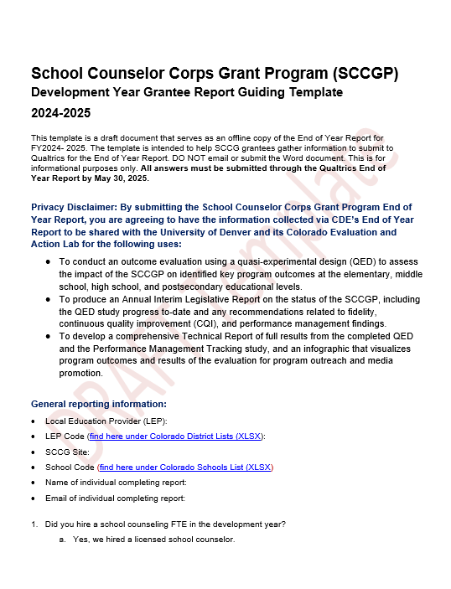
DYP and Reporting
Access the guiding template on the SCCG Reporting webpage.
  Step 1: Foundation to School Counseling
    Questions 5 and 6
  Step 2: Intentional Data Review and Findings
    Questions 7, 8, and 9
  Step 3: Data and Needs Assessment
    Questions 10 and 11
  Step 4: Needs and Goals
    Question 12
  Step 5: Root Cause and Interventions
    Questions 13 and 14
  Step 6: Reporting and Planning

Slide 11

Cohort 14 Fall Training
September 17, 2024, from 9:00 AM to 4:00 PM
  Where: Colorado Springs, CO at the DoubleTree by Hilton Hotel
    1775 East Cheyenne Mountain Blvd Colorado Springs, CO 80906
  Who should attend? SCCG program contact and each funded site’s administrator.
  Registration- you will get a link from Qualtrics to register.
    Complete form if you have not already.
  Meals: meals will not be provided so plan to pack a lunch, order in, or visit a local eatery during the one-hour lunch break.
  What to bring?
      Bring data
      Laptop
      Logins passwords to student info
      Bring school and district mission and vision
Focus on
DYP Steps 1-3

Slide 12

DYP Webinars
Webinars will occur from 8:00 to 10:00 AM via Zoom.
  October 2, 2024: Webinar #1
    Comprehensive School Counseling and Mission and Vision Workshop
  November 6, 2024: Webinar #2
    School Counselor and Administrator Collaboration
  February 19, 2025: Webinar #3
    Data-Driven Programming for Beginners
  March 19, 2025: Webinar #4
    Interventions, SMART Goals and Development Year Reporting Workshop
  April 30, 2025: Webinar #5
    Action Planning

Slide 13
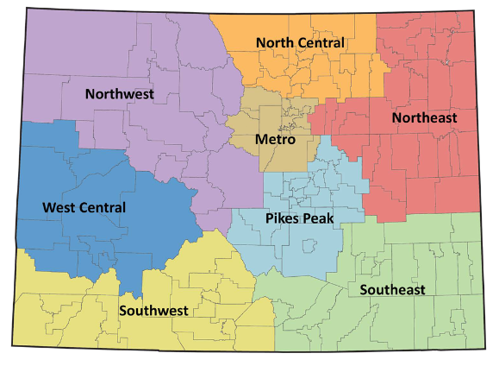
Regional Trainings
  Each training will occur from 8:00 AM to 4:00 PM and lunch is provided.
    October 15, 2024: Southwest Region in Durango, CO
    October 30, 2024: Northwest and West Central Region in Glenwood Springs, CO
    November 13, 2024: Southeast Region in Lamar, CO
    December 11, 2024: North Central and Northeast in Greeley, CO
    January 14, 2025: Denver Metro Region
    February 4, 2025: Pikes Peak Region in Colorado Springs, CO
  Registration:
    An email link will be sent directly to the you.
    SCCG program contact and each funded site’s administrator must attend.
    Details of event will be shared once registered.
  Focus:
    SMART Goals, ICAP, and Sustainability

Slide 14

Questions

Slide 15
Next Steps
  Sign in for record of attendance.
    A certificate of attendance will be sent to email inputted on form.
  Prepare for fall in-person training.
    Complete form for Fall Training Invitation.
    Bring:
      Bring data
      Laptop
      Logins passwords to student info
      Bring School/District Mission and vision
  Complete Zoom survey questions.
  Download your cohort’s calendar and register for upcoming trainings.

Slide 16


Contact Us
If questions come up, please reach out.
SCCG Program
Jennicca Mabe​
Mabe_j@cde.state.co.us ​
303-923-0974​
Brooke Morgan​
Morgan_b@cde.state.co.us​
303-923-0966​
CDE Grants Fiscal
Gloria Kochan
kochan_g@cde.state.co.us
720.916.6488

Slide 17
References
American School Counselor Association. (n.d.b). Empirical research studies supporting the value of school counseling.
https://www.schoolcounselor.org/getmedia/7d00dcff-40a6-4316-ab6c-8f3ffd7941c2/Effectiveness.pdf
American School Counselor Association. (2023a). The school counselor and academic development.
Statements/ASCA-Position-Statements/The-School-Counselor-and-Academic-Development
American School Counselor Association. (2023b). The school counselor and career development.
Statements/ASCA-Position-Statements/The-School-Counselor-and-Career-Development
American School Counselor Association. (2023c). The school counselor and social/emotional development.
Positions/Position-Statements/ASCA-Position-Statements/The-School-Counselor-and-Social-Emotional-Developm
Colorado Department of Education. (2024, August 15). School Counselor Corps Grant Program Legislation.
https://www.cde.state.co.us/postsecondary/sccg-legislation

Slide 18
Thank you!
We look forward to seeing you soon!

