Slide 1
School Counselor Corps Grant
Virtual Welcome
2024-2025
August 21, 2024

Slide 2
Before We Begin
This training will be recorded.
Closed-captioning: click the Live Transcript option on your bottom Zoom toolbar, under more.
Slides and recording will be posted to the Grant Training website.
Notes:
Grant Training Website: https://www.cde.state.co.us/postsecondary/sccg-grant-trainings

Slide 3
Housekeeping
Sign in for record of attendance.
Change your name in Zoom to include your name and school/organization.
Keep video on throughout the webinar.
Use the raise hand function or chat to engage.
Notes:
Attendance Form: https://docs.google.com/forms/d/e/1FAIpQLSfZmbiSEaMOpfSpRttg76Ebzk9DRnpjSYRCcwEDYPYsnYmZ4A/viewform?usp=sf_link

Slide 4
Today’s Objectives
By the end of this session, grantees should:
Increase knowledge and understanding of the School Counselor Corps Grant (SCCG) Program.
Understand actionable steps to set the year up for success.
Increase awareness of resources available to support SCCG planning, implementation, and program requirements.

Slide 5
Meet Your CDE Grant Support
Jennicca Mabe
Brooke Morgan
Gloria Kochan
School Counseling Specialist
Mabe_j@cde.state.co.us
School Counseling Specialist
Morgan_b@cde.state.co.us
Grants Fiscal Analyst
Kochan_g@cde.state.co.us

Slide 6
SCCG Mission and Vision
SCCG Program Vision Statement:
Each Colorado Local Education Provider will have the awareness and access to apply for the School Counselor Corps Grant Program and enhance the implementation of comprehensive and sustainable school counseling programs.
SCCG Program Mission Statement:
The School Counselor Corps Grant Program will support sustainable comprehensive school counseling programs through training, technical support, and assistance to SCCGP grantees according to C.R.S. 22-91-101 through 105.

Slide 7
Our Role Within CDE
We are here to support you!
We assist grantees in developing and implementing comprehensive school counseling programs, working towards grant goals, and improve the level of school counseling across the state through:
Monitoring utilization of grant funds
Collaborating
Building Community
Professional development/training
Sharing information and best practices
Evaluating and reflecting

Slide 8
Jennicca Supports
Academy 20
Agate 300
Aguilar Reorganized 6
Archuleta County 50 Jt
Bethune R-5
Big Sandy 100J
Branson Reorganized 82
Burlington RE-6J
Calhan RJ-1
Cherry Creek 5
Cotopaxi RE-3
CSI-Colorado Early Colleges
CSI- New Legacy
CSI- The Academy of Charter Schools
Custer County C-1
Denver County 1 (DPS)
Denver Public Schools- Girls Athletic Leadership School
Elizabeth School District
Fremont RE-2
Lake County R-1
La Veta Re-2
Lewis-Palmer 38
Manzanola 3J
McClave Re-2
Montezuma-Cortez RE-1
Montezuma-Cortez RE-1- Southwest Open Charter School
Pueblo City 60
Pueblo County 70
Rocky Ford R-2
Salida R-32
San Juan BOCES
Sheridan 2
Trinidad 1
Vilas School RE-5

Slide 9
Brooke Supports
Adams-Arapahoe 28J (APS)
Adams-Arapahoe 28J- Vanguard Classical School East
Adams-Arapahoe 28J- Vega Collegiate School
Boulder Valley Re 2
Center 26 JT
Clear Creek RE-1
Colorado River BOCES- Yampah Mountain High School
Colorado Springs 11
Englewood 1
Fort Morgan Re-3
Fountain 8
Garfield Re-2
Garfield 16
Genoa-Hugo School C113
Greeley 6
Harrison 2
Harrison 2- Atlas Preparatory Middle School
Idalia RJ-3
Jefferson County R-1
Limon RE-4J
Lone Star 101
Peyton 23Jt
Poudre R-1
Sanford 6J
South Conejos RE-10
South Routt RE 3
Steamboat Springs RE-2
St. Vrain Valley RE1J
Summit RE-1
Upper Rio Grande School District C-7
Weld County RE-3J
Weld County RE-4
West Grand 1-JT
Wiggins School District RE-50(J)

Slide 10
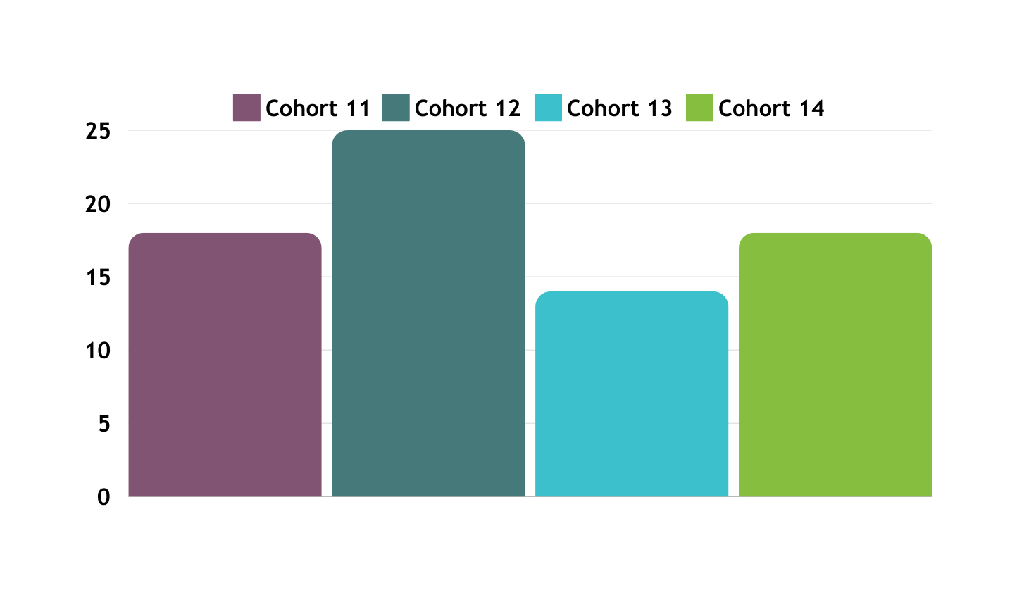
Number of Local Education Providers (LEP)
75 LEPs in FY2024-2025
Cohort 14:18
Cohort 13: 14
Cohort 12: 25
Cohort 11: 18
Number of LEPs
Cohort Years

Slide 11
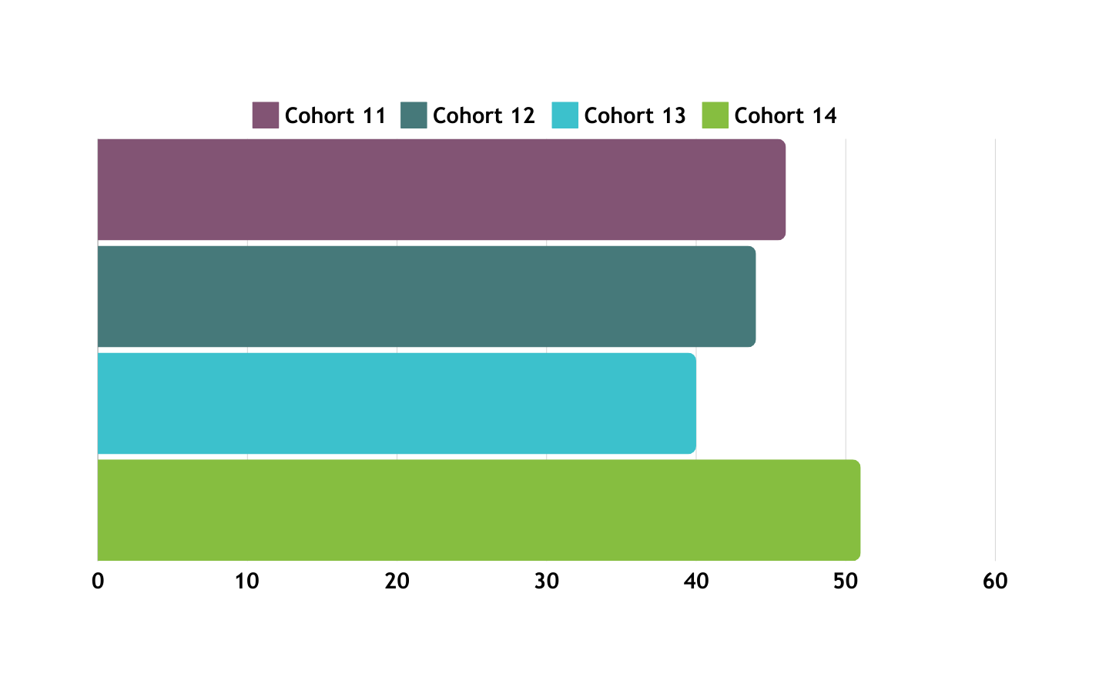
Number of SCCG Sites
181 funded sites in FY2024-25
Cohort 14: 51 sites
Cohort 13: 40 sites
Cohort 12: 44 sites
Cohort 11: 46 sites
Cohort Years
Number of Funded Sites

Slide 12
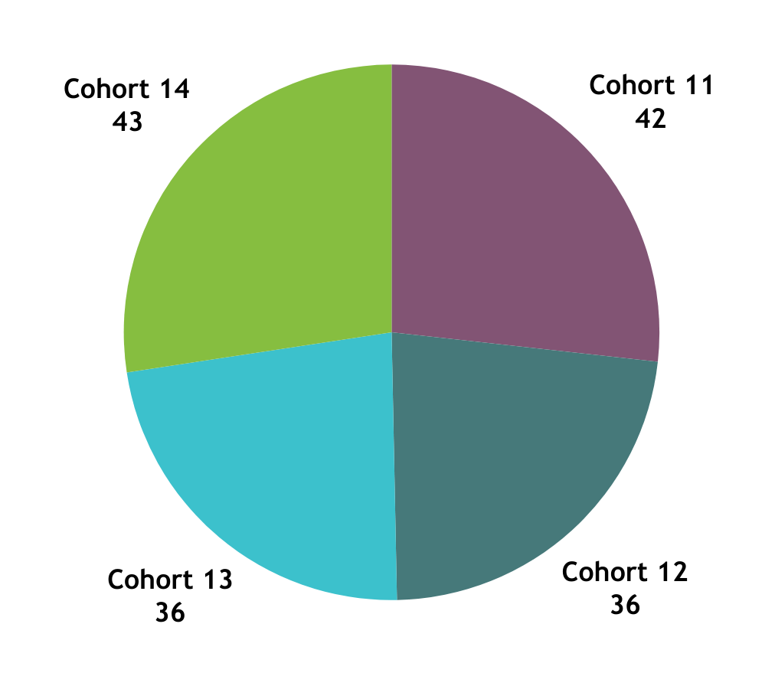
Number of School Counselor FTE
157 Planned School Counselor(SC) FTE in FY2024-25
Cohort 14: 43 SCs
Cohort 13: 36 SCs
Cohort 12: 36 SCs
Cohort 11: 42 SCs

Slide 13
Celebrating You!
Great SMART goals were written!
Awesome attendance to trainings!
First year of the Development Year Process!
Money went out for tuition reimbursement- we are growing school counselors around the state!
What is something from the past year you would like to celebrate?

Slide 14
The People Behind the Numbers

Slide 15
History and Background
Colorado Revised Statute (C.R.S) 22-91-101 through 22-91-105
2008: Established the SCCGP through HB08-1370
SB14-150: Updates to SCCGP
Additional requirements for implementing a comprehensive school counseling model, data collection to illustrate impact, etc.
SB17-068: Early Support for Student Success Through Access to School Counselors
Addition of elementary schools
HB19-1187: Increasing Completion Rates of Applications for Student Financial Aid for Higher Education
Appropriated funds from 2019-2022 for the purpose of educating and supporting students and families in completing and submitting the free application for federal student aid or applications for state student aid.
SB22-140: Expansion of Experiential Learning Opportunities Through Relationships with Employers
Work-based learning awareness, education, and opportunities
Read more and access legislation here.

Slide 16
The Why Behind the Work
Colorado Revised Statute 22-91-101
Reducing the student-to-counselor ratio to support...
Closing the achievement gap
Decrease the dropout rate
Increasing the number of students who matriculate into postsecondary education without the need for remediation
Best interests of the students in the state to...
Increase the number of school counselors available
Improve the level of school counseling services
What is your why?

Slide 17
Setting Your Year Up for Success
How do you personally define success?
How do you define student success?
How do you define programming success?

Slide 18
SCCG Steps to Success
Team members and responsibilities
First team meeting
End of year report
Tracking goals and progress
Implementation planning and calendars
Professional development needed
Sustainability plan

Slide 19
SCCG Team and Responsibilities
School Counselors
School Administrators
District
Leaders
Fiscal
Support
CDE Support
Attend trainings in-person and virtually
Drive programming and reflection of SCCG
Create and monitor SMART goals
Deliver interventions and programming
Collaborate with team for alignment and sustainability
Attend trainings in-person and virtually.
Collaborate with school counselor for programming, alignment, and sustainability
Attend trainings in-person and virtually
Collaborate with school counselors, administrators, and fiscal contacts
Support alignment across schools
Sustainability plans
Follow all local policies and guidelines
Work with program to complete budget
Submit budget
Complete and submit Interim Financial Report (IFR) and Annual Financial Report (AFR)
Attend virtual fiscal trainings
Address statutory requirements
Support, management, and technical assistance
Statewide trainings and professional development
Comprehensive school counseling implementation and advocacy
Evaluating and reflecting

Slide 20
SCCG Team and Roles
Please complete form now.
Contacts will be used to send individual registration links for trainings.
Turn camera off while completing and back on when finished.
Notes:
Contact Form: https://docs.google.com/forms/d/e/1FAIpQLSdY5mUtpCPHZ-v51aTYC13MeGSzBt38wbBnvsKi5ENscqnTuw/viewform

Slide 21
First Team Meeting
Review:
Team responsibilities
School counseling mission and vision
Fidelity of Implementation(FOI) Rubric
Reporting feedback
Grant Goals
What is your baseline this year?
How will you track progress? When?
What is your target for this year?
Implementation Plan:
What services?
Weekly calendar
Annual calendar
SCCG calendar

Slide 22
End of Year Reporting
“Begin with the end in mind”.
-Stephen R. Covey
Program reports for FY2024-2025 are due May 30, 2025.
Access templates for reports on the Program Reporting webpage.
Cohort 14- Development Year Report template
Cohorts 11, 12, and 13- End of Year Report template
Notes:
SCCG Program Reporting webpage: https://www.cde.state.co.us/postsecondary/sccg-program-reporting

Slide 23
Reporting and SCCG Evaluation
The information collected via CDE’s End of Year Report will be shared with the University of Denver and its Colorado Evaluation and Action Lab for the following uses:
To conduct an outcome evaluation using a quasi-experimental design (QED) to assess the impact of the SCCGP on identified key program outcomes at the elementary, middle school, high school, and postsecondary educational levels
To produce an Annual Interim Legislative Report on the status of the SCCGP, including the QED study progress to-date and any recommendations related to fidelity, continuous quality improvement (CQI), and performance management findings
To develop a comprehensive Technical Report of full results from the completed QED and the Performance Management Tracking study, and an infographic that visualizes program outcomes and results of the evaluation for program outreach and media promotion.

Slide 24
Implementation Plan and Calendars
Be Intentional
Define your scope and focus for the year
Align with SMART goals and student needs
Create a plan and calendar
Adjust if needed
Continuous improvement cycle
Create an overview of the school counseling programming
Who will receive services?
What services will be delivered? When? Where? How long?
What resources are needed?
What is anticipated impact?
Evaluate
Plan
Focus
Implement
(Colorado Department of Education, 2024a)
(American School Counselor Association, 2019)

Slide 25
Administrator Collaboration
Annual Administrative Conference
Formal discussion with school counselor(s) and administrator
Complete within the first two months of school
Increase understanding of the counseling program:
Priorities and alignment of goals
School counselor's use of time
Current ratios
Provided services
Professional development
School counselor commitments
Advocacy
(American School Counselor Association, 2021)
(American School Counselor Association, 2019)

Slide 26
Sustainability Plans
Planting seeds for success...
How will you present information?
Who will present information?
What data will be collected?
What data will be shared?
STAKEHOLDERS
DATA
TIMELINE
ROLE OUT
Focus on a sustainability goal each school year.
Who needs to hear the message and why?

Slide 27
Resources
What is your go-to favorite resource?
What resources do you need more of?
What is the best way to share resources?

Slide 28
Monthly Emails
Important dates
Resources
Grant requirements and deadlines

Slide 29
SCCG Grantee Website
Bookmark the
SCCG Current Grantee webpage!
Grant training dates, registration links and materials.
Grant reporting requirements and resources.
Fiscal deadlines and support.
Notes:
Current Grantee Website: https://www.cde.state.co.us/postsecondary/sccg-current-grantees

Slide 30
SCCG Resources Website
Bookmark the
SCCG Resources
Data collection quicklinks
Professional development opportunities
Resources and supports
Notes:
SCCG Resources: https://www.cde.state.co.us/postsecondary/scc_resources

Slide 31
Calendar and Grant Requirements
Download your cohort’s calendar on the
SCCG Current Grantee Webpage!
Notes:
SCCG calendars can be downloaded on website: https://www.cde.state.co.us/postsecondary/sccg-current-grantees

Slide 32
Hiring Guidance SCCG FTE
1
2
3
4
5
CONTACT
READ & COMPLETE
CONSIDER &
READ
COMPLETE
SUBMIT & WAIT
Consider if tuition reimbursement is an option
Read Tuition Guidelines
Read FAQs
Complete Tuition Reimbursement Assurances*
Submit budget with tuition reimbursement included*
Wait for final approval from CDE Program
*Email approval must be obtained before hiring and using grant funds.
Contact school counseling specialist to inform them you have started this process.
Read Hiring Guidelines
Complete Hiring Assurances*
It is not a SCCG requirement to offer tuition stipend/reimbursement to those working toward school counseling licensure.

Slide 33
Supplemental Planning
Pending approval, there are approximately $80,000 funds to disburse.
Funds planned to support school counselor FTE salaries.
Currently in the Education Data Advisory Committee (EDAC) process.
Planned to release this fall.
*All FY2024-2025 supplemental funds are pending confirmed distribution amount and CDE approval.

Slide 34
Questions

Slide 35
Mark Your Calendars!
Virtual Fiscal Welcome
Cohort 14: August 21, 2024, from 10:00 to 11:00 AM via Zoom
Cohorts 11, 12, and 13: August 22, 2024, from 8:00 to 9:00 AM via Zoom
Upcoming Trainings
Cohort 14: Fall In-Person Training on September 17, 2024
All Cohorts: Register for one regional training in the fall or winter
All Cohorts: Register for virtual professional development with Hatching Results, Inc. in February 2025

Slide 36
Next Steps
Cohorts 11, 12, and 13
Sign in for record of attendance.
A certificate of attendance will be sent to email on form.
Complete Zoom survey questions.
Download your cohort’s calendar and register for upcoming trainings.
Meet with your team and administrator.
Download the End of Year Reporting Guide template.
Cohort 14
Take a 5 minute break and then we will continue.

Slide 37
Contact Us
If questions come up, please reach out.
SCCG Program
Jennicca Mabe​
Mabe_j@cde.state.co.us ​
303-923-0974​
Brooke Morgan​
Morgan_b@cde.state.co.us​
303-923-0966​
CDE Grants Fiscal
Gloria Kochan
kochan_g@cde.state.co.us
720.916.6488

Slide 38
References
American School Counselor Association. (2019). The ASCA national model: A framework for school counseling programs
(4th Edition). Alexandria, VA: Author.
American School Counselor Association. (2021). Templates and tools: Annual administrative conference.
Programs/Templates-Resources
Colorado Department of Education. (2024, April 29). Unified improvement planning. https://www.cde.state.co.us/uip
Colorado Department of Education. (2024, August 15). School Counselor Corps Grant Program Legislation.
https://www.cde.state.co.us/postsecondary/sccg-legislation

Slide 39
Thank you!
We look forward to seeing you soon!

