Slide 1




School Counselor Corps Grant
Regional Training
2024-2025
Cohorts 13 and 14

Slide 2


Before We Begin
  Please sit with your team.
  Scan the QR Code on the table to sign-in for attendance.
  Slides are available on the Grant Training website.

Slide 3


Housekeeping
  Today’s Materials:
    Agenda
    Reports, note catcher, exemplars
  Restrooms
  Get up, move, take care of yourself

Slide 4



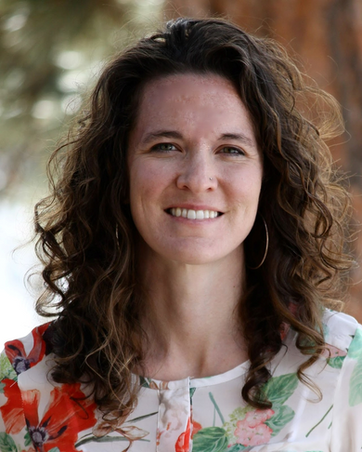
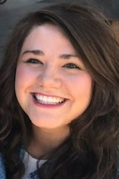
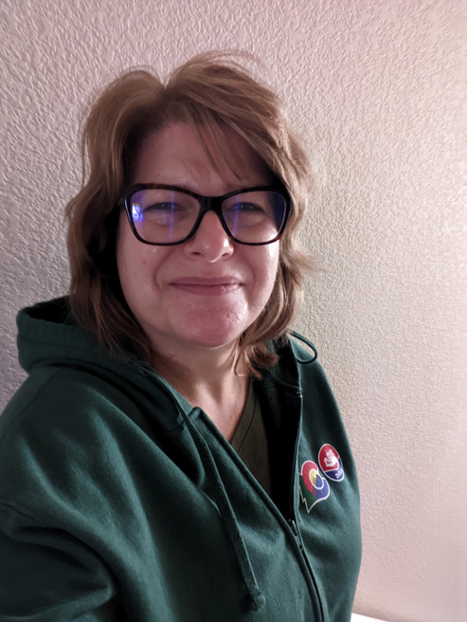
Meet Your CDE Grant Support
Jennicca Mabe
Brooke Morgan
Gloria Kochan
School Counseling Specialist
Mabe_j@cde.state.co.us
School Counseling Specialist
Morgan_b@cde.state.co.us
Grants Fiscal Analyst
Kochan_g@cde.state.co.us

Slide 5

Today’s Objectives
Cohort 14 familiarize themselves with Development Year Report.
Cohort 13 familiarize themselves with End of Year Report.
Cohort 14 Review the Development Year Report.
Cohort 13 Review the End of Year Report.
Cohort 14 Review Exemplars of the Development Year Report.
Cohort 13 Review Exemplars of the End of Year Report.

Slide 6
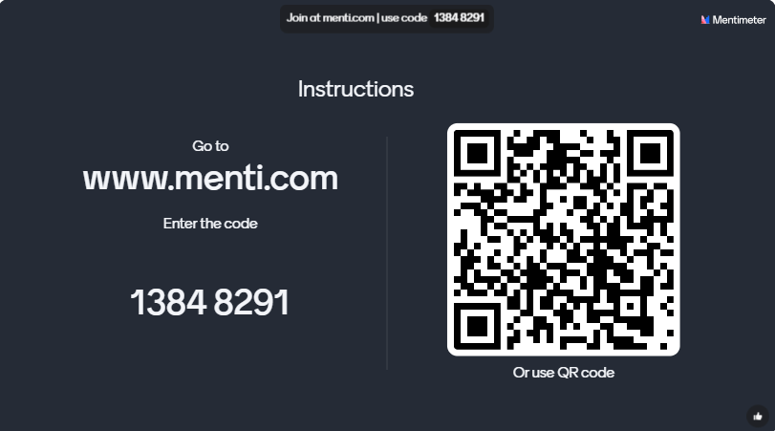
Checking In

Slide 7

Role of the School Counselor
  Know the role of a school counselor.
  Support the role of the school counselor.
  Sustain the role of the school counselor through data.

Slide 8

The Role of a School Counselor- ASCA
American School Counselor Association (ASCA)
  ASCA School Counselor Professional Standards (ASCA, 2019)
  ASCA Ethical Standards (ASCA, 2022)
  ASCA Appropriate Use of School Counselor (ASCA, n.d.)
  Learn more by visiting ASCA’s School Counselor Roles and Ratios website (ASCA, 2024a)
(ASCA, 2023)

Slide 9
Cohorts 13 and 14
Cohort 13
  Academy 20
  Adams-Arapahoe 28J
  Denver County 1
  Genoa-Hugo C113
  Jefferson County R-1
  La Veta Re-2
  Lake County R-1
  Montezuma-Cortez RE-1
  Pueblo City 60
  Pueblo County 70
  Trinidad 1
  Weld County School District RE-3J
  Weld RE-4
  Wiggins RE-50(J)
Cohort 14
  Academy 20
  Big Sandy 100J
  Branson Reorganized 82
  Clear Creek
  Cotopaxi RE-3
  CSI-Colorado Early Colleges
  Elizabeth School District
  Fort Morgan Re-3
  Fountain 8
  Garfield Re-2
  Greeley 6
  Idalia RJ-3
  Limon RE-4J
  Pueblo County 70
  Rocky Ford R-2
  Sheridan 2
  Summit RE-1
  West Grand 1-JT

Slide 10

SCCG Cohort Mixer
Find Your counter-part from another cohort or district.
  Introduce school and a fun fact about your school year.
  Discuss:
    What role do you support in your school or district with the SCCG?
    What is the greatest challenge your team has experienced with the SCCG?
    What is the biggest win your team has experienced with the SCCG
    Cohort 14, do you have any questions?
    Cohort 13, do you have any advice for new grantees?
Brooke Morgan
Elementary School Counselor

Slide 11
SCCG Reporting Similarities
  The Development Year Report and End of Year Report are both completed in Qualtrics.
    Links to Qualtrics will be emailed out in spring.
  SCCG reports are completed for each funded site.
  Tips for success:
    Start collecting data early.
    Meet with SCCG team, administration, district leadership, etc.
      Larger districts or multiple funded sites: district leaders are encouraged to collaborate with sites before the reports are submitted.

Slide 12

SCCG Reporting Differences
  SCCG Development Year Report:
    More narrative responses.
    Establishes SMART goals and a plan for implementation.
  SCCG End of Year Report:
    More quantitative responses.
    Illustrates progress and evidence towards goals.
    Demonstrates level of implementation.

Slide 13
Utilize Your SCCG Team
School Counselors
School Administrators
District
Leaders
CDE
Support
  Attend trainings in-person and virtually
  Drive programming and reflection of SCCG
  Create and monitor SMART goals
  Deliver interventions and programming
  Collaborate with team for alignment and sustainability
  Attend trainings in-person and virtually.
  Collaborate with school counselor for programming, alignment, and sustainability
  Attend trainings in-person and virtually
  Collaborate with school counselors, administrators, and fiscal contacts
  Support alignment across schools
  Sustainability plans
  Address statutory requirements
  Support, management, and technical assistance
  Statewide trainings and professional development
  Comprehensive school counseling implementation and advocacy
  Evaluating and reflecting

Slide 14

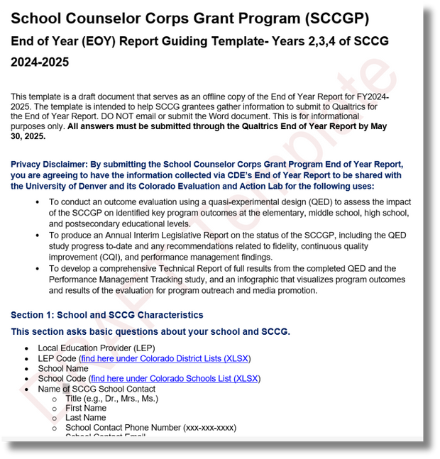
SCCG Reports
Download Guiding Templates
SCCG Development Year Report
SCCG End of Year Report

Slide 15

Reviewing Reports
  Cohort 14 review the Development Year Report.
    Answer questions on note catcher.
  Cohort 13 review the End of Year Report.
    Answer questions on note catcher.

Slide 16
Cohort 14's Development Year Report
  Who from your site will complete the Development Year Report?
  What team member will fill out each area of the report?
  What data for the Development Year Report is readily available?
  What data do you need to start collecting?
  After reviewing, what areas on the Development Year Report will be difficult?
  What progress have you made on the needs assessment?

Slide 17
Cohort 13's End of Year Report
  Who from your site will complete the End of Year Report?
  Who will fill out the section on...
  What data for the End of Year Report is readily available?
  What data do you need to start collecting?
  After reviewing, what areas on the End of Year Report will be difficult?
  Notice the End of Year Report is longer than last year’s Development Year Report. How will you manage the increase in reporting requirements?

Slide 18

Reflection #1
  Cohort 14: What progress have you made on the needs assessment?
  Cohort 13: Notice the End of Year Report is longer than last year’s Development Year Report. How will you manage the increase in reporting requirements?

Slide 19

Reporting Reviews
Brooke and Jennicca review each report and provide feedback or request revisions if needed.
Before submitting, make sure...
  Each question is fully answered.
    Narrative responses should be more than one sentence.
  SMART goals are student-outcome based with a measurable baseline and target included.
  ASK questions. We are here to help.
  Cohort 14:
    Make sure to write a true SMART Goal- training at November webinar.
  Cohort 13
    Goal progress should include data points and measurements.
    If you meet your goal, submit another goal.

Slide 20

SCCG Exemplar Reports
  Cohort 14 review the exemplar Development Year Report.
    Answer questions on note catcher.
  Cohort 13 review the exemplar End of Year Report.
    Answer questions on note catcher.

Slide 21
Development Year Report Exemplar- Cohort 14
  What did you notice about the initial data review exemplar?
  What did you notice about the needs assessment exemplar?
  Pick out the Specific, Measurable, Attainable, Relevant, Timebound (SMART) components on the exemplar.
  If you had to write a SMART goal today, what would it say?

Slide 22
End of Year Report Exemplar- Cohort 13
  What was something that stood out to you on the exemplar?
  On the guiding template, highlight the questions you do not need to complete because they are not applicable to the grade levels you serve.
  Have you thought about sustainability? How would you answer that question today?

Slide 23
Reflection #2
What was something that stood out to you on the exemplar?

Slide 24
Review

Slide 25
Reporting in Qualtrics
All reports are due May 30, 2025.
  Qualtrics does not save work. It may be helpful to work off the template and then transfer information all at once.
    Templates are available on the SCCG Reporting website.
  Reporting revisions will require you to resubmit the entire report.
  Qualtrics submission links will be emailed and posted to the website in Spring 2025.

Slide 26

Mark Your Calendars!
  Cohort 14's Webinars:
    Webinar #2: SMART Goals on November 6, 2024- register via Zoom
    Webinar #3: Identifying Gaps in Data with Hatching Results, Inc. on February 11, 2025- register via Zoom
  Cohort 13's Virtual Professional Development with Hatching Results, Inc. (pick one to attend):
    February 11, 2025: register via Zoom
    February 12, 2025: register via Zoom
  Interim Financial Report Due: February 10, 2025
  End of Year Report Due: May 30, 2025

Slide 27

Questions

Slide 28


Contact Us
SCCG Program
Jennicca Mabe​
Mabe_j@cde.state.co.us ​
303-923-0974​
Brooke Morgan​
Morgan_b@cde.state.co.us​
303-923-0966​
CDE Grants Fiscal
Gloria Kochan
kochan_g@cde.state.co.us

Slide 29
References
American School Counselor Association. (n.d). Appropriate and inappropriate activities for school counselors.
https://www.schoolcounselor.org/getmedia/8fe536c2-7a32-4102-8ce7-42e9b0683b3b/appropriate-activities-of-school-counselors.pdf
American School Counselor Association. (2019). ASCA School Counselor Professional Standards & Competencies. Alexandria, VA: Author.
https://www.schoolcounselor.org/getmedia/a8d59c2c-51de-4ec3-a565-a3235f3b93c3/SC-Competencies.pdf
American School Counselor Association. (2022). ASCA ethical standards for school counselors.
https://www.schoolcounselor.org/getmedia/44f30280-ffe8-4b41-9ad8-f15909c3d164/EthicalStandards.pdf
American School Counselor Association. (2023). The role of the school counselor.
https://www.schoolcounselor.org/getmedia/ee8b2e1b-d021-4575-982c-c84402cb2cd2/Role-Statement.pdf
American School Counselor Association. (2024a). School counselor roles and ratios.
https://www.schoolcounselor.org/About-School-Counseling/School-Counselor-Roles-Ratios

Slide 30
Thank you!
We look forward to seeing you soon!

