Slide 1




School Counselor Corps Grant
Fiscal Training
Cohort 14

Slide 2


Before We Begin
  This training will be recorded.
  Closed-captioning: click the Live Transcript option on your bottom Zoom toolbar, under more.

Slide 3

Housekeeping
  Change your name in Zoom to include your name and school/organization.
  Keep video on throughout the webinar.
  Use the raise hand function or chat to engage.

Slide 4



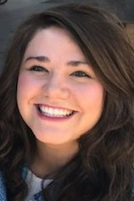
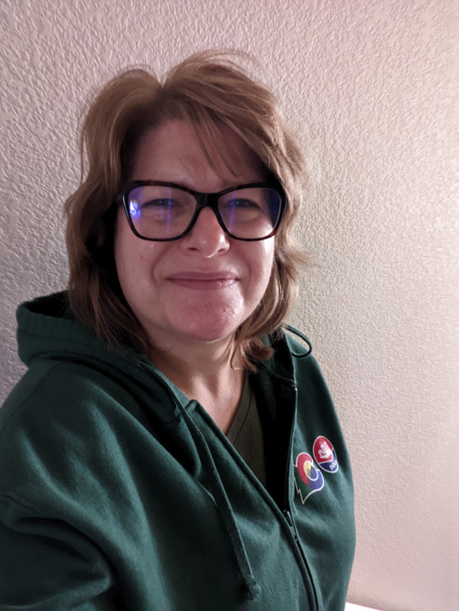
Meet Your CDE Grant Support
Jennicca Mabe
Brooke Morgan
Gloria Kochan
School Counseling Specialist
Mabe_j@cde.state.co.us
School Counseling Specialist
Morgan_b@cde.state.co.us
Grants Fiscal Analyst
Kochan_g@cde.state.co.us

Slide 5

Today’s Objectives
By the end of this session, grantees should:
Gain awareness of the roles and responsibilities that support the School Counselor Corps Grant Program (SCCGP).
Increase understanding of the Code of Federal Regulations and Cost Principles.
Be able to complete budget workbooks and fiscal reporting requirements.
Calendar fiscal deadlines and reporting requirements

Slide 6
SCCG Team Roles
School Counselors
School Administrators and Leaders
Fiscal
Support
Grants Fiscal
CDE
Program CDE
  Attend trainings in-person and virtually
  Drive programming and reflection of SCCG.
  Create and monitor SMART goals
  Deliver interventions and programming
  Collaborate with team for alignment and sustainability
  Attend trainings in-person and virtually.
  Collaborate with school counselors and fiscal contacts for programming, fiscal, and sustainability alignment
  Follow all local policies and guidelines
  Work with program to complete budget workbooks
  Submit budget workbooks
  Complete and submit Interim Financial Report (IFR) and Annual Financial Report (AFR)
  Attend virtual fiscal trainings
  Technical Assistance on your Budget Workbook
  Interim Financial Report (IFR) and Annual Financial Report (AFR) Review
  Budget reviews
  Grant Award Letter (GAL) and Amendments
  Payments and Disbursements
  Address statutory requirements
  Support, management, and technical assistance
  Statewide trainings and professional development
  Comprehensive school counseling implementation and advocacy
  Evaluating and reflecting

Slide 7
Establish Norms and Timeline
  When should team tasks to be accomplished?
  Reporting dates
  Budget deadlines
  When will the team meet?
  How often will the team meet?
SCCG MEETINGS
DEFINE TASKS
TIMELINE
  Who will attend CDE trainings
  How will information be shared?
  How will schools and finance collaborate?
  Who completes the budgets
  Who will submit the budgets?

Slide 8


What is the 2 CFR 200?
  Title 2 - Code of Federal Regulations - Part 200
  IN GENERAL: If spending considerations for a state grant are not addressed in legislation, CDE Fiscal rules defer to the 2 CFR 200.

Slide 9
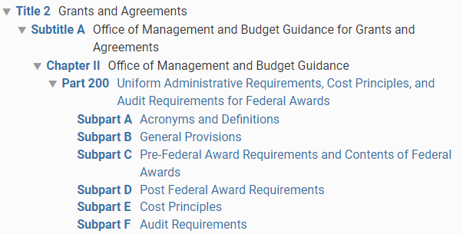
2 CFR 200
  Title 2 - Code of Federal Regulations - Part 200
    Provides and establishes uniform administrative requirements, cost principles, and audit requirements.

Slide 10
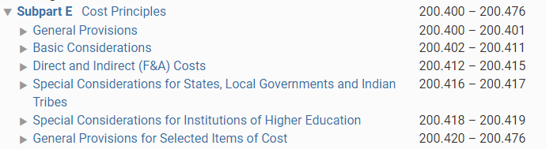
2 CFR 200-Continued
  Title 2 - Code of Federal Regulations - Part 200 - Subpart E Cost Principles

Slide 11


Why Can't We Give Gifts, Shirts, Or Prizes?

Slide 12
2 CFR 200 Cont.
Title 2 - Code of Federal Regulations - Part 200 - Subpart E Cost Principles -
Group .420-.476
  200.421 Advertising and public relations
  (c) The term “public relations” includes community relations and means those activities dedicated to maintaining the image of the non-Federal entity or maintaining or promoting understanding and favorable relations with the community or public at large or any segment of the public.
  (e) Unallowable advertising and public relations costs include the following:
    (3) Costs of promotional items and memorabilia, including models, gifts, and souvenirs;

Slide 13




Cost Principals
Cost Principles should guide your budget writing.
Necessary
Allocable
Reasonable

Slide 14

Cost Principals- Necessary
  Is the cost NECESSARY for the grant's performance?
  Did you comply with your organization's policies in incurring the cost or charge?
Necessary

Slide 15
Cost Principals- Reasonable
  Is the associated dollar amount prudent?
  Is the associated dollar amount consistent with other costs, grants, organizations?
  Are expenses for this grant consistent with your district’s policies?
Reasonable

Slide 16
Cost Principals- Allocable
  Is the cost DIRECTLY ALLOCABLE to the grant?
  Is the cost worth the benefit to meet the goals of the grant?
  If 100% of the expense is charged to SCCG, SCCG must be the only beneficiary of the expense.
Allocable

Slide 17
CDE Deadline to Spend
JUNE 30, 2025
*Make sure you know your district deadline, it may be earlier!

Slide 18


Allowable Use of Funds
All spending must relate to the goals of the SCCG program. Budgets are approved by the SCCG team after budget documents are submitted-unless they require pre-approval (see next slide).
Allowable activities include:
  Licensed school counselor salaries and benefits (those who are working toward licensure- with approval);
  Grant related travel to in-person required trainings and professional development;
  Career awareness and postsecondary preparatory services; ​
  Professional development; ​
  School counseling program development and implementation- including but not limited to:
    Career awareness and postsecondary preparatory services and programs
    ICAP platforms, SEL programs, transition programs, school counseling books and resources
  Consulting Services
Funds may not be used for the following (including, but not limited to): ​
  Capital equipment ​
  Building improvements, construction, or maintenance​;
  Indirect costs, or incentives for students and or staff; or
  FTE related to non-school counseling positions (i.e. school psychologists, social workers, clinical counselors).

Slide 19
Special Guidelines for Budgets
Some budget items require pre-approval and additional details before adding them to the budget workbook.
Please reach out to assigned school counseling specialist if you plan to add any of the following to the budget workbook:
  FTE not specific to a licensed school counselor
  School counselor tuition
  Technology over $1,500
  Professional development in July

Slide 20

Budgets Should...
  Be approved before spending;
  Include the month date and year of all trainings and conferences;
  Be the most up to date and accurate representation of spending;
  Be turned in by deadlines or speak to School Counseling Specialist if an extension is needed;
  Be adjusted and resubmitted if revisions are needed; and
  Follow your district’s financial guidelines.
  The district or school is solely responsible for how money is spent, so it is best practice to have district staff prepare the budget, not a consultant.

Slide 21
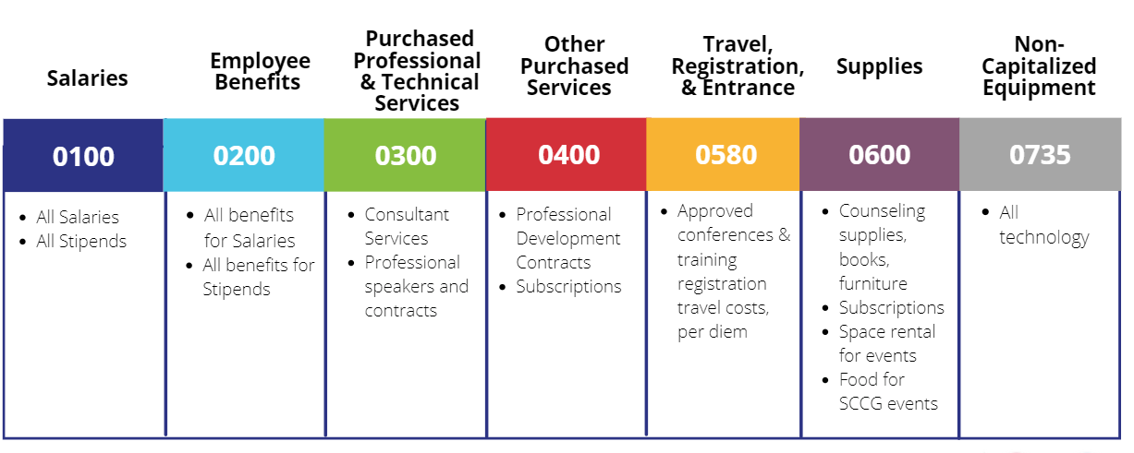
Budget Codes
No SWAG or incentives

Slide 22
Personnel Costs
  Salaries (0100): staff regular salaries and stipends
  Employee Benefits (0200): staff regular benefits
  Purchased Professional & Technical Services (0300): consultants for direct service
  Other Purchased Services (0500): professional development contracts

Slide 23
Salaries- FTE
0100
Minimum Description Requirements:
Examples of
Requirements:
  1.0 FTE for Licensed School Counselor at Fake School
  School Counselor, 100% salary
  HS Counselor, .75 FTE
  Staff Role and/or Title
  FTE allocation
  School location - if multi-school grantee

Slide 24
Salaries- Stipends
0100
The use of stipends must meet local/district policies and be approved by district HR and/or finance departments.
  Stipends up to $1,000: In the budget description on the budget workbook provide:
    How the stipend aligns with SCCG goals
    Title/role
    Job description
  Stipends above $1,000: In the budget description on the budget workbook provide:
    How the stipend aligns with SCCG goals
    Title/role
    Job description
    Hourly rate
Examples of Requirements:
  Teacher stipends for planning, prep, and attendance for 4 parent and student FASA training nights. $250 each
  School Counselor-Counseling program development stipend: 7 sessions X 4 hours X $50 per hour X 5 counselors

Slide 25
Employee Benefits
0200
Minimum Description
Requirements:
Examples of
Requirements:
  Benefit costs for stipends
  Benefit costs for school counselor FTE
  Clearly identify which staff member the cost belongs to
*Important Fiscal Note:
  When reviewing budgets, benefits rates above 40% will be flagged for follow-up.
    While it's not unallowable, we will need to verify that you have actually calculated the cost of benefits rather than making an estimation of the cost. This estimation has led to significant unspent funds in past years and as no carryover is allowed moving forward.
    We need to work together to make sure that line items reflect actual costs.

Slide 26
Examples of Requirements:
Purchased Professional and
Technical Services
0300
Minimum Description Requirements:
  Who?
  What?
  Cost per hour/item
  Why is it necessary?
  ASCA on-site training; $3,500 for 45 staff members
  SCCG Consultant Name- $10,000 to support writing sustainability plan.

Slide 27
Other Purchased Services
0400
Minimum Description Requirements:
Examples of Requirements:
  Who?
  What?
  Cost per hour/item
  Why is it necessary?
  Best Printing Co. - provides paper and ink for printing all instructional materials and supplies for college fair; $2,000 allocable to SCCG program

Slide 28
Supplies & Operating Costs
  Travel, Registration and Entrance (0580): approved conferences/training, per diem—include dates of conferences, number of travelers, and estimated costs such as hotels, air, and mileage
  Supplies (0600): counseling supplies, books, food, furniture
  Non-Capitalized Equipment (0735): technology

Slide 29
Travel, Registration and Entrance
0580
Minimum Description Requirements:
Examples of Requirements:
  $500 for registration to 2023 CSCA conference; $300 per night at the hotel (5 nights); per diem @ $42/day (5 days);
  Who?
  What?
  Cost per hour/item
  Why is it necessary?
  If you are attending summer PD, all expenditures MUST be spent before June 30th, 2025!

Slide 30
American School Counselor
Association Conference
0580
  SCCG funds can only be used for the July 2025 ASCA conference if you are not in the final year of the grant cycle. (Allowable for Cohorts 12,13, and 14 only)
  You can add the ASCA conference costs to your FY2024-25 budget for items that will be processed before June 30, 2025. For example, registration and flights that must be paid for before June 30, 2025, can be added.
  All “on the ground” costs; including but not limited to per diem, mileage, hotel, etc. must be written into the continuation budget for the FY2025-26. These are items that cannot be paid for prior to the June 30, 2025, deadline.
  While we do plan to approve items, all final approvals are based on legislative allocations for SCCG funding in FY2024-25.

Slide 31
Non-Capitalized Equipment
0735
Minimum Description Requirements:
Examples of Requirements:
  What?
  Cost per hour/item
  Why is it necessary?
  Headphones for students to complete FAFSA & other SCCG program activities - $25/each x 100
  Laptop for new counselor - Dell - $750 (no individual device can exceed $1,500)

Slide 32
Supplies
0600
Minimum Description Requirements:
Examples of Requirements:
  What?
  Cost per hour/item
  Why is it necessary?
  Professional Development Books (ASCA - SEL) - $35/each x 25 staff
  Refreshments for School Counselor PD day - 25 staff @ $30 each

Slide 33
Grant Terms
  Grant Award Letter (GAL): The official contract between CDE and the recipient of funding.
  Continuation Budget: A budget to show how funds will continue to be spent in the next spending/fiscal year.
  Budget Revision: Major changes made to a budget during the school year - rule of thumb is adding new budget line items and/or any change greater than 10% of the budget. Must be resubmitted to Smartsheets.
  Annual Financial Report (AFR): A report to show how funds were spent in a previous spending year. Submitted via Smartsheets.
  Interim Financial Report (IFR): A report to show how spending is progressing through the current spending year due mid year.

Slide 34
Interim Financial Reports
Due February 3, 2025
  Interim Financial Report (IFR) is a mid-year financial "check-in" that helps both the Fiscal and Program teams review spending progress.
  Submit a detailed General Ledger showing all grant expenses from July 1, 2024 through December 31, 2024.
  The SCCG team may follow up after IFRs are reviewed if grantees are not on-track with spending.
  Training will occur in the future.

Slide 35
Continuation Budget
Continuation Budgets Due: May 30, 2025
  Each LEA will submit one Continuation Budget for FY2025-26.
    The budget will illustrate the plans for future spending.
  The SCCG team reviews the budget workbooks in June and July to have them approved in August and ready for spending once funds are disbursed and Grant Award Letters (GAL) are received.

Slide 36
Annual Financial Report
Annual Financial Reports Due September 30, 2025
  Annual Financial Report (AFR) is the end-of-year financial report where fiscal and program can ensure that all items allocated to the grant on the general ledger were previously approved in the budget.
  Submit a detailed General Ledger showing all grant expenses from July 1, 2024 through June 30, 2025.
  Complete the AFR Detail Tab in the Budget Workbook
  Fiscal and program will follow-up regarding unspent funds and the reversion process.
  Training will occur in the future.

Slide 37
Budgets in GAINS
GAINS SLIDES

Slide 38

Fiscal Deadlines
  Interim Financial Reports (IFR)
    Due: Friday, February 10, 2025
  Last Date to Submit Budget Revisions for FY2024-25:
    Due: Thursday, May 15, 2025
  Continuation Budgets
    Due: Friday, May 30, 2025
  Annual Financial Report (AFR) for FY2024-25:
    Due: Tuesday September 30, 2025

Slide 39

Questions

Slide 40


Contact Us
If questions come up, please reach out.
SCCG Program
Jennicca Mabe​
Mabe_j@cde.state.co.us ​
303-923-0974​
Brooke Morgan​
Morgan_b@cde.state.co.us​
303-923-0966​
CDE Grants Fiscal
Gloria Kochan
kochan_g@cde.state.co.us
720.916.6488

Slide 41
Thank you!
Please reach out with questions.

