Slide 1





School Counselor Corps Grant
Fiscal Training
Cohorts 12 and 13

Slide 2


Before We Begin
  This meeting will be recorded.
  Closed-captioning: click the live transcript option on your bottom Zoom toolbar, under more.
  Slides and recording will be posted to the Grant Training website.
  Attendance will be taken through a Zoom survey at the end of the training.

Slide 3




Engage Today
Join us by:
Updating your name in Zoom and include your school.
Muting your microphone.
Using the raise hand function or typing in the chat.
Keeping your video on.

Slide 4






Meet Your CDE Grant Support
Jennicca Mabe
Brooke Morgan
Gloria Kochan
School Counseling Specialist
Mabe_j@cde.state.co.us
School Counseling Specialist
Morgan_b@cde.state.co.us
Grants Fiscal Analyst
Kochan_g@cde.state.co.us

Slide 5

Today’s Objectives
By the end of this session, grantees should:
Gain awareness of the roles and responsibilities that support the School Counselor Corps Grant Program (SCCGP).
Increase understanding of the Code of Federal Regulations and Cost Principles.
Be able to complete budget workbooks and fiscal reporting requirements.
Calendar fiscal deadlines and reporting requirements.

Slide 6

Grantee Adoptee
  Raise your hand if you are new.
  Contact us:
    For documents and historical grant information
    Support

Slide 7
SCCGP Team
School Counselors
School Administrators
Fiscal
Support
Grants Fiscal
CDE
Program
CDE
  Attend trainings in-person and virtually
  Collaborate with school counselor for programming, alignment, and sustainability
  Technical assistance on the budget
  Interim Financial Report (IFR) and Annual Financial Report (AFR) Review
  Budget reviews
  Grant Award Letter (GAL) and Amendments
  Payments and Disbursements
  Attend trainings in-person and virtually
  Drive programming and reflection of SCCG
  Create and monitor SMART goals
  Deliver interventions and programming
  Collaborate with team for alignment and sustainability
  Follow all local policies and guidelines
  Work with program to complete budget workbooks
  Submit budget workbooks
  Complete and submit Interim Financial Report (IFR) and Annual Financial Report (AFR)
  Attend virtual fiscal trainings
  Address statutory requirements
  Support, management, and technical assistance
  Statewide trainings and professional development
  Comprehensive school counseling implementation and advocacy
  Evaluating and reflecting

Slide 8
Team Norms and Timeline
  When should tasks be accomplished?
  Reporting dates
  Budget deadlines
  When will the team meet?
  How often will the team meet?
SCCG MEETINGS
DEFINE TASKS
TIMELINE
  Who will attend grant trainings?
  How will information be shared?
  How will schools and fiscal collaborate?
  Who will complete the budgets?
  Who will submit and approve the budgets?

Slide 9
Is SCCGP State or Federally Funded?
The School Counselor Corps Grant Program is
funded by the Colorado State Legislature Budget
However,
In general, If spending considerations for a state grant are not addressed in
legislation, CDE Fiscal rules defer to the 2 CFR 200.

Slide 10
What is the CFR 200?
  Title 2 - Code of Federal Regulations - Part 200
    Provides and establishes uniform administrative requirements, cost principles, and audit requirements.
      Subpart E Cost Principles
        Provides guidance for how money should be spent.

Slide 11


Gifts, Shirts, Prizes, and Incentives
  200.421 Advertising and public relations
    (c) The term “public relations” includes community relations and means those activities dedicated to maintaining the image of the non-Federal entity or maintaining or promoting understanding and favorable relations with the community or public at large or any segment of the public.
    (e) Unallowable advertising and public relations costs include the following:
    (3) Costs of promotional items and memorabilia, including models, gifts, and souvenirs;

Slide 12




Cost Principles
Cost Principles should guide your budget writing.
Necessary
Allocable
Reasonable

Slide 13

Cost Principles- Necessary
  Is the cost NECESSARY for the grant's performance?
  Did you comply with your organization's policies in incurring the cost or charge?
Necessary

Slide 14
Cost Principles- Reasonable
  Is the associated dollar amount prudent?
  Is the associated dollar amount consistent with other costs, grants, organizations?
  Are expenses for this grant consistent with your district’s policies?
Reasonable

Slide 15
Cost Principles- Allocable
  Is the cost DIRECTLY ALLOCABLE to the grant?
  Is the cost worth the benefit to meet the goals of the grant?
  If 100% of the expense is charged to SCCGP, SCCGP must be the only beneficiary of the expense.
Allocable

Slide 16
CDE Deadline to Spend
JUNE 30, 2026
* Make sure you know your district deadline, it may be earlier!

Slide 17


Allowable Use of Funds
All spending must relate to the goals of the SCCG program. Budgets are approved by the SCCG team after budget documents are submitted-unless they require pre-approval (see next slide).
Allowable activities include:
              Licensed school counselor salaries and benefits (those who are working toward licensure- with approval);
              Grant related travel to in-person required trainings and professional development;
              Career awareness and postsecondary preparatory services; ​
              Professional development; ​
              School counseling program development and implementation- including but not limited to:
              Career awareness and postsecondary preparatory services and programs
              ICAP platforms, SEL programs, transition programs, school counseling books and resources
              Consulting Services
Funds may not be used for the following (including, but not limited to): ​
              Capital equipment ​
              Building improvements, construction, or maintenance​;
              Indirect costs, or incentives for students and or staff; or
              1.0 FTE related to non-school counseling positions (i.e. school psychologists, social workers, clinical counselors).

Slide 18
Special Guidelines for Budgets
Some budget items require pre-approval and additional
details before adding them to the budget workbook.
Please reach out to your assigned school counseling specialist if you plan to add any of the following to the budget workbook:
  Hiring an individual that is not licensed
  FTE not specific to a licensed school counselor
  School counselor tuition
  Technology over $1,500
  Professional development in July

Slide 19

Budgets Should...
  Be approved before spending;
  Include the month date and year of all trainings and conferences;
  Be the most up to date and accurate representation of spending;
  Be turned in by deadlines or speak to School Counseling Specialist if an extension is needed;
  Be adjusted and resubmitted if revisions are needed; and
  Follow your district’s financial guidelines.
  The district or school is solely responsible for how money is spent, so it is best practice to have a district fiscal agent prepare the budget, not a consultant.

Slide 20
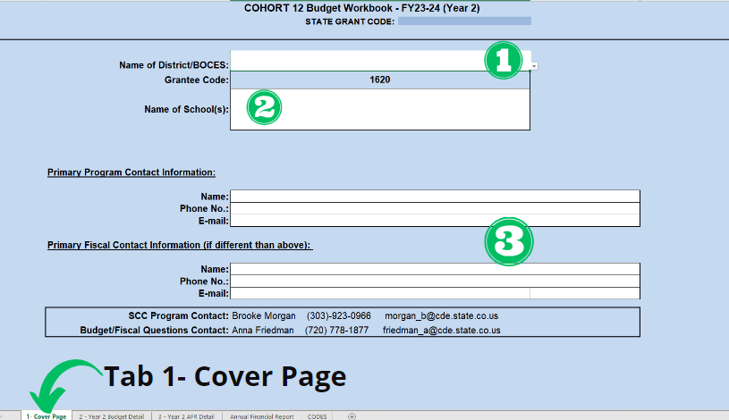
Budgets- Cover Page
  Find your District/BOCES/Charter from the drop-down menu
  Name the FUNDED sites
  Enter the most up-to-date:
    Program Contact
    Fiscal Contact

Slide 21
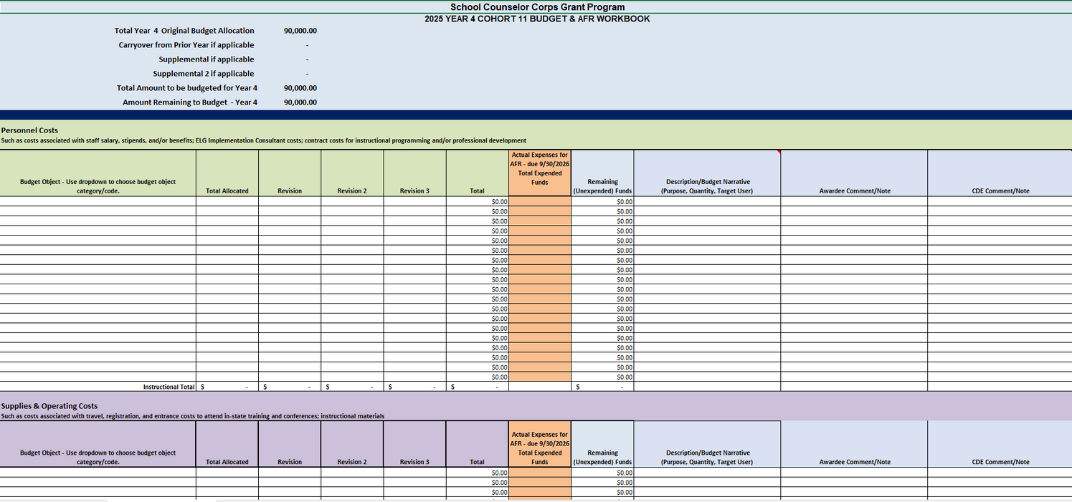
Budget Details
  District/BOCES Information: will automatically fill based on the information entered Tab 1
  Budget Available, Budgeted For, and Total Remaining: specific to award amount
  Two Sections for Budget Items:
    Personnel Costs
    Supplies and Operating Costs

Slide 22
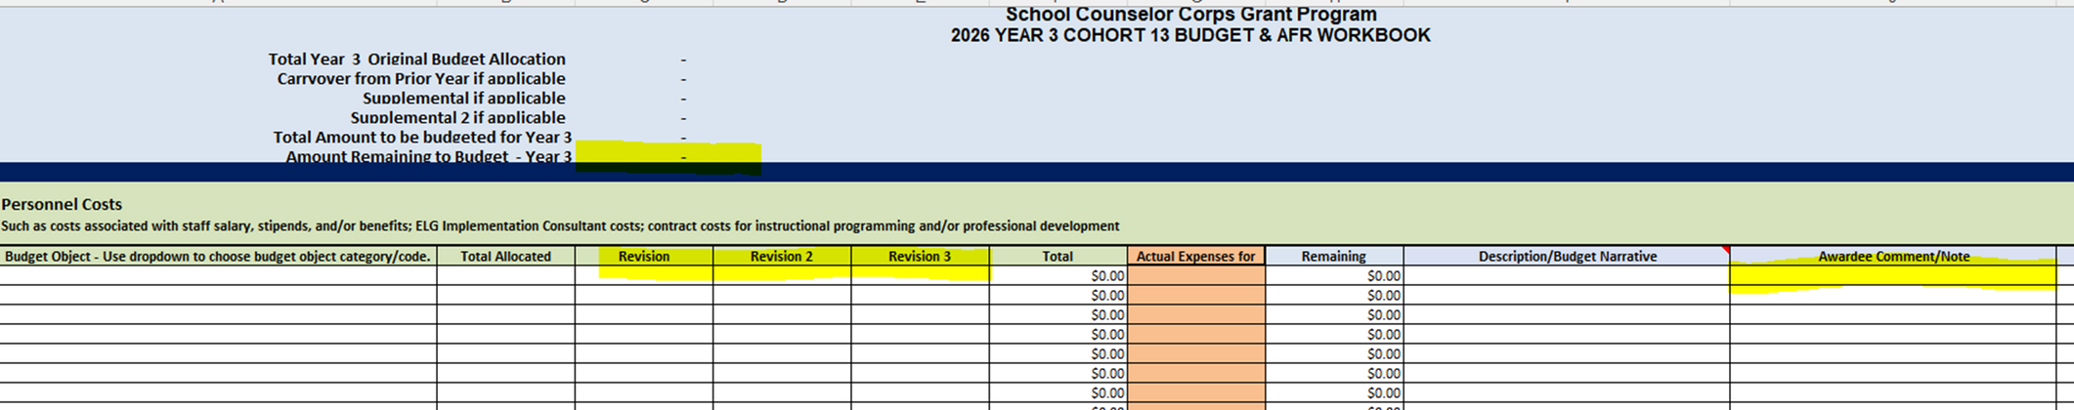
Budget Revision
  A budget revision is required after the first budget proposal is approved and:
    An expense changes the direction of the original intention of the expense.
    An expense exceeds 10% of the line item’s allocation.
  To revise a budget:
    Update the budget item amount in the correct revision column, enter the amount to add or subtract from the original budget in the Revision column to make the change.
    Add narrative in the description of the change (i.e. Decreased FAFSA nights to two nights and reallocated funds to new budget line #15).
    Resubmit to Smartsheets for approval of revision.

Slide 23
Budget Codes
  0100-Salaries
  0200-Employee Benefits
  0300-Purchased Services- Consultant Services and Professional Speakers
  0400-Purchased Services, Professional Contracts, and Subscription Services
  0580-Travel, Registration and Entrance
  0600-Supplies
  0735-Non-Capitalized Equipment

Slide 24
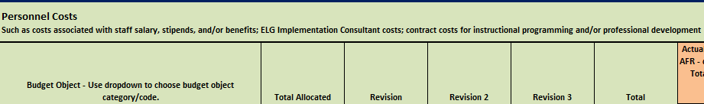
Personnel Costs
  Salaries (0100): staff regular salaries and stipends
  Employee Benefits (0200): staff benefits and tuition
  Purchased Professional and Technical Services (0300): consultants and professional speakers
  Other Purchased Services (0400): professional contracts, and subscription services

Slide 25
Salaries 0100
Minimum Description Requirements:
  Staff Role and/or Title
  FTE allocation
  School location - if multi-school grantee
Examples of
Requirements:
  1.0 FTE for Licensed School Counselor at Fake School
  School Counselor, 100% salary

Slide 26
Salaries- Stipends 0100
The use of stipends must meet local/district policies and be approved by district HR and/or finance departments.
  Stipends up to $1,000: In the budget description on
the budget workbook provide:
    How the stipend aligns with SCCG goals
    Title/role
    Job description
  Stipends above $1,000: In the budget description on
the budget workbook provide:
    How the stipend aligns with SCCG goals
    Title/role
    Job description
    Hourly rate
Examples of Requirements:
  Teacher stipends for planning, prep, and attendance for 4 parent and student FASA training nights. $250 each
  School Counselor-Counseling program development stipend: 7 sessions X 4 hours X $50 per hour X 5 counselors

Slide 27
Employee Benefits 0200
Minimum Description
Requirements:
  Clearly identify which staff member the cost belongs to
Examples of
Requirements:
  Benefit costs for stipends
  Benefit costs for school counselor FTE
*Important Fiscal Note:
  When reviewing budgets, benefits rates above 40% will be flagged for follow-up.
    While it's not unallowable, we will need to verify that you have actually calculated the cost of benefits rather than making an estimation of the cost. This estimation has led to significant unspent funds in past years and as no carryover is allowed moving forward.
    We need to work together to make sure that line items reflect actual costs.

Slide 28
Benefits 0200:
Tuition and Associated Books
Minimum Description
Requirements:
  Include name of higher education institution and employee
Examples of
Requirements:
  Tuition cost to School Counseling University for JB
  Books for Masters in School Counseling
*Important SCCG Note:
  See Tuition/Hiring Guidance workflow
  Fill out assurances
  Tuition can only be paid for those in grant funded positions

Slide 29
Purchased Services- 0300
Consultant and Professional Speakers
Minimum Description Requirements:
  Who?
  What?
  Cost per hour/item
  Why is it necessary?
Examples of Requirements:
  ASCA on-site training; $3,500 for 45 staff members
  SCCGP Consultant Name- $10,000 to support writing sustainability plan.

Slide 30
Purchased Services, Professional Contracts, and Subscription Services 0400
Minimum Description Requirements:
  Who?
  What?
  Cost per hour/item
  Why is it necessary?
Examples of Requirements:
Best Printing Co. - provides paper and ink for printing all instructional materials and supplies for college fair; $2,000 allocable to SCCG program

Slide 31
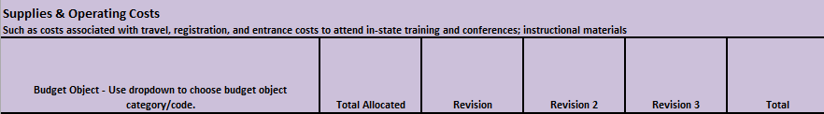
Supplies and Operating Costs
  Travel, Registration and Entrance (0580): approved conferences/training, per diem—include dates of conferences, number of travelers, and estimated costs such as hotels, air, and mileage
    Per diem- please adjust for conference meals
  Supplies (0600): counseling supplies, books, food, furniture
  Non-Capitalized Equipment (0735): technology

Slide 32
Travel, Registration, and Entrance 0580
Minimum Description Requirements:
  Who?
  What?
  When?
    Include month and year
    TBD by Oct 1, 2025
  Cost per hour/item
  How does it relate to school counseling
Examples of Requirements and Notes:
$500 for registration to the October 202 CSCA conference; $300 per night at the hotel (5 nights); per diem @ $42/day (5 days);
  If you are attending summer PD, all expenditures MUST be spent before June 30th, 2026!
  Per diem, please adjust for conference meals

Slide 33
American School Counselor
Association (ASCA) Conference
  SCCG funds can only be used for the July 2026 ASCA conference if you are not in the final year of the grant cycle (allowable for Cohorts 13,14, and 15 only).
  You can add the ASCA conference costs to your FY2025-26 budget for items that will be processed before June 30, 2026. For example, registration and flights that must be paid for before June 30, 2026, can be added.
  All “on the ground” costs- including but not limited to per diem, mileage, hotel, etc. must be written into the continuation budget for the FY2026-27. These are items that cannot be paid for prior to the June 30, 2026, deadline.
  “On the ground” cost from the 2025 ASCA Conference are allowable on the FY2025-2026 budget.

Slide 34
Supplies 0600
Minimum Description Requirements:
  What?
  Cost per hour/item
  Why is it necessary?
  We recommend only paying food costs when services are limited
Examples of Requirements:
  Professional Development Books (ASCA - SEL) - $35/each x 25 staff
  Food for School Counselor PD day - 25 staff @ $15 each

Slide 35
Non-Capitalized Equipment 0735
Minimum Description Requirements:
  What?
  Cost per hour/item
  Why is it necessary?
  Use district policy
Examples of Requirements:
  Headphones for students to complete FAFSA and other SCCG program activities - $25/each x 100
  Laptop for new counselor - Dell - $750 (no individual device can exceed $1,500)

Slide 36
Grant Terms
  Grant Award Letter (GAL): The official contract between CDE and the recipient of funding.
  Continuation Budget: A budget to show how funds will continue to be spent in the next spending/fiscal year.
  Budget Revision: Major changes made to a budget during the school year - rule of thumb is adding new budget line items and/or any change greater than 10% of the budget.
  Annual Financial Report (AFR): A report to show how funds were spent in a previous spending year.
    Submitted via Smartsheets.
  Interim Financial Report (IFR): A report to show how spending is progressing through the current spending year, due mid year.

Slide 37
Interim Financial Report
Due February 13, 2026
  Interim Financial Report (IFR) is a mid-year financial "check-in" that helps both the Fiscal and Program teams review spending progress.
  Upload a detailed General Ledger showing all grant expenses from July 1, 2025, through December 31, 2025.
  The SCCG team may follow up after IFRs are reviewed if grantees are not on-track with spending.
  IFRs and AFRs should be submitted via Smartsheets here.

Slide 38
Continuation Budget
Continuation Budgets Due: May 29, 2026
  Each LEP will submit one Continuation Budget for FY2026-27.
  The budget will illustrate the plans for future spending.
  The SCCG team reviews the budgets in June and July to have them approved in August and ready for spending once funds are disbursed and Grant Award Letters (GAL) are received.

Slide 39
Annual Financial Report (AFR)
Annual Financial Report Due: September 30, 2025 (for 24-25SY)
  Annual Financial Report (AFR) is the end-of-year financial report where fiscal and program can ensure that all items allocated to the grant on the general ledger were previously approved in the budget.
  Submit a detailed General Ledger showing all grant expenses from July 1, 2024, through June 30, 2025.
  Fiscal and program will follow-up regarding unspent funds and the reversion process.
  Annual Financial Reports for the 2025-2026SY will be due September 30, 2026.
IFRs and AFRs should be submitted via Smartsheets here.

Slide 40
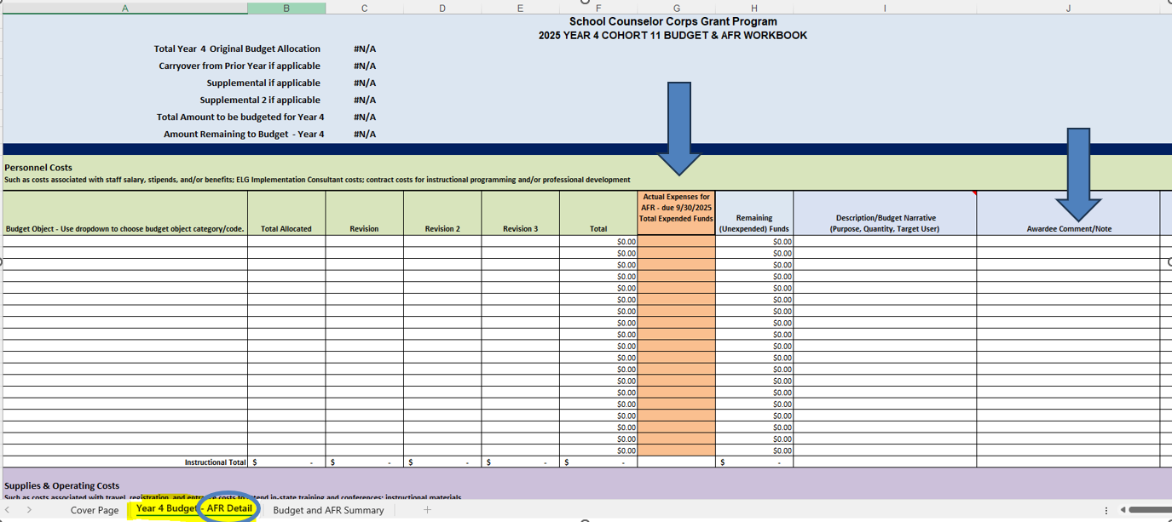
Annual Financial Report
Detail Tab
  Report actual cost in the orange (column G) at the end of each fiscal year.
  Report comments for why Actual Cost differ from the Budgeted Cost in Column J.

Slide 41
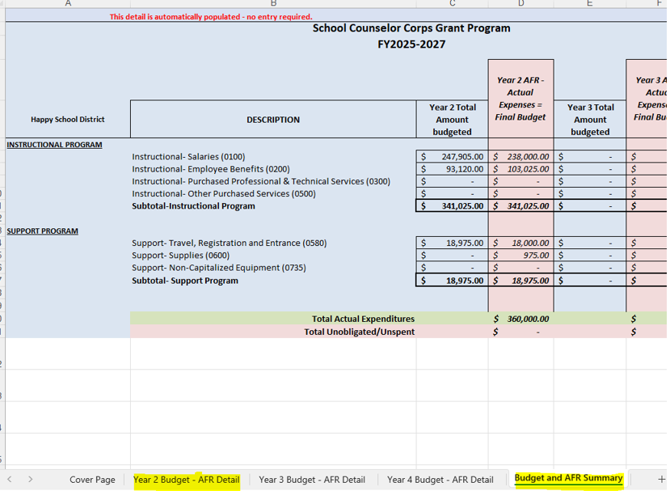
Annual Financial Report
Budget and AFR Summary
  *If your budget does NOT have an AFR Detail or Annual Financial Report tab, you are using the wrong template.*
  The AFR tab is auto populated.
    No entry required.

Slide 42
Carryover
Because of the current state budget shortfall, we do not anticipate any carryover will be allowed in the 2025-2026SY.

Slide 43

Fiscal Deadlines
  Annual Financial Report (AFR) for FY2024-25
    Due: September 30, 2025
  Interim Financial Report (IFR) for FY2025-26
    Due: February 13, 2026
  Last Date to Submit Budget Revisions for FY2025-26:
    Due: May 15, 2026
  Continuation Budgets
    Due: May 29, 2026

Slide 44

Attendance and To-Dos
  Please complete the Zoom survey and share your email for attendance credit at today’s training.
  SCCG fiscal links can be found on the SCCG Fiscal Resources webpage.

Slide 45

Questions

Slide 46


Contact Us
If questions come up, please reach out.
SCCG Program
Jennicca Mabe​
Mabe_j@cde.state.co.us ​
303-923-0974​
Brooke Morgan​
Morgan_b@cde.state.co.us​
303-923-0966​
CDE Grants Fiscal
Gloria Kochan
kochan_g@cde.state.co.us

Slide 47
Thank you!
Please reach out with questions.

