Slide 1




School Counselor Corps Grant
Regional Training
2024-2025
Cohorts 11 and 12
Notes:
Jennicca

Slide 2


Before We Begin
  Please sit with your team.
  WIFI: Devices must be registered. See directions to register here.
    User: 1EventServices
    Password: Union!164
  Scan the QR Code on the table to sign-in for attendance.
  Slides are available on the Grant Training website.
Notes:
Jennicca

Slide 3


Housekeeping
  Today’s Materials:
    Agenda
    Note Catcher
  Restrooms
  Get up, move, take care of yourself
Notes:
Jennicca

Slide 4


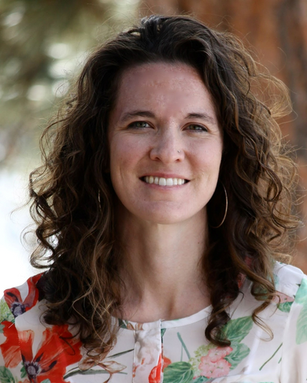
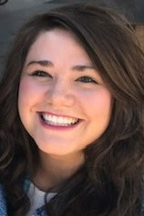
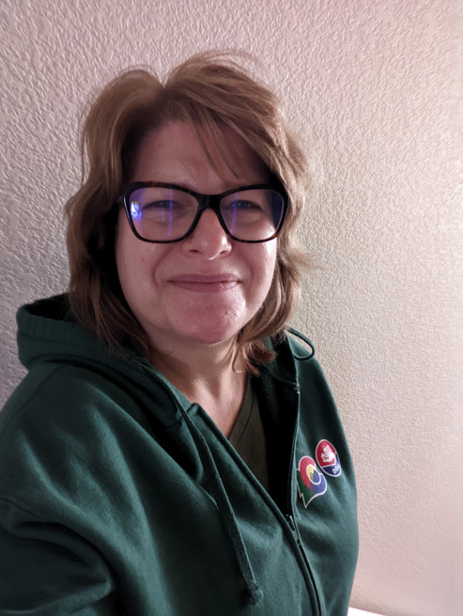
Meet Your CDE Grant Support
Jennicca Mabe
Brooke Morgan
Gloria Kochan
School Counseling Specialist
Mabe_j@cde.state.co.us
School Counseling Specialist
Morgan_b@cde.state.co.us
Grants Fiscal Analyst
Kochan_g@cde.state.co.us
Notes:
Jennicca

Slide 5
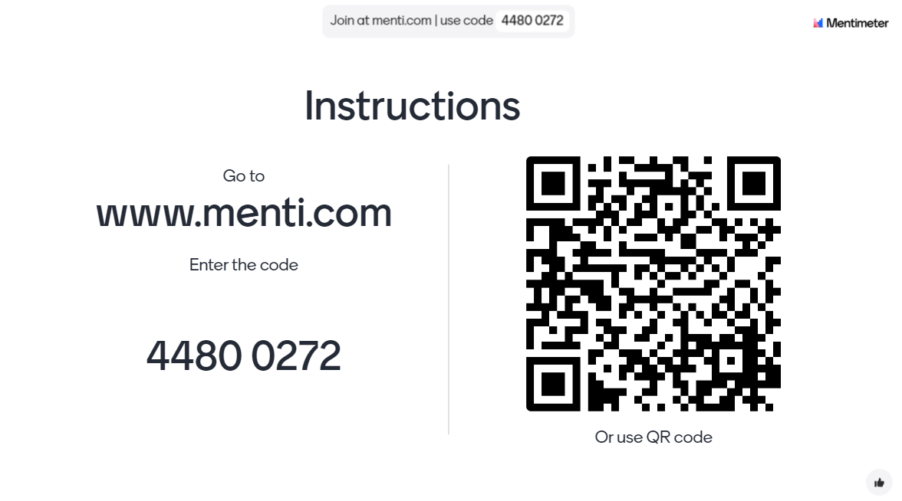
Check-In
Notes:
Menti Link: https://www.menti.com/almgwkf8f2kr

Slide 6

Today’s Objectives
By the end of this session, grantees should:
Reflect on the SCCG past, present, future.
Create a SCCG sustainability plan.
Notes:
Brooke

Slide 7

SCCG Reflection Part I
  What have you learned by having the SCCG?
  What is the greatest strength for your school with the SCCG? Why?
Notes:
Brooke

Slide 8

Role of the School Counselor
  Know the role of a school counselor.
  Support the role of the school counselor.
  Sustain the role of the school counselor through data.
Notes:
Jennicca

Slide 9

The Role of a School Counselor- ASCA
American School Counselor Association (ASCA)
  ASCA School Counselor Professional Standards (ASCA, 2019b)
  ASCA Ethical Standards (ASCA, 2022)
  ASCA Appropriate Use of School Counselor (ASCA, n.d.)
  Learn more by visiting ASCA’s School Counselor Roles and Ratios website (ASCA, 2024a)
(American School Counselor Association (ASCA), 2023a)
Notes:
Brooke
How many know about the ASCA National model
What are we doing on this slide?

Slide 10
The Role of a School Counselor- CDE
CRS 22-91-102
  (6) “School counselor” means a person who holds a special services provider license with a school counselor endorsement issued pursuant to article 60.5 of this title 22 or who is otherwise endorsed or accredited by a national association to provide school counseling services. “School counselor” includes a person who holds a special services intern authorization pursuant to section 22-60.5-111 (3).”
CDE Licensing
  Master's Degree or higher in School Counseling as defined by accreditation by the Council for Accreditation of Counseling & Related Educational Programs (CACREP)
  Minimum of 100 clock hour practicum
  Minimum of 600 clock hour internship, with multiple grade levels of students under the supervision of a licensed school counselor
Notes:
Brooke
How many know about the ASCA National model
What are we doing on this slide?

Slide 11
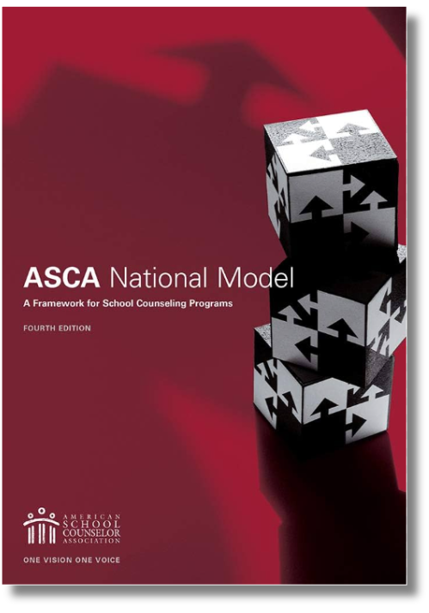
ASCA National Model
Leadership Advocacy Collaboration Systemic Change
“School counselors deliver school counseling programs that enhance student growth in three domain areas: academic, career, and social/emotional development. As a part of that program, school counselors implement strategies and activities to help all students enhance their academic development – the mindsets and behaviors students need to maximize their ability to learn - while recognizing that growth in all three domains is necessary for students to be successful now and later in life.”
(ASCA, 2023b, para.1)
Notes:
Brooke
How many know about the ASCA National model
Support ALL students
Comprehensive, multi-domain, holistic, developmental
Academic achievement, career readiness, social emotional​​​
Data-driven, focused, and intentional ​​​
Improve student outcomes, overcome barriers, close achievement gaps, prepare students for success after high school​​
Define, manage, deliver, and assess

Slide 12
SCCG Reflection Part II
  What has been the biggest challenge for your school with the SCCG?
  How do you hope to sustain the SCCG?
Notes:
Brooke

Slide 13
SCCG Sustainability Plan
SUSTAINABILTY AREA
DATA
STAKEHOLDERS
TIMELINE
ROLE OUT
Notes:
Brooke

Slide 14

Sustainability Plan Message
SUSTAINABILTY AREA
Determine the message. What needs to be sustained?
  SCCG school counseling FTE
    Role according to American School Counselor Association Model
    Comprehensive school counseling model
  Programs and events related to SCCG
  Resources the SCCG funded
  Professional development
  Other?
Notes:
Brooke

Slide 15
Sustainability Plan Message Part I
DATA
Support the message with data findings
School Counselor FTE
Programs and Events
Data
  Number of school counselors hired
  School counselor ratio
  Student impact summary and statements
  Staff impact summary and statements
  List of programs run by the school counselor (i.e. ICAP, CTE, Peer Counseling, Social-Emotional Learning)
  Funding needed
  Use of time data 80/20 (ASCA, 2024b)
  Number of classroom lessons delivered
  Student meetings (in three domains) tracker
  National advocacy: ASCA National Model, ASCA Ratio data, ASCA Professional Standards
  Name and number of events hosted utilizing SCCG funds (college visits, FAFSA event, career fair)
  List of programs made possible by SCCG (i.e. ICAP, CTE, Peer Counseling, Social-Emotional Learning, Work-Based Learning)
  Curriculum purchased with SCCG funds and lessons delivered
  Data tracked progress
  Attendance at events or in programs
  Outcomes of events (matriculation), FAFSA completion
  List of interventions made possible by additional staffing or resources
  Student impact summary and statements
  Staff impact summary and statements
  Impact on graduation rate, early warning system, D & F’s
Notes:
Brooke

Slide 16
Sustainability Plan Message- Part II
DATA
Support the message with data findings
Resources SCCG Funded
Professional Development
Data
  List of classes (advisory, ICAP, AP, WBL)
  Student use of platforms and programs
  School Counselor and teacher use of platforms and subscriptions
  Data tracked progress
  Explanation of technology
  Staff impact summary and statements
  Office supplies needed for comprehensive school counseling
  Student school counseling supplies (books, games, fidgets, etc.)
  Logged number of professional development hours through the SCCG
  Conferences, trainings, webinars, certificates
  Summary of how professional development changed comprehensive school counseling
  ASCA National Model
  Book studies
  Administrator impact statement
Notes:
Brooke

Slide 17
Sustainability Plan Data
DATA
What was the impact of SCCG in these student outcome areas?
School Counseling Program
Student Achievement
Attendance
Behavior
Notes:
Brooke

Slide 18
Sustainability Plan Data Refresh
DATA
Primary Data
“Defines the who, what and why of school counselors’
work with students.”
  Participation Data
    Describes who participated and what activities were implemented.
  Standards, Mindsets and Behavior Data
    Illustrates students progress and “what they learned.”
  Outcome Data
    Measures impact of strategy, intervention, or activity on attendance, achievement, and/or discipline (behavior).
Supplementary Data
Background and additional information
about identified needs.
  “Contextualize the problems”
  Helpful to determine contributing factors and targeted interventions.
  Based on perspectives and experiences.
  Methods for gathering supplementary data:
    Conversations and interviews
    Needs assessments
    Climate and opinion surveys
(ASCA, 2019a, pp. 34- 36)
(ASCA, 2019a, pp. 37-38)
Notes:
Brooke

Slide 19
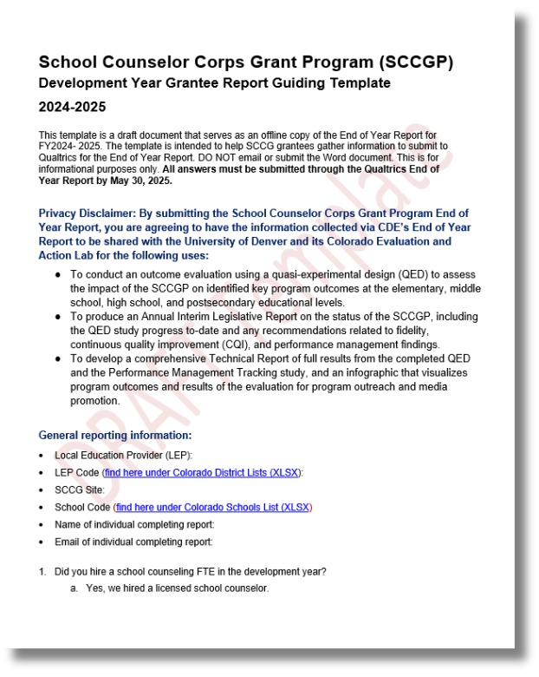

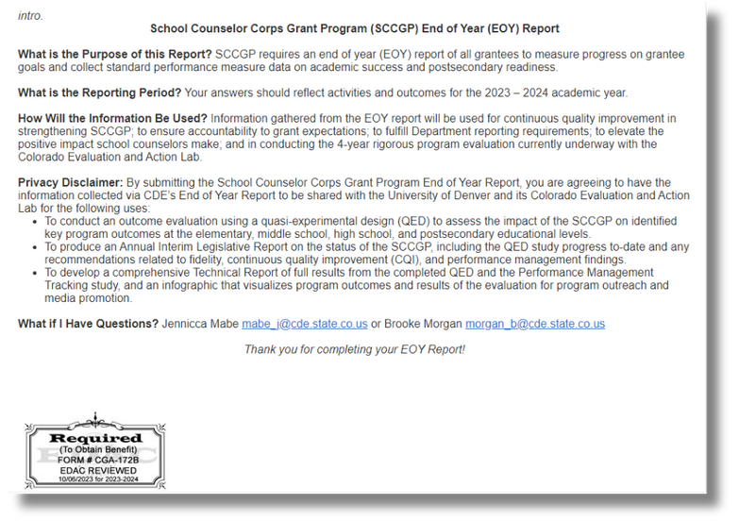
Sustainability Plan Data Sources
DATA
Previous Legislative Reports
2-3 End of Year Reports
1- SCCG Development Year Report
Notes:
Brooke

Slide 20
Who Has Access to Data?
DATA
DID YOU KNOW?
“Data Hunter” and “Data Scientist” are job titles.
Write it down...
  Who is your district data hunter/scientist for each bucket?
SCHOOL COUNSELING PROGRAM
STUDENT ACHIEVEMENT
ATTENDANCE
BEHAVIOR
Notes:
Jennicca

Slide 21

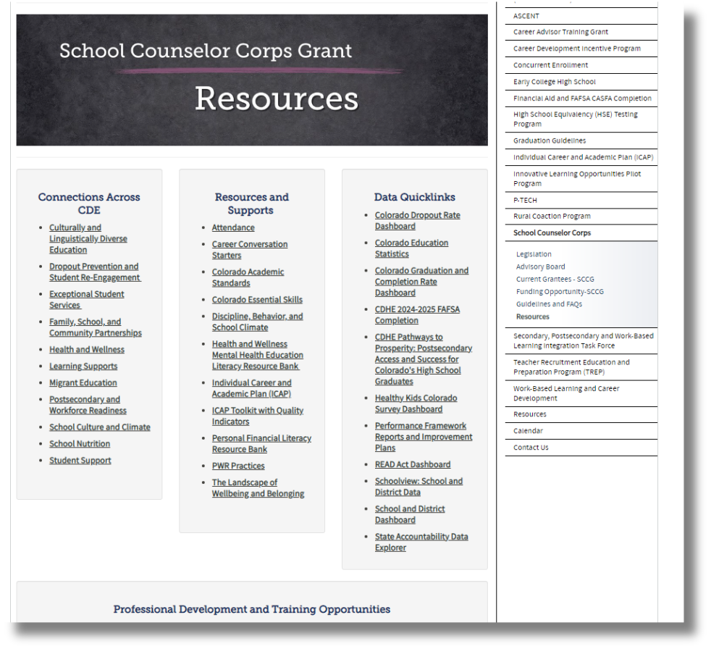
SCCG Data Quicklinks
DATA
Bookmark the
SCCG Resources website to access publicly available data sources.
Notes:
Brooke

Slide 22
Sustainability Plan Stakeholders
STAKEHOLDERS
Align sustainability area with data and stakeholders.
Make a list of different stakeholders.
  Who needs to hear the message?
    What message?
  Who needs to see the data?
    What data?
  Where can you present to these stakeholders?
  Who on the SCCG team knows the stakeholders best?
SCHOOL COUNSELOR FTE
  SCHOOL BOARD
  COMMUNITY OF PARENTS
DATA
PROGRAMS AND
EVENTS
DATA
  ADMINISTRATION
  SCHOOL STAFF
Notes:
Brooke

Slide 23
Who Can Help?
STAKEHOLDERS
School Counselors
School Administrators
District
Leaders
CDE
Support
  Attend trainings in-person and virtually
  Drive programming and reflection of SCCG
  Create and monitor SMART goals
  Deliver interventions and programming
  Collaborate with team for alignment and sustainability
  Attend trainings in-person and virtually.
  Collaborate with school counselor for programming, alignment, and sustainability
  Attend trainings in-person and virtually
  Collaborate with school counselors, administrators, and fiscal contacts
  Support alignment across schools
  Sustainability plans
  Address statutory requirements
  Support, management, and technical assistance
  Statewide trainings and professional development
  Comprehensive school counseling implementation and advocacy
  Evaluating and reflecting
Notes:
Brooke

Slide 24
Sustainability Plan Timeline
TIMELINE
Map out important dates.
November | December | February | March | April | May
11/14: Team meeting to collect SCCG data to sustain FTE and programs- Jennicca, Brooke, Michelle 11/28: Student impact minutes -Michelle | 12/2: Student impact statements assigned in advisory -Jennicca 12/4: Collect student impact statements in advisory-Jennicca | 2/3: Decide data priorities- Jennicca, Brooke, Michelle 2/15: Create staff one-pager from data- Brooke | 3/10: Form to be on school board agenda due to district admin- Michelle 3/20: Start PowerPoint Presentation- Jennicca 3/22: Michelle starts video of programs | 4/1: Student and guardian permission to present- Brooke 4/15: Powerpoint finished 4/20: Team meeting to prep Powerpoint slides- Jennicca, Brooke, Michelle & student | 5/3: Team meeting, practice presentation 5/15: Present School Board Meeting 6:00
Notes:
Brooke

Slide 25
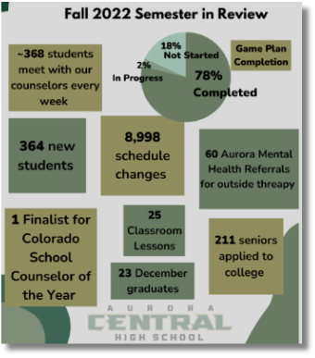




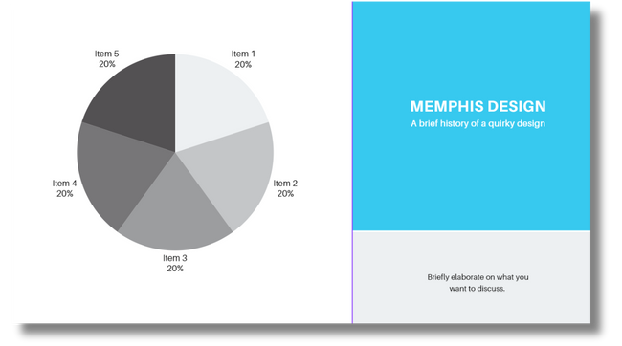
Sustainability Plan Examples
ROLE OUT
How do you plan to share the message?
  Presentation
  Flyers
  Bulletin boards
  Video of programs
  Social Media
We love our School counselor
Aurora Central High School
Counseling Department, 2023
Notes:
Brooke

Slide 26

Mark Your Calendars!
  Virtual Professional Development with Hatching Results, Inc.
    February 11, 2025: register via Zoom
    February 12, 2025: register via Zoom
  Interim Financial Report Due: February 2, 2025
  End of Year Report Due: May 30, 2025
Notes:
Brooke

Slide 27

Questions
Notes:
Brooke

Slide 28


Contact Us
If questions come up, please reach out.
SCCG Program
Jennicca Mabe​
Mabe_j@cde.state.co.us ​
303-923-0974​
Brooke Morgan​
Morgan_b@cde.state.co.us​
303-923-0966​
CDE Grants Fiscal
Gloria Kochan
kochan_g@cde.state.co.us
Notes:
Brooke

Slide 29
References Part I
American School Counselor Association. (n.d). Appropriate and inappropriate activities for school counselors.
https://www.schoolcounselor.org/getmedia/8fe536c2-7a32-4102-8ce7-42e9b0683b3b/appropriate-activities-of-school-counselors.pdf
American School Counselor Association. (2019a). The ASCA national model: A framework for school counseling programs (4th Edition). Alexandria, VA: Author.
American School Counselor Association. (2019b). ASCA School Counselor Professional Standards & Competencies. Alexandria, VA: Author.
https://www.schoolcounselor.org/getmedia/a8d59c2c-51de-4ec3-a565-a3235f3b93c3/SC-Competencies.pdf
American School Counselor Association. (2022). ASCA ethical standards for school counselors.
https://www.schoolcounselor.org/getmedia/44f30280-ffe8-4b41-9ad8-f15909c3d164/EthicalStandards.pdf
American School Counselor Association. (2023a). The role of the school counselor.
https://www.schoolcounselor.org/getmedia/ee8b2e1b-d021-4575-982c-c84402cb2cd2/Role-Statement.pdf
American School Counselor Association. (2023b). The school counselor and academic development.
https://www.schoolcounselor.org/Standards-Positions/Position-Statements/ASCA-Position-Statements/The-School-Counselor-and-Academic- Development
American School Counselor Association. (2024a). School counselor roles and ratios.
https://www.schoolcounselor.org/About-School-Counseling/School-Counselor-Roles-Ratios
Notes:
Brooke

Slide 30
References Part II
American School Counselor Association. (2024b, May). Templates and tools: Use-of-time 5-day calculator.
https://www.schoolcounselor.org/AboutSchool-Counseling/ASCA-National-Model-for-School-Counseling-Programs/Templates-Resources
Aurora Central High School Counseling. (2023). SCCG CDE site visit [Google Slides].
Colorado Department of Education. (2024, September 16). School Counselor Corps Grant Program Resources.
https://www.cde.state.co.us/postsecondary/scc_resources
Notes:
Brooke

Slide 31
Thank you!
We look forward to seeing you soon!
Notes:
Brooke

