Slide 1
Another PowerPoint Presentation About Counseling

Slide 2
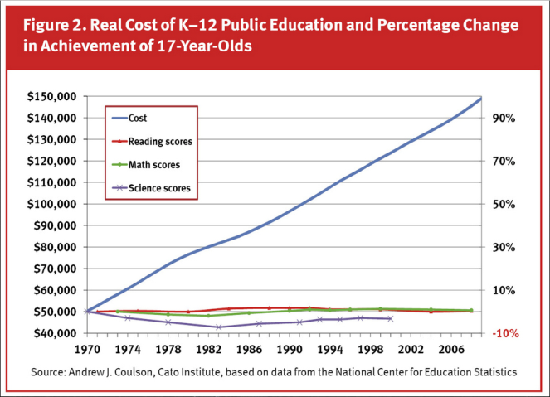
A Chart

Slide 3
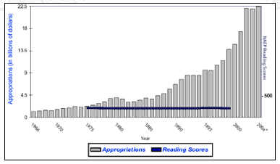
Another Chart

Slide 4
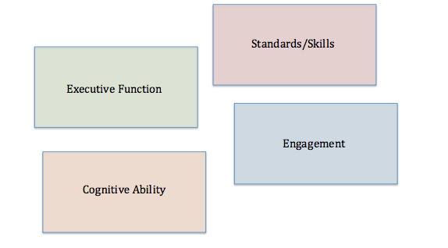
Some Components of Academic Success

Slide 5
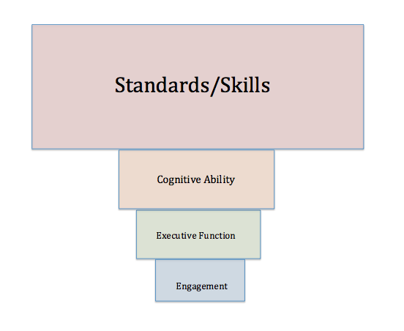
Current Emphasis

Slide 6
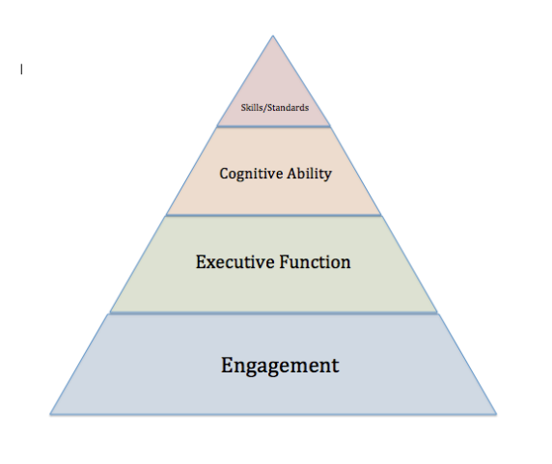
A Suggested Placement of Emphasis

Slide 7
Our Observation
In our school:
Academic underperformance is almost never a result of cognitive deficiency, poor methodology, or lack of resources.
Academic success is almost never the result of advanced cognitive ability, correct methodology or ample resources.
The level of engagement is commensurate with the level of success.

Slide 8
Engagement
Effort
Perceived Relevance
Comfort
Concrete Vision

Slide 9
Conclusions
Our values should be evident in our practice.
The key success factors are not currently measured – we must teach them anyway.
The key success factors are driven by social and environmental factors rather than curricular or methodological factors.
The counseling staff are best trained to deal specifically with these success factors.

Slide 10
Initiatives Driven by the Counseling Department
Crew
High Trails (6th Grade)
Student Advisory Groups
Student-Led Parent Conferences
Graduation Guidelines
Promotion Policy

Slide 11
Please feel free to contact us with any questions or suggestions
Dave Slothower
Calhan School District RJ-1
719-346-2766 x409
dslothower@calhanschool.org
Allie Taylor
Calhan School District RJ-1
719-347-2766 x530
alexzandra.taylor@calhanschool.org

