Slide 1
Concurrent Enrollment Advisory Board Meeting
January 23, 2020

Slide 2
AGENDA
Welcome, Roll Call & Minutes Approval 1:00 p.m.
Sarah Heath
New Members Welcome 1:10 p.m.
AG Office: Sunshine Law Overview 1:20 p.m.
Officer Elections 2:05 p.m.
CDE Updates – Michelle Romero 2:15 p.m.
SB 19-176 – Communications with Stakeholders on Implementation
SB 19-176 – CE Expansion & Innovation Grant Program Update
SB 19-176 – CE Website Update
ASCENT – Mary Anne Hunter
CDHE Updates – Carl Einhaus 2:45 p.m.
Previous discussions follow up 3:00 p.m.
Schedule 2020 meetings (Apr, Jul/Aug, Oct)
Sharing out from attending any conferences
Creation of sub-committees, such as new member onboarding and handbook
Public Input 3:30 p.m.
Action Plan and Next Steps 3:45 p.m.
Next meeting:
Date: April ___, 2020
Location MSU South Campus (tentative)
Adjourn 4:00 p.m.

Slide 3
Welcome, Roll Call & Minutes Approval - Sarah Heath

Slide 4
NEW MEMBERS WELCOME
Reynaldo “Chico” Garcia
Kim Maxwell
Jenise Rosa
David Vetter

Slide 5
AG OFFICE: SUNSHINE LAW OVERVIEW

Slide 6
OFFICER ELECTIONS
Nominated for Chair at last meeting:
Tammy Ward
Nominated for Vice Chair at last meeting:
Mark Thompson

Slide 7
CDE UPDATES
SB 19-176 – Communications with Stakeholders on Implementation
SB 19-176 – CE Expansion & Innovation Grant Program Update
SB 19-176 – CE Website Update

Slide 8
Concurrent Enrollment Expansion and Innovation Grant Program 2019-2020 Approved Grantees (School and/or District)
Adams-Arapahoe 28J (APS)
Alamosa School District
Archuleta County School District 50JT
Boulder Valley School District RE-2
Branson School District RE-82
Center Consolidated School District 26JT
Cherry Creek School District 5
Clear Creek School District RE-1
CSI - Caprock Academy
CSI – Colorado Military Academy
CSI - The Academy
Delta County School District
Denver Public Schools - Abraham Lincoln
District 49 (Falcon)
Eagle County School District
Eaton School District RE-2
Englewood School District 1
Greeley-Evans School District 6
Harrison 2 - Atlas Prep
Harrison 2 - James Irwin Charter
Littleton Public Schools
Mancos School District RE-6
Mesa County Valley School District 51
North Conejos School District
Poudre School District
Poudre School District - Compass Community
South Conejos School District RE-10
Southeastern BOCES
Thompson School District R2-J
Upper Rio Grande School District C-7
Westminster Public Schools
Wiley School District RE-13JT
Approximately $1.48 million available for grant distribution for the 2019-2020 school year.
36 applications were received for a total request of $1,682,610.
The applicants included 13 districts designated as rural or small rural, 15 urban/suburban districts, 7 charter schools, and 1 BOCES.
CDE recommended approval for 32 of schools/districts. Of the approved applicants, 12 are rural or small rural, 13 urban/suburban, 6 charter schools and 1 BOCES.

Slide 9
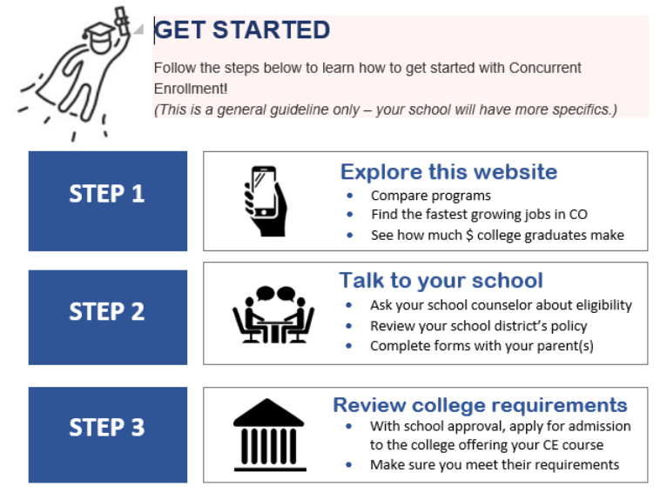
CE WEBSITE UPDATE

Slide 10
ASCENT UPDATES
February 5, 2020 @ 10:30am-12:00pm: 2020-21 Training/Q&A Webinar More info: http://www.cde.state.co.us/postsecondary/ascentslotrequestprocess
May 1, 2020 is deadline for ITP submission

Slide 11
CDHE UPDATES

Slide 12
Previous discussions follow up
Schedule 2020 meetings (Apr, Jul/Aug, Oct)
Sharing out from attending any conferences
Creation of sub-committees, such as new member onboarding and handbook

Slide 13
Public Input
Action Plan and Next Steps
Next meeting:
Date: April ____, 2020
Location: MSU South Campus (tentative)
Adjourn

Slide 14
Thank you!

