Slide 1
FAFSA Jeopardy

Slide 2
Final Jeopardy
EX
Scholarships
Summer Melt
College
Paying for College
FAFSA
Completion Project
100
100
100
100
100
100
200
200
200
200
200
200
300
300
300
300
300
300
400
400
400
400
400
400
500
500
500
500
500
500

Slide 3
Scholarships
100
Scholarships are earned only on good grades?
False

Slide 4
Scholarships
200
How much should you pay to apply for financial aid or scholarships?
$0- Never Pay!!!!

Slide 5
Scholarships
300
What is a first generation student?
A student whose parents did not complete a bachelor’s degree or higher

Slide 6
scholarships
400
Name four places where you can find scholarship information.
Counseling Office
Local businesses
The college you plan to attend

Slide 7
scholarships
500
Name 3 documents you may be asked to submit when applying for a scholarship
Application
Essay
Letter of Recommendation
Resume
Cover Letter

Slide 8
Summer melt
100
What is summer melt?
30% attrition rate between high school and any type of college

Slide 9
Summer melt
200
Name 3 strategies to reduce summer melt.
(1) Summer pay for counselors to assist with life event (2) coordinate with pre-collegiate groups (3) admissions app & fin aid complete (4) personal contact with families/students/email/text

Slide 10
Summer melt
300
What are the reasons students cite for not continuing their education?
Life Event/Family Event (death, pregnancy, etc.)
Can’t afford it
Need to work/take care of siblings

Slide 11
Summer melt
400
What are available resources to pay for summer melt?
Counselor Corps Grant
Pre-collegiate programs
PPR
Social-emotional state grant

Slide 12
Summer melt
500
Why would summer melt be helpful to your school or district?
Name the difference between the Federal Subsidized and Unsubsidized Student Loans
“Success for my district and school are not measured by high school graduation and by life success” Arne Duncan

Slide 13
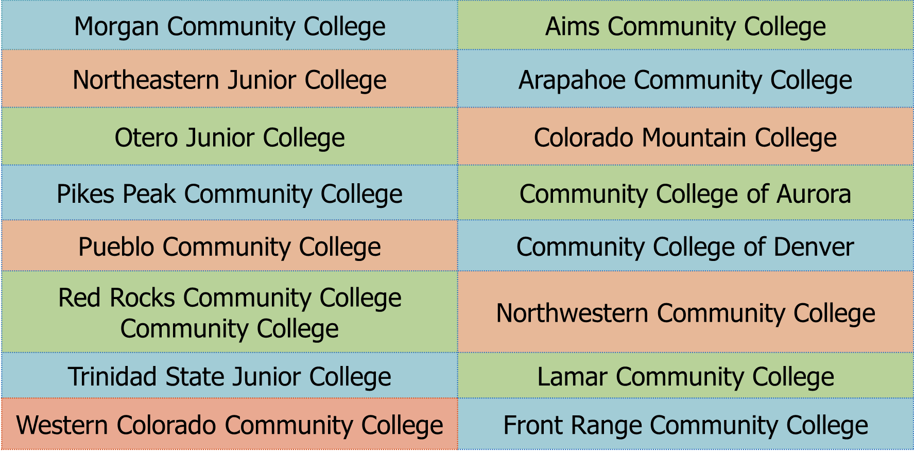
College
100
Name 2 public community colleges.

Slide 14
college
200
Why are non-resident students charged so much more tuition than resident students?
Non-resident families don’t pay state taxes in that state, a portion of which goes to support that state’s public colleges.

Slide 15
college
300
What % of students who complete a FAFSA during spring of senior year enroll in college within 12 months?
Nationally: 90% Colorado: 85%

Slide 16
college
400
What’s the estimated percentage of jobs that will require education and training beyond high school by 2020 in Colorado?
74%

Slide 17
college
500
What does WUE stand for?

Slide 18
Paying for College
100
Who should you contact if you have concerns regarding Financial Aid?
The financial aid office of your perspective college

Slide 19
Paying for College
200
What is the COF (College Opportunity Fund)?
Is money in a form of a stipend that helps you pay for college. ($75/ credit hour)

Slide 20
Paying for College
300
What is a financial aid award letter and what does it tell you?
A notification of the money you have been awarded to attend the college

Slide 21
Paying for College
400
Apart from tuition and fees, what are two other expense you will encounter in college.
Tuition & Fees
Room & Board
Books/Supp.
Personal/Med
Transportation

Slide 22
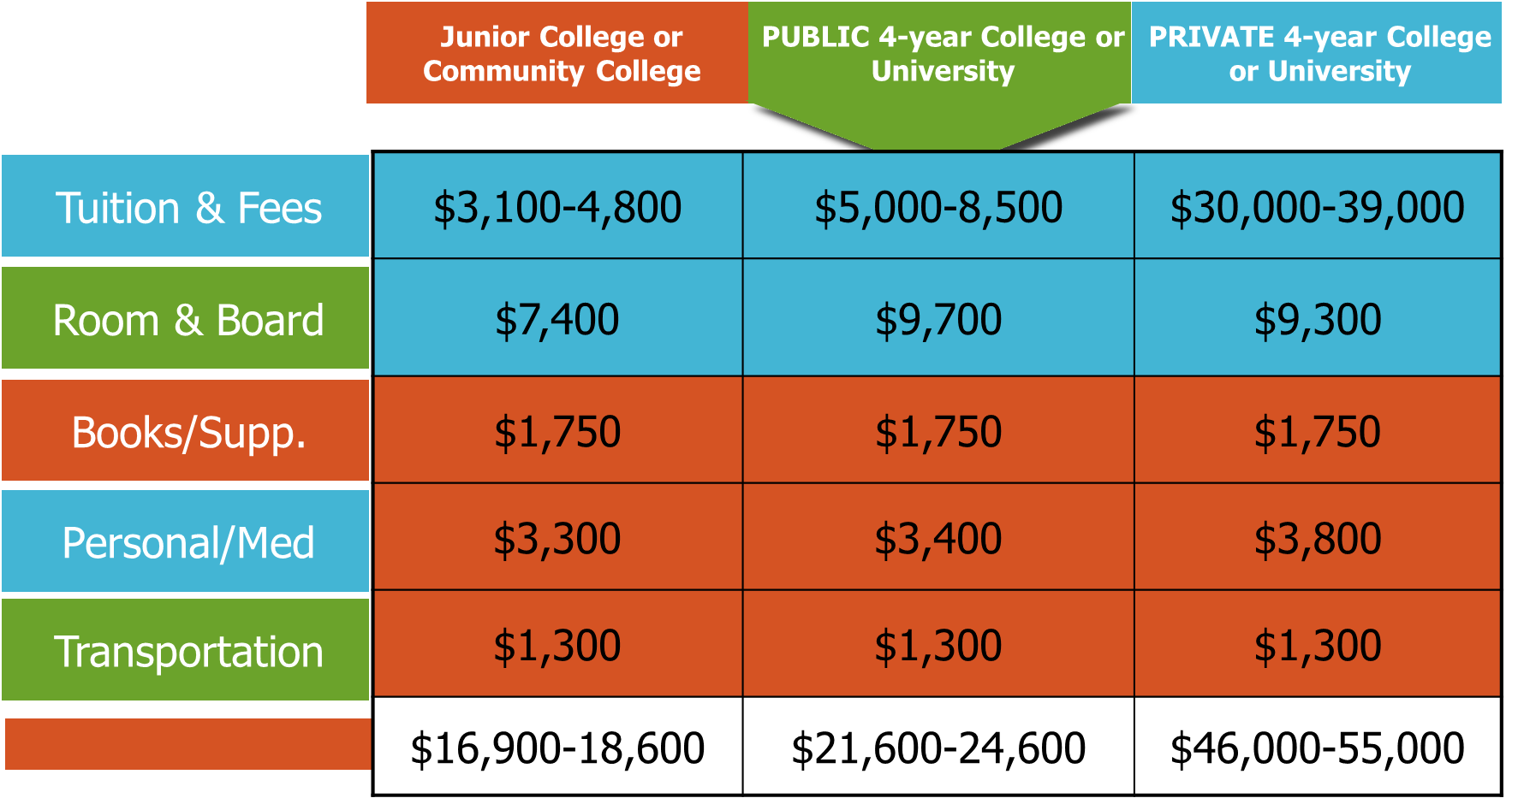
Paying for College
500
Name two budget items below that you have control over.
Total

Slide 23
FAFSA
100
What is the FAFSA meant to do?
Be a rationing tool to ensure Federal and state resources are equitably distributed.

Slide 24
FAFSA
200
What is the URL for Colorado’s FAFSA completion website?
Highered.colorado.gov/fafsa

Slide 25
FAFSA
300
Free Application for Federal Student Aid – inform PWR measures and most predictive indicator of actual college enrollment.
FAFSA stands for & what are the benefits for districts to participate in completion project?

Slide 26
FAFSA
400
(1) Partner with college to offer FAFSA nights (2) Utilize completion project data (3) Early awareness for families
Name 3 FAFSA completion strategies for schools and districts.

Slide 27
FAFSA
500
What is Satisfactory Academic Progress (SAP)?
Could lose financial aid if you fail to:
Maintain at least 2.0 GPA
Complete at least 75% of your attempted classes
Exceed 180 total credit hours for undergrad

Slide 28
Completion project
100
Who Colorado’s partner in leading the FAFSA Completion Project?
U.S. Dept of Ed

Slide 29
Completion Project
200
How many states has Colorado committed to help in the FAFSA project?
24

Slide 30
Completion Project
300
What is Colorado’s role in the project?
(1)Deliver turn key portal (2) Lead PLC (3) Host annual training

Slide 31
Completion project
400
In addition to Colorado, what other states were the first to create a portal?
Illinois & Maine

Slide 32
Completion project
500
Why is the FAFSA completion project a big deal for Colorado?
We are leading the nation to replicate a national best practice.

Slide 33
Example
100
Learning to save and manage your money can prevent or reduce stress.
TRUE

Slide 34
Final Jeopardy
???
What is the history of the national FAFSA completion project? When did the Feds discontinue and why?
December 2014 – ED notified states in early 2014 that the FAFSA project should be a state-led effort.

