Slide 1
Colorado counselor corps professional development modules
Module 5: Using Needs Assessment and Environmental Scan Data to Create SMART Goals and Action Plans
Notes:
This is the fifth module in a series of six.

Slide 2
Module Content
How Goal Development and Action Plans fit into the ASCA National Model
Setting SMART Goals
Identifying Interventions
Developing Action Plans
Notes:
In the last module you learned how to analyze and prioritize data resulting from your needs assessment and your environmental scan. In this module you will learn how to put that information into action through articulation of SMART Goals and the subsequent development of action plans.

Slide 3
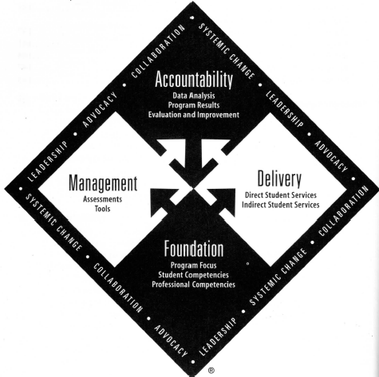
Goals and action plans within the ASCA National Model
Notes:
Essentially goal development is an extension of the needs assessment and environmental scan processes. In this way it still resides within the Management Component of the National Model. Similarly action plans, before they are implemented constitute management activity. When the plans are put into action within the school counseling program, then you are working within the Delivery Component. As data is collected during and after implementation and shared with key stakeholders, the Accountability Component is then the focus. That aspect will be covered in the next and last of the modules in this series.

Slide 4
Setting smart goals
Notes:
SMART Goals are a standard in the field of education and are endorsed by the ASCA National Model.

Slide 5
GATHERING YOUR TEAM
Goal setting should not be done in isolation.
Involve a variety of stakeholders
Ensure that all on the team understand the process
Clarify where the data came from
Facilitate the process in a way that all can be heard
Bolster buy-in through team member ownership of the outcome
Notes:
Before beginning to work on developing goals from your identified needs and gaps, you will need to gather your team. Many of the team members may be those who have already been working with you throughout the process like your advisory council, but not necessarily. As mentioned in the earlier module on needs assessments, your team should be comprised of a variety of stakeholders with varying talents. Once you have selected your team and have received the initial commitment from each of them, you should take the time to formally train them about the goal-setting and program planning process. Clearly explain to them that this process is grounded in the data that emerged from you needs assessment and environmental scan that were in turn based upon several guiding questions. Remember to use the group facilitation skills that you were taught in your graduate program to ensure that all members of the team feel honored and heard. Finally, by articulating to team members that they are key players and have ownership of the outcomes, you will bolster team member buy-in.

Slide 6
SETTING SMART GOALS
Specific Issue
What is the specific issue based on our school’s data?
Measurable
Attainable
Results-Oriented
Time Bound
When will our goal be accomplished?
Is the goal reported in results-oriented data (process, perception and outcome)?
What outcome would stretch us but is still attainable?
How will we measure the effectiveness of our interventions?
https://www.youtube.com/watch?v=aOnN1iVGMO4
Notes:
The acronym for SMART goal development within the ASCA National Model is a bit different than the commonly distributed acronym. ASCA describes a SMART goal as one that addresses a specific issue as identified through your data, is measureable, is attainable, is reported in results-oriented data, and is time bound. This rendition of the SMART goal acronym is consistent with the goal terminology used in educational reform and leadership. The embedded video offers a nice explanation of SMART goal development through relevant examples. The heading of this slide is hyperlinked to a SMART Goal Worksheet offered through ASCA. You should complete at least one of these goal worksheets for each of the guiding questions you developed earlier. The SMART Goal Worksheet is one of the deliverables in this module.
Have you ever been involved in SMART goal development in the past? What have you learned about the process from that experience?

Slide 7
Identifying interventions
Notes:
You are now ready to use your needs assessment and environmental scan data along with your SMART goals to identify appropriate interventions.

Slide 8
THE ROOT OF THE ISSUE
You can not start to develop strategies for addressing gaps or needs without getting to the “root of the issue.”
If you are unable to identify and address the root of the issue, the issue will keep coming back.
Employ the “6 Why” method
One example:
Why are students dropping out? Because they are not accumulating enough credits to graduate.
Why? Because they are failing their classes.
Why? Because they report that going to class is boring, so they do not attend class.
Why? Because teachers lecture too much.
Why? Because no one has shown teachers how to make their subject matter more interesting.
Why? Because the district has not provided the supports necessary to help teachers develop
new skills for working with adolescent learners.
RMC Research Corporation, 2008, p. 14
Notes:
The needs analysis worksheet and the Factor Analysis Summary Report offer insight into the most pertinent or urgent needs and gaps in services, but they do not indicate why those gaps are there. You have created SMART goals based upon what the ideal would be if the needs and gaps were resolved but you can’t move forward and design strategies for meeting those goals until you fully understand the root of the issues. If you move too quickly and start choosing interventions and developing action plans without identifying the root causes you may have short term success with your goal, but eventually the issue will return. One way to get to the root of the issue is to employ the “6 Why” method. This method involves asking why 6 times in response to the first answer one provides to the question as an issue. The colored text in the box was taken from “A Guide to Comprehensive Needs Assessments” and demonstrates how this process works.

Slide 9
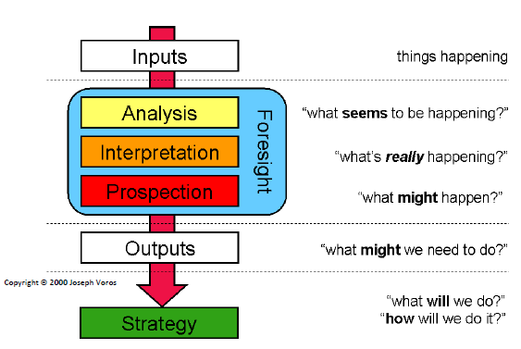
REVISITING THE ENVIRONMENTAL SCANNING PROCESS
This area of the
model is addressed
in the current module.
Conway, 2009
Notes:
Here again is the graphic of the environmental scanning process. As you can see, this module addresses the Outputs and Strategy areas of the graphic.

Slide 10
FROM ISSUE TO INTERVENTION
Interventions should be research-based
One needs to consider feasibility
Most effective are school-wide, family-based and classroom delivered
Career interventions most effective when infused into other curriculum
Small groups can be helpful for students needing more intensive help
There will always be a need for some individual counseling intervention
Demmitt, Carey, & Hatch (2007)
Notes:
Demmitt, Carey, and Hatch in their 2007 book, Evidence-Based School Counseling: Making a Difference with Data-Driven Decisions, addresses the need for thoughtful selection of interventions to address the root of the issues and meet SMART goals. First, interventions should be research-based and feasible. There are several different resources for identifying these interventions but perhaps one of the most comprehensive is the Center for School Counseling Outcome Research and Evaluation housed at the University of Massachusetts in Amherst. Research has indicated that the most effective interventions are those that are school-wide, family-based, and classroom delivered. Furthermore career interventions are most effective when infused into the broader school curriculum. Small group and individual interventions are more appropriate for students with deeper personal/social issues or those that need more intensive short-term support.

Slide 11
Putting Interventions into action
Notes:
Now it is time to turn those data-based interventions into action plans!

Slide 12
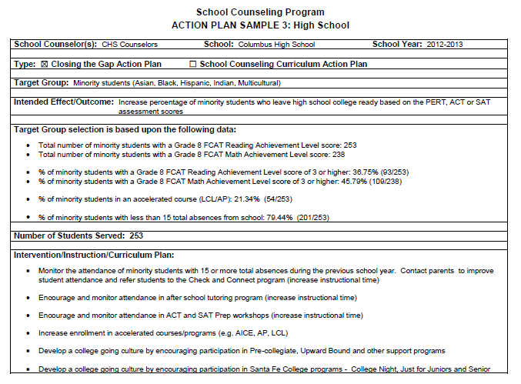
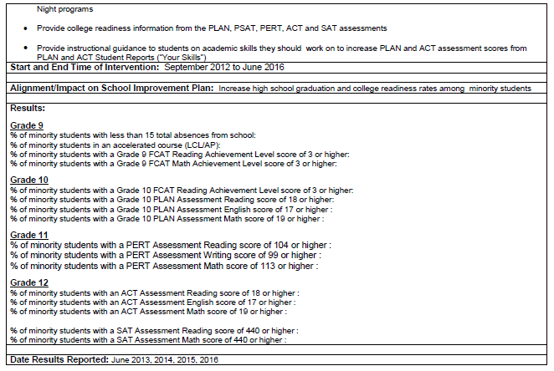
Creating a Comprehensive Action Plan
Modified from form byAlachua Public Schools. Downloaded at http://www.sbac.edu/pages/ACPS/Departments_Programs/DepartmentsLZ/Guidance/4921314836428531314/4921314934220833938
Notes:
Several different action plan templates exist to guide you and your team in developing appropriate implementation strategies. The form offered through this slide is slightly modified from the Alachua Public School District in Gainesville, FL and offers a versatile format for articulating a data-driven action plan. The blank version of this form is hyperlinked to the slide title for easy access. This Comprehensive Action Plan is one of the deliverables.

Slide 13
THE ASCA ACTION PLANS
The Curriculum Action Plan
The Small Group Action Plan
The Closing the Gap Action Plan
https://www.youtube.com/watch?v=ofVDLVDp4VA
Notes:
ASCA also offers several action plan templates through their National Model publications. The linked files were downloaded from the electronic resources offered by ASCA for purchase. If you have purchased the ASCA National Model book, then you are free to use them. If you have not purchased the book, you are encouraged to do so. These action plans are also part of the deliverables for this module. Although the video on this slide is set in a classroom context it might help you to understand better the backward design process involved in group development of your action plans.

Slide 14
RECAP
In this module you learned about:
How SMART Goals and Action Plans fit into the ASCA National Model
How to generate smart goals with your team
Strategies for identifying appropriate interventions to meet your SMART goals
Creating action plans based upon data-driven interventions
Notes:
In this module you learned about how SMART goals and action plans fit into the ASCA National Model. You also learned that having a strong team to generate goals and identify research-based interventions is critical to meeting needs identified through needs assessment and environmental scans data. Lastly, you saw action plans in action and are now ready to move on to the last module in this training series and tie everything together.

Slide 15
The Deliverables for Module 5 are:
The SMART Goal Worksheet
The Comprehensive School Counseling Program Action Plan
The School Counseling Curriculum Action Plan
The Small-Group Action Plan
The Closing the Gap Action Plan

Slide 16
REFERENCES
American School Counselor Association (2012). ASCA National Model: A framework for school counseling programs (3rd ed.). Alexandria, VA: Author.
Demmitt, C., Carey, J. C., & Hatch, T. (2007). Evidence-Based School Counseling: Making a Difference With Data-Driven Practices. Thousand Oaks, CA: Corwin Press.
RMC Research Corporation. (2008). A Guide to Comprehensive Needs Assessment. Prepared for the Colorado Department of Education by The Southwest Comprehensive Center at WestEd. Available online at http://www.cde.state.co.us/FedPrograms/dl/consapp_na_guide.pdf

