Slide 1
Colorado counselor corps professional development modules
Module 4: Analyzing Needs Assessment and Environmental Scan Data
Notes:
In the past three modules you have learned about the ASCA National Model, how to conduct a needs assessment and how to carry out an environmental scan. In this module you will discover how to analyze the data from your needs assessment and environmental scan so that you can work with your advisory council to make programmatic decisions.

Slide 2
Module Content
Qualitative vs. Quantitative Data
Analyzing Qualitative Data
Analyzing Quantitative Data
Disaggregating Data
Descriptive Statistics
Needs Assessment Data Results
Environmental Scan Data Results
Deliverables
Notes:
You have worked hard to gather a variety of information about your program, your school and your community. Now it is time to start making sense of all this information. In this presentation you will learn about the differences between qualitative and quantitative data along with how to analyze each in a way that will make the results meaningful to you. Furthermore, you will learn how to best represent your results for both needs assessment data and environmental scan data.

Slide 3
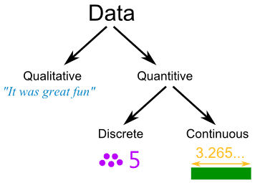
Qualitative vs. quantitative data
Image from http://www.mathsisfun.com/data/data.html
Notes:
As you have discovered through working with your needs assessment and environmental scan materials, two very different types of data emerges, qualitative and quantitative.

Slide 4
DATA WITH DIFFERENT PURPOSES
Quantitative
Deals with numbers
Data can be measured
Length, height, area, volume, weight, speed, time, temperature, humidity, sound levels, cost, members, ages, etc.
Quantitative Quantity
Qualitative
Deals with descriptions
Data can be observed but not measured
Colors, textures, smells, taste, appearance, beauty, etc.
Qualitative Quality
Video from http://www.youtube.com/watch?v=EcKrT_IegoU
Notes:
Your needs assessment and environmental scan might very well have produced both quantitative and qualitative data. If you utilized focus groups or interviews in your needs assessment protocol, qualitative data is present. If you utilized only a survey without any open-ended questions, then you could very well have only quantitative data in your needs assessment results. Your environmental scan data very likely produced both types of data also. As the video on this slide articulates, neither type of data alone can produce clear enough information to make robust data-driven decisions. Quantitative data deals with numbers and can be measured objectively. In addition to examples listed on the slide, relevant examples of quantitative data from your needs assessment and environmental scans may include student grade level, age, number of students participating in your curriculum, etc. One way to easily remember the basic characteristics of this type of data is to remember quantitative = quantity.
Qualitative data on the other hand is descriptive in nature. It generally involves words or images of data that can be observed but not measured. Qualitative data within our context would include parent reflections regarding their feelings about the school counseling program or a narrative description of student behavior in the hallway. Remember, qualitative = quality.

Slide 5
Analyzing qualitative data
Notes:
Yes, even narratives and images can be analyzed.

Slide 6
CONTINUOUS QUESTIONS
What patterns/common themes emerge around specific items in the data?
How do these patterns (or lack thereof) help to shed light on the guiding questions?
Are there any deviations from these patterns?
If, yes, what factors could explain these atypical responses?
What interesting stories emerge from the data?
How can these stories help to shed light on the guiding questions?
Do any of the patterns/emergent themes suggest that additional data needs to be collected?
Do any of the guiding questions need to be revised?
Do the patterns that emerge support the findings of other corresponding qualitative analyses that have been conducted?
This figure was adapted from the National Science Foundations’s (1997) Analyzing Qualitative Data. Chapter 4 in User Friendly Handbook for Mixed Methods Evaluations. Accessed 6/23/2013 at http://toolkit.pellinstitute.org/evaluation-guide/analyze/analyze-qualitative-data/
Notes:
Remember that throughout your analysis of the qualitative data you need to remain inquisitive and reflective. Some questions that you should keep repeating throughout the process include:
What patterns or common themes seem to be emerging around specific items in the data?
Are there any deviations from these emerging themes or patterns?
What interesting stories are emerging from the data?
Do any of the patterns or themes suggest that additional data needs to be collected?
Do the patterns that emerge support the findings of the other qualitative data that has already been analyzed?

Slide 7
STEPS IN QUALITATIVE DATA ANALYSIS
Process and Reflect on Data Immediately
Begin Analyzing as Data is Being Collected
Data Reduction
Identify Meaningful Patterns and Themes
Data Display
National Science Foundation, 1997, Accessed 6/23/2013 at http://toolkit.pellinstitute.org/evaluation-guide/analyze/analyze-qualitative-data/
Notes:
1. As soon as data is collected it is critical that you immediately process the information and record detailed notes.
These notes could include: Things that stuck out to you, time/date details, other observations, and highlights from the interaction.
2. Qualitative data analysis should begin as soon as you begin collecting the first piece of information.
The moment the first pieces of data are collected you should begin reviewing the data and mentally processing it for themes or patterns that were exhibited. It is important to do this early so that you will be focused on these patterns and themes as they appear in subsequent data you collect.
3. Qualitative studies generally produce a wealth of data but not all of it is meaningful. After data has been collected, you will need to undergo a data reduction process in order to identify and focus in on what is meaningful. When trying to discern what is meaningful data you should always refer back to your guiding questions and use them as your framework. Additionally, you should rely on your own intuition as the evaluator and the expertise of other individuals with a thorough understanding of the program.
4. In order for qualitative data to be analyzable it must first be grouped into the meaningful patterns and/or themes that you observed. This process is the core of qualitative data analysis.
This process is generally conducted in two primary ways: Content analysis and Thematic analysis. Content analysis is the micro-examination of smaller data segments and thematic analysis is the macro-examination of larger data segments, often based upon guiding questions.
5. After identifying themes or content patterns, assemble, organize, and compress the data into a display that facilitates conclusion drawing. The display can be a graphic, table/matrix, or textual display. This is a critical step as you move into data interpretation, goal-setting and action plan development as covered in Module 5.

Slide 8
Analyzing quantitative data
Notes:
And now on to the kind of data analysis that you have probably been thinking of.

Slide 9
DATA IS POWER
Video by the
Data Quality Campaign
https://www.youtube.com/watch?v=77UPUxB2b7o
Notes:
This short video is intended to inspire you as you begin this next stage of your work.

Slide 10
STEPS IN QUANTITATIVE DATA ANALYSIS
Make a backup copy of your raw data
Enter data into a data analysis software package or spreadsheet.
Ensure that all data is numeric in nature; recode discrete data into numeric codes.
Generate descriptive statistics (frequency, percentage, mean, etc.).
Conduct inferential statistics if appropriate (comparative or correlation).
http://www.youtube.com/watch?v=Z4n9CfOuaf8
Notes:
Be sure make sure that you create a backup copy of your raw data – computers sometimes have a tendency to eat your data ;-).
Enter your data into EXCEL. We suggest Excel as it is a very robust tool and most educators have access to it as part of your school’s software.
Clean and recode data if necessary. All discrete data, that which is in categories, needs to be recoded into meaningful numeric identifiers. An example of this would be to recode all girls as “1” and all boys as “2”.
Generate basic descriptive statistics such as frequencies, percentages, and mean. Frequencies and percentages are often used with discrete data and means and standard deviations with continuous data.
Conduct inferential statistics if they are appropriate for your guiding questions. For example, if you are interested in determining if there is truly a gap between girls taking advanced science courses and boys taking advanced science courses, you would want to conduct a comparative analysis. In this case you would likely use number of science courses enrolled in as your data point and then compare the girls and boys using a chi-square analysis or t-test. If you wanted to know if parent attendance at parent-teacher conferences impacted student GPA you might conduct a correlation analysis. This module is not the place for an in-depth lesson on statistical procedures, but the short video does give you a basic introduction to data analysis with EXCEL. We suggest that you utilize your resources to help you with the data analysis – someone on your advisory committee or evaluation team is sure to be comfortable with it.

Slide 11
Disaggregation of Data
Limited Language Proficiency
Gender
Race
Socio-economic Status
Participation in Indentified Programs
Mobility
Grade
Achievement Indicator (GPA, etc.)
Notes:
Sometimes you will not be able to see the big picture before you take a closer look at smaller pieces. Disaggregation of data involves classifying your data on particular demographic characteristics then exploring any differences in those groups. Disaggregated data can be used descriptively or comparatively.

Slide 12
CREATING VISUAL DISPLAYS OF DATA
Generate Meaningful charts and tables for easy access to data
http://www.youtube.com/watch?v=jLW1A7j7r3Y
Notes:
Create meaningful charts and tables for easy access to the data. This is a critical step as you move into data interpretation, goal-setting and action plan development as covered in Module 5. The video on this slide shares the basics of creating charts in Excel.

Slide 13
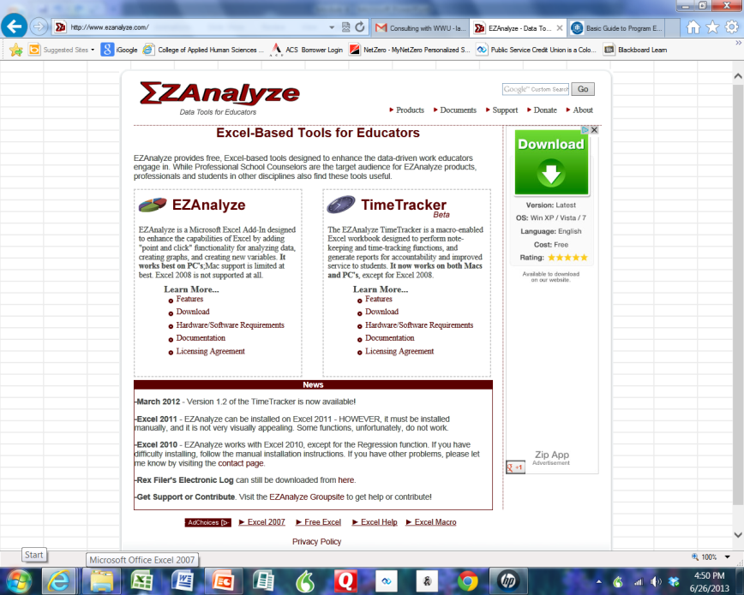
MORE RESOURCES FOR QUANTITATIVE DATA ANALYSIS
Kahn Academy at https://www.khanacademy.org/
Stat Pages at http://statpages.org/index.html
Open Stat at http://www.statprograms4u.com/OpenStatMain.htm
EZAnalyze is a robust and free software tool that works within Excel and has been developed specifically for educators.
www.ezanalyze.com
Notes:
New and helpful resources emerge on the internet every day. If you need to learn more about basic statistics and data analysis, the Kahn Academy is a great place to start. This website offers a number of professionally done and engaging videos on a variety of topics. Who knows, you might even find something there to use in your core curriculum. Stat Pages also offers tutorials and guides related to data and statistics. It is more text heavy than Khan Academy but a good resource none the less. Open Stat is a website that houses a number of links to statistical analysis free ware. This slide also offers a link to EZAnalyze, a free software tool designed especially for educators. This program works as an add-on to Excel and the real beauty of this program is that it utilizes common educational language for analytic procedures. It also has a parallel software program called TimeTracker that can be used to track your time as a school counselor, essentially aiding in conducting a time-task analysis. Both EZAnalyze and TimeTracker have built in tools for graph development.

Slide 14
Needs assessment data results
A Guide for Comprehensive Needs Assessment
Notes:
There are several unique aspects to reporting needs assessment data results. Most of the information on the next three slides come from the booklet “A Guide for Comprehensive Needs Assessment” Prepared for the Colorado Department of Education by RMC Research Corporation, a subcontractor to the Southwest Comprehensive Center at
WestEd. This document is included in it’s entirety within the resources folder and it is highly encouraged that you access and read it as it is very informative.

Slide 15
ANALYZING SURVEY DATA
Percentages
Comparative analyses between two groups regarding percentage of group that endorsed a dichotomous item (Z test for proportions)
Comparative analyses between more than two groups regarding percentage of group that endorsed a dichotomous item (Chi-Square)
Comparing means on a 5-point scale between two groups (t-test for independent groups)
Comparing means on a 5-point scale between more than two groups (One-way Analysis of Variance)
A Guide for Comprehensive Needs Assessments, 2008, p. 17
Notes:
Once data are collected there are a number of statistical strategies that can be used for analysis. For example, when investigating how migrant students are doing in comparison to their peers, the needs assessment committee may administer a survey for all students to complete in a certain set of schools, then add a question about whether the students participated in the migrant program. That item can be used to create two groups and to look at differences statistically. Some very simple statistics, such as the percentage of students who agreed or strongly agreed with an item, can be calculated and compared for two groups using statistical tests, like a z test for proportions. If there are more than two groups of students, techniques such as Chi-square tests can be used. For the mean or average responses on items rated on a 5-point scale, the t test for independent groups can be used for two groups. If there are more than two groups, one-way analysis of variance (ANOVA) can be used, with
post-hoc t tests if results are statistically significant. One word of caution is warranted here, however. These statistical tests have complex assumptions, and it is easy to misuse them. When in doubt about the use of these statistical techniques, always seek advice from colleagues in the central office who have the appropriate expertise.

Slide 16
PRIORITIZING IDENTIFIED NEED
Simple Approaches
Multiple Criteria Approach
Disaggregated Prioritization
Risk Assessment
A Guide for Comprehensive Needs Assessments, p. 17
Notes:
Once needs assessment data are collected and analyzed, it is important to follow through with the results of needs assessments and determine which are the most important. Simple approaches entail procedures such as rank ordering the needs, without any particular formal procedure. This approach is used in situations that are not complex. The multiple criteria approach is used when needs are more complex and are judged against criteria that address importance and feasibility. Weighted total priority scores can then be created. Disaggregated prioritization involves rank ordering the criteria to be used. Then a need is judged by each of the criteria, beginning with the highest-ranked criteria first. This technique simplifies the prioritization process, because criteria are addressed one at a time. Risk assessment is done by examination of the needs relative to the risk of not addressing them. This is particularly useful in situations where not addressing a need is related to a risk of major importance, such as child abuse.

Slide 17
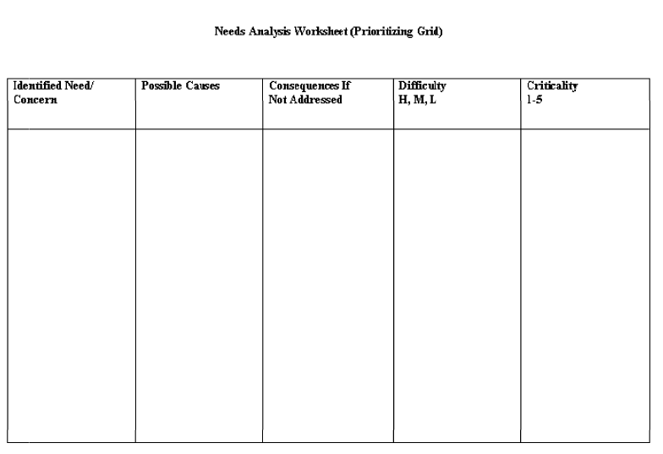
WORKSHEET FOR MULTIPLE CRITERIA APPROACH
Parents identify a
Need for a financial
Aid night in spite of
Having one each year
With low attendance.
Financial aid night is not well advertised.
Fewer students will
Matriculate to college.
L
2
Notes:
This slide presents one layout for a needs analysis worksheet utilizing a multiple criteria approach. You can use this worksheet to organize your needs assessment data (the title is hyperlinked to the blank worksheet) or you may develop one of your own. This is a deliverable item within this module.

Slide 18
Environmental scan data results
Notes:
Environmental scan data results are reported much in the same way as needs assessment data, yet there are a few unique qualities.

Slide 19
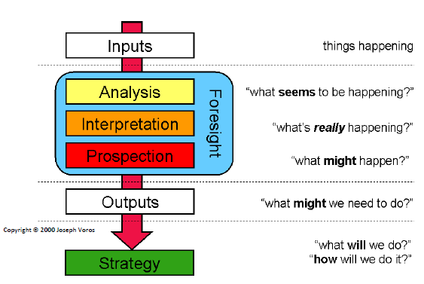
OVERVIEW OF THE ENVIRONMENTAL SCANNING PROCESS
This area of the
model is addressed
in the current module.
Conway, 2009
Notes:
Here again is the graphic of the environmental scanning process. As you can see, this module addresses the “Foresight” area of the graphic as it covers analysis, interpretation, and prospection.

Slide 20
Making your Macro-Systemic External Scan Data Come Alive!
New Excel Products
DataTracker
PowerViewer
GeoFlow
New and exciting products through EXCEL
http://www.youtube.com/watch?v=-9fwaaS_swQ
Notes:
This slide offers a video from Marc Reguero introducing Excel’s newest add-ons (DataTracker, PowerViewer, and GeoFlow). DataTracker pulls big data from the internet through a search tool within Excel and downloads the data right into your Excel spreadsheet. You can modify the data, columns, or rows and those modifications remain intact as macros so when you refresh data at any point your changes stay with the file. The amazing thing is that your spreadsheet does maintain a static link to the data source so you can easily update to the most recent data at any time. PowerViewer allows you to create amazing charts and graphics then you can manipulate them and make them 3D with GeoFlow! GeoFlow is still in the Beta 4 stage and is only compatible with Excel 2013. These products can be used to supplement your scan data but even more importantly to create dynamic and interesting data summaries. These tools along with some of the qualitative and quantitative tools introduced earlier help you analyze the raw data.

Slide 21
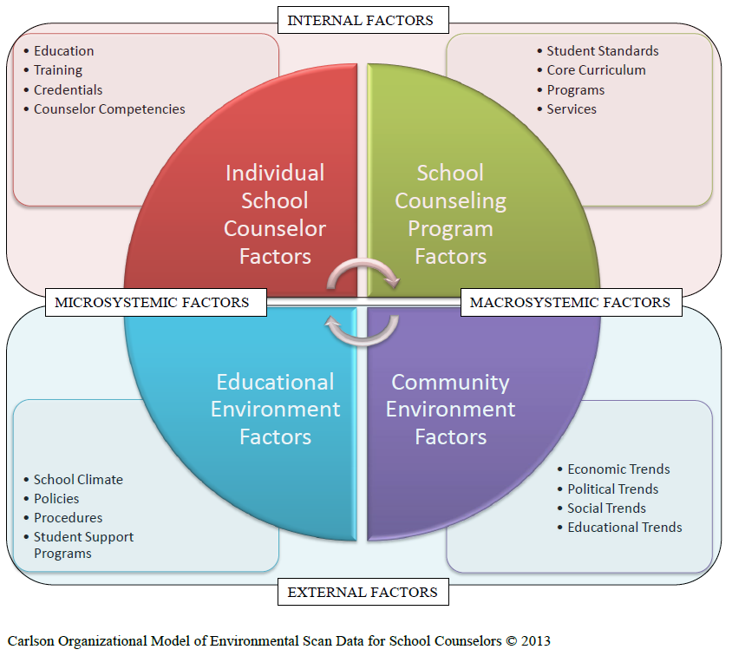
FROM ANALYSIS TO INTERPRETATION
Notes:
Now that you have conducted some basic descriptive and perhaps inferential analyses of your raw data you are ready to collate it into a format that will allow for interpretation and prospection. It makes sense to use the organizational model that you used when conducting your scan. Remember you have already begun preparing your scan data for this analysis by recording it on your Factor Analysis Summary. The next slide will cover the scoring of the FAS.

Slide 22
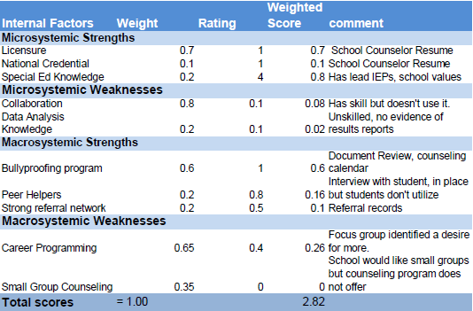
COMPLETING THE FACTOR ANALYSIS SUMMARY FORM
Utilize the Factor Analysis Summary Form
1. List strengths and weaknesses (5-10) in the appropriate Factors column.
2. Weight each factor from 1.0 (Most Important) to 0.0 (Not Important) in the Weight column based on that factor’s probable effect on the school/school counseling program's strategic position. The total weight for each factor category must sum to 1.00.
3. Rate each factor from 5 (Outstanding) to 1 (Poor) in the Rating column based on the school’s/school counseling program's response to that factor.
4. The coded formula multiplies each factor’s weight times its rating to obtain each factor’s weighted score in the Weighted Score column.
5. Use the Comments column for rationale used for each factor. It is also helpful to record where you found the data here so that if you have to go back to clarify or supplement the data you can access it more easily.
6. The weighted scores are added within the formula to obtain the total weighted score for the school/school counseling program in the Weighted Score column. This tells how well the school/school counseling program is responding to the factors in its external or internal environment.
You will focus on the
middle columns
at this stage.
Notes:
You will now continue to utilize the Factor Analysis Summary Form that you began in Module 3. For each of the factors, assign a weight in the second column. This weight should range between 0 and 1 based upon that factor’s probable effect on your program. Remember that the total weight for each factor category must sum to 1.00. Next, in the third column you will rate each factor from 1 to 5 based upon the counseling program’s current response to that factor. 1 is poor and 5 is outstanding. The weighted score column is automatically generated through the embedded formula in Excel, but essentially this is the factor’s weight times its rating. At the bottom of this column, the weighted scores are summed to give you an idea of how the counseling program is responding to the factors in it’s internal or external environments. Remember that even if it is a weak factor, there is typically some representation of it within your current programming.
One final note here about the Comments column. You have likely already recorded some descriptive information here regarding the source and general outcomes of your data, but you should also include any quantitative results from the analyses of your raw scan data. This completed Factor Analysis Summary Form is a deliverable for this module.

Slide 23
RECAP
In this module you learned more about:
The differences between qualitative and quantitative data
The basics of qualitative data analysis
The basics of quantitative data analysis
How to collate and prioritize needs assessment data
How to collage and prioritize environmental scan data
Notes:
In this module you learned about the differences between qualitative and quantitative data as well as the basics of analysis for each of them. You learned about prioritizing needs as identified by the results of your needs assessment data and how to use the Factor Analysis Summary Form to collate and prioritize your environmental scan data. Armed with your Needs Analysis Worksheet and your Factor Analysis Summary Form you are now ready to work with your advisory committee to explore in depth the gaps you have found and collectively develop goals and action plans. This process is covered in Module 5.

Slide 24
The Deliverables for Module 4 are:
The Needs Analysis Worksheet
The Factor Analysis Summary

Slide 25
REFERENCES
National Science Foundation (1997) . Analyzing Qualitative Data. Chapter 4 in User Friendly Handbook for Mixed Methods Evaluations. Accessed 6/23/2013 at http://toolkit.pellinstitute.org/evaluation-guide/analyze/analyze-qualitative-data/
RMC Research Corporation. (2008). A Guide to Comprehensive Needs Assessment. Prepared for the Colorado Department of Education by The Southwest Comprehensive Center at WestEd. Available online at http://www.cde.state.co.us/FedPrograms/dl/consapp_na_guide.pdf

