Slide 1

CDIP Data Submission Information Webinar
2024-2025

Slide 2
Notice of Recording
This webinar is being recorded.
The recording and slide deck will be available on the CDE CDIP web page following the webinar.

Slide 3
Agenda
Introductions
CDIP Overview
Funding Structure
CDIP Reporting Timeline
CDIP List Reminders
Pre-Apprenticeships/Apprenticeships
CDIP List Updates
Legislative Update
Q & A

Slide 4



Meet the team
Sami Mooney
Marina Kokotovic
Eivi Colmenero
Education Consultant
Colorado Workforce Development Council (CWDC) & CDE
Supervisor of Postsecondary & Workforce Readiness Programs, CDE
Post Secondary and Workforce
Readiness Specialist, CDE

Slide 5

Always Keep in Mind...

Slide 6
What is the Career Development Incentive Program (CDIP)?
The Career Development Incentive Program (CDIP), or Career Development Success Program, provides financial incentives for school districts and charter schools that encourage high school students, grades 9-12, to complete:
  Tier 1: qualified industry credential programs, pre- apprenticeships and apprenticeships;
  Tier 2: Workplace training programs (internships); or
  Tier 3: Computer Science Advanced Placement (AP) courses, with a score of 3 or higher.

Slide 7
Funding Information
Participating districts, charter schools or BOCES could receive up to $1,000 for each pupil who completes a program, and 120% of the per-pupil amount for each pupil who is eligible for free or reduced-price lunch, distributed in tiered order.
Funding is one time per pupil per year
In the 2023–2024-year students were funded at $913.37 for FRL and $761.14 for Non-FRL
Funding is determined each year based on appropriations

Slide 8
Reporting Timeline
March 2025
  Intent to Participate (ITP) Opens
    We use this to create the 2024-2025 contact list of participants and collect assurances.
April 14th 2025
  Pipeline Data Collection Opens
    Districts can submit data for students
June 1st 2025
  All data due for July 1, 2024 through June 1, 2025
July 2025
  CDE cleans data for funding
September/October Funds distributed to districts

Slide 9
CDIP List Reminders
The CDIP approved list gets updated annually, published as a part of the Talent Pipeline Report.
  The 2024-2025 CDIP list was published in December 2023
The list for the 2025-2026 SY is active
  Review for programs phasing off the list (removed)
  Review for new programs to start embedding (new)

Slide 10
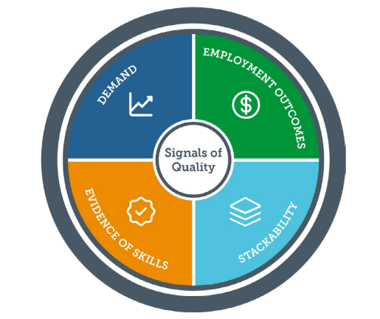
CDIP Approved Programs List
CDIP certifications are screened against criteria is SB 23-065.
In 2024, this criteria was updated to include standards in the Colorado Quality and In-demand Non-degree Credentials Framework.
Is it attainable for students grades 9-12?
Does it meet criteria for the 4 signals of quality in the Colorado Quality and In-demand Non-degree Credentials Framework?

Slide 11
Pre-Apprenticeship
Quality pre-apprenticeships are designed to assist individuals who may not currently possess the minimum requirements for selection into a Registered Apprenticeship program to meet the minimum selection criteria established in a program sponsor’s apprenticeship standards.
Planning to report pre-apprenticeships this year?
Verify the pre apprenticeship is connected with a registered apprenticeship program by asking for the USDOL registration number.
FAQ: HBI CORE – report this program under the master list of codes. Other HBI programs can be reported in the pre apprenticeship category.

Slide 12
Registered Apprenticeship
Registered Apprenticeship is an industry-driven, high-quality career pathway where employers can develop and prepare their future workforce, and individuals can obtain paid work experience, receive progressive wage increases, classroom instruction, and a portable, nationally-recognized credential. Registered Apprenticeships are industry-vetted and approved and validated by the U.S. Department of Labor or a State Apprenticeship Agency.
Planning to report registered apprenticeship?
Verify that the program is registered by asking for the USDOL registration (or RAPIDS number)
**Transition note for SY 2024-2025 ONLY: Local education providers may also report apprenticeship programs that are in the process of getting registered. If reporting an ‘in progress’ program, include the full name of the program and training provider.

Slide 13
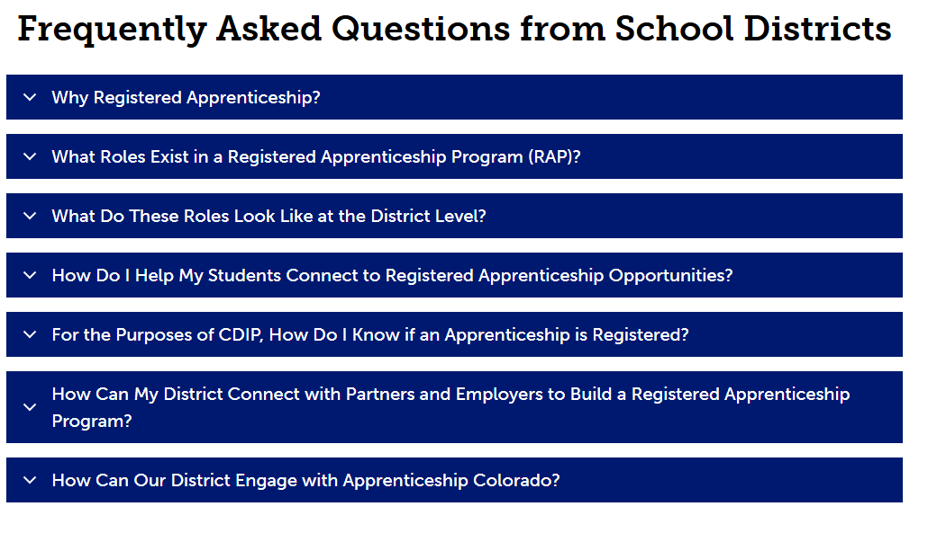
Apprenticeship for School Districts Resource
Visit the Apprenticeship for School Districts webpage

Slide 14
Looking ahead to SY 2025-2026: New approvals
New approval highlights
Qualified Behavioral Health Assistant
American Allied Health Veterinary Assistant National Certification exam
NC3 Fundamentals of Electricity AC/DC
EETC Principles of Small Engine Technology
Pre-apprenticeship: Interim Credentials
Sterile Compounding Certification
Dante Level 2 (Audio/ Visual)

Slide 15
Looking ahead to SY 2025-2026: Removals
Several certifications that are present on the 2024-2025 list are removed from the 2025-2026 list.
Removals with significant participation include:
START (Skills, Tasks and Results)
Entrepreneurship and Small Business Certification (ESB)
Energy Industry Fundamentals (EIF)
Ford ACE program
ICEV Food Safety and Science
ICEV Meat Evaluation

Slide 16
CDIP and Accountability Questions
CDIP and Accountability Questions?

Slide 17

PWR Update
Michelle Romero
Director of Office of Postsecondary and Workforce Readiness

Slide 18
Questions?

Slide 19
Thank you!
Thank you

