Slide 1
Colorado counselor corps professional development modules
Module 3: Conducting Environmental Scans
Notes:
Now that you have begun to explore some of the needs within your school and have some guidance based upon the preliminary data from your needs assessment, it is time to learn how to identify internal and external programs and resources related to these needs so that you can more clearly articulate gaps in services or programs. This process is called environmental scanning and in Module 3 you will learn how to collect information through a comprehensive environmental scan.

Slide 2
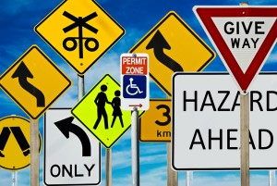
Module Content
How environmental scans fit into the ASCA National Model and the program planning process
What is an environmental scan anyway?
The Three Steps of the Environmental Scanning Process
Developing a Methodology
Scanning the Environment
Analyzing the Scan and Drawing Conclusions
Deliverables
Notes:
Environmental scans are complimentary to needs assessments and give you a more robust picture of the needs within your school. In this presentation you will learn how an environmental scan fits into the ASCA National Model, you will learn about the general nature of environmental scans, and you will explore the three steps to completing and environmental scan.

Slide 3
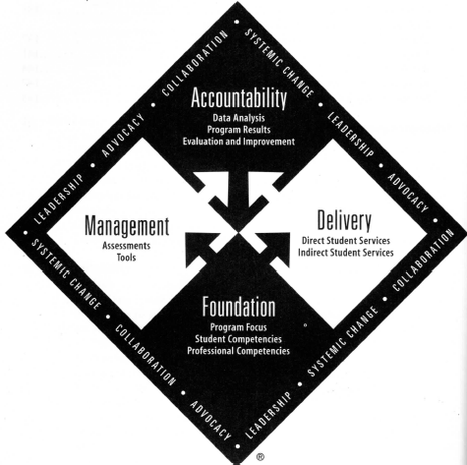
Environmental scans within the ASCA National Model
Notes:
As with the needs assessment process, environmental scans reside most fully within the management component of the ASCA National Model. This is the component of the model that most directly addresses how school counselors use data to inform program decisions. The delivery component is also relevant to the environmental scans discussion in that the process involves looking at programs that are in place and identifying gaps between intended outcomes of programs and the needs as identified through the needs assessment process. Beyond this, the themes of leadership, advocacy, collaboration and systemic change are certainly salient to any environmentally rich program improvement process.

Slide 4
A SNAPSHOT OF PROCESSES
Needs Assessment:
What problems are identified by key stakeholders?
Environmental Scan:
What programs and services exist that are intended to meet the needs identified in the needs assessment? Where are the gaps?
Comprehensive Strategic Plan:
Advisory council and other key stakeholders work with the school counselor to develop strategies to address unmet needs and close service/program gaps.
Notes:
This is a refresher slide from Module 2 designed to help you keep in mind the processes and how they fit together. In the first step you conduct a needs assessment to determine what problems or needs are present. This was covered fully in Module 2 that you have already completed. Next, you will conduct a scan of the internal and external resources including existing programs and services to clarify those programs and services that are currently in place and are intended to meet the identified needs. Again, multiple sources of data are used in environmental scans and you will learn more about them in this module. Finally, you will utilize your advisory council and will collaborate with other key stakeholders to make programmatic decisions intended to address the gaps identified through the needs assessment and environmental scanning process. This step is covered in Module 6.

Slide 5
WHAT IS AN ENVIRONMENTAL SCAN ANYWAY?
“Is more concerned with anticipating the future than describing the present.”
“Is wider in scope than traditional data collection sources because it is based on the assumption that major impacts on the school system can come from unsuspected sources.”
“Is focused on the interaction of events and trends.”
“Is an integral part of the planning process.”
Poole, 1991, pp. 40 & 41
Notes:
You are constantly scanning the environment around you in informal ways. As a counselor, you have been nurturing and developing your skills of observation and have been utilizing these abilities to critically think about “what is” and use that as a foundation for clinical decision-making. Environmental scanning for program improvement is very similar. Poole, 1991, identifies four critical differences between traditional data gathering and environmental scanning. First, environmental scans look at what is present to gain insight into possible future events or trends. For example, one might look at the college-going rates over the past nine years to try to understand how future economic trends might impact future college-going rates. Secondly, environmental scan data is much more comprehensive in scope than traditional data collection sources. Environmental scans use social, political, and economic indicators from regional and national sources as well as local sources to gain a clearer picture of trends and associations. Third, unlike traditional data collection, environmental scans focus on the interactions between events and trends, recognizing that changes in one area such as economics can have impacts upon educational settings and programming. Finally, it is important to remember that environmental scanning is an integral part of the planning process and that it occurs continuously throughout every step of the planning process.
The video on this slide shares with you how one Dean utilizes the environmental scanning process to improve services in her school.

Slide 6
THE THREE STEPS OF CONDUCTING AN ENVIRONMENTAL SCAN
Developing a Methodology for the Environmental Scan: Set parameters and plan for the scanning process.
Scanning the Environment: Collect data from multiple contexts and ensure inclusion of both internal and external data.
Analyzing the Scan and Drawing Conc lusions: Information should ideally come from both perception-based measures as well as from archival sources.
Project Launch, 2010
Notes:
Project Launch of the Substance Abuse and Mental Health Services division of the Center for Mental Health Services, 2010, outlines the three steps in conducting an environmental scan. The first step is to prepare for the process by developing a methodology for project completion. In this step you will set key parameters and plan for collecting data. The second step is the collection of data from a scan of the environment. In this module you will learn about contextual scanning and accessing both internal and external data sources. The third and final step involves analyzing the scan and drawing conclusions. This module will cover the preparation of data for analysis but more specific information regarding the thorough analysis of data will be covered in Module 4.

Slide 7
Stage 1: developing a methodology for the environmental scan
Notes:
The first step in completing an environmental scan is to develop a methodology.

Slide 8
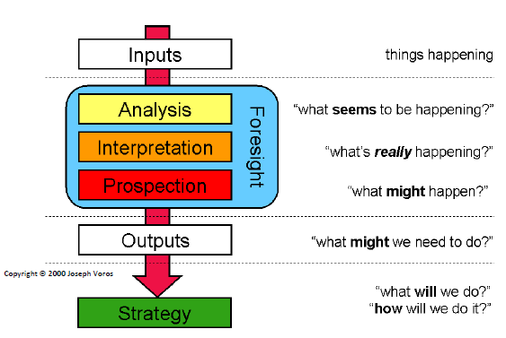
OVERVIEW OF THE ENVIRONMENTAL SCANNING PROCESS
This area of the
model is addressed
in the current module.
Conway, 2009
Notes:
The above graphic was developed by Joseph Voros and is taken from an Environmental Scan Guide produced by Maree Conway, President and CEO of Thinking Futures. As illustrated in the graphic, an environmental scan involves gathering data from multiple systems. At this stage in the process events and things happening constitutes the input into the model. This is the content covered in this module. The middle portion of the model consists of three processes related to foresight. These processes include analysis (what seems to be happening), interpretation (what’s really happening), and prospection (what might happen). The Foresight portion of this model will be covered in Module 4 of the training series. The bottom two levels of the model involve working with your advisory council and other key stakeholders to articulate outputs (what might you need to do) and strategies (what will you do and how will you do it). These levels will be covered in Module 6 of this series.

Slide 9
KEY FACTORS IN YOUR METHODOLOGY
Get administrative and organizational buy-in
Recruit a strong team
Identify and collate important resource tools such as technology and materials for your team
Take time to train your team
Establish benchmarks and timelines
Conduct your activities with the end product in mind
Notes:
This list outlines key factors that will support a successful environmental scan. At the very foundation it is important that you get administrative and organizational buy-in. You will not only likely need personnel resources to gather your data, but you will need access to facilities for your team meetings and access to school and district-wide data. Secondly, recruit a strong team. Your team should include not only individuals from a variety of stakeholder groups (students, teachers, parents, etc.) but should also offer a variety of talents (interpersonal skill, data analysis skill, etc.). Third, identify and collate important resource tools such as technology and materials for your team. Providing appropriate technology and resources will keep everyone engaged and working at the highest level towards your common goal. Team members will come into the process with differing levels of understanding about school counseling and environmental scanning so it will be important to offer comprehensive and meaningful training to make sure that everyone has the foundational knowledge needed for your project to be successful. Be sure to set realistic benchmarks and timelines in order to keep the project on track and to keep your team motivated. Finally, it is helpful to conduct your activities with the end product in mind. Remember, you are gathering information that will inform programmatic decisions you make to better meet the identified needs of your stakeholders.

Slide 10
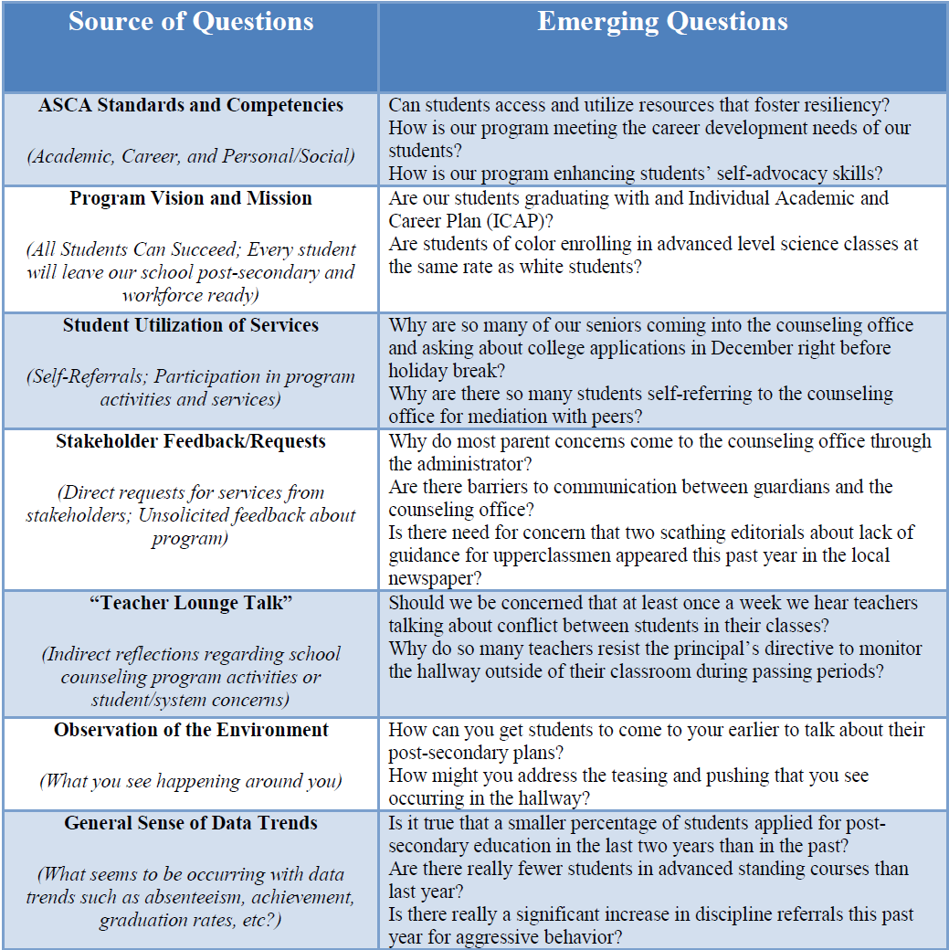
UTILIZE THE SAME GUIDING QUESTIONS AS YOU DETERMINED FOR THE NEEDS ASSESSMENT
ASCA standards and competencies
Program vision and mission statements
Student utilization of services
Stakeholder feedback/requests
“Teacher Lounge Talk”
Observation of the environment
General sense of data trends
Notes:
What guiding questions emerged from you work related to the information in Module 2?

Slide 11
Stage 2: Scanning the Environment
Notes:
Step 2 of the process involves collecting data resulting from a scan of the environment.

Slide 12
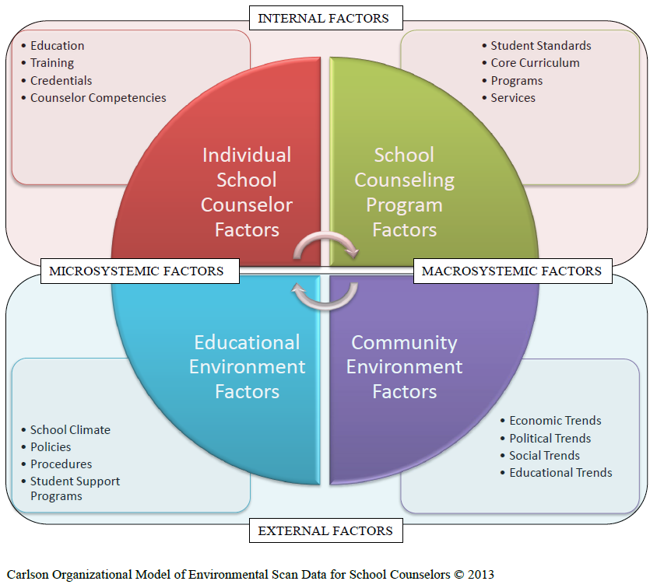
ORGANIZATIONAL MODEL OF ENVIRONMENTAL SCAN DATA FOR SCHOOL COUNSELORS
Notes:
There are many models of data organization for environmental scans in professions such as business and healthcare. Some research and literature addresses environmental scans in educational settings, but there is a dearth of research and literature focusing on environmental scans specifically related to school counseling. The graphic above depicts an organizational model developed by Laurie Carlson that provides a framework for accessing and organizing environmental scan data related specifically to the field of school counseling. The model synthesizes information from a number of authors on the topic including Conway, Poole, and Slaughter. This model is quadratic in nature, utilizing four quadrants through three layers. Sources of data are classified within the Internal-External and Microsystemic-Macrosystemic dichotomies. Individual School Counselor Factors such as counselor education, training, certification, and competency represent the Internal-Microsystemic Factors. School counseling program factors such as student standards, core counseling curriculum, programs, and services constitute the Internal-Macrosystemic Factors. The Community Environment Factors of economic, political, social, and educational trends make up the External-Macrosystemic Factors. And school climate, policies, procedures, and student support programs lie within the Educational Environment Factors and represent those factors at the External-Microsystemic Level. The circular arrows within the center of the diagram reflect the inter-relatedness of all sources of data. When conducting an environmental scan, the school counselor along with the team should revisit the specific data points within each category to ensure appropriateness and to articulate any additional data points that would be relevant for that particular school.

Slide 13
METHODS OF ENVIRONMENTAL SCAN DATA COLLECTION
Focus Groups
Interviews
Questionnaires
Document Review
Database Exploration – Including School-wide Data
State, Regional, and National Websites
Use a team approach to collect the data
Each team member researches one or more of the factors.
Each team member prepares a list of relevant factual data for the individual factor they are researching.
Team members share their completed list with the entire team.
Notes:
Many of the same strategies used in gathering needs assessment data can be used in gathering environmental scan data also. Generally, however, the distinction is that with needs assessment data you are collecting people’s perceptions of their needs whereas with environmental scan data you are learning about “what is.” Some added resources include professional, school, and community documents as well as school-wide, local, state, and national databases. There are also several state, regional, and national websites that offer aggregated and trend data. Utilizing the entire team for data collection will help ensure a robust outcome and will contribute to the validity of your findings as well as provide a foundation for the collaboration that will have to occur when developing strategies to meet identified gaps. The factors themselves as well as a reference to where the data was found should be recorded on the Factor Analysis Summary Form that is provided with this training module. Quantitative scoring of the forms will be covered in Module 4 and thus will become a deliverable within that module although you will begin to use it with this current step.

Slide 14
UTILIZE APPROPRIATE AND RELEVANT ASCA MODEL TOOLS
Individual School Counselor Factors
School Counselor Competency Checklist
School Counseling Program Factors
School Counseling Program Assessments
Educational Environment Factors
School Data Profile
Notes:
Within the National Model, ASCA offers tools to help you gather useful data for your environmental scan. On this slide you will see three such tools listed underneath the factor category that they inform. You need to complete each of these forms as deliverables within this module.

Slide 15
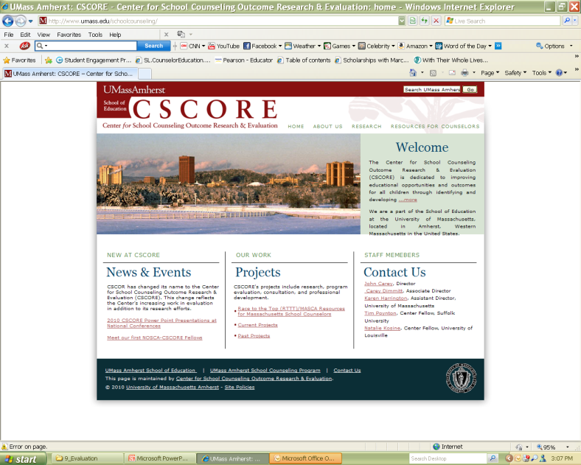
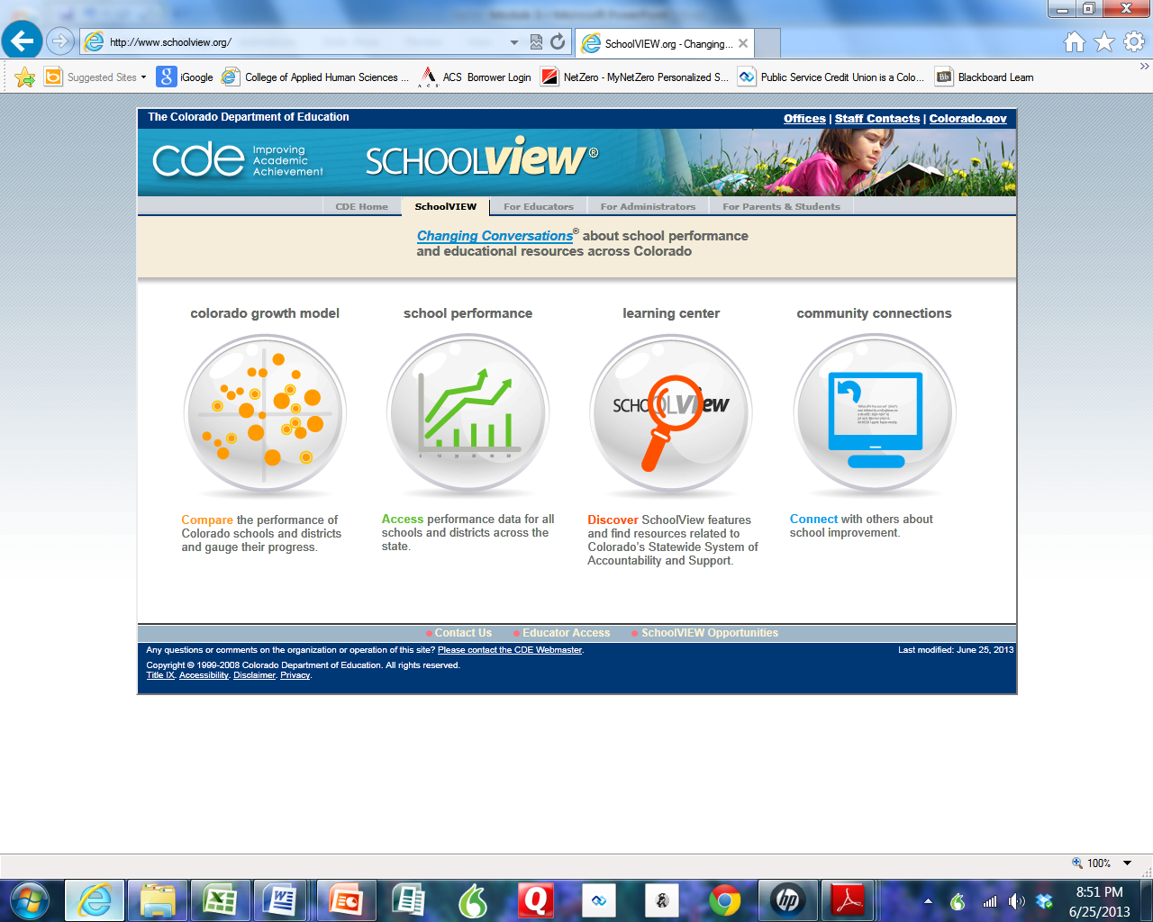
SOME HELPFUL RESOURCES FOR ACCESSING EXTERNAL DATA
Macrosystemic
Microsytemic
Notes:
There are a number of available web-based resources for you to use as you gather environmental scan data. The Center for School Counseling Outcome Research and Evaluation (http://www.umass.edu/schoolcounseling) serves as a clearinghouse for data-based school counseling outcome research. Similarly, the Colorado Department of Education maintains a website called SchoolView (www.schoolview.org) that is a very user friendly tool for accessing and exploring school specific, district, and state-wide data.
Thinking about the different data collection methods which appeal to you most and why? Which tend to scare you? What are your reservations?

Slide 16
StEP 3: Analyzing the data and drawing conclusions
Notes:
Although step 3 involves both the analysis of the data and drawing conclusions, we will cover only preparation for analysis in this module and leave the rest for Module 4.

Slide 17
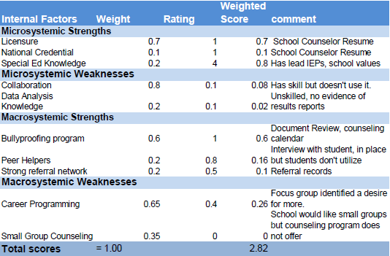
PREPARING THE DATA FOR ANALYSIS
Utilize the Factor Analysis Summary Form
1. List strengths and weaknesses (5-10) in the appropriate Factors column.
2. Weight each factor from 1.0 (Most Important) to 0.0 (Not Important) in the Weight column based on that factor’s probable effect on the school/school counseling program's strategic position. The total weight for each factor category must sum to 1.00.
3. Rate each factor from 5 (Outstanding) to 1 (Poor) in the Rating column based on the school’s/school counseling program's response to that factor.
4. The coded formula multiplies each factor’s weight times its rating to obtain each factor’s weighted score in the Weighted Score column.
5. Use the Comments column for rationale used for each factor. It is also helpful to record where you found the data here so that if you have to go back to clarify or supplement the data you can access it more easily.
6. The weighted scores are added within the formula to obtain the total weighted score for the school/school counseling program in the Weighted Score column. This tells how well the school/school counseling program is responding to the factors in its external or internal environment.
You will focus on the
first and last columns
at this stage.
Notes:
The factors themselves as well as a reference to where the data was found should be recorded on the Factor Analysis Summary Form that is provided with this training module. Quantitative scoring of the forms will be covered in Module 4 and thus will become a deliverable within that module although you will begin to use it with this current step.
Identify any concerns that you have at this point regarding the planning and conducting of environmental scans.

Slide 18
RECAP
In this module you learned about:
Where Environmental Scans fit into the ASCA National Model
The nature of Environmental Scans
The steps in the environmental scanning process
Notes:
In this module you learned about where environmental scans fit into the ASCA national model. You also learned that environmental scans are a robust way of looking at “what is” from multiple perspectives. Finally, you learned that there are three steps in the environmental scanning process and these include developing a methodology, scanning the environment, and analyzing the scan and drawing conclusions. Now lets analyze some data!

Slide 19
The Deliverables for Module 2 are:
School Counselor Competency Checklist
School Counseling Program Assessment
School Data Profile
The First and Last Columns of the Factor Analysis Summary Form

Slide 20
REFERENCES
Conway, M. (2009). Environmental scanning: What it is…how to do it. Hotham Hill, Australia: Thinking Futures.
Poole, M. L. (1991). Environmental scanning is vital to strategic planning. Educational Leadership, 4, 40-41.
Project Launch. (2010). Environmental Scanning and Strategic Planning Guidance. Available online at http://toolkit.promoteprevent.org/sites/toolkit.promoteprevent.org/files/dev.toolkit.promoteprevent.org/files/Environmental%20Scan%20Guidance_Launch.pdf.
Slaughter, R. (1999). A new framework for environmental scanning. Foresight, the Journal of Future Studies, Strategic Thinking and Policy, 1, 5, 441-451. DOI: 10.1108/14636689910802331

