Slide 1
Automatic Enrollment in Advanced Courses Grant Program
Application Webinar 2023-24
November 22, 2023

Slide 2
Introduction

Slide 3
Background
Traditionally, disadvantaged minorities and low-income students of all racial and ethnic backgrounds who perform well in school do not enroll in advanced classes at the same rate as their peers, regardless of preparedness.
All students deserve the opportunity to learn higher-level content, and students who have access to a rigorous curriculum perform better across multiple measures, including graduating high school and completing higher education.
A school's or district's course placement policies and decisions impact a student's opportunity to reach their full academic potential.

Slide 4
Purpose
This grant is intended to increase the number of students enrolled in advanced courses for subjects in which the student has demonstrated proficiency.
Increase equity
Decrease barriers for students
“Advanced course” can be:
AP or IB courses
Courses that the district has designated as honors, gifted, or accelerated
Concurrent Enrollment courses

Slide 5
Who can apply?
A School District (a school operating within the district may not submit a standalone application);
A School* (if its district does not apply);
A BOCES;
A Charter School** authorized by a School District or by the Charter School Institute.
*An application from an individual school must be submitted by its Chief Administrative Officer. If the school is not a charter school, then the district’s superintendent will sign the application. The school’s district will be the fiscal agent, if funded.
**A charter school’s authorizer will be the fiscal agent, if funded. A charter school may also be included in a district application.

Slide 6
Eligibility Criteria
The statutory language:
An LEP is eligible for the grant program if the LEP automatically enrolls each student entering the ninth grade or higher in an advanced course based on any of the following criteria:
The student achieved a score that is equivalent to, or exceeds, demonstrating proficiency on the state assessment that was administered pursuant to section 22-7-1006.3 for the preceding academic year, referred to in this section as an "eligible score", as follows:
Students who achieve an eligible score in a subject related to mathematics must be automatically enrolled in advanced courses in mathematics;
Students who achieve an eligible score in subjects relating to reading and writing must be enrolled in advanced courses in English, social studies, humanities, or other related subjects; and
Students who achieve an eligible score in a subject related to science or social studies must be automatically enrolled in advanced courses in science or social studies; or
Any other measure applied to all students enrolled in the LEP that, in the judgment of the LEP, is an indicator that a student demonstrates the ability to succeed in an advanced course.
An eligible local education provider shall permit a parent of a student to remove the student from an advanced course in which the student has been automatically enrolled. A local education provider may permit a parent of a student to exempt the student from any automatic enrollment in advanced courses.
In other words:
The school/district/BOCES is or will automatically enroll in advanced courses those students whose scores show they are ready for advanced coursework.
Using scores from the CMAS or
Another measure that is applied equally to all students
Parents must be allowed to remove their student from an auto-enrolled advanced course.

Slide 7
Available Funds
Approximately $220,000 is available.
There is no maximum on amounts applicants may request. Previous applications ranged from $5,000 to $79,000.
Amount awarded is calculated as follows:
Use the aggregate info to determine the overall average cost per student across all grantees
Multiply the average cost by students served per application
Award grantees based on students served
If there are not enough funds to fully fund each grantee, each grantee’s award amount will be reduced proportionately.
Rule 3.04

Slide 8
Use of Funds
Allowable:
Adding more advanced courses
Technology for use in advanced classes
Incentivizing teachers
Teacher training/professional development
Developing curriculum
Parent/student engagement
Family nights (food ok)
Student success/support time
Not Allowable:
Hiring new teachers
Incentivizing students
“Indirect costs” (ambiguous)
Supplanting rather than supplementing

Slide 9
Duration of the Grant
This is a one-year/one-time grant
Funds will be sent to grantees by April 1, 2024
Grantees will have the entirety of school year 2024-25 to spend down funds
Continued funding of this grant is dependent upon the State Legislature each year
Grantees may apply for the grant again if they propose a new use of funds (build upon what they previously did with the grant money)

Slide 10
Reporting
End-of-Year Report
Due by June 30, 2025
The number of students enrolled in advanced courses before and after the grant;
The number of students automatically enrolled in advanced courses before and after the grant, including 4th-8th grade if applicable;
Student demographic information;
How grant dollars were used.
Financial Report
Due by September 30, 2025
Application budget compared to actual expenditures
Due to CDE’s Grants Fiscal Office

Slide 11
How to Apply

Slide 12
Submitting Your Application
New system: GAINS
First, submit an Intent to Apply by Jan. 8, 2024
Then, submit your formal application in GAINS between Jan. 2 and 15, 2024
Application Materials: Use these for reference only to prepare responses that you will submit in GAINS
Application (Word)
Budget (Excel)

Slide 13
Review Process
Applications will be reviewed by CDE staff to ensure they contain all required components.
Please use the rubric as a guide to ensure a complete application!
This is a competitive grant: applicants must meet all rubric criteria to be approved for funding. Applications that do not meet all criteria may be asked to submit revisions that would bring the application up to a fundable level. There is no guarantee that submitting an application will result in funding or funding at the requested level. All award decisions are final. Applicants that do not meet the qualifications may reapply for future grant opportunities.
Priority is given to applicants who do not have an existing automatic enrollment process/program in place.

Slide 14
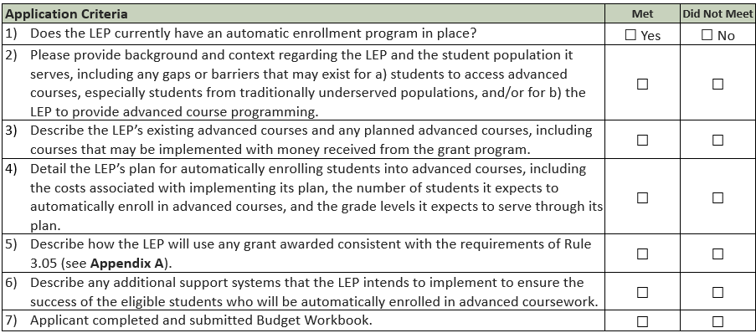
Rubric

Slide 15
Timeline
October 30, 2023: Application opened
November 2023: Pre-recorded webinar posted
January 8, 2024: Intent to Apply due (strongly encouraged)
January 15, 2024: Applications due in GAINS by 4pm
by March 15, 2024: Applicants notified of award status
by April 1, 2024: Funds sent to grantees
April 2024 to June 2025: Implementation period
June 30, 2025: End-of-year reports due
September 30, 2025: Annual Financial Report (AFR) due

Slide 16
Contacts

Slide 17
Who to Contact
Program Questions:
Alena Barczak, Office of Postsecondary & Workforce Readiness (303) 548-8427| Barczak_A@cde.state.co.us
Budget/Fiscal Questions:
Sondra Vela, Office of Grants Fiscal (720) 202-5853| Vela_S@cde.state.co.us
Application/GAINS Questions:
Mandy Christensen, Office of Competitive Grants and Awards (303) 866-6250 | Christensen_A@cde.state.co.us

