Slide 1
Protecting the Rights of Students with Disabilities in Charter School Enrollment
Bill Kottenstette
Date: 12/09/2021

Slide 2
Agenda
The challenge
Work that is happening
Recent OCR filings
Questions for online schools

Slide 3
The Challenge

Slide 4
Ensuring Successful Transitions for Students with Disabilities in Schools of Choice
Because plans for students with disabilities (IEP and 504) are personalized, when a child transitions from one school to another, particular care needs to be taken to review the student’s plan.
Ensure the plan is properly constructed for student success in the new school.
When there are plan concerns, ensure that these conversations take place within the IEP or 504 team meeting
While there is shared understanding of the importance of this review, the timing of when this review happens matters
Timing of the review has been a central focus of the recent OCR filings we have seen
A broader challenge relates to communications in choice enrollment. Are student rights well articulated through the choice process?

Slide 5
Work that is happening

Slide 6
Strategies
Websites
Do all families understand how to be included in the enrollment process?
Does the website communicate a welcoming and inclusive message?
Does the website inadvertently discourage enrollment?
Staff
Do front line staff answer questions correctly that encourage and welcome enrollment from all families?
Are staff well trained so that they can manage effective IEP and 504 meetings? MTSS processes?
Authorizer relations
Are roles and responsibilities between the authorizer and the school clearly articulated?
Are approaches consistent with state/federal regulations and guidance?
Are there collaborative strategies that can be explored to strengthen capacity at the school level?

Slide 7
Resources from CACSA (CO Association of Charter School Authorizers) and the CEE (Collaborative for Exceptional Education)
Video modeling language for staff with inclusive language to address questions around enrollment
https://coauthorizers.org/resource/promoting-access-choice-through-inclusive-language/
FAQ and talking points for charter and district staff on inclusive language
https://coauthorizers.org/wp-content/uploads/2021/10/CACSA.CEE_.StaffTraining.TalkingPoints.InterimEdition.pdf
Presentation deck on Inclusive Language
https://coauthorizers.org/wp-content/uploads/2021/10/Promoting-Access-and-Choice-Through-Inclusive-Language.pdf
Website checklist and model language
https://coauthorizers.org/wp-content/uploads/2021/09/dcl-faq-201612-504-charter-school.pdf
OCR Guidance on 504/Idea, (see pp. 20-24)
https://coauthorizers.org/wp-content/uploads/2021/09/dcl-faq-201612-504-charter-school.pdf

Slide 8
Recent OCR Filing (switch to AG slides)

Slide 9
Update on Rulemaking
Authorizer standards rulemaking noticed at the 11/10/21 SBOE meeting. Hearing scheduled for January (12th or 13th)
Link to official draft: https://www.coloradosos.gov/CCR/eDocketDetails.do?trackingNum=2021-00754
We are planning to propose additional rulemaking to a separate rule (1 CCR 301-8 - Rules for the Administration of the Exceptional Children’s Educational Act). It should get noticed in January for a hearing in March

Slide 10
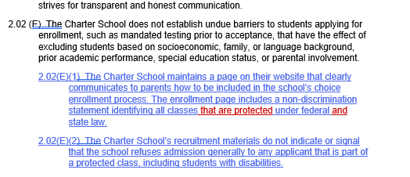
Samples: Official filing found here:

Slide 11
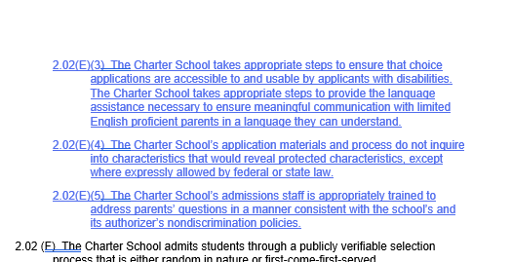
Samples: Official filing found here:

Slide 12
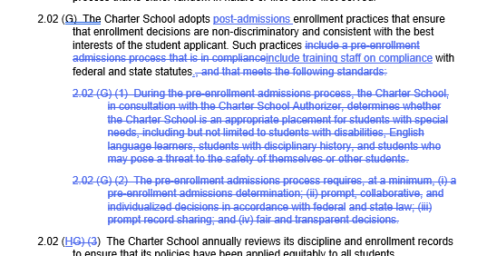
Samples: Official filing found here:

Slide 13
What Does This Mean for Online Schools?

Slide 14
Differentiating between district-managed and charter-managed online schools
Charter Managed:
OCR Guidance applies
District Managed:
OCR guidance is charter specific; however, there are elements of the guidance that give perspective on non-charter enrollment. Examples follow…

Slide 15
Page 4
Is there any difference in the Section 504 nondiscrimination rights of students with disabilities in charter schools as compared to students with disabilities in other schools in traditional LEAs?
No. Charter school students with disabilities, including current and prospective charter school students with disabilities, have the same rights under Section 504 as other current and prospective public school students with disabilities at the elementary and secondary school level.

Slide 16
Page 5
There is often a difference between how students enroll in schools in traditional LEAs and how students are recruited, apply and are admitted to, and thus enrolled in charter schools. For schools in traditional LEAs, the basis for enrollment in the district is generally residence that falls within the attendance boundaries of the school and LEA…
Under Section 504, prospective students of traditional LEAs are entitled to nondiscrimination on the basis of disability in the enrollment process, as well as nondiscriminatory treatment when enrolled in the school…
Regardless of the procedures used, under Section 504, prospective charter school students are entitled to nondiscrimination on the basis of disability in that process – including the recruitment, application, and admission parts of the process – as well as nondiscriminatory treatment when enrolled.

Slide 17
Page 6
There is no difference between the Section 504 rights of students with disabilities who are enrolled in charter schools and those who are enrolled in other public elementary or secondary schools.

Slide 18
Page 6
Is there any difference in the Section 504 rights of students with disabilities if a charter school is a virtual or online school?
No. There is no difference in the Section 504 rights of charter school students with disabilities who seek to enroll in and who are enrolled in a charter school that is a virtual school as compared to those who seek to enroll in and are enrolled in a charter school that is a brick-and mortar school.

Slide 19
Questions

