Slide 1
Family, School, Community Engagement Practices during COVID-19
February 3, 2021

Slide 2
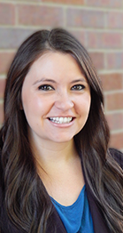
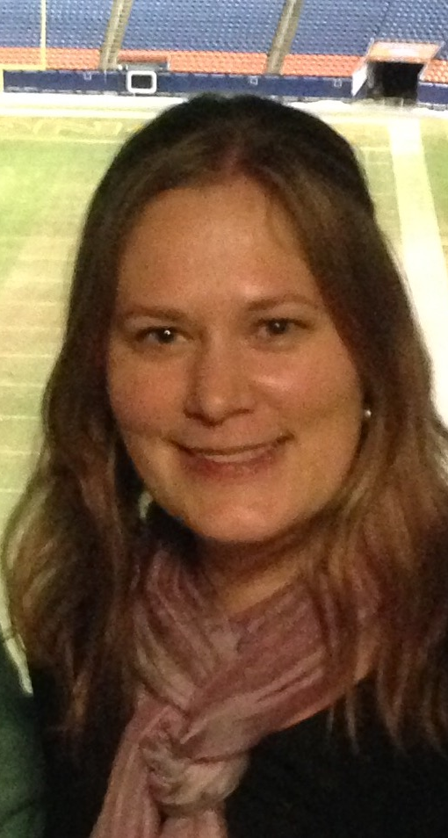
Introduction
Kristen Collins-Senior Consultant Family & Community Engagement and Title V
Collins_K@cde.state.co.us
(720) 481-0736
Darcy Hutchins-Director of the Office of Family, School, Community Partnerships
Hutchins_D@cde.state.co.us

Slide 3
Overview:
To enhance understanding of stakeholder engagement practices being implemented across the state and opportunities to partner with schools and districts.
Share Framework
Share resources on CDE
Discuss practices being implemented
Additional opportunities to learn or partner with schools/districts

Slide 4
Journey to 2021:
Colorado’s Family, School and Community Partnerships (FSCP) Framework
Colorado’s Definition: Families, early childhood programs, schools, and communities actively partnering to develop, implement, and evaluate effective and equitable practices to improve educational outcomes for children and youth
Four Essential Elements to guide FSCP Implementation
Annual collection of Promising Partnership Practices

Slide 5
Four Essential Elements to Guide FSCP:
Create an Inclusive Culture
An inclusive culture honors the lived experience of families in early childhood programs and school community
Build Trusting Relationships
Trusting Relationships enable families and programs/schools to partner about the education outcomes for children and youth
Design Capacity Building Opportunities
Capacity building opportunities for staff and families promote shared leadership about educational outcomes for children and youth
Dedicate Necessary Resources
Necessary resources integrate and elevate partnering practices to scale

Slide 6
Sharing Practices:
Discussion:
List strategies and engagement practices implemented before COVID-19
How (if at all) has COVID-19 changed engagement practices?
https://jamboard.google.com/d/1Dh1Ia_WSRzozay3fq3vjNKSDAD3u1VWm11ABXpyjfNs/edit?usp=sharing

Slide 7
Jefferson County Public Schools-Family Engagement Liaisons
In addition to providing information to families, Family Engagement Liaisons (FELs) in Jeffco Public Schools are building on their existing relationships with families and having conversations on a regular basis through personal phone calls, texts, videos, virtual coffee chats. This gives schools an opportunity to listen to the needs of families and provide appropriate resources. Specific examples include:
Make personal phone calls to listen and respond to needs with appropriate resources.
Call to encourage families whose students aren’t ‘logging in’ or engaging in on-line platforms.
Launch Virtual Coffee Chats, PTA meetings, Open Family Virtual Chat Time with Principal and Staff.
Help families sift through all the information and help families prioritize.
Advocate for and support families who speak languages other than English.
Access multiple communication platforms including Twitter, Facebook -Facebook Live, SeeSaw, Remind,
What’s App, School websites, Google and Zoom meetups, Printed and handwritten messages.

Slide 8
Resources:
FSCP Key: A monthly newsletter highlighting the latest research around FSCP, district practices and CDE updates regarding CDE trainings and resources
FSCP Self Assessment Rubric
Monthly Coffee Chats with district representatives across the state implementing family, school and community engagement practices
Feb 19, 2021 10:00 AM
Mar 19, 2021 10:00 AM
Apr 16, 2021 10:00 AM
May 21, 2021 10:00 AM
Jun 18, 2021 10:00 AM
Annual collection of Promising Partnership Practices

Slide 9
Questions/Thoughts
Questions?
Thoughts?

