Slide 1
Verification Collection Report Webinar
School Nutrition Unit
Notes:
Welcome to the Verification Collection Report Webinar for 2022. [Introduction] We have lots of material to cover today, but hope to make this final part of the verification process as smooth as possible. We’ll have some time for questions at the end, but if we don’t get to everyone’s question, we will follow up with you!

Slide 2
Mute/
Unmute
Video
On/Off
Chat
Closed Caption
Notes:
Let’s first cover some quick Zoom housekeeping items before we jump into the content.
All attendees will enter muted. You will know that you are muted if the microphone button in the lower left corner has a slash across it. Next to the microphone is a camera icon. Click the camera icon to turn it on which will remove the slash across the icon. It is completely optional to turn on your camera today.
If you keep moving across the bottom portion of your screen you will see a chat icon in the middle. If you have any questions today, please insert them into the chat-we will monitor the chat and compile a list of questions to address at the end of the webinar if we have time.
We will insert the PowerPoint slides for today with speaker notes into the chat for you to download.
To the right of the chat icon, is an icon for closed captioning if you needed it. Go ahead and click this button for subtitles.

Slide 3
Conditions for Success
Be present + engaged
Participate in discussion
Actively listen
Mute your microphone when you’re not talking
Bring a positive attitude and be ready to share
Be respectful, inclusive and open minded
Notes:
Here are some other conditions for success to make our time together today as meaningful as possible include.
Are there any other conditions that would help ensure a successful session that you would like to add today?

Slide 4
CDE School Nutrition
Vision
Mission
Nourish young bodies and minds. End childhood hunger.
We support the child nutrition community through innovation, training, and partnerships to ensure all youth have access to healthy meals.
Notes:
We have spent time updating our vision and mission.

Slide 5
Non-Discrimination Statement
In accordance with federal civil rights law and U.S. Department of Agriculture (USDA) civil rights regulations and policies, this institution is prohibited from discriminating on the basis of race, color, national origin, sex (including gender identity and sexual orientation), disability, age, or reprisal or retaliation for prior civil rights activity. Program information may be made available in languages other than English. Persons with disabilities who require alternative means of communication to obtain program information (e.g., Braille, large print, audiotape, American Sign Language), should contact the responsible state or local agency that administers the program or USDA’s TARGET Center at (202) 720-2600 (voice and TTY) or contact USDA through the Federal Relay Service at (800) 877-8339.
To file a program discrimination complaint, a Complainant should complete a Form AD-3027, USDA Program Discrimination Complaint Form which can be obtained online at: https://www.usda.gov/sites/default/files/documents/USDA-OASCR%20P-Complaint-Form-0508-0002-508-11-28-17Fax2Mail.pdf, from any USDA office, by calling (866) 632-9992, or by writing a letter addressed to USDA. The letter must contain the complainant’s name, address, telephone number, and a written description of the alleged discriminatory action in sufficient detail to inform the Assistant Secretary for Civil Rights (ASCR) about the nature and date of an alleged civil rights violation. The completed AD-3027 form or letter must be submitted to USDA by:
(1) mail: U.S. Department of Agriculture Office of the Assistant Secretary for Civil Rights; 1400 Independence Avenue, SW Washington, D.C. 20250-9410;
(2) fax: 833-256-1655 or 202-690-7442; or
(3) email: program.intake@usda.gov.
Download USDA Non-Discrimination Statement Translations here.
This institution is an equal opportunity provider.
Notes:
We include the nondiscrimination statement in our trainings as a reminder of our responsibilities to ensure all eligible people may participate in our child nutrition programs. As equal opportunity providers, we prohibit discrimination in our programs and provide fair and equitable treatment to every participant. This statement has been updated this year, so just a quick reminder to make sure it’s updated on your materials.
For the full disclosure statement, visit the School Nutrition civil rights webpage.

Slide 6
Learning Objectives
By the end of this training, sponsors will be able to:
Define valid verification responses versus non-responses
Correctly identify directly certified students as SNAP, TANF and/or Migrant only
Interpret trends in direct certification numbers, verification response rates and submitted applications
Assess accuracy of data submitted in the Verification Collection Report (VCR)
Professional Standards
Free and Reduced-Price Meal Benefits (3100)
Notes:
By the end of this training, you will have gained knowledge in interpreting valid verification responses versus non-responses, properly categorized your directly certified students in order to accurately report them, identified trends in your data and learned to assess the accuracy of your data.
After completing the evaluation that will be emailed to you, you will receive one hour of professional standards credit in Free and Reduced-Price Meal Benefits.

Slide 7
Poll
How familiar/comfortable are you with the VCR?
A: Ready to tackle it; I’m an old pro!
B: A little stressed, but I’ll be okay.
C: I have no idea what I am doing, but I’m here to learn!
Notes:
Poll 1
With the housekeeping out of the way and before we dive into the content of today’s presentation, I want to get a feel for who we have in our audience today.
How familiar/comfortable are you with the VCR?
A: Ready to tackle it; I’m an old pro!
B: A little stressed, but I’ll be okay.
C: I have no idea what I am doing!

Slide 8
What is the VCR?
The Verification Collection Report (VCR) is a collection of information about your annual verification activity. It is also known as the FNS-742.
The VCR is required to be completed annually, due February 1.
Failure to complete the report on time will result in corrective action.
*For more information about Verification, check out our webinar from earlier this month: https://www.cde.state.co.us/nutrition/incomeverificationwebrecord92722
Notes:
Let’s start with the basics: what is the Verification Collection Report? It is a report of the verification activities you conduct annually. It is also referred to as the FNS – 742. It is a required report due February 1st. If you fail to submit the data by that date, it will result in a corrective action, so it’s important. But, we are here to help!
If you need a refresher on verification, check out the school nutrition website!

Slide 9
RCCI & Provisionals
 | RCCIs – all residential students | RCCIs – with day students | CEP – district wide | CEP – group of schools | Provision 2 – district wide | Provision 2 – group of sites/only breakfast or only lunch
Verification |  | X – only for applications collected for day students |  | X – only non-CEP schools | X – only during base year | X – only non-Provision 2 and/or base years
VCR |  | X | X – section 1 and 2 only | X | X – section 1 and 2 only | X
Notes:
Depending on what type of sponsor you are, your requirements for verification and the VCR are different. This chart represents the verification activities and VCR requirements based on RCCI/Provisional types. This can be good reference to know which parts are required of you. An x in the box indicates a required activity.

Slide 10
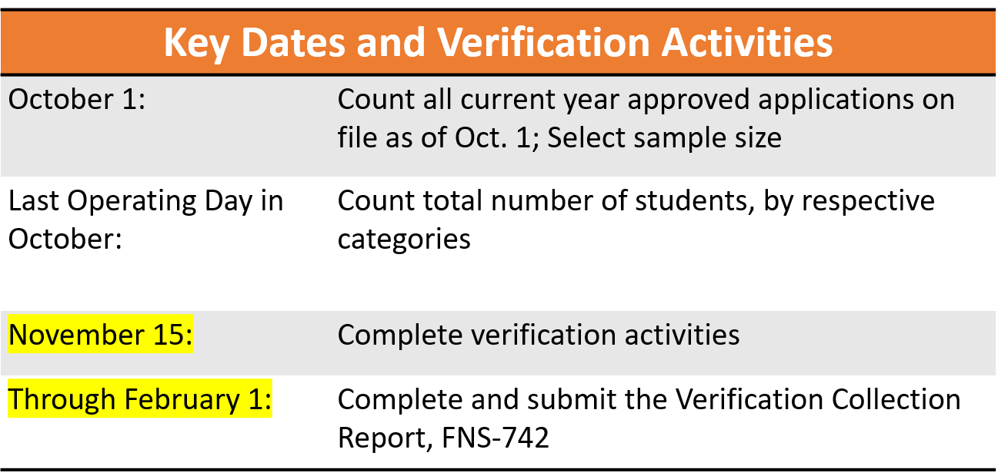
Verification
Verification is the confirmation of eligibility for free and reduced-price school meals based on applications.
Notes:
Let’s remember why we conduct verification. It’s to confirm the eligibility for free and reduced-price school meal applications. Or, to have families substantiate what they submitted on their initial free and reduced applications by providing written income/assistance program documentation.
Please review the table showcasing key verification dates. On October 1, you should have conducted a count of approved applications on file for the current school year. You will report these counts as of Oct. 1 in the VCR.
You should have access in your district to a student count, or the total number of students enrolled in the district who have access to the NSLP and/or SBP by specific categories which we will review later. Those counts are also reported in the VCR.

Slide 11
Verification: Responded vs. Not Responded
Responded Means:
The household provided sufficient documentation
Verbal or written notification the household declines benefits
The household is directly certified**
Not Responded Means:
The household did not provide sufficient documentation
The household did not provide a response
Notes:
As you complete verification, you’ll determine if each sampled application can be counted as “Responded” or “Not Responded”. This is part of what gets reported in the VCR. We’ll explore the other details that get reported later in the presentation. If you have more questions about how to determine if a household has responded, resources are available in the “Verification” section of the School Nutrition website.
Responded means that the household provides sufficient documentation, and their benefits were confirmed, or the household declined benefits, or the students were identified as directly certified after the application was selected for verification.
Not responded means that the household did not provide enough information for a determination, or they didn’t respond, and adverse action was taken.

Slide 12
How to complete the VCR
Use the resources available:
VCR Instructions
Webinar content
CDE Team
Notes:
To complete the VCR, we have a number of resources to help you, as some of the questions can be tricky. We have detailed instructions available on our website, that will be an important tool for you. We will also have this webinar, with the slides available. And finally, reach out to me or your point of contact on the CDE team to help!

Slide 13
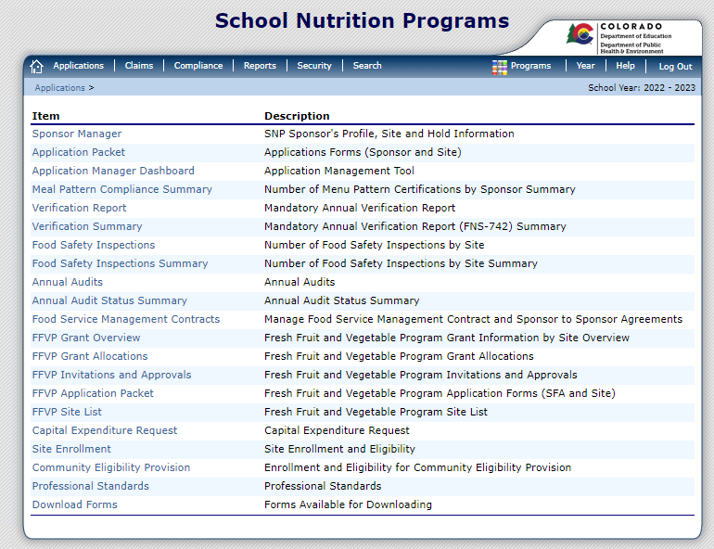
Getting Started
Access the VCR
The VCR is completed in the SNP Portal in the School Nutrition Programs section under the Applications tab.
Current Users: use your existing username and password
New Users: Complete the New User Request form: https://app.smartsheet.com/b/form/dfb3a3d8b17647faad9d84f925325f58
Notes:
In order to get started, you will access the VCR through the School Nutrition Programs Portal. Reach out to your point of contact if you need assistance with accessing the portal. The Verification Report is found in the School Nutrition Programs section, then under the “Applications” tab.

Slide 14
Getting Started - continued
The first time accessing the VCR, click “Modify.
This will open the form for the school year.
Notes:
The first time you access the report, you’ll choose “Modify” to open the form for the year.

Slide 15
Sections of the VCR
General Information
Section 1: | Total number of schools, RCCIs and enrolled students
Section 2: | SFAs with schools operating alternate provisions
Section 3: | Students approved Free but not subject to verification (i.e., directly certified)
Section 4: | Students approved Free/Reduced via household application
Section 5: | Verification Results
Notes:
Once inside, these sections will appear. We will walk through each section. It’s a lot of information and we’ll be moving quickly… but just remember you can access these slides later.

Slide 16
General Information
Enter correct contact information for the person completing the report.
Notes:
The contact information is the very top portion of the VCR, and one of the most common errors we see.
This information defaults, by the system, to the person listed as the Child Nutrition Director in the sponsor application. If the Child Nutrition Director is not the person completing this form, this section must be updated to reflect the name and contact information of the person completing the form. Please ensure this information is correct as it is used to notify the SFA if there are any corrections needed.

Slide 17
Section 1
Column A. Enter the number of schools/institutions of each type.
Column B. Enter the total number of students enrolled at each type of school/institution as of October 31 with access to the National School Lunch Program and School Breakfast Program.
Notes:
Section 1 asks for the number of schools and number of students for different types of institutions. Most districts will only need to complete line 1-1, since they do not have Residential Child Care Institutions, or RCCIs. Districts with RCCIs will complete lines 1-2, and then break down that number in lines 1-2a and 1-2b.
Some things to keep in mind on this section: Line 1-1, column A will pre-populate with the number of schools from the application. Also, only schools and student who participate in NSLP or the SBP should included.

Slide 18
Section 2
Only to be completed by Sponsors operating Provision 2 or CEP. The numbers reported should be the numbers as of October 31.
For non-provision Sponsors, this section is greyed out.
Notes:
Section 2 of the VCR will need to be completed only by SFAs with at least one school on Provision 2 or CEP.
For everyone else, these boxes will be grayed out.
These counts should be from Oct. 31, and Column A is for the number of schools, while Column B is for number of enrolled students.
You can also refer to the VCR detailed instructions for more clear directions. Please contact me for assistance in completing this section if you operate a provision program and are confused about this section.

Slide 19
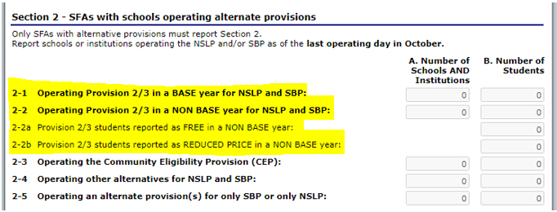
Section 2 – Prov 2 Sponsors
Sponsors with schools operating Provision 2 may fill out lines
2-1, 2-2, 2-2a, and 2-2b, and maybe line 2-5.
Notes:
Sponsors with schools operating Provision 2 may fill out lines 2-1, 2-2, 2-2a, and 2-2b, depending on if they are in a base year or non-base year. You may have schools in both categories.
Fill out 2-1 for schools in their base year, and fill out 2-2 for schools in a non-base year. If you fill out 2-2, you should also fill out 2-2a and 2-2b.
For 2-2a, report the number of FREE students at all participating schools in a non-base year.
For 2-2b, report the number of REDUCED students at all participating schools in a non-base year.
And if you have any schools that are only using Provision 2 for either breakfast or lunch, fill out 2-5.

Slide 20
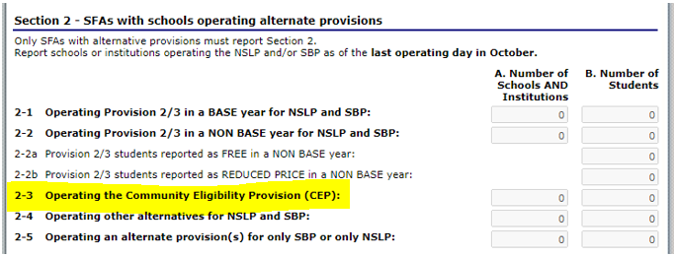
Section 2 – CEP Sponsors
Sponsors operating CEP will fill out line 2-3.
Notes:
Sponsors operating CEP will fill out line 2-3 adding the number of schools participating, and the number of students enrolled.

Slide 21
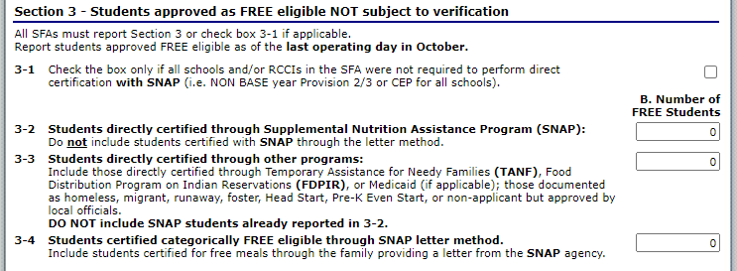
Section 3
Report numbers of students who were determined eligible for free meals without an application.
Report numbers as of October 31.
Notes:
Section 3 is where you report how many students were determined eligible for free meals without using an application.
This section is important for CDE as it establishes how well we are doing at matching all of the students who should be directly certified. The numbers here should accurate as of October 31.
Line 3-1 should be checked only by those Sponsors with every school in the district in a non-base year of Provision 2 OR those with every school in the district on CEP OR RCCIs with day students. All other SFAs will not check this box.

Slide 22
Section 3 –Line 3-2
3-2: All Directly Certified SNAP Students and Extended Eligible SNAP students
Notes:
Line 3-2 is the most critical field on the VCR! In this field, put the total number of all direct certification students who participate in the Supplemental Nutrition Assistance Program, also known as SNAP and any Extended Eligible SNAP students in your district. This line should only include students you have matched in the direct certification system and they were listed as SNAP, BOTH, SNAP/MIGRANT or BOTH/MIGRANT and any students you have extended eligibility to based on those matches.
The reporting of line 3-2 is very important for each state as USDA requires every state to match 95% of eligible SNAP students. CO does a great job with this. Last year, Colorado was over 102%. Keep it up!

Slide 23
Section 3 – Line 3-3
3-3: Students certified as eligible through TANF, FDPIR, Migrant, Homeless, Runaway, Foster & Head Start
Notes:
In Line 3-3, put the total number of all non-SNAP directly certified Students as of Oct 31st. This will include all your homeless, migrant, runaway, foster, and Head Start students identified by school officials. This also includes any students on your direct certification lists identified as participating in Temporary Assistance for Needy Families or TANF, any extended eligible TANF, Migrant or TANF/MIGRANT. Make sure you don’t include any SNAP students in this field.
A good rule of thumb for line 3-3 is to include all students you certified from a list but were not already directly certified or extended eligible with SNAP.

Slide 24
Section 3 – Line 3-4
3-4: Students certified as eligible who provided a letter showing their SNAP status.
Notes:
In Line 3-4, put the total number of students who were determined eligible by providing a letter showing their SNAP status. This is not a common scenario, so don’t worry too much if you don’t have any students eligible in this way.

Slide 25
Poll
You receive a list of foster students from your county human services office. Should you report all foster students from this list as of 10/31 on line 3-3?
A: No, These students should be reported somewhere else
B: Yes, Line 3-3 is the right place to report these students
Notes:
Time for another poll:
You receive a list of foster students from your county human services office. Should you report all foster students from this list as of 10/31 on line 3-3?
A: No, These students should be reported somewhere else.
B: Yes, Line 3-3 is the right place to report these students.
*These students are considered directly certified through other programs.

Slide 26
Section 4
# as of Oct. 1
# as of Oct. 31
Section 4: Information about the applications you received.
Pay close attention to the columns and dates in this section.
Notes:
Section 4 is where information is reported about the applications you received. This section can be tricky because the data is as of two different dates. Column A is the number of applications as of Oct 1. These are the same numbers you used to determine your sample size for Verification. And in Column B, you’ll report the number of students as of Oct 31, which is the last operating day of October this year.
Districts operating CEP would only complete this section for schools not using CEP, as no applications are collected at schools implementing CEP.

Slide 27
Section 4 – Line 4-1
# as of Oct. 1
# as of Oct. 31
4-1 Information about the applications that qualified as FREE by providing a case number or indicating foster students, and how many students qualified on applications using a case number or indicating foster.
Notes:
4-1: Report the total number of categorical applications that were on file on October 1 in Column A. This includes all SNAP, TANF, FDPIR, and foster-only applications. In other words, list all your CASE NUMBER and foster-only applications. In column B, report the number of students who appeared on these types of applications as of Oct. 31. This would also include students who were determined extended eligible through SNAP, TANF or FDPIR information on the application.
In this section, mixed applications may be tricky, where students may have different eligibility occur on the same application, like an application that includes a foster student and other students in the household who do not meet income guidelines. Applications with more than one eligibility type, you would report in 4-2 or 4-3.

Slide 28
Section 4 – Line 4-2
# as of Oct. 1
# as of Oct. 31
4-2 Information about the income applications that qualified as FREE, and how many students qualified by income as FREE eligible.
Notes:
In line 4-2, Report the total number of free income applications that were on file on October 1. Report the number of students approved as FREE eligible on Oct 31 in column B.

Slide 29
Section 4 – Line 4-3
# as of Oct. 1
# as of Oct. 31
4-3 Information about the income applications that qualified as REDUCED, and how many students qualified by income as REDUCED eligible.
Notes:
In line 4-3, Report the total number of Reduced income applications that were on file on October 1. Report the number of students approved as REDUCED eligible on Oct 31 in column B.
Lines T-1 and T- 2 will auto-fill!

Slide 30
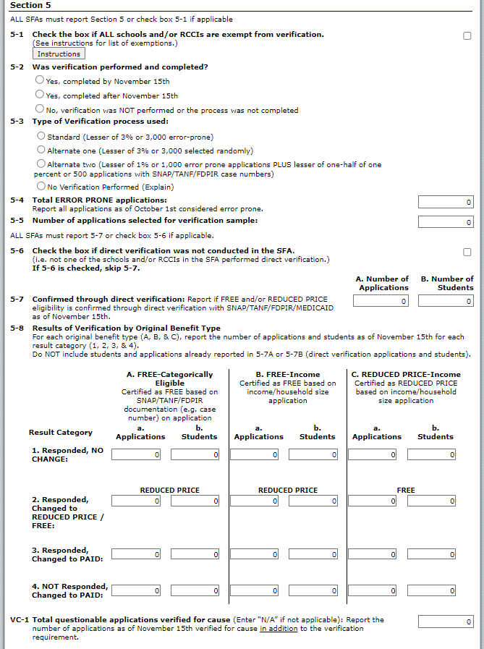
Section 5
Notes:
Section 5 is where you report your activities around Verification. If you used the verification tracker through the process, you should be in good shape to complete this part of the report!

Slide 31
Section 5 – Line 5-1
5-1: Check this box ONLY if you are an RCCI or sponsor on district-wide CEP or Provision 2 in a non-base year. More information is available by clicking the “Instructions” box.
If you collect income applications, Skip 5-1.
Notes:
For line 5-1, check this box ONLY if you are an RCCI or sponsor on district-wide CEP or Provision 2 in a non-base year.
If you collect income applications and are required to conduct verification, Skip 5-1.

Slide 32
Section 5 – Line 5-2
5-2: Was the Verification process completed and when?
Notes:
For line 5-2, this is where you describe the timeline of your verification activity. Was it completed on time on Nov. 15? OR was it completed after Nov 15? OR did verification not occur or was it incomplete? In order to be in compliance, verification should have been completed by Nov. 15.

Slide 33
Section 5 – Line 5-3
5-3: What was your sampling procedure?
Notes:
For line 5-3, this is where you would let us know what sampling procedure was used for verification. Most sponsors will use the “Standard” sample, unless you have been notified that you were eligible to use an alternate process.
If no Verification was performed, an explanation will need to be given, and may result in Corrective Action.

Slide 34
Section 5 – Lines 5-4 & 5-5
5-4: Report the number of error-prone applications received from families, as of Oct 1.
5-5: Will auto-populate.
Notes:
Line 5-4: If you chose a sample size that included error prone applications, this box will be available for data entry. Enter the total number of error prone applications as of October 1.
Now, line 5-5 will auto populate based on what type you selected as your sample size on line 5-3. It calculates the correct sample size based off the information you entered in section 4 and the sample size selected, as we talked about earlier.

Slide 35
Section 5 – Line 5-6
5-6: Check the box
5-7: Will auto-populate
Notes:
For line 5-6, Direct Verification is not currently used in Colorado, so all sponsors should check the box and then line 5-7 will auto-populate with zeros.

Slide 36
Section 5 – Line 5-8
Notes:
Line 5-8 and the many fields below it collect the results of the verification process. A reminder, this section *does not* include information about directly certified students.
Lines 1-4 ask about applications you verified during the annual process and line VC-1 asks about any applications you may have verified for cause outside of your normal sample size. You are to report the original status of the application and then report what the result of verification was. We’ll look more closely at how to do this.

Slide 37
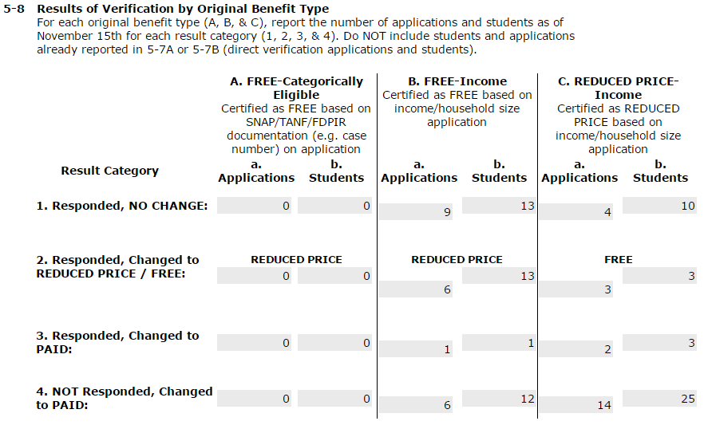
Section 5 – Line 5-8 continued
Columns represent ORIGINAL status of applications
Rows represent RESULT of verification
Notes:
This section should be read that the columns (in green) designate the original status of the application, and the rows (in blue) indicate how the application changes through the process of verification. Let’s look at an example: If a verified application was originally free based on income, and it changed to paid as part of the verification process, it would be listed in Column B (Free-Income) for the original status and in Row 3 (Responded, Changed to Paid) for the result.
The very last line, VC-1, asks for the total number of applications verified for cause as of November 15 . List all applications verified for cause on VC-1 and list the results in table 5-8 alongside your other verification results. Applications entered in this section should equal the number of verified applications from line 5-5 and any applications verified for cause that are entered on line VC-1, unless you had households that became directly certified.
For example, if you had to verify 2 applications in your annual sample size and you verified 3 applications for cause, you will report 5 results in table 5-8.
We use the data entered in these tables to analyze response trends (students that respond and change in status) and non-response rates. You can use the data specifically from Row 4 to analyze your own verification non-response rates. This will be useful to analyze the effectiveness of methods you’re using to encourage families to respond. You can also use data submitted in section 3 to identify trends of your directly certified students from year to year.

Slide 38
Section 5 – Line 5-8 continued
Notes:
The three columns are divided into A. FREE Applications determined by categorical eligibility, then Column B, FREE Applications that were determined based on income, and Column C. Reduced Price Applications that were determined by income. Each application you chose for verification will fit into one of those categories.
Under each category, there are further sub-columns, a and b for each type of application. Column a is to report the number of each type of application, and column b is to report the number of students. Another example, if you had 2 free applications, one with 2 student and one with 3 students, that were chosen for verification based on income, and there was no change to the status after the families responded, you would record those in Column B, with the number of applications, *two* in sub-column a, and the number of students on those applications in sub-column b. which would be *five*.

Slide 39
Section 5 – Line VC-1
Notes:
The very last line, VC-1, asks for the total number of applications verified for cause as of November 15 . List all applications verified for cause on VC-1 and list the results in table 5-8 alongside your other verification results.
Applications entered in 5-8 should equal the number of verified applications from line 5-5 PLUS applications verified for cause that are entered on line VC-1, unless you had households that became directly certified during the Verification process.
We use the data entered in these tables to analyze response trends (students that respond and change in status) and non-response rates. You can use the data specifically from Row 4 to analyze your own verification non-response rates. This will be useful to analyze the effectiveness of methods you’re using to encourage families to respond. You can also use data submitted in section 3 to identify trends of your directly certified students from year to year.

Slide 40
Submitting the VCR
Once all sections are completed, Select Save
Select Finish; The main screen will display the VCR as Submitted
Notes:
Once you have completed all sections of the VCR, or if you have started it and want to come back to it later, you can select save, then finish. If there are no errors, your report will be in a submitted status on the main page.

Slide 41
Errors
If sections are incomplete or incorrect, an error message will display
Select Edit to review the error message
If you are unsure of what the error is, contact CDE School Nutrition
Notes:
If something is incorrect or incomplete you will receive an error message after you hit save. You can click edit to review the errors immediately or you can select finish and come back later. Your report will show a status of error until you do revisit it. You can come back to the report and fix your errors at anytime by selecting “Modify”.

Slide 42
VCR Review
CDE School Nutrition will review all VCR reports for accuracy
FINAL VCR SUBMISSIONS DUE February 1
No errors means the submission will be approved
The status of “Approved” can be seen on the main page
Notes:
School Nutrition reviews each VCR upon submission. If there are errors, or any discrepancies with data submitted, School Nutrition will email/call the person listed as the contact at the top of the report.
We will work with you to fix any errors. If there are no errors, we will approve your VCR. You can view the status of your report on the main page. The final due date of your VCR is February 1. Please submit as early as possible to account for time needed to fix possible errors.

Slide 43
Questions?

Slide 44
Register for Online Training
School Nutrition moved all of its online trainings to a new platform.
To access online trainings and receive professional standards credit, register for a FREE Moodle account
https://app.smartsheet.com/b/form/c22b69634b4e4a8596306d45ac107c2f
Notes:
School Nutrition has moved all of its online trainings to a new platform. To access the online trainings and receive professional standards credit, you need to register for a FREE Moodle account. Registration only takes a few seconds to complete. Once you have submitted your registration, our office will create your account. You will receive an email to confirm your Moodle account and then you will be able to access the trainings. If you have any questions, please contact Alicia Grove at grove_a@cde.state.co.us or 720-795-2038.

Slide 45
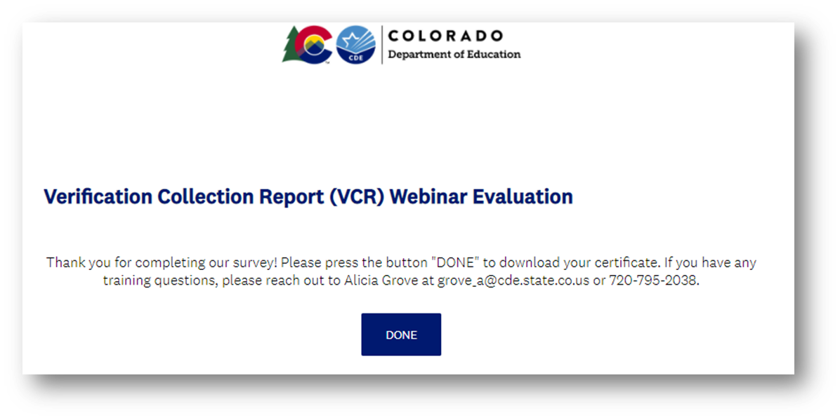
Training Evaluation & Certificate
Click this link to complete a quick training evaluation
https://www.surveymonkey.com/r/MG8Z5SV
When you submit the evaluation click “DONE” on the survey thank you page to download your certificate
Notes:
This link will be emailed out to all training attendees. This information is included for those watching this training at a later date as a recording.
Thank you so much for your feedback - we are always looking for ways to improve our trainings to better support you.

Slide 46
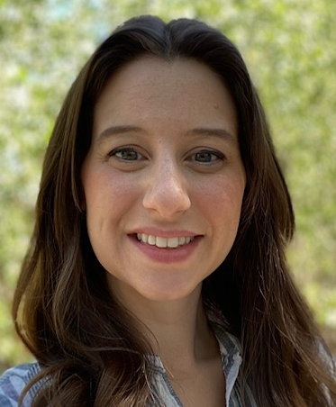
Thank you!
Nell Dochez
Senior Consultant
dochez_n@cde.state.co.us
720-948-5145
https://www.cde.state.co.us/nutrition

