Slide 1
Pandemic-EBT Data Collection
March 30, 2022
Presenters: Rachael Burnham, Christian Francisco
The webinar will start promptly at 2:00 p.m.
Notes:
Hello and Welcome to our Nutrition P-EBT Data Collection Training. Thanks so much for tuning in to make sure we get the best data possible to issue benefits to students in need.

Slide 2
Mute/
Unmute
Video
On/Off
Chat
Closed Caption
Notes:
First, I will cover some quick Zoom housekeeping items before we jump into the content.
All attendees will enter muted. You will know that you are muted if the microphone button in the lower left corner has a slash across it. Next to the microphone is a camera icon. Click the camera icon to turn it on which will remove the slash across the icon. It is completely optional to turn on your camera today.
If you keep moving across the bottom portion of your screen you will see a chat icon in the middle. If you have any questions today, please insert them into the chat-we will monitor the chat and compile a list of questions to address at the end of the webinar if we have time.
We will insert the PowerPoint slides for today with speaker notes into the chat for you to download.
To the right of the chat icon, is an icon for closed captioning if you needed it. Go ahead and click this button for subtitles.

Slide 3
CDE School Nutrition
Vision
Mission
Nourish young bodies and minds. End childhood hunger.
We support the child nutrition community through innovation, training, and partnerships to ensure all youth have access to healthy meals.
Notes:
We have spent time updating our vision and mission.

Slide 4
Non-Discrimination Statement
In accordance with Federal civil rights law and U.S. Department of Agriculture (USDA) civil rights regulations and policies, the USDA, its Agencies, offices, and employees, and institutions participating in or administering USDA programs are prohibited from discriminating based on race, color, national origin, sex, disability, age, or reprisal or retaliation for prior civil rights activity in any program or activity conducted or funded by USDA. Persons with disabilities who require alternative means of communication for program information (e.g. Braille, large print, audiotape, American Sign Language, etc.), should contact the Agency (State or local) where they applied for benefits. Individuals who are deaf, hard of hearing or have speech disabilities may contact USDA through the Federal Relay Service at (800) 877-8339. Additionally, program information may be made available in languages other than English.
To file a program complaint of discrimination, complete the USDA Program Discrimination Complaint Form, (AD-3027) found online at: https://www.usda.gov/oascr/how-to-file-a-program-discrimination-complaint, and at any USDA office, or write a letter addressed to USDA and provide in the letter all of the information requested in the form.
To request a copy of the complaint form, call (866) 632-9992. Submit your completed form or letter to USDA by: (1) mail: U.S. Department of Agriculture Office of the Assistant Secretary for Civil Rights; 1400 Independence Avenue, SW Washington, D.C. 20250-9410; (2) fax: (202) 690-7442; or (3) email: program.intake@usda.gov.
This institution is an equal opportunity provider.
Notes:
We include the nondiscrimination statement in our trainings as a reminder of our responsibilities to ensure all eligible people may participate in our child nutrition programs. As equal opportunity providers, we prohibit discrimination in our programs and provide fair and equitable treatment to every participant. For the full disclosure statement, visit the School Nutrition civil rights webpage.

Slide 5
Conditions for Success
Be present and engaged
Put your cell phone out of arms reach
Close out email or other tabs
Avoid multi-tasking or doing other work
Actively listen, be curious and ask questions
Engage in respectful discussion and feedback
Assume positive intent
Notes:
We want to be respectful of everyone’s time and with a new collection abwe want to set up conditions for success in our discussions and training. These apply to us as presenters as well.
so please be sure to keep present and engaged and make sure cell phones out of reach as best you can, close out email or other tabs to avoid multitasking or doing other work. We ask this because your eagle eyes may spot something we didn’t catch or have a question or insight that might help others
Lets remember to be active in listening and feel empowered to ask questions
Engage in respectful discussion and feedback. We’re all here to learn from and sharpen each other. And like I said this goes for us as well
Assume positive intent.

Slide 6
Learning Objectives
Learning Objectives
Define the file layout requirements based on preferred reporting option
Navigate the data pipeline to successfully submit district data
Identify data errors and utilize resources to amend errors
This Photo Unknown Author is licensed under CC BY-SA-NC
Notes:
Our hope for you is that by the end of this training you will be able to:

Slide 7
What is Pandemic Electronic Benefits Transfer (P-EBT) program?
Notes:
We understand that there are a number of Data Respondents who are brand new to their role so we will briefly recap the program

Slide 8
P-EBT
Families First Coronavirus Response Act (FFCRA) created P-EBT to assist families who lost access to free or reduced-price school meals due to school closures in response to COVID-19.
P-EBT has been extended to cover the 2021-22 school year for school-aged students
Colorado’s state plan for the 2021-2022 school year was approved by USDA on January 26, 2022
Approved Plan: https://www.fns.usda.gov/sites/default/files/resource-files/CO-sy-21-22-school-pebt-plan.pdf
Approval Letter: https://www.fns.usda.gov/sites/default/files/resource-files/CO-sy-21-22-pebt-approval-letter-schools.pdf
This Photo by Unknown Author is licensed under CC BY-SA-NC
Notes:
The families first coronavirus response act created the P_EBT program to assist families who lost access to free and reduced price school meals because of school closures in response to COVID19.
The program his been expanded to cover the 2021-22 school year for school aged students. Colorados plan was approved by USDA on January 26th 2022

Slide 9
P-EBT
Eligibility:
The child is eligible for free or reduced-price meals and attends a school that normally operates the National School Lunch Program (NSLP).
The child has not received meals at school because
The school was operating on a hybrid or remote schedule for at least 5 consecutive days; or
The child has opted-in to fully remote learning/hybrid learning; or
The student was absent due to a COVID-19 outbreak.
This Photo by Unknown Author is licensed under CC BY-SA

Slide 10
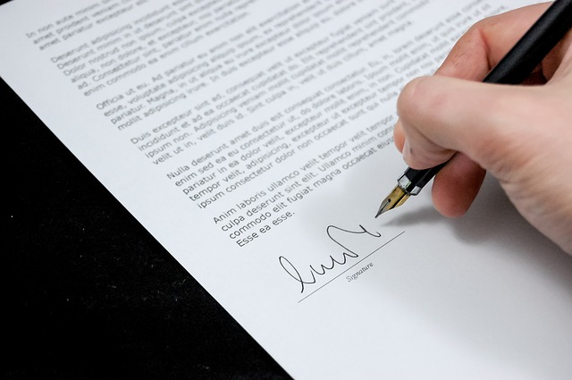
2021 – 22 P-EBT Plan
The SY21-22 approved plan requires districts to provide data in a more detailed way.
To account for differences in how districts might capture the data, the P-EBT Data Collection within the Data Pipeline has different options for providing that data
Districts can provide data in ANY of the following methods
100% Remote or Hybrid Learning with a Begin Date and an End Date
100% Remote or Hybrid Learning for the full semester
100% Remote or Hybrid Learning for each month
Notes:
Last year, Colorado was allowed to assign benefits for students indicated as Full Time Remote Learning for the months of Sept-March.
This year our federal partners are requiring us to provide more detailed data

Slide 11
Data Requirements

Slide 12
P-EBT Data Collection in Data Pipeline
Recommendation:
Provide FULL universe of students enrolled during the current SY
BENEFITS TO PROVIDING FULL UNIVERSE
Able to use historical October Count data
Able to use CDPHE COVID Outbreak data
District can submit multiple records for the same student
Different school enrollments
Different learning modalities throughout the semester
This Photo by Unknown Author is licensed under CC BY-SA-NC
Notes:
The P-EBT team strongly encourages districts to provide their FULL universe of students enrolled during the 2021-2022 school year but districts can opt to provide data for a subset of students.
BENEFITS TO PROVIDING FULL UNIVERSE
P-EBT team can use FRPL eligibility from 2019-2020, 2020-2021 AND 2021-2022 school years to assess P-EBT benefit assignment; Some districts may not have historical FRPL data readily available.
Students may be eligible for P-EBT benefits based on COVID-19 related outbreak data received from Colorado Department of Public Health and Environment (CDPHE).
Multiple records for the same student can be submitted to account for enrollment in different schools or engagement in different learning modalities or engagement in the same learning modality during different timeframes.

Slide 13
P-EBT Data Collection in Data Pipeline
There will be TWO separate collections, one for Fall Semester and one for Spring Semester.
Collection 1 - Fall 2021 Semester includes:
August,
September
October
November
December
Collection 2 – Spring 2022 Semester includes:
January
February
March
April
May

Slide 14
P-EBT Data Collection in Data Pipeline
The same privacy and data sharing assurances from last school year continue to be in place.
P-EBT legislation allows districts to share data with CDE without parental consent.
(e) RELEASE OF INFORMATION.—Notwithstanding any other provision of law, the Secretary of Agriculture may authorize State educational agencies and school food authorities administering a school lunch program under the Richard B. Russell National School Lunch Act (42 U.S.C. 1751 et seq.) to release to appropriate officials administering the supplemental nutrition assistance program such information as may be necessary to carry out this section.
This Photo by Unknown Author is licensed under CC BY-SA

Slide 15
P-EBT Data Collection in Data Pipeline
The P-EBT Data Collection is broken into different sections
Student Demographic and Parent/Address Data
Type of Learning Modality
Learning Modality Timeframe
Attendance data
Let’s take a closer look at the different sections of the P-EBT Data Collection.
This Photo by Unknown Author is licensed under CC BY-NC
Notes:
The P-EBT Data Collection in the Data Pipeline may appear to be a much longer collection than last school year; not all fields have to be completed for all students.

Slide 16
P-EBT Data Collection in Data Pipeline
Student Demographic and Parent/Address Data
Should be provided for ALL students submitted by the District
Basic information, very similar to the collection from last school year
Type of Learning Modality
Should be provided for ALL students submitted by the District
Four options to choose from
100% Full Time Remote Learning
Hybrid Learning
In-Person
Enrolled in Online School

Slide 17
P-EBT Data Collection in Data Pipeline
Learning Modality Timeframe
Should be provided for a SUBSET of students submitted by the District
Should ONLY be provided for students where the Type of Learning Modality is
100% Full Time Remote Learning, OR
Hybrid Learning
Three options/methods for providing the data are available:
Begin/End Date
Per Semester
Per Month

Slide 18
P-EBT Data Collection in Data Pipeline
Attendance Data
Should be provided for ALL students submitted by the District
Attendance should be YES if the student has AT LEAST ONE EXCUSED ABSENCE during each respective month
Notes:
Now that we have covered a basic understanding of the different sections, let’s do a quick activity ice breaker

Slide 19
P-EBT Data Collection Rules
Business Rules
There are many business rules in the P-EBT Data Collection to assist with submitting the data accurately and completely
A full list of the rules are available on the P-EBT Data Collection Website:
https://www.cde.state.co.us/datapipeline/2021-2022pebtbusinessrules
This Photo by Unknown Author is licensed under CC BY
Notes:
Now that we have covered a basic understanding of the different sections, let’s do a quick activity ice breaker

Slide 20
P-EBT Data Collection Rules
Business Rules Highlights
Learning Modality and Learning Modality Timeframe (Reporting Method)
If Learning Modality is 1 – Full Time Remote or 2 - Hybrid, a Reporting Method must be selected
If Learning Modality is 3 – In-Person or 4 – Online Academy, the Reporting Method MUST be NULL/Blank
The Reporting Method selected will dictate which timeframe fields are required and which much be left NULL/Blank; Rules exist to reinforce the prescribed conditions
For this Collection 1 – Fall 2021 Semester, NONE of the Semester 2 fields can be completed
If the reported Non School Program Code is ‘05’, the Learning Modality MUST be ‘1 – Remote’
Please visit the P-EBT Data Collection Website for a full list of the Business Rules.
This Photo by Unknown Author is licensed under CC BY
Notes:
These are just a couple of the rules that have been applied to the collection in the Data Pipeline. We wanted to highlight these because they include logic applied to the additional fields in this year’s collection.
For districts who are submitted their entire universe of enrolled students (which we highly recommend), the Reporting Method and Learning Modality Timeframe only needs to be provided for students who were either full time remote or hybrid learning. For other students who were either in-person or enrolled in an online academy, you can skip to the attendance section of the data collection.
While many districts reported during our facilitated sessions last year that they did not use the Full Time Remote option under the Non School Program Code, we were advised to include it in the data collection. If a district DID in fact use that code, that student should be reported as a full time remote learner for at least a portion of the year.
A complete list of the business rules included in the P-EBT Data Collection are available on the P-EBT Data Collection website.
Now…let’s have some fun and refamiliarize ourselves with using a JamBoard! The link for the JamBoard has been posted in the chat. Let’s spend 90 seconds on the next activity.

Slide 21
Interactive Activity
JAMBOARD: https://jamboard.google.com/d/1K1fxTa12QLZDrxKKkl6ms7iJL7TzA5h2cu2kNeaobvQ/viewer?f=0
Notes:
Now lets get some practice using our interactive jamboard. Go ahead and click the link. You’ll see at the top center you can navigate between pages and on the very left you’ll find a sticky note icon. You will use that to type responses. Hopefully most of you are old enough to remember Highlight Magazine!!! On the JamBoard, quickly identify one of the differences you see in the pictures. You are welcome to use any color post it you want.
You can post questions on Page 11 of the JamBoard or feel free to use the chat feature within Zoom. We will do our best to address questions at the end of the session. If there is not sufficient time, we will follow up with emails to address questions and concerns.
Now let’s take a deeper dive into the different sections of the P-EBT Data Collection.

Slide 22
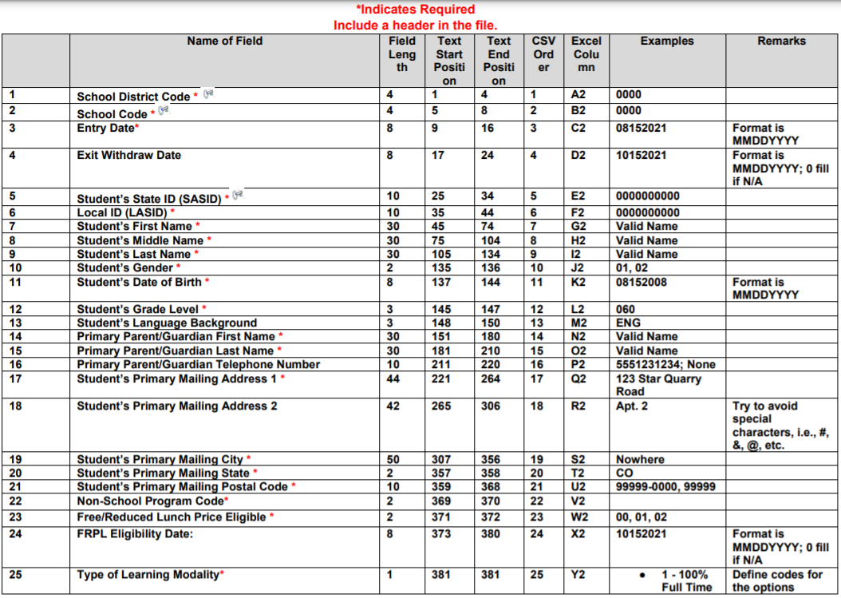
Student Demographic and Parent/Address Data
Notes:
The first section is student demographic and Parent/Address data
First and foremost the amount of digits is key. So if you get errors your first step is to see if the field length is accurate or if how you are saving your file is stripping zeros.

Slide 23
Student Demographic and Parent/Address Data
MOST of the data elements for this section of the P-EBT Data Collection remain the same with a few notable changes:
County Code was removed.
Free/Reduced Lunch Price Eligible code set has been updated.
FRPL Eligibility Date was added as an OPTIONAL element.
Non-School Program was added.
This Photo by Unknown Author is licensed under CC BY-NC-ND
Notes:
County Code was removed. This element will be determined based on geocoding from the address provided.
Free/Reduced Lunch Price Eligible – The code set was changed to reflect the same code set from the Student School Association Interchange data collection to reduce confusion.
FRPL Eligibility Date was added as an OPTIONAL element. This data could prove to be helpful in determining retroactive benefit eligibility and for troubleshooting for the Support Center. If the district has the data readily available, please provide it. If the district does not have the data readily available, the field can be zero-filled (00000000).
Non-School Program – This is identical to the data that is provided in the Student School Association Interchange data collection.

Slide 24
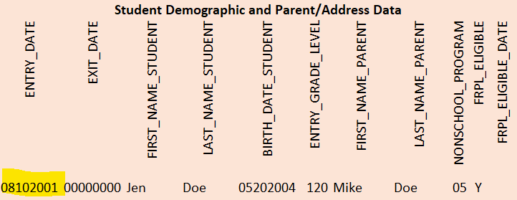
EXAMPLE: Student Demographic & Parent/Address
Jen Doe
Student was enrolled at district/school on August 10, 2021
Error:
ENTRY_DATE was erroneously entered as 8/10/2001 instead of August 10, 2021
ENTRY_DATE cannot be prior to the BIRTH_DATE_STUDENT
Notes:
Let’s take a look at this example and an error that could occur with the new entry date fields in the P-EBT Data Collection in the Student Demographic and Parent/Address Data section.
Here you can see the ENTRY_DATE was entered as August 10, 2001. Most likely, it should have been August 10, 2021 and is the result of a typo. There is a rule in the Data Pipeline that prevents the ENTRY_DATE from being BEFORE the student was born so in this case, a validation error in the data pipeline would be triggered.
Next, we have some details about a student and the respective file that has been uploaded to the Data Pipeline. Take 90 seconds and see if you can identify any errors with the data. The link for the JamBoard has been posted in the chat again. We are on page 2 of the JamBoard.

Slide 25
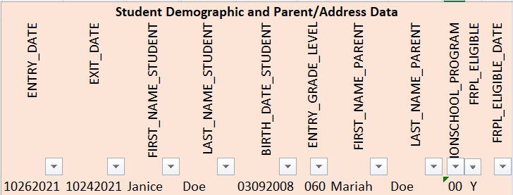
ACTIVITY 1: Student Demographic & Parent/Address
Janice Doe
Student was enrolled at district/school on October 26, 2021
Student withdrew from the district/school on December 24, 2021
JAMBOARD: https://jamboard.google.com/d/1K1fxTa12QLZDrxKKkl6ms7iJL7TzA5h2cu2kNeaobvQ/viewer?f=1
Notes:
We had several people identify that the EXIT_DATE is not reflective of the information provided. The date was entered as October 24, 2021 instead of December 24, 2021. This will trigger a validation error in the Data Pipeline because the EXIT_DATE cannot be PRIOR to the ENTRY_DATE.
Most of the data in this section will not cause any issues as it is basic data districts are used to submitting for most data collections. The ENTRY and EXIT date are new to the P-EBT Data Collection this year.
Now, let’s look at the Learning Modality section.

Slide 26
Type of Learning Modality

Slide 27
Four different Learning Modalities to choose from for each student:
Type of Learning Modality
This Photo by Unknown Author is licensed under CC BY
This Photo by Unknown Author is licensed under CC BY
100% Full Time Remote
Hybrid Learning
In-Person
Enrolled in On-Line School
Notes:
100% Full Time Remote Learning – The student is engaged in Remote Learning while remaining enrolled in their local brick and mortar school. The student is being taught by a teacher who is also teaching students who are in-person. That last piece was guidance provided by FNS.
Hybrid Learning – The student is engaged in Remote Learning for 2-3 days per week and in-person for the other days. The student must be remote for a full days. This is not for students who are taking a class or two remotely during the day.
In-Person – The student is attending their local brick and mortar school in-person all day every day (not including absences).
Enrolled in On-Line School – The student is 100% learning virtually and is no longer enrolled in their local brick and mortar school.

Slide 28
Type of Learning Modality
1 – 100% Full Time Remote Learning
2 – Hybrid Learning
Students in the first two learning modality options may be eligible for P-EBT benefits based on learning modality and all data fields should be completed.
This Photo by Unknown Author is licensed under CC BY

Slide 29
Type of Learning Modality
3 – In-Person
4 – Enrolled in Online Academy
Students in the last two learning modality options will NOT be considered eligible for P-EBT benefits based on learning modality…HOWEVER…
Students MAY be eligible for P-EBT benefits as the result of a COVID-19 related outbreak or a school-wide change in learning modality.
For example,
A student may be in a grade level and have a confirmed absence during a COVID-19 outbreak at their school and therefore be eligible for P-EBT.
A school may decide to switch temporarily to a hybrid learning schedule to accommodate social distancing due to a high numbers of COVID-19 cases in their area and students at that school may be eligible for P-EBT.
This Photo by Unknown Author is licensed under CC BY-NC-ND

Slide 30
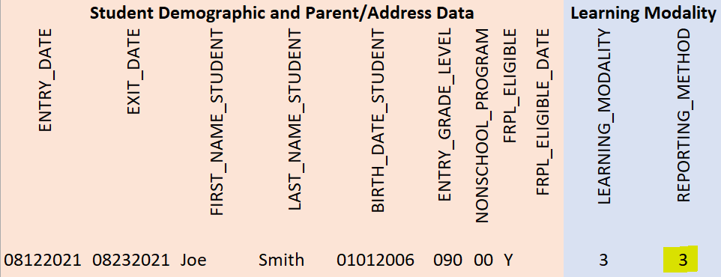
EXAMPLE: Learning Modality and Timeframe
Joe Smith
Student was In-Person Learning for the Entire Semester (Aug-Dec)
Error:
If the LEARNING_MODALITY is 3 (In-Person), the REPORTING_METHOD should not be completed.
Notes:
Looking at another example, you can see the Learning Modality selected was 3 which is In-Person learning BUT, a Reporting Method was also selected. If the Learning Modality is 3 (In-Person) or 4 (Enrolled in Online Academy), the student should NOT have a Reporting Method selected.
In the next slide, there are several rows of students entered. On the JamBoard, please identify which students have erroneous data and briefly explain why. The JamBoard has been posted in the Zoom chat.

Slide 31
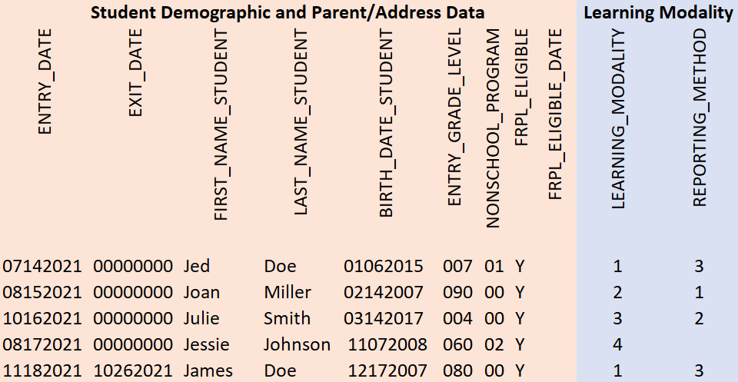
ACTIVITY 2: Learning Modality and Timeframe
JAMBOARD: https://jamboard.google.com/d/1K1fxTa12QLZDrxKKkl6ms7iJL7TzA5h2cu2kNeaobvQ/viewer?f=2
Notes:
The Learning Modality for Julie Smith has been entered as 3 which is In-Person but a Reporting Method was also selected. The Reporting Method should be NULL or blank.
Additionally, the EXIT_DATE for James Doe is PRIOR to the ENTRY_DATE (yes, we snuck an error from the first section in on you!)
Let’s move on to the Learning Modality Timeframe section.

Slide 32
Learning Modality Timeframe

Slide 33
Learning Modality Timeframe
The Learning Modality Timeframe data ONLY needs to be completed for students who are engaged in one of the first two learning modalities:
100% Full Time Remote Learning
Hybrid Learning
The Learning Modality Timeframe does NOT need to be completed for students who are engaged in one of the second two learning modalities:
In-Person
Enrolled in On-Line Learning
This Photo by Unknown Author is licensed under CC BY-NC-ND

Slide 34
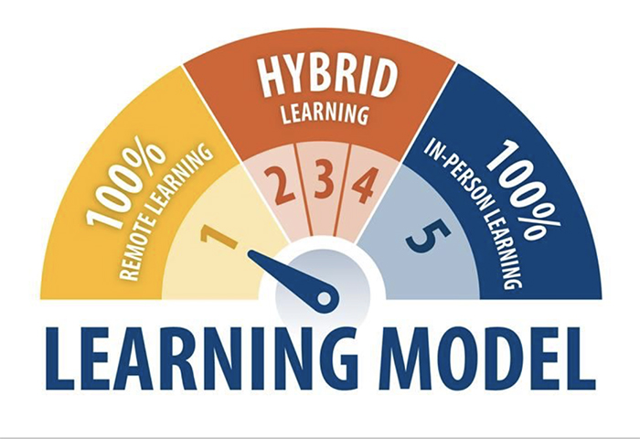
Learning Modality Timeframe
Learning Modality Timeframe
There are THREE OPTIONS for providing the timeframe in which a student is engaged in either 100% Full Time Remote Learning or Hybrid Learning.
ONLY ONE of the three options has to be provided for each student.
Begin/End Dates – Provide a begin and an end date for the period the student is enrolled in 100% Full Time Remote or Hybrid Learning.
Per Semester – If the student was enrolled for the entire semester, the district can opt to complete this option and select ‘01’
Per Month – If the student was enrolled for part of the semester, the district can opt to complete this option and select ‘01’ for the months the student was enrolled in 100% Full Time Remote or Hybrid Learning
This Photo by Unknown Author is licensed under CC BY
Notes:
Begin/End Dates – Provide a begin and an end date for the period the student is enrolled in 100% Full Time Remote or Hybrid Learning. If the student remains enrolled in 100% Full Time Remote or Hybrid Learning for the entire Fall Semester, please use 12/31/2021 for the end date.
Per Semester – If the student was enrolled for the entire semester and the begin and end dates are not available, the district can opt to complete this option and select ‘01’
Per Month – If the student was enrolled for part of the semester and the begin and end dates are not available, the district can opt to complete this option and select ‘01’ for the months the student was enrolled in 100% Full Time Remote or Hybrid Learning; To be considered enrolled for the month, the student should be engaged in either option for at least half of the scheduled school days for that month

Slide 35
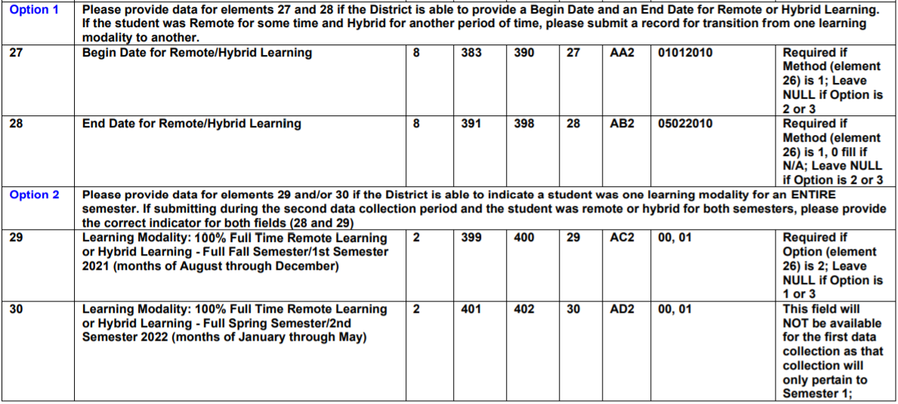
Learning Modality Timeframe OPTIONS
For Option 2, only row 29 will be relevant for the first P-EBT Data Collection (Fall 2021 Semester. Row 30 will be used for the second P-EBT Data Collection (Spring 2022 Semester)
Notes:
For Option 2, only row 29 - Learning Modality: 100% Full Time Remote Learning or Hybrid Learning - Full Fall Semester/1st Semester 2021 (months of August through December) will be relevant for the first P-EBT Data Collection.

Slide 36
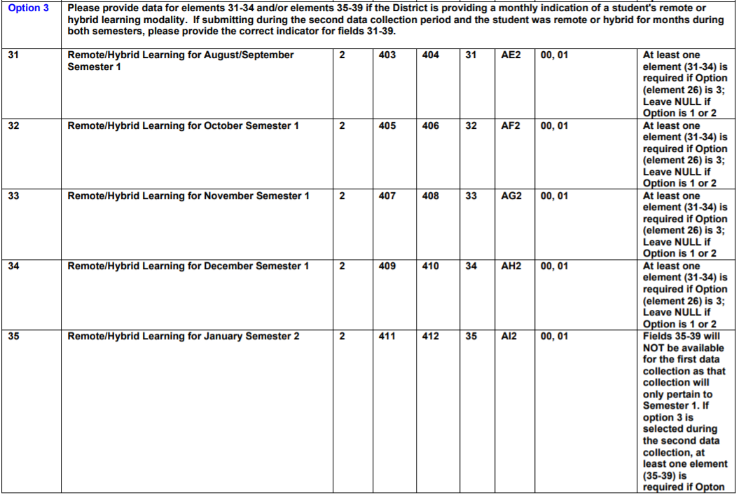
Learning Modality Timeframe OPTIONS
For Option 3, only rows 31-34 will be relevant for the first P-EBT Data Collection (Fall Semester, months of August – December).
Remember, only ONE option needs to be completed for students engaged in 100% Full Time Remote or Hybrid Learning.

Slide 37
EXAMPLE: Learning Modality and Timeframe
Jed Doe
Student was 100% Full Time Remote Learning (option 1)
District opted to report the timeframe for each month (option 3)
Student was Remote Learning from the beginning of the school year through the end of November
Error:
There was no Learning Modality Timeframe entered for the month of Aug/Sept (REMOTE_AUG_SEP_1)

Slide 38
ACTIVITY 3: Learning Modality and Timeframe
Jenny Doe
Student was 100% Full Time Remote Learning (option 1)
District opted to report the timeframe for each semester (option 2)
Student was Remote Learning for the entire Fall 2021 semester
JAMBOARD: https://jamboard.google.com/d/1K1fxTa12QLZDrxKKkl6ms7iJL7TzA5h2cu2kNeaobvQ/viewer?f=3
Notes:
They did not report by semester

Slide 39
ACTIVITY 4: Learning Modality and Timeframe
Julie Smith
Student was In-Person (option 3) for the entire Fall 2021 semester
JAMBOARD: https://jamboard.google.com/d/1K1fxTa12QLZDrxKKkl6ms7iJL7TzA5h2cu2kNeaobvQ/viewer?f=4
Notes:
They were learning modality 3. They did not need to report a time frame

Slide 40
ACTIVITY 5: Learning Modality and Timeframe
Jolie Smith
Student was 100% Full Time Remote (option 1) for the entire Fall 2021 semester
District opted to provide the Begin and End Dates for the Learning Modality Timeframe (option 1)
The student was engaged in remote learning from August 21, 2021 and remained enrolled in remote learning thru the time of the data collection
JAMBOARD: https://jamboard.google.com/d/1K1fxTa12QLZDrxKKkl6ms7iJL7TzA5h2cu2kNeaobvQ/viewer?f=5
Notes:
Because they were in that learning modality for the entirety of the semester the time frame did not need to be reported

Slide 41
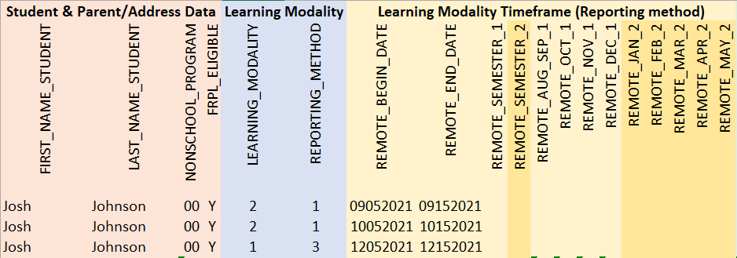
ACTIVITY 6: Learning Modality and Timeframe
Josh Johnson
Student was 100% Full Time Remote (option 1) from Sept. 5 thru Sept. 15, 2021
Student returned to In-Person from Sept 16 thru Oct. 5, 2021
Student returned to 100% Full Time Remote from Oct. 5 thru Oct. 15, 2021
Student returned to In-Person from Oct. 16 thru December 4, 2021
Student engaged in a hybrid learning schedule from Dec. 5 to the end of the Semester
JAMBOARD: https://jamboard.google.com/d/1K1fxTa12QLZDrxKKkl6ms7iJL7TzA5h2cu2kNeaobvQ/viewer?f=6
Notes:
This is an example of how students can have multiple records due to different modalitites thruouth the year
Errors Learning modality for Sept should be a 1
Learning Modality for October 5-15 should be a 1
Dec 5 should be learning modality 2 and should have a 00000 in end date
In person modalities should have been uploaded for completeness

Slide 42
ACTIVITY 7: Learning Modality and Timeframe
Joan Miller
Student was reported by the district as NonSchool Program Code of 05
Student was 100% Full Time Remote Learning for the entire Fall 2021 Semester
JAMBOARD: https://jamboard.google.com/d/1K1fxTa12QLZDrxKKkl6ms7iJL7TzA5h2cu2kNeaobvQ/viewer?f=7
Notes:
Full time remote should be a learning modality of 1

Slide 43
Attendance Data
CDPHE COVID related outbreak data OR Parent Reported COVID related absence
The P-EBT plan requires confirmation of an excused student absence during the timeframe of the outbreak to consider a student for P-EBT benefits based on COVID related outbreak
Attendance data should be submitted for ALL students
Parents will be able to submit a dispute if their student was absent due to COVID even if the school did not report an outbreak to CDPHE
Confirmation of an excused student absence is required; if the data is not submitted during the collection, districts/schools will have to verify that through the escalation process
This Photo by Unknown Author is licensed under CC BY
Notes:
Colorado is using COVID-19 related outbreak data received from CDPHE however the approved plan also requires confirmation of an absence during the outbreak period as well. Therefore, the P-EBT Data Collection includes information on a monthly basis about student attendance.
It is important for districts to provide attendance data for ALL students, even if there has been no outbreaks identified at the schools. Parents will be able to submit a dispute if their student was absent due to COVID-19 that was NOT included in a school reported outbreak but the P-EBT team is still required to confirm at least one excused absence during the time period the parent is reporting.

Slide 44
Attendance Data
Attendance Data
Districts should submit ‘01’ if the student had AT LEAST ONE EXCUSED ABSENCE during each respective month.
There is NOT a requirement that the district track whether the excused absence was related to COVID-19, only that the student had an excused absence.
The approved plan is allowing Colorado to make an assumption that the excused absence was due to COVID-19 if it occurred during the timeframe of a reported outbreak (or parent reported absence).
Students may be eligible to receive a state-wide average amount of P-EBT benefit in these scenarios.
This Photo by Unknown Author is licensed under CC BY-ND
Notes:
To complete the attendance section of the P-EBT Collection, we are asking districts to submit ‘01’ if the student had AT LEAST ONE EXCUSED ABSENCE during each respective month. There is NOT a requirement that the district track whether the excused absence was related to COVID-19, only that the student had an excused absence. The approved plan is allowing Colorado to make an assumption that the excused absence was due to COVID-19 if it occurred during the timeframe of a reported outbreak (or parent reported absence).
Students may be eligible to receive a state-wide average amount of P-EBT benefit in these scenarios.

Slide 45
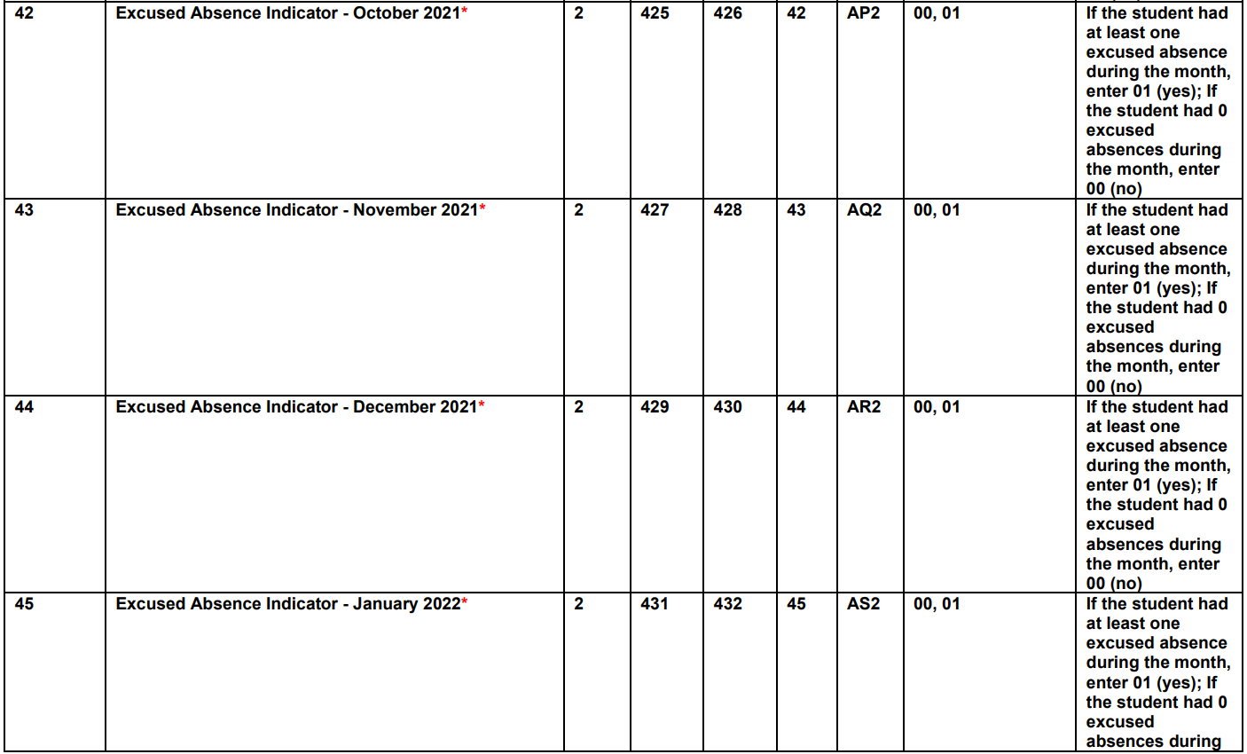
Attendance Data
Rows 45+ are NOT to be completed for the first P-EBT Data Collection.
Notes:
For the first P-EBT Data Collection, for the Fall Semester (months of August thru December), only rows 40-44 need to be completed. Rows 45+ will be relevant for the second P-EBT Data Collection.
If the student had an excused absence for AT LEAST ONE day during the month, the district should enter ‘01’ for that respective month. If the student did not have ANY excused absences during the month, the district should enter ‘00’.
Again, please provide attendance data for ALL students submitted, regardless of their learning modality.

Slide 46
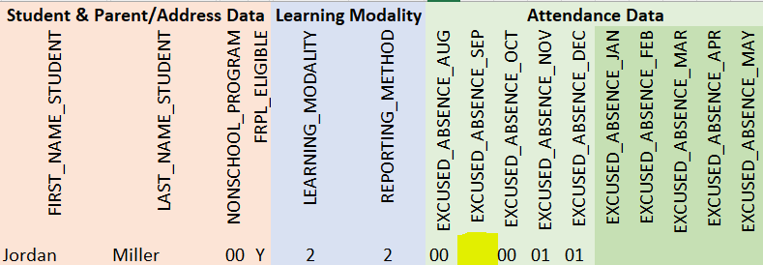
EXAMPLE: Attendance
Jordan Miller
Student did not have any days absent during the month of August
Student was absent for three days during the month of September
Student did not have any days absent during the month of October
Student was absent for seven days during the month of November
Student was absent for two days during the month of December
Error:
There is nothing reported for EXCUSED_ABSENCE_SEP; The value of ‘01’ should have been submitted for the month.

Slide 47
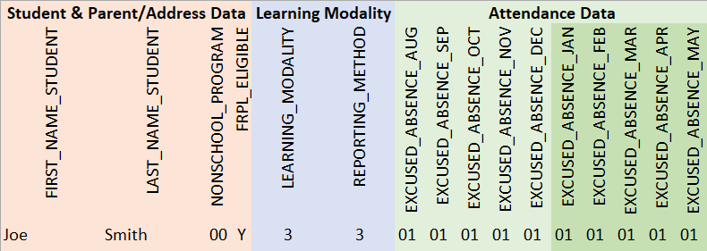
ACTIVITY 8: Attendance
Joe Smith
Student had at least one day of absence during each month of the entire school year
JAMBOARD: https://jamboard.google.com/d/1K1fxTa12QLZDrxKKkl6ms7iJL7TzA5h2cu2kNeaobvQ/viewer?f=8
Notes:
Only this semester should be filled out

Slide 48
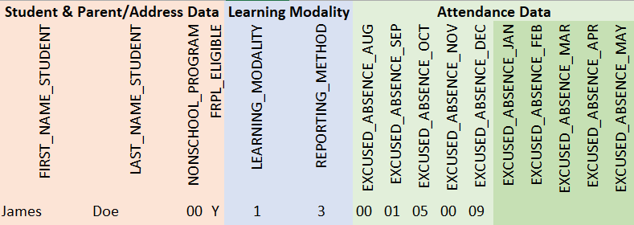
ACTIVITY 9: Attendance
James Doe
Student did not have any days absent during the month of August
Student was absent for one day during the month of September
Student was absent for five days during the month of October
Student did not have any days absent the month of November
Student was absent for nine days during the month of December
JAMBOARD: https://jamboard.google.com/d/1K1fxTa12QLZDrxKKkl6ms7iJL7TzA5h2cu2kNeaobvQ/viewer?f=8
Notes:
Only 00 or 01 is acceptable

Slide 49
Data Collection Timeline
Collection 1: Fall 2021 Semester
Months of August through December
P-EBT Data Collection opens Monday, April 4, 2022
P-EBT Data Collection closes Friday, April 29, 2022
Benefits to be issued mid-summer
Collection 2: Spring 2022 Semester
Months of January through May
P-EBT Data Collection opens Monday, May 2, 2022
P-EBT Data Collection closes Friday, June 17, 2022
Benefits to be issued in early Fall 2022
Summer – TBD
Pending summer plan approval
This Photo by Unknown Author is licensed under CC BY

Slide 50
P-EBT Resources
Ensure relevant staff are aware of training and available support
1:1 support -> P-EBT.datapipeline.support@cde.state.co.us
P-EBT Data Collection Website: https://www.cde.state.co.us/datapipeline/p-ebtdatacollection
Business Rules:

Slide 51
Evaluation
Let us know how we did with this evaluation survey. You’re feedback will let us know how to best support you and how to improve in future presentations:
https://www.surveymonkey.com/r/5QQ9FSV

Slide 52
Case Study
Jen Doe (999999980)
Enrolled during the full Fall Semester
Type of Learning Modality = (1)100% Full Time Remote
Learning Modality Timeframe = (1)Begin/End Date
Started Remote Learning = 8/10/21
Ended Remote Learning = Ongoing
Notes:
NO ERRORS

Slide 53
Case Study
Jan Miller (999999981)
Enrolled during the full Fall Semester
Type of Learning Modality = (2)Hybrid
Learning Modality Timeframe = (2)Per Semester
Started Remote Learning = 8/1/21
Ended Remote Learning = Ongoing
Notes:
NO ERRORS

Slide 54
Case Study
Joe Smith (999999982)
Enrolled briefly during the month of August
Type of Learning Modality = (3)In-Person
Learning Modality Timeframe = (2)Per Semester
Started Remote Learning = 8/1/21
Ended Remote Learning = Ongoing
Notes:
Errors:
Should not have a Learning Modality Timeframe indicated (Type of Learning Modality is not 100% Remote or Hybrid)
Semester_1 is marked as YES
Months of Aug/Sept, Oct and Dec are marked as YES
Student was IN-PERSON
Student was only enrolled for ~10 days in the month of August
ATTENDANCE HAS BEEN ENTERED FOR January thru May; Not applicable for the first P-EBT Data Collection (Fall Semester ONLY)

Slide 55
Case Study
Jill Johnson (999999983)
Enrolled starting in September for the full Fall Semester
Type of Learning Modality = (4)Enrolled in Online School
Learning Modality Timeframe = N/A
Started Remote Learning = N/A
Ended Remote Learning = N/A
Notes:
NO ERRORS

Slide 56
Case Study
Jed Doe (999999984)
Enrolled during the full Fall Semester
Type of Learning Modality = 100% Full Time Remote
Learning Modality Timeframe = Per Month
Started Remote Learning = 8/10/21
Ended Remote Learning = 10/1/21
Started Remote Learning = 11/24/21
Ended Remote Learning = 1/10/22
Notes:
ERRORS:
Student should not have the months of October and November marked as YES (‘01’); Only eligible for benefit for the months of Aug/Sept and December
Ended Remote learning October 1st and started again November 24th

Slide 57
Case Study
Joan Miller (999999985)
Enrolled for the full Fall Semester
Type of Learning Modality = (2)Hybrid
Learning Modality Timeframe = (1)Begin/End Date
Started Remote Learning = 10/10/21
Ended Remote Learning = 12/1/21
Notes:
Error:
End date is not accurate; End date of Hybrid learning is PRIOR to the Begin Date

Slide 58
Case Study
Julie Smith (999999986)
Enrolled staring in October for the full Fall Semester
Type of Learning Modality = (3)In-Person
Learning Modality Timeframe = N/A
Started Remote Learning = N/A
Ended Remote Learning = N/A
Notes:
Errors:
Learning Modality Timeframe of “Per Semester” has been selected
YES (01) has been entered for Remote Semester 1
Student is not eligible because the student was In-Person

Slide 59
Case Study
Jessie Johnson (999999987)
Enrolled staring in October for the full Fall Semester
Type of Learning Modality = (4)Enrolled in Online School
Learning Modality Timeframe = N/A
Started Remote Learning = N/A
Ended Remote Learning = N/A
Notes:
NO ERRORS

Slide 60
Learning Modality Timeframe
EXAMPLE 1:
Student is enrolled in 100% Full Time Remote Learning from 8/14/21 – 11/10/21 and then switches to Hybrid Learning from 11/11/21 through 12/31/21. ONLY ONE OF THE OPTIONS BELOW NEEDS TO BE COMPLETED.
Begin/End Date option: Student would have two records.
One where the Learning Modality selected is 100% Full Time Remote and the Begin Date is 8/14/2021 and the End Date is 11/10/2021.
A second record would indicate the Learning Modality as Hybrid learning and the Begin Date is 11/11/2021 and the End Date is 12/31/2021.
Per Semester option: This option is not valid because the student was not enrolled in the same learning modality for the entire semester.

Slide 61
Student Learning Modality Timeframe
EXAMPLE 1 (Continued):
Student is enrolled in 100% Full Time Remote Learning from 8/14/21 – 11/10/21 and then switches to Hybrid Learning from 11/11/21 through 12/31/21.
Per Month option: The student would have two records and the monthly options would be completed accordingly:
Record one would have 100% Full Time Remote selected as the learning modality and the months filled out as indicated below:
Aug/Sept = ‘01’
October = ‘01’
November = ‘00’ (the student was Hybrid for more days than Remote)
December = ‘00’
Record two would have Hybrid selected as the learning modality and the months filled out as indicated below:
Aug/Sept = ‘00’
October = ‘00’
November = ‘01’ (the student was Hybrid for more days than Remote)
December = ‘01’

Slide 62
Learning Modality Timeframe
EXAMPLE 2:
Student is enrolled in 100% Full Time Remote Learning from 8/14/21 – 2/2/22. ONLY ONE OF THE OPTIONS BELOW NEEDS TO BE COMPLETED.
Student would have one record and the learning modality selected would be 100% Full Time Remote Learning for any option.
Begin/End Date option:
Begin Date = 8/14/2021
End Date = 12/31/2021.
Per Semester option:
100% Full Time Remote Learning or Hybrid Learning - Full Fall Semester/1st Semester 2021 (months of August through December) = ‘01’
Per Month option:
Aug/Sept = ‘01’
October = ‘01’
November = ’01’
December = ‘01’

Slide 63
Learning Modality Timeframe
EXAMPLE 3:
Student is enrolled in 100% Full Time Remote Learning from 8/14/21 to 9/20/21, returns to In-Person and then returns to 100% Full Time Remote Learning from 11/29/21 to 1/10/22 . ONLY ONE OF THE OPTIONS BELOW NEEDS TO BE COMPLETED.
Student would have two records and the learning modality selected would be 100% Full Time Remote Learning for both records.
Begin/End Date option:
Record one:
Begin Date = 8/14/2021
End Date = 9/20/2021
Record two:
Begin Date = 11/29/21
End Date = 12/31/21
Per Semester option:
This option is not valid because the student was not enrolled in the same learning modality for the entire semester (student returned to in-person learning for a period of time)

Slide 64
Learning Modality Timeframe
EXAMPLE 3 (Continued):
Student is enrolled in 100% Full Time Remote Learning from 8/14/21 to 9/20/21, returns to In-Person and then returns to 100% Full Time Remote Learning from 11/29/21 to 1/10/22.
Student would only need to have one record for this option because the same learning modality would be 100% Full Time Remote Learning for both timeframes.
Per Month option:
Aug/Sept = ‘01’ (student is Remote for more than half the month)
October = ‘00’ (student was in-person during this month)
November = ’00’ (student was in-person more than half the month)
December = ‘01’ (student was remote for the full month)

