Slide 1
Local Food Program Application Information Webinar – 2022-2023 School Nutrition Unit Pursuant to HB 19-1132

Slide 2
Mute/
Unmute
Video
On/Off
Chat
Closed Caption
Notes:
First, I will cover some quick Zoom housekeeping items before we jump into the content.
All attendees will enter muted. You will know that you are muted if the microphone button in the lower left corner has a red slash across it. Next to the microphone is a camera icon that works the same way. It is completely optional to turn on your camera today.
If you keep moving across the bottom portion of your screen you will see a chat icon in the middle. I want everyone to take a moment to bring up the chat and enter your name and district or organization. Also, if you have any questions today, please insert the into the chat-we will monitor the chat and compile a list of questions to address at the end of the webinar. To the right of the chat icon, is an icon for closed captioning if you needed it. Go ahead and click this button for subtitles if needed.
There is also a button for reactions which allow participants to communicate with the host and other participants without disrupting the flow of the meeting. Feel free to use these reactions throughout the webinar.
We will insert the PowerPoint slides for today with speaker notes into the chat for you to download.

Slide 3
Non-Discrimination Statement
In accordance with Federal civil rights law and U.S. Department of Agriculture (USDA) civil rights regulations and policies, the USDA, its Agencies, offices, and employees, and institutions participating in or administering USDA programs are prohibited from discriminating based on race, color, national origin, sex, disability, age, or reprisal or retaliation for prior civil rights activity in any program or activity conducted or funded by USDA. Persons with disabilities who require alternative means of communication for program information (e.g. Braille, large print, audiotape, American Sign Language, etc.), should contact the Agency (State or local) where they applied for benefits. Individuals who are deaf, hard of hearing or have speech disabilities may contact USDA through the Federal Relay Service at (800) 877-8339. Additionally, program information may be made available in languages other than English.
To file a program complaint of discrimination, complete the USDA Program Discrimination Complaint Form, (AD-3027) found online at: https://www.usda.gov/oascr/how-to-file-a-program-discrimination-complaint, and at any USDA office, or write a letter addressed to USDA and provide in the letter all of the information requested in the form.
To request a copy of the complaint form, call (866) 632-9992. Submit your completed form or letter to USDA by: (1) mail: U.S. Department of Agriculture Office of the Assistant Secretary for Civil Rights; 1400 Independence Avenue, SW Washington, D.C. 20250-9410; (2) fax: (202) 690-7442; or (3) email: program.intake@usda.gov.
This institution is an equal opportunity provider.
Notes:
We include the nondiscrimination statement in our trainings as a reminder of our responsibilities to ensure all eligible people may participate in our child nutrition programs.

Slide 4
School Nutrition Vision Nourish young bodies and minds. End childhood hunger. Mission We support the child nutrition community through innovation, training, and partnerships to ensure all youth have access to healthy meals.
Notes:
Last year we took time to update School Nutrition Unit’s vision and mission. Our vision is to nourish young bodies and minds and to end childhood hunger. And our mission is to support the child nutrition community through innovation, training, and partnerships to ensure all youth have access to healthy meals.

Slide 5
Agenda
Program introduction and history
Key program and application elements
Submission process and timeline
Notes:
Here is our very straight forward agenda for the day. I am first going to do a brief program introduction and history. I will then review the key program and application elements. Lastly, we will cover the submission process and timeline.

Slide 6
Warm Up
Notes:
Just for a little fun before we get started, I’d like you to go into the chat and click on the emoji button. We are going to do a chat storm….Find an emoji that describes how you are feeling today, don’t hit enter yet! And when I count down from 3, we will all hit enter and see a big chat storm of our feelings. There are tons of emojis, so I will give you all a few seconds to look through them.

Slide 7
LFP Introduction & History

Slide 8
LFP Intent & Purpose
The Local Food Program (LFP) offers eligible Child Nutrition Sponsors a reimbursement for the purchase of Colorado grown, raised, and processed products.
Procure local products
Foster nutrition education
Bolster Farm to School activities across the state
Support Colorado producers and processors
Notes:
The Local Food Program (LFP) offers eligible Child Nutrition Sponsors a reimbursement for the purchase of Colorado grown, raised, or processed products.
The purpose of this grant program is to encourage school nutrition providers to procure local products, foster nutrition education, bolster Farm to School activities in the state, and support Colorado producers and farmers.

Slide 9
LFP Outcomes
Enrich communities with fresh, healthy food
Provide kids and teens access to nutritious, high quality, food so they are ready to learn and grow
Support local producers by changing food purchasing habits
The intent of this funding is to reimburse SFAs for local purchases.
Notes:
Farm to School programs, such as the Local Food Program, enrich communities with fresh, healthy food and supports local producers . The Local Food Program is one avenue for sponsors to use to provide students to nutritious, high quality, local food so they are ready to learn and grow. Not only are students gaining access to healthy local foods, but the program is also strengthening the local economy. The program will have a financial impact for Colorado farmers, ranchers, food processors, manufacturers and encourages them to expand their market channels to Child Nutrition Programs.
Just as a reminder, the intent of this program, at the foundational level, is to reimburse SFAs for local purchases. I will talk more about what reimbursement really means and how it is defined in this program.

Slide 10
LFP History
HB1132-
Bill introduced to legislature in January 2019
Signed into law May 2019
Sponsors applied in November 2019
COVID → Funding suspended
Funding reinstated in July 2021
Original applicants awarded funding for SY 21-22
First program year ends July 2022
Second program year starts Aug 2022
Notes:
Bill introduced to legislature in January 2019
Signed into law May 2019
Sponsors applied in November 2019
COVID → Funding suspended
Funding reinstated in July 2021
Original applicants awarded funding for SY 21-22
First program year ends July 2022
Second program year starts Aug 2022

Slide 11
Technical Assistance Grant
Nourish Colorado was awarded with $150,000 to provide technical assistance to participating sponsors, producers, food hubs, growers, etc.
Notes:
As part of this program, CDE’s School Nutrition Unit awarded Nourish Colorado with $150,000 each program year to provide technical assistance to participating sponsors, producers, food hubs, growers, and other groups this program might reach. Nourish will issue sub-grants to promote the use of Colorado grown, raised, and processed products. Sponsors will be given more information as any technical assistance grants or trainings from Nourish becomes available.

Slide 12
Key Program & Application Elements

Slide 13
Eligible Applicants
Eligible SFAs include:
School Districts
Board of Cooperative Services (BOCES)
Charter Schools
Residential Child Care Institutions
Sponsors are ineligible to participate, if in the prior year, more than 2,150,000 lunches were served.
Applications must be authorized and submitted through the SFA.
Notes:
SFAs who participate in the National School Lunch Program are eligible to apply for this opportunity. An eligible SFA is defined as:
A School District;
A Board of Cooperative Services (BOCES) that operates a public school;
A Charter School; or
A Residential Child Care Institution.
Sponsors are ineligible to participate in the program if in the prior year, more than 2,150,000 lunches were served. The reasoning behind this is because if some of our bigger districts were to apply and be funded, their numbers are so large that they would use all of the funding right away. I want to reiterate that this is a pilot program, and I know there are hopes that this might become a statewide program. If you are ineligible this year, check back in next spring to see if these requirements have changed. This was writing into the legislation itself, so we don’t have any wiggle room with this regulation. Please contact CDE program staff if you are uncertain about your eligibility.
Applications must be authorized and submitted through the SFA. So if you are a charter school looking to apply to LFP, you will need to work with your SFA director to submit the application and adhere to the program requirements.

Slide 14
Available Funds and Duration of Grant
Approximately $500,000 is available for the 2022-2023 school year.
Sponsors will be awarded for a one-year period and applicants must reapply each year.
Sponsors selected for award by May 2, 2022.
Reimbursements will be distributed in October 2022.
Sponsors must utilize the funding by July 1, 2023.
Notes:
Approximately $500,000 is available for the 2022-2023 school year. Sponsors will be awarded for a one-year period and applicants must reapply each year. The reimbursement amount is contingent on the total number of sponsors that apply, as well as the total number of lunches served the prior school year.
Sponsors be selected by May 2, 2022.
Reimbursements will be distributed in October 2022.
Sponsors must utilize the funding by July 1, 2023.
Subsequent year funding is contingent upon appropriations from the Colorado General Assembly.

Slide 15
Allowable Use of Funds
Sponsors that receive a grant under the LFP must use the reimbursement to procure Colorado grown, raised, processed, and value-added products.
Allowable expenditures must be necessary and reasonable for proper and efficient administration of child nutrition programs and adhere to program regulations.
Funding may not be used for any expenses outside of the nonprofit school food account.
Notes:
Sponsors that receive a grant under the LFP must use the reimbursement to procure Colorado grown, raised, processed, and value-added products. I will be going into detail about these three categories on the next slide.
As always in Child Nutrition Programs, allowable expenditures must be necessary and reasonable for proper and efficient administration of child nutrition programs and set program regulations. Funding may not be used for any expenses outside of the nonprofit school food account.
The products purchased with these funds must meet the categories outlined above.

Slide 16
What can you buy?
Colorado Grown means all fruits and vegetables, grains, meats, and dairy products grown or raised in Colorado
Minimally Processed means raw or frozen fabricated products that retain their inherent character, such as shredded carrots, diced onions, or raw hamburger patties
Value-Added means products that are altered from their unprocessed or minimally processed state through preservation techniques, including cooking, baking, or canning.
Notes:
If awarded the funds, the sponsor would commit to using the money for Colorado grown, processed, and value-added products. Colorado grown means all fruits and vegetables, grains, and dairy products, grown or raised in Colorado. Very simple, straight forward definition. I do want to note here that liquid milk is excluded and does not count as a CO grown product for this specific program. And if you are going to purchase Colorado meat, remember that it MUST be processed in a USDA inspected facility.
Minimally processed means raw or frozen fabricated products that retain their inherent character, such as shredded carrots, raw bison patties for hamburgers, or dried products such as beans. Minimally processed does not include any products that are heated or cooked.
Value added” means products that are altered from their unprocessed or minimally processed state through preservation techniques, including cooking, baking, or canning. For instance, this could be tortillas, cheese sauce, green chili, tamales, etc.

Slide 17
Notes:
This is a screenshot of the tracker that has been used for this current school year. While there might be some minor edits, this represents the form that will be required. We encourage sponsors to fill out the tracker monthly, so that purchases do not pile up.

Slide 18
Priority Criteria:
Commitment to local procurement and agricultural education
A kitchen with the ability to store, prepare, and serve local food products
Successful participation in the Local Food Program during School Year 2021-2022
Greater than 25% of its students are eligible for free or reduced-price meals district-wide.
Having served fewer than 1,250,000 lunches in the determining school year
Notes:
There are some aspects of the application scoring where sponsors might receive additional points. Sponsors also score points by thoroughly answering the narrative portion of the application. These are the 5 criteria that will given priority.
Commitment to local purchasing or food and agricultural education.
A kitchen with the ability to store, prepare, and serve local food products.
Successful participation in the Local Food Program during School Year 2021-2022.
Greater than 25% of its students are eligible for free or reduced-price meals district-wide.
Having served fewer than 1,250,000 lunches in the determining school year.

Slide 19
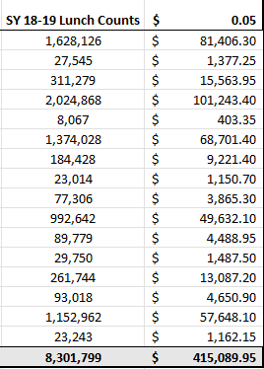
Reimbursement Calculation
Sponsors will receive $0.05 per lunch served in the prior school year***

Slide 20
Evaluation and Reporting
Starting SY 22-23, the sponsor must report and track separately the total dollar amount purchased on:
Colorado Grown/Raised Products
Colorado Processed Products
Colorado Value-Added Products
Use the code 0639 to track local food purchases in chart of accounts
CDE is authorized to monitor sponsors ensure program integrity and to reallocate funds if program integrity issues are identified.
Notes:
Sponsors that receive a grant are required to report, at a minimum, the following information to the CDE on or before August 1, 2023: Starting SY 22-23, the sponsor track the total dollar amount purchased on:
Colorado Grown/Raised Products
Colorado Processed Products
Colorado Value-Added Products
CDE has developed a tracker that includes all required data and information required in this program. Tracking on the CDE established form will be required.
We also recommend to start tracking any CO purchases now by using the code 0639 in your chart of accounts. It’s not required to use this code, but suggested. CDE is authorized to monitor sponsors ensure program integrity and to reallocate funds if program integrity issues are identified. Such monitoring could include budget documentation or requesting detailed lists of food purchases and expenditures.

Slide 21
Application Process and Timeline

Slide 22
Timeline
March 7, 2022
Application Opens
March 31, 2022
Informational Webinar
April 1, 2022
Intent to Apply Due
April 15, 2022
Application Deadline
May 2, 2022
Sponsors Awarded
October 2022
Reimbursements Paid
Notes:
Ask tech support to drop intent to apply form in the chat

Slide 23
Review Process and Timeline
Applications will be reviewed by CDE staff and peer reviewers to ensure applications contain all required components.
This is a competitive process - applicants must score at least 40 points out of the 100 possible points to be considered for funding.
Notes:
Applications will be reviewed by CDE staff and peer reviewers to ensure applications contain all required components. Applicants will be notified of final award status no later than May 2, 2022. The number of sponsors that receive the grant will depend on the number of applicants, as well as the total number of lunches served the prior school year.
This is a competitive process - applicants must score at least 40 points out of the 100 possible points to be considered for funding.
Applications that score below 40 points may be asked to submit revisions that would bring the application up to a fundable level.
There is no guarantee that applying will result in funding. All award decisions are final. Applicants that do not meet the qualifications may reapply for future grant opportunities.

Slide 24
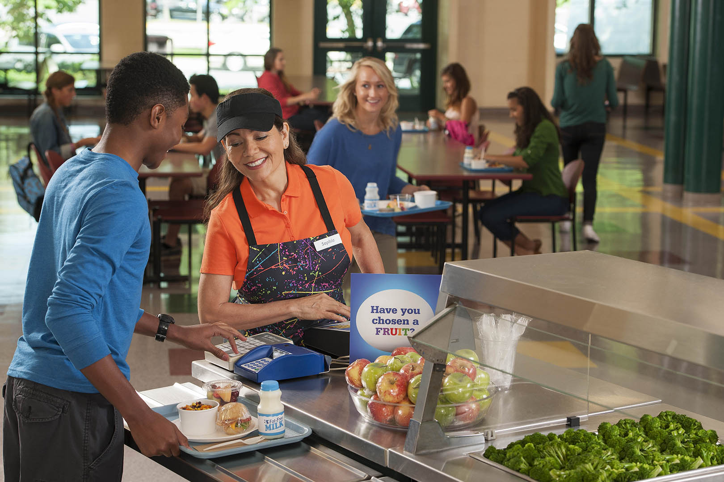
Application Details
Applications must be completed (and submitted through the online application form) by
Friday, April 15, 2022, by 11:59pm
Incomplete or late applications will not be considered
If you do not receive an email confirmation of your application, email: CompetitiveGrants@cde.state.co.us.
Application materials are available for download on CDE’s School Nutrition Farm to School webpage.
Notes:
Applications must be completed (including all elements outlined below) and submitted through the online application form by Friday, April 15, 2022, by 11:59pm.
Incomplete or late applications will not be considered.
If you do not receive an email confirmation of receipt of your application from the application system within 24 hours after the deadline, please email CompetitiveGrants@cde.state.co.us.
Application materials are available for download on CDE’s School Nutrition Farm to School webpage.

Slide 25
Application Format and Required Elements
The Program Assurances Form must include original signatures of the District Food Service Director, Procurement/ Purchasing Specialist, and Business Official
The total of the entire narrative should not exceed four pages
Part I: Application Introduction:
Part IA: Applicant Information
Part IB: Program Assurances Form
Part II: Narrative:
Section A: Demonstration of commitment to local purchasing or food and agricultural education
Section B: Demonstration of kitchen with the ability to store, prepare, and serve local food products
Section C: Demonstration of successful participation in LFP during School Year 2021-2022
Notes:
The Program Assurances Form must include original signatures of the District Food Service Director, Procurement/ Purchasing Specialist (if applicable), and Business Official. Like mentioned on the previous slide, it needs to be uploaded when the application is being complete in the Smartsheet form. Just make sure you are gathering those before the deadline.
For consistency and time, total of all narrative responses together should not exceed four pages (about 2,000 words)
The format outlined below must be followed in order to ensure consistent application of the evaluation criteria. I will go over the evaluation rubric for specific selection criteria on the next slide
There are two parts to the application.
Part I: Application Introduction
Part II: Narrative

Slide 26
Narrative Criteria and Evaluation Rubric
Section A: Demonstration of Commitment to Local Purchasing or Food and Agricultural Education | Minimally Addressed or Does Not Meet Criteria | Met Some but Not All Identified Criteria | Addressed Criteria but Did Not Provide Thorough Detail | Met All Criteria with High Quality
1) Describe the frequency and volume of the sponsors local food purchases during the previous school year. | 0 | 1 | 3 | 5
2) Describe the process for working with vendors to bring local food into the food service department (e.g., when to contact them, writing solicitations, menu planning, etc.). | 0 | 1 | 3 | 5
3) Explain how local foods are promoted on the sponsor’s menus. (e.g., menus indicate which items are local, messaging on school website, CO Proud School Meal Day, etc.). | 0 | 1 | 3 | 5
4) Describe how local foods are incorporated into menus. Include a description of how often local foods are on menus. | 0 | 1 | 3 | 5
5) Explain any nutrition and/or agriculture educational activities that the sponsor participated in this school year. Include all relevant partners and their roles. | 0 | 1 | 3 | 5
6) Describe how the sponsor utilizes other initiatives to promote local foods (e.g., school gardens, working with student groups or teachers, etc.). | 0 | 1 | 3 | 5
Section B: Demonstration of Kitchen with the Ability to Store, Prepare, and Serve Local Food Products | Minimally Addressed or Does Not Meet Criteria | Met Some but Not All Identified Criteria | Addressed Criteria but Did Not Provide Thorough Detail | Met All Criteria with High Quality
1) Explain the ability of the kitchens in the food service department to adequately store, prepare, and serve local food products (e.g., freezer or storage space, kitchen equipment, staff knowledge, etc.). | 0 | 10 | 20 | 30
Section C: Successful Participation in LFP during School Year 2021-2022 [if applicable] |  |  | Not Applicable or Did Not Meet Criteria | Met Criteria
1) If you participated in the Local Food Program for School Year 2021-2022, describe your challenges and successes with the program. |  |  | 0 | 10
Notes:
There are three sections of the narrative part of the application. The first is your demonstration of commitment to local purchasing and or nutrition education. The second section is your demonstration of your ability to store, prepare, and service local food products. And the last section will only pertain to a few sponsors, but if you participated in the LFP during SY 21-22, you would need to describe your challenges and successes with the program.
I would recommend typing out these questions with your response in a separate word document that you can save on your computer. That way your answers are saved in case your browser crashes or the site times out. You can then easily copy and paste your answers into the Smartsheet form.

Slide 27
Notes:
We are just wrapping up the first program year, so a few weeks ago I checked in with several of the participating sponsors to get general feedback. This is a screenshot from the jamboard we used—sponsors were excited to be able to offer these amazing CO staples using LFP funds. During the check in sponsors said this program had allowed them to continue F2S procurement during the pandemic and were able to continue to prioritize local! I have heard a lot of success stories and can connect you to a district that participated if you wanted to find out more about their experiences.

Slide 28
Questions? Contact us!
Program Questions:
Becca Boone, Nutrition Consultant
(720) 450-4357 | Boone_R@cde.state.co.us
Budget/Fiscal Questions:
Lyza Shaw, Business Operations Supervisor
(303) 854-4915 | Shaw_L@cde.state.co.us
Application Process Questions:
Mandy Christensen, Office of Grants Program Administration
(303) 957-6217 | Christensen_A@cde.state.co.us
Notes:
Here is our contact information if you have questions that pop up. Contact me for general questions, Lyza Shaw for any fiscal or budgeting questions, and Mandy Christensen with questions about the application process.
And with that, I am going to open it up to any questions that might have come through in the chat. Sharon, can you please read the first one??

