Slide 1
Earth Day 2021
Restore Our Earth
Colorado Child Nutrition Programs Statewide Sharing Call
April 22, 2021
Notes:
Hi Everyone! I’m McKenna Pullen and I’m joined today by Alicia Grove and our newest intern, MaryRose Brown. Welcome to our monthly statewide sharing call for Child Nutrition Program operators. Just a reminder that you can register for these calls through the Dish each month or via the CDE- School Nutrition training website.
This is the second call of our Masterclass Leadership series, which is a part of our Blueprint to End Hunger grant through the Colorado Health Foundation. Today is Earth Day, so to celebrate the occasion we will spend our time together learning about strategies to increase sustainability of your food service operations.

Slide 2
Audio Details
Audio- green means you are connected and can hear the presenters
Audio- gray means you not connected to audio
Mute and unmute yourself on the conference line
Use the down arrow to connect to your audio
Conference line- please mute
For technical difficulties, contact Allison Butler:
Butler_a@cde.state.co.us
303-242-6830
Notes:
McK
I’m going to cover some quick housekeeping items before we jump into the conversation.
All attendees who join via computer audio will enter muted to reduce background noise. If you have joined via the conference line, please mute your line to reduce background noise. There are call out boxes on this slide that describe how to connect to your audio through Adobe Connect. If there is any background noise, we will go ahead and mute your microphone to ensure everyone on the call can hear.
If you experience audio or technical difficulties, please contact Allison Butler. Her information is available in the chat.
Just below the presentation are the weblinks and files pods. The files pod contains the PowerPoint slides with speaker notes. We will refer to the resources in these pods during the presentation.
Lastly, if you have any questions or comments that don’t pertain to the topic being discussed at that moment, please put them in the chat pod—we will monitor the chat and compile a list of questions to address at the end of the webinar if we have time. Otherwise, feel free to unmute and engage!

Slide 3
Together We Can
CDE Vision
All students graduate ready for college and careers and are prepared to be productive citizens of Colorado.
CDE School Nutrition Unit Mission
The School Nutrition Unit is committed to ensuring all school-aged children have equal access to healthy meals by supporting, training, and connecting Colorado’s child nutrition community.
Notes:
McK
The vision of CDE is to make sure that all students are ready for college and careers that will make them productive citizens of Colorado. The mission of our unit is our commitment to ensuring that all school aged children have equal access to health meals by supporting, training, and connecting Colorado’s child nutrition community.

Slide 4
In accordance with Federal civil rights law and U.S. Department of Agriculture (USDA) civil rights regulations and policies, the USDA, its Agencies, offices, and employees, and institutions participating in or administering USDA programs are prohibited from discriminating based on race, color, national origin, sex, disability, age, or reprisal or retaliation for prior civil rights activity in any program or activity conducted or funded by USDA. Persons with disabilities who require alternative means of communication for program information (e.g. Braille, large print, audiotape, American Sign Language, etc.), should contact the Agency (State or local) where they applied for benefits. Individuals who are deaf, hard of hearing or have speech disabilities may contact USDA through the Federal Relay Service at (800) 877-8339. Additionally, program information may be made available in languages other than English.
To file a program complaint of discrimination, complete the USDA Program Discrimination Complaint Form, (AD-3027) found online at: https://www.usda.gov/oascr/how-to-file-a-program-discrimination-complaint, and at any USDA office, or write a letter addressed to USDA and provide in the letter all of the information requested in the form.
To request a copy of the complaint form, call (866) 632-9992. Submit your completed form or letter to USDA by: (1) mail: U.S. Department of Agriculture Office of the Assistant Secretary for Civil Rights; 1400 Independence Avenue, SW Washington, D.C. 20250-9410;
(2) fax: (202) 690-7442; or (3) email: program.intake@usda.gov. This institution is an equal opportunity provider.
Notes:
McK

Slide 5
Conditions for Success
Be present and engaged
Put your cell phone out of arms reach
Close out email or other tabs
Avoid multi-tasking or doing other work
Mute your microphone when you’re not talking
Participate in discussion
Be respectful, inclusive, and open minded
Bring a positive attitude and be ready to share
Actively listen
Notes:
McK
This call is meant to be an open space to ask questions, brainstorm, and share your ideas with your peers.
Please share however your are comfortable – by unmuting or typing into the chat. We want to hear from you during these calls!

Slide 6
Icebreaker
Go for a walk
Park cleanup
How are you celebrating
Earth Day?
Start composting
Incorporate into a menu
Read/watch Earth Day information
Notes:
MaryRose
Type into the chat – how are you planning on celebrating Earth Day? Even if you didn’t know today was Earth Day – what can you do this weekend to support our planet?
Go for a walk or hike and appreciate nature, participate in a group cleanup, add something to your school menu, what else?

Slide 7
Discover ways to reduce the Foodprint of your menu
Identify strategies to reduce food waste in your cafeteria
Learning codes: Menu planning (1100), Food production (2100)
Learning Objectives
Notes:
MaryRose

Slide 8
Earth Day History
April 22, 1970
1 billion individuals each year
190+ countries engaged
Notes:
MaryRose
The First Earth Day in April 1970 Because there was no EPA, no Clean Air Act, no Clean Water Act. ... In spring 1970, Senator Gaylord Nelson of Wisconsin created Earth Day as a way to force this issue onto the national agenda. Twenty million Americans demonstrated in different U.S. cities, and it worked!

Slide 9
Restore Our EarthTM
As the world returns to normal, we can’t go back to business-as-usual
Notes:
MaryRose
Earth Day celebrations have continued since then and the theme this year is Restore Our Earth. With this theme in mind, we wanted to spend our time together today talking about strategies to reduce your foodprint, food waste at school, and strategies to create a more climate friendly menu.

Slide 10
What is a FoodPrint?
Measures the environmental impacts associated with the growing, producing, transporting, and storing of our food
Notes:
MaryRose
Your “foodprint” is the result of everything it takes to get your food from the farm to your plate. Many of those processes are invisible to consumers, such as natural resources consumed and greenhouse gases emitted. Industrial food production — including animal products like beef, pork, chicken and eggs and also crops — takes a tremendous toll on our soil, air and water, as well as on the workers and the surrounding communities.
Having a larger foodprint means that the food you eat or serve in your cafeterias uses more resources than some other types of food do. We’ll talk through some strategies that you can reduce your cafeteria foodprint, and you might even learn some ways you can reduce in your home, too!

Slide 11
Find Your FoodPrint
Quiz
Notes:
MaryRose
Chat: https://foodprint.org/quiz/
- Take the full quiz on your own if you want
For anyone who is interested to learn more, you can take the foodprint quiz that’s linked in the chat. We won’t go through the whole quiz, but let’s do a few quick polling questions to get a sense of what factors lead to a larger or smaller foodprint. When answering these questions, think about how you would eat at home, and there are no wrong answers – we’re just trying to establish a baseline.
Poll 1:
Q: If there’s room on my plate, I’ll fill it with….
Mostly fruits and vegetables
Some fruit or veggies and some meat
Mostly meat
Poll 2:
Q: If I don’t finish my meal….
Toss what's left in the trash.
Compost it like a boss.
Eat it for lunch the next day.
Leftovers? Never. I'm a member of the Clean Plate Club.
Put what's left in the fridge... where it will stay forever.
Poll 3:
Q: I’d be willing to pay more for food if… (select all that apply)
I knew the workers who produced it were treated well.
It included a chef to cook it for me.
I knew there were fewer pesticides in it.
I knew the animals were treated humanely. I won the lottery.
It was healthier for me.
I knew my money went directly to farmers in my community.

Slide 12
That’s the impact of 1 person…
Now multiply by the number of students you are serving!
If there’s room on a student’s plate…
Offer fresh fruit or carrots with low-fat ranch
If students don’t finish their meals…
Do they like the food?
Is compost an option at your school?
If you have leftovers in the serving line…
Can you review historical production records?
I can allocate more of my budget to purchasing high quality products…
If I purchase seasonal items that may cost less
Use DoD produce
Notes:
MaryRose
Now that you’ve learned about your own foodprint, let’s take it to the next level and think about your cafeterias. It’s the end of the school year after a really tough year, so changing up your operations might be the last thing you want to think about, but summer is a great time to take the time to plan for next year! Consider incorporating some of the strategies on the slide to reduce the foodprint of your menus.

Slide 13
Finding Common Ground Activity
Now it is your turn…
We are going to take a few minutes to strategize ways everyone can reduce their FoodPrint in every kitchen.
After each question I will give everyone a minute to type an answer in the chat and we can find common ground and learn from each others ideas!
Notes:
MaryRose

Slide 14
Sustainability Considerations
Notes:
MaryRose

Slide 15
It all starts with procurement
On average schools spend about $1.40 per meal on food.
That’s more than $85 million spent on school lunch in CO each year
Notes:
MaryRose
While there are some ways to reduce waste in the cafeteria, being intentional and thoughtful about the products you buy makes a huge impact! These numbers are a couple of years old, but the impact is still the same – school districts spend a lot of money on food each year! YOU have the opportunity to lead the movement for food system change and express your community’s values while influencing supply chains.
Changing the food system means creating a system based on values. It means understanding relationships between distributors, vendors, and their suppliers and increasing transparency along the entire supply chain.

Slide 16
Meat Consumption
Buy Quality Meat
Where is it coming from?
local/regional
How is it produced?
pasture vs. industrial
Experiment with beans and legumes
Focus on flavor
Smaller Portions
Use meat as a garnish
Move to the center of the plate
Notes:
MaryRose
Meat products have a larger foodprint than meat alternates, such as beans and legumes.
There are numerous opportunities to purchase meat from Colorado producers no matter where you live in the state. When possible, consider sourcing from producers that employ sustainable production systems.
You can also experiment with adding beans, legumes, or even hummus to your menus in place of traditional meat options. This can be a great way to involve kids in menu development – host a taste test with different products so you know what they like before making a change.

Slide 17
Animal and Worker Welfare
Get to know your local farms and farmers
Look for Fair Trade and Rainforest Alliance labels
Notes:
MaryRose
It takes a lot of people to produce the food on your plate - from farmers to field workers to food processors. How those workers and animals are treated makes a difference. When thinking about meat or other food purchases, consider whether workers have access to safe and healthy working conditions and fair compensation.
Local producers will be able to tell you how their workers are treated and which practices they use to raise their animals.

Slide 18
Food Waste
Notes:
Alicia

Slide 19
The life of a strawberry
https://www.youtube.com/watch?v=uTaFYF1nA4c
Notes:
Alicia

Slide 20
Food Waste
More than wasted food
Water
Time
Labor
Money
Energy
Notes:
Alicia
“Globally, if food waste could be represented as its own country, it would be the third largest greenhouse gas emitter, behind China and the US” – United Nations Environment
More than 40% of food is thrown out every year in the US. When you waste food, you waste all the resources it took to produce that food (think: water, time, labor) plus your own nutrition budget! Think about this in your own kitchens – where can you reduce waste in all stages from ordering, to meal prep, to students consuming the food?

Slide 21
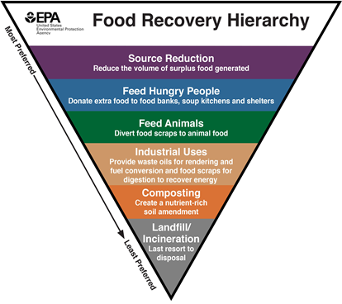
Food Recovery
Recover unused food and feed hungry people when source reduction is not possible
School Food Recovery Options
Share Table
Food Donation
Composting
Notes:
Alicia-
The Environmental Protection Agency recommends recovering unused food and using it to feed hungry people when source reduction is not possible
There are several school food recovery options including share tables, food donation, and composting. This is not an exhaustive list but provides a good starting point. We will cover these options in more detail in the subsequent slides. USDA is committed to preventing hunger and for responsible use of federal dollars. As a reminder, all sponsors/SFAs must plan, prepare, and order food with the goal of providing one meal per child at each meal service. If a program has leftover or unusable foods on a frequent basis, menu planning and production practices should be adjusted to reduced leftovers or unusable foods. Nevertheless, because of unforeseen circumstances, occasionally there will be leftover food and we want to provide guidance on how to handle this food.

Slide 22
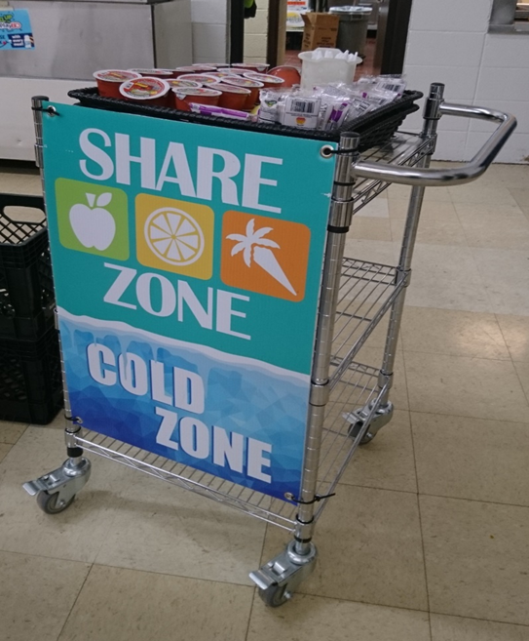
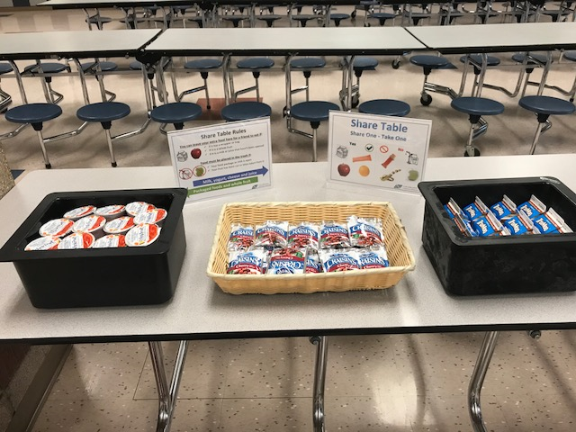
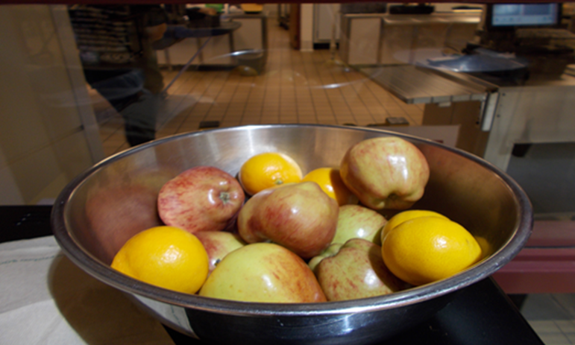
Share Tables
CO school nutrition staff viewed share tables as the most feasible food recovery option
Children return whole food and beverage items that they do not wish to eat so these items can be recovered
Comply with all health and safety codes
Recovery options:
Children take items from share table
Re-service in future meals
Donation to pantry or non-profit
Cooked ingredient for future meal
Notes:
Alicia
In “A systems examination of school food recovery in Northern Colorado,” school nutrition staff viewed share tables as the most feasible food recovery option.
Prescott MP, Grove A, Bunning M, Cunningham-Sabo L. "A systems examination of school food recovery in Northern Colorado." Resources, Conservation and Recycling, 2020, 154(3): 104529. https://doi.org/10.1016/j.resconrec.2019.104529
USDA recognizes that, for various reasons, children may not always want to consume certain food or beverage items included in their meal. “Share tables” are tables or stations where children may return whole food or beverage items they choose not to eat, if it is in compliance with local and State health and food safety codes. These food and beverage items are then available to other children who may want additional servings. For example, if a banana is served as part of a meal, a child can return the unopened banana to the share table. To ensure compliance with food safety requirements, sponsors/SFAs should discuss plans for a share table with their local health department prior to implementation and ensure their policies for saving and sharing food or beverage items are consistent with their HACCP plan. Share tables allow food or beverage items to be reused in a number of ways, depending on the program’s preference including: re-service in future meals, items may be donated to a non-profit organization, such as a community food bank, homeless shelter or other non-profit charitable organization, or as a cooked ingredient for a future meal.
If you are interested in implementing share tables, please watch the share table webinar recording included in the resources slide of this presentation. It includes many helpful tips and resources including signage and templates to notify parents and school staff about share tables. Also feel free to reach out to Alicia Grove, the consultant who oversees food safety for any share table questions.
Our SOP: https://www.cde.state.co.us/nutrition/foodsafetysopresistributionfoodsharetables
USDA Memo: https://www.cde.state.co.us/nutrition/usdamemosp412016sharetables

Slide 23
Food Donation
Program food not consumed may be donated to eligible food banks or charitable organizations
Liability protection
Comply with all health and safety codes
Consider school breaks
Notes:
Alicia
USDA Memo: SP 11-2012, CACFP 05-2012, SFSP 07-2012 Guidance on the Food Donation Program in Child Nutrition Programs https://fns-prod.azureedge.net/sites/default/files/cn/SP11_CACFP05_SFSP07-2012os.pdf#page=3
The USDA allows food donation in all child nutrition programs. Where it is not feasible to reuse leftovers or extra food, program food may be donated to eligible local food banks or charitable organizations. The statute extends protections against civil and criminal liability for persons or organizations when making food donations to the extent provided under the Bill Emerson Good Samaritan Food Donation Act. When donating food all state and local health and sanitation codes must be followed. A good time to consider food donation would be around school breaks. If you have excess product that will not last the duration of a winter, spring, or summer break; this would be an opportunity to donate that product to a local food bank. For example, we have heard that extra milks may be donated over breaks or produce that may not last. We recommend establishing a relationship with your local food bank and checking in with your local public health agency to ensure you are familiar with their donation requirements and it is allowable in your area.

Slide 24
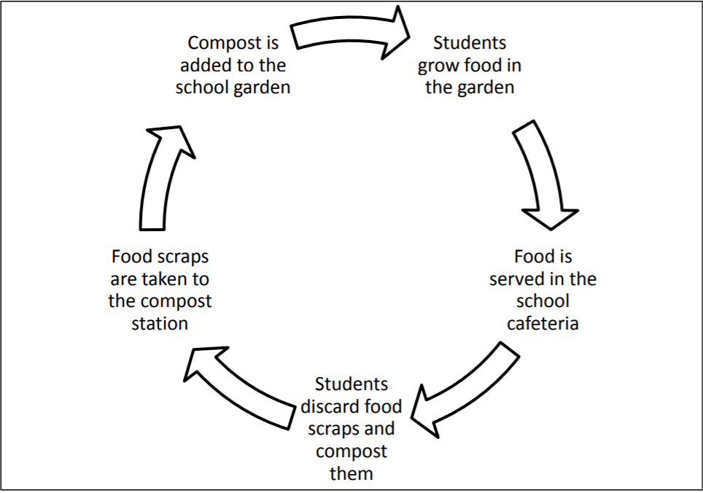
Composting
Food waste becomes soil
Educational opportunities
One school, district-wide, or offsite
Resources
Eco-Cycle School Compost Programs
Guide to Starting a School Compost Program
LifeLab School Compost Resource Page
Notes:
Alicia
Composting can be another way to reduce food waste at your schools. The basic idea of composting is that food scraps are decomposed to create humus, a dark brown organic matter that can be used in soil in school gardens. Starting a composting initiative in your school or schools can be a great way to teach children about food waste, decomposition, and gardening.
The resources listed on this page provide numerous ideas for composting. If you’re new to the idea, consider starting a small pilot program at one school before expanding to other sites. You might even find that a local company will pick up your compost materials if your school doesn’t have the capacity to compost onsite.

Slide 25
Local Procurement

Slide 26
Local & Seasonal Sourcing
More nutritionally dense
Fewer food miles
Supports local producers/economy
Can improve participation
Farm to School Fact Sheet
Check out the Seasonal Food Guide!
Notes:
Alicia
When you buy locally sourced food, you support local producers and local economies. Seasonal food is more nutritionally dense and can taste a lot better than food served out of season that traveled a long way to get on a plate. Serving high quality meals can also help improve program participation.
Check out the Seasonal Food Guide which I will put in the chat: https://foodprint.org/eating-sustainably/seasonal-food-guide/

Slide 27
Local Procurement Reminders
You define local
Radius, region, state, county
Start small!
Bulk meal kits
Bulk Meal Resource
Colorado Proud
Colorado Proud companies
Agriculture Map
Recipes
Notes:
Alicia
In Farm to School and Summer, local is defined by the sponsor. Local may be defined by a certain radius, region, within the state, or in a specific county. This flexibility can allow sponsors to purchase items that will work best for their program. After you’ve decided how you will define “local”, you need to determine how you want that product to get to your meal sites. We’ll talk through options on the next slide.
It might feel overwhelming to start buying local food for your meal program, but keep in mind that Farm to School and Summer is not all-or-nothing. Start small by incorporating one or two menu items, like local raspberries or sweet corn into a menu. You can gather feedback from children at your sites about which local items they want to see on your menu.
This would be a great summer to take advantage of the waivers and add local items into bulk meal kits. Sponsors could add a carton of local berries or a few peaches into a kit to last a child multiple days. For sponsors who aren’t used to purchasing and preparing local food items this could be an easy introduction as it reduces the food preparation time if you provide whole fruits and vegetables. This method also reduces the amount of packaging in each meal kit – further reducing your foodprint!
The Colorado Department of Agriculture’s Colorado Proud program is a great way to easily identify local products in the grocery store, and items from your distributor might even be labeled as Colorado Proud. Visit their website for more details.
Participants – type into the chat: what is your favorite or most popular Colorado product that you serve?

Slide 28
Local Procurement Methods
Direct Purchasing
Gardens
Farmers’ Market
Indirect Purchasing
Food Retailer
Food Bank
Farmer or producer
Distributor
DoD Fresh
Meal Vendor
Notes:
Alicia
There are several ways that summer sponsors can incorporate local products into summer menus. Sponsors can use produce from school gardens or even use the micro purchase method to purchase directly from a farm or farmers market. If you serve local menu items during the school year, contact your local producers now so you can both begin planning for your summer program. You can also reach out to other local producers or even the farmers markets in your area to start building relationships and planning for summer.
Sponsors can also add local items through indirect methods. You can contact a local food bank or other food retailers to see if they have local items available in the quantity you need. If you receive food through a distributor you can ask which local products they carry, and even look through DoD Fresh and USDA Foods guides to see which items are listed as local. Finally, if you purchase meals from a meal vendor you can work with them to add local menu items when possible.

Slide 29
Farm to Summer Challenge
During the week of July 11 - 17, pledge to:
TASTE: incorporate local products
Colorado Market Maker
TEACH: provide nutrition and agriculture education
CONNECT: share stories on social media
Farm to Summer Toolkit - coming soon!
Register here!
Notes:
Alicia
We are hosting the Farm to Summer Challenge during the week of July 11-17. When you sign up for the challenge you are pledging to do 3 things.
First, incorporate a local product into one of your summer meals! Maybe you can serve some sweet Olathe corn, or peaches and cherries from the Western slope. Colorado has a diverse agricultural scene, and the summer is the best time to enjoy it! Sponsors can purchase local products through a distributor, farmers market, or even the grocery store.
The second way to participate is to teach youth through nutrition and agricultural education. Perhaps you can do a virtual farm tour with a Colorado producer, or youth can even get their hands dirty planting or harvesting their own summer garden. You’ll learn more ways to involve children and youth on the next slide.
The last part of the challenge is to connect by sharing stories and success on social media. Posting on social media, through a district or organization website, or even a newsletter is a great way to let your community know that you are supporting local agriculture and are serving high quality meals at your summer meal sites. Sharing your stories can help your community see what a great program you operate and can be a good way to identify other best practices and learn new ideas from other sponsors.
Click on the link in this slide to sign up for the Farm to Summer Week Challenge. We’re finalizing a Farm to Summer Toolkit now – once finalized, sponsors who register for the Farm to Summer challenge will receive the toolkit to help them execute the challenge!
Participants could be nominated for a Turnip the Beet award. This award showcase sponsors who go above and beyond to offer high quality summer meals.

Slide 30
Resources for Children and Youth
Power of Produce (POP) Club
EPA Guide to Conducting Student Food Waste Audits
Meatless Monday K-12 Food Service Guide
17 Resources for Teaching About Food Waste
Denver Urban Gardens Gardening Resources
Notes:
Alicia
Here are some resources you can use to engage children and youth at your summer or school sites.

Slide 31
Additional Resources
Farm to School and Summer webpage
Colorado Department of Agriculture
Farm Fresh Directory
Glimpse of CO Agriculture
CO Produce Calendar
Reducing Food Waste
EPA Get Kids to Eat More and Waste Less Guide
USDA-What You Can Do to Help Prevent Wasted Food
No Kid Hungry- Strategies to Reduce Food Waste in Schools & Child Nutrition Programs
Check out the Real Food Encyclopedia!
Share Tables
Food Safety: Share Tables 101 webinar recording
For questions, contact Alicia Grove at grove_a@cde.state.co.us or 720-795-2038
Notes:
Alicia

Slide 32
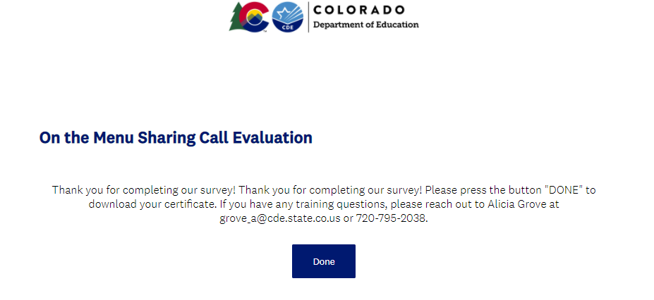
Training Evaluation and Certificate
Click this link to complete a quick training evaluation
https://www.surveymonkey.com/r/8KB7RZM
When you submit the evaluation click “DONE” on the survey thank you page to download your certificate
Notes:
Alicia
This link will be emailed out to all training attendees. This information is included for those watching this training at a later date as a recording.
Thank you so much for your feedback- we are always looking for ways to improve our trainings to better support you.

Slide 33
Questions?

