Slide 1
Consolidated Application – How to Solve Error Messages

Slide 2
Agenda
We will go over the most common errors within the Consolidated Application and how to fix them!
  Contacts
  School Profile
  Non-public Schools
  Funds pages
  Budget Summary
  Set-Asides and Content Category Calculations
  Budget Locations
  Document Uploads

Slide 3
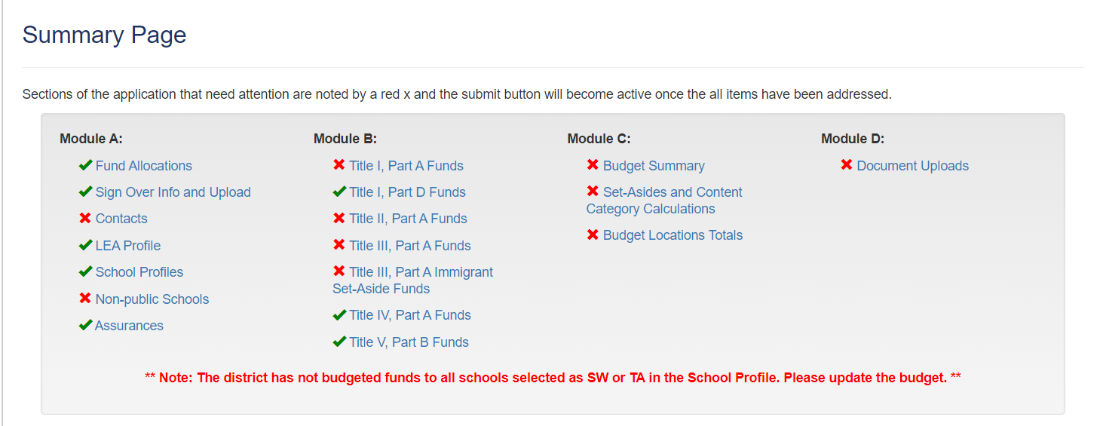
Summary Page Errors

Slide 4
School Profile Errors
Indicate how you want to serve your schools on the LEA Profile
View the eligibility on the School Profiles page
If you do select to serve schools and want to change your method of serving, ensure all schools are “NS”
Then go back to the LEA Profile and change the method, then view the School Profiles.

Slide 5
Contact us with Questions!
If reviewing this slide deck after the live presentation, feel free to contact your Regional Contact, the Grants Program Administration Office, or the Grants Fiscal Office. Questions can also be sent to consolidatedapplications@cde.state.co.us

