Slide 1
Accreditation and Request to Reconsider in 2022
Aislinn Walsh, Accountability Support Manager
School Improvement and Planning

Slide 2
Agenda
Brief overview of 2022 state accountability
District and school accreditation process
General process and timeline
Accreditation form walkthrough
District-created framework
New school ratings
Insufficient state data ratings
Request to reconsider (R2R) process
Eligibility for R2R
Conditions for a request
Submitting evidence
R2R Local Assessment Tool
Reviewing a submission
Next steps and support
Meeting Norms
This webinar is being recorded. Slides and the recording will be posted to the CDE website. Q&A at the end of this session won’t be recorded.
Please mute your sound if you are not speaking.
Use the chat feature to ask questions throughout the presentation. I will take pause breaks to answer chat questions.

Slide 3
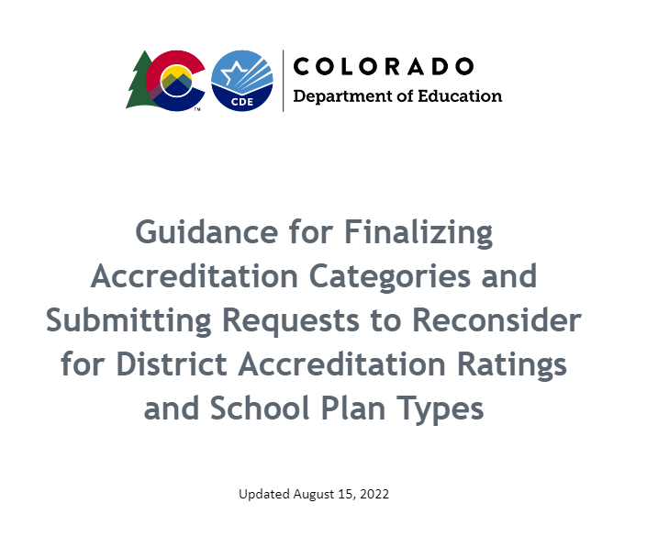
Guidance is Now Available
To access guidance on the accreditation and request to reconsider process, go to https://www.cde.state.co.us/accountability/requesttoreconsider

Slide 4
2022 Accountability Overview

Slide 5
SB 22-137 - Transition Back to Standard K-12 Accountability
Restarts framework calculations for fall 2022 using 2019 statewide performance indicator targets.
Addition of growth participation rate to framework reports.
Accreditation and plan type ratings will be assigned, but clock status will not automatically advance (on or off).
Change in clock status may be approved through the request to reconsider process, and the request to reconsider process is opened back up more broadly.
Clarification that State Board may take into consideration the 2022-2023 plan type for schools and districts (currently 12 schools and 2 districts) with directed action.
Expands the School Transformation grant (currently embedded with EASI grant) to districts with Improvement plan type.
SB 22-137

Slide 6
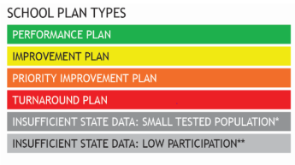
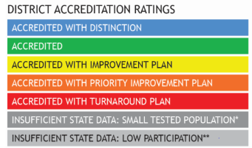
Ratings
Descriptors
Meets Participation
Above 95% total participation rate in ELA and Math in 2022*
Low Participation
Below 95% total participation rate in ELA and Math in 2022*
Decreased Due to Participation**
Below 95% accountability participation, once parent excuses are removed, in two or more content areas.
+
*Science participation is included for informational purposes only in 2022. **This penalty is not being used in 2022.

Slide 7
Performance Watch
Accountability Clock
Unique to 2022
Priority Improvement/ Turnaround
Year 0
Priority Improvement or Turnaround
Year 1+
Performance/ Improvement
On Watch
Year 2+
Priority Improvement/ Turnaround with State Board Action
Year 5+

Slide 8
Current 2022 State Accountability Timeline
Anticipated Timeframe | Activities/Actions
June 24 | Districts Receive ACCESS Growth Data.
August 9 | Districts Receive CMAS and P/SAT Growth Data; Performance Framework Source Data Files; Achievement, Growth, and PWR data dashboards are available through online UIP.
August 17 (SBE Meeting) | Public Release of Colorado Growth Data Results; AEC designations finalized.
September 2 | Preliminary AEC and Non-AEC Performance Frameworks Released to Districts (participation and framework dashboards are available through online UIP) - Public release 3 days later (8/29). School Accreditation & Request to Reconsider Form is available to district accountability contacts through the UIP online system.
Beginning of September | ESEA identifications released to districts.
September 23 | School Accreditation & Request to Reconsider Form submissions due.
October 25 | Unified Improvement Plan (UIP) Submissions due. For Districts/Schools participating request to reconsider, final request materials due.
November 10-11 (SBE Meeting) | District accreditation ratings & school plan types finalized for districts/schools not participating in request to reconsider.
December 14-15 (SBE Meeting) | District accreditation ratings & school plan types finalized for districts/schools participating in request to reconsider.
January 16, 2023 | Newly identified schools and districts eligible to submit UIP for CDE review and posting.

Slide 9
District and School Accreditation

Slide 10
District and School Accreditation General Process
CDE reviews performance
Districts review and verify ratings
Districts can request reconsideration
Ratings are finalized by the state board
Districts sign their accreditation contract
August
September
October
November/December
December
The Education Accountability Act of 2009 (S.B. 09-163) and H.B. 18-1355 authorize the Colorado Department of Education to conduct an annual review of the performance of public schools and districts in the state.
Each year, districts have the opportunity to review and verify the state identified district accreditation rating or school plan types.
If the district disagrees with the initial rating/plan type, then additional performance data may be submitted to the department through the request to reconsider process.
Preliminary ratings/plan types and requests to reconsider are approved and finalized by the State Board of Education.
Once the district’s rating and all school plan types are finalized, districts that are rated Improvement or below must sign the district’s accreditation contract. Contracts for districts rated Accredited or above will be automatically renewed unless a new contract is requested.

Slide 11
2022 School Accreditation and R2R Timeline
The accreditation form opens August 24th.
See below for details on important dates for this year.
Preliminary Frameworks Released
School and district ratings are released to districts.
Final Request Materials Due
Final request materials (e.g., district narrative, local data) are due.
September 23
November 10-11 & December 14-15
September 2
October 25
School Accreditation & Request to Reconsider Form Submissions Due
To initiate the process, the accountability contact will need to “agree” or “disagree” with the preliminary rating and/or clock status using the Accreditation and Request to Reconsider form.
District and School Plan Types Finalized during the State Board Meeting
For districts and schools, ratings will be considered final after the state board meeting.

Slide 12
School Accreditation and Request to Reconsider Form
Districts Using a District-Created Framework
Districts with New Schools
Districts with Insufficient State Data (ISD) Ratings
All Districts
To officially sign off in the form, the district needs to indicate they agree or disagree (if available) with the ratings and complete the assurance that the superintendent and local board chair were consulted and verified the selected ratings.
Districts must provide information about the performance framework and attach it to the form. CDE will defer to the district rating only if (1) the framework is more rigorous than the state framework and (2) the rating shows a lower rating.
Districts must select a plan type using the dropdown for new schools. The plan type should be based on the district’s own evaluation of performance.
For districts and schools labeled “ISD” or “ISD: Low Participation”: The district is not eligible to assign a rating and the site will maintain the ISD rating and any associated clock status.
For districts and schools labeled “ISD: Small Tested Population” or “ISD: No Students at Grade Levels Tested for State Assessments”:
If the site is on Performance Watch, it will maintain the ISD rating and any associated clock status.
If the site is Improvement or higher, districts can select a plan type, based on the district’s evaluation of performance, using the dropdown.

Slide 13
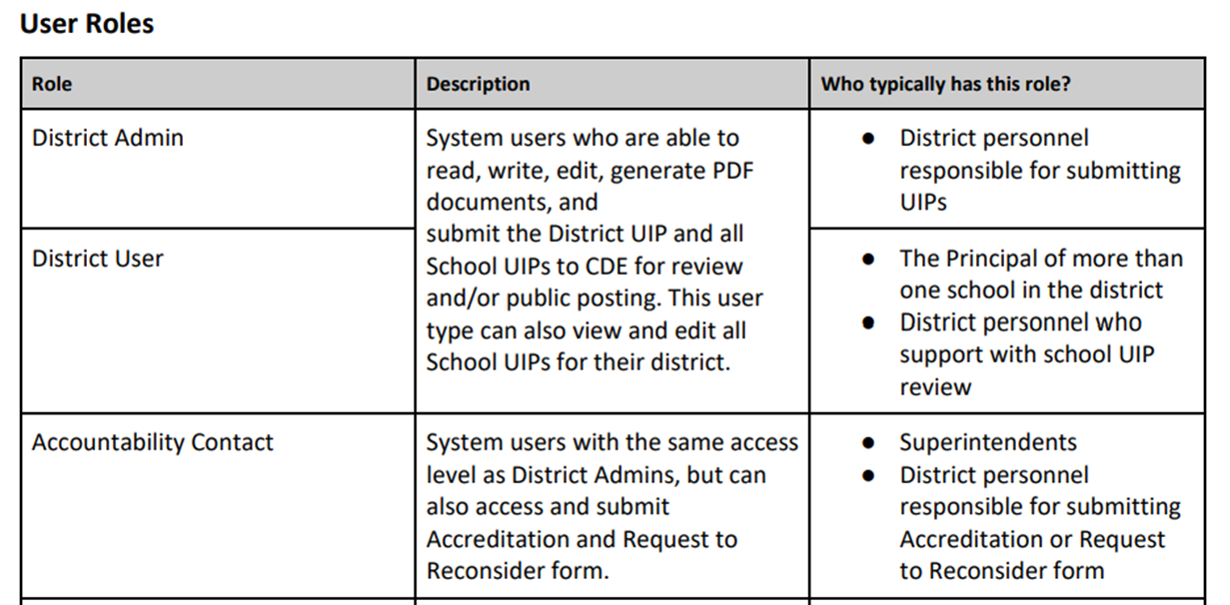
Accessing the Form
Does your district have updated accountability contacts?
Current List of Accountability Contacts
Link to a description of the process and to access the form to update contacts
Did your district’s Local Access Manager (LAM) designate your system login role from “District Admin” or “District User” to “Accountability Contact”?
UIP Online System User Setup Management
Still don’t have access to the form? Contact your district’s LAM to request they change your system login role using this form: https://edx.cde.state.co.us/CDEIdM/districtLAMSupport.jsp.

Slide 14
School Accreditation and Request to Reconsider Form Walkthrough
The form is pre-populated with the preliminary ratings/plan types/clock years for schools and districts (it does not reflect any request to reconsider decisions).
The form guides users to select the accreditation options available for their district (either agree or disagree).

Slide 15
Submitting the Form and Assurance
To submit the form, district accountability contacts need to assure these selections have been verified by the superintendent and local board chair. For district charter schools (not applicable to charter schools authorized by the Charter School Institute), the district needs to affirm these selections have also been verified by the charter school’s board chair. The completed form is due September 23.

Slide 16
Completing Request Tabs
For any eligible sites where the district indicates they disagree with the rating/clock year, a request tab will appear for each site.
This area includes a dropdown to indicate the type of request the site is making and an area to add a district narrative (if required) or any attachments (if required). There is a submit button under each request tab. Final submissions are due October 25.

Slide 17
Summary of Form Requirements
The completed form is due September 23. Evidence for requests are due October 25.
If the district does not submit the form by the deadline or indicate to CDE the need for an extension, the department will consider the preliminary district accreditation rating and school plan types final and will submit them to the state board for approval.
If no sites in the district are engaging in R2R, no additional materials are needed until ratings/plan types are finalized by the state board in November. Once ratings are finalized, districts that are rated Improvement or lower will need to sign the district’s accreditation contract.

Slide 18
District Accreditation Process
District accreditation contracts will be available to superintendents via Docusign once plan types are finalized by the state board in November and December. The contract must be signed by the superintendent and the local board president by the end of December.
Districts Accredited with Improvement or lower: Contracts must be annually completed.
Districts Accredited with ISD: Districts must complete their accreditation contract in 2022.
Districts Accredited or Accredited with Distinction: The existing contract will be automatically renewed unless the district requests an updated contract. CDE recommends that a new contract be signed when there is a new superintendent and/or board president. Otherwise, contracts must be signed at least every five years.

Slide 19
District Accreditation Sample
A sample template of the accreditation contract is available in the District Accountability Handbook (Appendix B), available here: https://www.cde.state.co.us/accountability/stateaccountability

Slide 20
Request to Reconsider

Slide 21
Request to Reconsider (R2R) Overview
Request to reconsider is the district’s opportunity to request reconsideration of a school or district’s preliminary plan type based on additional evidence.
The state board adopted rules that reflect an eligibility requirement of 90% total participation on state assessments for 2022.
In 2022, request to reconsider becomes the avenue for schools/districts to adjust clock years (e.g. exit Performance Watch, move to On Watch).

Slide 22
Participation Rate Calculations
Total participation parent excusals are counted as non-participants (i.e., they are included in the denominator)
Accountability participation parent excusals are excluded from both numerator and denominator
These ratings reflect whether accountability participation rates meet or exceed 95%.

Slide 23
Determining R2R Eligibility
District/school R2R eligibility will be in a new “Participation” tab available in the online UIP data dashboards (available to districts 9/2).
To find this dashboard, any UIP user can log into the UIP and find their eligibility under the “Data Narrative - Trend Analysis” tab. The dashboard also includes their sites’ achievement, growth, and PWR data.
District contacts can also use the spreadsheets available in Syncplicity to access participation information.

Slide 24
Example Request to Reconsider Results Over Time
2021 Final Plan Type (Rolled over over from 2019 SPF) | 2022 Preliminary Plan Type | Request Type | 2022 Final Plan Type (Approved Request to Reconsider) | 2023 Final Plan Type (Clock progress resumes) | 2024 Final Plan Type
Performance | Improvement | Rating Change | Performance | Performance | Performance
Priority Improvement - Y3 | Performance - Y3 (clock status held from 2019 SPF) | Clock Adjustment | Performance - Y3 On Watch | Improvement (no longer on clock or on watch) | Priority Improvement - Y1
Priority Improvement - Y3 | Priority Improvement - Y3 (clock status held from 2019 SPF) | Both Rating Change and Clock Adjustment | Improvement - Y3 On Watch | Priority Improvement - Y4 | Improvement - Y4 On Watch

Slide 25
2022 R2R Decision Tree
Is the school/district eligible?
Does the school/district have 90% total participation on state assessments in both ELA/EBRW and Math?
School/district cannot participate in a request to reconsider in 2022
No?
Yes?
Does the school/district meet a condition for a request?
Expedited Clock Adjustment
Has CDE notified the district of their eligibility for this request?
Body of Evidence
Does local data meet expectations outlined in the the Local Assessment Tool?
Accountability Participation Impact
Was a rating decreased due to test misadministrati-ons or small n counts?
Calculation
Error
Was a mathematical calculation error presented in their frameworks?
Impact of AECs on the District Performance Framework
Has CDE notified the district of their eligibility for this request?
Districts with a Single School
Has CDE notified the district of their eligibility for this request?
Districts with a Closed School
Does the district have a closed school that impacted the calculation of their framework?
If yes to any box,
If no to any box,
Site may participate in a request to reconsider
Site cannot participate in a request to reconsider

Slide 26
R2R Condition / Pathway | Description (to participate in 2022 R2R schools/districts are required to have 90% total participation on state assessments)
Expedited Clock Adjustment* | For schools and districts on the clock or on watch, if state data demonstrates 90% total participation and a rating of Improvement or higher, the district will be notified of their eligibility for an expedited recommendation to change the school/district clock status. Additional evidence not needed. District needs to confirm clock adjustments using the accreditation form.
Impact of Alternative Education Campuses* | Districts may request the removal of AEC results from overall DPF rating calculation, as long as all AECs have earned Performance ratings in the current year. Districts with only AECs may elect to use the AEC framework rating as the district accreditation rating.
Districts with a single school* | Districts with a single school may elect to use the calculated SPF rating as the district accreditation rating.
Body of Evidence | School/district may provide supplemental evidence of different performance than preliminary state assignment. Need 95% total participation on local assessments (nationally normed). AECs cannot participate in this request condition.
Extenuating Circumstances | School/district with extenuating circumstances (i.e., “Act of God”) may submit a request based on conditions that impacted the state assessment administration window (cannot include pandemic impacts). This is part of the Body of Evidence condition.
Accountability Participation Impact | Districts and schools that had their rating “decreased due to participation” by not meeting the 95% accountability participation rate in two or more content areas may make a request if the requirement was not met due to reasons other than parent refusals (e.g., test misadministrations) or due to issues with N counts for smaller systems.
Calculation Error | Districts and schools that had a mathematical calculation error in the data in their framework may make a request. This generally excludes data submission concerns through the Student Biographical Data (SBD) collection.
Districts with a closed school | Districts with Priority Improvement or Turnaround Plan types that have closed a school due to low performance may request a recalculated DPF with the results of the closed school removed.
*CDE will inform districts on their eligibility for this condition.

Slide 27
Submitting a Request
If a district disagrees with the preliminary ratings for their eligible sites, the district must indicate they disagree using the Accreditation and Request to Reconsider form. The following are the steps to successfully submit a request:
To initiate, the accountability contact should indicate “District Agrees?” - “No” for each eligible site and submit the accreditation form by the September 23 due date.
By submitting the form, request to reconsider tabs will be triggered. Click on the tabs for each site and begin to compile evidence according to the site’s eligible request condition.
Complete the criteria for each request and click submit on each tab. All evidence must be submitted by October 25.

Slide 28
Request Components
All Requests
Body of Evidence, Accountability Participation Impact, Calculation Error, or Districts with a Closed School Requests
Meet 90% or higher total participation on state assessments in 2022.
Complete the Accreditation and Request to Reconsider form (including assurance).
On the request tab for each site, use the dropdown to select which request condition is requested (e.g., Expedited Clock Adjustment, Body of Evidence).
Submit the request tab for each site.
Include a district narrative that presents the district’s rationale for why the district disagrees with the state identified rating/plan type/clock status.
Include the condition of the request
Include a description of any relevant data analysis or rationale (can use an attachment)
If participating in a Body of Evidence request, include the submission of the 2022 Local Assessment Tool excel template along with the above narrative. Include the completed template as an attachment.

Slide 29
Completing Request Tabs
If completing Expedited Clock Adjustment, Impact of AEC on the DPF, or Districts with a Single School requests, select the request type in the dropdown and submit the tab for that site.

Slide 30
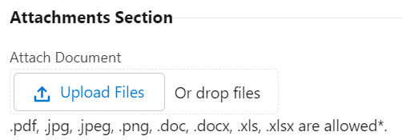
Completing Request Tabs
For Body of Evidence, Accountability Participation Impact, Calculation Error, or Districts with a Closed School requests, complete the dropdown for the request type, type the district narrative, and upload any attachments (ex., the Local Assessment Tool template) before submitting the request for that site.

Slide 31
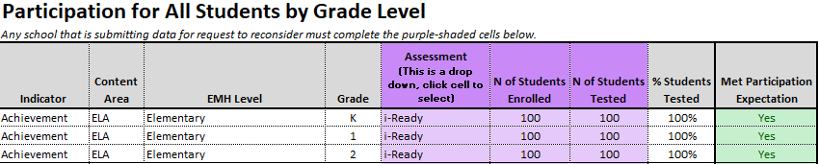
2022 Local Assessment Tool (available on the website 9/8)
1
Enter district and school code.
2
Enter participation and local assessment data.
3
Use the ratings and points tab to see if participation and local assessment data indicates that the site meets the threshold for a request.

Slide 32
Reviewing a Request
Cross-unit CDE team reviews requests
The review will be conducted by a cross-unit CDE team. CDE staff will evaluate the extent to which the request meets the conditions and criteria and whether the additional evidence supports a different rating and/or clock status.
CDE staff makes recommendations to the Commissioner
The staff will then make a recommendation to the Commissioner as to the district’s final accreditation rating, school plan type, and/or clock status.
The Commissioner requests approval from the board
The Commissioner will request the state board to approve the department’s recommendations on ratings, plan types, and/or clock status at the State Board of Education meeting in December.

Slide 33
Reviewing a Request
The department will only consider requests that meet one or more of the conditions for a request to reconsider as outlined in the policy guidance document.
Requests will not be considered if the request is to change individual performance indicator ratings or data points within the frameworks.
All requests received by October 25, 2022 are public documents and part of public record. If a district does not wish for a request to be a part of public record, it may opt to rescind the request prior to October 25 by resubmitting the Accreditation and Request to Reconsider form.

Slide 34
What is our R2R theory of action?
Minimally burdensome to complete (assurance instead of multiple signatures, no required draft submission)
Clear, transparent, and accessible (dashboard eligibility, office hours)
Rigorous and upholds state accountability standards (updated Local Assessment Tool submission)
From this (in legislation):
To this (in rule):
To this (in guidance):

Slide 35
R2R Support and Technical Assistance
Office Hours
Website
General Contact
Begins Wednesday August 17 and will be held from 2-4pm every Wednesday and Thursday until the process concludes, click here to register.
To access accreditation and R2R guidance and tools, go to: https://www.cde.state.co.us/accountability/requesttoreconsider
Aislinn Walsh, walsh_a@cde.state.co.us or (720) 614-2151

Slide 36
Other Resources
District Accountability Handbook - This handbook provides an outline of the requirements and responsibilities for the state, district, and school stakeholders in the state’s accountability process.
Priority Improvement and Turnaround Districts and Schools: A Supplement to the CDE District Accountability Handbook - This supplement provides further details on the requirements and responsibilities for the state, district, and school stakeholders for those identified as Priority Improvement and Turnaround.
Participation and Accountability Guide - This resource describes assessment participation requirements and the role of participation in both state and federal accountability.
Performance Watch Labels and Progression - This resource describes the performance watch process for the 2022-2023 school year and the associated requirements for each plan type, clock year, and performance watch status.

Slide 37
Q & A
(recording will stop here)

